Slide 1
Robotics Game Server
V. Chernikov
O. Markelov
S. Morozov
I. Shatalov

Slide 2
Our goal
To gain experience in software development, including:
Working in a team
Setting requirements for the project
Defining project architecture
Researching technologies required for the project
Implementing the solution
Presenting the project

Slide 3
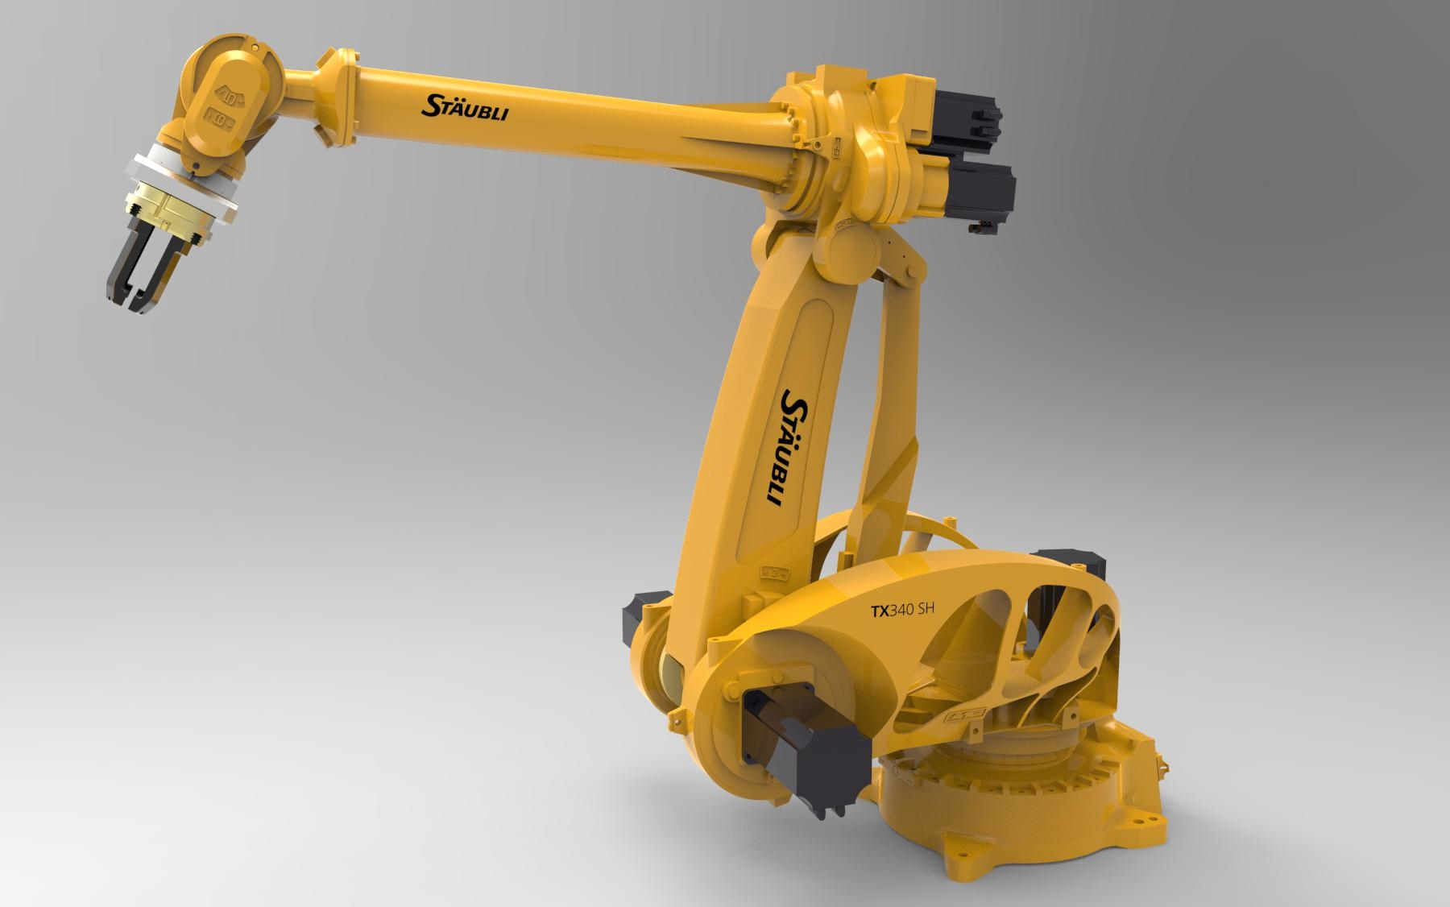
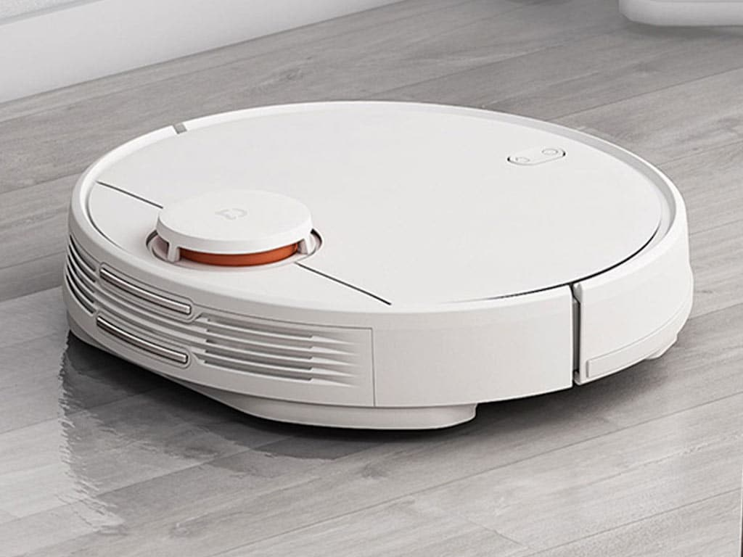
Project objective
Robots play an increasingly important role in our life. They include:
Robotic vacuum cleaners
Smart homes
Self-driving cars
Industrial robots
etc.
Software for these systems gets more and more complicated, and it requires a higher number of skilled developers. This means a higher demand for teaching tools in this field.

Slide 4
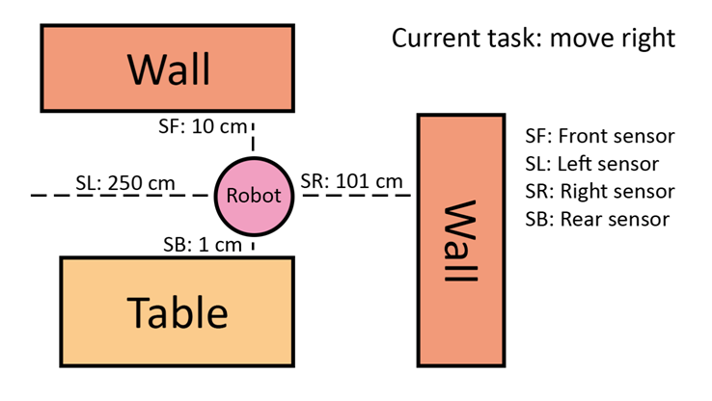
Project objective
To create a system for people with little experience in programming to practice their skills. A student can write code for a robot that exists on a level in order to achieve a level goal once the code is executed on the server. The code has access to the robot’s sensor readings and can use them to choose future actions of the robot. New levels can be added by teachers.
Example of a robot

Slide 5
Why is this application relevant?
Help people gain problem solving skills
Make programming accessible
Create a learning environment
Develop a platform for monitoring of learning achievements

Slide 6
Software Requirements
The system must be able to process user solutions and provide a meaningful report
Teachers should be able to create and modify tasks
The system should be scalable, using several processor cores or dedicated machines
User's code and results should be stored and accessible by the teacher

Slide 7
Stages of development
Vision
Software Requirements
Prototyping
Architecture Design
Implementation
Testing

