Slide 1
Robotics Game Server
S.O. Morozov
Team members:
V.V. Chernikov
O.S. Markelov
S.O. Morozov
I.V. Shatalov

Slide 2
Goal
A system that can be used for teaching students programming
A client-server application
Students learn by submitting programs for robots that operate on levels created by a teacher

Slide 3
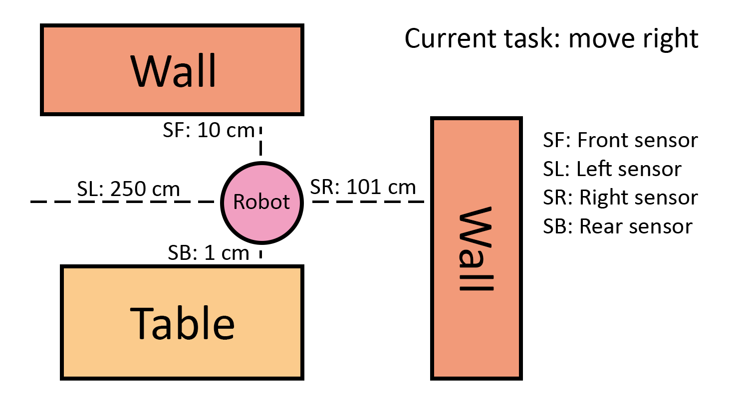
Example of a Robot

Slide 4
Student
Submits solutions
Edits, saves and loads solutions
Views and saves simulation logs
Watches the level playback

Slide 5
Teacher
Creates and edits levels
Sees the students’ results and solutions
Manages students’ accounts

Slide 6
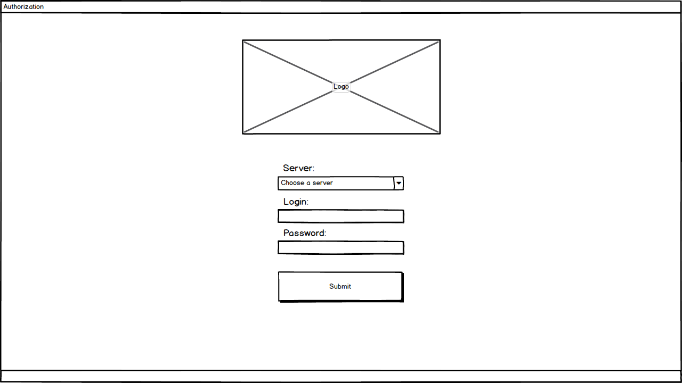

Slide 7
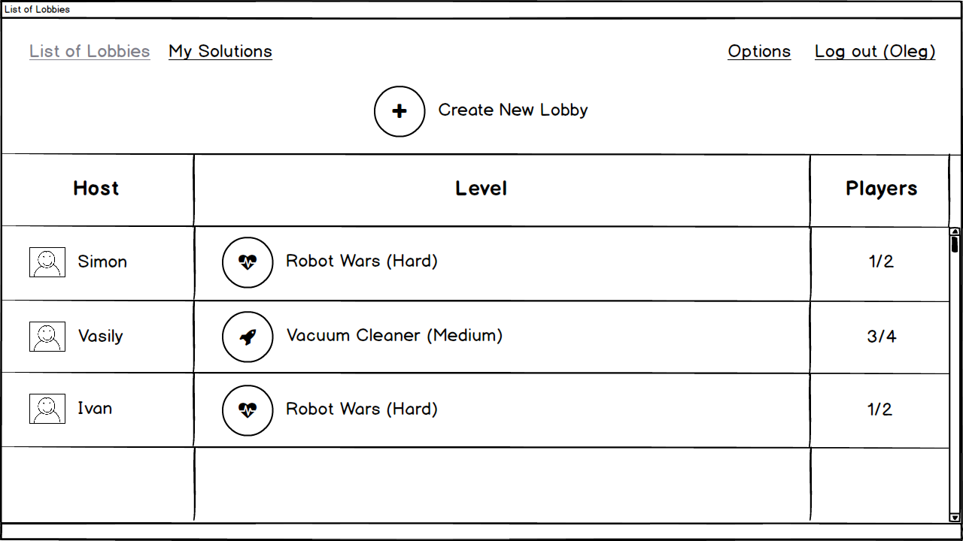

Slide 8
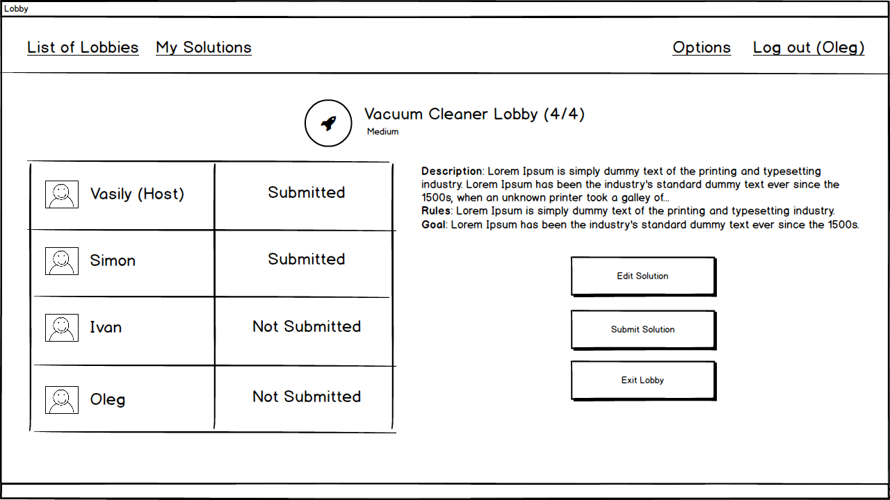

Slide 9
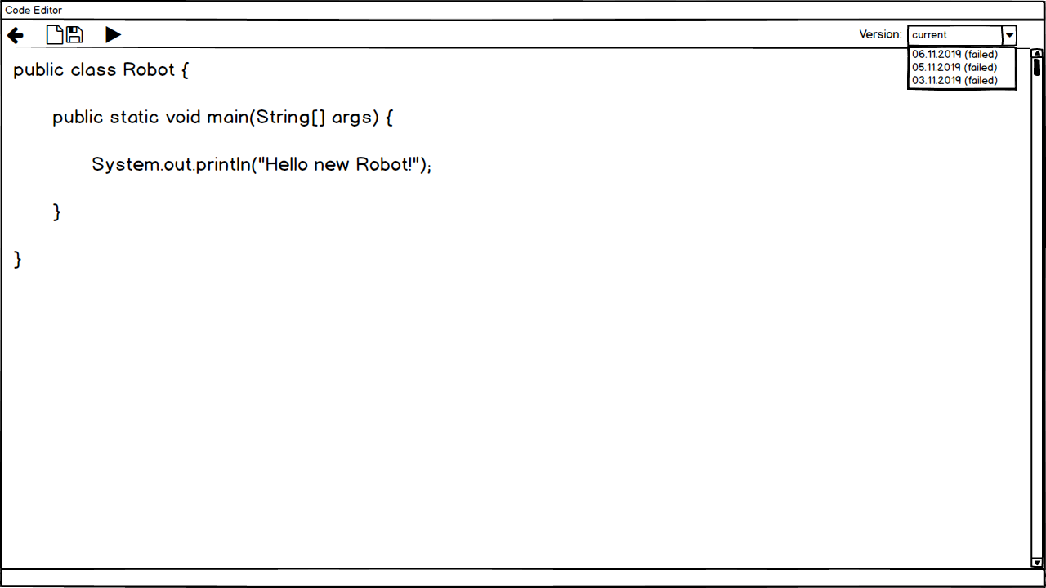

Slide 10
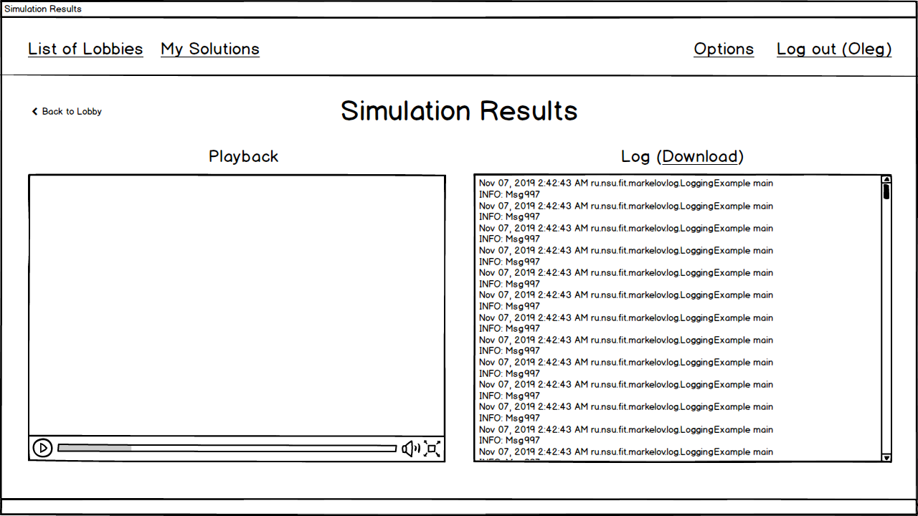

Slide 11
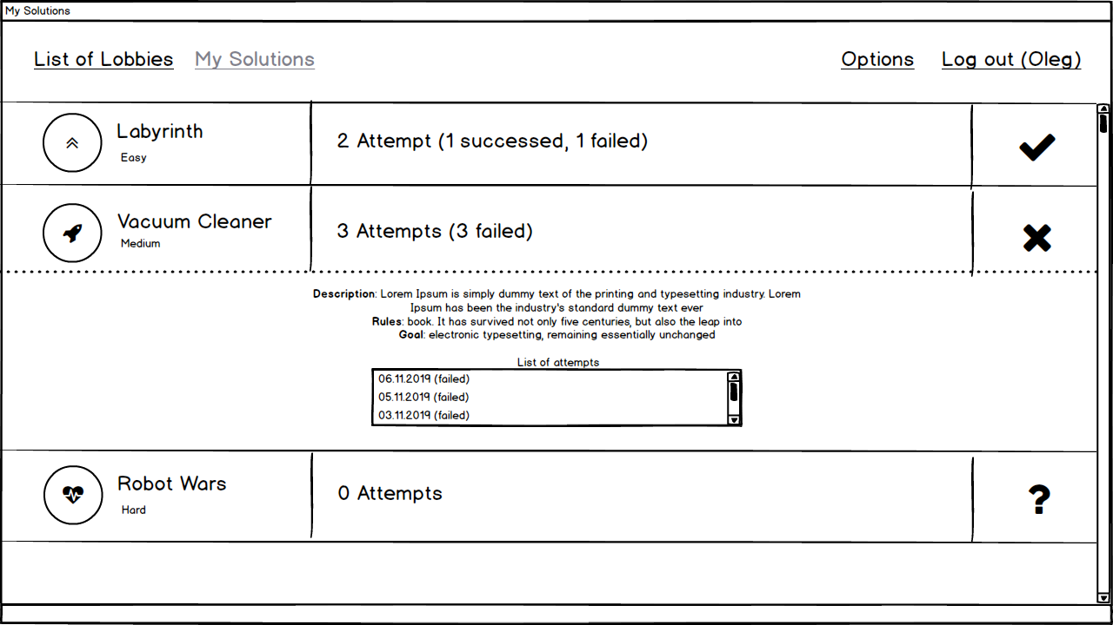

Slide 12
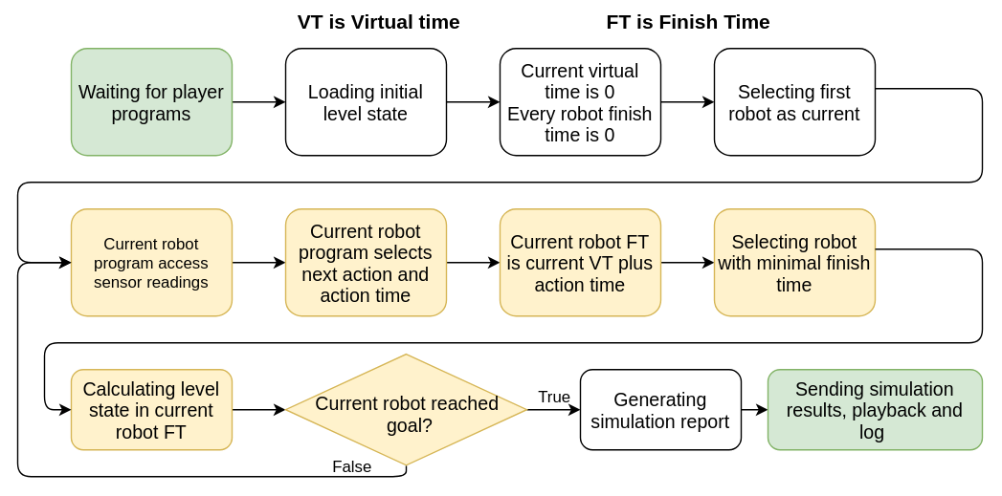
Simulation process

Slide 13
Technologies
RESTful API for client/server communication
Java/Groovy for client and server
Groovy for students’ solutions

Slide 14
Thank you for attention

