Slide 1
Robotics Game Server
V.V. Chernikov
S.O. Morozov
O.S. Markelov
I.V. Shatalov

Slide 2
Goal
A system that can be used for teaching students programming
A client-server application
Students learn by submitting solutions for programming tasks (levels) created by a teacher

Slide 3
Student
Simulates robot on a level
Edits, saves and loads solutions
Views and saves simulation logs
Watches the level playback

Slide 4
Teacher
Creates and edits levels
Sees the students’ results and solutions
Manages students’ accounts

Slide 5
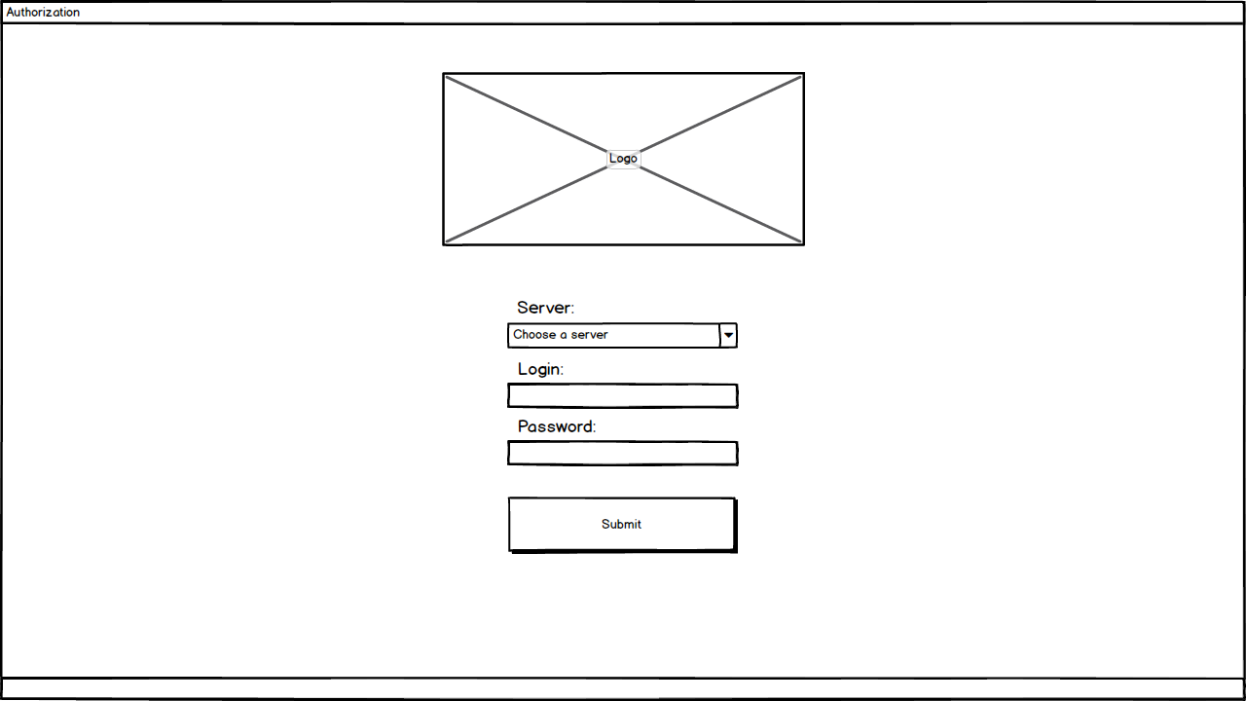

Slide 6
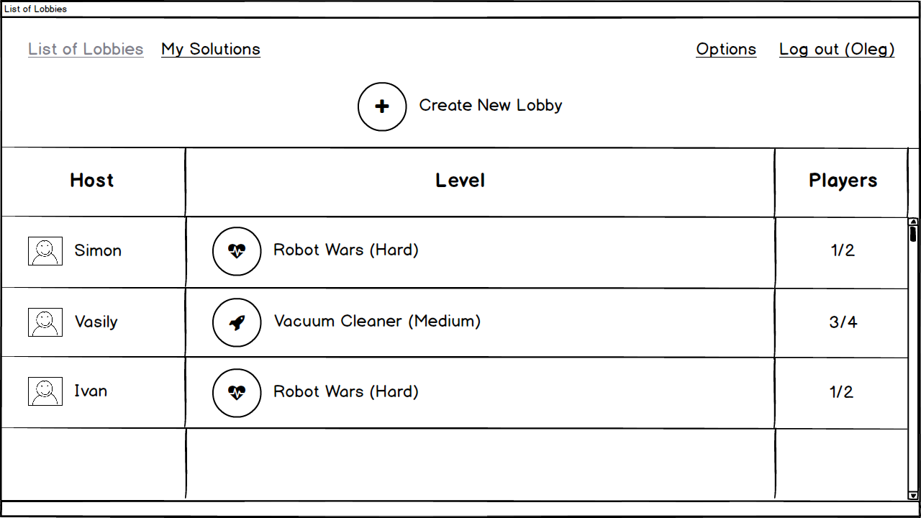

Slide 7
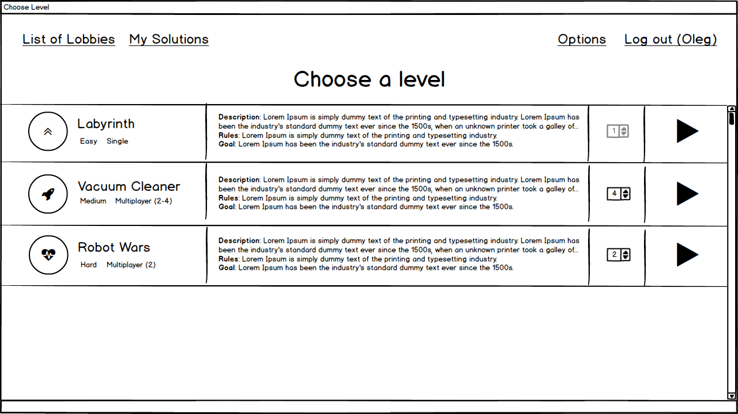

Slide 8
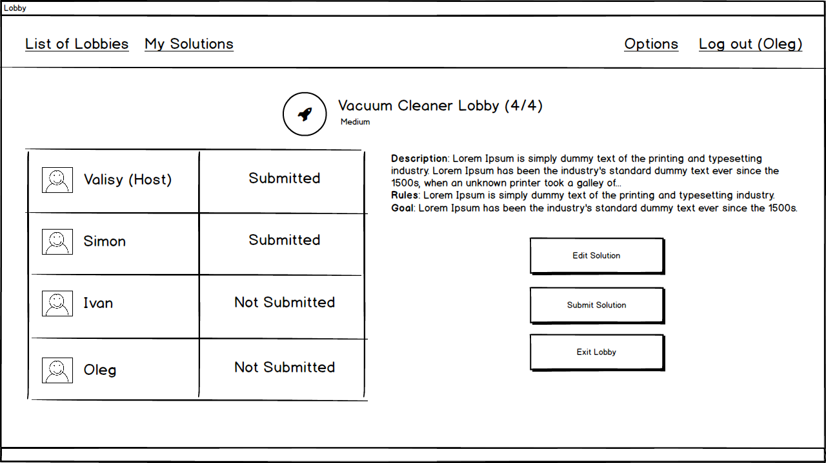

Slide 9
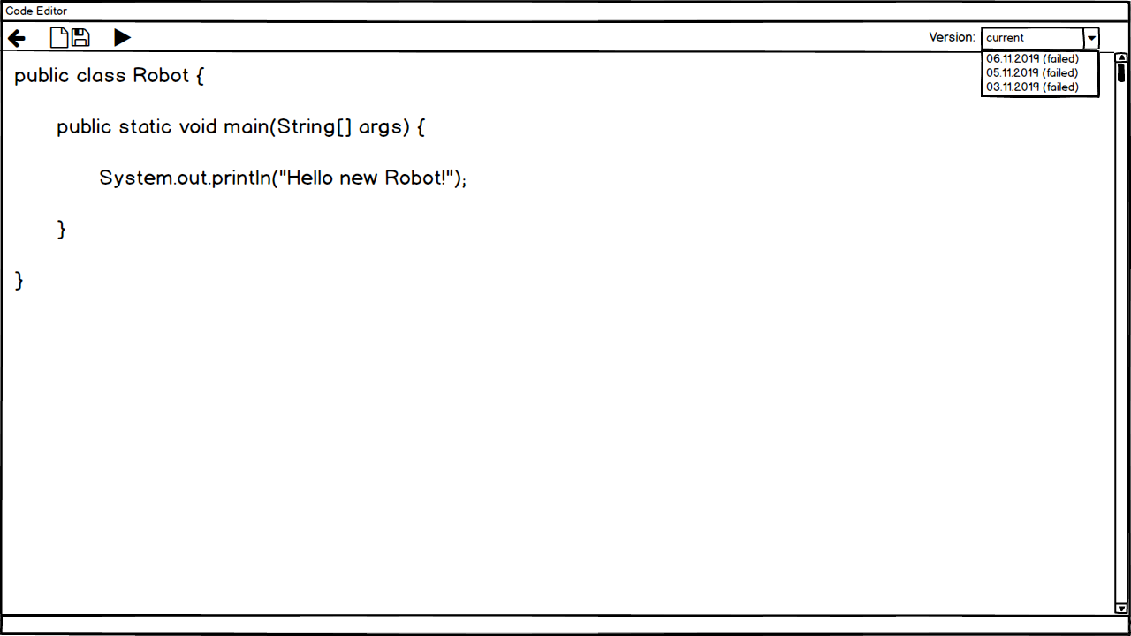

Slide 10
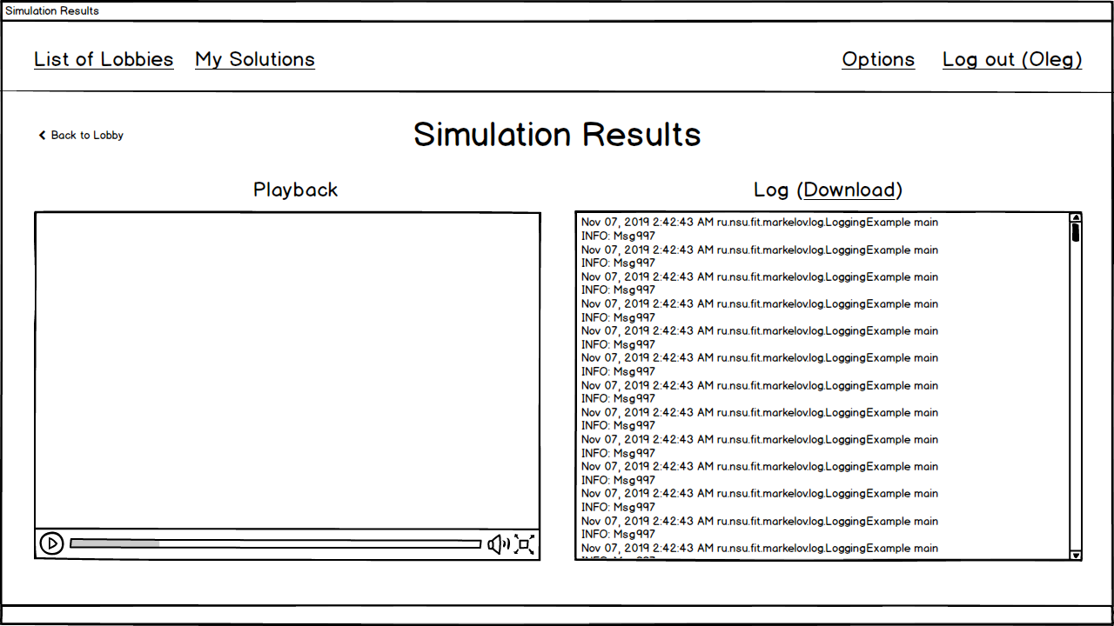

Slide 11
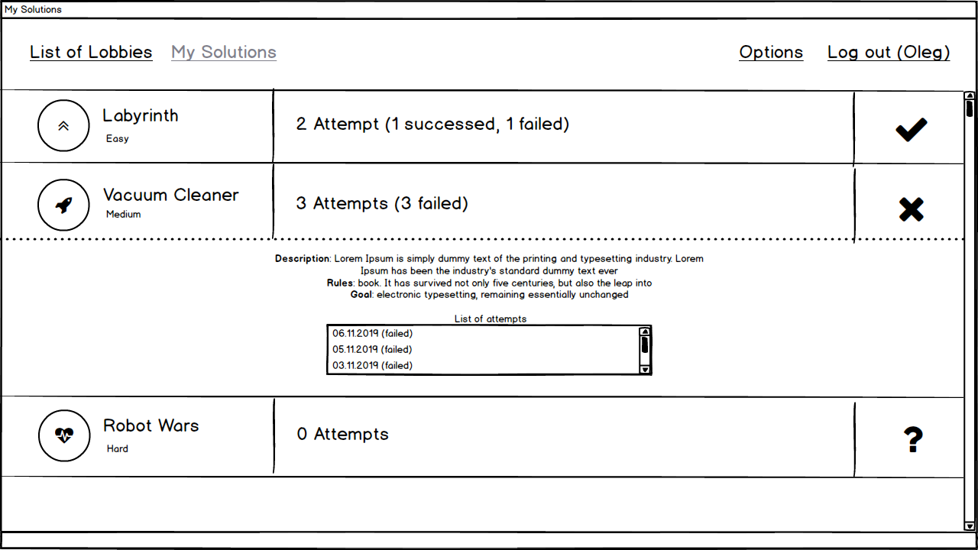

Slide 12
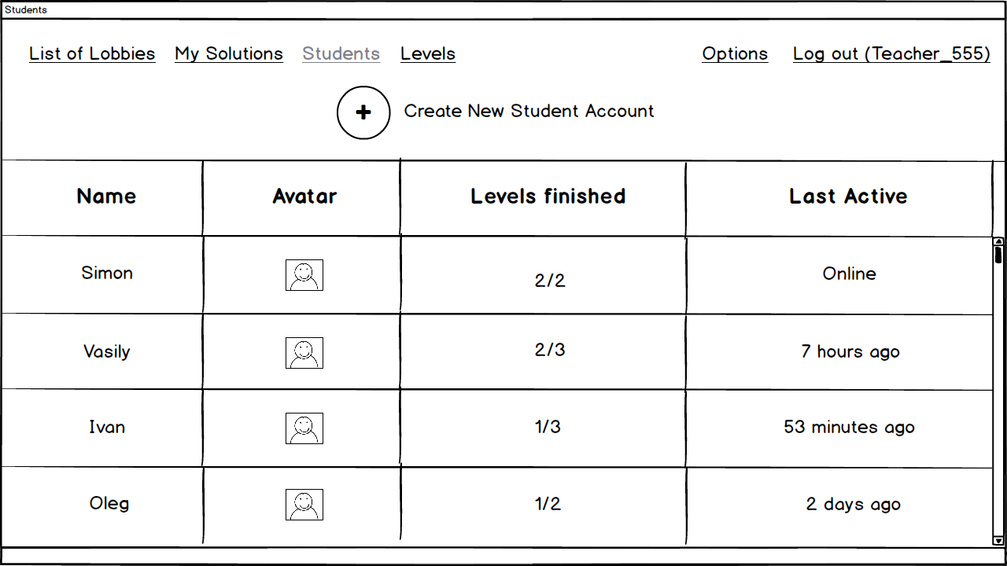

Slide 13
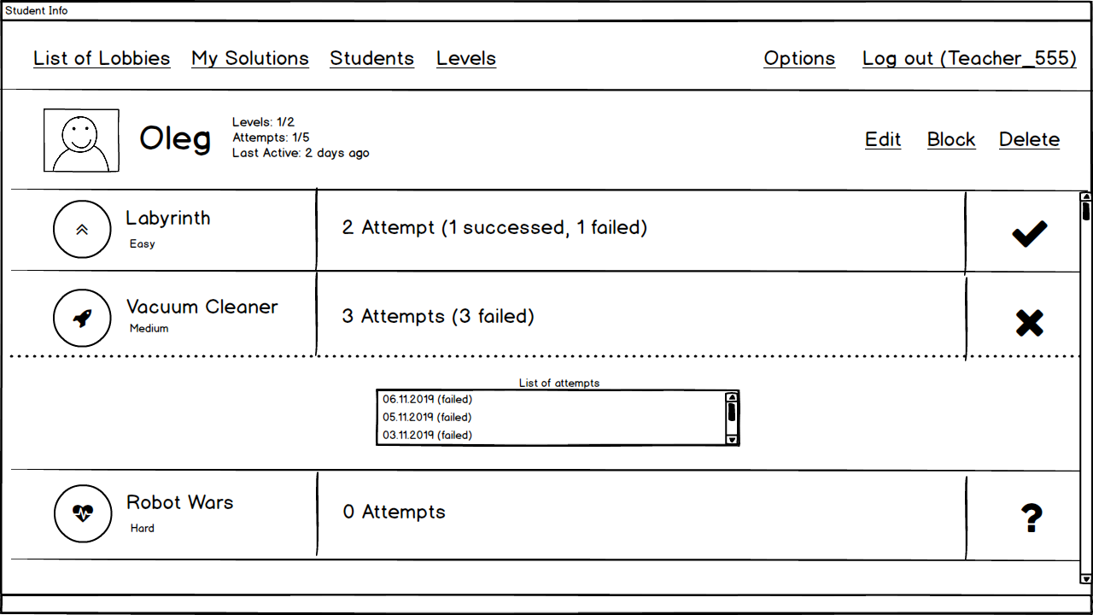

Slide 14
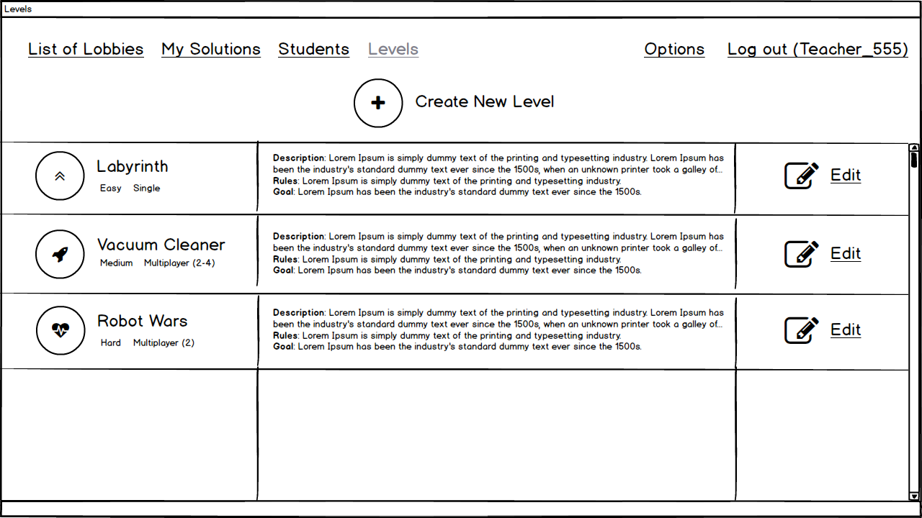

Slide 15
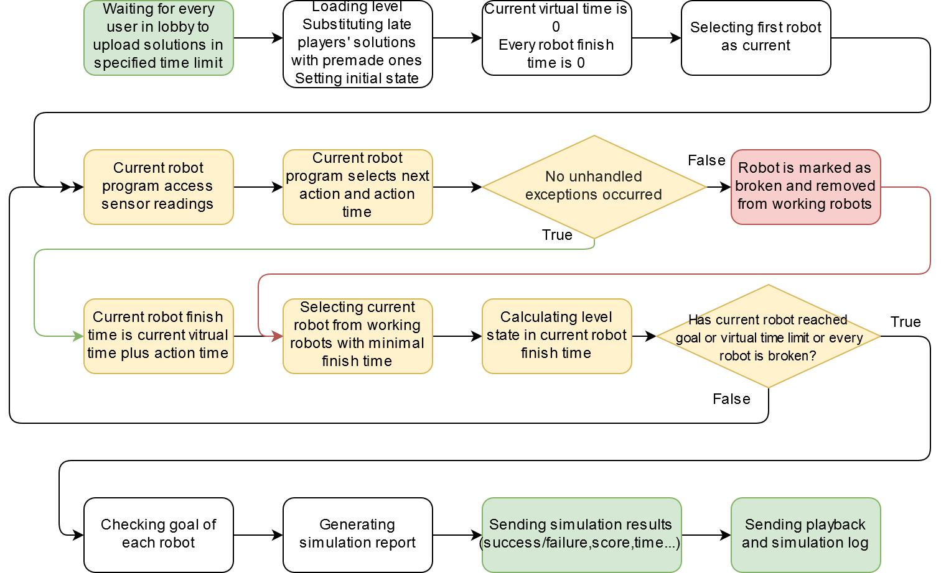

Slide 16
Summary
Technologies:
Java/Groovy
RESTful API
Prototypes:
User interface prototype
Server prototype

