Slide 1
Quantum Information I: No-Cloning Theorem
CS166 FA2025: Week 4

Slide 2
Ctrl + C, Ctrl + V
We take copying information for granted and use it all the time.
Is it possible to do the same for quantum information?

Slide 3
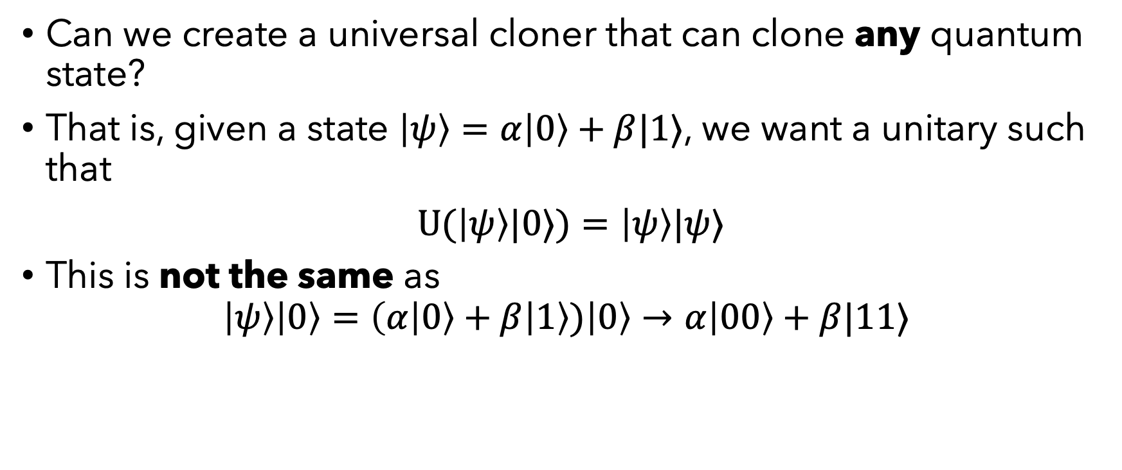
Cloning
Can we create a universal cloner that can clone any quantum state?
That is, given a state $\left|ψ\right\rangle =α\left|0\right\rangle +β|1⟩$, we want a unitary such that
$U(\left|ψ\right\rangle |0⟩)=\left|ψ\right\rangle |ψ⟩$
This is not the same as
$$\left|ψ\right\rangle \left|0\right\rangle =\left(α\left|0\right\rangle +β | 1\right\rangle )\left|0\right\rangle →α\left|00\right\rangle +β|11⟩$$

Slide 4

Question 56
Consider the following two states
$\left|φ_{1}\right\rangle =α\left|00\right\rangle +β\left|11\right\rangle$
$\left|φ_{2}\right\rangle =\left|ψ\right\rangle \left|ψ\right\rangle =\left(α\left|0\right\rangle +β | 1\right\rangle )⊗\left(α\left|0\right\rangle +β | 1\right\rangle )$
Suppose we measure Alice’s qubit for each of the above two states. What is the probability of measuring $|0⟩$ for each state?

Slide 5

Question 56: Solution
$\left|φ_{1}\right\rangle =α\left|00\right\rangle +β\left|11\right\rangle$
Only one term where Alice’s qubit is $|0⟩$, $|00⟩$ with amplitude $α$.
Probability of seeing $|0⟩$ is ${\left|α\right|}^{2}$
State after is $|00⟩$ since there is only one term.

Slide 6
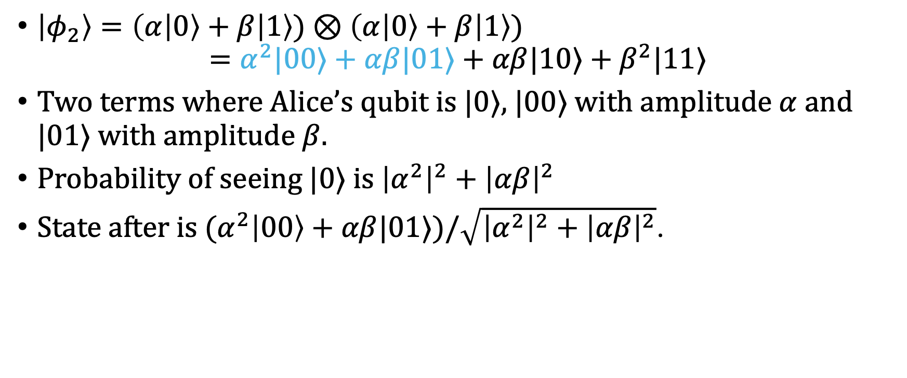
Question 56: Solution
$\left|φ_{2}\right\rangle =\left(α\left|0\right\rangle +β | 1\right\rangle )⊗\left(α\left|0\right\rangle +β | 1\right\rangle )$
$$=α^{2}|00⟩+αβ|01⟩+αβ|10⟩+β^{2}|11⟩$$
Two terms where Alice’s qubit is $|0⟩$, $|00⟩$ with amplitude $α$ and $|01⟩$ with amplitude $β$.
Probability of seeing $|0⟩$ is ${\left|α^{2}\right|}^{2}+{\left|αβ\right|}^{2}$
State after is ${(α}^{2}\left|00\right\rangle +αβ|01⟩)/\sqrt{{\left|α^{2}\right|}^{2}+{\left|αβ\right|}^{2}}$.

Slide 7
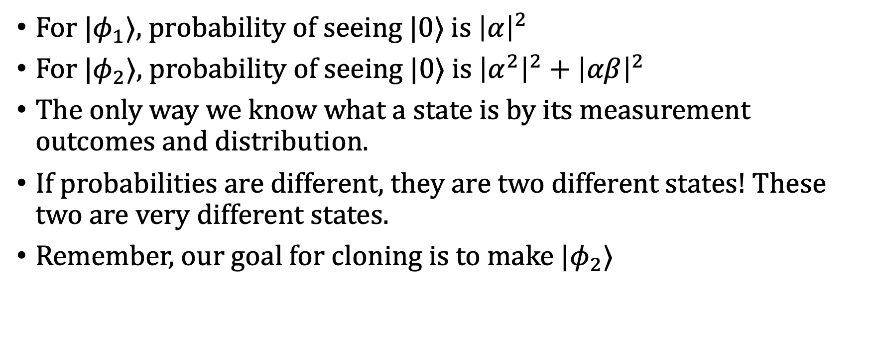
Question 56: Solution
For $|φ_{1}⟩$, probability of seeing $|0⟩$ is ${\left|α\right|}^{2}$
For $|φ_{2}⟩$, probability of seeing $|0⟩$ is ${\left|α^{2}\right|}^{2}+{\left|αβ\right|}^{2}$
The only way we know what a state is by its measurement outcomes and distribution.
If probabilities are different, they are two different states! These two are very different states.
Remember, our goal for cloning is to make ${|φ}_{2}⟩$

Slide 8

No Cloning Theorem
Let $|ψ⟩$ be a state on $n$ qubits. There is no unitary operator $U$ such that
$$U(|ψ⟩|0^{n}⟩)=|ψ⟩|ψ⟩$$
for any state $\left|ψ\right\rangle$.

Slide 9
Inner Products
Remember, the inner product tells us the “similarity” of two vectors.
Orthogonal: <v|w> = 0
Same direction: <v|w> = 1

Slide 10

Question 57
Consider two quantum states $|v⟩$ and $|w⟩$. Suppose we apply some unitary $U$ to each of these states to get vectors $U|v⟩$ and $U|w⟩$. What happens to the “overlap” between the two states?

Slide 11
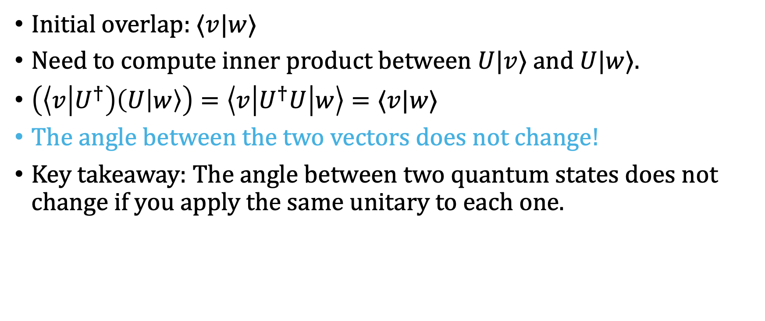
Question 57: Solution
Initial overlap: $⟨v|w⟩$
Need to compute inner product between $U|v⟩$ and $U|w⟩$.
$\left(\left\langle v | U^{†}\right)\left(U | w\right\rangle \right)=\left\langle v\left|U^{†}U\right|w\right\rangle =⟨v|w⟩$
The angle between the two vectors does not change!
Key takeaway: The angle between two quantum states does not change if you apply the same unitary to each one.

Slide 12

Inner Product Trick (Product States)
Suppose we have two separable states.
$\left|A\right\rangle =\left|a_{1}\right\rangle ⊗|a_{2}⟩$
$\left|B\right\rangle =\left|b_{1}\right\rangle ⊗|b_{2}⟩$
Then, we can compute the inner product as follows:
$$⟨A|B⟩=(\left\langle a_{1}\right|⊗\left\langle a_{2}\right|)(|b_{1}⟩⊗|b_{2}⟩)=⟨a_{1}|b_{1}⟩⟨a_{2}|b_{2}⟩$$

Slide 13
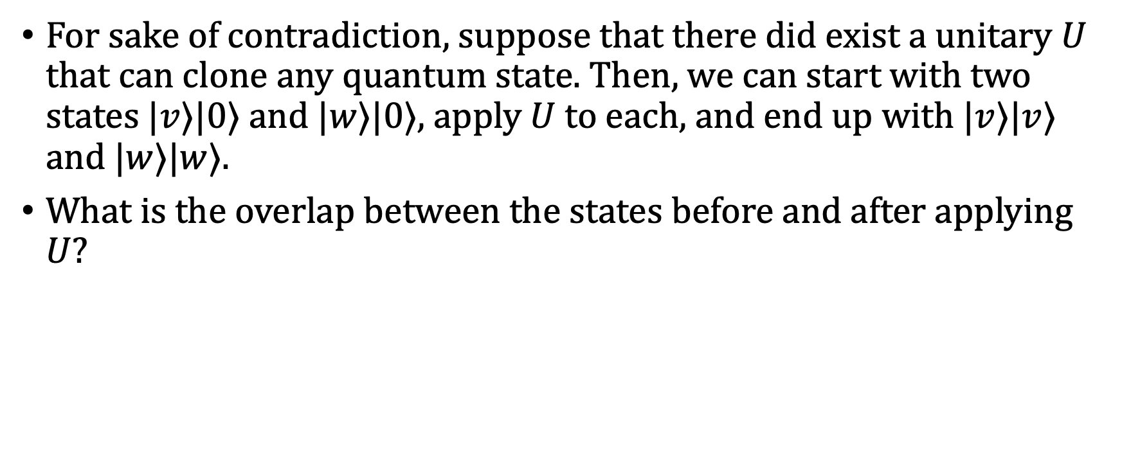
Question 58
For sake of contradiction, suppose that there did exist a unitary $U$ that can clone any quantum state. Then, we can start with two states $|v⟩|0⟩$ and $|w⟩|0⟩$, apply $U$ to each, and end up with $|v⟩|v⟩$ and $|w⟩|w⟩$.
What is the overlap between the states before and after applying $U$?

Slide 14
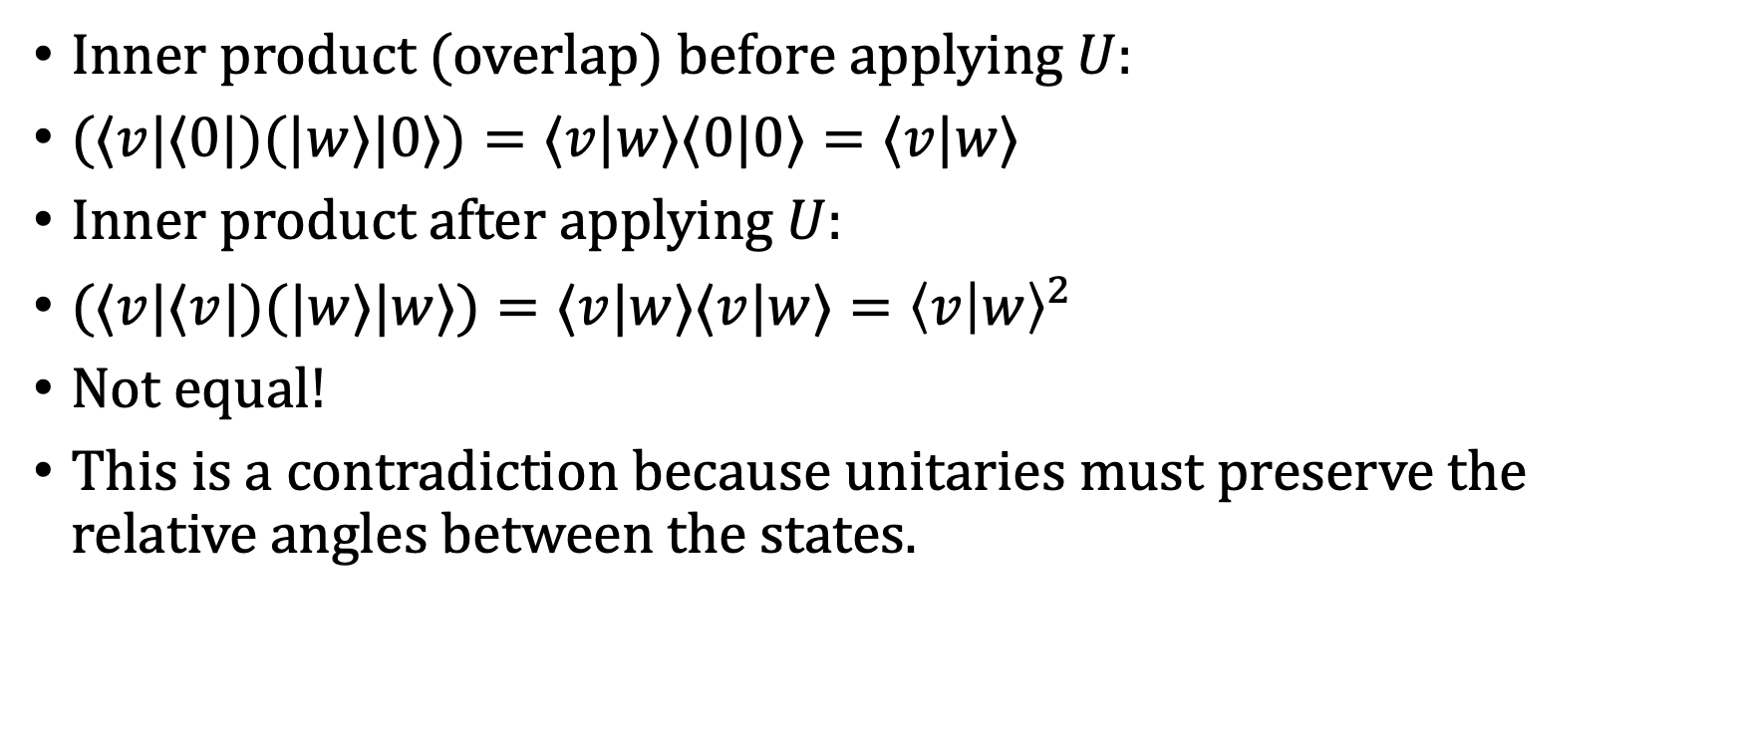
Question 58: Solution
Inner product (overlap) before applying $U$:
$(⟨v|⟨0|)(|w⟩|0⟩)=⟨v|w⟩⟨0|0⟩=⟨v|w⟩$
Inner product after applying $U$:
$(⟨v|⟨v|)(|w⟩|w⟩)=⟨v|w⟩⟨v|w⟩={\left\langle v | w\right\rangle }^{2}$
Not equal!
This is a contradiction because unitaries must preserve the relative angles between the states.

Slide 15
Question 59
Based on the previous problem, are there states that we can clone?

Slide 16

Question 59: Solution
Based on the previous problem, are there states that we can clone?
$⟨v|w⟩$ vs. ${\left\langle v | w\right\rangle }^{2}$
If $|v⟩$ and $|w⟩$ are the same or orthogonal, we can build a cloner.
Same or orthogonal… orthonormal basis!

Slide 17

Question 59: Solution
Based on the previous problem, are there states that we can clone?
$⟨v|w⟩$ vs. ${\left\langle v | w\right\rangle }^{2}$
If $|v⟩$ and $|w⟩$ are vectors in an orthonormal basis, we can build a cloner.

Slide 18

Question 60
Find a unitary $U$ that “clones” single qubit standard basis states. That is, an operator such that
$U(|0⟩|0⟩)=|0⟩|0⟩$ and $U(|1⟩|0⟩)=|1⟩|1⟩$

Slide 19
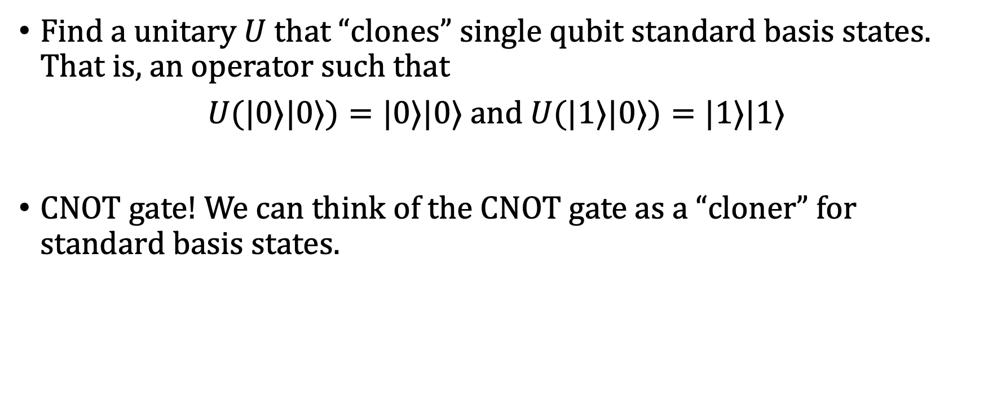
Question 60: Solution
Find a unitary $U$ that “clones” single qubit standard basis states. That is, an operator such that
$U(|0⟩|0⟩)=|0⟩|0⟩$ and $U(|1⟩|0⟩)=|1⟩|1⟩$
CNOT gate! We can think of the CNOT gate as a “cloner” for standard basis states.

Slide 20
Question 61
Does the CNOT gate clone a Hadamard basis state?

Slide 21

Question 61: Solution
No! It does not clone Hadamard basis states.
$$CNOT(|+⟩|0⟩)=CNOT(\frac{1}{\sqrt{2}}\left|0\right\rangle \left|0\right\rangle +\frac{1}{\sqrt{2}}\left|1\right\rangle \left|0\right\rangle )$$
$$=\frac{1}{\sqrt{2}}\left|0\right\rangle \left|0\right\rangle +\frac{1}{\sqrt{2}}\left|1\right\rangle \left|1\right\rangle ≠\left|+\right\rangle \left|+\right\rangle$$

Slide 22

Question 62
Find a unitary $V$ that “clones” single qubit Hadamard basis states. That is, an operator such that
$V(|+⟩|0⟩)=|+⟩|+⟩$ and $V(|−⟩|0⟩)=|−⟩|−⟩$

Slide 23
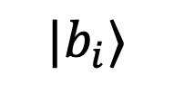
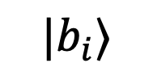

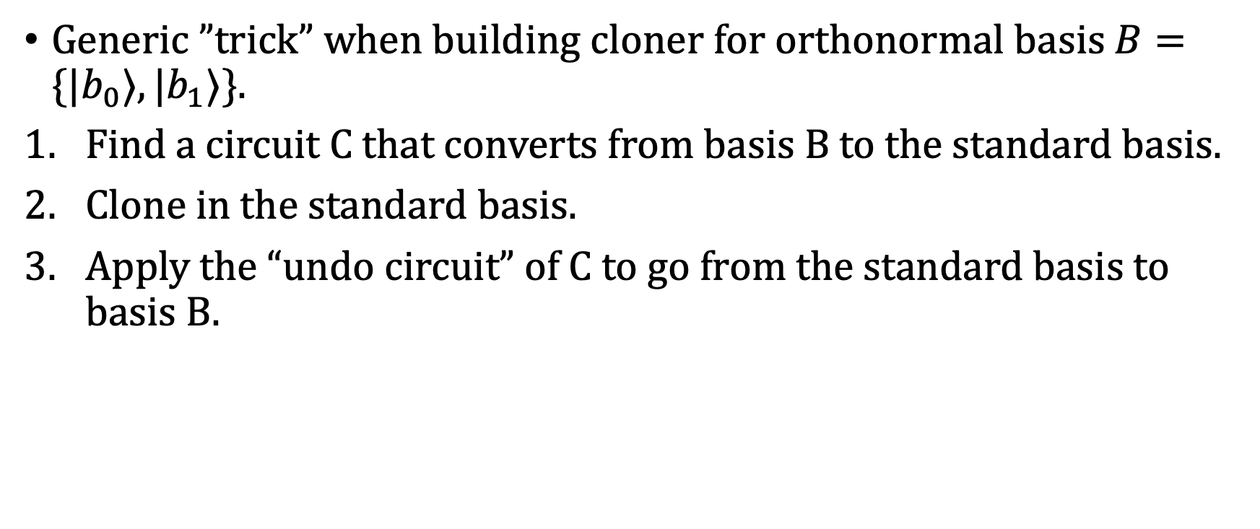


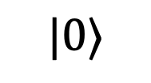
Question 62: Solution
Generic ”trick” when building cloner for orthonormal basis $B=\{|b_{0}⟩,|b_{1}⟩\}$.
Find a circuit C that converts from basis B to the standard basis.
Clone in the standard basis.
Apply the “undo circuit” of C to go from the standard basis to basis B.
$$|b_{i}⟩$$
$$C$$
$$C^{†}$$
$$|b_{i}⟩$$
$$|0⟩$$
$$C^{†}$$
$$|b_{i}⟩$$

Slide 24
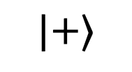
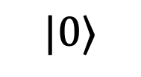
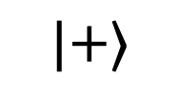
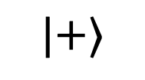



Question 62: Solution
For the Hadamard basis, we can use the H gate to go between the two bases.
$$|+⟩$$
$$H$$
$$H$$
$$|+⟩$$
$$|0⟩$$
$$H$$
$$|+⟩$$

Slide 25
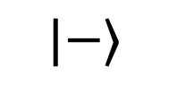
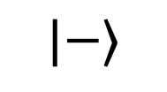
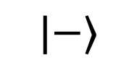
Question 62: Solution
For the Hadamard basis, we can use the H gate to go between the two bases.
$$|−⟩$$
$$H$$
$$H$$
$$|−⟩$$
$$|0⟩$$
$$H$$
$$|−⟩$$

Slide 26
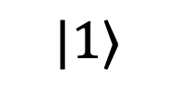
Question 63
Does this circuit clone a standard basis state?
$$|1⟩$$
$$H$$
$$H$$
$$|0⟩$$
$$H$$

Slide 27
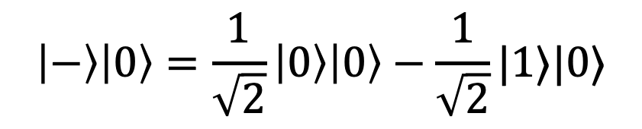
Question 63: Solution
Does this circuit clone a standard basis state?
$$|1⟩$$
$$H$$
$$H$$
$$|0⟩$$
$$H$$
$$\left|−\right\rangle \left|0\right\rangle =\frac{1}{\sqrt{2}}\left|0\right\rangle \left|0\right\rangle −\frac{1}{\sqrt{2}}|1⟩|0⟩$$

Slide 28
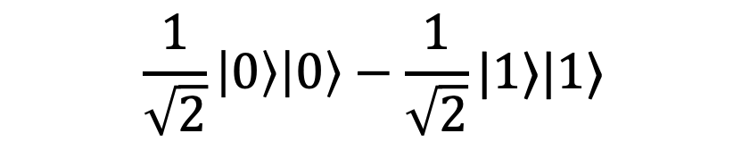
Question 63: Solution
Does this circuit clone a standard basis state?
$$|1⟩$$
$$H$$
$$H$$
$$|0⟩$$
$$H$$
$$\frac{1}{\sqrt{2}}\left|0\right\rangle \left|0\right\rangle −\frac{1}{\sqrt{2}}|1⟩|1⟩$$

Slide 29
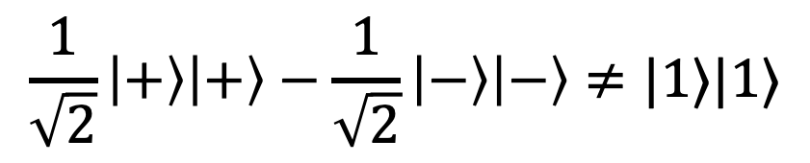
Question 63: Solution
Does this circuit clone a standard basis state?
$$|1⟩$$
$$H$$
$$H$$
$$|0⟩$$
$$H$$
$$\frac{1}{\sqrt{2}}\left|+\right\rangle \left|+\right\rangle −\frac{1}{\sqrt{2}}\left|−\right\rangle \left|−\right\rangle ≠|1⟩|1⟩$$

Slide 30
More on Wednesday…!

