Slide 1
Research and Implementation of Medical Image Feature Extraction Based on TensorFlow
Yu Hengjian
2017.06.09

Slide 2
Contents
Research background
Main works
Results
Conclusion
2

Slide 3
Background
Essential in automatic computeraided diagnosis
Classical method is hard to copy
Expert experience required in this region
3

Slide 4
Main works
Segmentation Module
Linear Spectral Clustering Algorithm (LSC)
Feature Extraction Module
Deep Convolutional Neural Network (DCNN)
Classification Module
Stacked AutoEncoder(SAE)
User Module
Detect the potential lymphoma area
Detect the liver to reduce the false positive of lymphoma area
4

Slide 5
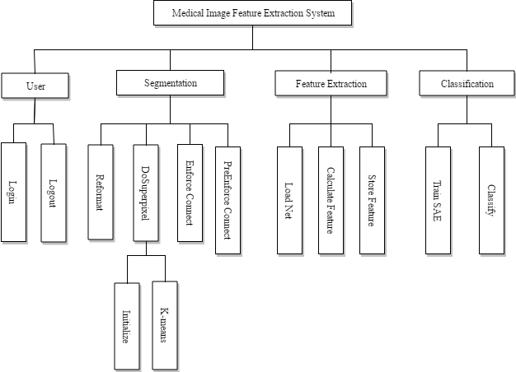
Main works(2)
5

Slide 6
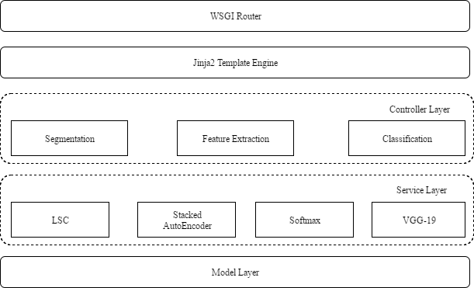
Main works(3)
6

Slide 7
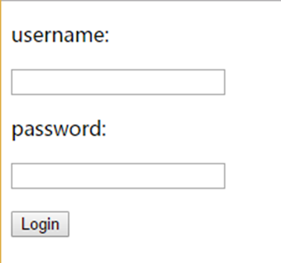
User Module
7

Slide 8
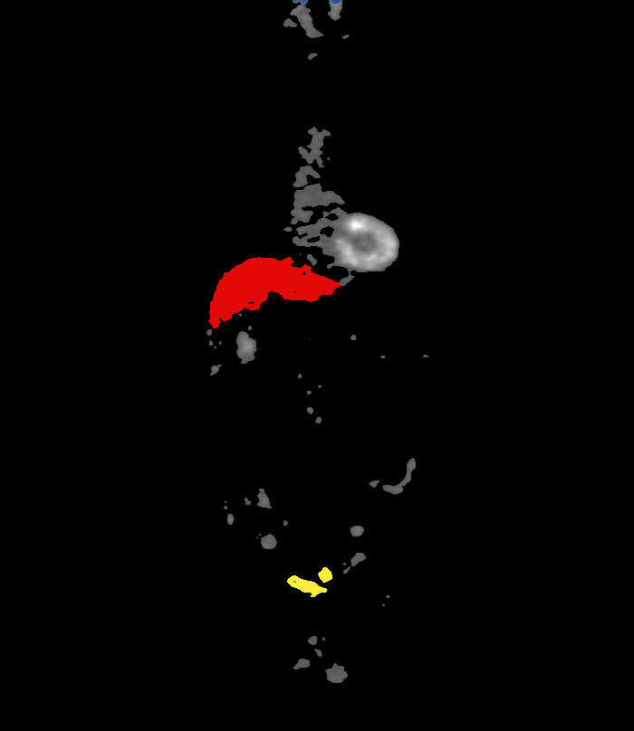
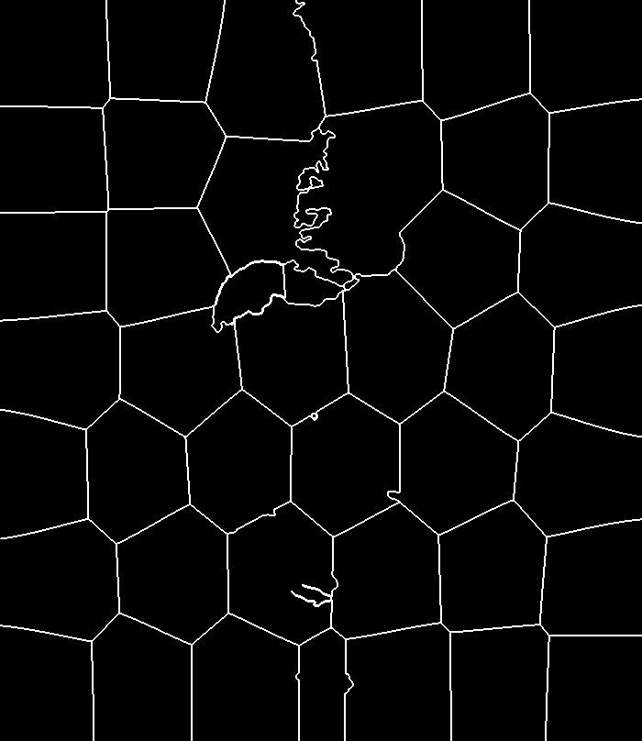
Segmentation Module
Linear Spectral Clustering
8

Slide 9
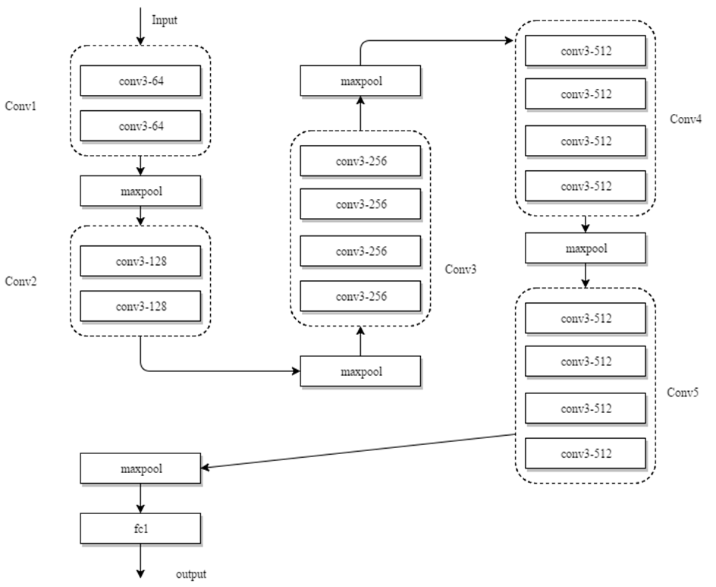
Feature Extraction Module
First 17 layers of VGG-19 net
9

Slide 10
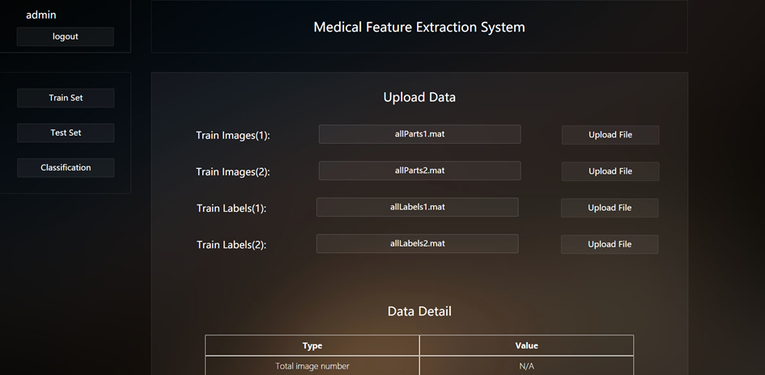
Feature Extraction Module
10

Slide 11
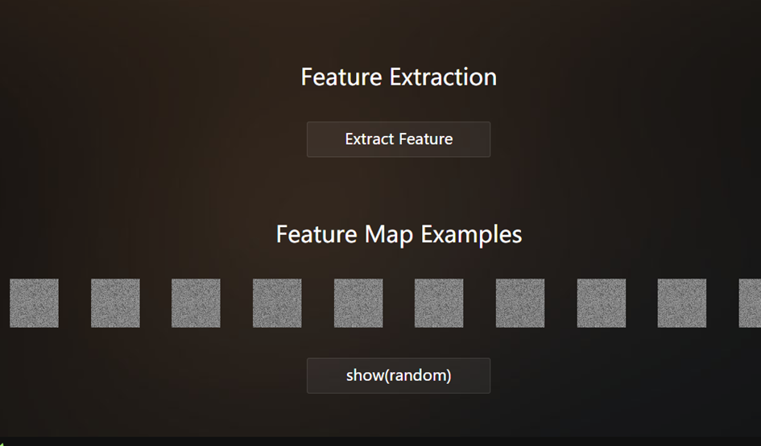
Feature Extraction Module(2)
11

Slide 12
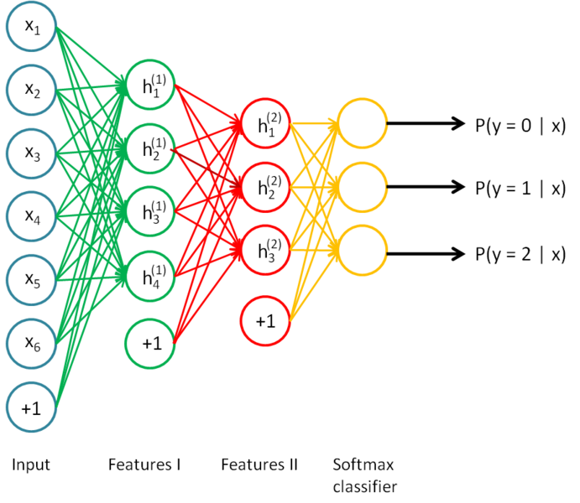
Classification Module
Stacked AutoEncoder
12

Slide 13
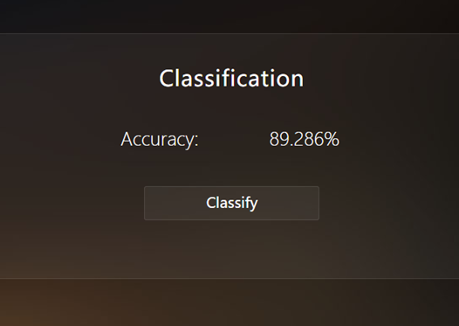
Classification Module(2)
13

Slide 14
Results
51,535 superpixels
Type | Liver | Lymphoma | Background
Accuracy(2AE) | 88.1% | 90.8% | 79.4%
Accuracy(3AE) | 88.9% | 96.2% | 84.5%
14

Slide 15
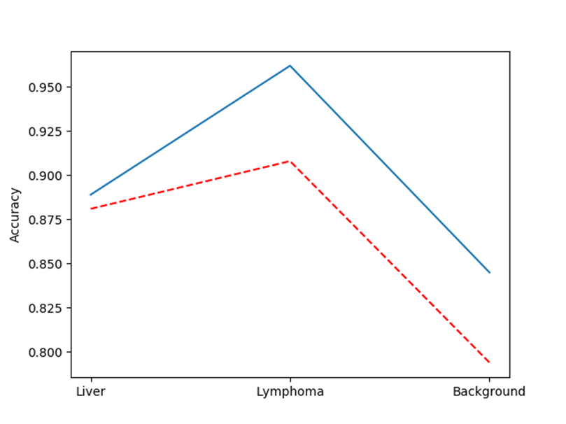
Results(2)
Blue solid line: three autoencoders
Red dashed line: two autoencoders
15

Slide 16
Conclusion
Good reliability
Sensitive to detect the lymphoma area
16

