Slide 1
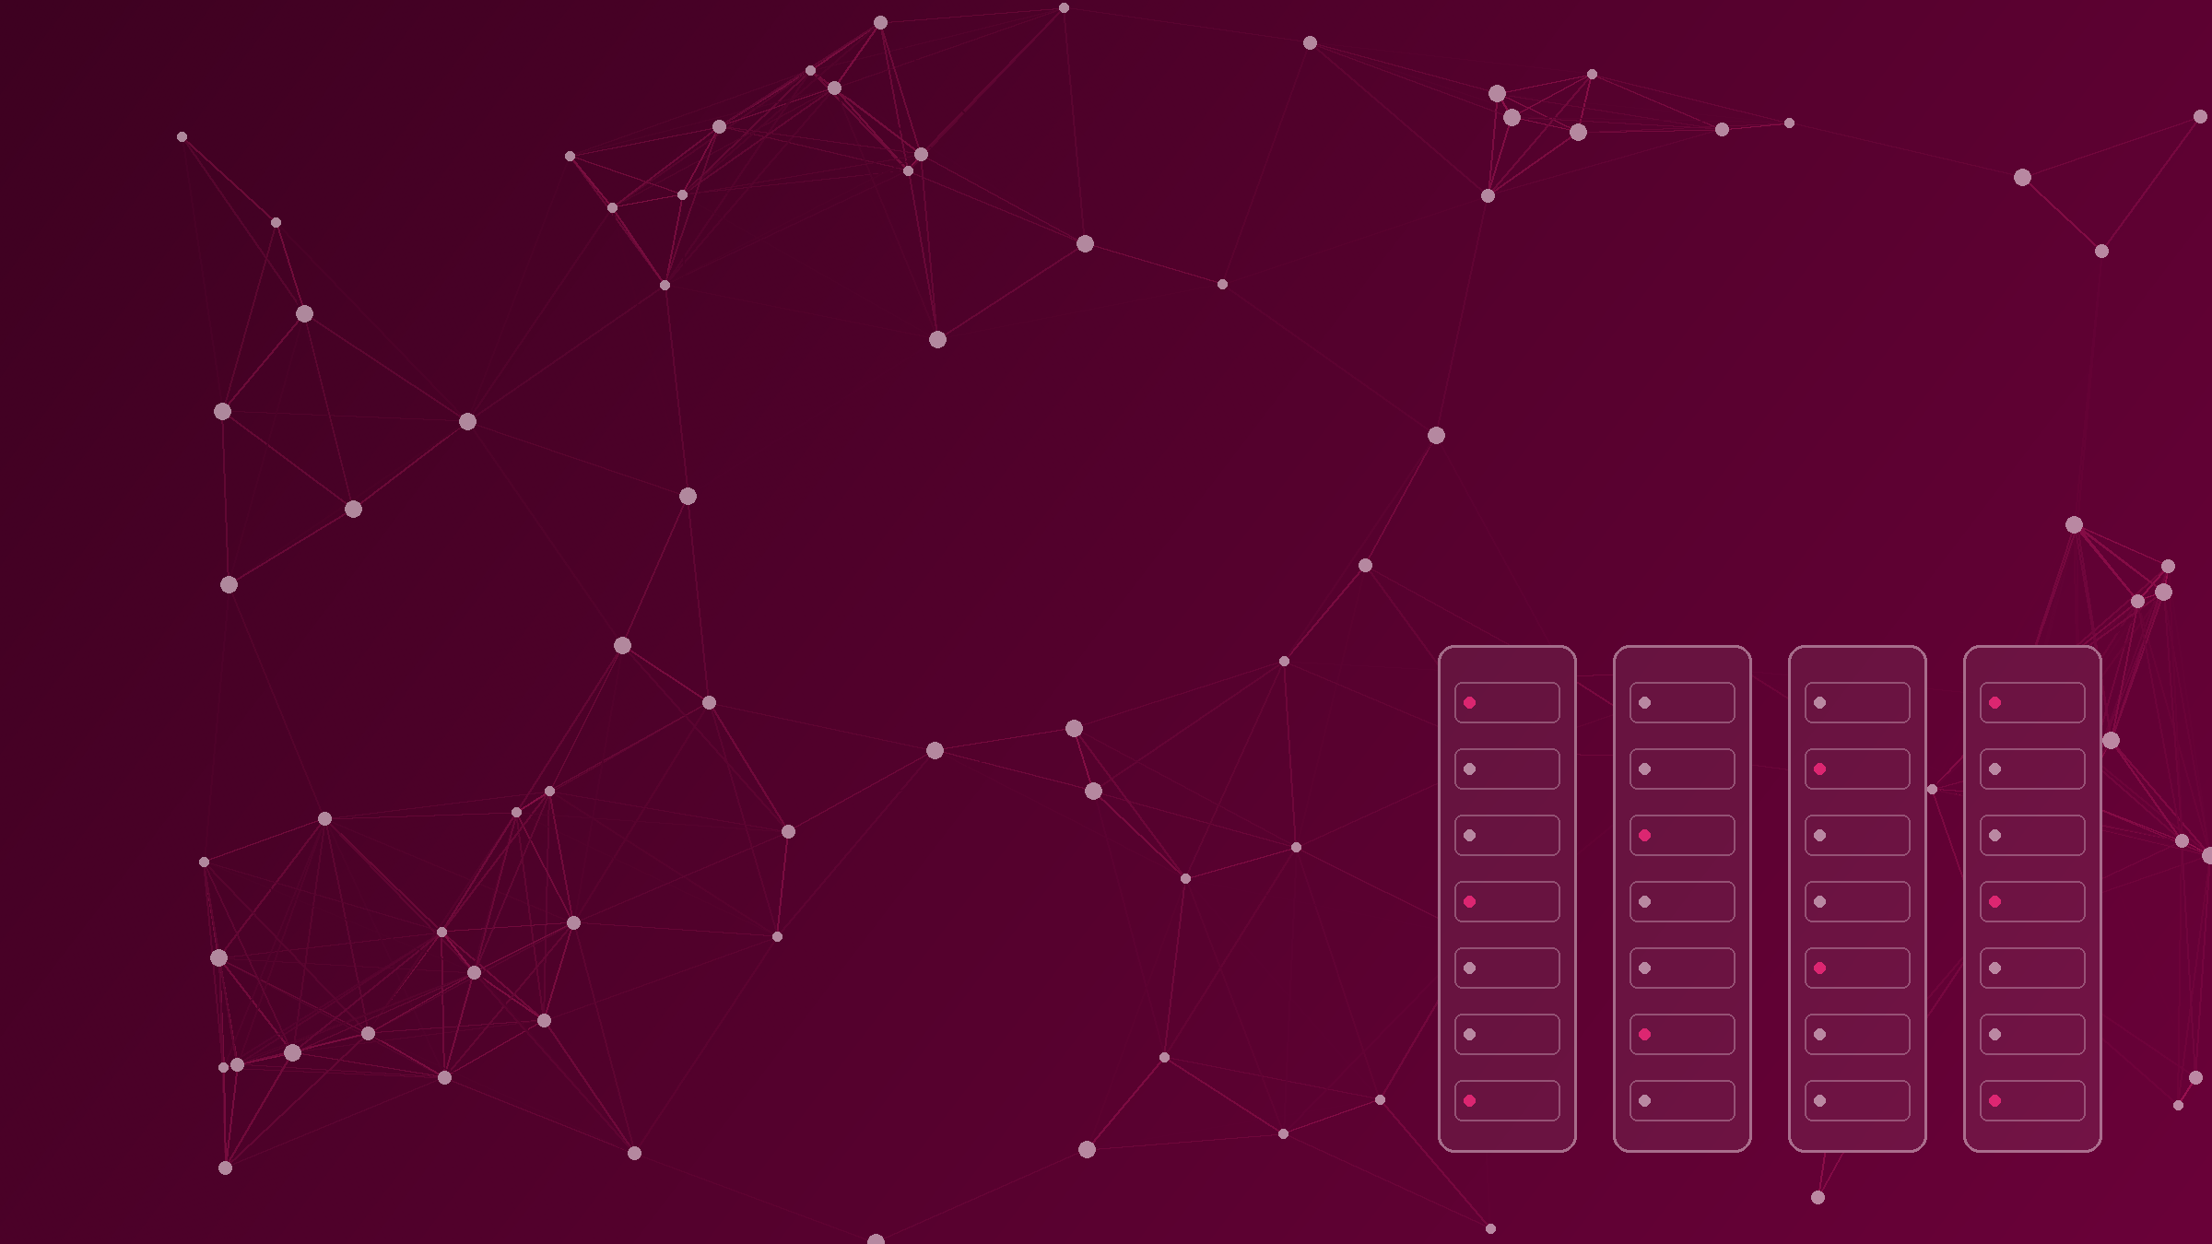

UptimeShield
Parametric Insurance for Technology Provider Outages
Capstone Project | Alpha Interns |Sk.Shiguftha Shameem
Hartford Training Program | Hartford India..
Notes:
SCRIPT (about 15 seconds): Good morning. I am [your name]. My capstone project is UptimeShield: an insurance platform that pays a business automatically when an online service it depends on, like a cloud host or a payment gateway, goes down for too long. I will cover the problem, the solution, how it works, how it is built, and a quick look at the product.

Slide 2
Problem Statement
When a provider goes down, your business goes down
Cloud host
Sales and sign-ups stop at once
Your online
business
Payment gateway (DOWN)
The business cannot fix it itself
Login / API service
Normal insurance is slow: it needs proof of loss
Real market: AIG and Parametrix launched cloud-outage cover in August 2026
UptimeShield | Parametric Business-Interruption Insurance Platform
2
Notes:
SCRIPT (about 40 seconds): Every online business depends on services it does not control: a cloud host, a payment gateway, a login service. When one of them fails, sales stop immediately and the business cannot fix it. Normal insurance is slow because the business must prove its loss. That is the gap. This is also a real market: in August 2026 AIG and Parametrix launched cover for cloud outages. (Sources: Insurtech Insights, 14 Aug 2026; FinTech Global, 27 Jan 2026.)

Slide 3
Objectives
1 Strengthen Business Resilience
Protect businesses from the financial impact of critical third-party technology provider outages.
2 Accelerate Claims and Settlement
Automate outage evaluation and payout eligibility to enable faster, transparent claim processing
3 Deliver a Secure,Scalable Insurance Ecosystem
Connect the complete insurance lifecycle through a role-based, reactive microservices architecture
UptimeShield | Parametric Business-Interruption Insurance Platform
3
Notes:
SCRIPT (about 45 seconds): UptimeShield is parametric insurance. That means we agree three things up front: how long an outage must last to count, how much we pay for every ten minutes, and the maximum payout. Then the platform records outages, checks them against those rules, and moves the claim to payment. No long investigation. One important point: an outage alone does not guarantee payment. It must be resolved, it must pass the limit, and the settlement must pass its checks.

Slide 4
Our Solution: UptimeShield
Agree the rules first. Pay automatically when they are met
1 Agree up front
Minimum outage minutes, payout rate and maximum payout are set on the policy
2 Measure the outage
Provider outages are recorded with a start and an end time
3 Decide and pay
The system compares the outage with the rules and sends the claim to settlement
Faster, clearer and more consistent than waiting for a loss investigation
UptimeShield | Parametric Business-Interruption Insurance Platform
3
Notes:
SCRIPT (about 45 seconds): UptimeShield is parametric insurance. That means we agree three things up front: how long an outage must last to count, how much we pay for every ten minutes, and the maximum payout. Then the platform records outages, checks them against those rules, and moves the claim to payment. No long investigation. One important point: an outage alone does not guarantee payment. It must be resolved, it must pass the limit, and the settlement must pass its checks.

Slide 5
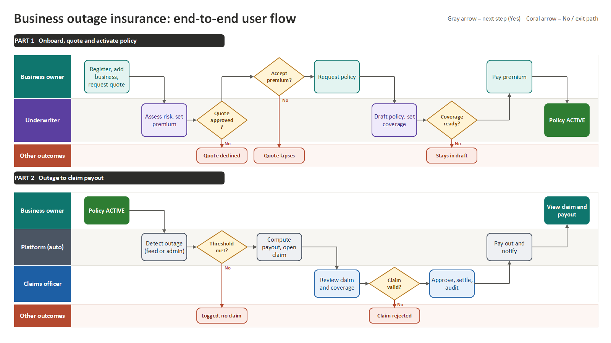
How It Works: Business Flow
UptimeShield | Parametric Business-Interruption Insurance Platform
4
Notes:
SCRIPT (about 40 seconds): Here is the journey. The business registers and lists its dependencies. Underwriting creates a quote and approves it, and a policy is issued. If a provider goes down, the monitoring team records the outage. When it is resolved, the trigger service checks the duration against the policy. If it qualifies, a claim is opened, the settlement team approves the amount, and the business gets a notification. Every step stores a status.

Slide 6
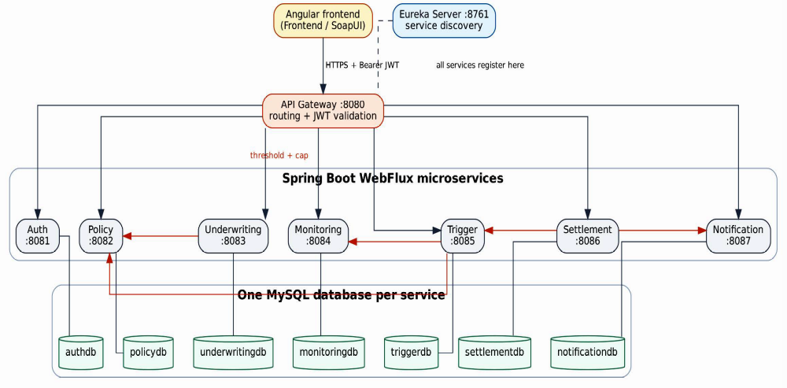
System Architecture
One gateway, seven small services, one database each
UptimeShield | Parametric Business-Interruption Insurance Platform
5
Notes:
SCRIPT (about 45 seconds): This is the architecture. The Angular app talks only to the API Gateway, which checks the login token. Eureka is the phone book: services find each other by name. There are seven Spring Boot services, each doing one job and each owning its own MySQL database. They call each other through five service-to-service calls, for example the Trigger service asks Monitoring for the outage and Policy for the coverage at the same time. The whole backend is reactive, so it does not block while waiting.

Slide 7
How We Built It
Frontend, backend, data, security and quality
Frontend
Backend
Data and Platform
Security and Quality
■ Angular
■ TypeScript
■ NgRx and RxJS
■ Tailwind CSS
■ Java 17
■ Spring Boot 3.5.6
■ Spring WebFlux
■ R2DBC
■ MySQL (one per service)
■ Eureka discovery
■ Spring Cloud Gateway
■ WebClient calls
■ JWT login at gateway
■ Roles in the token
■ JUnit 5 and Mockito
■ Actuator monitoring
UptimeShield | Parametric Business-Interruption Insurance Platform
6
Notes:
SCRIPT (about 35 seconds): Quickly, the stack. Frontend is Angular with TypeScript, NgRx, RxJS and Tailwind. Backend is Java 17 and Spring Boot 3.5.6 with WebFlux, so it is non-blocking. Data is MySQL, one database per service, with Eureka for discovery and Spring Cloud Gateway as the single entry. Security uses JWT login checked at the gateway. For quality we have unit and repository tests, and Actuator health and metrics for monitoring.

Slide 8
Backup: How a Payout Is Decided
Five steps, kept separate
Observed outage
Trigger condition
Eligibility
Calculation
Settlement
Provider outage with start and end time
Duration meets the agreed minutes
Triggered evaluation opens a claim
Rate per ten minutes, limited by the cap
Validated, approved, audited
Premium = risk score x active pricing rule multiplier. Underwriter can override within +/-20%.
Coverage terms on every policy: thresholdMinutes, payoutRatePerTenMinutes, payoutCap.
UptimeShield | Parametric Business-Interruption Insurance Platform
9
Notes:
Use if asked: how do you calculate the payout? Answer: duration is compared with the threshold; if it qualifies, estimate = rate per ten minutes, limited by the payout cap; settlement can never approve more than the estimate.

Slide 9
Backup: Microservices
Each service has one job
Service | Port | Job
Auth | 8081 | Register, login, issue JWT
Policy | 8082 | Businesses, dependencies, policies, coverage terms
Underwriting | 8083 | Pricing rules, quotes, premium overrides
Monitoring | 8084 | Providers and outage events
Trigger | 8085 | Evaluate outages, create eligible claims
Settlement | 8086 | Validate, approve, audit, complete settlements
Notification | 8087 | Create and store notifications
UptimeShield | Parametric Business-Interruption Insurance Platform
10
Notes:
Use if asked: what does each service do?

Slide 10
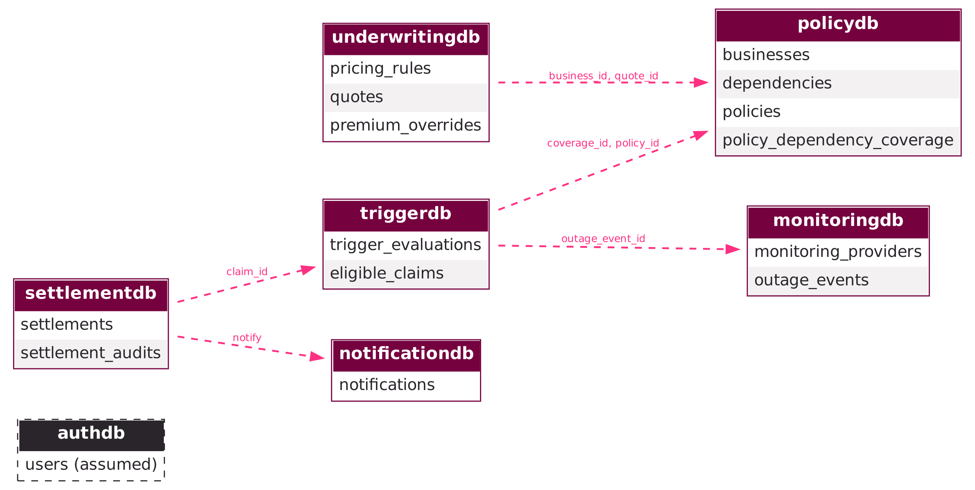
Backup: Database Design
One database per service; keys only inside a database
policydb
underwritingdb
monitoringdb
triggerdb
settlementdb
notificationdb
Links between services are IDs, not foreign keys.
UptimeShield | Parametric Business-Interruption Insurance Platform
11
Notes:
Use if asked: why separate databases? Answer: each service owns its data, so one service cannot break another; cross-service links are IDs checked through WebClient.

Slide 11
Backup: Security and Quality
Login, roles, tests and monitoring
Security
Quality and monitoring
JWT issued at login and checked by the Gateway. Six roles defined: business owner, underwriter, monitoring operator, claims officer, settlement officer, admin.
JUnit 5, Mockito and StepVerifier tests; repository tests with H2; Actuator health, metrics and logs; Eureka dashboard.
Safe payouts: duration and threshold are fetched on the server, never trusted from the client. Duplicate settlements are blocked.
UptimeShield | Parametric Business-Interruption Insurance Platform
12
Notes:
Use if asked about security: login returns a signed JWT; the gateway validates it before routing. Six roles exist in the token. Be honest: strict per-role permission checks are the next step.

Slide 12
The Product
What the user sees
Edit these captions to match your screenshots
UptimeShield | Parametric Business-Interruption Insurance Platform
7
Notes:
SCRIPT (about 40 seconds): Here are the screens. [Point to each screenshot.] This is the landing page. This is where a business requests a quote and sees its policy. And this is where a claim is evaluated and settled. If you have time, I can show it live: log in, resolve an outage, evaluate it, and see the claim appear. (TIP: replace each box with a screenshot, and edit the captions.)

