Slide 1
Welcome to My Industrial Attachment Presentation
Enosis Solutions
House 27, Road 8, Gulshan 1,
Dhaka, Bangladesh.

Slide 2
Presented By:
Israt Jahan Reshma
ID: 18ICTCSE041
Bangabandhu Sheikh Mujibur Rahman Science & Technology University, Gopalganj
Department of Computer Science and Engineering

Slide 3
Special Thanks to:
Marajul Islam Software Engineer
Enosis Solutions

Slide 4
Training On
“Software Development and Working Environment of a Software Company”

Slide 5
Services
Web Application Development
Mobile Application Development
Custom Application Development

Slide 6
What we have learn:
How a company get an order
How they distribute their work
How to deal with a problem during development
Risk analysis
Software delivery process
Software testing
Payment method of an employee

Slide 7
How to get an order???
Unite living
A client of Norway
Website for rent a house
Themeforest, Codecanyon, Fiverr, Upwork

Slide 8
Work Distribution
Project Manager
Team Lead
Developer
SQA Engineer
Client Review

Slide 9
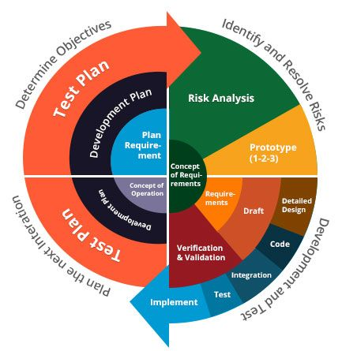
Process Model

Slide 10


Risk Analysis & Problem Handling
Discuss with team leaders
Choose the best approach

Slide 11
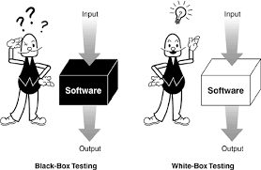
Testing Method
In Gain Solutions:
White box testing is done by developer
Black box testing is done by SQA Engineer
Manual Testing
Automated Testing: Cypress

Slide 12


Payment
Client
Gain Solutions
Developers

Slide 13
Thanks to All

