Slide 1
Computer Simulation and Modeling
Simulation of Inventory System

Slide 2
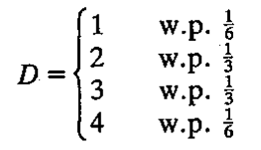
Problem Statement
A company that sells a single product would like to decide how many items it should have in inventory for each of the next n months.
Let us consider the sizes of the demands, D
At the beginning of each month, the company reviews the inventory level and decides how many items to order from its supplier.
If the company orders Z items, it incurs a cost of K + iZ, where K = $32 is the setup cost and i = $3 is the incremental cost per item ordered.

Slide 3

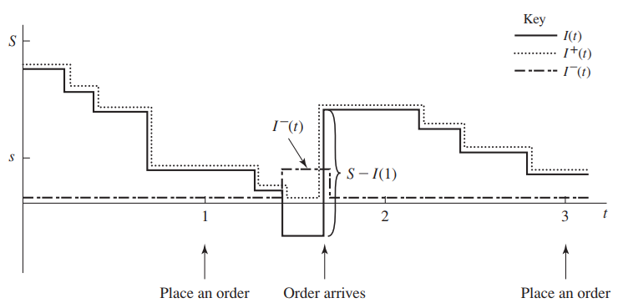
Problem Statement
When an order is placed, the time required for it to arrive (called the delivery lag or lead time) is a random variable that is distributed uniformly between 0.5 and 1 month.
The company uses a stationary (s, S) policy to decide how much to order
where I is the inventory
level at the beginning of
the month.

Slide 4
Problem Statement
When a demand occurs, it is satisfied immediately if the inventory level is at least as large as the demand.
If the demand exceeds the inventory level, the excess of demand over supply is backlogged and satisfied by future deliveries. A negative inventory level is occurred here.
When an order arrives, it is first
used to eliminate as much of the
backlog (if any) as possible;
the remainder of the order
is added to the inventory.

Slide 5
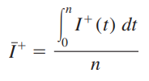
Average Holding Cost
Let I(t) be the inventory level at time t.
Let I⁺(t) = max{I(t), 0} be the number of items physically on hand in the inventory at time t.
The time-average (per month)
number of items held in inventory
for the n-month period,
The average holding cost
per month is hĪ⁺.

Slide 6

Average Shortage Cost
Let I–(t) = max{–I(t), 0} be the backlog at time t.
The time-average (per month) number of items in backlog for the n-month period,
The average backlog cost
per month is πĪ–.

Slide 7
Lab Exercise
Assume that the initial inventory level is I(0) = 60, setup cost = $32, incremental cost = $3, holding cost = $2 and backlog cost = $5 per item. Simulate the inventory system for n = 40 months and use the average total cost per month (which is the sum of the average ordering cost per month, the average holding cost per month, and the average shortage cost per month) to compare the following nine inventory policies:

