Slide 1
Computer Simulation and Modeling
Single Server Queuing System

Slide 2
Problem Statement
Let us consider a service facility with a single server – e.g. ,
a one operator banking service or an information desk at an airport – for which
we would like to estimate the (expected) average delay in queue (line) of arriving customers
the delay in queue of a customer is the length of the time interval from the instant of his arrival at the facility to the instant he begins being served.

Slide 3
State Variables
The status of the server , i.e., either idle or busy
The status of the server is needed to determine, upon a customer's arrival , whether the customer can be served immediately or must join the end of the queue.
The number of customers waiting in queue to be served (if any)
It is used to determine whether the server will become idle or begin serving the first customer in the queue.
The time of arrival of each person waiting in queue
It is needed to compute his delay in queue, which is the time he begins being served (which will be known) minus his time of arrival.

Slide 4
Notations
t_{i} = time of arrival of the i-th customer (t_{o} = 0)
A_{i} = t_{i} – t_{i – l} = interarrival time between (i – 1)st and i-th arrivals of customers
S_{i} = time that server actually spends serving i-th customer (exclusive of customer's delay in queue)
D_{i} = delay in queue of i-th customer
c_{i} = t_{i} + D_{i} + S_{i} = time that i-th customer completes service and departs
e_{i} = time of occurrence of i-th event of any type (i-th value the simulation clock takes on, excluding the value e_{o} = 0)

Slide 5
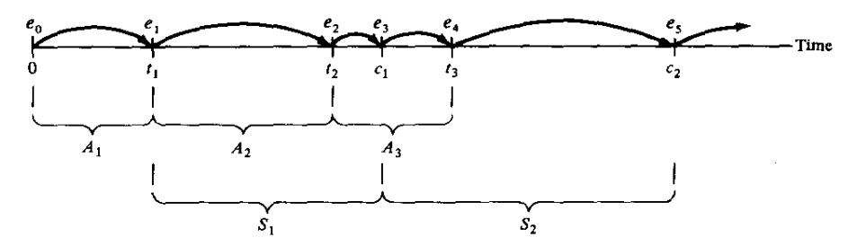
Single Server Queuing System

Slide 6
Components and Organizations
System state: The collection of state variables necessary to describe the system at a particular time.
Simulation clock: A variable giving the current value of simulated time.
Event list: A list containing the next time when each type of event will occur.
Statistical counters: Variables used for storing statistical information about system performance.
Initialization routine: A subprogram to initialize the simulation model at time zero.
Timing routine: A subprogram that determines the next event from the event list and then advances the simulation clock to the time when that event is to occur.

Slide 7
Components and Organizations
Event routine: A subprogram that updates the system state when a particular type of event occurs (there is one event routine for each event type).
Library routines: A set of subprograms used to generate random observations
Report generator: A subprogram that computes estimates (from the statistical counters) of the desired measures of performance and produces a report when the simulation ends.
Main program: A subprogram that invokes the timing routine to determine the next event and then transfers control to the corresponding event routine to update the system state appropriately. The main program may also check for termination and invoke the report generator when the simulation is over.

Slide 8
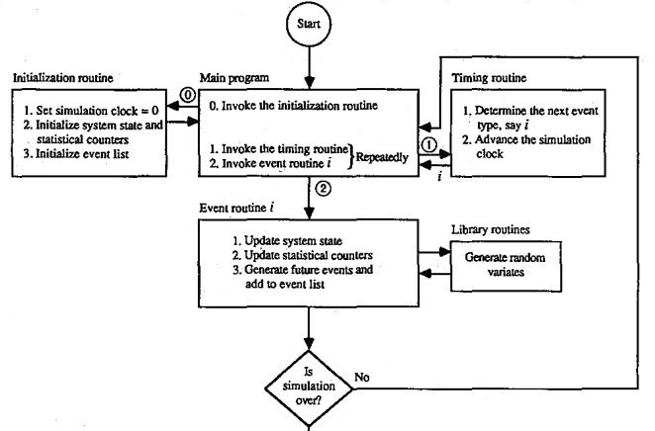
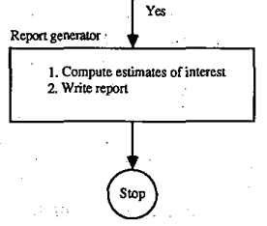
Flow of control

Slide 9
Performance of the System
To measure the performance of the system, we look at estimates of three quantities
expected average delay in queue
The delays of n customers during the simulation, we denote it by d(n).
expected average number of customers in the queue
The number of customers not being served is denoted by q(n).
how busy the server is
The expected utilization of the server i.e. the proportion of time the server is busy, we denote it by u(n).

Slide 10
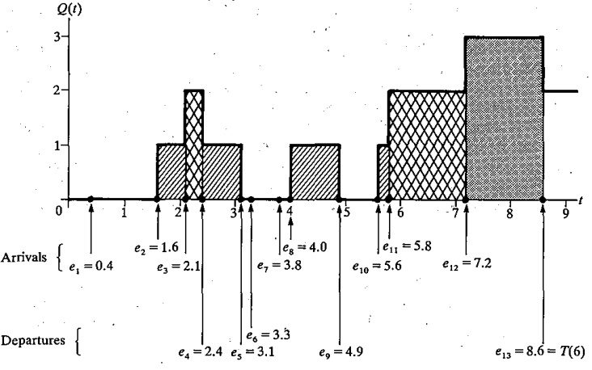
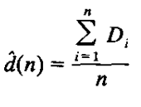
Expected Average Delay
From a single run of the
simulation resulting in
customer delays D₁, D₂ , … ,
D_{n} , an obvious estimator
of d(n) is

Slide 11
Expected Average Number of Customers
We denote the number of
Customers in the queue at
time t by Q(t).
Let T(n) be the time
required to observe our n
delays in queue.
Let p_{i} be the expected
proportion of the time that
Q(t) is equal to i.

Slide 12

Expected Average Number of Customers
A reasonable definition of
q(n) would be
p_{i} is the observed (rather
than expected) proportion of
the time during the simulation
that there were i customers in
the queue.

Slide 13
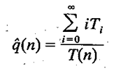
Expected Average Number of Customers
Let T, be the total time
during the simulation that the
queue is of length i, then
T(n) = T₀ + T₁ + T₂ + ... and
p_{i} = T_{i} / T(n).
So we can write,

Slide 14

Expected Average Number of Customers
T₀ = (1.6 – 0.0) + (4.0 – 3.1) +
(5.6 – 4.9) = 3.2
T₁ = (2.1 – 1.6) + (3.1 – 2.4)
+(4.9 – 4.0)+(5.8 – 5.6) = 2.3
T₂ = (2.4 – 2.1) + (7.2 – 5.8)
= 1.7
T₃ = (8.6 – 7.2) = 1.4
= (0 X 3.2) + (1 X 2.3) +
(2 X 1.7) + (3 X 1.4) = 9.9
q(6) = 9.9/8.6 = 1.15

