Slide 1
Welcome to my presentation
on
Industrial Attachment
Course code: CSE311
Presented By
Solaiman Hossain
ID: 18CSE220
Session: 2018-19
Dept of CSE, BSMRSTU
Trained By
Md. Marajul Islam
Associate Software Engineer
Enosis Solutions

Slide 2
Training On
Working environment of a software development company

Slide 3
Company Profile
Company Name: Enosis Solutions
Location: House - 27 Road No 8, Gulshan 1, Dhaka 1212
Year of Establishment: 2003
About company
CEO of Enosis Solution is Jishan Shah.
From 2003 to 2023 the company has not only frown significantly but also has evolved to become the leading Software Development & IT Service Provider company in Bangladesh.

Slide 4
Services
Web Application Development
Mobile Application Development
Custom Software Development
Quality Assurance and Testing

Slide 5
Types of Software that are used for software development:
Jira
Slack
Skype
Bob
Bitbucket
Adobe XD
GitHub
MySQL

Slide 6
What have we learned?
How a company get an order?
How they distribute their work?
How to deal with a problem during development?
Risk analysis
Software delivery Process
Software testing
Payment method

Slide 7
How to get an order?
Online Marketplace
Fiver
Upwork
LinkedIn Marketing
Email Marketing
Software Agency

Slide 8
Work Distribution
Project Manager
Team Lead
Developer
Client
QA Engineer

Slide 9
Work Distribution
Team
Developers
QA
Frontend
Backend
DevOps

Slide 10
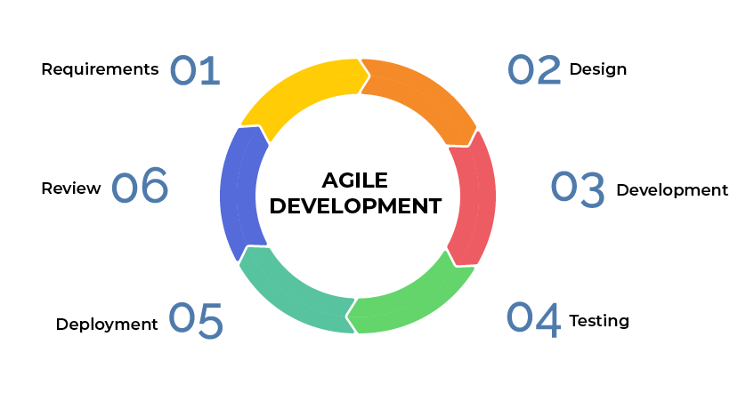
Process Model

Slide 11
Testing Method
White Box Testing
Black Box Testing

Slide 12
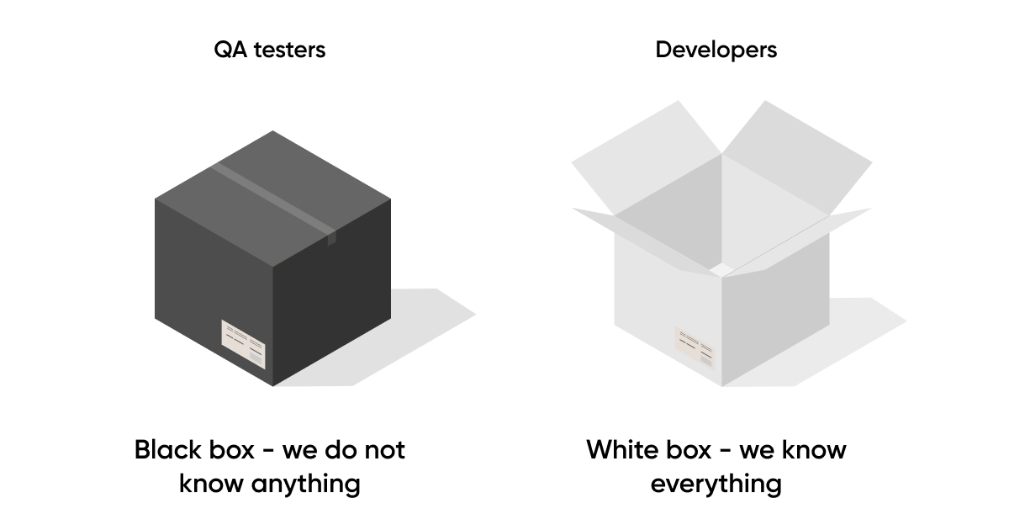
Testing Method

Slide 13
Risk Analysis and Problem Handling
Discuss with team leaders
Choose the best approach

Slide 14
Recruitment Process
Apply Role
CV Review
Interview Call
Screening
Technical Interview
HR Interview

Slide 15
Thank You

