Slide 1
UNIVERSITY PROJECT · AI COURSE PROJECT
AI-Based Voice-Controlled LED Using Raspberry Pi Pico
BUILD PATH
My Voice
AI Voice Classifier
ON / OFF Command
Raspberry Pi Pico
K M Shihab Jamil
Relay
We created a voice-controlled lighting prototype by combining a trained AI voice-command classifier with Raspberry Pi Pico and a relay-controlled LED.
LED

Slide 2
01 · PLAN
We planned the project as two connected systems
AI software prepares the decision; hardware turns it into light.
AI SOFTWARE
HARDWARE
From recordings to predictions
From code to physical light
Record commands, create a dataset, prepare audio, train a classifier, test it, and generate ON/OFF predictions.
Program the Pico, build the relay driver, connect the LED, receive serial commands, and control the physical light.
PLANNED WORKFLOW
01
02
03
04
05
06
Voice
Audio Input
AI Model
ON/OFF
Serial
Pico → Relay → LED

Slide 3
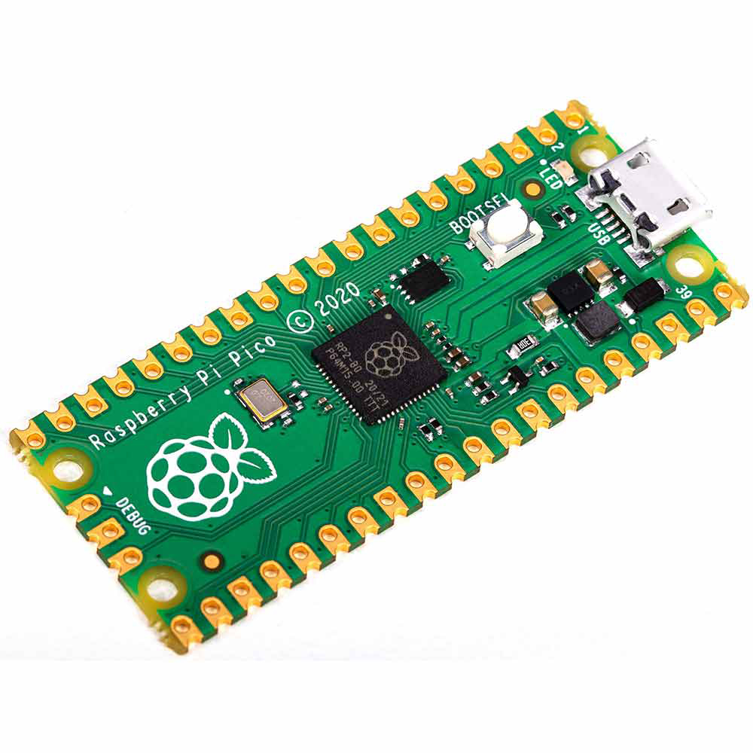
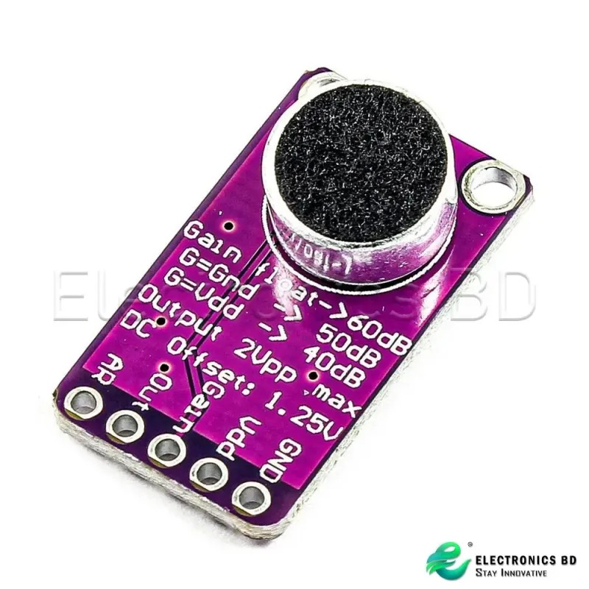
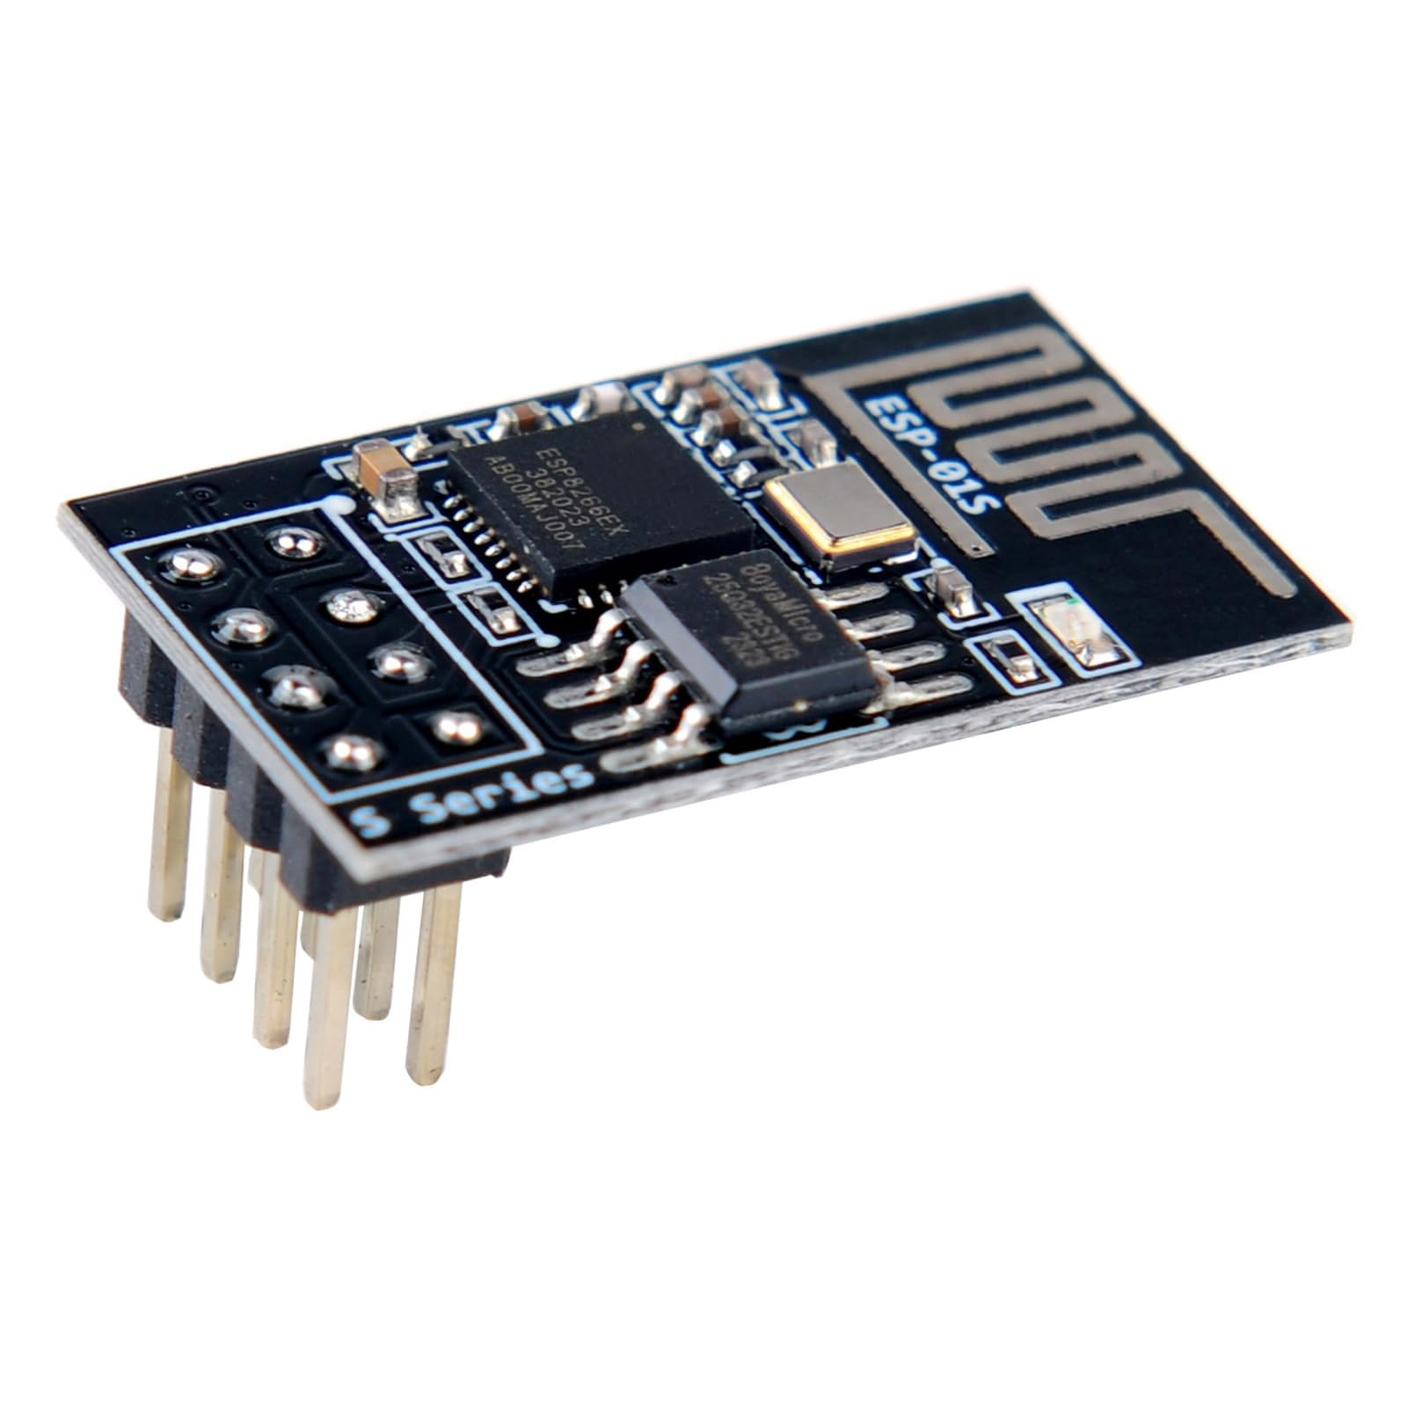

02 · COMPONENTS
We assembled the hardware around a Pico-controlled relay chain
We connected the Pico to the breadboard, built the transistor-based relay driver circuit, and connected the relay to control the LED.
Hardware relationship: Pico GPIO → Transistor Driver → Relay → LED
COMPONENTS
SUPPORT PARTS
Raspberry Pi Pico
MAX9814 microphone amplifier module
5V relay module
D882P transistor
S9013 transistor
LED light
150 Ω resistors
Breadboard
Jumper wires
USB cable

Slide 4
03 · ASSEMBLY
We tested the Pico and relay before adding the AI
We verified the physical chain first, so the AI would not hide a hardware problem.
01
02
03
04
Connect
Detect
Test GPIO
Test relay
Thonny IDE, MicroPython, USB, and COM3 connection.
Confirm the Pico and MicroPython environment.
Check GPIO behavior and LED ON/OFF testing.
Verify serial communication and relay switching.
Control logic: ON command → Pico receives ON → GPIO activates relay → LED turns ON. OFF reverses the chain.

Slide 5
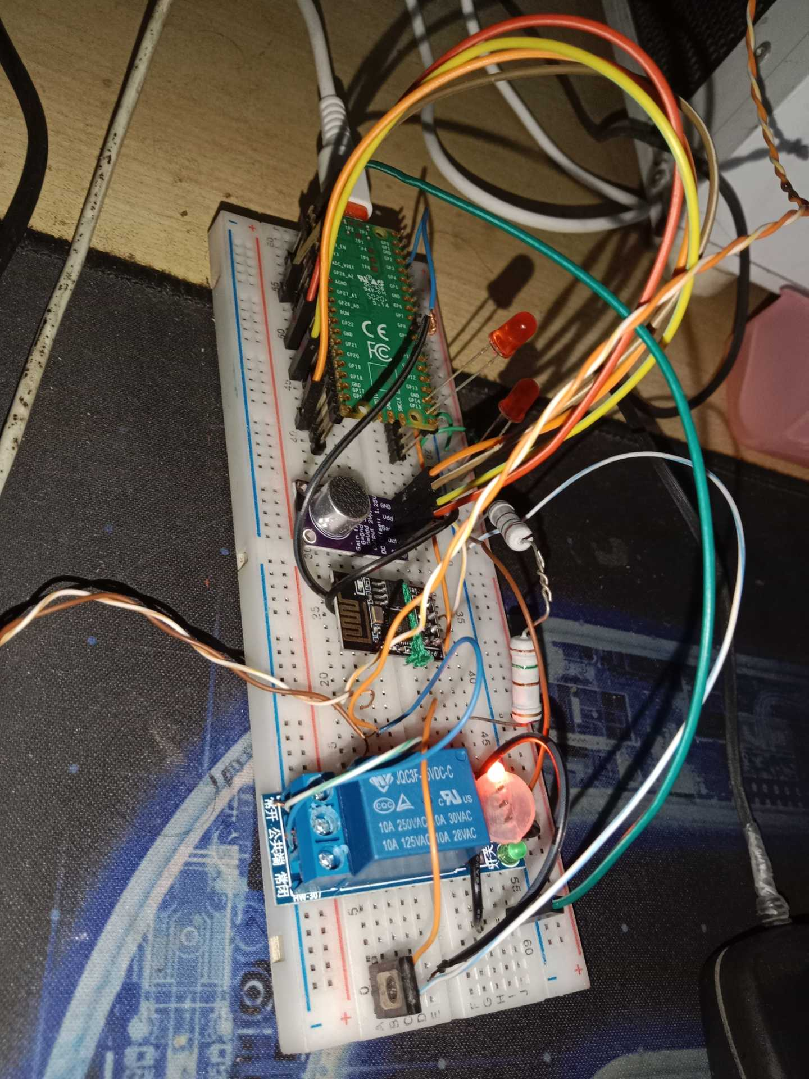
04 · DATASET
We started the dataset with my own voice
We recorded multiple samples for two command classes: “Light On” and “Light Off."
“I started by creating a dataset from my own voice recordings.”

Slide 6
05 · DATA PREPARATION
We expanded the recordings, then converted audio into features
My recordings and selected additional Google/public voice samples became one organized training dataset.
COMBINED DATASET
Two sources, two classes
PREPROCESSING FLOW
Our recordings + additional Google/public voice dataset → combined dataset → Light On / Light Off classes.
1
2
3
4
5
Audio Files
Audio Preprocessing
Feature Extraction
Numerical Features
Training Dataset
We selected suitable additional samples and organized them into the same command classes; the public dataset is not identical to my recordings.

Slide 7
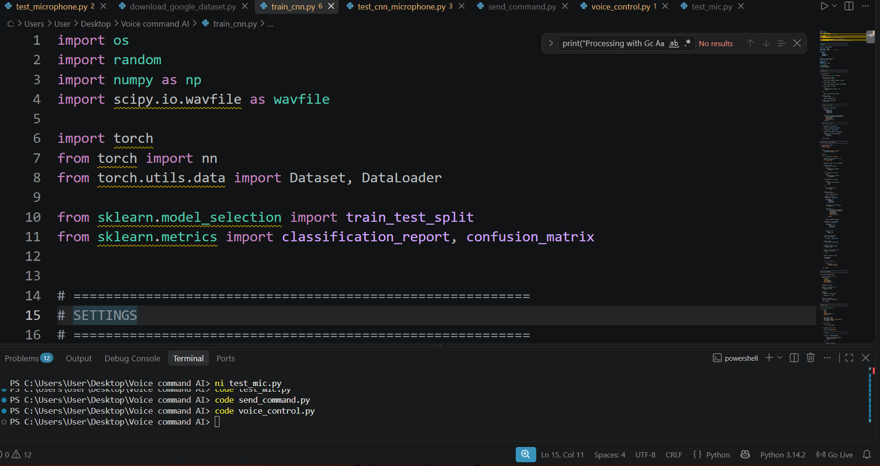
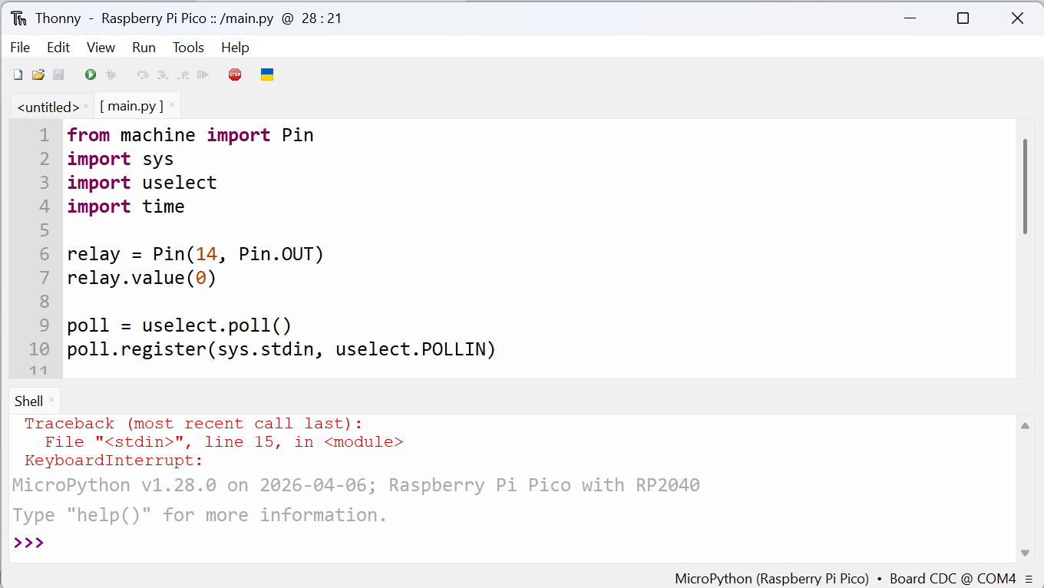
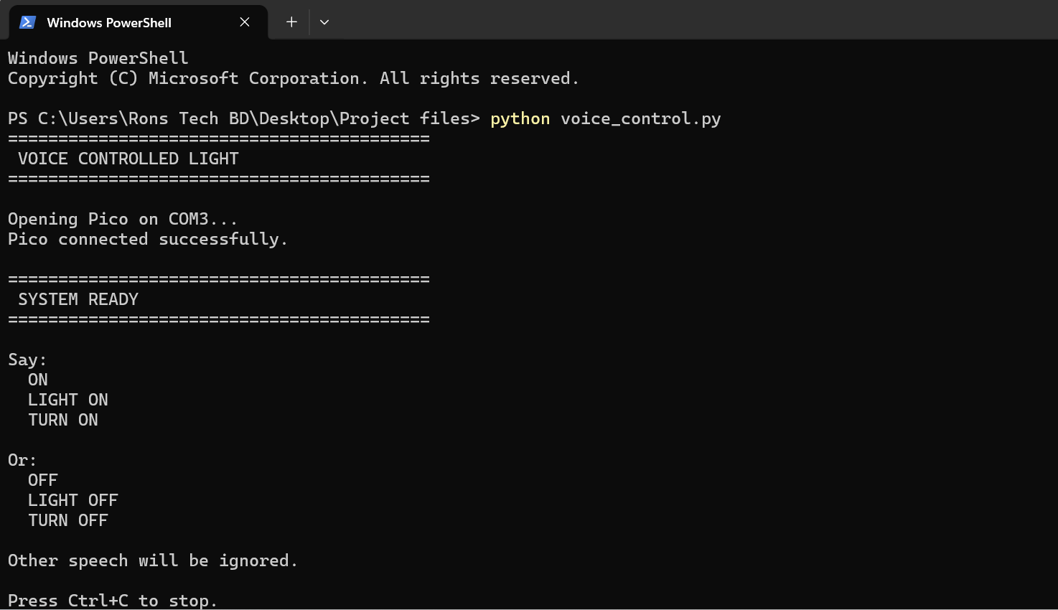
06 · AI TRAINING
We trained a classifier to distinguish the two commands
We used the prepared voice dataset to train a machine-learning model for LIGHT ON and LIGHT OFF.
The model learned patterns from audio features and was saved for prediction.
01
02
03
04
Audio Dataset
Feature Extraction
Training Data
AI Classification Model
Prepared Light On and Light Off samples.
Features were organized for learning.
Audio became numerical features.
Training produced a saved trained model.

Slide 8
07 · MODEL TESTING
We tested the model before connecting the hardware
We checked whether the model identified the intended command before physical integration.
INPUT “LIGHT ON”
INPUT “LIGHT OFF”
→ ON
→ OFF
Model identifies the intended command.
Model identifies the intended command.

Slide 9
08 · INTEGRATION
We connected the AI prediction to the Pico through serial communication
The prediction became a simple ON or OFF message through USB serial communication.
SOURCE
INPUT
MODEL
PREDICTION
SERIAL
OUTPUT
My Voice
Microphone / Audio
Trained AI
ON / OFF
USB → Pico
GPIO → Relay → LED
IF MODEL PREDICTS ON
IF MODEL PREDICTS OFF
AI → “ON” → Pico → Relay ON → LED ON
AI → “OFF” → Pico → Relay OFF → LED OFF

Slide 10
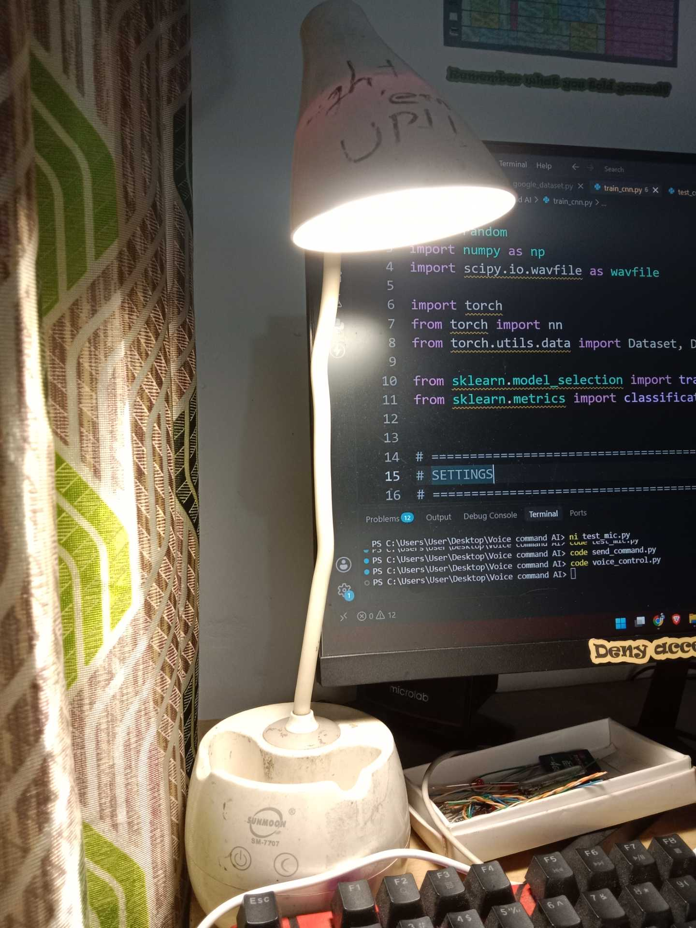
09 · FINAL PROJECT
We combined the full chain into a working prototype
Voice → AI → Hardware Control
We combined my own voice dataset, a trained AI classifier, Raspberry Pi Pico, relay control, and an LED into one voice-controlled prototype.
What we created
Recorded commands · organized and expanded the dataset · prepared audio features · trained and tested the classifier.
Programmed the Pico with MicroPython · assembled the transistor and relay circuit · connected AI output to the Pico through serial communication.
FUTURE WORK
Connect the MAX9814 directly to the Pico, integrate an ESP8266 Wi-Fi module, control multiple lights, add more voice commands, and expand toward an IoT smart-home controller.

