Slide 1

Stats & Facts
Group Project
Supervised Learning
Car Rentals Analysis
Alfredo Funicello | Amr Rashad | Shihab Hamati

Slide 2
Introduction Behavior of daily rental rate Effect of different features Full Linear Regression Other Explorations

Slide 3
Dataset & Exploration Path
Car Rentals data collected from different websites for major US cities, in July 2020
There are 5581 observations
Curious about how the different features affect car rental prices (e.g., age of the car, fuel type, ratings, etc.)
Variables were explored individually and together
Linear regression was used to generate model

Slide 4
Introduction Behavior of daily rental rate Effect of different features Full Linear Regression Other Explorations

Slide 5
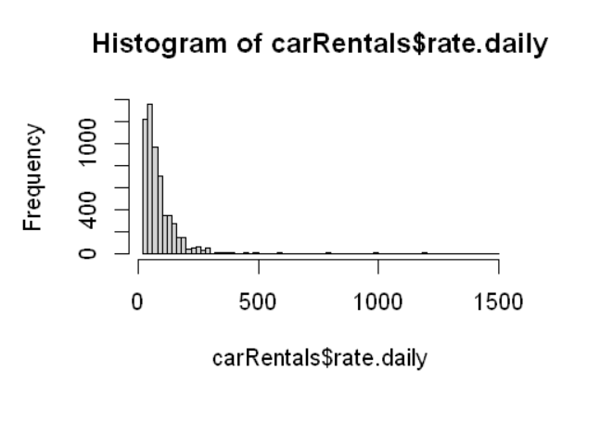
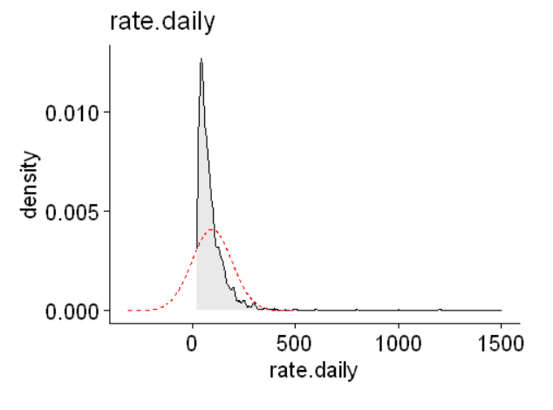
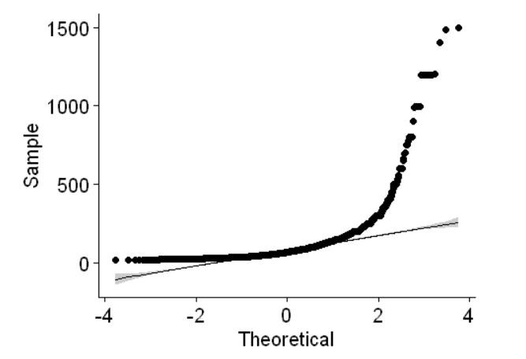
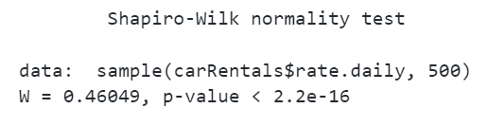
Understanding the Dependent Variable Distribution
Variable “rate.daily” suffers from non-linearity
This can be observed visually from the histogram, confirmed visually by the QQ plot, and tested numerically by the Shapiro test

Slide 6
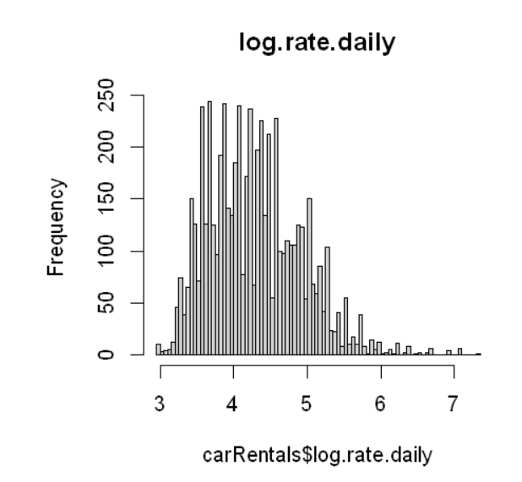
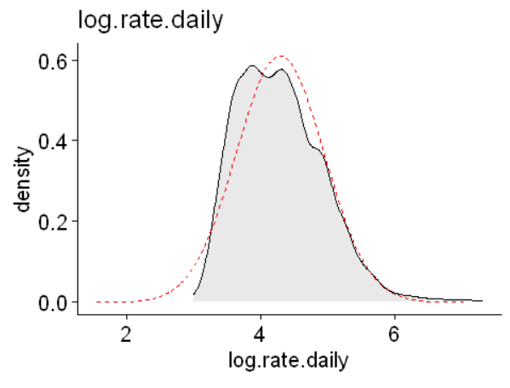
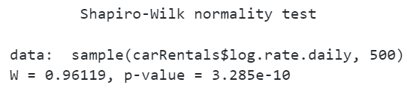
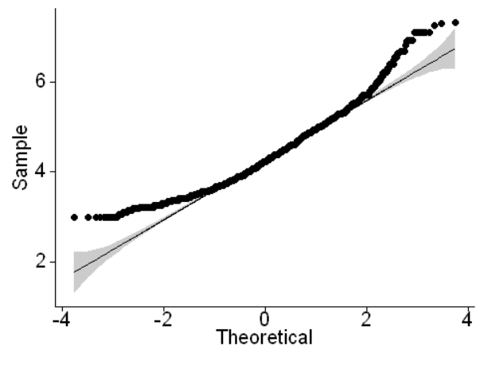
Transformation of the Dependent Variable
Daily rental rate is non-zero and positive, so a simple log transformation is applied to achieve a closer-to-normal distribution

Slide 7
Handling outliers
There are 32 observations that lie beyond 2*IQR away from the Upper Quartile of the log-transformed daily rate
Upon further exploration, we identify 2 main groups of outliers:
classical cars, even if log(rate) is not outlier (16 observations)
mostly prestigious brands with high rates (29 observations)
Classical cars were dropped (as they have a different market model and insufficient sample size to explore it)
Outliers of current models were retained

Slide 8
Introduction Behavior of daily rental rate Effect of different features Full Linear Regression Other Explorations

Slide 9
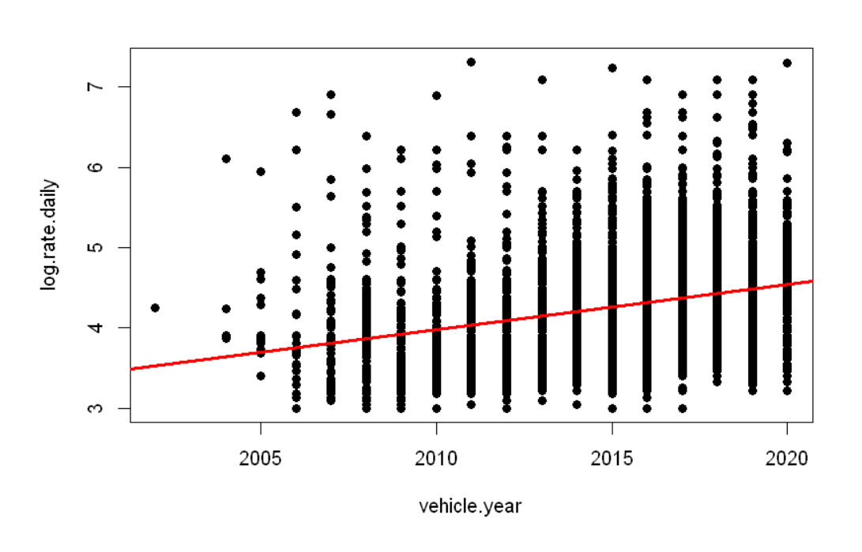
Year: Newer cars are more expensive, as expected

Slide 10
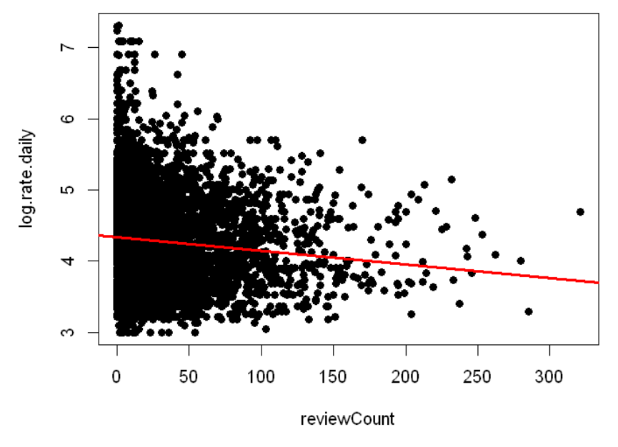
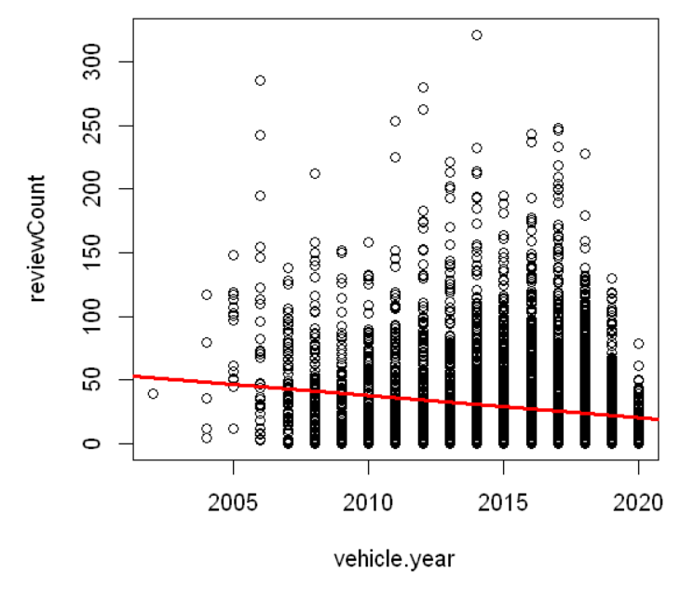
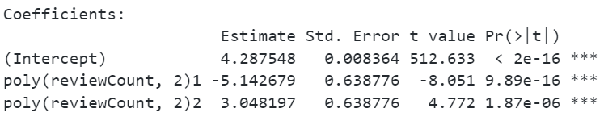
Number of reviews: negative correlation (counterintuitive)
Counterintuitively, the more reviews the lower the rate
This is because more reviews are more likely to be older cars
A quadratic model could better explain the effect of more reviews vs age
Higher order polynomials are significant up to 6th order, but loose interpretability

Slide 11
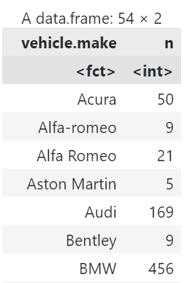
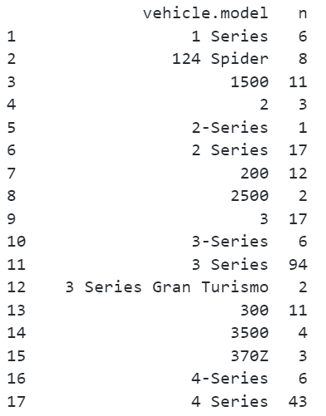
Car brand and model required data cleaning
Since data sources are different, slight variations in spellings of car brands or types existed, and they were reconciled

Slide 12
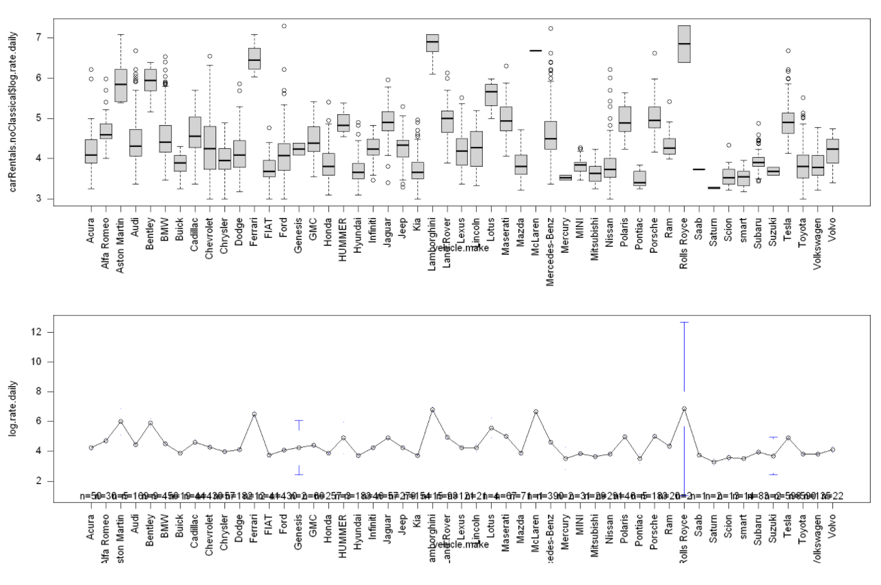

Car brand is a significantly explanative feature for the rental rate

Slide 13
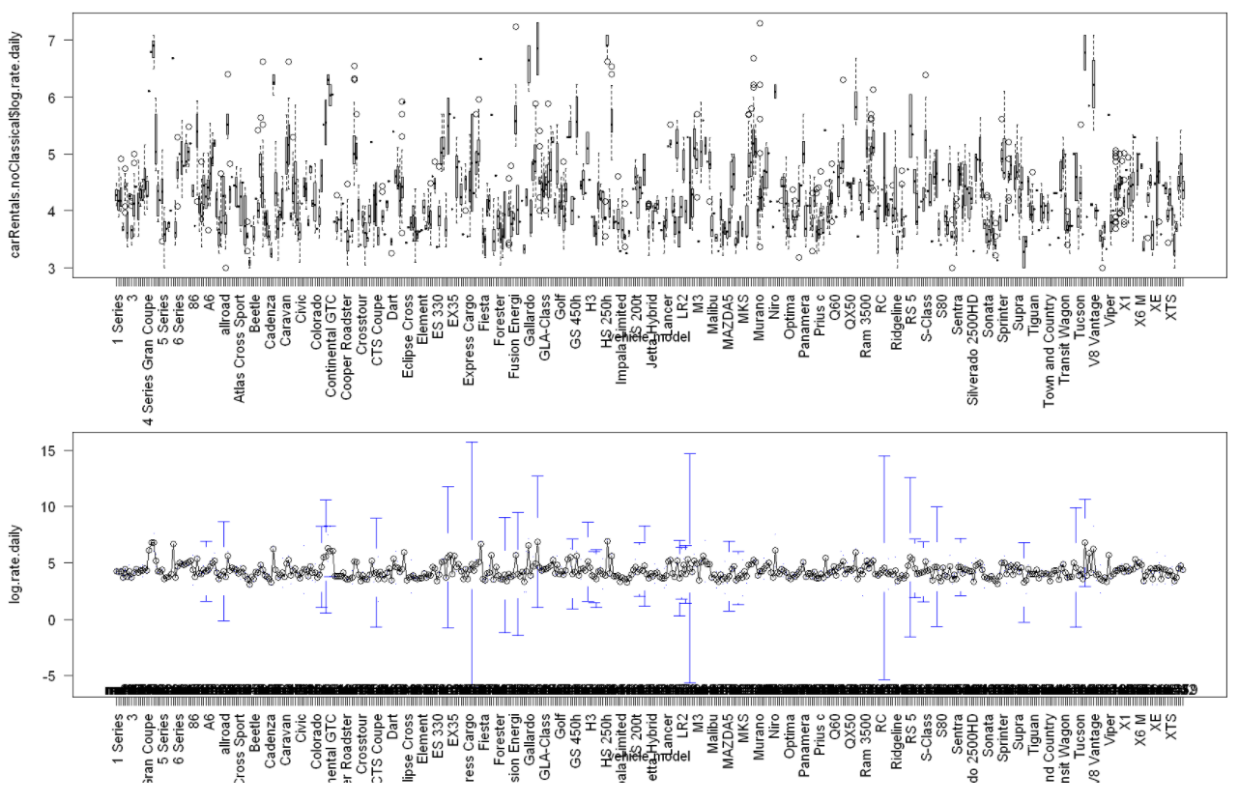

Car model is also a significantly explanative feature for the rental rate

Slide 14
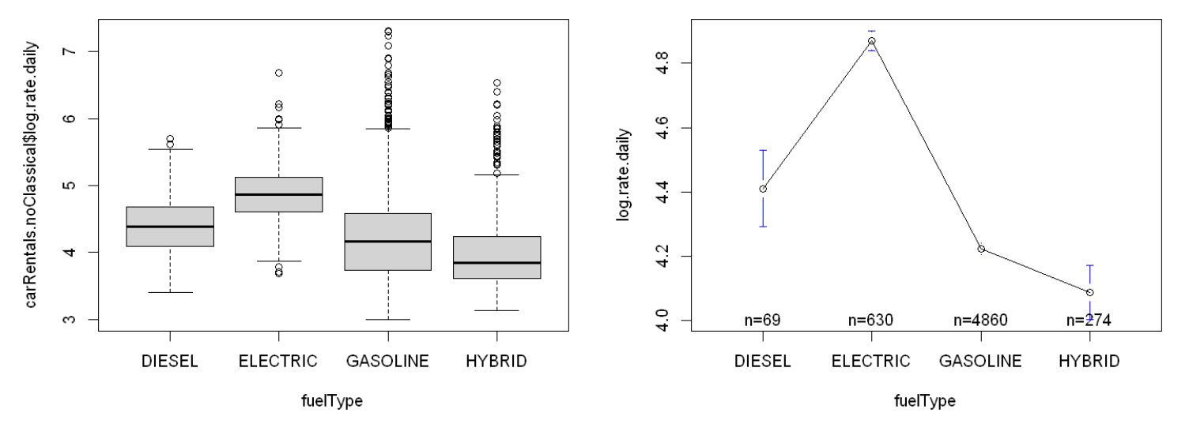
The type of fuel, vehicle type, and proximity to airports have significant effects on price (1/2)
Electric cars are the most expensive on average
We expect this to be due to a combination of:
purchase price level differences for rental companies
customer fuel costs – increased willingness to pay more on rental and less on fuel to reduce overall cost)

Slide 15
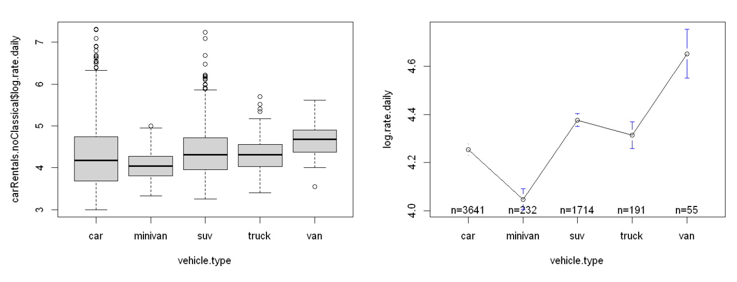
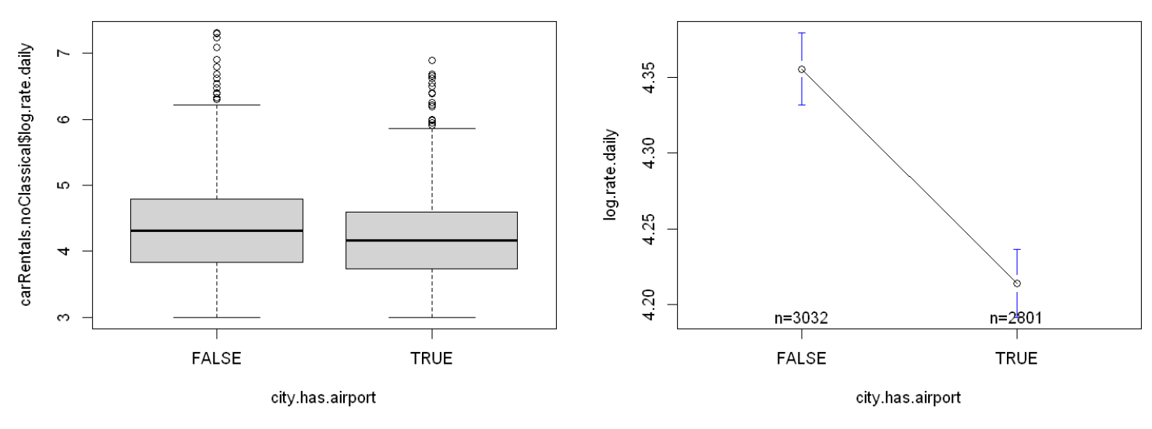
The type of fuel, vehicle type, and proximity to airports have significant effects on price (2/2)

Slide 16
Introduction Behavior of daily rental rate Effect of different features Full Linear Regression Other Explorations

Slide 17
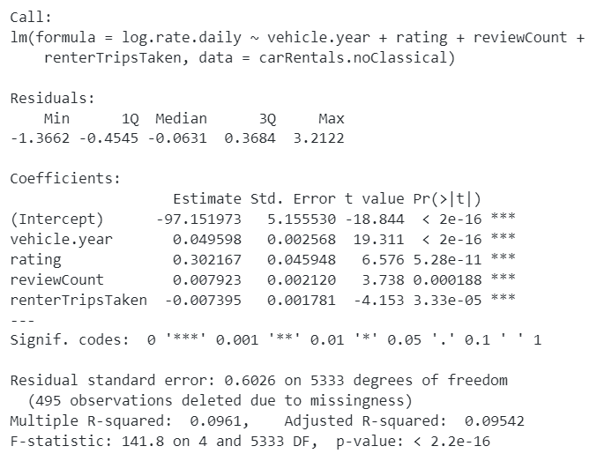
The numerical features are not sufficient to produce the optimal linear regression model

Slide 18
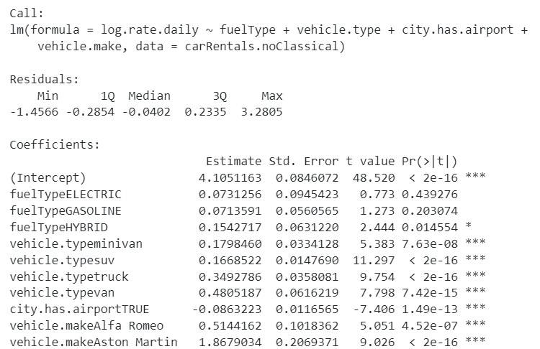

The categorical features yield better model’s performance*
…
…
…
…
…
* Excluding model type at this point

Slide 19
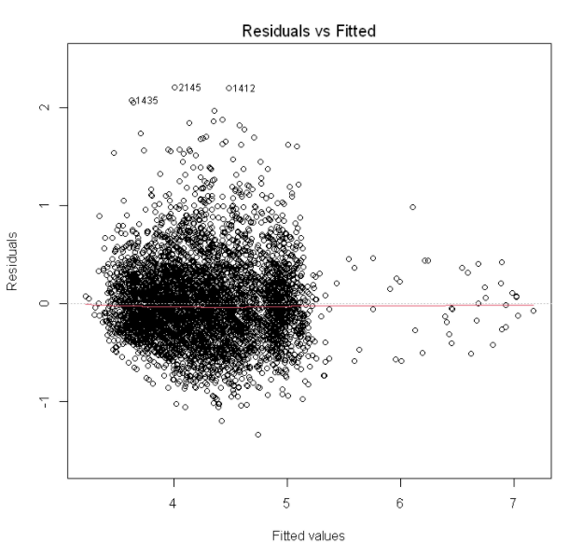
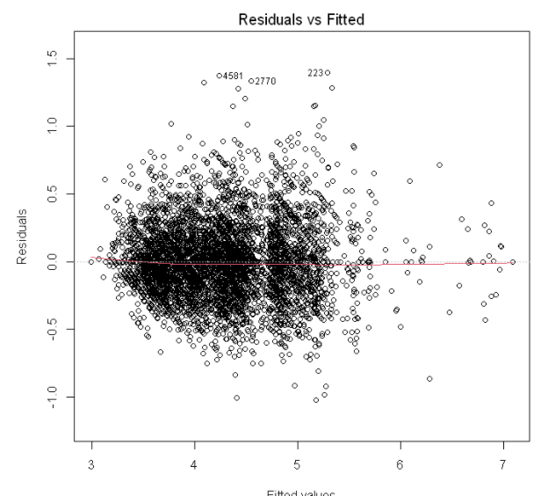
Overall model (with numeric features): Including car model yields better in-sample fit
However, this is the effect of grouping observations into more dummy variables (51 brans vs 490 models ~ almost 10 times less per dummy)
Further exploration of whether this leads to overfitting should be performed if the model is to be used for prediction purposes later on
Included: Make
Excluded: Model
Included: Model
Excluded: Make

Slide 20
Thank you

