Slide 1
IP ADDRESS

Slide 2

IP Address

Slide 3

IP Address
Internet
Download

Slide 4
IP Address
Home address
House: 100
Street: Tajmahal Road
Area: Mohammadpur
City: Dhaka
Country: Bangladesh
IP Address
70.54.14.178
Internet

Slide 5
IP Address
IP Address
70.54.14.178

Slide 6
IP Address
Internet Protocol

Slide 7
IP Address
IP V4
&
IP V6

Slide 8
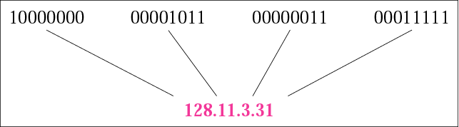
IP v4
32 bits
0-255

Slide 9
IP v4
Note:
The address space of IPv4 is
2³² or 4,294,967,296.

Slide 10
Example
Find the error, if any, in the following IP addresses:
a. 111.56.045.78 b. 221.34.7.8.20
c. 75.45.301.14 d. 11100010.23.14.67
Solution
a. There are no leading zeroes in dotted-decimal notation (045).
b. We may not have more than four numbers in an IP address.
c. In dotted-decimal notation, each number is less than or equal
to 255; 301 is outside this range.
d. A mixture of binary notation and dotted-decimal notation is not
allowed.

Slide 11
IP v4 Limitations and IP v6

Slide 12
IP Address
IP V4
&
IP V6

