Slide 1


Case Study: Supply and Sale Management with Business Intelligence
MOHAMMAD SHIHAB UDDIN
ID: 164138
Course Title: Business Analytics
Batch No: 29
Bangladesh Korea Information Access Center (BK-IAC)
Department of Computer Science and Engineering (CSE)
Bangladesh University of Engineering & Technology (BUET)

Slide 2
ANALYSIS AIMS
This analysis aims to answer the following questions based on
Descriptive analysis,
Predictive analysis, and
Prescriptive analysis.
Select the facts, the dimensions, the fact table, the dimensional tables for the above analysis.
Perform the above three analyses on specified items (I00151, I00085).
Perform the above three analyses on a store (S0001).
Recommend the feasibility of a new store in a certain area.
Classify the customers based on the purchase and personal profile.
Recommend the advertisement of an item to the customers based on the classification of the customers.
Recommend anything else that you would like to increase profit or decrease losses. There are no restrictions in this case, the more you explore, the better.

Slide 3
EXPLORING THE FILE
The file contains the following sheets
Fact_table - Contains the main transactional data or transaction details including customer, time, item, store, quantity sold, unit, unit price, and total price. It has 100000 rows and 9 columns .
Trans_dim - Includes details about transactions, Provides information about the payment method, including transaction type and associated bank name. It has 39 rows and 3 columns.
Item_dim - Contains item-related information. Details about items, including item name, type, price, manufacturing country, supplier, stock quantity, and unit. It has 264 rows and 8 columns.
Customer_dim - Contains customer-related information, Contains customer information like name, contact details, address, district and division. It has 9191 rows and 9 columns.
Time_dim - Includes time-related data for each transaction. Stores time-related information such as date, hour, day, week, month, quarter, and year. It has 4999 rows and 8 columns.
Store_dim - Contains store-related information. Provides information about stores including size, location, city, upazila, district, and division. It has 44 rows and 7 columns.
After the doing merge, there has been Number of rows 100000 and columns 39.

Slide 4
UNDERSTANDING THE DATA
The file contains the following
28 object type columns or string data.
11 number type columns or numeric data.
4 number type data column, sold quantity, unit price, total price and stock quantity are effective summarize.
Other 6 number type data column are related to date breakdown.
Dropping 9 irrelevant columns from merge sheet
After that most of the missing values in the name column, which we can ignore for now as it doesn't significantly impact the analysis.

Slide 5
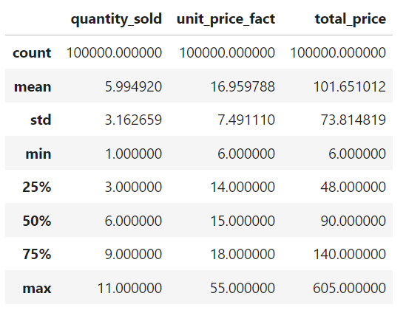
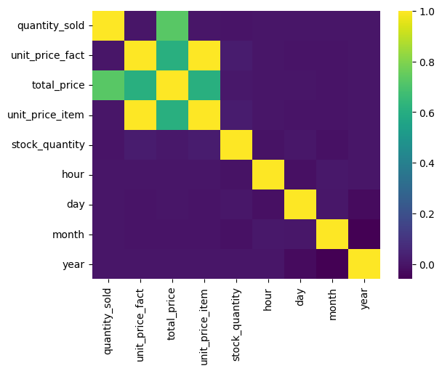
UNDERSTANDING THE DATA
CORRELATION
STATISTICS

Slide 6
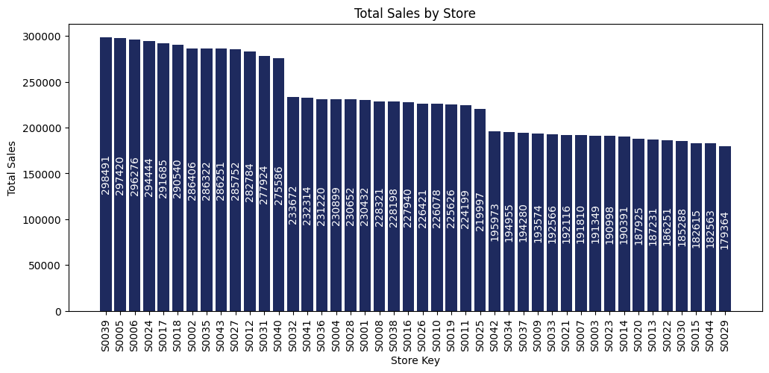
STORE WISE SALES
From above chart shows the total sales by store, where my assign store (S0001) is 19th position out of 44, located in Dhaka and topmost one in Chittagong

Slide 7
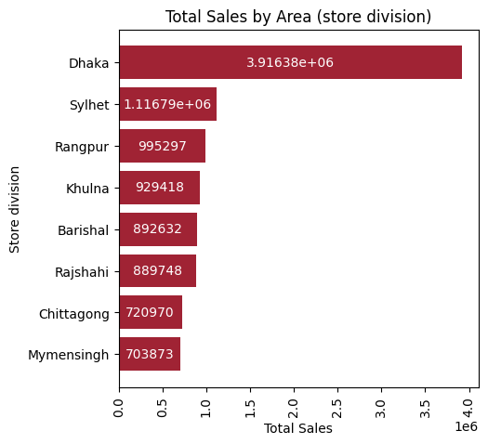
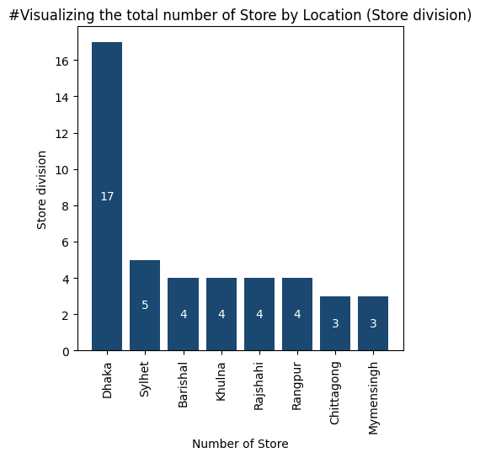
AREA WISE SALES
Dhaka is the most significant sales area and, other location moderately close, ranging from about 0.9 million to 0.7 million, Mymensingh is the lowest sales division
Most of the store (17) in Dhaka division and other between 5 to 3 out of 44

Slide 8
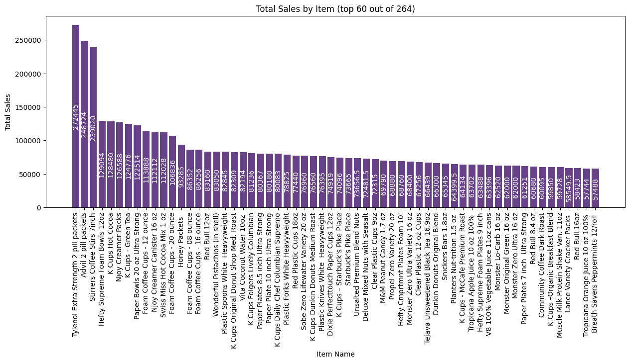
ITEM WISE SALES
The most sales Item name is "Tylenol Extra Strength 2 pill packets", it’s value 272445, This is a Medicine.
Where my assign item name are "Cheetos Flamin' Hot 1 oz" and "Tropicana Orange Juice 10 oz 100%",These are Food - Chips and Beverage - Juice item, value 18734 and 57744

Slide 9
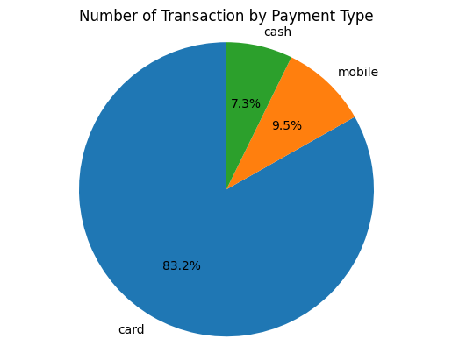
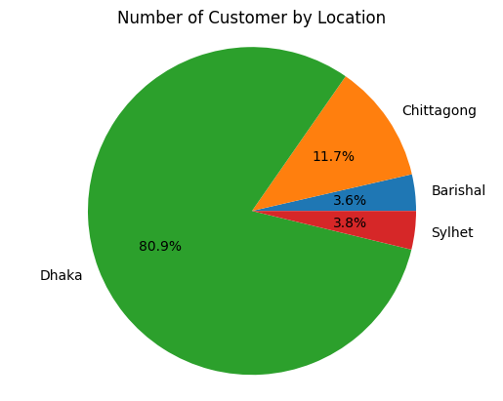
PAYMENT METHOD & CUSTOMER
Most of the transaction was by using card, only 7.3% using cash, we want to increase other transaction type, we can some offer using those type transaction
Most of the customer in Dhaka, there are no customer in Khulna, Rajshahi, Rangpur and Mymensingh

Slide 10
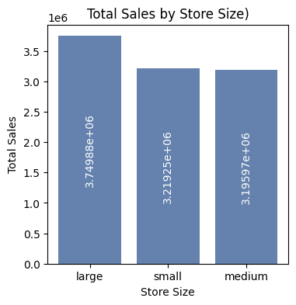
STORE SIZE WISE SALES
Sales doesn't matter small and medium size store, when we will open new store, it's size may be either large or small

Slide 11
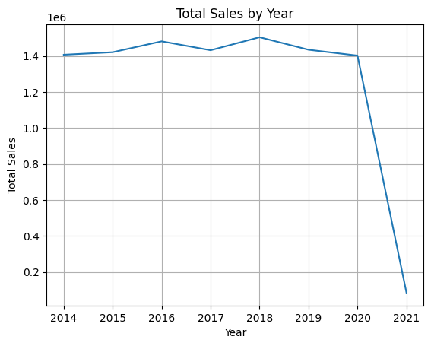
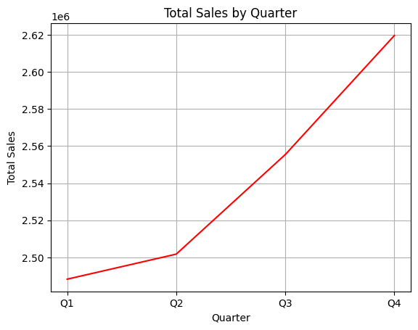
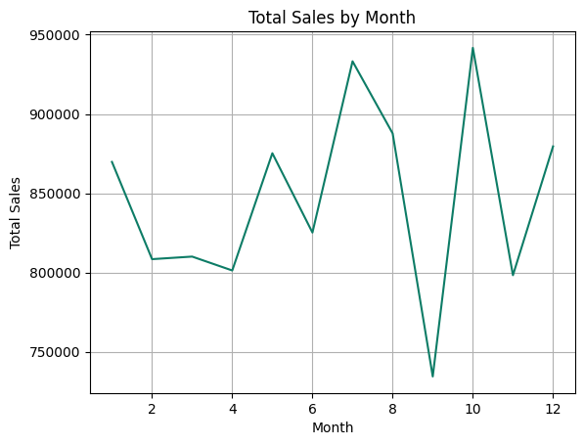
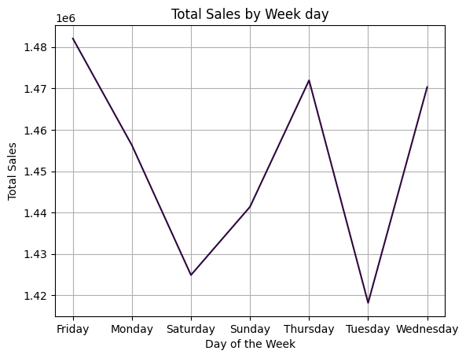
SALES OVER TIME
Sales were relatively consistent from 2014 to 2020, ranging from about 1.4 million to 1.5 million. There’s a significant drop in 2021, likely due to incomplete data
Across quarters, with no single quarter consistently outperforming others across years. Q4 generally tends to have higher sales.
Sales vary month to month with no consistent pattern across years, September is lowest, and October is highest.
Friday having the highest sales and Tuesday the lowest over the week

Slide 12
REGRESSION ANALYSIS
 | Training Score | Testing Score | R2 Score | Mean Squared Error | Mean Absolute Error
Linear Regression (Single feature) | 0.52 | 0.52 | 0.52 | 4.76 | 1.73
Linear Regression (Multiple feature) | 0.89 | 0.89 | 0.89 | 554.12 | 12.91
Lasso (L1) Regularization | 0.89 | 0.89 | 0.89 | 554.219 | 12.84
Ridge (L2) Regularization | 0.89 | 0.89 | 0.89 | 554.12 | 12.91
ElasticNet (hybrid) Regularization | 0.89 | 0.89 | 0.89 | 560.56 | 12.32
Based on these results, Linear Regression (Multiple feature) seems to be the most effective model for predicting the success of a new store based on the available features (['unit_price_fact','quantity_sold', 'total_price’]).
Regularization did not increase the score, Linear Regression (Single feature) is the lowest score

Slide 13
CLASSIFICATION ANALYSIS
 | Accuracy | Precision | Recall | F1 Score
Logistic Regression | 0.94 | 0.87 | 0.87 | 0.87
Decision Tree | 1.0 | 1.0 | 1.0 | 1.0
Random Forest | 1.0 | 1.0 | 1.0 | 1.0
SVM | 0.96 | 0.93 | 0.93 | 0.93
Random Forest and Decision Tre performed the best with an accuracy of 100%,
Logistic Regression and SVM also performed reasonably well but with slightly lower scores.
Based on these results, Random Forest seems to be the most effective model for predicting the success of a new store based on the available features (['division_store', 'store_size', 'trans_type', 'item_type', 'unit_price_fact', 'quantity_sold’]) and creating new feature with binary value one is above or equal to 75% value of total_price other one is less than 75%

Slide 14
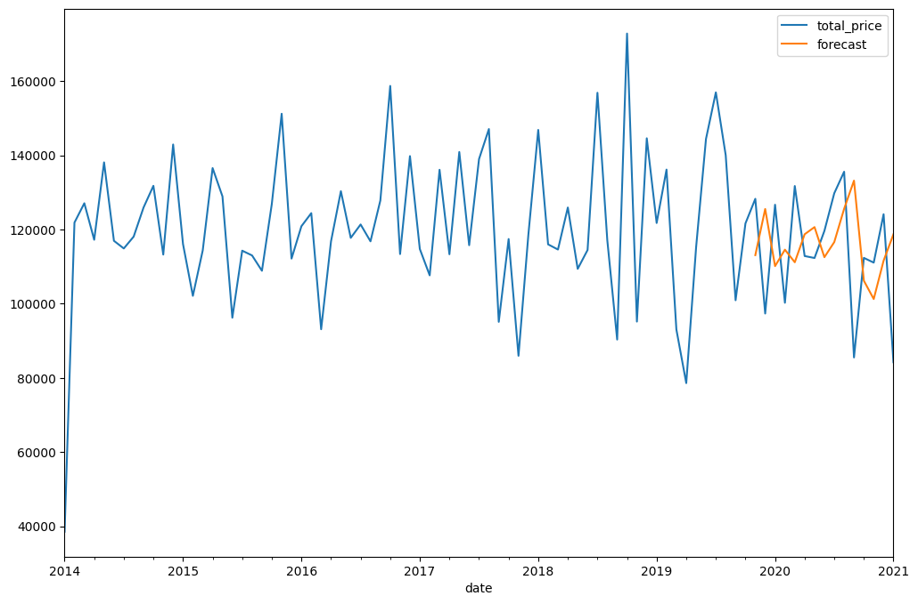
TIME SERIES ANALYSIS: ARIMA
The plot is showing how well the model forecasts compared to actual sales data over the time, It has noise patterns that means random variation in the series. Data is stationary, so d is 0, from Partial Autocorrelation and Autocorrelation p and q are 1

Slide 15
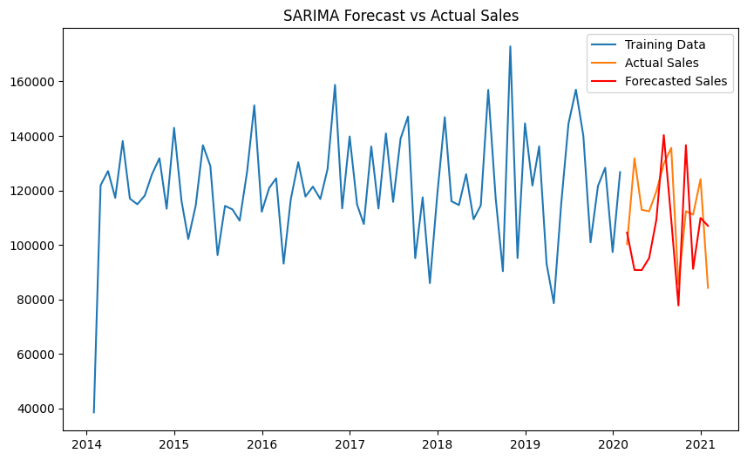
TIME SERIES ANALYSIS: SARIMA
The plot is showing how well the model forecasts compared to actual sales data over the time

Slide 16
RECOMMENDATIONS
Most of the store (17) in Dhaka and other area between 5 to 3 out of 44. we can open new store outside Dhaka
Most of the transaction (83.2%) was by using card, 7.3% using cash and 9.5% mobile, we want to increase other transaction type, we can give some offers or discounts using those type transaction
Most of the customer (80.9%) in Dhaka, there are no customer in Khulna, Rajshahi, Rangpur and Mymensingh, so we can attract new customer those area giving some offer or discount
The sales at the beginning of the year are quite low compared to the end of the year so we can give some offers or discounts at the beginning 1st and 2nd quarter
Saturday and Tuesday are less sales, we can give some offers or discounts those days
To reduce the cost of opening a new store, we can open the small size store because small or medium size store's sales are same
Random Forest seems to be the most effective model for predicting the success of a new store based on the available features.
SARIMA is better in time series analysis for prediction according to pattern

