Slide 1
INNOFUND
project PResentation
A platform for crowdfunding a project

Slide 2
OUR TEAM
Aqib mahmud rime
170041002
Md shihab shahriar
170041016
Refaat Mohammad alamgir
170041031

Slide 3
cURRENT PROBLEMS AND OUR MOTIVATION
Failed dreams
Innovative projects fail to launch only because there isn’t enough funding.
Mass production impossible
Promising projects fail to make it to the market due to a lack of backers.
Lack of funding for student competitors
Not enough investment for startups
Students participating in int’l competitions find it hard to fund their expenses.
New, small businesses do not enough capital to launch and make their company thrive.

Slide 4
Our Solution
A website that will be used as a one-stop platform for funding prospective projects and startups. The crowdfunding can be of different types :
Equity-based - entrepreneurs are able to raise money for their business by selling off part of their company to outside investors in exchange for capital
Rewards-based - the individuals supporting the cause or idea are given different types of rewards as a way of showing appreciation
Profit-sharing - a form of crowdfunding model in which contributors receive a share in the profits of the business

Slide 5
Features
feature 1
Users with proper authentication can start campaign for business/startup or invest in other’s campaign
feature 2
User can host the project / startup asking for donation based or equity based or reward based investment or they can use the mixture.
feature 3
Proper authentication will be maintained in case of equity based project / startup.

Slide 6
Features
feature 4
Campaigners can upload videos for promotion and
marketing
feature 5
Can pay through Credit Card, Bkash or other mobile banking system via SSLcommerz
feature 6
Can control project campaign through interactive dashboard

Slide 7
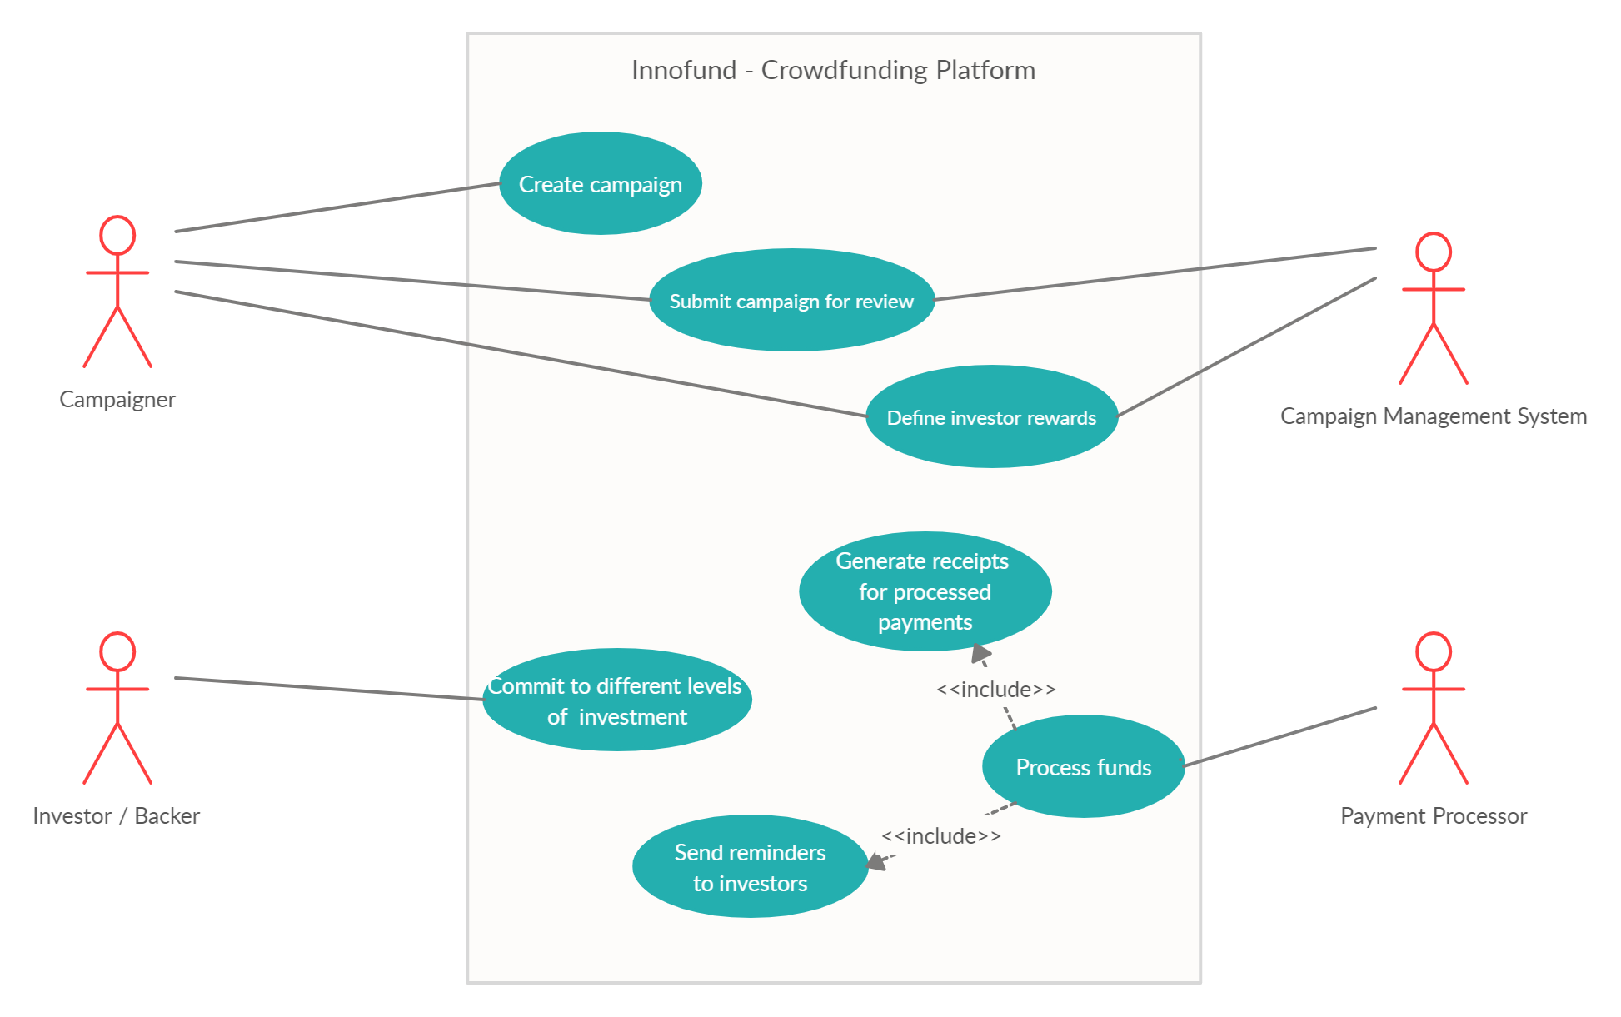
Use case diagram

Slide 8
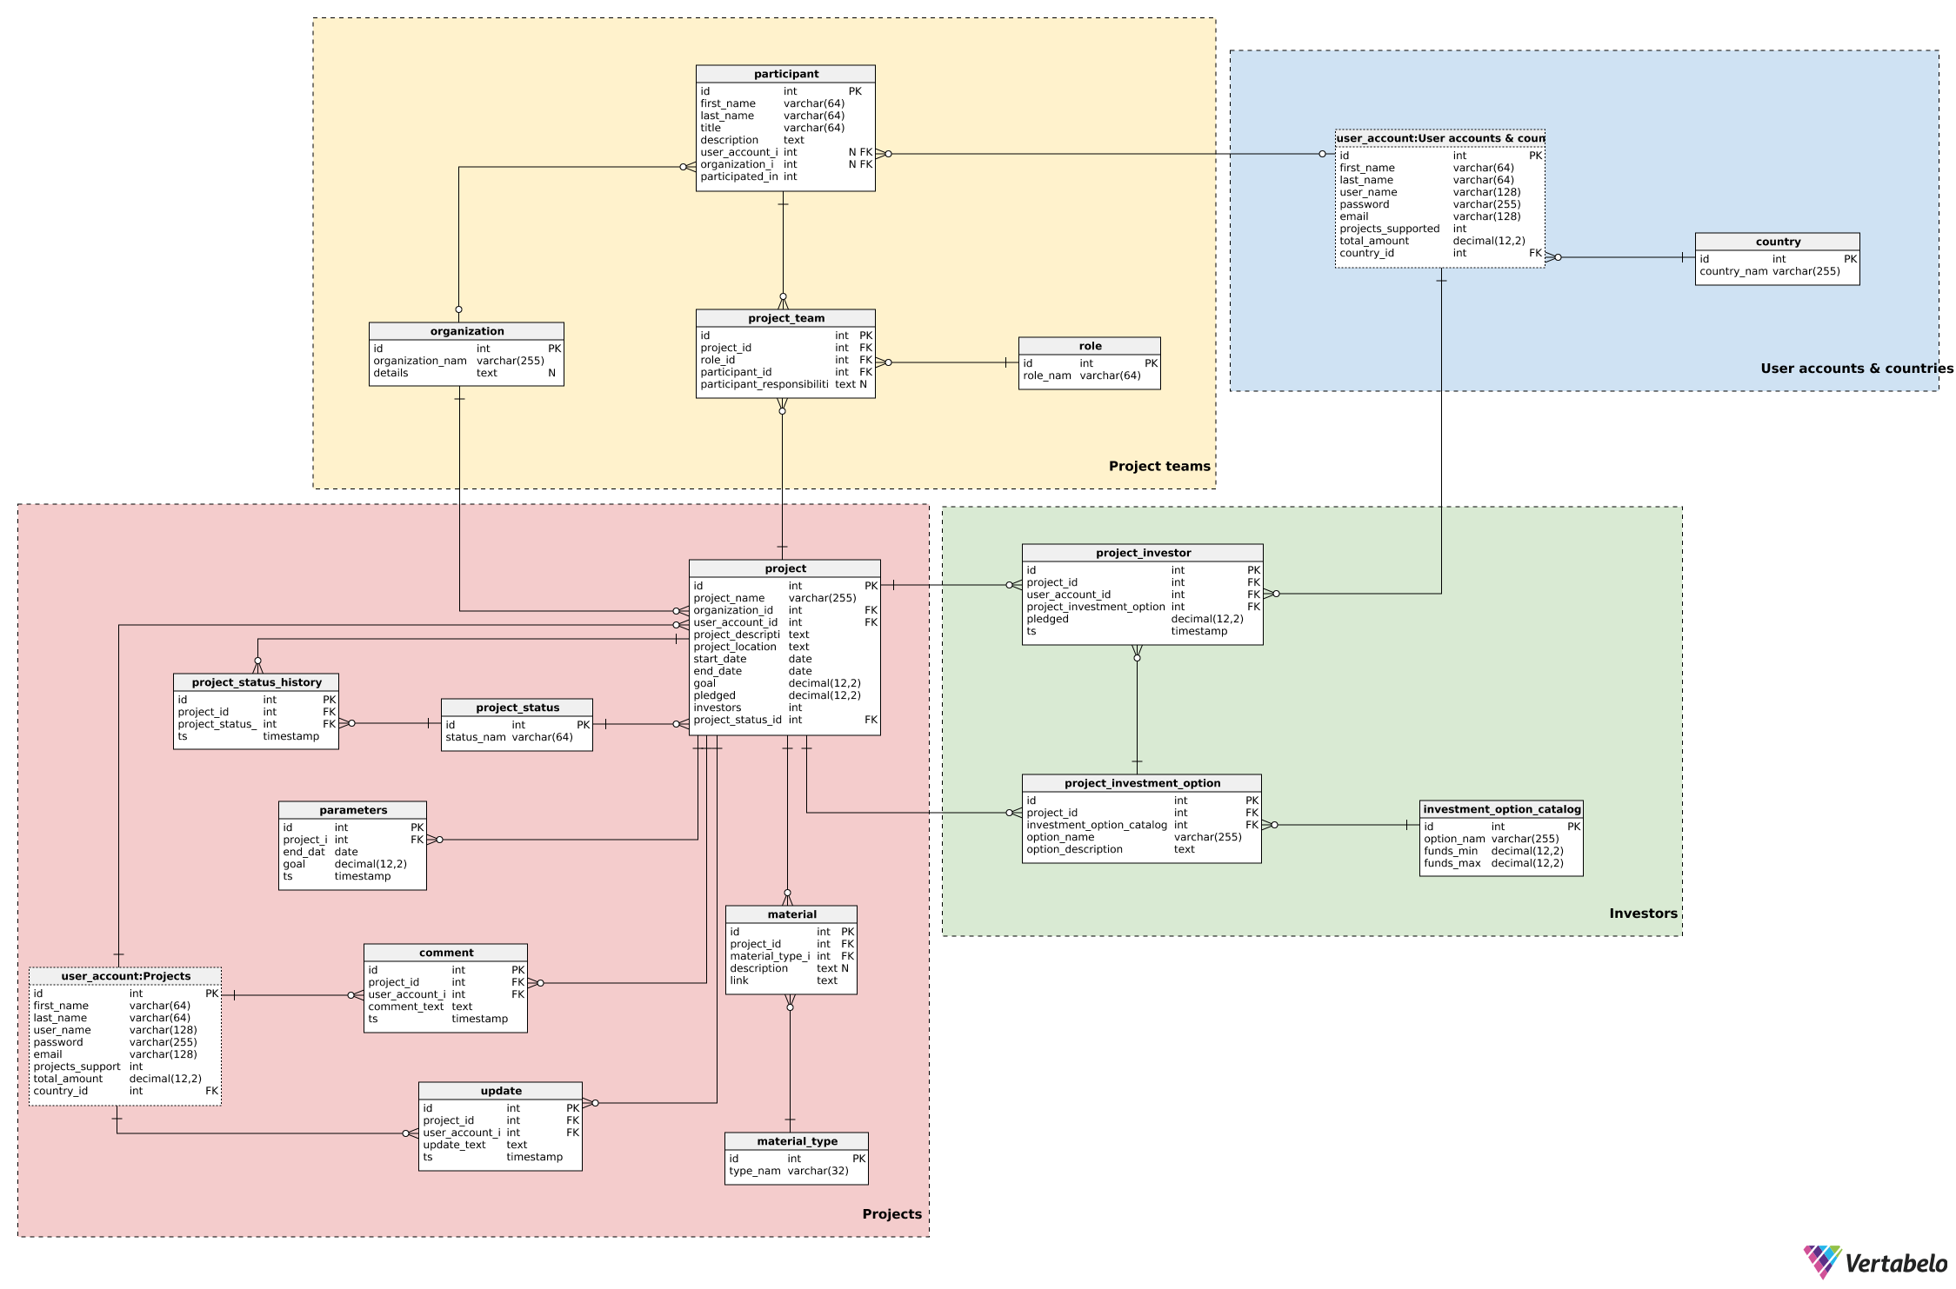
ER diagram

Slide 9
Tools used
Languages & Framework :
Front end - React framework
Back end - Node.js
Database - MySql database
Development environments :
Webstorm IDE
VS Code

Slide 10
Future plans
Make all features functional
Perfect the UI design
Strengthen security
Strengthen fake startup filtering policy
Develop a user trust policy that will attract more investors & project initiators
Market platform in our community

Slide 11
Website Link and github Links
The website is hosted on Netlify and you can access it through this link - https://eager-pike-77eafa.netlify.app/
Github Links
Client side - https://github.com/shihabshahriar16/innofund_client
Server side - https://github.com/shihabshahriar16/innofund_server

Slide 12
THANKS
Does anyone have any questions?

