Slide 1




Can AI Foundation Models Beat Traditional Statistical Models?
Retail forecasting has to balance accuracy, efficiency and business value
1
Can pre-trained AI forecast as well as traditional methods, and faster?
2
Does a better forecast mean a better replenishment decision?
→
→
→
Sales history
Forecast
Order
Shelf
Group 3: Charlotte Zhu, Shihan Wang, Jing Chang, Rachel Liu · Time Series Analysis and Forecasting · UCLA Anderson
Notes:
SPEAKER 1 (0:45)
Good afternoon, we're Group 3. A retail forecast has three jobs: be accurate, be cheap and fast enough to run every day for thousands of products, and support good stocking decisions. LightGBM, a machine-learning method, dominates this kind of retail data and has become the industry default. Since then, AI foundation models, pre-trained on huge datasets, can forecast a product they have never seen, with no training at all. So we ask: can these AI models beat traditional statistical and machine-learning methods, on accuracy and on efficiency?
TRANSITION: Here is our data and how we tested.

Slide 2
5,748 daily series, one 28-day test window
Training: Jan 29, 2011 – May 22, 2016 (1,941 days) · models fitted and tuned here
Test: 28 days
May 23 – Jun 19, 2016, never seen by any model. LightGBM tuning used only the last 28 training days.
4 stores × 1,437 items
California, food category = 5,748 item × store series
WRMSSE
The official M5 score: scaled, sales-weighted error; below 1 beats naive
One test window
All results come from a single 28 days; rankings could shift
Notes:
SPEAKER 1 (1:20)
We used Walmart's M5 data: all 1,437 food items in four California stores, so 5,748 daily series, each one item in one store, from 2011 to 2016.
Every model trains on data up to May 22, 2016, and forecasts the next 28 days, the official M5 test window, which no model sees. The one model we tuned, LightGBM, was tuned only on the last 28 training days.
Three features make this data hard. Sales follow a weekly rhythm: weekends sell about 20% above an average day. Food-stamp payment days add about 10%. And demand is sparse: the typical item sells nothing on half of all days.
We score accuracy with WRMSSE, the official M5 metric: it scales each product's error by how hard it is to forecast and weights it by dollar sales. Lower is better, and below one beats a naive forecast. One caveat up front: this is a single 28-day window.
TRANSITION: Speaker 2 will introduce the models.

Slide 3
Five models plus a simple average
Model | Family | How it is fitted | What it sees
AutoETS | Statistics | One model per series (exponential smoothing) | Own history
AutoARIMA | Statistics | One model per series (seasonal ARIMA) | Own history
LightGBM | Machine learning | One model trained across all items, predicts each item | History + price, calendar, SNAP
Chronos | AI foundation model | Pre-trained by Amazon, zero-shot: no training on our data | Own history
Ensemble | Combination | Unweighted average of AutoETS and LightGBM | Their two forecasts
Seasonal naive | Benchmark | Repeats the same weekday last week | Last week
Claude (experiment) | General-purpose AI | Reads sales as text and reasons; 112 series only | History + price, calendar
Inputs differ: AutoETS, AutoARIMA and Chronos see only each series' own history; LightGBM and Claude also see prices and the calendar.
Notes:
SPEAKER 2 (1:05)
We compared five models. AutoETS and AutoARIMA are classic time series models: they fit one model to each product's own history, with a weekly cycle.
LightGBM is the dominant approach for this kind of retail data. It is one machine-learning model trained across all products at once, which then predicts each product. It also sees prices, holidays and food-stamp days.
Chronos is Amazon's pre-trained AI model for time series, trained on about 100 billion data points from energy, traffic, weather and more. It was not trained on our data: the Chronos paper keeps M5, and every retail dataset it uses, out of training as held-out tests. Seasonal naive, 'same weekday last week', is the benchmark.
We also test the simplest possible combination: an unweighted average of AutoETS and LightGBM. And as an experiment, a second AI joins on a subset of series: Claude, a general-purpose language model, which we'll come back to later. Note that the inputs differ: only LightGBM and Claude see prices and the calendar.
TRANSITION: So which model is best, and at what? Here's the scorecard.

Slide 4
Traditional wins accuracy; AI wins speed
Model | Overall accuracy (WRMSSE) | Store totals (daily error) | Single items (RMSSE) | Time for all series | Training needed
Ensemble (AutoETS + LightGBM) | 0.604 | 3.6% | 0.90 | ~3 min | Yes
LightGBM | 0.646 | 4.1% | 0.92 | 80 s | Yes
AutoETS | 0.661 | 4.9% | 0.93 | 86 s | Yes
AutoARIMA | 0.892 | 9.9% | 0.94 | 39 min | Yes
Chronos (AI) | 0.949 | 10.4% | 0.92 | 10 s | None
Seasonal naive (benchmark) | 0.814 | 5.5% | 1.17 | <1 s | None
Green = best in its column (benchmark excluded)
Best traditional choice: the AutoETS + LightGBM average, for accuracy. Best AI strength: Chronos, for speed with no training.
Notes:
SPEAKER 2 (1:00)
Here is the scorecard: traditional models against AI, on four questions. First, how to read it: RMSSE measures how big a model's errors are compared with a naive "same as yesterday" forecast on the same product, and WRMSSE combines that across all products, weighted by dollar sales. Store totals show the average daily percentage error. In every accuracy column, smaller is better. Who is most accurate overall? A traditional model: the simple average of AutoETS and LightGBM, with LightGBM alone second and AutoETS close behind. Who forecasts store totals best? Again the traditional models. For single products? It's close, and there the AI is level with LightGBM. And who is fastest? The AI, Chronos, by far: seconds instead of minutes, with no training at all.
So from a traditional point of view, the best choice is the AutoETS-plus-LightGBM average, and the AI's real strength is speed. The green cells show the winner of each column.
POINT AT: the green cells, column by column.
TRANSITION: Let's see what those forecasts actually look like.

Slide 5
Traditional tracks the peaks; the AI runs low
Follows the peaks
The traditional average rises and falls with every weekend
Flat line
AutoARIMA's product-by-product forecasts add up to a flat total
Right shape, too low
Chronos sees the weekly rhythm but forecasts about 11% low
Notes:
SPEAKER 2 (1:00)
Here's what that looks like. The black line is actual daily sales across all four stores during the test month. The traditional average, in teal, rises and falls with every weekend peak. AutoARIMA, in green, is almost flat, and Chronos, in orange, has the right shape but sits too low.
Why? AutoARIMA and Chronos look at one product at a time. For a product that sells a unit or two a day, the best guess is a flat line, and thousands of flat lines added up miss the weekend. LightGBM learns from all products together, so it sees the weekend rush, and averaging it with AutoETS smooths out the rest. Zoom into a single product, though, and the lines come together: one product's daily sales are mostly noise.
TRANSITION: So the specialist AI is fast but less accurate. What about a generalist AI that reads and reasons? Speaker 3.

Slide 6
Claude: a language model that reads sales as text
Chronos vs Claude: both pre-trained, zero-shot
 | Chronos | Claude
Trained on | Time series | Text
Reads our data as | Numbers | Rows of text
Returns | Quantiles | Forecast + explanation
All 5,748 series | 10 s, free | Hours; paid per request
100 sampled items: AutoETS 0.938 best, AutoARIMA 0.951, Claude 0.958. Same items for every model.
Claude covered a subset to keep cost down: 100 random items + 12 totals, compared on the same series. Totals were also fitted directly for the other models.
Notes:
SPEAKER 3 (1:15)
Now a generalist AI. We used Claude through its API. For each product, our code sends the past year of daily sales as plain text, one row per day with the date, holidays, food-stamp days and price, plus an instruction: forecast the next 28 days and answer in a fixed format. Claude reads the numbers, reasons about patterns such as weekends and holidays, and sends back 28 daily forecasts with a short explanation. No statistical model is fitted; it works from what it learned in training.
Each request costs money and takes a few seconds, so to keep the cost down we used a subset instead of all 5,748 series: 100 randomly chosen products and the 12 store-by-department totals. Every other model was scored on exactly the same series, and to keep it fair, the other models were also fitted directly on those totals.
How did it perform? On the store totals, very well: it matched our best traditional forecast, the AutoETS-plus-LightGBM average, and beat every single model, including Chronos. On individual products it was in the pack, behind AutoETS and AutoARIMA. So the generalist AI was more accurate than the specialist one, but far slower and more costly to run at scale.
POINT AT: the Claude bars at the top of the chart, then the comparison table.
TRANSITION: Using a language model also brings a specific risk.

Slide 7





Using an LLM to forecast: risks and safeguards
Risk
What we did
Pre-training contamination
M5 is public and may be in Claude's training data
Named vs blind test: names, dates and year removed. Accuracy unchanged (0.579 vs 0.583)
Unstable output
Answers can vary between runs
Fixed prompt and model; every response saved and cached
Cost and scale
Paid per request; slow at scale
Tested a subset (100 items + 12 totals); same subset for every model
Malformed answers
Wrong length or format
Required a fixed JSON format, checked 28 days returned, retried on failure
The blind test reduces identity cues, but it cannot guarantee that contamination is excluded: the sales pattern itself could be recognised.
Notes:
SPEAKER 3 (1:00)
The obvious worry: M5 is public data, so Claude may have seen these exact sales during training, and be remembering rather than forecasting. So we ran a blind test. Every forecast was made twice: once with the real labels, meaning Walmart, the store and product IDs, and the real dates; and once with all of that hidden, just 'day 1, day 2' with no names and no year.
Think of it as a blind taste test. It's the same idea as a permutation test in statistics: if the labels carry no information, taking them away shouldn't change the result. And it didn't: accuracy was practically identical with and without the labels, 0.579 versus 0.583. Knowing it was Walmart in 2016 gave Claude no advantage.
We also saved every response so the results can be re-checked, and checked that every answer came back in the right format. One honest limit remains: hiding the labels can't hide the sales pattern itself. If Claude had memorised the shape of these series, a blind test couldn't catch it, so contamination can't be fully ruled out.
IF ASKED (permutation test): it is the same idea, not a formal permutation test. A real one reshuffles labels many times to get a p-value; we made one with-labels vs without-labels comparison.
BACKGROUND (not to read aloud): Our code asked Claude for 28 daily forecasts in a fixed JSON format. We checked each reply had exactly 28 days and retried automatically if not. 224 requests = 112 series x 2 versions (named and blind); all came back usable. Every reply is saved in our repo.
TRANSITION: Speaker 4 will wrap up and show the dashboard.

Slide 8



Our answer: not yet on accuracy, yes on speed
Traditional methods lead on accuracy
Limitations
LightGBM, AutoETS and their average are the three best
One 28-day test window: close rankings could flip in another month.
Claude: 112 series only; the blind test can't fully rule out contamination.
Accuracy is not the business goal. Ordering is a newsvendor problem: running out costs the margin (underage), unsold food costs its price (overage). The best order is a margin-set quantile, not the forecast, and our accuracy metrics weigh both errors equally.
Chronos wins on speed
10 s for all series, no training
Claude matched the best on totals
Promising, but tested on 112 series only
Notes:
SPEAKER 4 (1:45)
So, can AI foundation models beat traditional methods? Our answer: not yet on accuracy, yes on speed. LightGBM, AutoETS and their simple average were the three most accurate. Chronos was the clear winner on speed: ten seconds, no training. And Claude matched the best traditional approach on store totals.
Our results have limits. First, Claude was tested on a subset, and our blind test can't fully rule out that it saw this public data. Second, sales are not demand: when a shelf is empty, sales show zero even if customers wanted the product.
And the most important limitation for a business: accuracy isn't the real goal. Ordering stock is a newsvendor problem with two different costs. If you order too little, you lose the margin on every sale you miss; that's the underage cost. If you order too much, unsold food is wasted at its cost; that's the overage cost. Because those costs depend on the margin, the best order isn't the forecast itself but a quantile of demand, and our accuracy metrics treat over- and under-forecasting the same. So what happened when we turned each model's forecasts into actual orders? For most products, it barely mattered which model we used: the profit differences were small enough to be luck. Only for high-margin products, where running out of stock is expensive, did the more accurate model, LightGBM, clearly make more money.
So our recommendation: average a statistical model like AutoETS with LightGBM, use Chronos where speed or a lack of training data matters, and choose models on the metric that matches the business decision. Our next step is a rolling backtest over several windows.
Let me show you the business problem in our dashboard.
TRANSITION: click the screenshot on the next slide.

Slide 9
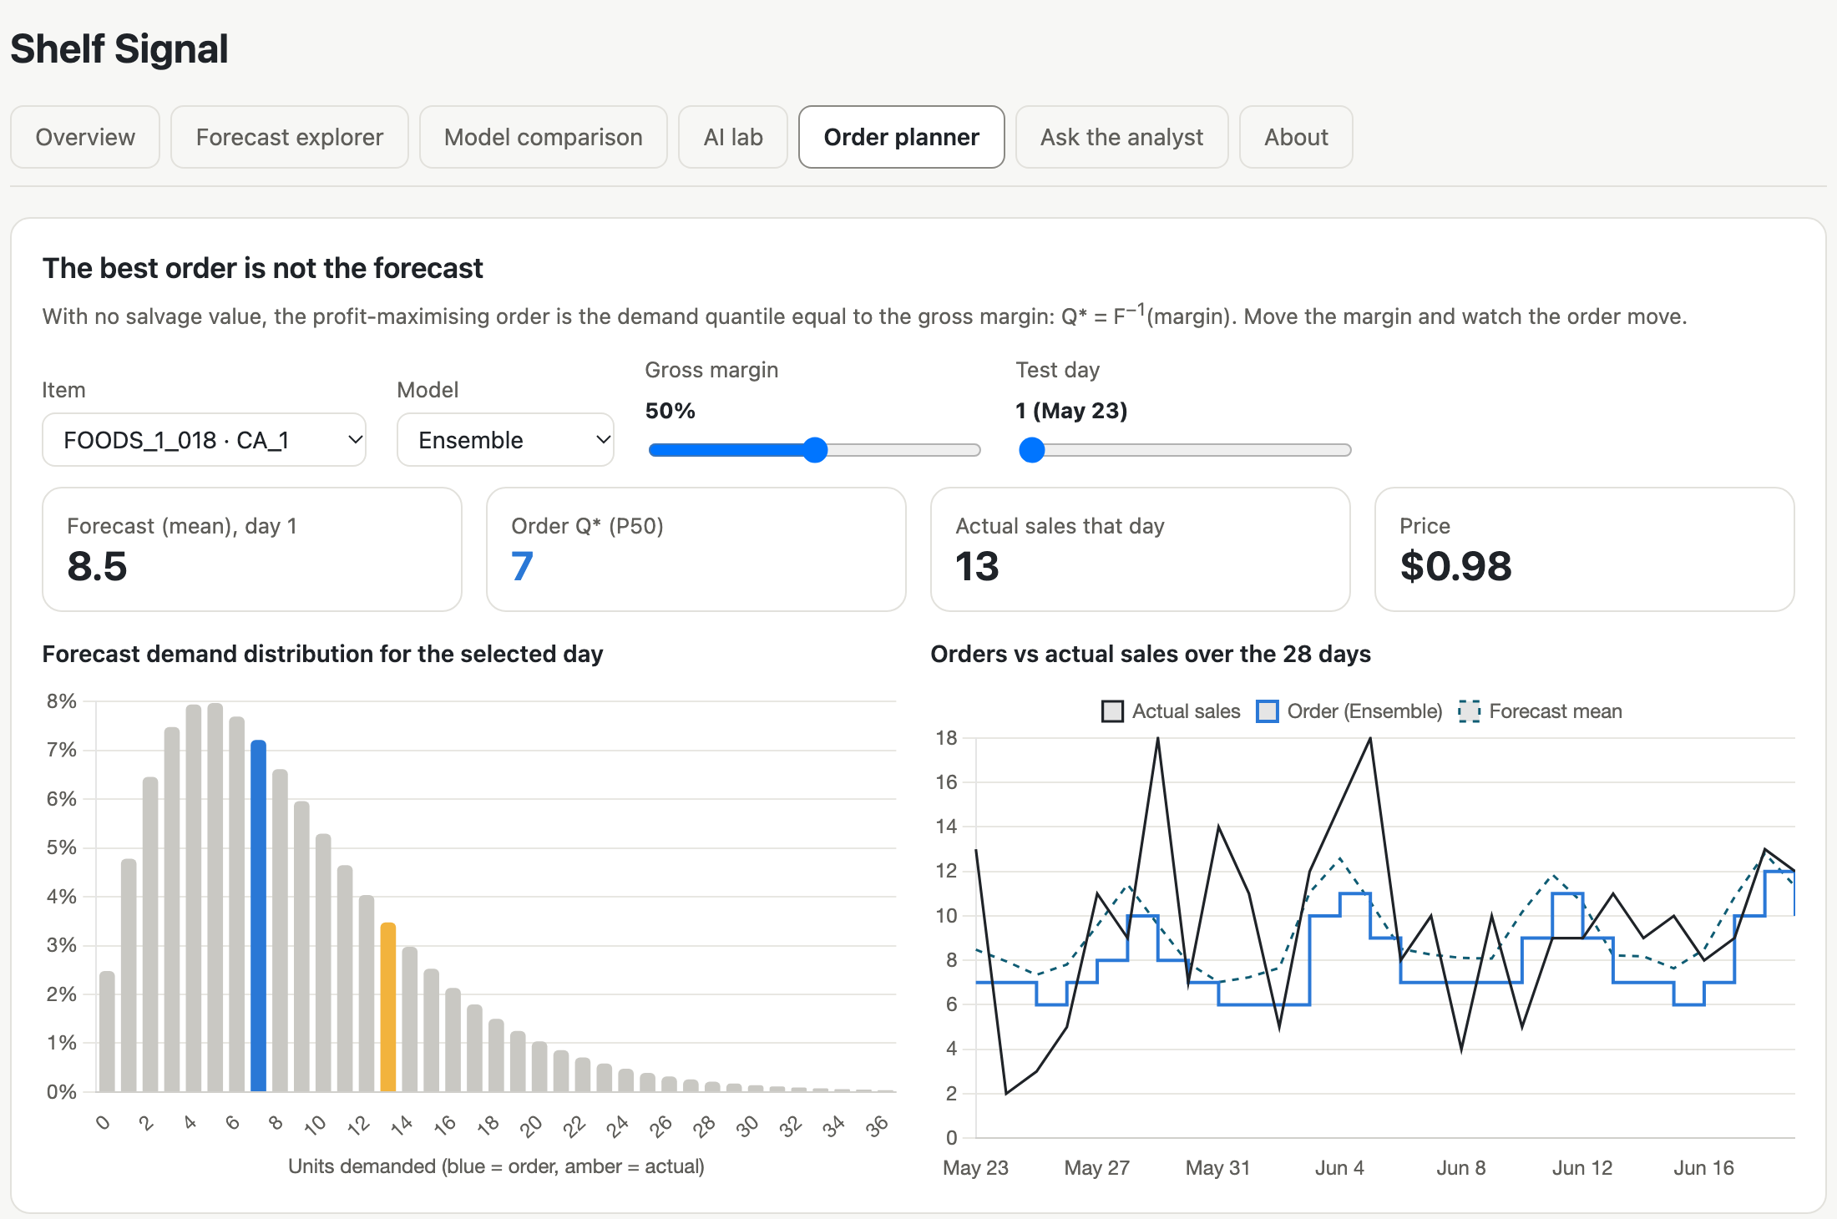



Demo: Shelf Signal dashboard
Forecast explorer
One store's department: every model against actual sales
AI lab
Claude's own reasoning, and the named-vs-blind test
Order planner
Change the margin: the order moves between P20 and P80
Thank you — questions?
Open live dashboard ↗ · shihan-2002.github.io/shelf-signal-dashboard
Notes:
SPEAKER 4 (1:30 demo + 0:15 close)
[Click the screenshot to open the dashboard. If the internet fails, play the screen recording.]
(0:00-0:20) FORECAST EXPLORER. This is Shelf Signal, which extends our teammate's original dashboard with all our models. Here's one store's department total: the black line is actual sales, and you can switch each model on and off. The ensemble and LightGBM follow the weekend peaks; Chronos runs low.
(0:20-0:40) AI LAB. Here Claude explains its own forecast in plain English, and this chart is the named-versus-blind test: every point sits on the diagonal, so real names gave it no advantage.
(0:40-1:30) ORDER PLANNER. Now the business problem. For this item, the model forecasts about eight units for the day. At a 50% margin, the best order is the median of demand. Drop the margin to 20%: a wasted unit now costs four times a lost sale, so the order falls. Raise it to 80%: a lost sale costs four times a wasted unit, so we order more. Same forecast, different decision. The table scores every model's orders against actual sales: the profit ranking isn't the same as the accuracy ranking, and at typical margins the differences are small.
(close) That's our project: traditional methods still lead on accuracy, AI wins on speed, and the right order depends on your costs. Thank you, and we're happy to take questions.
[Press Cmd+Tab to return to the slides for Q&A.]

