Slide 1

Objective
WHERE
WHEN
HOW
Which location is more profitable in the neighborhood of New York
Which time of the year should you list to gain more bookings
How should you list? What to include in the description and what not to include?
Improving the Revenues of the Airbnb Host

Slide 2
Outline
Overall Exploratory Analysis
Sentiment Analysis
Recommendations
Pricing Anlaysis
Quantitative Analysis of
Customer Satisfaction

Slide 3
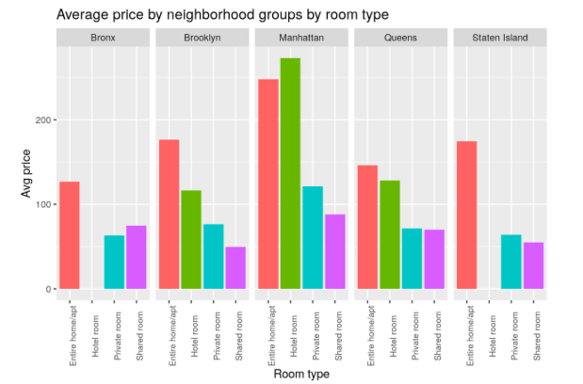
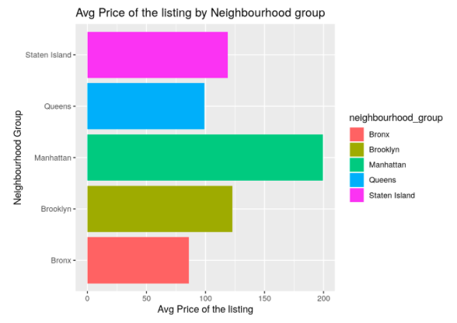
Deep Dive
Manhattan tops average pricing among neighborhood groups across different room types; Hotel rooms followed by entire home or apartment tops the pricing chart

Slide 4
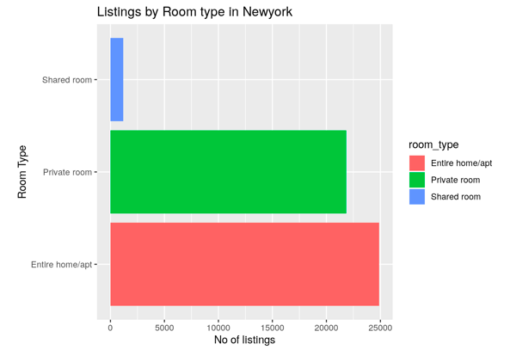
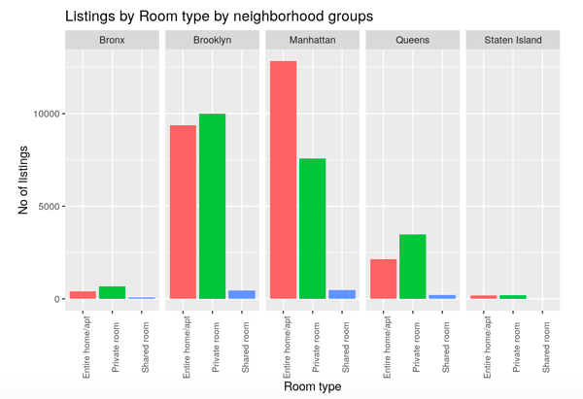
Deep Dive
Manhattan has more number of listings and that too entire houses/apartments are listed

Slide 5
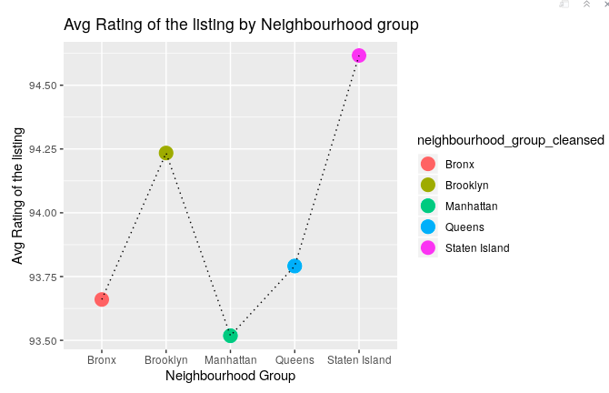
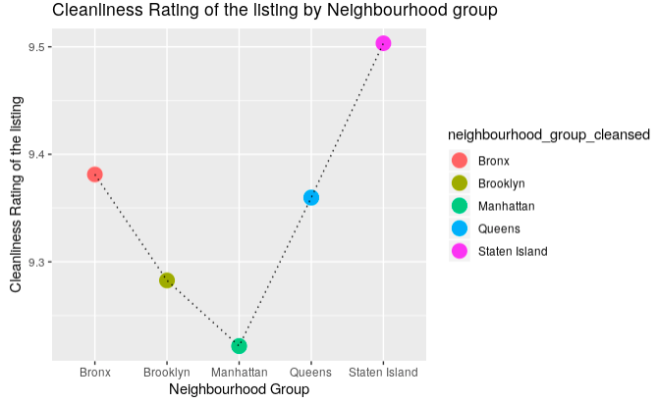
Deep Dive
Staten Island stands out in terms of both Average rating score and cleanliness rating

Slide 6


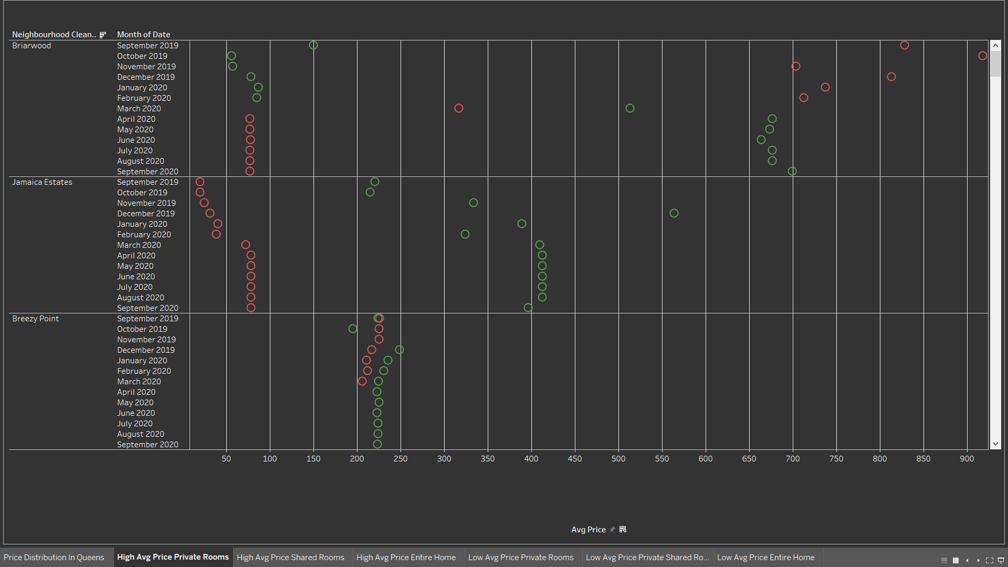
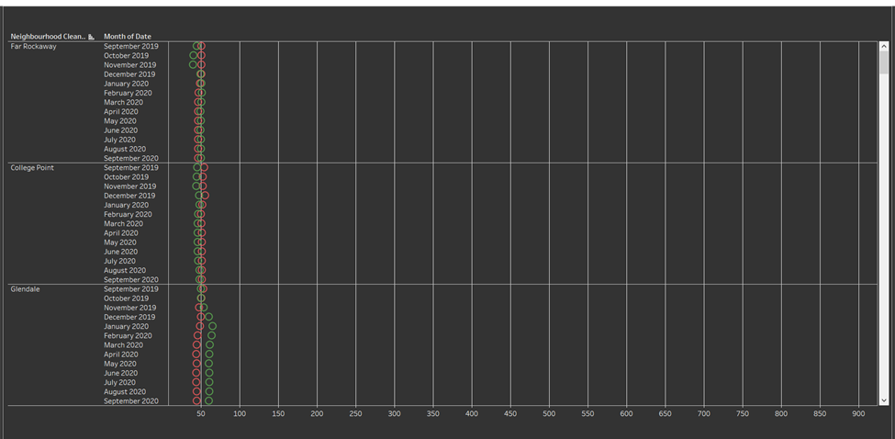
Where
Top 3 Queens Neighborhoods
High Average Price Private Rooms
Low Average Price Private Rooms
Briarwood ($680 in summer and $100 in winter)
Jamaica Estates ($400)
Breezy Point ($225)
Far Rockaway ($50)
College Point ($50)
Glendale ($50)

Slide 7
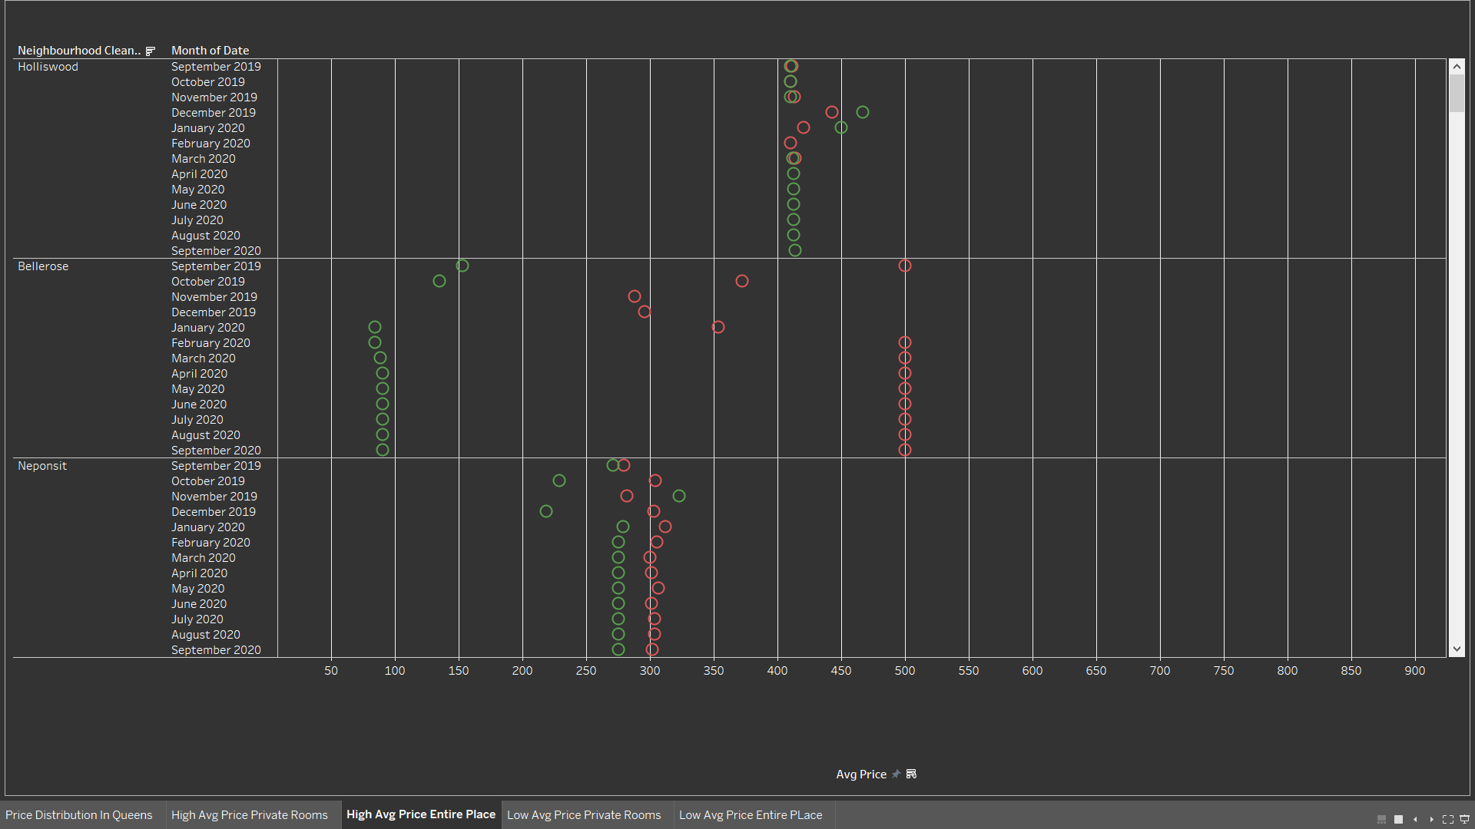
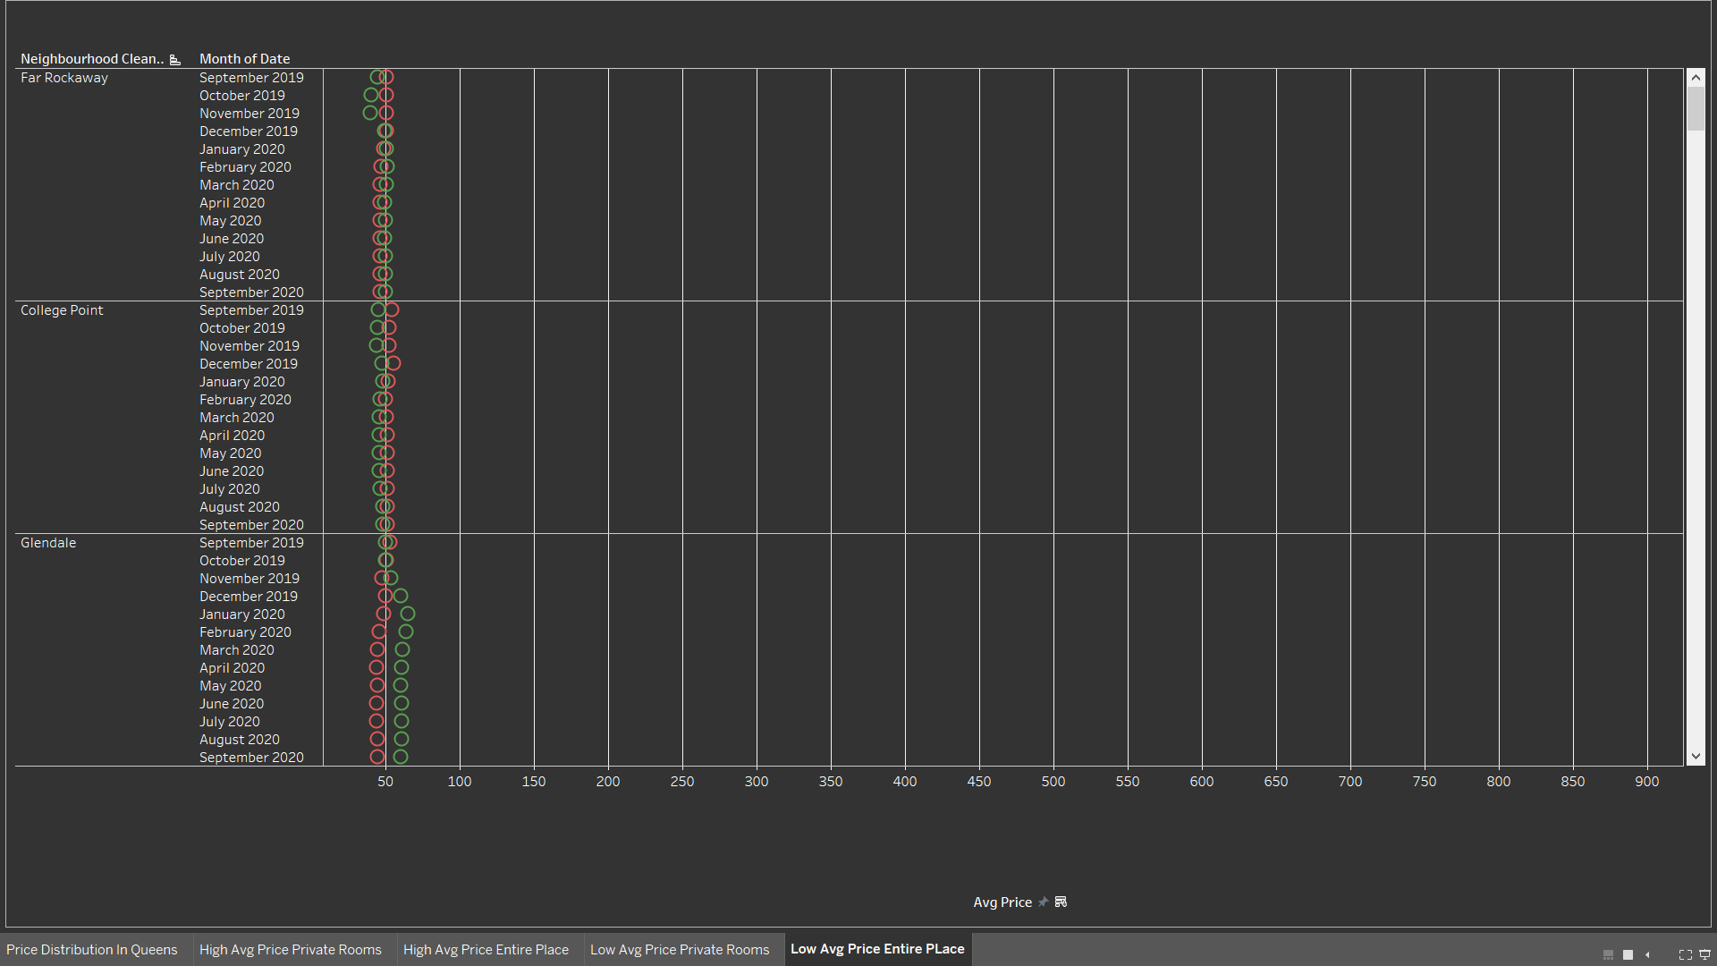
Where
Top 3 Queens Neighborhoods
High Average Price Entire Place
Low Average Price Entire Place
Holliswood ($410)
Bellerose ($100, $500 high non-booked prices)
Neponsit ($280)
Far Rockaway ($50)
College Point ($50)
Glendale ($50)

Slide 8
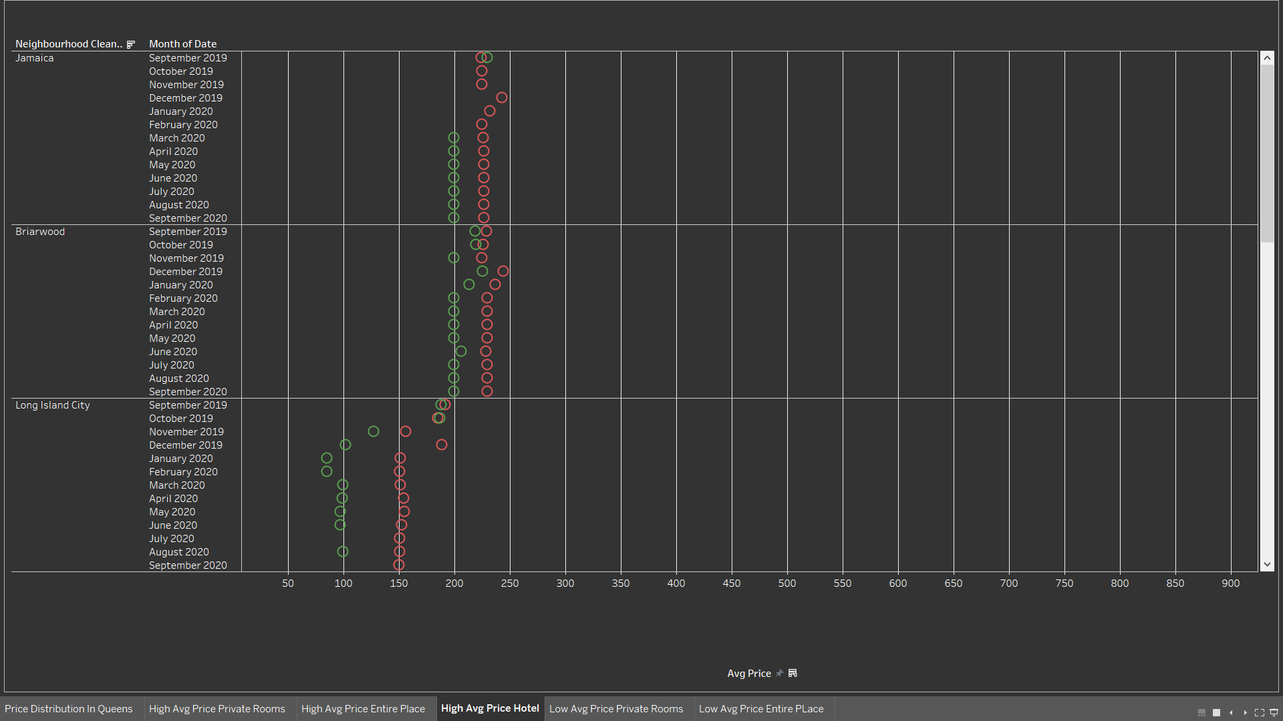
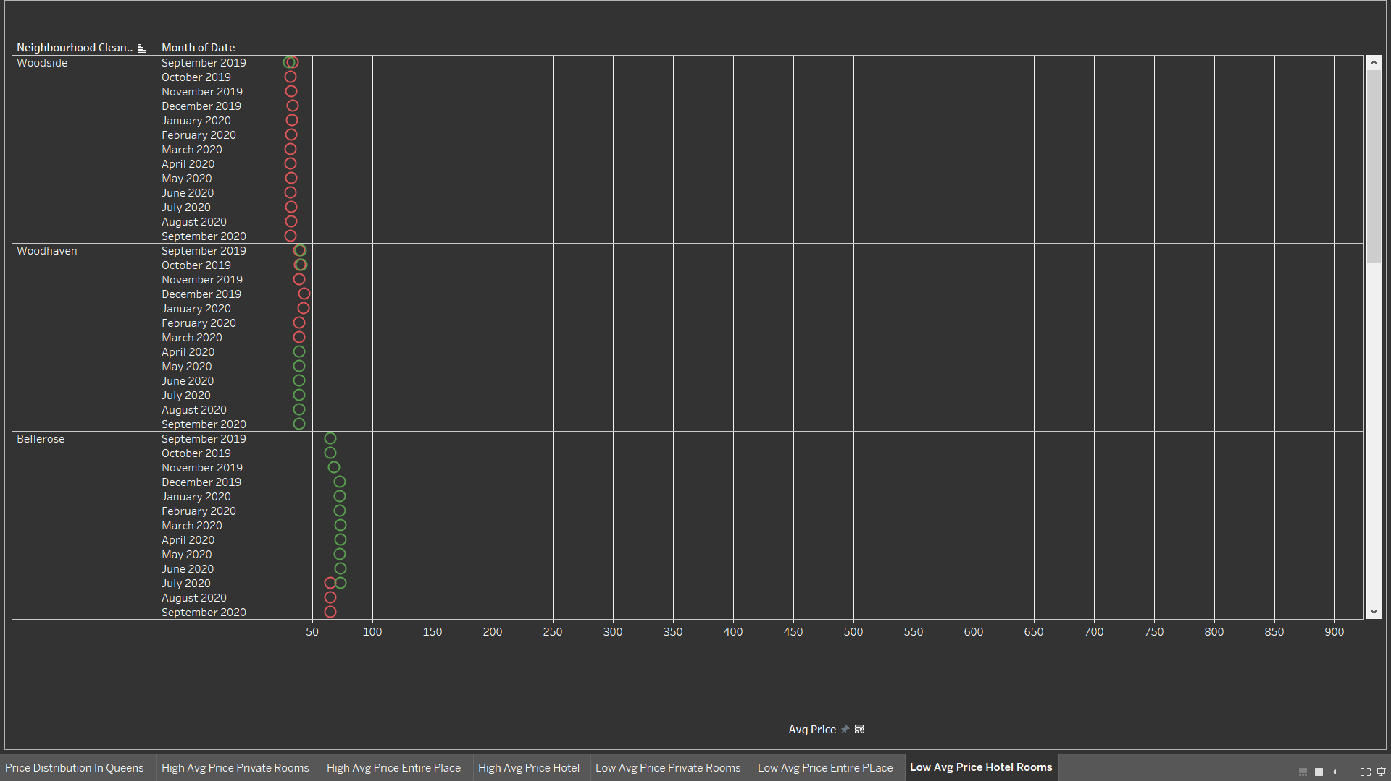
Where
Top 3 Queens Neighborhoods
High Average Price Hotel Room
Low Average Price Hotel Room
Jamaica ($200)
Briarwood ($200)
Long Island City ($100)
Woodside ($30)
Woodhaven ($50)
Bellerose ($70)

Slide 9
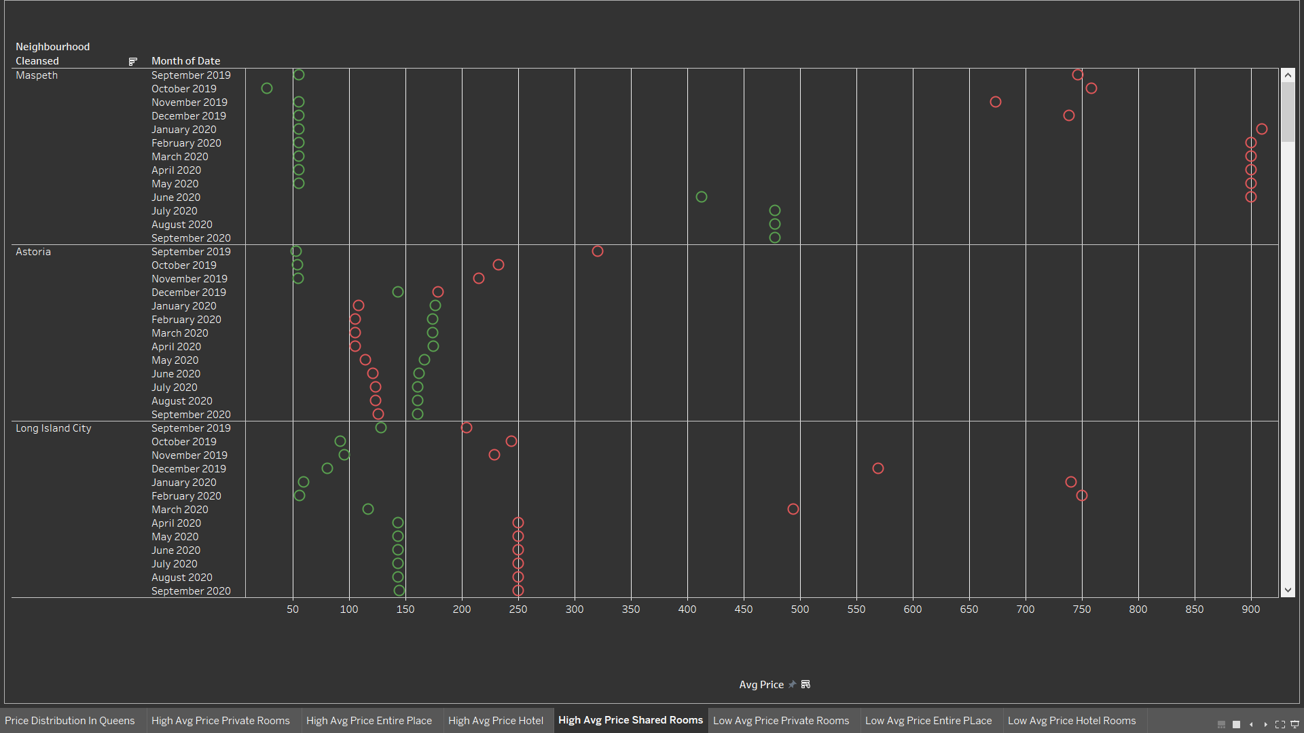
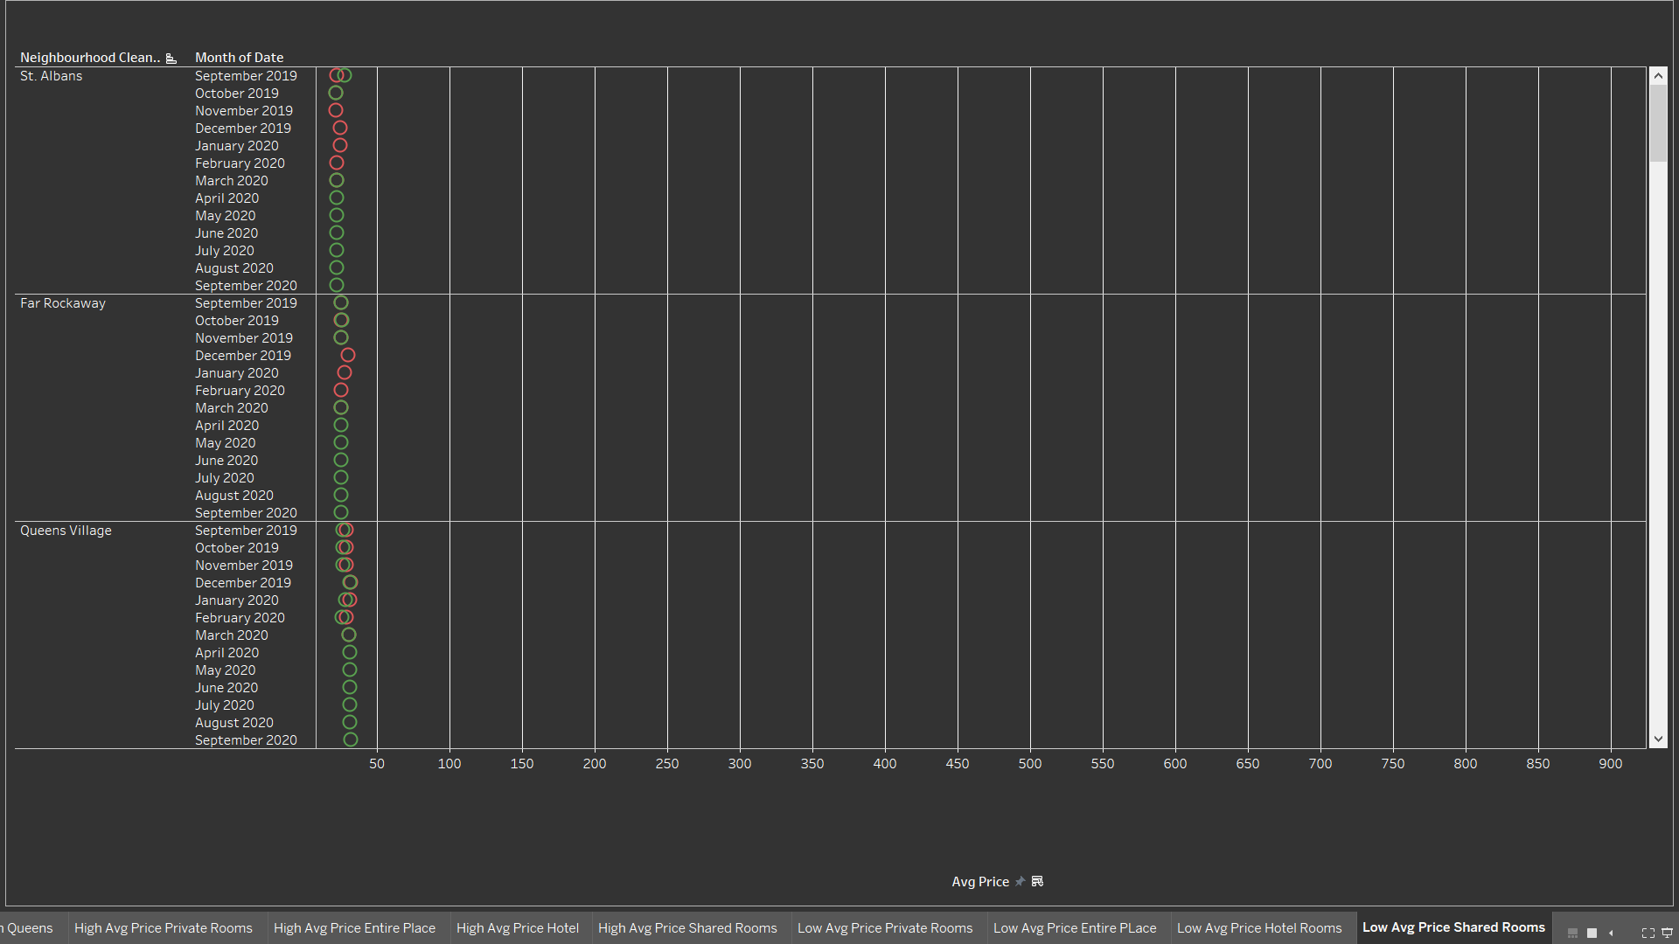
Where
Top 3 Queens Neighborhoods
High Average Price Shared Rooms
Low Average Price Shared Rooms
Maspeth ($55, $900 high non-booked prices)
Astoria ($170)
Long Island City ($150)
St Albans ($22)
Far Rockaway ($25)
Queens Village ($30)

Slide 10
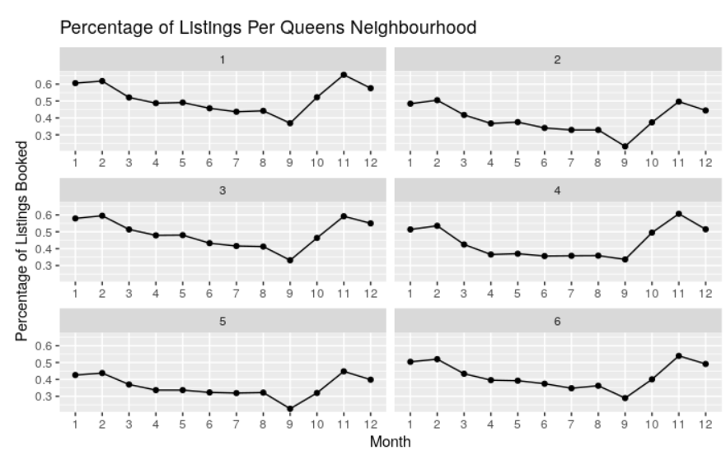
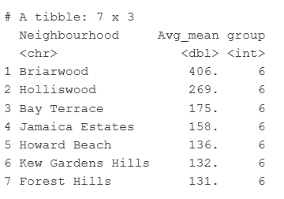
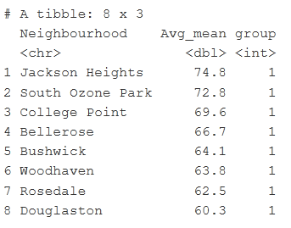
When
Percentage of Listings Per Month
50%
40%
40%
50%
37%
35%
25%
March and April
September
October
July and August
January and February
May and June
November and December
Queens Neighborhood in Group 6 and Group 1

Slide 11
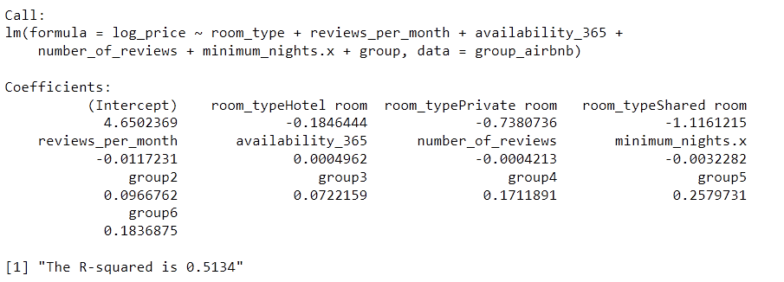
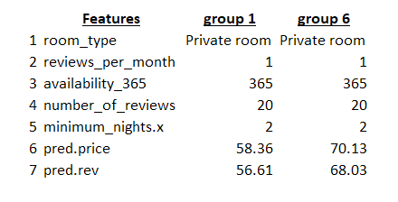
Model
Pricing Model
Linear Regression:
Log-price = 4.650 - 0.185(room_type|Hotel) - 0.738(room_type|Private) - 1.116(room_type|Shared) -0.0117(reviews per month) + 0.000496(availability) - 0.0004213(number of reviews) - 0.00322(minimum nights) + 0.0967(group2) + 0.0722(group3) + 0.171(group4) + 0.258(group5) + 0.184(group6)
Revenue Gained in Group 1 and Group 6
* Relative to Entire Place Room Type and Group 1
*Host earns 97% of listing price

