Slide 1
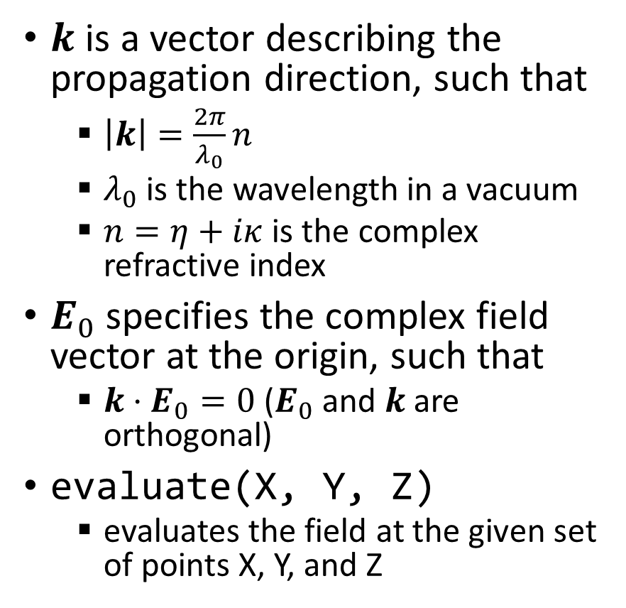
Plane Wave Class
$k$ is a vector describing the propagation direction, such that
$\left|k\right|=\frac{2π}{λ_{0}}n$
$λ_{0}$ is the wavelength in a vacuum
$n=η+iκ$ is the complex refractive index
$E_{0}$ specifies the complex field vector at the origin, such that
$k⋅E_{0}=0$ ($E_{0}$ and $k$ are orthogonal)
evaluate(X, Y, Z)
evaluates the field at the given set of points X, Y, and Z

Slide 2



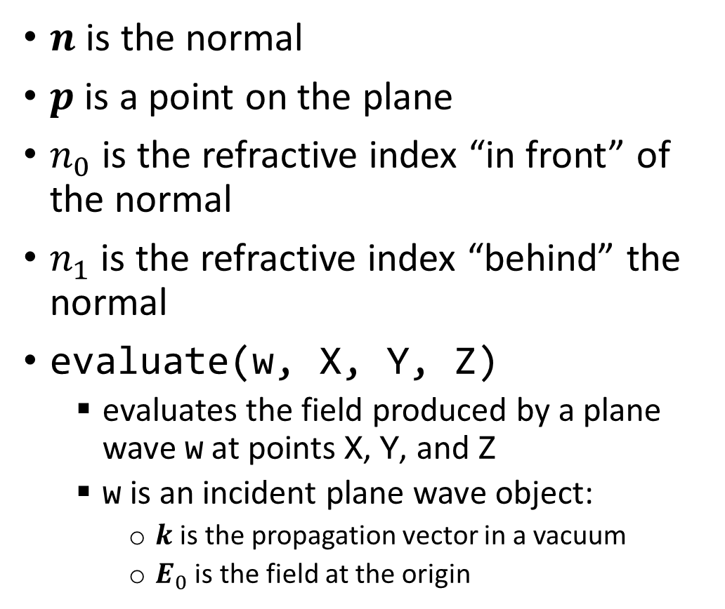
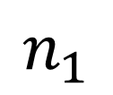
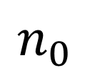

Planar Boundary Class
$n$ is the normal
$p$ is a point on the plane
$n_{0}$ is the refractive index “in front” of the normal
$n_{1}$ is the refractive index “behind” the normal
evaluate(w, X, Y, Z)
evaluates the field produced by a plane wave w at points X, Y, and Z
w is an incident plane wave object:
$k$ is the propagation vector in a vacuum
$E_{0}$ is the field at the origin
$$n_{1}$$
$$n_{0}$$
$$p$$
$$n$$
$$E_{0}$$
$$k$$

Slide 3
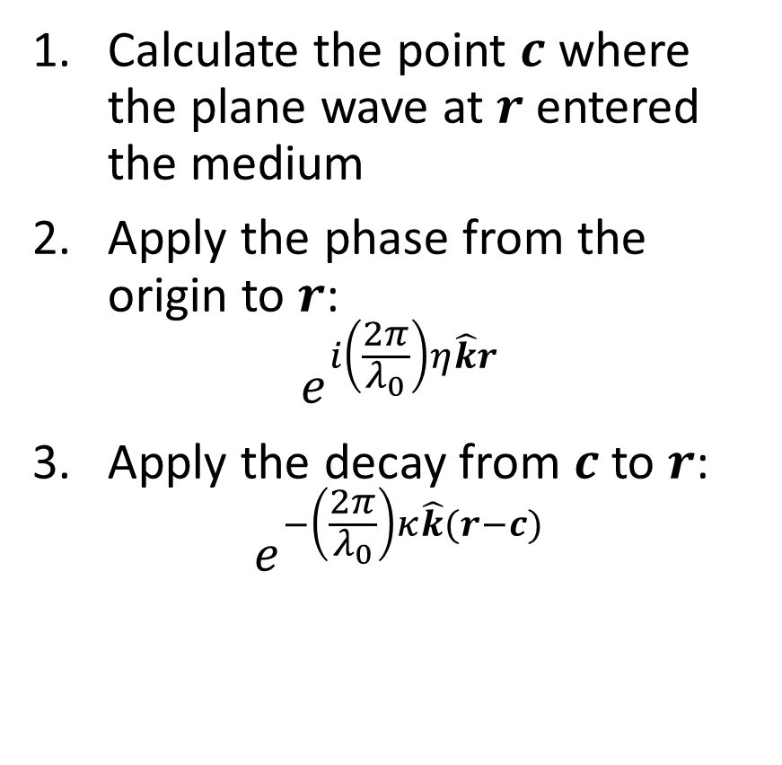
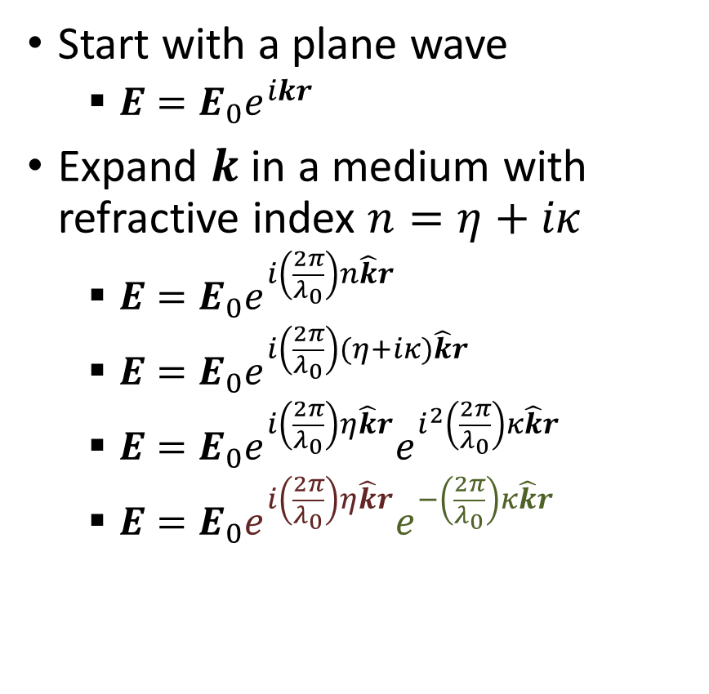
Propagation of a plane wave in a material
Start with a plane wave
$E=E_{0}e^{ikr}$
Expand $k$ in a medium with refractive index $n=η+iκ$
$E=E_{0}e^{i\left(\frac{2π}{λ_{0}}\right)n\hat{k}r}$
$E=E_{0}e^{i\left(\frac{2π}{λ_{0}}\right)(η+iκ)\hat{k}r}$
$E=E_{0}e^{i\left(\frac{2π}{λ_{0}}\right)η\hat{k}r}e^{i^{2}\left(\frac{2π}{λ_{0}}\right)κ\hat{k}r}$
$E=E_{0}e^{i\left(\frac{2π}{λ_{0}}\right)η\hat{k}r}e^{−\left(\frac{2π}{λ_{0}}\right)κ\hat{k}r}$
Calculate the point $c$ where the plane wave at $r$ entered the medium
Apply the phase from the origin to $r$:
$$e^{i\left(\frac{2π}{λ_{0}}\right)η\hat{k}r}$$
Apply the decay from $c$ to $r$:
$$e^{−\left(\frac{2π}{λ_{0}}\right)κ\hat{k}(r−c)}$$
phase
shift
decay

Slide 4


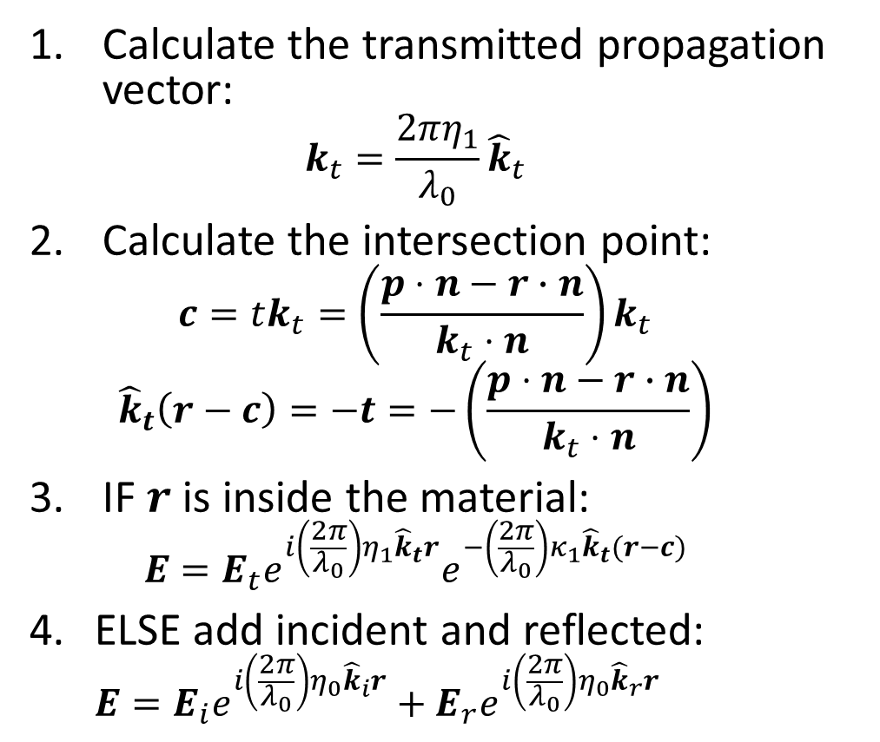


Calculate the field
Calculate the transmitted propagation vector:
$$k_{t}=\frac{2πη_{1}}{λ_{0}}{\hat{k}}_{t}$$
Calculate the intersection point:
$$c=tk_{t}=\left(\frac{p⋅n−r∙n}{k_{t}⋅n}\right)k_{t}$$
$${\hat{k}}_{t}\left(r−c\right)=−t=−\left(\frac{p⋅n−r∙n}{k_{t}⋅n}\right)$$
IF $r$ is inside the material:
$$E=E_{t}e^{i\left(\frac{2π}{λ_{0}}\right)η_{1}{\hat{k}}_{t}r}e^{−\left(\frac{2π}{λ_{0}}\right)κ_{1}{\hat{k}}_{t}(r−c)}$$
ELSE add incident and reflected:
$$E=E_{i}e^{i\left(\frac{2π}{λ_{0}}\right)η_{0}{\hat{k}}_{i}r}+E_{r}e^{i\left(\frac{2π}{λ_{0}}\right)η_{0}{\hat{k}}_{r}r}$$
$$n_{1}$$
$$n_{0}$$
$$p$$
$$n$$
$$r$$
$$k_{t}$$
$$E_{i}$$
$$k_{i}$$

Slide 5
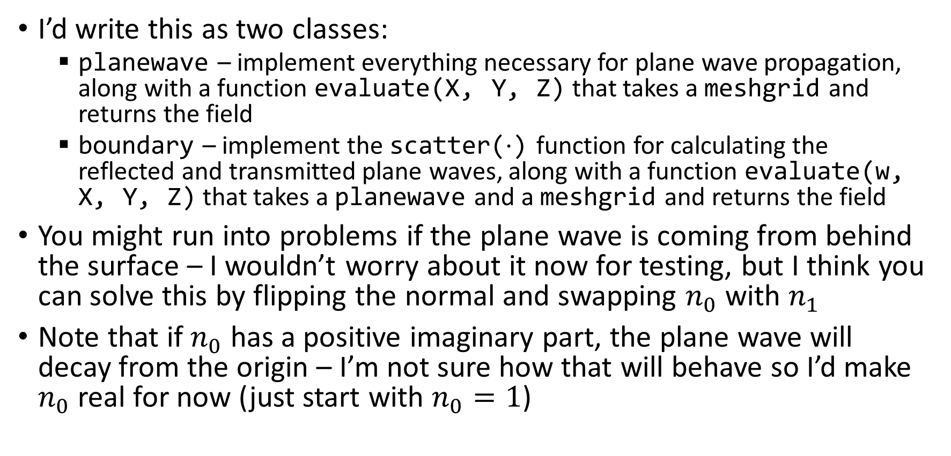
Implementation details
I’d write this as two classes:
planewave – implement everything necessary for plane wave propagation, along with a function evaluate(X, Y, Z) that takes a meshgrid and returns the field
boundary – implement the scatter($⋅$) function for calculating the reflected and transmitted plane waves, along with a function evaluate(w, X, Y, Z) that takes a planewave and a meshgrid and returns the field
You might run into problems if the plane wave is coming from behind the surface – I wouldn’t worry about it now for testing, but I think you can solve this by flipping the normal and swapping $n_{0}$ with $n_{1}$
Note that if $n_{0}$ has a positive imaginary part, the plane wave will decay from the origin – I’m not sure how that will behave so I’d make $n_{0}$ real for now (just start with $n_{0}=1$)

