Slide 1
Customer Segmentation
Table of Contents:
Methodology Overview
Data Transformation
Exploratory Data Analysis
Scaling & Feature Selection
Modelling and Results
Suggested Improvements

Slide 2
Methodology Overview

Slide 3



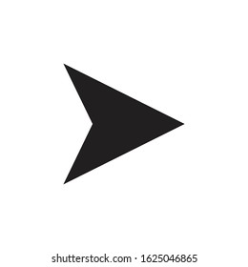


From Development to Model Management
Data Preprocessing
Scaling & Feature Selection
Exploratory Data Analysis
Model Management
Modelling
Notes:
1. Explain given datasets and problems

Slide 4
DATA PREPROCESSING

Slide 5
Additional Features are created for better customers profiling
Data Types Conversion
Missing Values Imputation
Fill discount_amount_usd with 0
Data Quality Check
sales_value_usd > 0
Data Transformation
Conversion from transaction-wise to customer-wise data
Creation of new features
total_sales_after_discount = sales_value_usd × sales_unit
discount_percent = (original_price_usd - sales_value_usd) / original_price_usd × 100
day_of_week
is_weekend
Min, mean, median, max
weekend_transaction_count_percent
Recency-Frequency-Monetary matrix
Notes:
Convert datetime
Missing value in discount_amount_usd, discount_amount_usd != original_price_usd - sales_value_usd
There are rows having sales_value_usd = 0, assume free gift/ return
convert transaction-wise into customer-wise data to perform customer segmentation
Create new feature to better characterize customer spending behavior using multiprocessing
Total_sales_after_discount indicates purchasing power
Discount_percent to check if discount affects spending of a customer
Day_of_week and is_weekend to check transaction day
Min, mean, median, max: transaction statistics
Recency: days from last purchase
Frequency: transaction count
Monetary: total money spent

Slide 6
EXPLORATORY DATA ANALYSIS

Slide 7
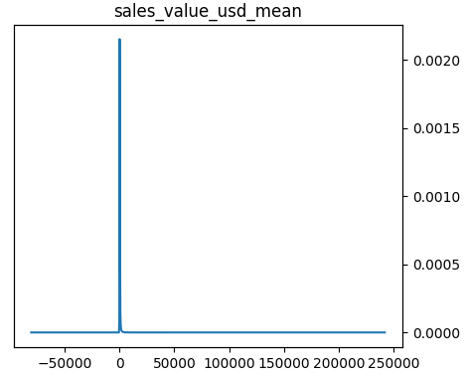
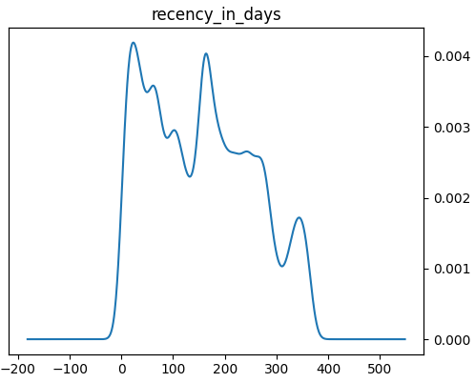
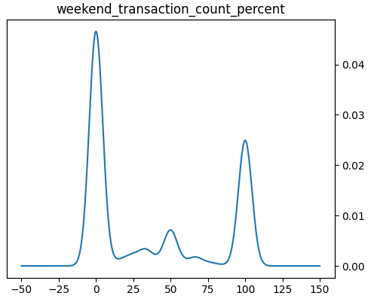
Most features are right-skewed with huge range of values
Right-skewed features
Sales_value_usd, Original_price_usd, Discount_amount_usd,monetary total_sales_after_discount
Sales_unit
frequency
Discount_percent
Non-normally distributed features
Recency
Bimodal distribution features
Weekend_transaction_count_percent
More transaction happens on weekday
Check excel out for more details
Notes:
Kmeans requires symmetrical distribution, same scale
More transactions happen on weekday, perception of spending more on weekend is wrong

Slide 8
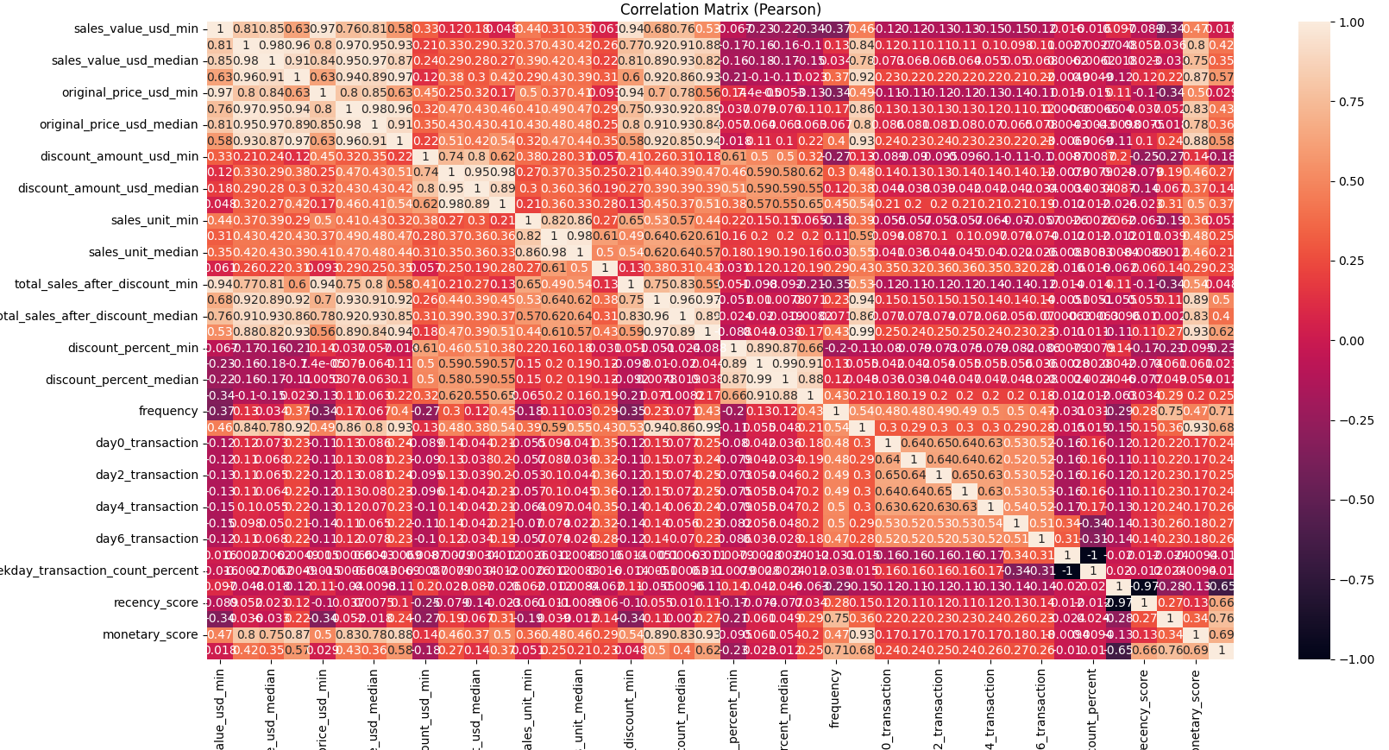
Correlation Plot
Correlated Variables
Sales_value, original_price_usd, total_sales_after_discount, monetary, monetary_score
Notes:
total_sales_after_discount, original_price_usd, discount_amount_usd are correlated. Choose total total_sales_after_discount_mean over original_price and discount_amount_usd as it encapsulates info from the rest
To drop highly correlated features

Slide 9
DATA TRANSFORMATION & FEATURE SELECTION

Slide 10
Following operations are performed before proceeding to modelling stage
Scaling
Log transformation to reduce right-skewness
Standard Scalar
Selected Features
Total_sales_after_discount_mean
RFM matrix
Notes:
First few trial: try different sets of features-> apply pca to reduce data dimension avoid curse of dimensionality where Euclidean distance becomes inflated. Everything seems like equidistance
Final approach: choosing many features do not help. Resort to simple model. Choose only total_sales_after_discount_mean and rfm
Choose total_sales_after_discount_mean over median since they are highly correlated (0.96)

Slide 11
MODELLING AND RESULTS

Slide 12
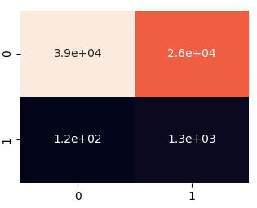
Approach 1: Clustering
Clustering algorithm: K-Means
Number of cluster=2
Inertia: 20e3
Silhoutte score: 0.33
Rand-score: 0.52
Where 0=‘A’, 1=‘B’
Notes:
Why Kmeans not DBSCAN bcuz DBSCAN will automatically determine cluster and not all points will be assigned a cluster
Why 2 clusters allows us to strategize marketing campaign faster due to less number of customer segment. It can be a good start and less resource needs to poured in analyse and customize offer/attraction packages for different customer
Inertia is Sum of squared distances of samples to their closest cluster center. The smaller the better
Silhoutte score: mean intra-cluster distance (a) and the mean nearest-cluster distance (b) for each sample. The higher the better. [-1, 1]
RI = (number of agreeing pairs) / (number of pairs), accuracy in disguise

Slide 13
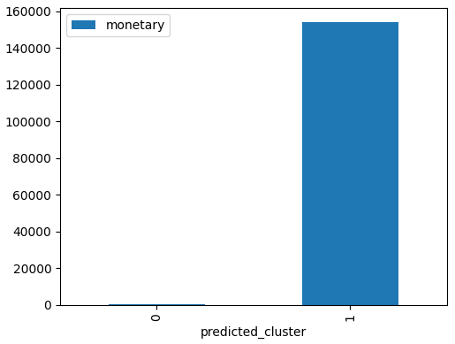
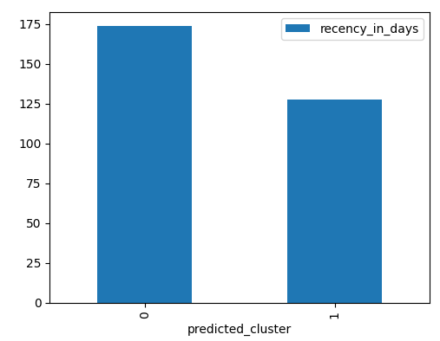
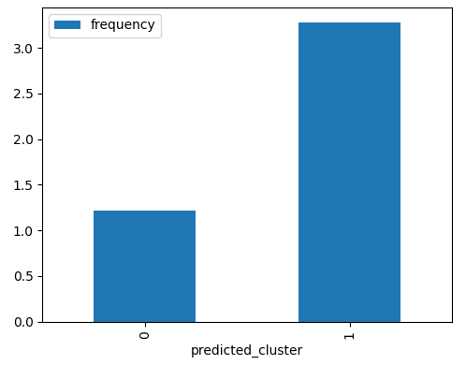
Deliverable 1: Customer Profiling
Cluster A
Cluster B
Low spending power
Less frequent flight passenger
48703 customers (58%)
High spending power
Frequent flight passenger
33370 customers (42%)
Notes:
1. Cluster A: total spending is lower, the last transaction date is longer (maybe they take flight less frequently or they don’t buy so often, can do promotion), less transaction
2. Cluster B: total spending is higher, last transaction is nearer, more transaction
3. Focus on cluster B since 42% of customer accounts for more than 90% revenue/ profit
4. Launch loyal customer campaign for cluster B customers
5. Not sure who will take charge of the selling off strategy. One way to keep them loyal is to do something marketing strategy like Hermes. Allow exclusive items to be sold based on booking. Not to sell at massive scale. Create an impression that it is honours to own such product

Slide 14
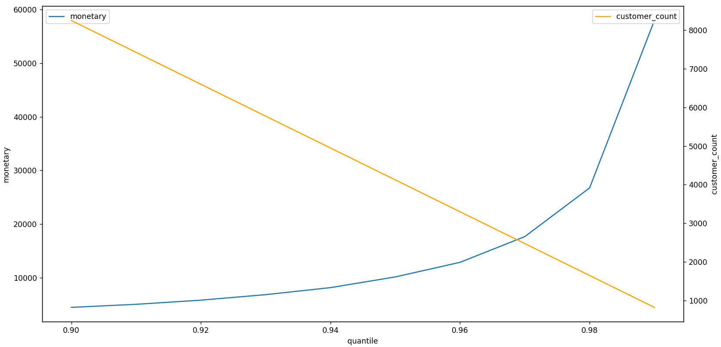
Deliverable 1: Customer Profiling (Cont’d)
Cluster C (Optional)
Top spending segment (monetary is above 0.97 quantile, stands at USD 17,643)
Cluster Count=2475
Can be combined with Cluster B when 2 clusters are preferred
Notes:
There can be a cluster for niche customer
Determined using elbow plot based on monetary
These customer is above 0.97 quantile, accounts for 2475 people, 3% of people

Slide 15
Deliverable 2: Prediction
Cluster assignment for individual customer can be found in excel below

Slide 16
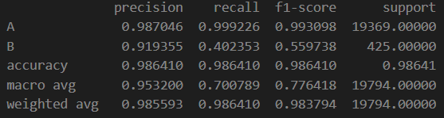
Approach 2: Classification
Classification algorithm: SVM-RBF kernel
Prediction:
Classification report as below:
Notes:
Classification approach
Use SVM-RBF bcuz this is the common classification model which is robust to outlier (the spending power between customers has huge diff)
F1-score 0.78

Slide 17
MODEL MANAGEMENT

Slide 18
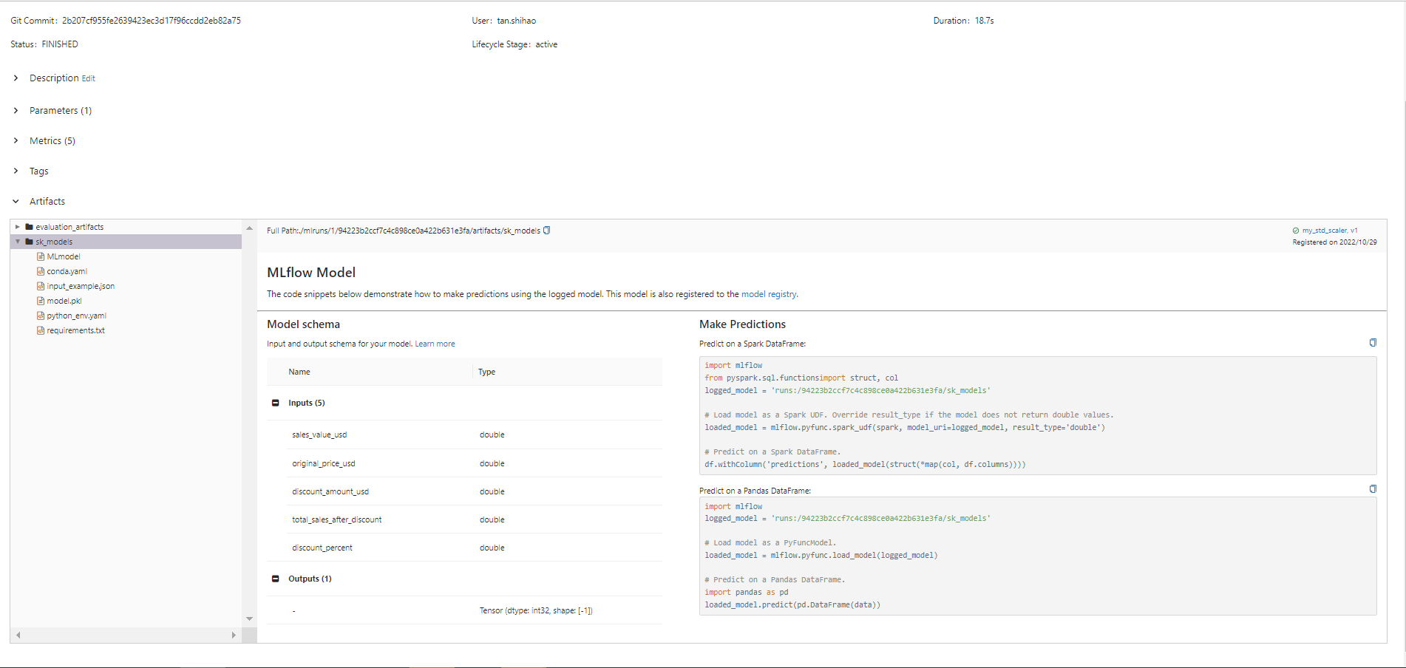
Model Versioning, Parameters, Metrics & Artifact Logging via MLFlow
Notes:
A good digital project does not stop at building a commendable model.
We should practice MLOps
In this case, mlflow is used for model versioning for continuous enhancement
It stores parameters (#clusters), metrics (silhouette score), artifacts (figure and models) and allow model-to-model comparison

Slide 19
SUGGESTED IMPROVEMENTS

Slide 20
Way Forward
General
Basic particulars of customers can be made available for better demographic analysis
Apply weighted average between recency_score, frequency_score and monetary_score
Outlier Removal/ Treatment
Classification:
Address imbalanced data through SMOTE or any other approaches
Adopt Conv1D for automated feature engineering
Use neural network as classifier
Hyperparameter Tuning
Other approaches for customer segmentation:
Outlier/ Anomaly detection
Source code: shihao28/Clustering (github.com), shihao28/MachineLearning (github.com)
Notes:
Demographic analysis: Age, gender, occupation, race, religion, what kind of product they buy
Weighted average for rfm because their significance maybe different

