Slide 1
Synapxe
Content Intelligence Pipeline
By: Tan Shi Hao

Slide 2
Table of Contents
System Architecture
Live Demo
Technical Deep Dive
Lessons Learned

Slide 3
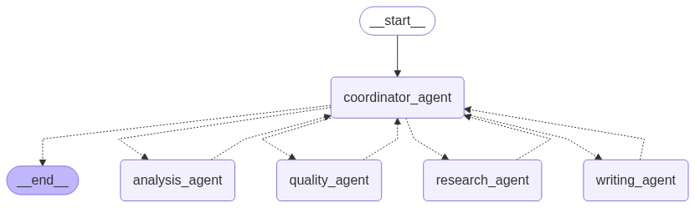
Architecture
The overall architecture consists of coordinator agent, research agent, analysis agent, writing agent and quality agent.
A single coordinator_agent receives the user prompt and routes it to one of four specialist workers (analysis_agent, research_agent, writing_agent, quality_agent). Each worker reports back, and the coordinator decides the next step until the flow reaches __end__.

Slide 4
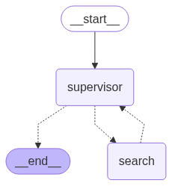
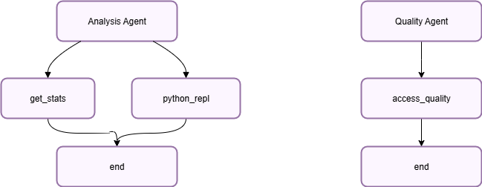
Architecture (Cont’d)
Research Agent
Handles information gathering. A lightweight supervisor node decides whether to invoke a search worker (which uses ReAct + web_search using SerpAPI) or finish immediately.
Analysis Agent
It's a ReAct agent. It has access to 2 tools (get_stats + python_repl) to query the statistics through API call and to produce visualization.
*Note: Query statistics tool is a dummy function implementation.

Slide 5
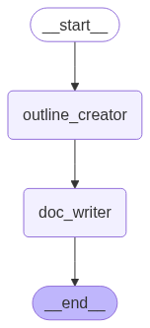
Architecture (Cont’d)
Writing Agent
Produces the draft. It always starts with outline_creator, then hands the outline to doc_writer to generate the write-up, and finally exits.
Quality Agent
It's a ReAct agent. It scores how completely the draft fulfills the user_request using access_quality tool.

Slide 6
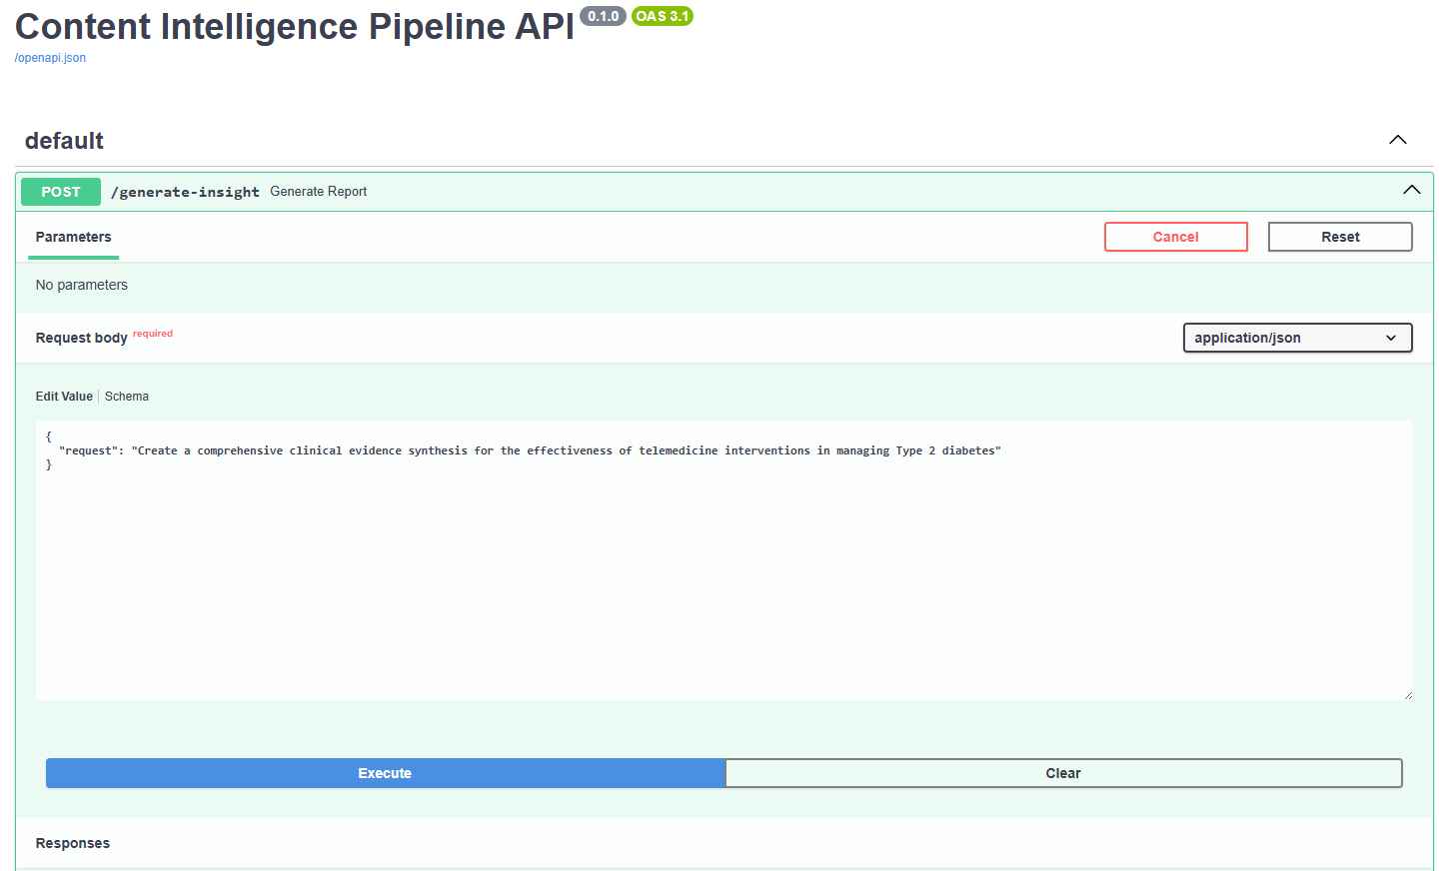
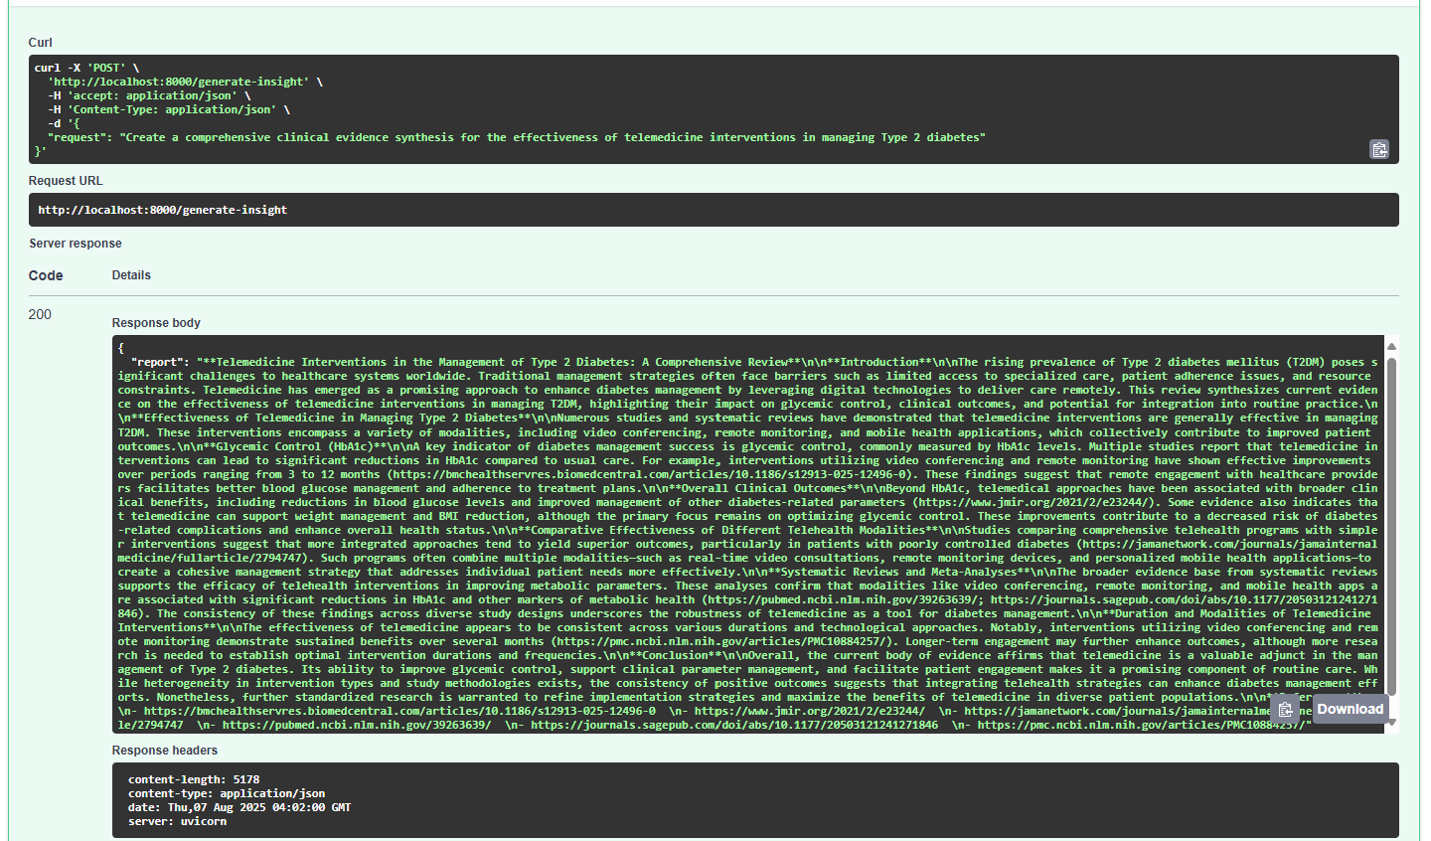
Live Demo

Slide 7
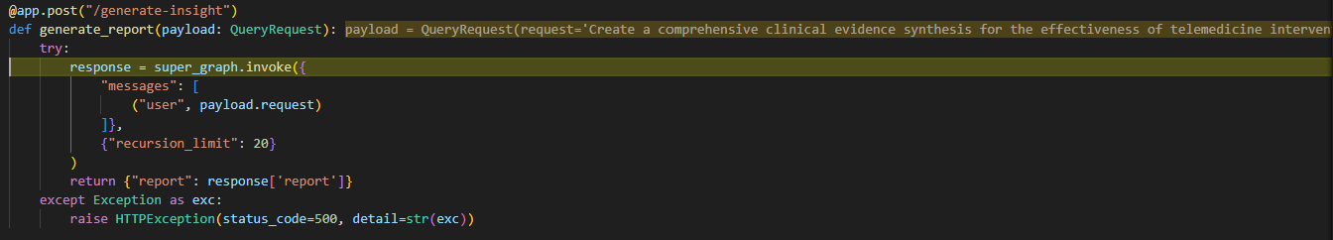
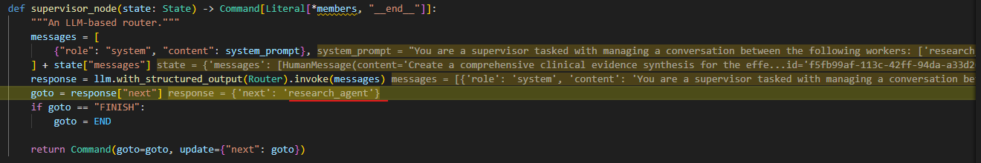
Technical Deep Dive
1
FastAPI receives the following request body
{
"request": "Create a comprehensive clinical evidence synthesis for the effectiveness of telemedicine interventions in managing Type 2 diabetes"
}
2
Coordinator Agent is invoked and it routes the request to Research Agent
Coordinator Agent Prompt:
You are a supervisor tasked with managing a conversation between the following workers: research_agent, analysis_agent, writing_agent, quality_agent. Given the following user request, respond with the worker to act next. Each worker will perform a task and respond with their results and status. When finished, respond with FINISH.

Slide 8
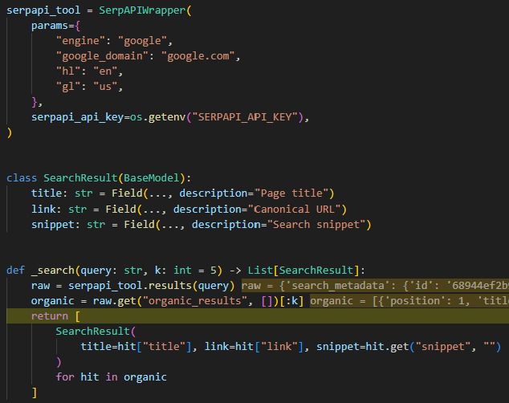
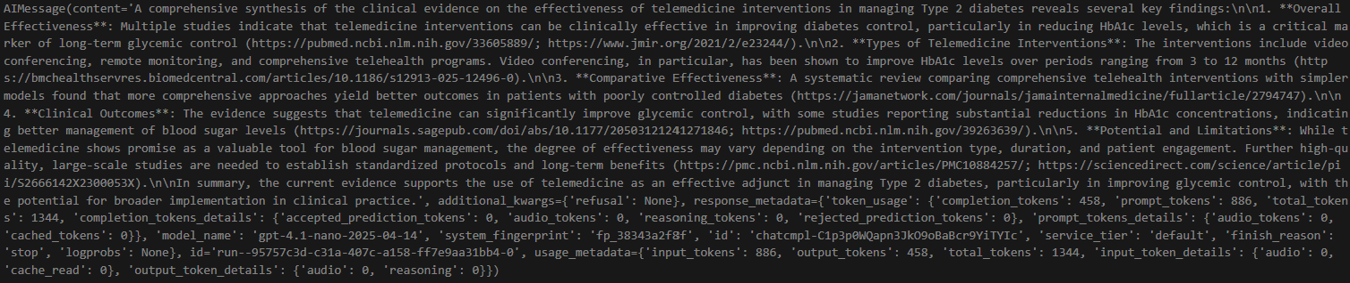
Technical Deep Dive (Cont’d)
3
Research Agent performs research by calling web_search tool.
web_search tool uses SerpAPI and the search result is parsed into a Pydantic Model that contains
title
link (url)
snippet (summary)
4
Based on the web_search result, Research Agent generates the final response and the control is handed back to Coordinator Agent

Slide 9
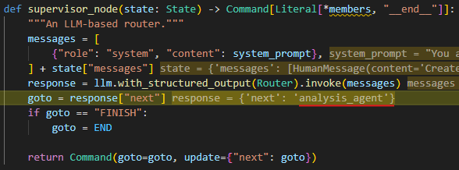
Technical Deep Dive (Cont’d)
5
Coordinator Agent decides to call Analysis Agent to perform analysis
6
Analysis Agent uses
get_stats tool to retrieve statistics
python_repl_tool to plot a graph
Analysis Agent Prompt: You should get statistics, generate charts and save it as chart.png.
get_stats_tool result:
python repl_tool result:

Slide 10
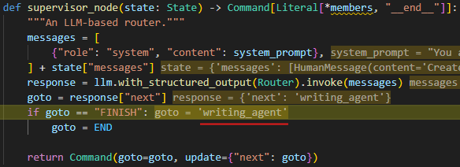
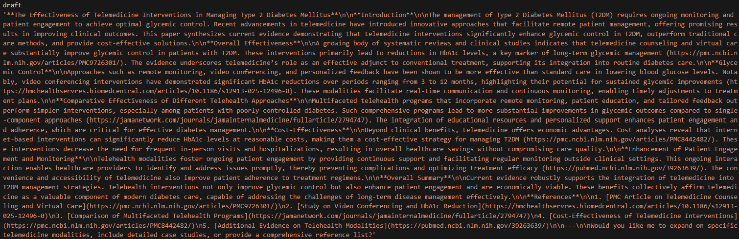
Technical Deep Dive (Cont’d)
7
Coordinator Agent regains the control and it decides to call Writing Agent to draft the final write-up
8
Writing Agent calls
outline_step node to come up with concise bullet-points based on the research results.
draft_step node to prepare final draft which follows the defined outline and includes citations.
outline_step result:
draft_step result:

Slide 11
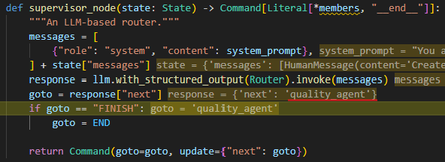
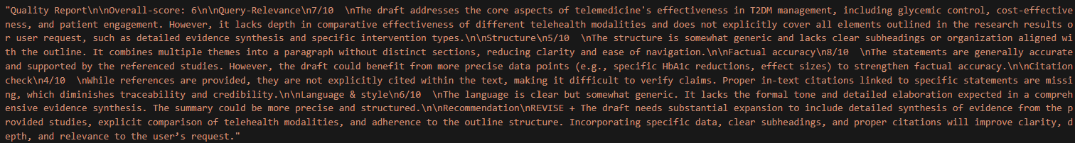
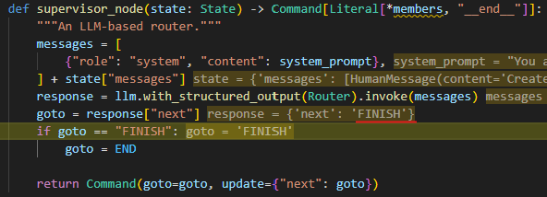
Technical Deep Dive (Cont’d)
9
Coordinator Agent calls Quality Agent to access the quality of the final write-up
10
Quality Agent uses access_quality tool to evaluate the quality of the write-up by comparing against the initial research result and the proposed outline.
access_quality tool result:
11
Coordinator Agent decides to end the execution

Slide 12
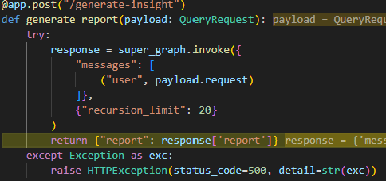
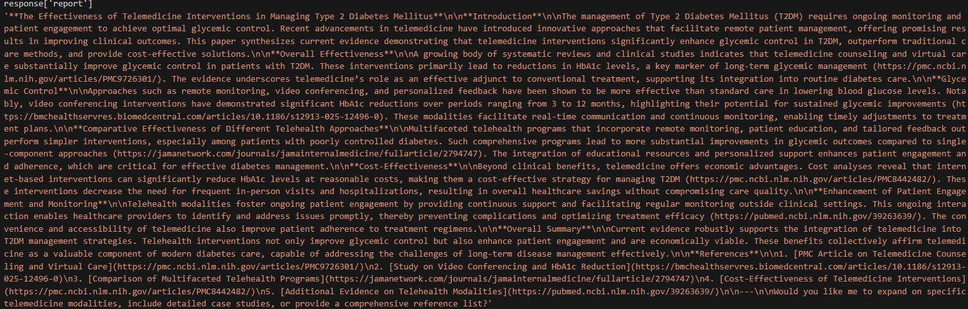
Technical Deep Dive (Cont’d)
12
The final response returned to user is the final draft composed by Writing Agent

Slide 13
Lesson Learned
Architect for clear boundaries and future scale
Treat every agent as a single-responsibility micro-service and let the coordinator handle orchestration. This separation keeps the codebase maintainable and ensures scalability of individual agents as workflows grow more complex
Treat resilience and traceability as first-class features
Build in robust error-handling, retries, and detailed logging to follow every agent interaction and recover gracefully when something break

