Slide 1
Action Recognition
Table of Contents:
Overview
Data Collection
Data Preparation
Data Augmentation
Model Selection (Pre-training)
Model Training, Selection & Learning Tracking
Inference Preparation & Deployment
Post Deployment Tracking

Slide 2
Overview

Slide 3



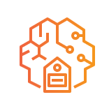
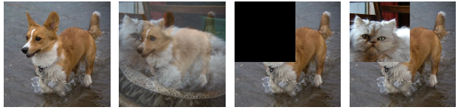
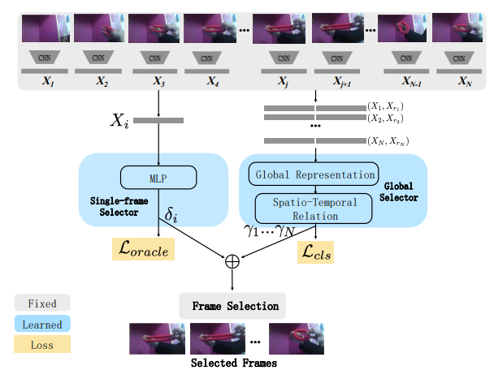






Overview
Pre-training
Data Collection
Data Preparation
Data Augmentation
Model Selection
Development
Model Training, Selection and Learning Tracking
Production
Post Deployment Tracking
Inference Preparation & Deployment
Trained
Model
Retraining

Slide 4
Data Collection

Slide 5
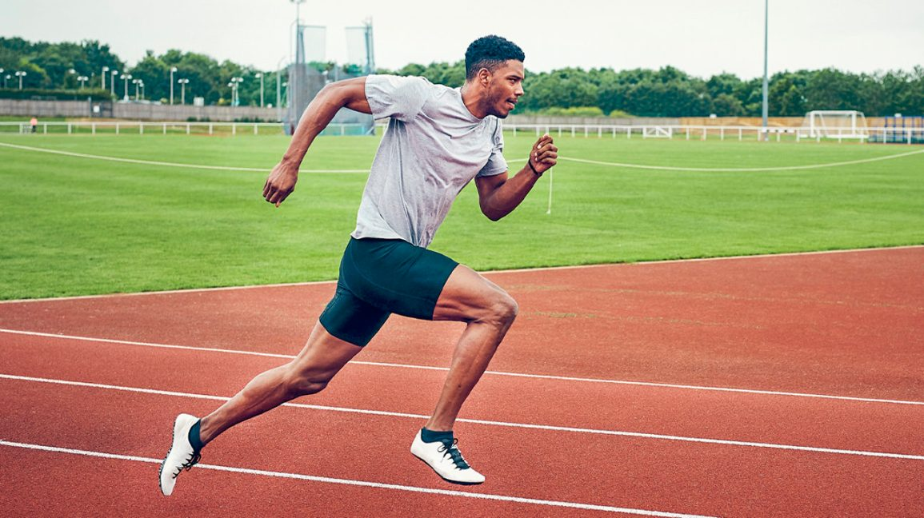



The train and test data should come from similar domain
Scene is important to computer vision task
Although a lot of public datasets are freely available, perform dataset collection at the targeted deployed setting is still crucial for best model performance
Camera Setup:
IP camera renders live feed video using RTSP protocol
Minimum 30 FPS
Resolution: 1920×1080 (2MP)
Collected data can be stored either locally or on cloud

Slide 6
Data Preparation

Slide 7

Curate and Label Images
Quality of collected images should be inspected for high quality training process in subsequent stage. E.g. Blurred images should be removed
Images with disturbances such as different lighting condition or noise can be treated using image processing tools.
Image labelling can be done using open-source tools or cloud services
Open-sourced Image Labelling Tools
(LabelMe, LabelImg)
AWS Ground Truth

Slide 8
Data Augmentation

Slide 9
Data augmentation is crucial for optimal performance
Plenty augmentation techniques are available to achieve the following
To ensure a variety of images are available for training
To prevent overfitting
Popular data augmentation techniques offered by Pytorch include
Random resize
Random cropping
Random affine transformation
Random color jitter
CutMix
Etc
Augmentation can be performed offline or on-the-fly during training
Raw Image
Mixup
Cutout
CutMix

Slide 10
Model Selection (Pre-training)

Slide 11
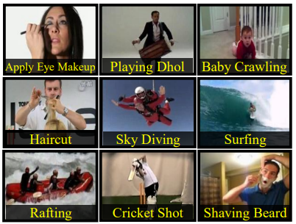
SMART is selected as solution
UCF101 is the one of the most popular public dataset in action recognition domain with 4592 citations as recorded by Google Scholar
Sampling through Multi-frame Attention and Relations in Time (SMART) produces most astounding results (98.64% accuracy) based on the leaderboard in paperswithcode
Thus, it serves as good baseline to kickstart the development and more work can be done to further improvise its performance
Sample Images from UCF101

Slide 12
Snapshot of SMART Technical Paper
Research Problem
Video has huge information redundancy
Processing full video is computationally expensive
Research Objective
To perform frame selection SMART-ly for action recognition by considering only important frames
Illustration of SMART

Slide 13
Snapshot of SMART Technical Paper (Cont’d)
Methodology
Select top-N frames using SMART selection strategy by employing single-frame and global selector
Frame is represented using MobileNet and GloVE features jointly
Single-frame selector: MLP is used to express frame importance score
Global Selector:
Information from individual frame is aggregated into global features through attention module.
Relation model and Long-Short Term Memory (LSTM) are used to compute temporal relationships among frames.
Action of the selected frames is recognized using deep CNN

Slide 14
Model Training, Selection & Learning Tracking

Slide 15
Model Training, Selection & Learning Tracking
A commendable deep learning-based training script should cover the following:
Data Ingestion Pipeline (Datasets & Dataloaders)
Data Augmentation
Loss Function (Cross entropy loss/Focal loss/Label smoothing loss/Contrastive loss/Center Loss etc.)
Metrics (Accuracy/Recall/Precision/F1-score etc.)
Optimizer
Learning rate scheduler
Multiple trials can be run using different combinations of parameters. The best model should be selected by considering following:
Model that gives highest metrics based on evaluation dataset
The chosen metrics is selected based on class distribution
Accuracy can be used for dataset with almost evenly distributed classes
Recall/Precision/F1-score is opted for imbalanced class

Slide 16


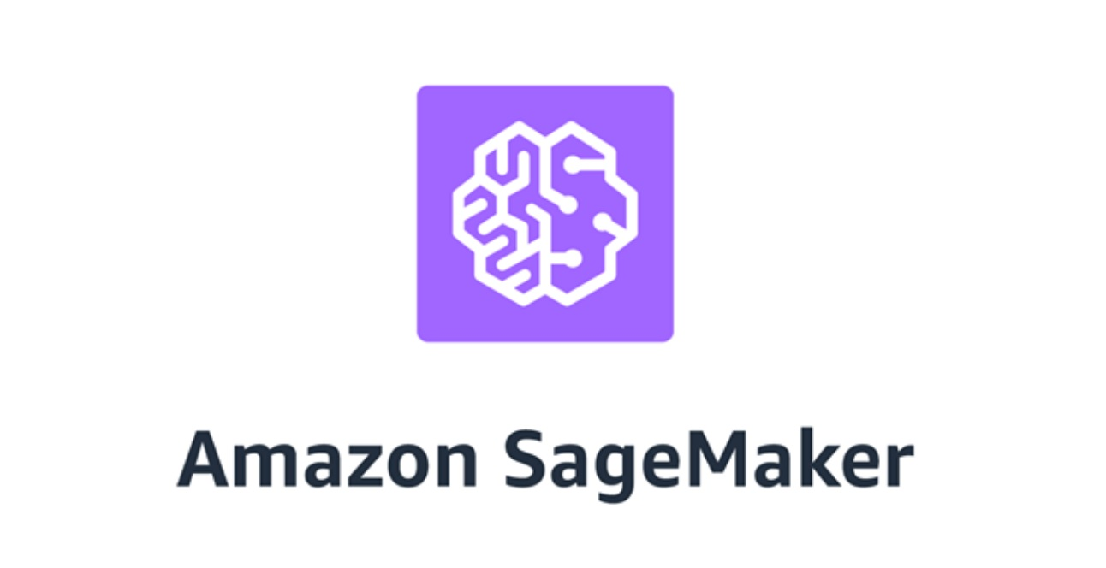
Model Training, Selection & Learning Tracking (Cont’d)
Development
Environment
Training process can be monitored by:
Observing training and evaluation loss
Observing training and evaluation accuracy
The above should not have large discrepancy else it can be either underfitting or overfitting
Development environment can be either local or on cloud
MLFLow can be used for model versioning to ease final model selection
Development tools
Model Versioning

Slide 17
Inference Preparation & Deployment

Slide 18
Inference Preparation & Deployment
Set up deployment environment with following consideration
computational power (CPU, RAM, GPU specification)
On-premise server (sensitive data) or cloud server
Optimizing inference speed
Converting native pytorch model to TensorRT
Quantization: Inference on fp16 and even int8 but with slight drop in accuracy
Model pruning by removing less important layers using NVIDIA TAO Toolkit
Use NVIDIA Trition Server or NVIDIA Deepstream as inference pipeline for speed optimization

Slide 19

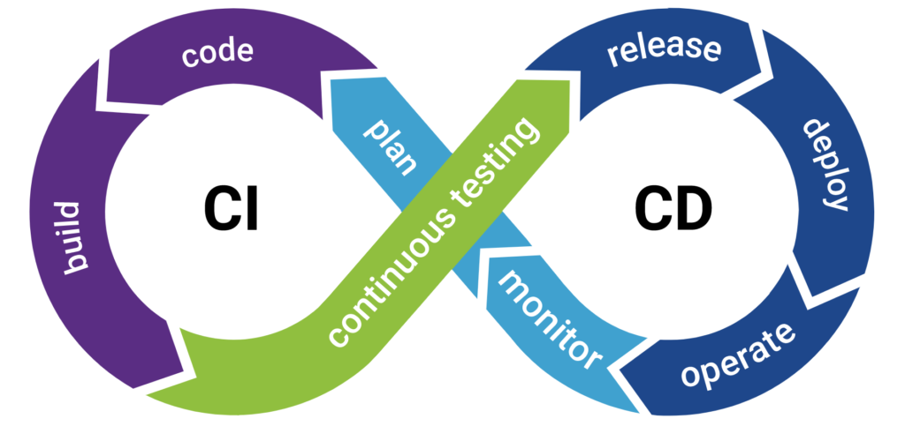




Inference Preparation & Deployment (Cont’d)
CICD Pipeline using YAML file
Automated unit testing i.e. pytest to avoid code breaking using CI pipeline
Containerization and upload docker image to DockerHub/Azure Container Registry/Amazon Elastic Container Registry
One-click away deployment to production environment using CD pipeline

Slide 20
Post Deployment Tracking

Slide 21
Post Deployment Tracking
Data drift occurs when images used during development is different from deployment. For instance
Change in background
Lighting condition
People behavior (pre-covid vs covid vs Post-covid time)
Etc
Continuous monitoring model accuracy is important.
Defining bad performance is important as well. E.g. impact of 5% accuracy drop in animal classification is different from that of lung disease classification based on X-ray

Slide 22
Post Deployment Tracking (Cont’d)
Model retraining process can be triggered when model performance is below predefined level.
For real-time application, tracking inference speed is crucial. Higher number of objects in frame will require more computational power to render result in real-time. E.g. Covid lockdown results in less number of crowd as compared to normal circumstances.

