Slide 1
A Tour AROUND LONDON Boroughs
Coursera APPLIED DATA SCIENCE Capstone PROJECT

Slide 2
PROBLEM IDENTIFICATION
Insufficient Information available at hand detailing which boroughs to visit regarding the food culture available for a Tourist
Where To Open A restaurant?
Which Restaurant should I visit in terms of quality and ratings?

Slide 3
DATA DESCRIPTION
The Data Required for the process are obtained as follows
Web Scrape the Wikipedia Table To Obtain The areas around London and its postcodes from https://en.wikipedia.org/wiki/List_of_areas_of_London
Use geocoder to find the latitude and longitude for each area and update the table.
Use Foursquare API to obtain venues around each location for the analysis

Slide 4
DATA WRANGLING ASSUMPTIONS
The Assumptions Made in Simplifying the dataframe for the machine learning prediction is as follows.
Unique Post codes were only analysed. As duplicate post codes still returned the same results thus this increased time and memory consumption. Eliminating this decreased the time consuming in obtaining results.
The Post town of London was only analysed thereby removing all Post towns apart from London.

Slide 5
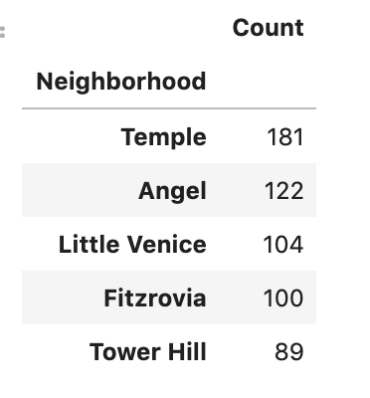
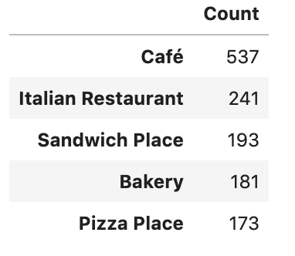
Foursquare API
Neighbourhoods which has high amount of venues resulting in large gatherings.
Most Occurred category of food venues in the London

Slide 6
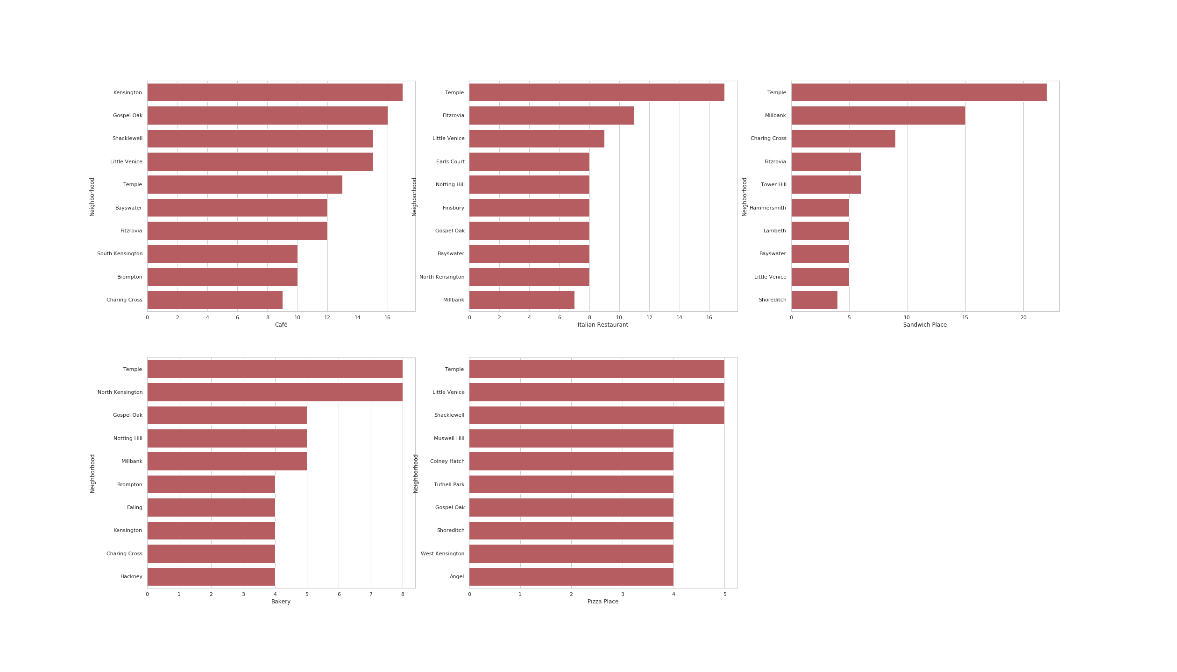

Slide 7
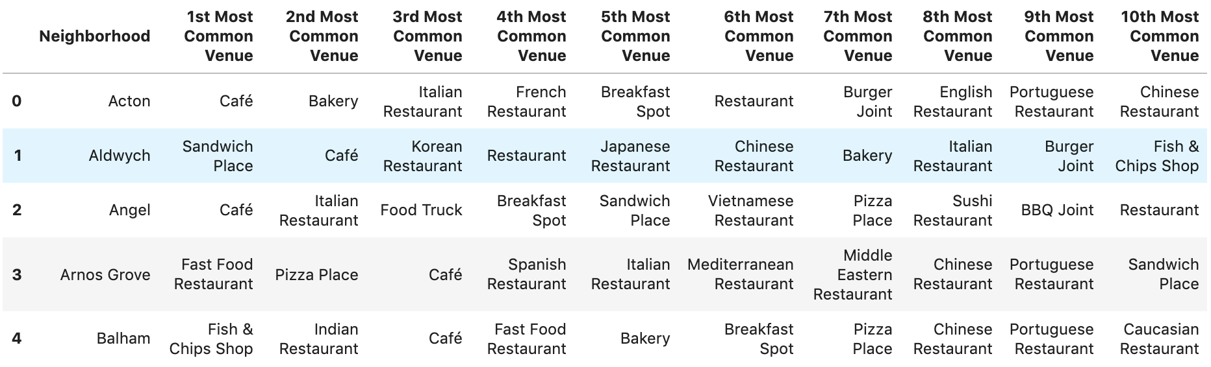
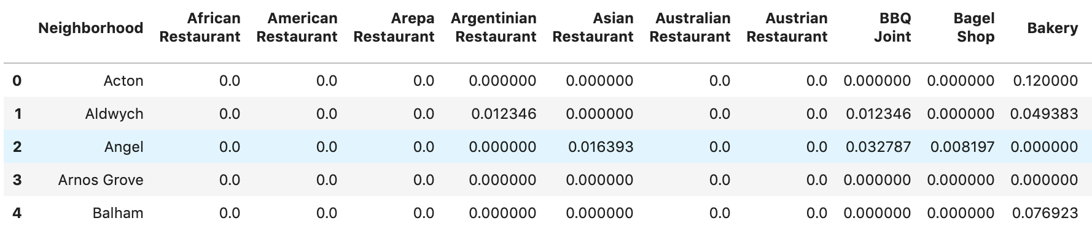
Top 10 Venues for each Neighborhood
Amount of Occurrence for each venue in a Neighborhood arranged by mean of its occurrence.

Slide 8
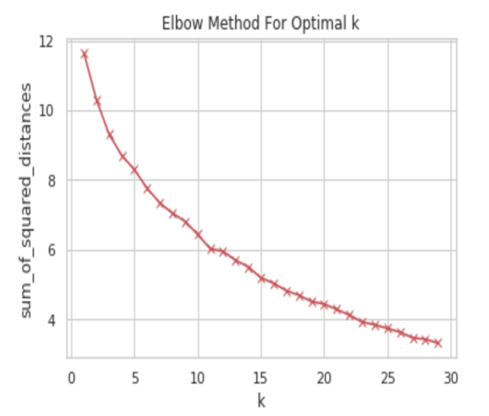
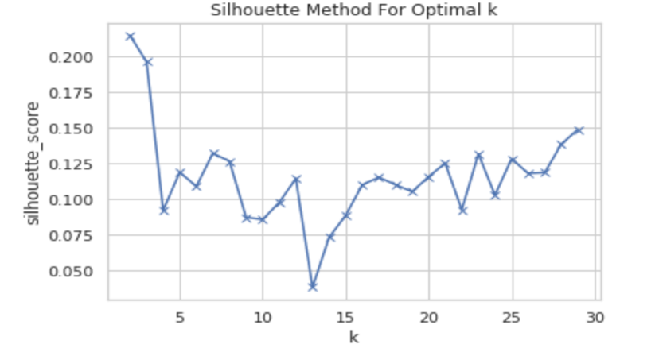
MACHINE LEARNING
The Algorithm used for Machine Learning is KMeans clustering algorithm. This was grouping restaurants and localities to similar clusters based on the features. The K value for the algorithm was chosen from following graphs as k=9.

Slide 9
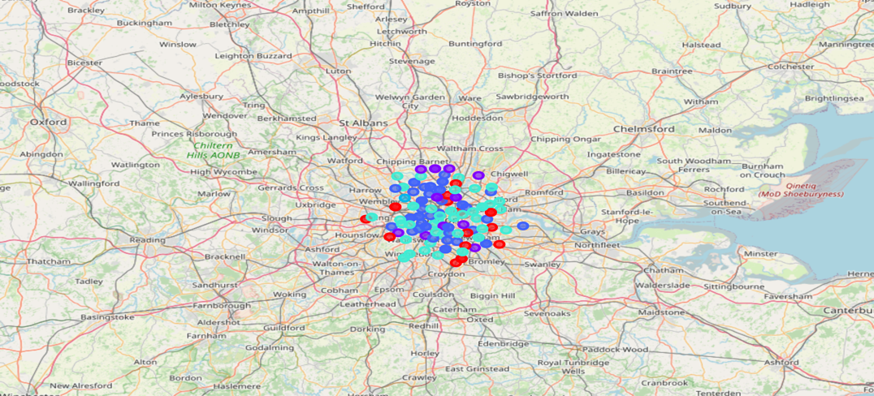

Slide 10
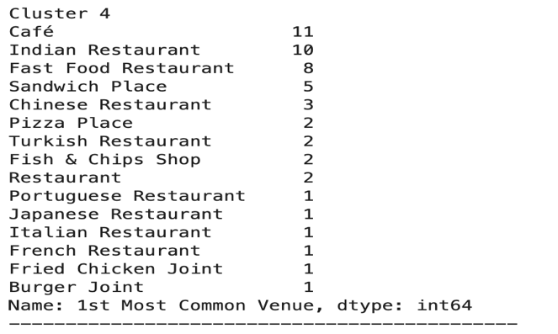
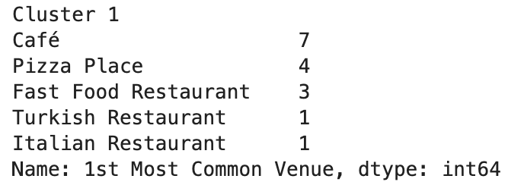
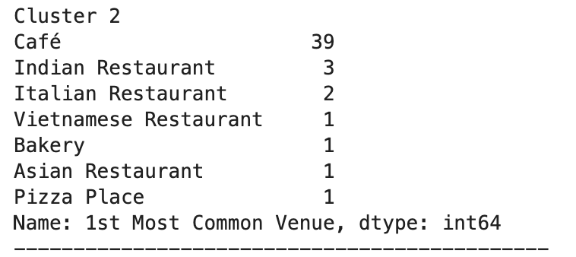
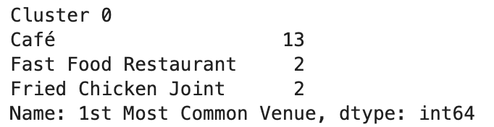
Major Clusters

Slide 11
DISCUSSION AND FUTURE WORKS
Obtaining Demographical features for each locality such as Population , Income, ratings for each restaurants to increase quality of clustering.
Limitation of Foursquare prevents further analysis. Suitable method to exceed this defect will provide higher quality clusters

