Slide 1
RIFFA 2.2.2 for dummy
2018/04/09 v1.0 Sheng Jui, Huang
2019/07/17 v2.0 Shih Wei, Hsieh
2021/07/30 v3.0 Yan Lun, Wu & Shu Fan, Wu
2022/08/12 v4.0 Shu Fan, Wu & Shih Hao, Huang
2023/08/17 v5.0 Ke Fan, Lin
2024/07/32 v5.1 Catfish, Yan
2025/07/31 v99.0 Jimmy, Shih

Slide 2
Outline
FPGA introduction
What is RIFFA
Practice
Other useful utilities

Slide 3
Outline
FPGA introduction
What is RIFFA
Practice
Other useful utilities

Slide 4
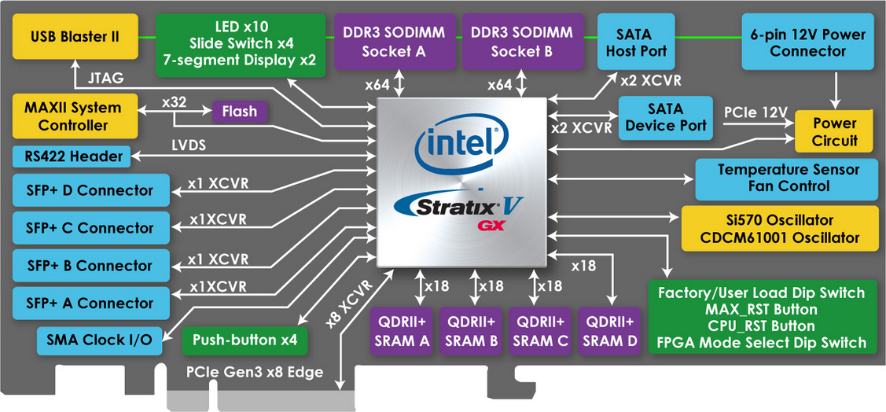
Terasic FPGA (Intel)
DE5-Net FPGA Development Kit
https://www.terasic.com.tw/cgi-bin/page/archive.pl?Language=Taiwan&CategoryNo=159&No=726
Altera Stratix® V GX FPGA (5SGXEA7N2F45C2)
Lots of resources in the web, includes user manual and CD
10 LEDs / 4 push-buttons / 4 slide switches / 2 seven-segment displays
622,000 logic elements (LEs)
50-Mbits embedded memory (built-in BRAM)
Also have internal SRAM, external DRAM on the board
512 18-bit x 18-bit multipliers / 256 27-bit x 27-bit DSP blocks

Slide 5
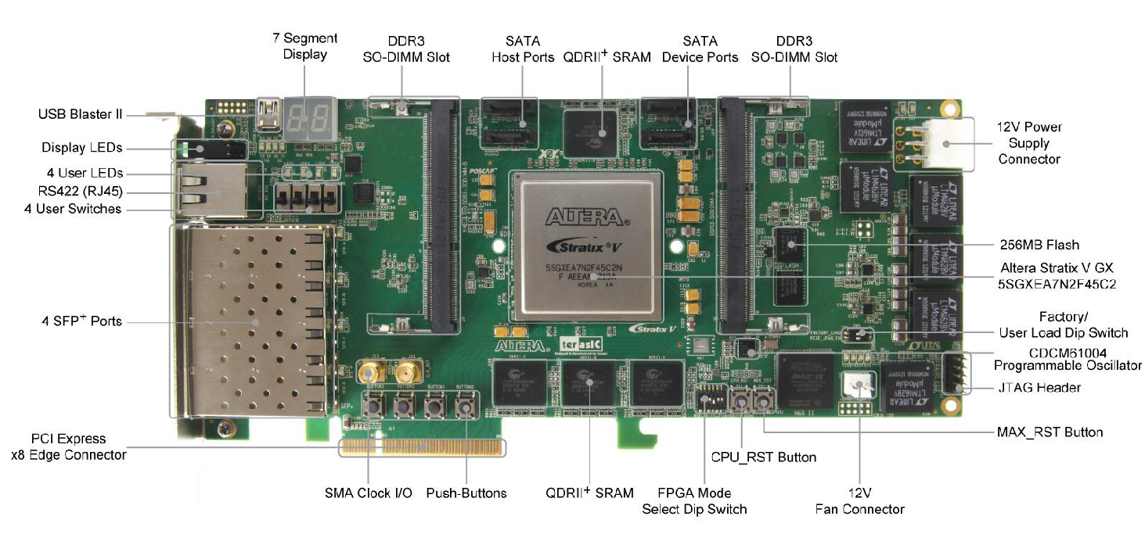
Terasic FPGA
PCIe
USB Blaster
12V Power Supply

Slide 6
Terasic FPGA
DE5a-Net FPGA Development Kit
https://www.terasic.com.tw/cgi-bin/page/archive.pl?Language=Taiwan&CategoryNo=229&No=1138
Arria 10 GX FPGA (10AX115N2F45E1SG)
Lots of resources in the web, includes user manual and CD
8 LEDs / 4 push-buttons / 2 slide switches / 2 seven-segment displays
1150K logic elements (LEs)
67Mbits embedded memory (50Mbits?)
3036 18-bit x 19-bit multipliers / 1518 Variable-precision DSP blocks

Slide 7
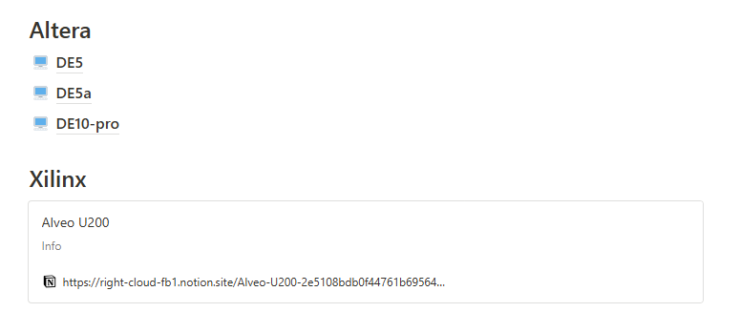
notion
https://bl430fpga.notion.site/bl430fpga/BL430-FPGA-bc15283eff644dbb99361cf0e3277a40

Slide 8
Server list
The resources in our lab
https://available-soursop-b6e.notion.site/Server-78a8b54198244cdca3d603d70ed0397c

Slide 9
Outline
FPGA introduction
What is RIFFA
Practice
Other useful utilities

Slide 10
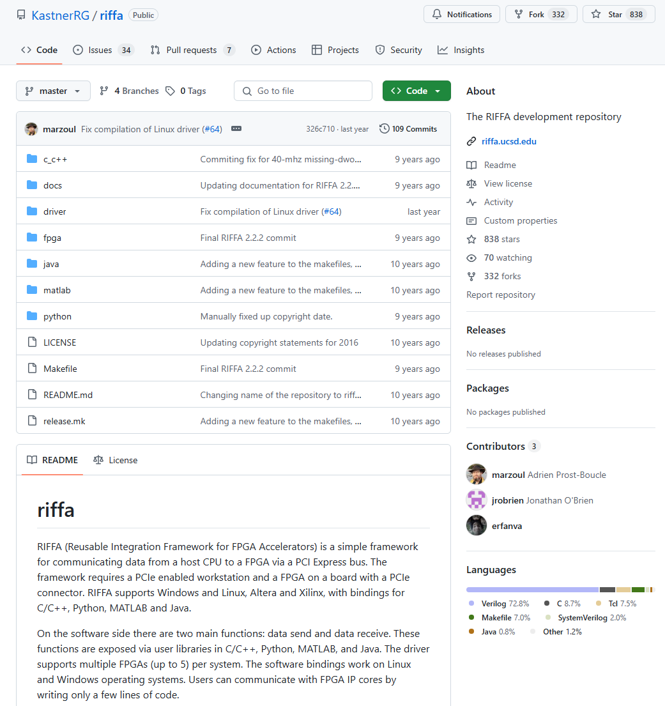
What is RIFFA

Slide 11
What is RIFFA
RIFFA:
Reusable Integration Framework for FPGA Accelerators
Requires a PCIe enabled workstation and a FPGA board with a PCIe connector
Pros:
Both the software and hardware interfaces have been greatly simplified
Ease of programming: details of the PCIe protocol, device driver, DMA operation, and all hardware addressing are hidden from both the software and hardware.
Support for Linux and Windows, software bindings for C/C++, Python, MATLAB , and Java
Cons:
Takes up resource: If no high speed data I/O communication is needed, then its better to not use it
Loss of flexibility

Slide 12
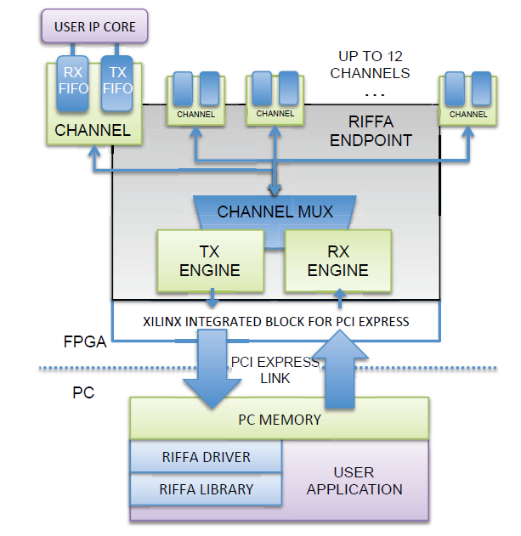
What is RIFFA
User cores interface with RIFFA 2.0 via a Channel core
The Channel core has FIFOs for receiving and sending data respectively.
The RX Engine core is responsible for extracting and demultiplexing received PCIe payload data.
The TX Engine core is responsible for formatting payload data into PCIe packets and multiplexing access to the PCIe link
The PCIe link configuration determines the width of the data bus. This width can be 32, 64, or 128 bits wide (RIFFA does not support 256 bits interface)
All PCIe Gen 1 and Gen 2 configurations up to x8 lanes are supported.
Where you need to plug your design

Slide 13
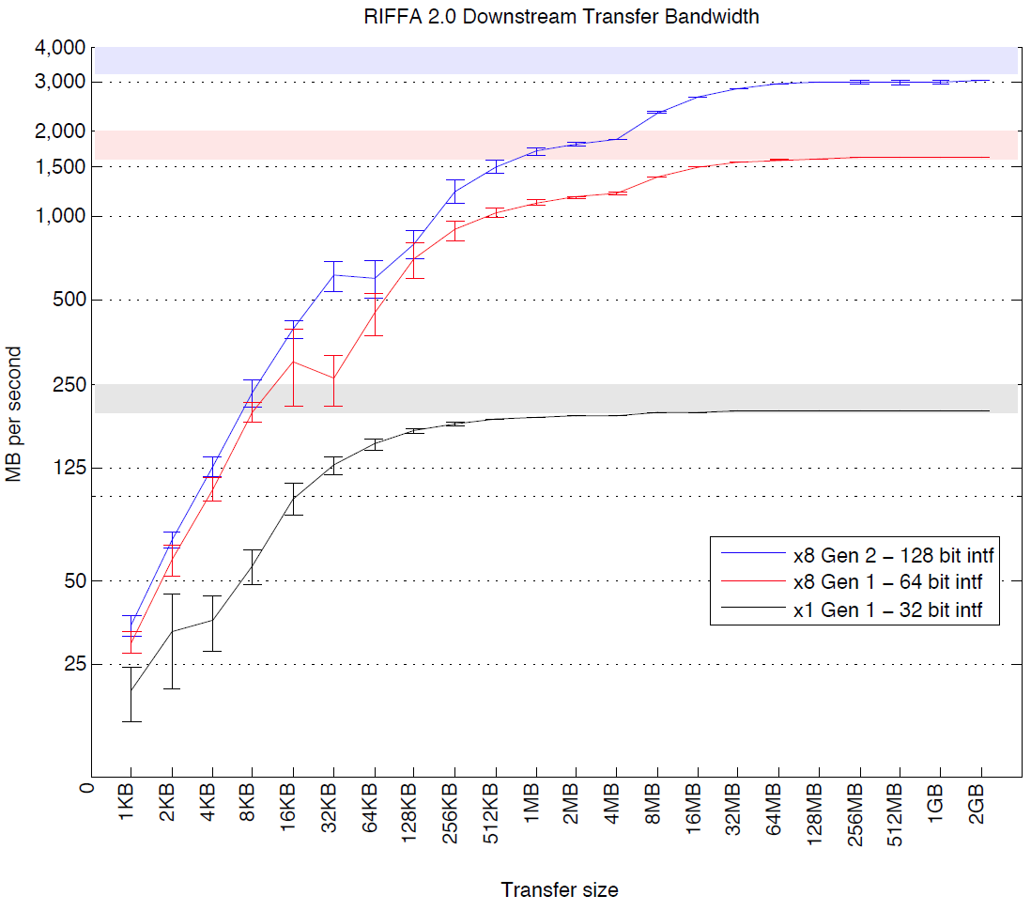
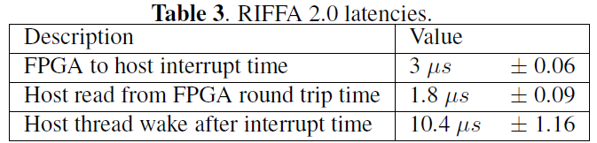
What is RIFFA
Sending data in smaller transfer sizes reduces effective throughput
Making a copy of a large buffer of data in software before sending it to the FPGA takes time and can severely impact throughput
Less transmission improves throughput
綜合前幾頁所述:
簡而言之，riffa就是一個已經寫好PCIE/FPGA driver和driver該互動的Verilog files的開源框架。

Slide 14
RIFFA Package
documentation
source
c_c++
Linux
x64
sample_apps → Our input file from c code
fpga
riffa_hdl → all submodules in riffa → You should place all your rtl code here
altera → Choose Our board (DE2i / DE4我們不用)
de5 / de5a → Different board
DE5QGen*x*If128 /
DE5QGen*x*If128_CLK → Different PCIe choice or CLK
Bit → The compilation file after synthesized (.sof file)
Constr → sdc file for FPGA
→ Modify by your own usage(例如你要調clk period)
Hdl → Top module file RIFFA 會自己去RIFFA_HDL找SUBMODULES (based on your qsf file setting)
ip → qsys file (Quartus使用qsys去接線設定)
prj
.qpf → Quartus project file → used in save project / open project
.qsf → Quartus setting file→ File setting and FPGA board setting

Slide 15
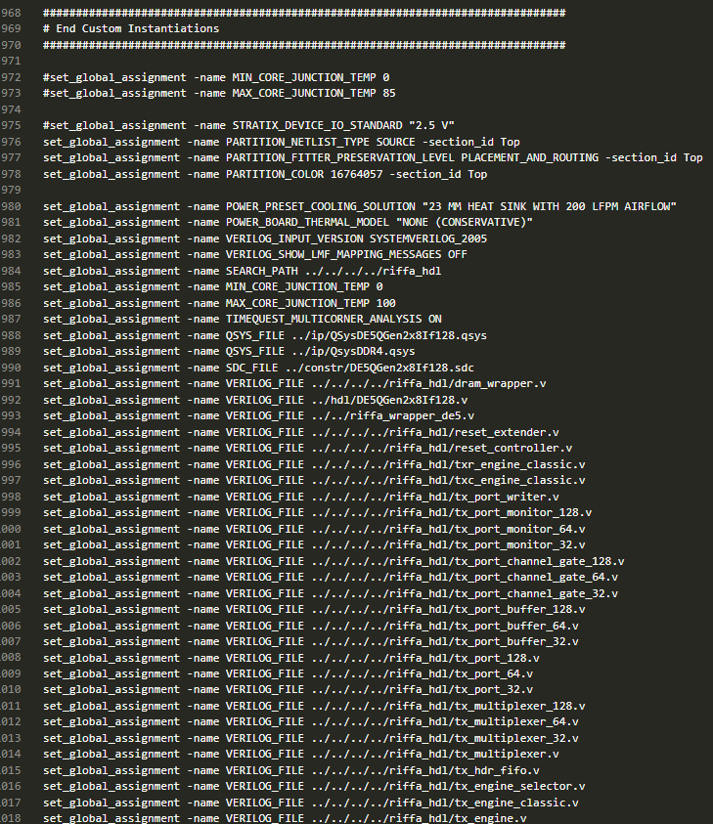
Example: How .qsf file looks like

Slide 16
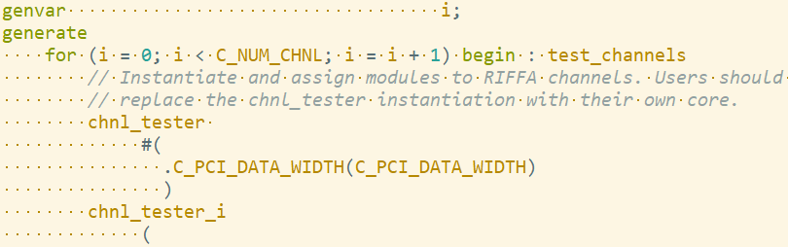
Top module file
 | DE5QGen2x8IF128.v | DE5QGen2x8IF128_CLK.v
C_PCI_DATA_WIDTH | 128 | 128
Qsys | QSysDE5QGen2x8If128 | QSysDE5QGen2x8If128_CLK
riffa_wrapper_de5 | At de5 folder | At de5 folder
chnl_tester | # of core parallel | different frequency
reference clk | chnl_clk | riffa_*_clk
Please check Appendix

Slide 17
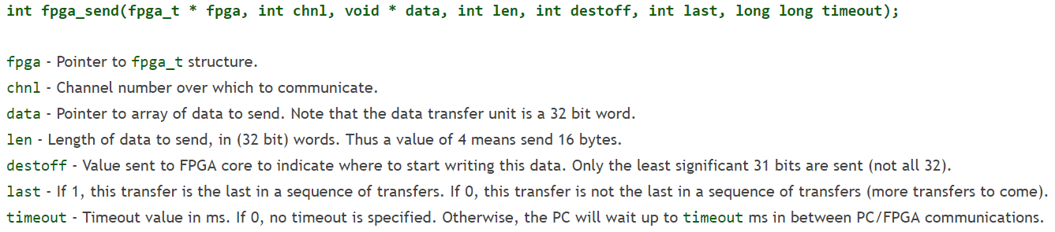
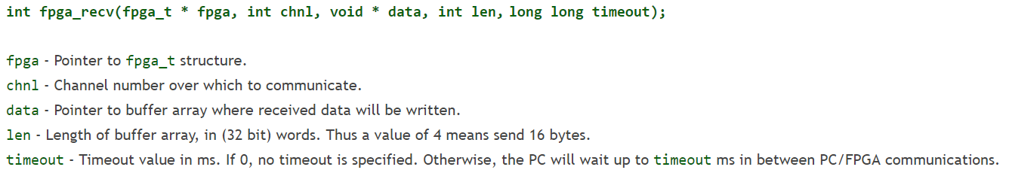
Software Interface
RX/ TX protocol:
Learn from example: our sample code

Slide 18
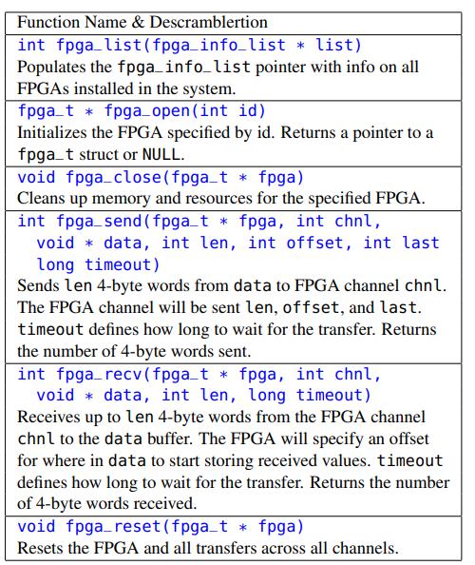
Software Interface
RX/ TX protocol:

Slide 19
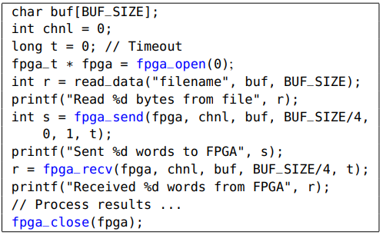
Sample usage
建議要以int宣告避免不必要的bug出現

Slide 20
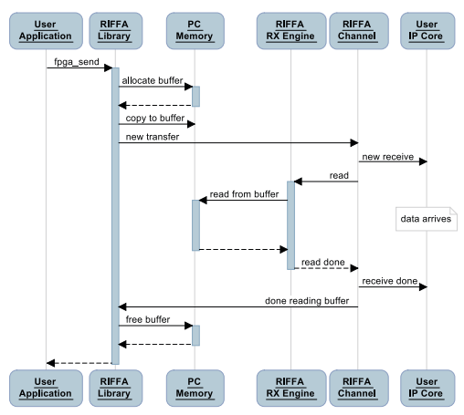
Full transmission – send

Slide 21
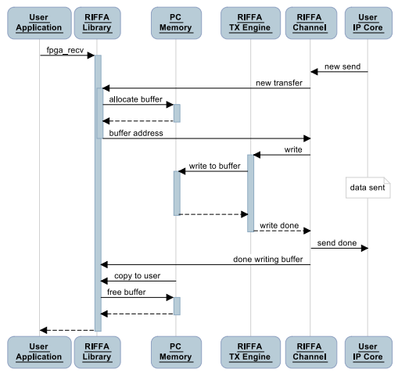
Full transmission – receive

Slide 22
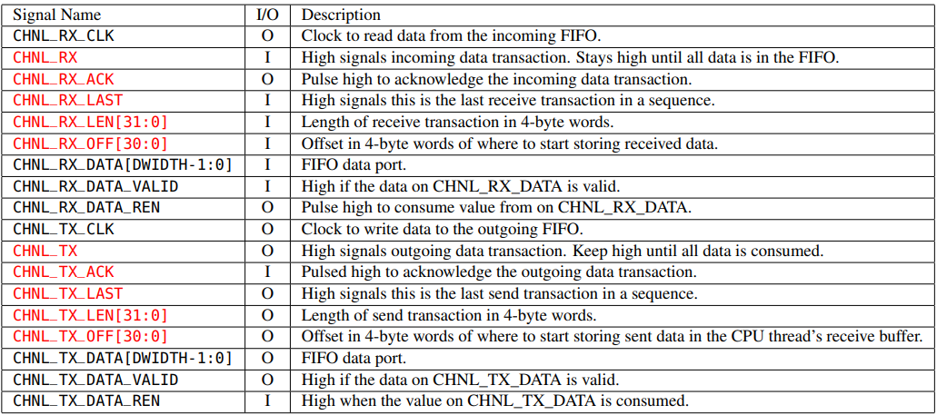
TX RX protocol ports

Slide 23
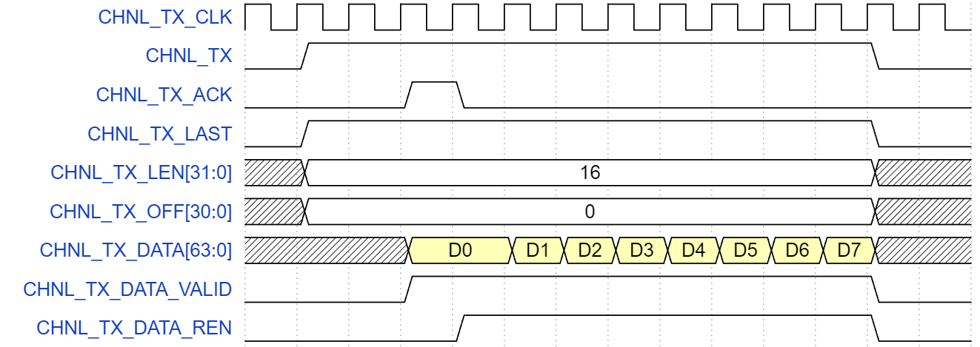
TX protocol
CHNL_TX_LEN: Total data size in “word [32bit]”
CHNL_TX_DATA: (128 bit): Transmitted data
CHNL_TX_DATA_VALID: Pull high when CHNL_TX_DATA is valid
CHNL_TX_DATA_REN: Whether C++ is receiving this data or not
Pay attention:
VALID will not always be high !!!
Make FPGA’s chnl_tester send next data only if VALID and REN are high simultaneously, else keep sending the same data.
Driver: FPGA
Driver: C++
Driver: FPGA
Driver: FPGA
Driver: FPGA
Driver: FPGA
Driver: FPGA
Driver: C++
23

Slide 24
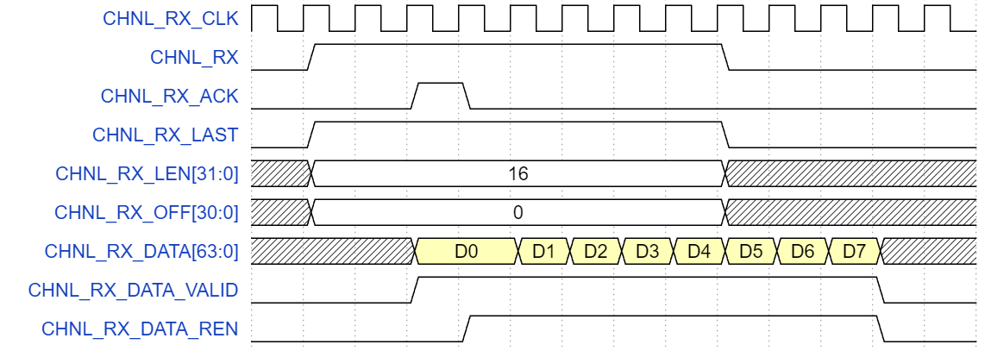
RX protocol
CHNL_RX_ACK: Need to be high for at least one cycle
CHNL_RX_LEN: Total data size in “word [32bit]”
CHNL_RX_DATA(128 bit): Transmitted data
CHNL_RX_DATA_VALID: Whether CHNL_RX_DATA is valid
CHNL_RX_DATA_REN: Control C++ to transmit next data or not
Pay attention:
VALID will not always be high !!!
RX will send next data only if VALID and REN are high simultaneously, else it will keep sending the same data.
Driver: C++
Driver: FPGA
Driver: C++
Driver: C++
Driver: C++
Driver: C++
Driver: C++
Driver: FPGA

Slide 25
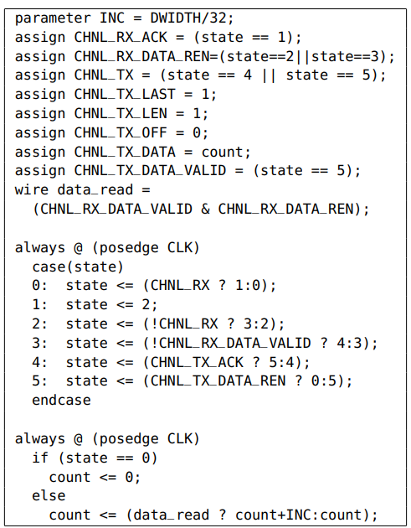
Sample usage
In this example, the user core receives data from the software thread, counts the number 4-byte words received, and then returns the count.

Slide 26
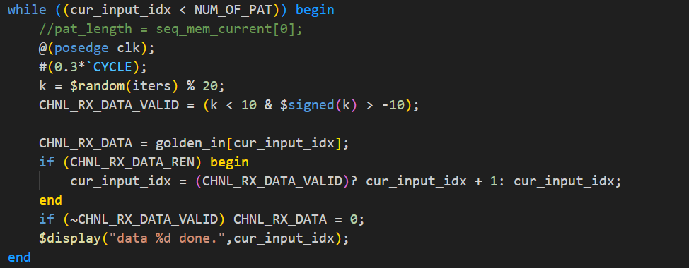
tb_chnl_tester.v -> RX
testbench中有模擬RIFFA TX傳輸行為，cur_input_idx為目前正在傳輸第幾個data，在符合條件時使idx增加
通常需要修改的是在第幾筆data時需要傳輸什麼，也就是data transaction part
Data transaction part
Protocol part

Slide 27
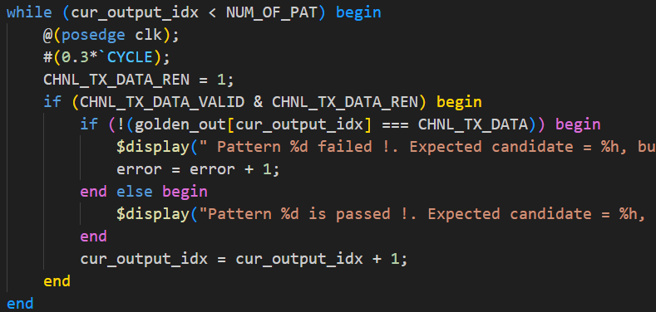
tb_chnl_tester.v -> TX
testbench中有模擬RIFFA TX傳輸行為
在符合條件時接收資料，並讓cur_output_idx 增加
把CHNL_TX_DATA的資料跟golden比較
Protocol part
Data transaction part
極度建議用RTL模擬完chnl_tester再上板測試
珍惜生命，盡量不要以燒板子的方式debug

Slide 28
Some hints
RX/TX 可以同時進行傳輸，也就是RX在傳輸的同時讓chn_tester中的CHNL_TX訊號也拉高來進行傳輸，但要注意REN,VALID等訊號的控制要寫好。
RX/TX 可以交互進行傳輸，利用RX_REN來使RX傳輸暫停，或使用TX_VALID訊號來使TX傳輸暫停，來控制在特定情況時要使用TX還是RX方向的傳輸。
善用tb_chnl_tester或signal_tap來檢查RIFFA interface有哪裡是沒有處理好的。

Slide 29
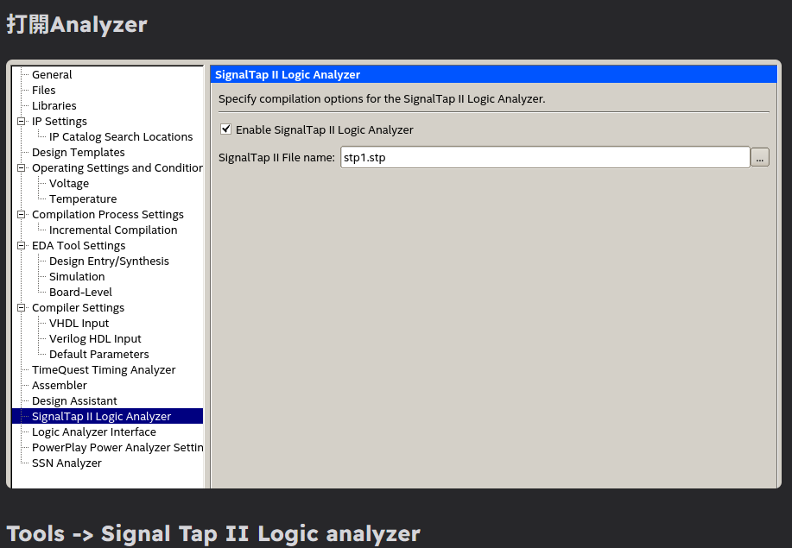
Signal Tap
https://hackmd.io/@VdgkdLfjTJqoAqqkM8zAvA/rk10ItfPR
有使用上問題的話可以google直接搜尋關鍵字
https://www.intel.com/content/www/us/en/docs/programmable/683819/25-1/faq.html
需同時在有quartus & fpga的server上

Slide 30
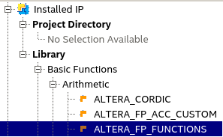
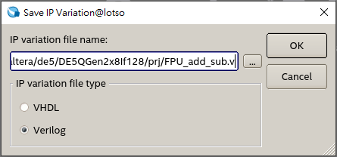
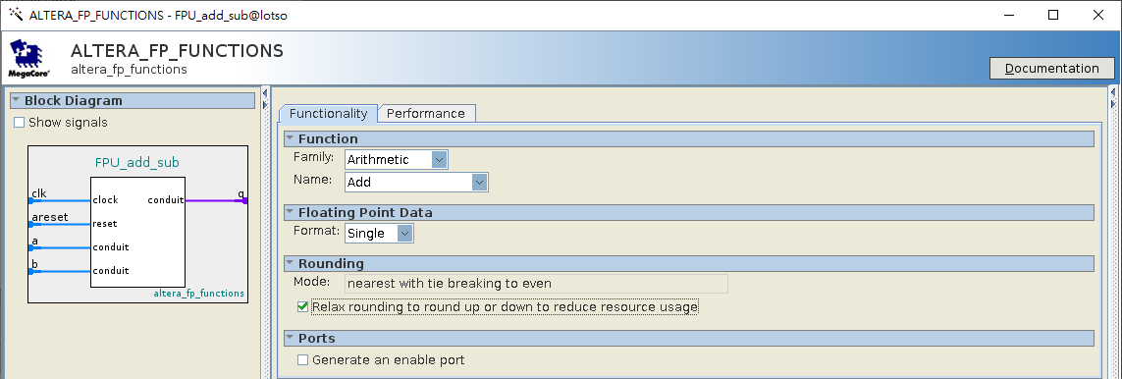
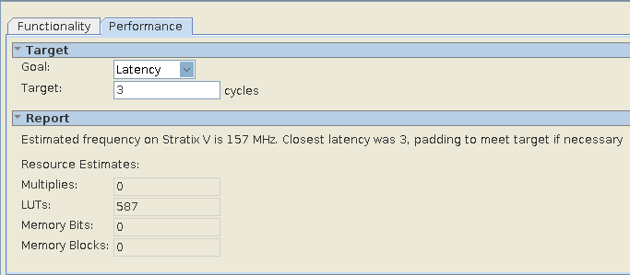
FPU IP
Tools > IP catalog > Library
Library > Basic Functions > Arithmetic > ALTERA_FP_FUCTIONS
Example File name: FPU_add_sub.v
選擇儲存的檔案名 (save IP variation)→
The file will be connect to .qsf file automatically
The generated files will be generated at prj/ directory
Choose 3 stages pipeline
and check performance

Slide 31

Adventure time
Website
RIFFA original paper:
http://kastner.ucsd.edu/wp-content/uploads/2014/04/admin/fpl-riffa2.pdf
GitHub:
https://github.com/KastnerRG/riffa
這些網站裡可能有意想不到的寶藏

Slide 32
Outline
FPGA introduction
What is RIFFA
Practice
Other useful utilities

Slide 33
Recommended design flow
It is recommended that you separate your design from the RIFFA transmission part
Use testbench to complete and debug your design.
Put your design into RIFFA channel (chnl_tester.v)
Use testbench to complete RIFFA channel with your design concluded
Complete C++ interface , print and check pattern from C++ interface
Compile and test on FPGA -> d(`･∀･)b
ASIC flow
FPGA flow
RIFFA Channel
Your design
RIFFA C++ interface
Print pattern
pattern generator
Testbench for
design
Testbench for
chnl_tester.v
Should be same pattern

Slide 34
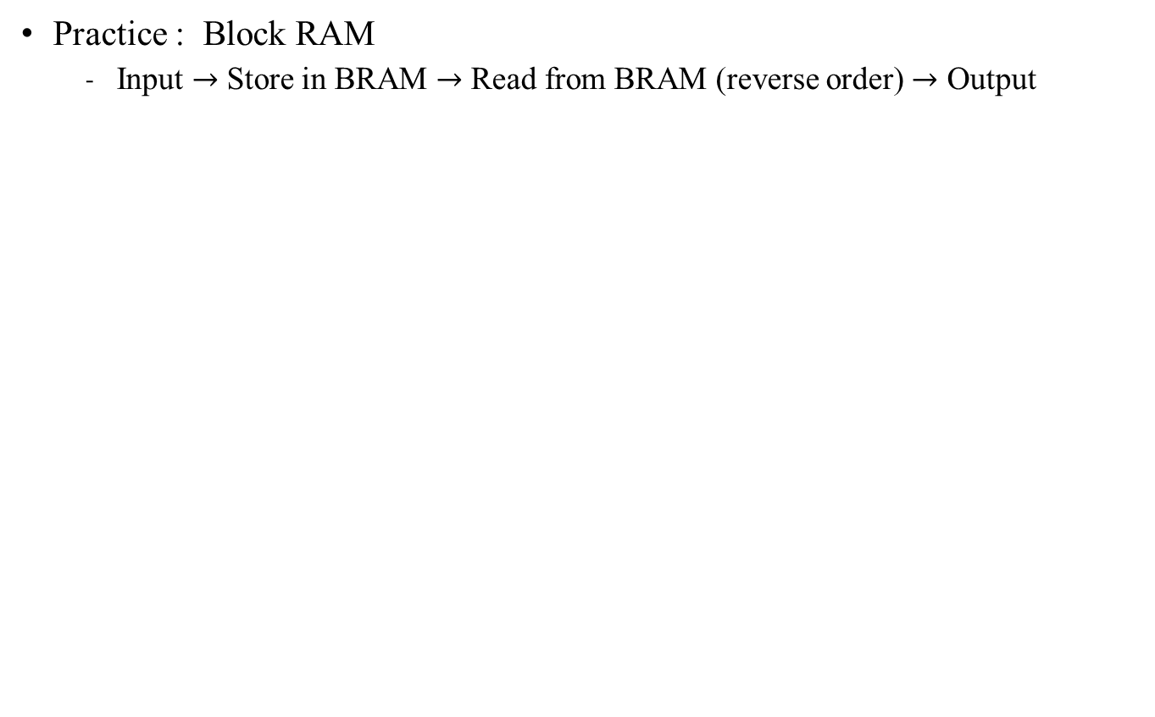
Practice time
Data input
Block RAM
Decreasing
Addr
Increasing
Addr
Data output

Slide 35
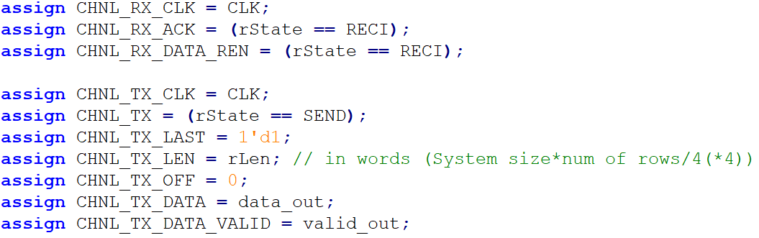
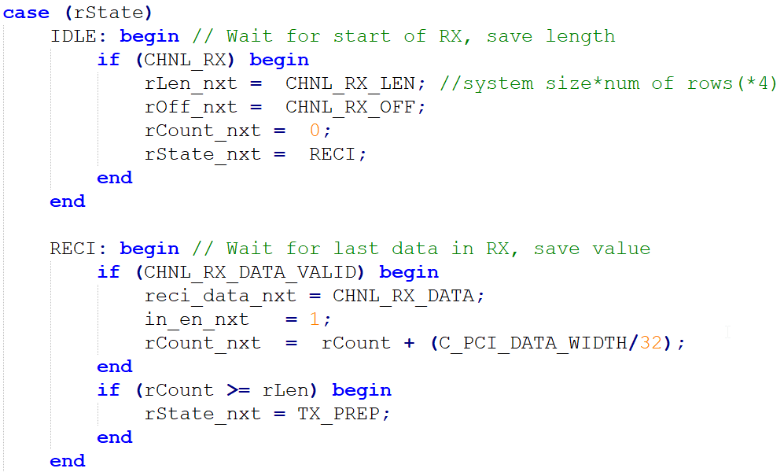
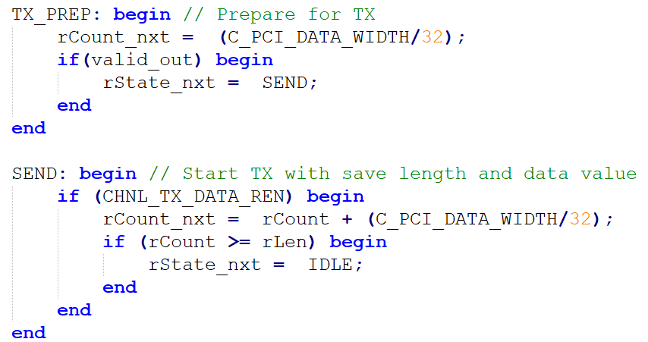
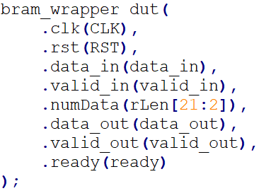
Practice time
Channel tester:
Plugged design

Slide 36
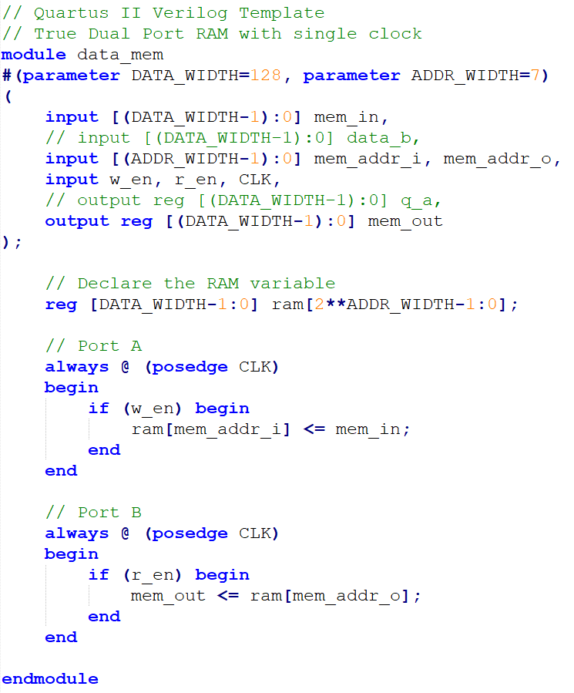

Practice time
Inferred dual port Block RAM:
Tips
Generate template memory file
Quartus → File → New file → Verilog HDL file
Insert template
Verilog HDL
There are lots of template to use
Select the RAM by your own

Slide 37
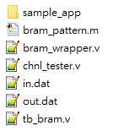

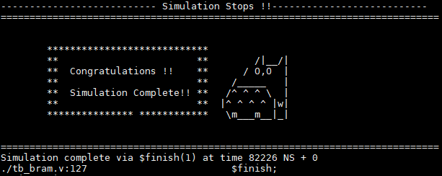
Step-by-step guide - RTL simulation
1. Download sample code:
2. Generate pattern from bram_wrapper.m (done)
3. Check design
Only need bram_wrapper.v in.dat out.dat tb_bram.v for simulation
Source file: source /cad/source.cshrc
For design: ncverilog tb_bram.v bram_wrapper.v +access+r
For RIFFA + design: source test_chnl
Practice 1

Slide 38
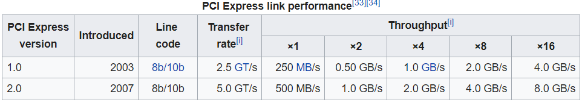
Step-by-step guide - FPGA simulation
Open Quartus II (License file: 25000@140.112.33.164)
Quartus 17.0:
/mnt/ds1515/opt/intelFPGA/17.0/quartus/bin/quartus &
Copy RIFFA from workstation
cp -r /mnt/ds1515/fpga/riffa_2.2.2/ ./
Open Project
Located at:
<your path>/riffa_2.2.2/source/fpga/altera/de5/DE#Gen#x#If###/prj/DE#Gen#x#lf###.qpf
DE#Gen#x#If###: we use DE5Gen2x8If128
Our FPGA: DE5
PCIe Spec: generation 2; 8 lanes; 128 bits width (250 MHz)
你也可以選擇不同版本的 Gen，RIFFA 支援多個 PCIe Gen 版本，但請確認你的主機板支援 PCIe x8 介面，通常大多數 PCIe 2x8（Gen2 x8）配置的主機板都可以支援
Gen2x8 | 250 MHz/ 128 bits
Gen2x4 | 125 MHz/ 128 bits

Slide 39
Step-by-step guide
4-1. Copy files from <WORKDIR>/test_BRAM/ to RIFFA directory:
<your path>/riffa_2.2.2/source/c_c++/linux/x64/
<your path>/riffa_2.2.2/source/fpga/riffa_hdl/
須先把sample_app裡面原有的資料全部刪除

Slide 40
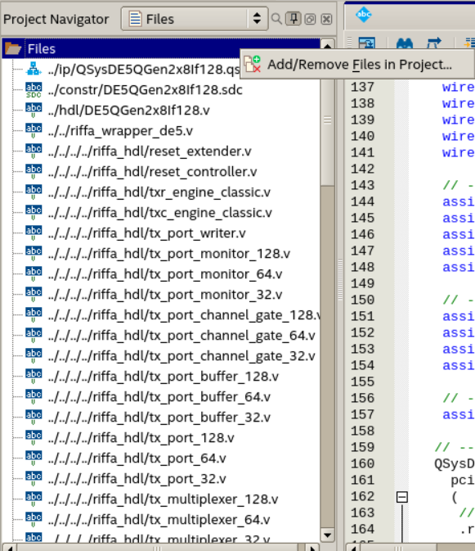

Step-by-step guide
4-2. If not added, use project navigator in quartus
Project Navigator
→ Files
→ add/remove files in Project (右鍵Files)
加入你的bram_wrapper (your design) 和你的 chnl_tester.v
(所有你的Verilog檔案)

Slide 41
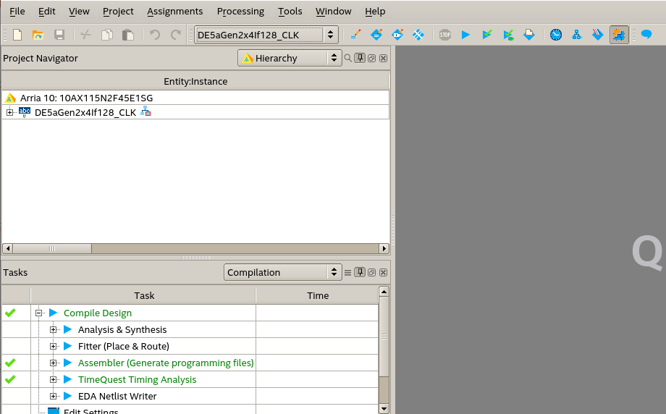

Step-by-step guide
Compile:
(before compilation, Quartus will autosave your current process →.qpf file)
(may take some time)
等右下角的進度顯示為100%
Press

Slide 42
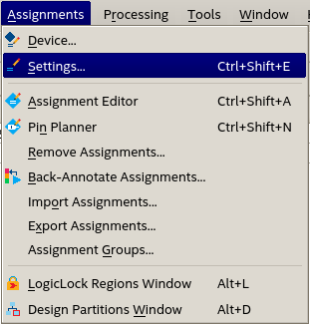
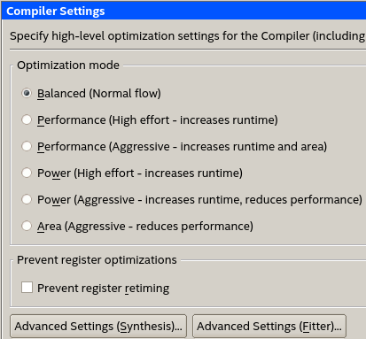
Step-by-step guide
Additional settings (Supplement)
You can select different compiler settings for better compilation
In advanced setting, synthesis or fitter can make different result
In .qsf file, you can make these setting by command.
Ex. 16 parallel compilier setting
set_global_assignment -name NUM_PARALLEL_PROCESSORS ALL
qsf file is very important~

Slide 43
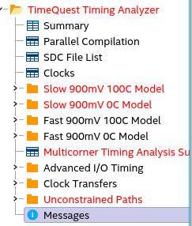
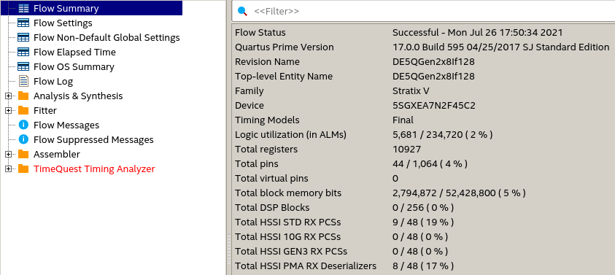
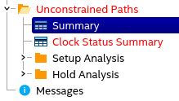
Step-by-step guide
確保fast corner一定要過就好
實際跑的環境不可能在slow corner
Pay attention to these
Compilation report
Ignore this for now
RIFFA有東西沒設定好，反正能動就先不管他

Slide 44
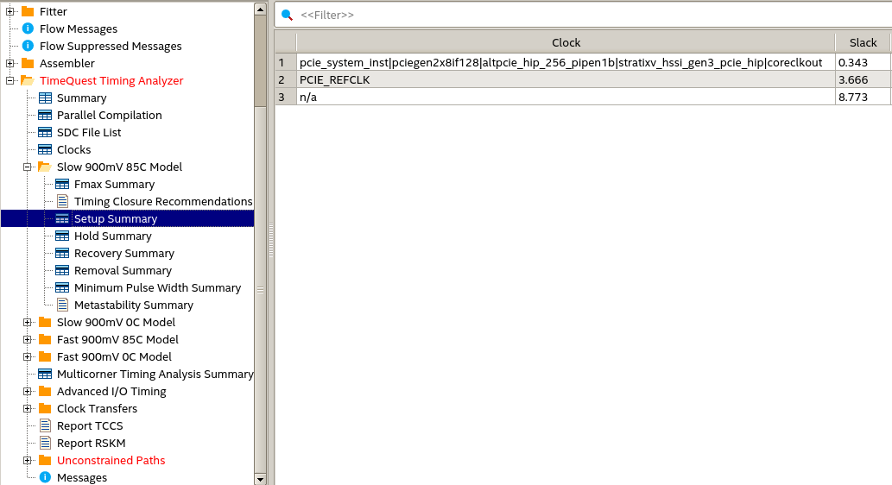
Step-by-step guide
Timing analyzer
WNS should be positive for all corners
Not ok, but we’ll skip for now

Slide 45
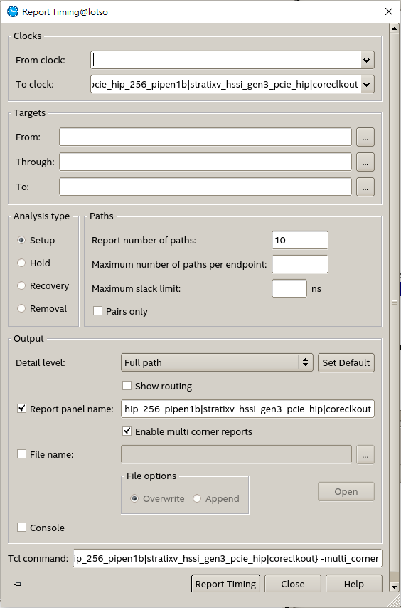
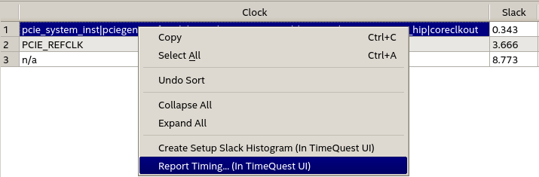
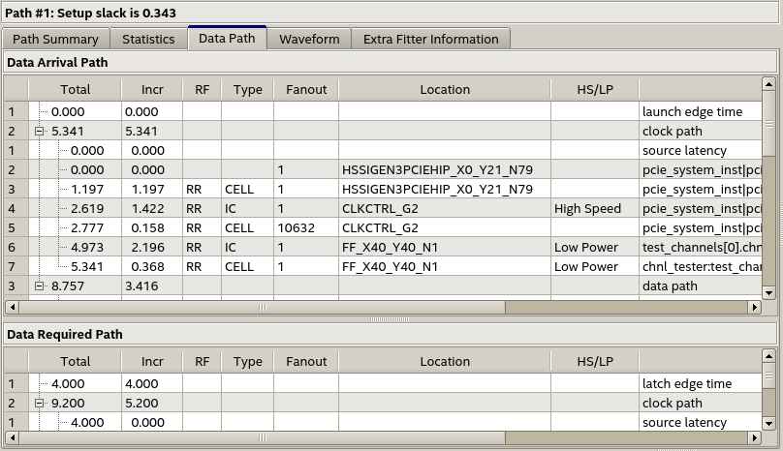
Step-by-step guide
Timequest timing analyzer
此工具可找到
Critical path

Slide 46
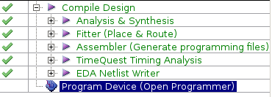

Step-by-step guide
Programmer
After finish compilation
cd <your path>/riffa_2.2.2/source/fpga/altera/de5/DE#Gen#x#If###/bit/
Run: /mnt/ds1515/opt/intelFPGA/17.0/quartus/bin/jtagconfig
這邊只有一個板子DE5 standard，所以c=1，如果發現有其他板子，看你要用哪塊，c就設定那個(但c=1會最快，因為離CPU最近)
Run: /mnt/ds1515/opt/intelFPGA/17.0/quartus/bin/quartus_pgm -m jtag -c 1 -o “p;DE5QGen2x8If128.sof ” (ppt格式關係，如複製指令貼上，””括號請重打)
After you compiled, DE#Gen#x#If###.sof under /bit/ folder will be updated
這個指令會把電路燒上板子， “p;DE#Gen#x#If###.sof ” 長得很奇怪但沒錯
下次想再重燒重跑只要有這個檔案就可了，不用再開Quartus
- Run: sudo reboot → soft reboot讓server的OS可以看到fpga的PCIe driver
Don’t close the machine while others are compiling!
Use “top” to check other users’ usage

Slide 47
Step-by-step guide
Run
cd <your path>/riffa_2.2.2/source/c_c++/linux/x64/sample_app
make
./testutil 0 //List FPGA info
./testutil 1 0 //Reset FPGA 0
./testutil 2 <numofdata> //numofdata: must be multiples of 4 in this lab
You can check bram_wrapper.v for the reason
以後當你自己設計design，不用照此lab一樣為4的倍數，這邊有這個設定是因為當初RTL code寫法

Slide 48
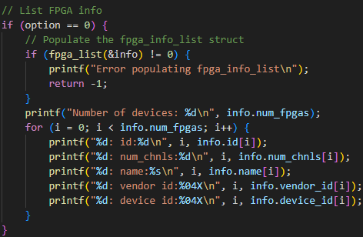
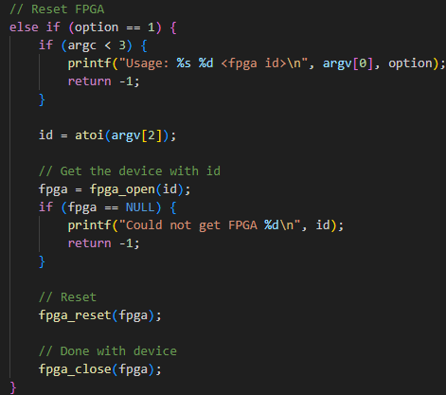
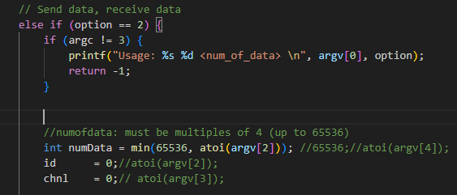
Step-by-step guide
Run

Slide 49


Step-by-step guide
Run -- remember to change your files here ( check testutil.cpp)
make
./testutil 2 <numofdata> //numofdata: must be multiples of 4
(up to 65536 due to the size of bram defined in bram_wrapper.v)

Slide 50
Step-by-step guide
只需修改input_memory與需傳輸的data大小
Input_memory與receive memory皆為int (32bit)的memory matrix，與TX/RX的128bit對應關係為:
TX/RX[n] = {mem[4n+3],mem[4n+2],mem[4n+1],mem[4n]}
生成memory時建議以INT型別來操作

Slide 51



Step-by-step guide
Run
其實可以自己調整你PCIe一次想傳輸的bits量，32/64/128。
(預設128 bits，真的想改請參考appendix)
如果你使用64/128 bits，RIFFA會自己幫你收集幾個INT(32 bits)再丟給你。

Slide 52

TODOs
Follow the previous step-by-step guide to finish the FPGA part
If you see this, you passed the FPGA test.
Screenshot !

Slide 53
DRAM Tutorial

Slide 54
DRAM tutorial
External Memory Interface IP
Avalon Memory-Mapped Protocol
Example Code
Quartus Project Settings
RTL Simulation with Qsys IP

Slide 55
DRAM tutorial
External Memory Interface IP
Avalon Memory-Mapped Protocol
Example Code
Quartus Project Settings
RTL Simulation with Qsys IP

Slide 56
Avalon Memory-Mapped Protocol
The Avalon Memory-Mapped interface specification is designed to accommodate peripheral development for the system-on-a-programmable-chip (SOPC) environment.
The specification provides peripheral designers with a basis for describing the address-based read/write interface found on master and slave peripherals.
The Avalon-MM interface defines: ■ A set of signal types ■ The behavior of these signals ■ The types of transfers supported by these signals .
For example, the Avalon-MM interface can be used to describe a traditional peripheral interface, such as SRAM, that supports only simple, fixed-cycle read/write transfers.
On the other hand, the Avalon-MM interface can also be used to describe a more complex pipelined interface capable of burst transfers.

Slide 57
External Memory Interface IP
Arria 10 External Memory Interfaces (EMIF)
這個IP可以將我們用Avalon Memory-Mapped介面傳輸的資料轉換為以DRAM介面傳輸的資料。
由於DRAM控制較複雜，有這個IP我們就能更方便的存取DRAM中的資料。
除了DRAM之外，這個IP也能改成與其他種類的外部記憶體溝通。 Ex. QDRII+ SRAM
External Memory
DRAM Protocol
Arria 10 EMIF
Avalon Memory-Mapped Protocol
User Logic
Notes:
EMIF（External Memory Interface）是一個由 Intel Quartus 自動產生的 IP，功能是：
對外提供 Avalon-MM Slave 接口
對內翻譯成 DDR 或 DDR4 的實體信號（DQS、DQ、ADDR、BA、CK 等）
你只要用 Avalon-MM 對他送 request，他會幫你做 timing + protocol 轉換
[你的模組（Master）]
│
▼
[Avalon-MM 信號]
│
▼
[EMIF IP（Slave）]
│
▼
[實體 DDR4 DRAM]

Slide 58

Your Dram Wrapper
EMIF IP
Notes:
“A master is an interface that initiates read and write transactions. A slave is an interface that responds to read and write transactions.” —《mnl_avalon_spec.pdf》§1.1, Avalon-MM Interface 概述
The interconnect fabric connects master interfaces to slave interfaces…”
也就是說，系統中會有「Master → Fabric → Slave」的單向控制關係，你是主控端
你是 Avalon-MM 的 Master，你只要發出請求給 Interconnect Fabric（這個會自動連線），實際負責回應的是 Slave，也就是 EMIF IP，你不需要實作 Slave！
EMIF 是現成的 Avalon-MM Slave IP，你在 Platform Designer/Qsys 裡面拖拉進來就好了
在模擬或單元測試情境中：
你的 Master（dut） → 自己寫的 fake amm_slave（模擬 EMIF）
你為了模擬整個 DRAM 系統：
自己先寫了一個 amm_slave 來回應你 master 發出的 Avalon-MM 交易
模擬行為可能只是延遲幾拍後回傳資料、或者存一個簡單記憶體陣列
這樣可以幫助你驗證：
你的 master FSM 有沒有正確處理 amm_wait 和 amm_rvalid
資料搬運流程有沒有出錯

Slide 59

Avalon MM-Master
接下來幾頁關於ports的設定(如burst/pipeline)會影響slave IP怎麼接收資料

Slide 60


Avalon Master Signals – 1

Slide 61


Avalon Master Signals – 2

Slide 62
Avalon MM Basic Signals
Signal Type | Width | Direction | Description
address | 1-32 | M -> S | Slave address.
read | 1 | M -> S | Read-request signal to the slave port.
readdata | 1-1024 | S -> M | Data transferred from slave to master by the read operation.
write | 1 | M -> S | Write-request signal to the slave port.
writedata | 1-1024 | M -> S | Data transferred from master to slave by the write operation.
waitrequest | 1 | S -> M | Used to stall the system interconnect fabric when the slave port is not able to respond immediately.
readdatavalid | 1 | S => M | Marks the rising clock edge when the slave asserts valid readdata.

Slide 63

Avalon MM Basic Waveform – Read No wait

Slide 64

Avalon MM Basic Waveform – Read Wait
Notes:
在 waitrequest == 0 時才能送出新的指令 表示 Interconnect & Slave 都 ready 了
送出 read/write 時要保持訊號穩定到被 accept 不穩定的話 Fabric 無法認出
讀取 readdata 前要等 readdatavalid == 1 避免抓到無效資料
不要假設某筆資料一定會馬上進來 Interconnect 和 Slave 可能延遲很多拍

Slide 65

Basic Avalon MM Operation in the Example
Read:
與SRAM操作類似。將read拉高並設定好address。但是當waitrequest訊號為1時，read、address必須保持為固定值。當readdatavalid訊號為1時，表示此時的readdata為有效值。

Slide 66

Avalon MM Basic Waveform – Write No wait

Slide 67

Avalon MM Basic Waveform – Write wait

Slide 68

Basic Avalon MM Operation in the example
Write:
與SRAM操作類似。將write拉高並設定好address和writedata。但是當waitrequest訊號為1時，write、writedata、address必須保持為固定值。

Slide 69
Avalon MM Slave Transfer Types
Variable Latency
Fixed Latency
Pipelined Variable Latency
Pipelined Fixed Latency
Tristate
Burst
More Info:
http://www1.cs.columbia.edu/~sedwards/classes/2009/4840/mnl_avalon_spec.pdf
http://www.innovateasia.com/asia/download/document/knowledge_11_Taiwan.pdf
Notes:
✅要使用 DDR4 + EMIF IP，那你要預設啟用 Pipeline + Burst 嗎？
🔸答案：是的，請預設 DDR4 是 Pipeline + Burst 模式。
因為：
📌 DDR4 本身就是：
高延遲記憶體 → 所有讀取都會有 pipeline latency（多拍後才資料有效）
以 Burst 為單位存取 → DDR4 硬體層面每次 access 通常是 burst 4、8、甚至 16
📌 EMIF Avalon-MM Slave 接口本身就支援：
✅ readdatavalid：對應 Pipeline
✅ burstcount / amm_burstcount：對應 Burst
✅ waitrequest：當 DRAM 還沒 ready 會 hold 住你
🔍 換句話說，你作為 Master 設計者，必須要有 pipeline & burst-aware 的邏輯設計，否則會讀不到資料或操作錯誤！
✅ EMIF IP 是不是你不用管、它會自動實作好？
🔸答案：是的，EMIF 是一個完整黑盒 Slave IP，你只要遵守 Avalon-MM 規則就好。
你「不用」去設計以下東西：
❌ 不需要自己去排 DRAM 時序（Activate、Precharge、CAS、RAS）
❌ 不需要管 DRAM 裡有幾個 bank，或行列位址
❌ 不需要自己排 burst mapping
這些都由 EMIF IP 裡的 Controller 內部幫你轉成 DRAM command protocol。

Slide 70

Avalon Master – Pipelined

Slide 71

Avalon Master – Write Burst

Slide 72

Avalon Master – Read Burst

Slide 73
DRAM tutorial
External Memory Interface IP
Avalon Memory-Mapped Protocol
Example Code
Quartus Project Settings
RTL Simulation with Qsys IP

Slide 74
Example Code
Platform: DE5
PCIe: Gen2x8 (250 MHz, 128 bit)
Data Flow:
Input
-> Store in BRAM (A)
-> Read from (A), Store in DDR3
-> Read from DDR3, Store in BRAM (B) (reversed order)
-> Read from (B)
-> Output
PCIe
On-Chip
Block-RAM
(A)
Off-Chip
DDR4
On-Chip
Block-RAM
(B)

Slide 75


Example Code Reproduce
Copy RIFFA from workstation
cp -r /mnt/ds1515/fpga/riffa_2.2.2/ ./
Open project directory DE5Gen2x8If128
Located at ./riffa_2.2.2/source/fpga/altera/de5/DE5Gen2x8If128/
Copy files under Quartus_Project into their corresponding folders
*.qpf, *.qsf -> prj
*.sdc -> constr
*.v -> hdl
*.qsys -> ip
Copy files under test_DRAM into their corresponding folders.
*.v -> ./riffa_2.2.2/source/fpga/riffa_hdl/
sample_app -> ./riffa_2.2.2/source/c_c++/linux/x64/
QsysDDR3A.qsys

Slide 76

Example Code Reproduce
Open project in Quartus 請參考前面
Open Qsys IP files and generate HDL (兩個IP都要)
Open Qsys tool
File -> Open -> ../ip/QsysDE5Gen2x8If128.qsys or ../ip/QsysDDR3A.qsys
Generate -> Generate HDL -> Generate
Check user-define SDC in the last order
Assignments -> Settings -> TimeQuest Timing Analyzer -> ok
Compile and Program Device 請參考前面
Reboot Computer and Test 請參考前面
QsysDDR3A.qsys

Slide 77

Example Code Reproduce – Qsys tool

Slide 78

Example Code Reproduce – You might occur
Error (209015): Can't configure device. Expected JTAG ID code 0x02E660DD for device 1, but found JTAG ID code 0x029030DD. Make sure the location of the target device on the circuit board matches the device's location in the device chain in the Chain Description File (.cdf).
代表你使用錯的fpga，可以去看.qsf檔案，裡面有設定你在使用的fpga型號 記得去跟server上有的對照，看你是不是用錯server的fpga

Slide 79
Example Code Reproduce
cd <your path>/riffa_2.2.2/source/c_c++/linux/x64/sample_app
make
./testutil 0 //List FPGA info
./testutil 1 0 //Reset FPGA 0
./testutil 2 numofdata

Slide 80
DRAM tutorial
External Memory Interface IP
Avalon Memory-Mapped Protocol
Example Code
Quartus Project Settings
RTL Simulation with Qsys IP

Slide 81

Quartus Project Settings
Check the user manual and example projects in the CD-ROM for more information
DE5: https://www.terasic.com.tw/cgi-bin/page/archive.pl?Language=Taiwan&CategoryNo=159&No=726&PartNo=4
DE5a: https://www.terasic.com.tw/cgi-bin/page/archive.pl?Language=Taiwan&CategoryNo=2&No=1138&PartNo=4
一般來說，需要你根據user manual建立起每個pin怎麼接起來的qsf file，幸好我們幫你做好了!
DRAM Assignment Settings
Add DDR4 and RZQ pin assignments to the *.qsf file
不同fpga有不同pin，需要自己設定如何和dram pins連接
可以開啟Quartus -> Setting -> 去設定pin

Slide 82
DDR4 Qsys IP Design
避免EMIF和clock-crossing bridge中間有timing violation。但會使latency增加。可省略。
處理跨越不同clock domain的AMM訊號
外部記憶體控制IP
Arria 10 EMIF
Pipeline Bridge
Clock-Crossing Bridge
DDR4 Protocol
AMM
AMM
AMM
To DDR
To user logic
(300 MHz)
(300 MHz)
(300 MHz) (user clk)
(user clk)
EMIF 通常工作在 DDR clock domain，而 Avalon-MM/PCIe 是另一個 clock。
你必須放一個 clock crossing bridge 來對應不同 domain 的 master/slave 通訊

Slide 83

DDR4 Qsys IP Design
如右圖設定IP連線與對外接腳(無須更改)
個別IP參數設定請參考IP_Settings資料夾 (clk、pipelining、burst、FIFO可視需求更改)
Example code的EMIF參數設定是直接照著DE5上裝置之DDR設的，請勿任意更改
如果想換不同fpga使用，或是換了新的DRAM，那需要去看他的DRAM設定去設置你的emif IP參數
完成後點選generate HDL

Slide 84

Quartus Top Module
包含:
對外DDR pin。
DDR4 IP instance與對應接腳。
Reset訊號是active low，與riffa reset反相。
chnl_tester與DDR4 IP的接口
EMIF校正狀態訊號 只有剛啟動時會出現 當success非1時 不能以AMM與EMIF溝通

Slide 85

SDC File
EMIF IP status signals to user logic and clock-crossing bridge (EMIF校正狀態訊號並未經過clock-crossing處理，且僅初始化時變動，故設false path)
RIFFA reset signal to Altera EMIF IP (recover time violation) (EMIF內部有reset synchronizer，故可忽略input async reset的recover time violation)

Slide 86


Timing
Compile完在EMIF內部仍有timing violation。
但這結果與terasic提供之範例程式結果相似，故暫時忽略。
推測為dram的clock crossing有false path沒下，但他的IP有處理好clock domain crossing的問題了，可以忽略來自ddr4 interface的neg slack

Slide 87
DRAM tutorial
External Memory Interface IP
Avalon Memory-Mapped Protocol
Example Code
Quartus Project Settings
RTL Simulation with Qsys IP

Slide 88
Simulation Memory IP Selection
In Altera EMIF IP…..
DE5a-Net uses Micron DDR4 SODIMM 64x 4GB Memory.
However, Micron does not provide verilog simulation model for SODIMM.
So, How do we do Verilog simulation with Memory IP ?
External Memory Pins
For DRAM

Slide 89


Simulation Memory IP Selection
Altera On-Chip (ex: SRAM) Memory IP
No external pin connection.
Limited memory size (<64Mbit)
因為on-chip & off-chip都是用Avalon MM protocol在跟interconnect fabric溝通，所以可以生成沒有外部pin的IP來測試你有沒有寫對protocol溝通模組
See ./Simulation/IPtest.qsys for more information

Slide 90
Memory IP Simulation Example Code
Simulation Memory IP Selection
Hand-crafted Avalon MM Slave Model
See ./Simulation/amm_slave.v for more information (A simple amm slave model in the variable latency transfer mode)
To run the example code in ./Simulation folder:
Open IPtest.qsys in Qsys tool and generate HDL with simulation code.
Data Flow
Testbench
On-Chip
Block-RAM
Model
Memory IP Simulation Model
On-Chip
Block-RAM
Model

Slide 91

RTL simulation with Qsys IP
Simulation using NCVerilog
cd (Qsys Path)/(IP Name)/sim/cadence/
setenv CDS_ROOT “/cad/cadence/INCISIV/cur/”
bash ncsim_setup.sh SKIP_ELAB=1 SKIP_SIM=1
cp <design and testbench files> ./
ncverilog <testbench_files> <design_files> +access+r

Slide 92
Appendix

Slide 93
Appendix 1: Modifying PCIe Appendix 2: _CLK version

Slide 94
Modifying the PCIE
GEN
1/2/3
LANE
x1/x2/x4/x8/x16
62.5 MHz:
Gen1x1
125 MHz:
Gen1x2, Gen1x4
Gen2x1, Gen2x2, Gen2x4
Gen3x1, Gen3x2
250 MHz:
Gen2x8
Gen3x4, Gen 3x8

Slide 95


Modifying the PCIe on the Qsys
Double click on
QSysDE#Gen#x#lf###:pcie_system_inst
Areas to be edited are highlighted
Edit settings in PCIeDE#Gen#x#If### first
Then for XCVRCtrlGen#x#, and XDRVCtrlGen#x#
Edit Number of reconfiguration interfaces accordingly
From 2x8 to 2x4 (250MHz 🡪 125MHz)
Qsys
PCI Express IP x8 🡪x4
Number of XCVRCtrl 10 🡪 5
Number of XCVRDrv 10 🡪 5
Top module file
C_NUM_LANES 8 🡪 4
Remove Qsys PCIE 4~7 channel for RX and TX
Remove the setting for .qsf file for PCIE lane 4~7 (optional)

Slide 96

Changing PCIe generation
Go to assignment editor
Change Values accordingly
PCIE_GEN1
PCIE_GEN2
PCIE_GEN3

Slide 97
Changing width
Go to DE#Gen#x#lf###.v
Change parameter C_PCI_DATA_WIDTH to width
For IP QSysDE#Gen#x#If### pcie_system_inst
.rx_st_data (rx_st_data[C_PCI_DATA_WIDTH-1:0]),
.tx_st_data (tx_st_data[C_PCI_DATA_WIDTH-1:0]),

Slide 98

Changing number of lanes
Go to DE#Gen#x#lf###.v
Change parameter C_NUM_LANES to number of lanes
For IP QSysDE#Gen#x#If### pcie_system_inst
.pcieserial_tx_out0 (PCIE_TX_OUT[0]),
.pcieserial_tx_out1 (PCIE_TX_OUT[1]),
...
.pcieserial_tx_out# (PCIE_TX_OUT[#]),
AND
.pcieserial_rx_in0 (PCIE_RX_IN[0]),
.pcieserial_rx_in1 (PCIE_RX_IN[1]),
...
.pcieserial_rx_in# (PCIE_RX_IN[#]),
# = C_NUM_LANES - 1
Go to assignment editor
Add PCIE_RX_IN[#], PCIE_RX_IN[#](n), PCIE_TX_OUT[#], PCIE_TX_OUT[#](n),

Slide 99
Appendix 1: Modifying PCIe Appendix 2: _CLK version

Slide 100


DE5QGen2x8If128_CLK
In hdl file
Top module
Use QSys to generate different clock
Open QSys file in ip directory
Modify the pll_0 IP for different clock
You can change the export name
Ensure consistency on QSys and Top module Qsys definition
There are twelve clock in RIFFA example, just delete some of them.

Slide 101

Using _CLK version
Open riffa_2.2.2/source/fpga/altera/de5/DE5QGen2x8If128_CLK/hdl/DE5QGen2x8If128_CLK.v“
Change module parameter: C_NUM_CHNL to 1
底下會有12個chnl_tester的instance，只留下你想要用的那個clk頻率的instance就好，其餘刪掉，並記得修改好線路編號
可參考雲端硬碟中的DE5QGen2x8If128_CLK.v 範例
quartus開啟project時記得打開_CLK版本的資料夾，燒到FPGA上時也是記得用_CLK版本的資料夾，接下來所有步驟相同，.sdc部分其實本來就已經設定好了，不用特意修改

