Slide 1
RIFFA 2.2.2 for dummy
2018/04/09 v1.0 Sheng Jui, Huang
2019/07/17 v2.0 Shih Wei, Hsieh
2021/07/30 v3.0 Yan Lun, Wu & Shu Fan, Wu
2022/08/12 v4.0 Shu Fan, Wu & Shih Hao, Huang
2023/08/17 v5.0 Ke Fan, Lin
2024/07/32 v5.1 Catfish, Yan

Slide 2
Outline
FPGA introduction
What is RIFFA
Practice #1
Other useful utilities

Slide 3
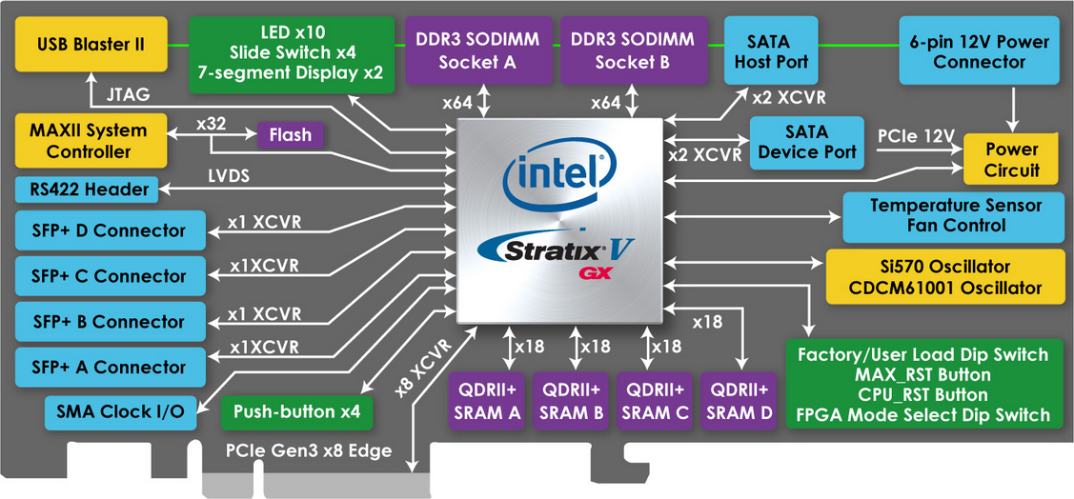
Terasic FPGA
DE5-Net FPGA Development Kit
https://www.terasic.com.tw/cgi-bin/page/archive.pl?Language=Taiwan&CategoryNo=159&No=726
Altera Stratix® V GX FPGA (5SGXEA7N2F45C2)
Lots of resources in the web, includes user manual and CD
10 LEDs / 4 push-buttons / 4 slide switches / 2 seven-segment displays
622,000 logic elements (LEs)
50-Mbits embedded memory
512 18-bit x 18-bit multipliers / 256 27-bit x 27-bit DSP blocks

Slide 4
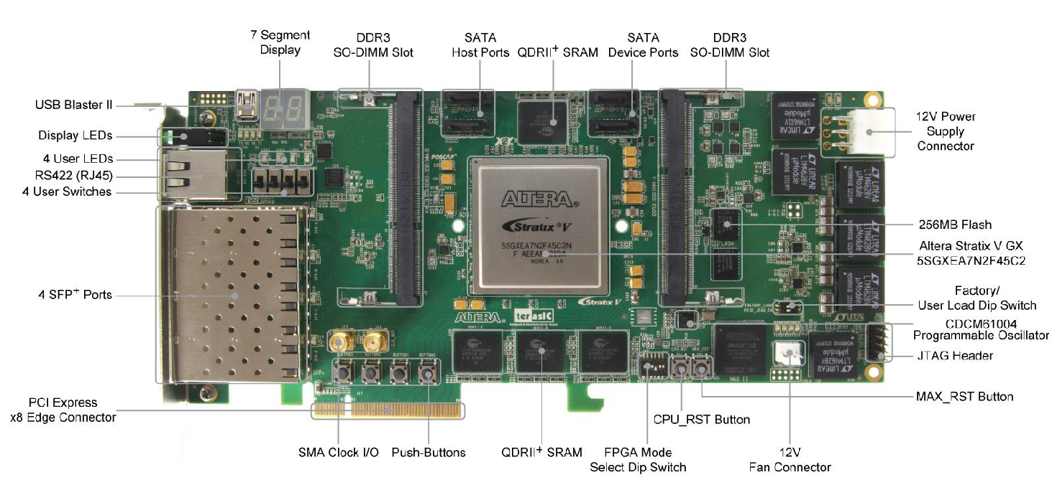
Terasic FPGA
PCIe
USB Blaster
12V Power Supply

Slide 5
Terasic FPGA
DE5a-Net FPGA Development Kit
https://www.terasic.com.tw/cgi-bin/page/archive.pl?Language=Taiwan&CategoryNo=229&No=1138
Arria 10 GX FPGA (10AX115N2F45E1SG)
Lots of resources in the web, includes user manual and CD
8 LEDs / 4 push-buttons / 2 slide switches / 2 seven-segment displays
1150K logic elements (LEs)
67Mbits embedded memory (50Mbits?)
3036 18-bit x 19-bit multipliers / 1518 Variable-precision DSP blocks

Slide 6
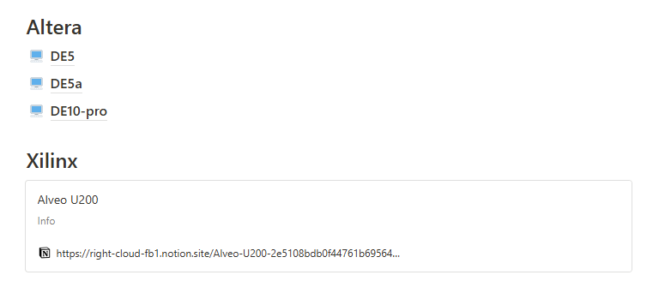
notion
https://bl430fpga.notion.site/bl430fpga/BL430-FPGA-bc15283eff644dbb99361cf0e3277a40

Slide 7
Server list
The resources in our lab
https://available-soursop-b6e.notion.site/Server-78a8b54198244cdca3d603d70ed0397c
若對server有問題的話可以詢問伺服器管理員:曾泓瑜學長與黃政勳學長

Slide 8
What is RIFFA
RIFFA:
Reusable Integration Framework for FPGA Accelerators
Requires a PCIe enabled workstation and a FPGA board with a PCIe connector
Pros:
Both the software and hardware interfaces have been greatly simplified
Ease of programming: details of the PCIe protocol, device driver, DMA operation, and all hardware addressing are hidden from both the software and hardware.
Support for Linux and Windows, software bindings for C/C++, Python, Matlab, and Java
Cons:
Takes up resource: If no high speed data I/O communication is needed, then its better to not use it
Loss of flexibility

Slide 9
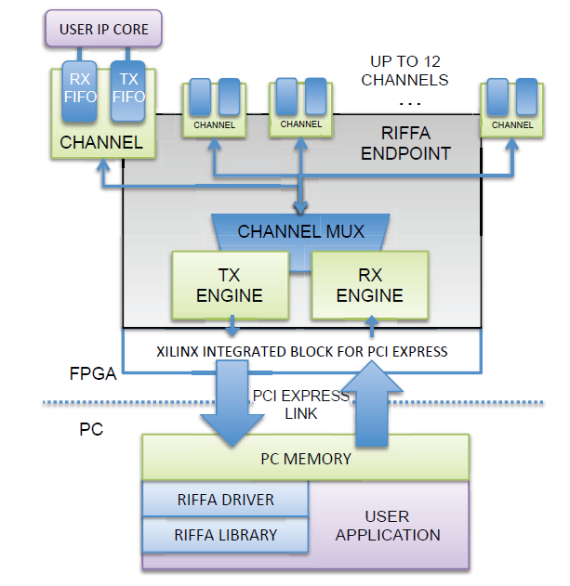
What is RIFFA
User cores interface with RIFFA 2.0 via a Channel core
The Channel core has FIFOs for receiving and sending data respectively.
The RX Engine core is responsible for extracting and demultiplexing received PCIe payload data.
The TX Engine core is responsible for formatting payload data into PCIe packets and multiplexing access to the PCIe link
The PCIe link configuration determines the width of the data bus. This width can be 32, 64, or 128 bits wide (RIFFA does not support 256 bits interface)
All PCIe Gen 1 and Gen 2 configurations up to x8 lanes are supported.
Where you need to plug your design

Slide 10
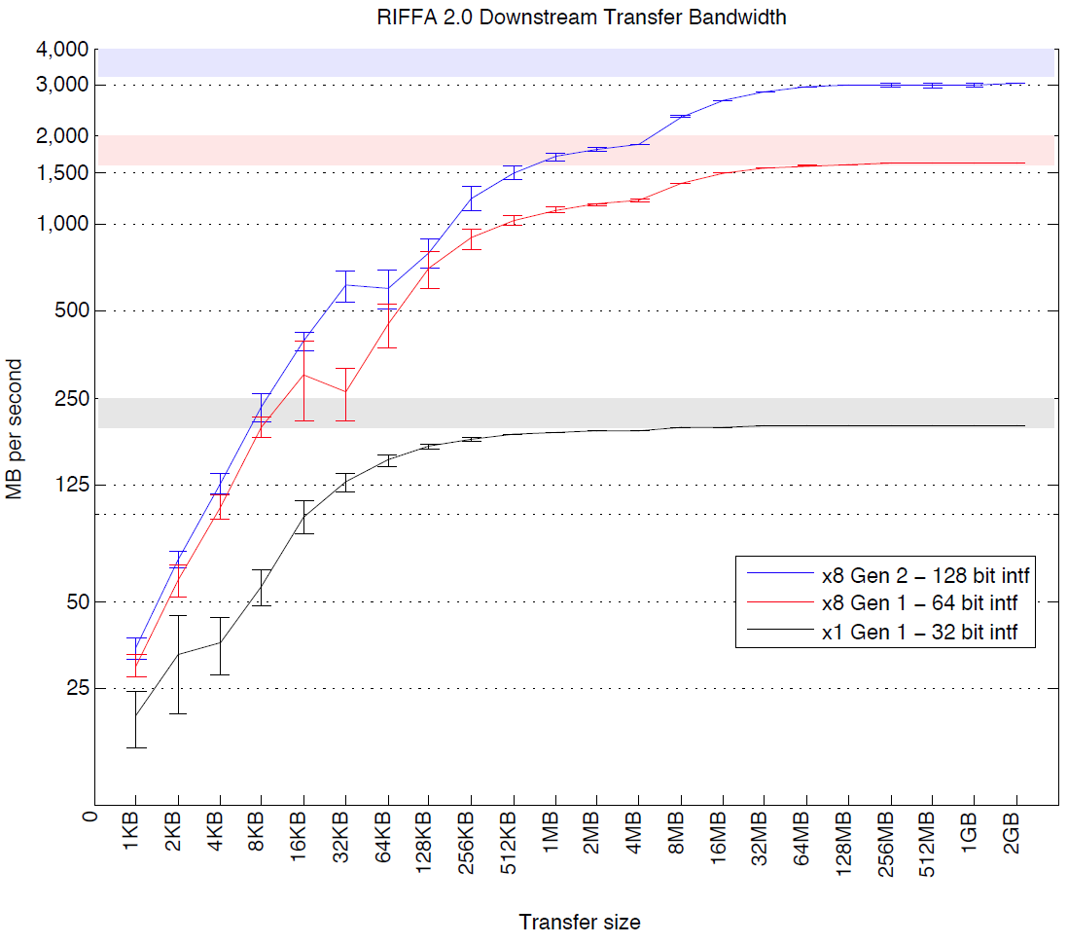
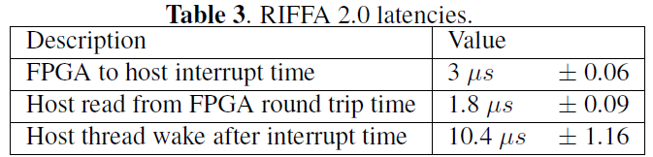
What is RIFFA
Sending data in smaller transfer sizes reduces effective throughput
Making a copy of a large buffer of data in software before sending it to the FPGA takes time and can severely impact throughput
Less transmission improves throughput

Slide 11
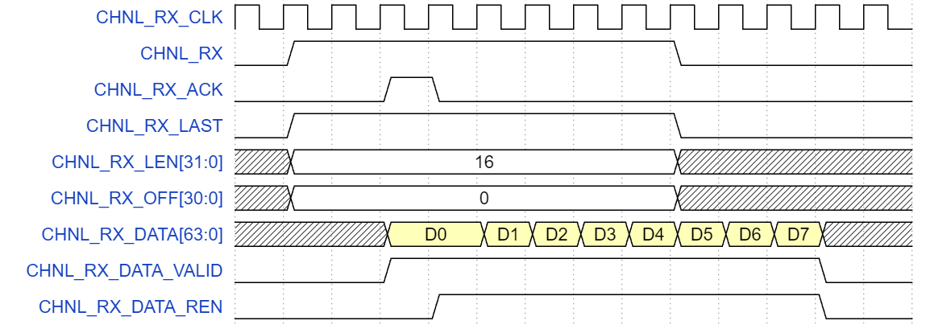
RX protocol basic
CHNL_RX_ACK: Need to be high for at least one cycle
CHNL_RX_LEN: Total data size in “word [32bit]”
CHNL_RX_DATA(128 bit): Transmitted data
CHNL_RX_DATA_VALID: Whether CHNL_RX_DATA is valid
CHNL_RX_DATA_REN: Control C++ to transmit next data or not
Pay attention:
VALID will not always be high !!!
RX will send next data only if VALID and REN are high simultaneously, else it will keep sending the same data.
Driver: C++
Driver: FPGA
Driver: C++
Driver: C++
Driver: C++
Driver: C++
Driver: C++
Driver: FPGA

Slide 12
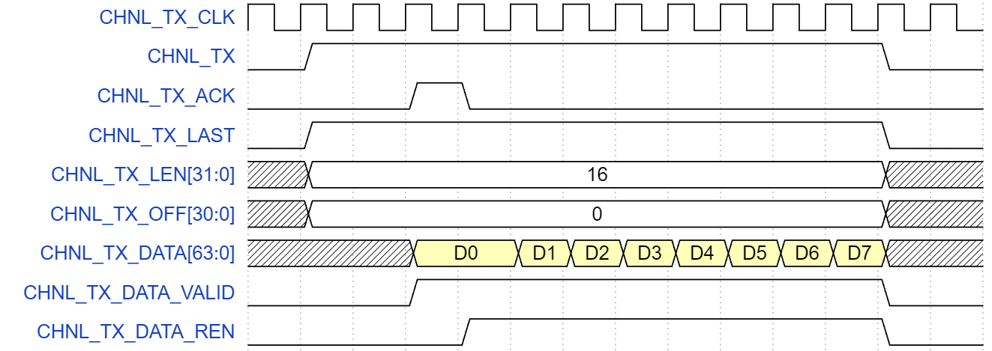
TX protocol basic
CHNL_TX_LEN: Total data size in “word [32bit]”
CHNL_TX_DATA: (128 bit): Transmitted data
CHNL_TX_DATA_VALID: Pull high when CHNL_TX_DATA is valid
CHNL_TX_DATA_REN: Whether C++ is receiving this data or not
Pay attention:
VALID will not always be high !!!
Make FPGA’s chnl_tester send next data only if VALID and REN are high simultaneously, else keep sending the same data.
Driver: FPGA
Driver: C++
Driver: FPGA
Driver: FPGA
Driver: FPGA
Driver: FPGA
Driver: FPGA
Driver: C++
‹#›

Slide 13
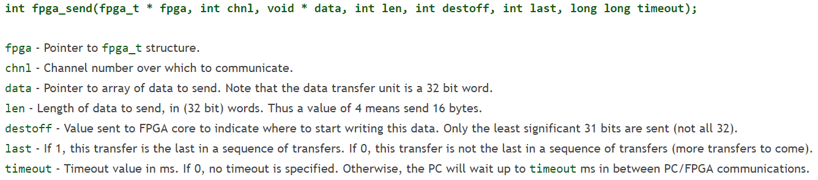
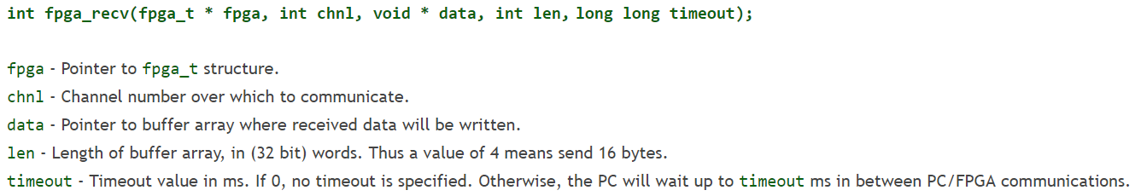
Software Interface
RX/ TX protocol:
Learn from example: our sample code

Slide 14
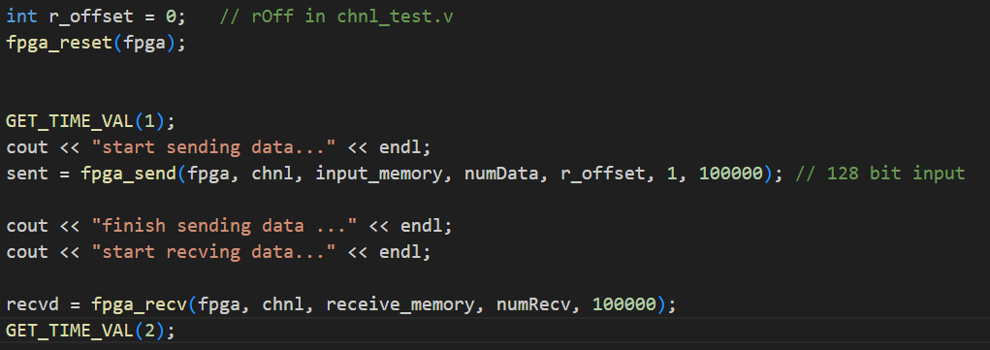
Sample code
只需修改input_memory與需傳輸的data大小
Input_memory與receive memory皆為int (32bit)的memory matrix，與TX/RX的128bit對應關係為:
TX/RX[n] = {mem[4n+3],mem[4n+2],mem[4n+1],mem[4n]}
建議生成input memory時以bitset<32>型別來操作，否則會容易出現bug

Slide 15
Recommended design flow
It is recommended that you separate your design from the RIFFA transmission part
Use testbench to complete and debug your design.
Put your design into RIFFA channel (chnl_tester.v)
Use testbench to complete RIFFA channel with your design concluded
Complete C++ interface , print and check pattern from C++ interface
Compile and test on FPGA -> d(`･∀･)b
ASIC flow
FPGA flow
RIFFA Channel
Your design
RIFFA C++ interface
Print pattern
pattern generator
Testbench for
design
Testbench for
chnl_tester.v
Should be same pattern

Slide 16
RIFFA
RIFFA package
documentation
source
c_c++
linux
x64
sample_apps 🡪 Our input file from c code
fpga
riffa_hdl 🡪 Place all the rtl code here
altera 🡪 Our board
de5 / de5a 🡪 Different board
DE5QGen*x*If128 / DE5QGen*x*If128_CLK 🡪 Different PCIe choice or CLK
bit 🡪 The compilation file
constr 🡪 sdc file for FPGA 🡪 Modify by your own usage
hdl 🡪 Top module file
ip 🡪 qsys file
prj
.qpf 🡪 Quartus project file
.qsf 🡪 Quartus setting file 🡪 File setting and compilation board setting

Slide 17
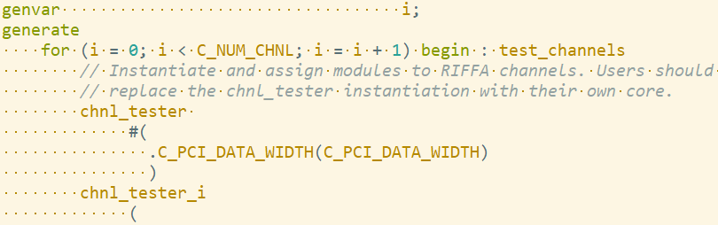
Top module file
 | DE5QGen2x8IF128.v | DE5QGen2x8IF128_CLK.v
C_PCI_DATA_WIDTH | 128 | 128
Qsys | QSysDE5QGen2x8If128 | QSysDE5QGen2x8If128_CLK
riffa_wrapper_de5 | At de5 folder | At de5 folder
chnl_tester | # of core parallel | different frequency
reference clk | chnl_clk | riffa_*_clk
Please check Appendix 3, too

Slide 18

Adventure time
Website
RIFFA original paper:
http://kastner.ucsd.edu/wp-content/uploads/2014/04/admin/fpl-riffa2.pdf
Github:
https://github.com/KastnerRG/riffa
這些網站裡可能有意想不到的寶藏

Slide 19
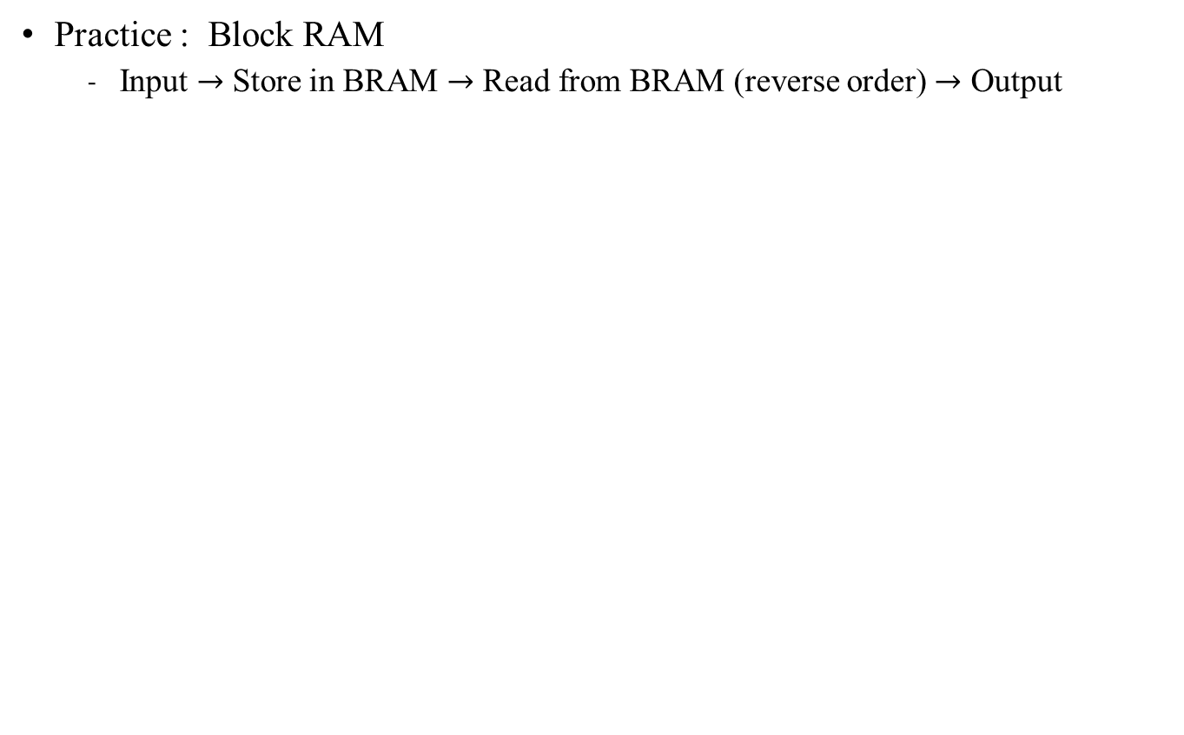
Practice time
Data input
Block RAM
Decreasing
Addr
Increasing
Addr
Data output

Slide 20
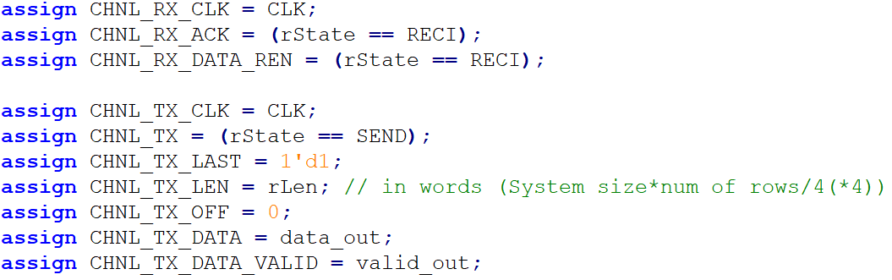
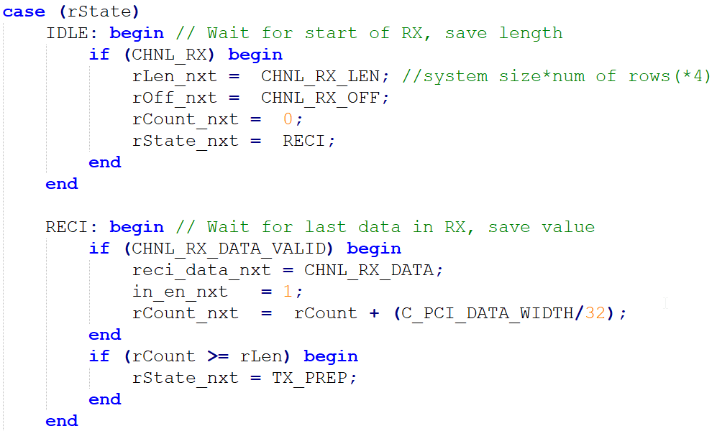
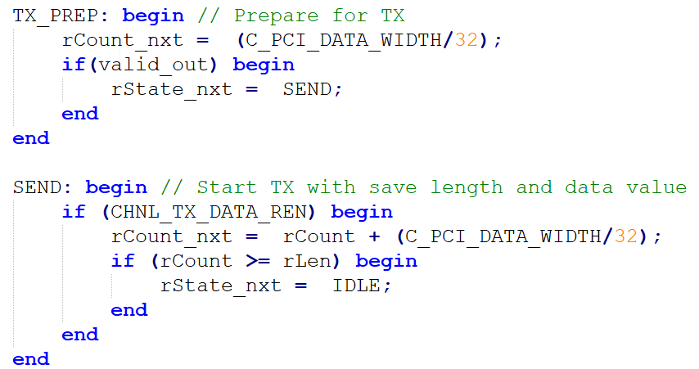
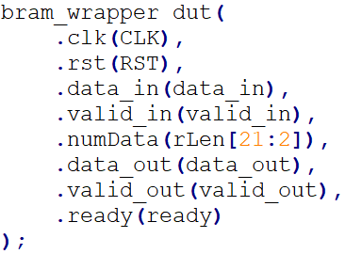
Practice time
Channel tester:
Plugged design

Slide 21
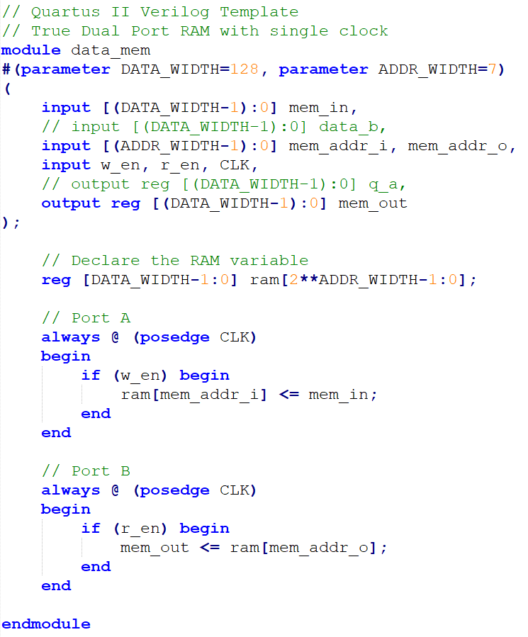

Practice time
Inferred dual port Block RAM:
Tips
Generate template memory file
Quartus 🡪 File 🡪 New file 🡪 Verilog HDL file
Insert template
Verilog HDL
There are lots of template to use
Select the RAM by your own

Slide 22
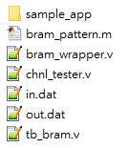

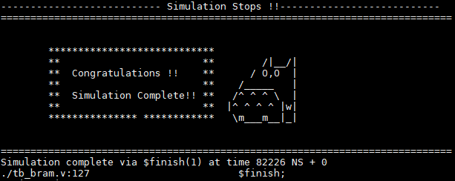
Step-by-step guide - RTL simulation
Download sample code:
Generate pattern from bram_wrapper.m (done)
Check design
Only need bram_wrapper.v in.dat out.dat tb_bram.v for simulation
Source file: source /cad/source.cshrc
For design: ncverilog tb_bram.v bram_wrapper.v +access+r
For RIFFA + design: source test_chnl
Practice 1

Slide 23
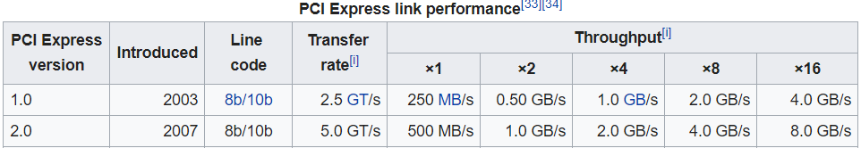
Step-by-step guide - FPGA simulation
Open Quartus II (License file: 25000@140.112.33.164)
Quartus 17.0:
/mnt/ds1515/opt/intelFPGA/17.0/quartus/bin/quartus &
Copy RIFFA from workstation
cp -r /mnt/ds1515/fpga/riffa_2.2.2/ ./
Open Project
Located at:
<your path>/riffa_2.2.2/source/fpga/altera/de#/DE#Gen#x#If###/prj/DE#Gen#x#lf###.qpf
de#: de5 / de5a
DE#Gen#x#If###: DE5Gen2x8If128
FPGA: DE5
PCIe Spec: generation 2; 8 lanes; 128 bits width (250 MHz)
Gen2x8 | 250 MHz/ 128 bits
Gen2x4 | 125 MHz/ 128 bits

Slide 24
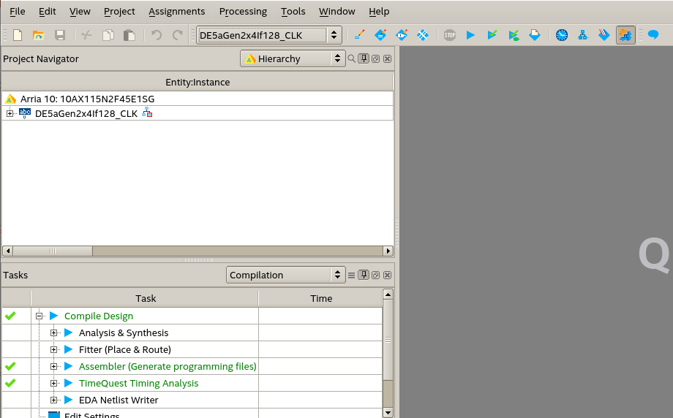
Step-by-step guide
須先把sample_app裡面原有的資料全部刪除
Replace files in RIFFA directory:
Compile:
(may take some time)
<your path>/riffa_2.2.2/source/c_c++/linux/x64/
<your path>/riffa_2.2.2/source/fpga/riffa_hdl/
Press

Slide 25
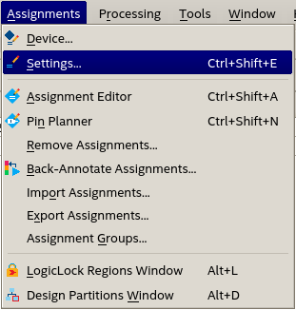
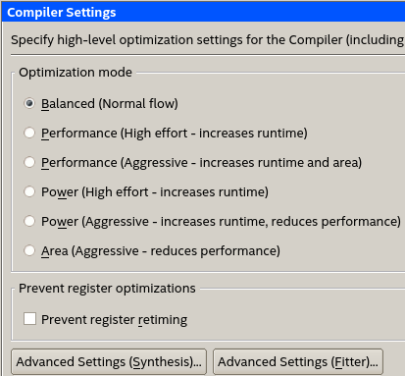
Step-by-step guide
Additional settings (Supplement)
You can select different compiler settings for better compilation
In advanced setting, synthesis or fitter can make different result
In .qsf file, you can make these setting by command.
Ex. 16 parallel compilier setting
set_global_assignment -name NUM_PARALLEL_PROCESSORS ALL
qsf file is very important~

Slide 26
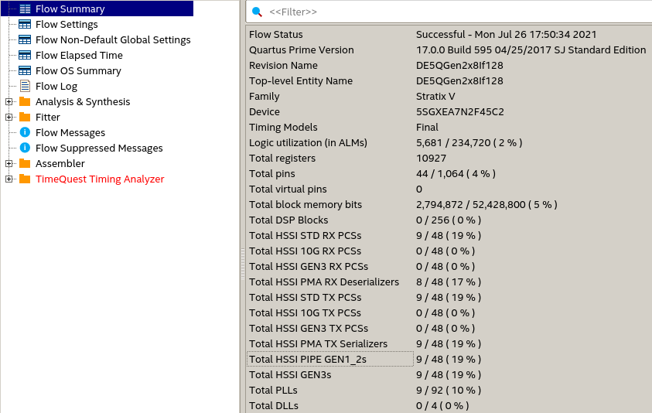
Step-by-step guide
Compilation report
Pay attention to these

Slide 27
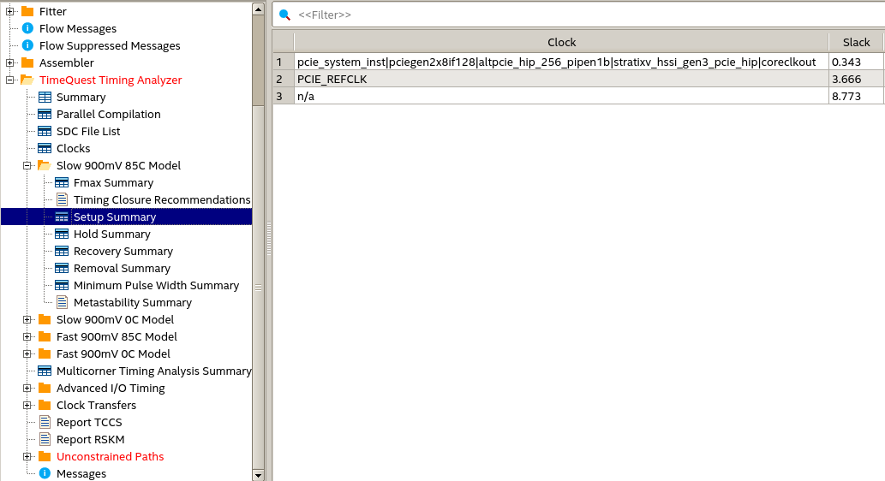
Step-by-step guide
Timing analyzer
WNS should be positive for all corners
Not ok, but we’ll skip for now

Slide 28
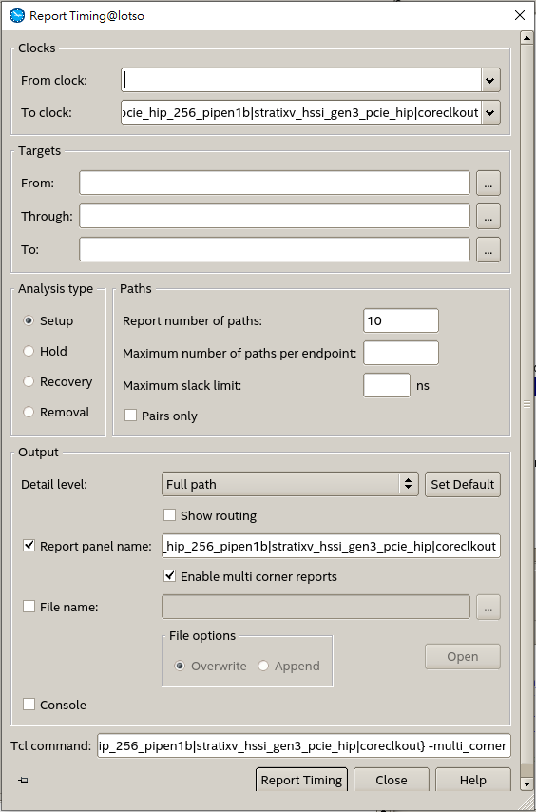
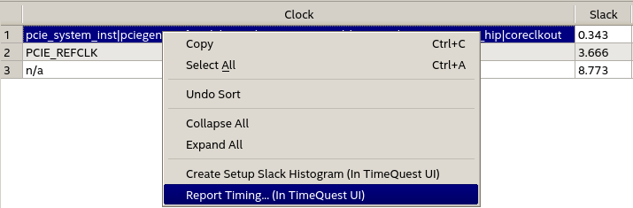
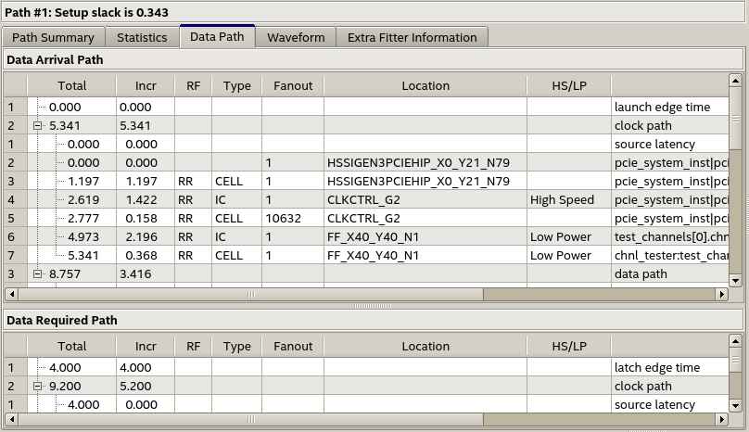
Step-by-step guide
Timequest timing analyzer
此工具可找到
Critical path

Slide 29
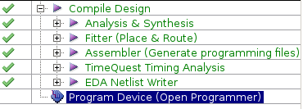
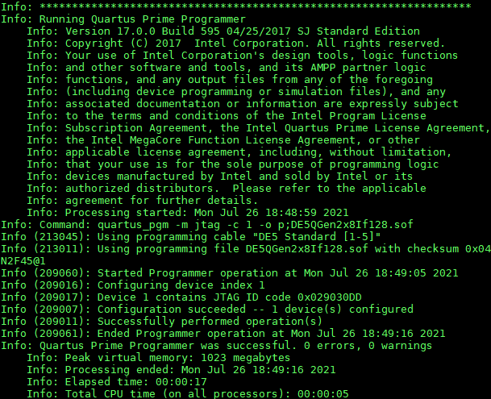
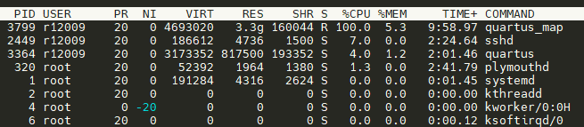
Step-by-step guide
Programmer
After finish compilation
cd <your path>/riffa_2.2.2/source/fpga/altera/de#/DE#Gen#x#If###/bit/
sudo /mnt/ds1515/opt/intelFPGA/17.0/quartus/bin/jtagconfig
sudo /mnt/ds1515/opt/intelFPGA/17.0/quartus/bin/quartus_pgm -m jtag -c 1 -o "p;DE5QGen2x8If128.sof »
Make sure to change the file name for new code
sudo reboot
Don’t close the machine while others are compiling!
Use “top” to check other users’ usage

Slide 30
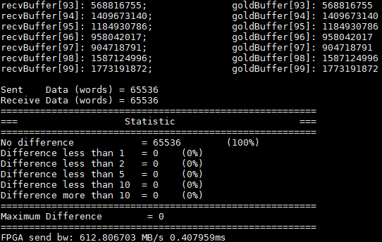
Step-by-step guide
Run
cd <your path>/riffa_2.2.2/source/c_c++/linux/x64/sample_app
make
./testutil 0 //List FPGA info
./testutil 1 0 //Reset FPGA 0
./testutil 2 <numofdata> //numofdata: must be multiples of 4 (up to 65536)
Congratulations !

Slide 31
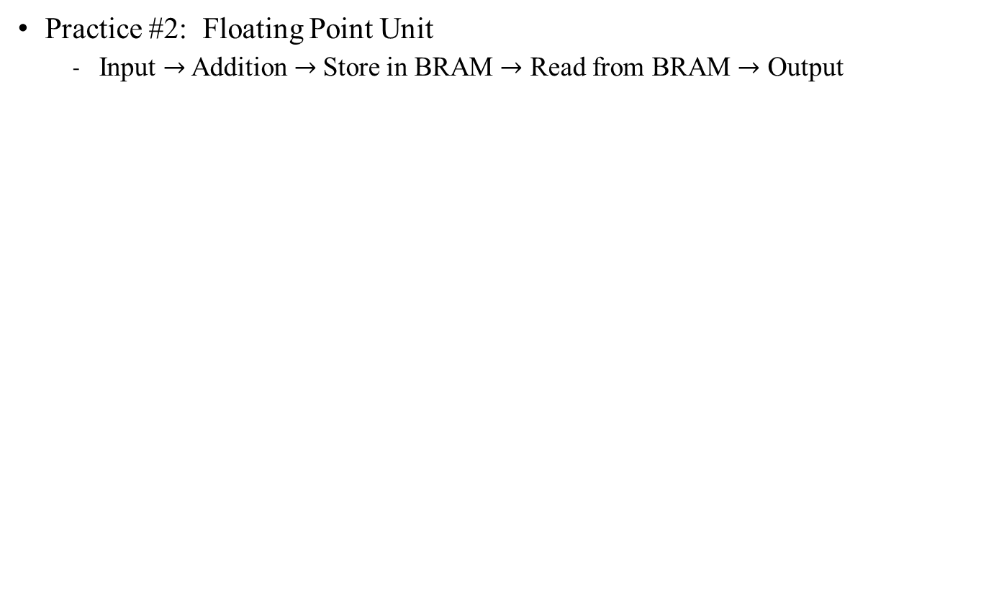
Practice time
Data input
Block RAM
Data output
(a, b, c, d)
(0, 0, 0, a+b+c+d)

Slide 32
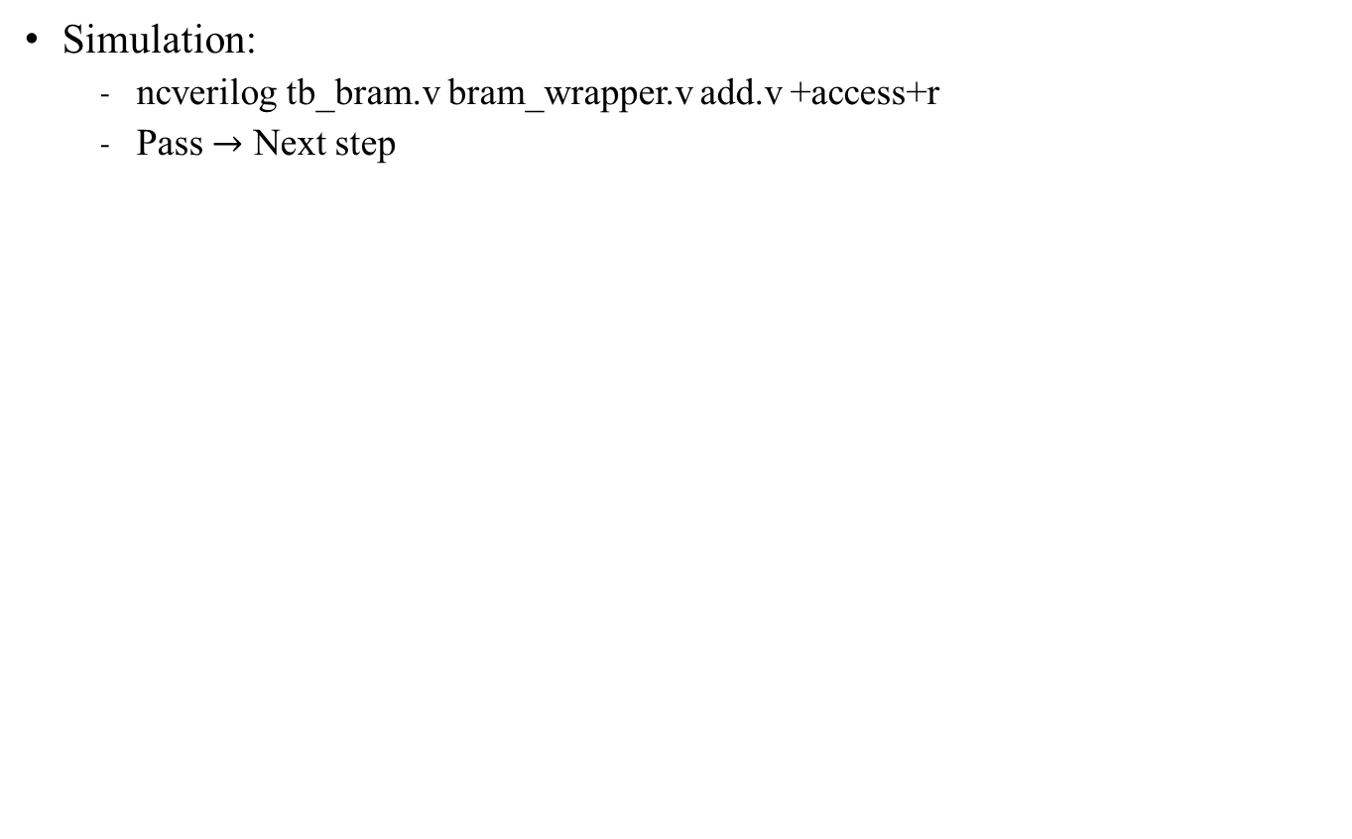
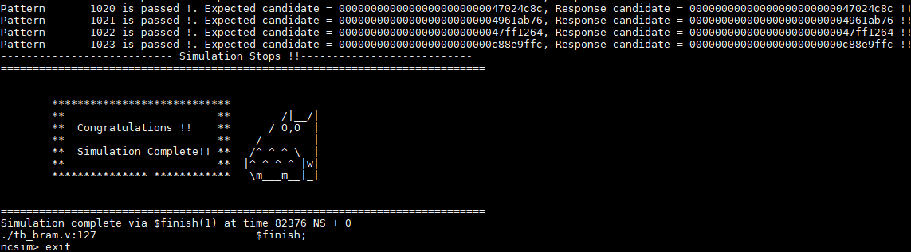
TODOs

Slide 33
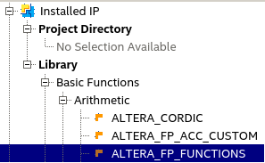
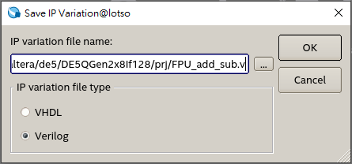
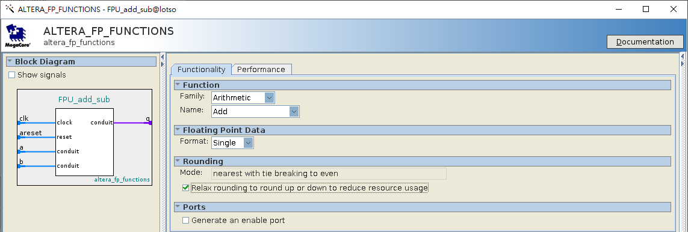
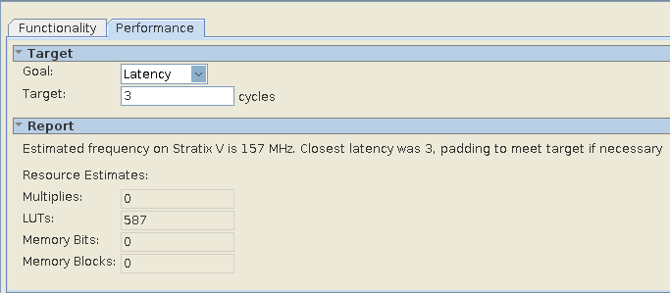
FPU IP
Library > Basic Functions > Arithmetic > ALTERA_FP_FUCTIONS
File name: FPU_add_sub.v
The file will be connect to .qsf file automatically
The generated files will be generated at prj/ directory
Choose 3 stages pipeline
and check performance

Slide 34
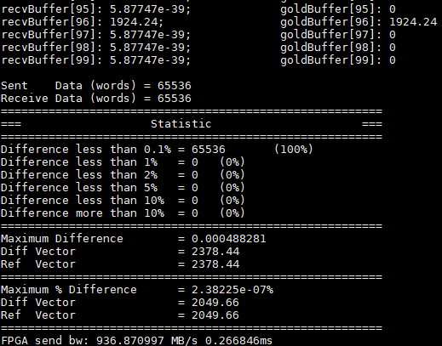
TODOs
Follow the step-by-step guide to finish the FPGA part
Run:
./testutil 2 65536
If you see this, you passed the FPGA test

Slide 35
Appendix

Slide 36
Appendix 1: Modifying PCIe Appendix 2: testutil Appendix 3: _CLK version Appendix 4: DE5a Appendix 5: Setting up FPGA Appendix 6: Modify I/O more output

Slide 37
Modifying the PCIE
GEN
1/2/3
LANE
x1/x2/x4/x8/x16
62.5 MHz:
Gen1x1
125 MHz:
Gen1x2, Gen1x4
Gen2x1, Gen2x2, Gen2x4
Gen3x1, Gen3x2
250 MHz:
Gen2x8
Gen3x4, Gen 3x8

Slide 38
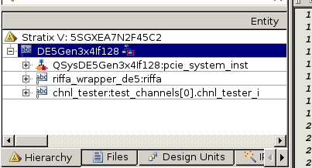
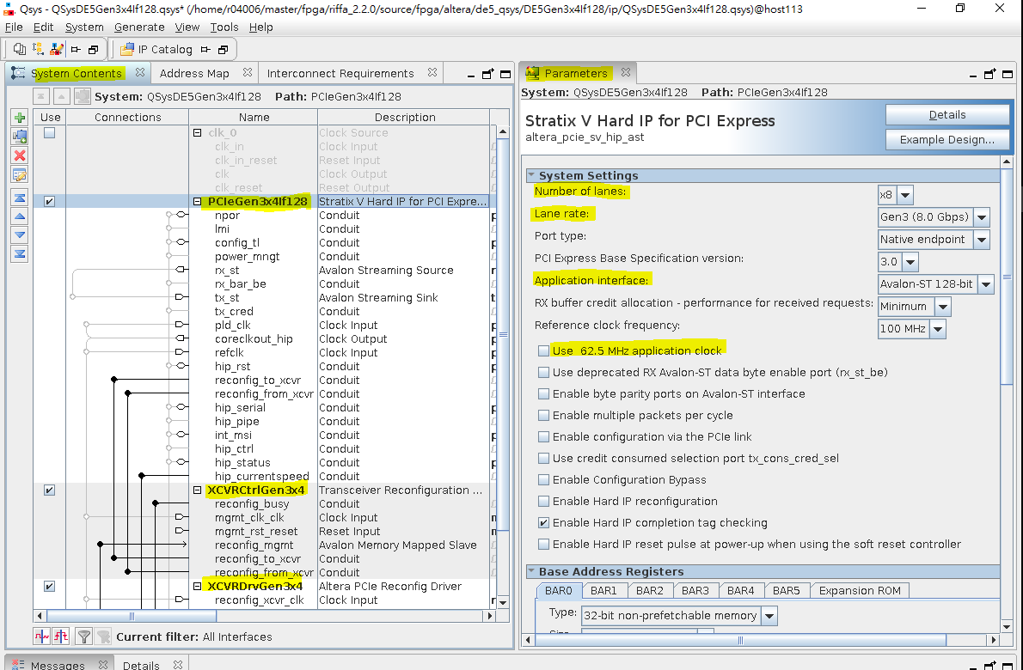
Modifying the PCIe on the Qsys
Double click on
QSysDE#Gen#x#lf###:pcie_system_inst
Areas to be edited are highlighted
Edit settings in PCIeDE#Gen#x#If### first
Then for XCVRCtrlGen#x#, and XDRVCtrlGen#x#
Edit Number of reconfiguration interfaces accordingly
From 2x8 to 2x4 (250MHz 🡪 125MHz)
Qsys
PCI Express IP x8 🡪x4
Number of XCVRCtrl 10 🡪 5
Number of XCVRDrv 10 🡪 5
Top module file
C_NUM_LANES 8 🡪 4
Remove Qsys PCIE 4~7 channel for RX and TX
Remove the setting for .qsf file for PCIE lane 4~7 (optional)

Slide 39
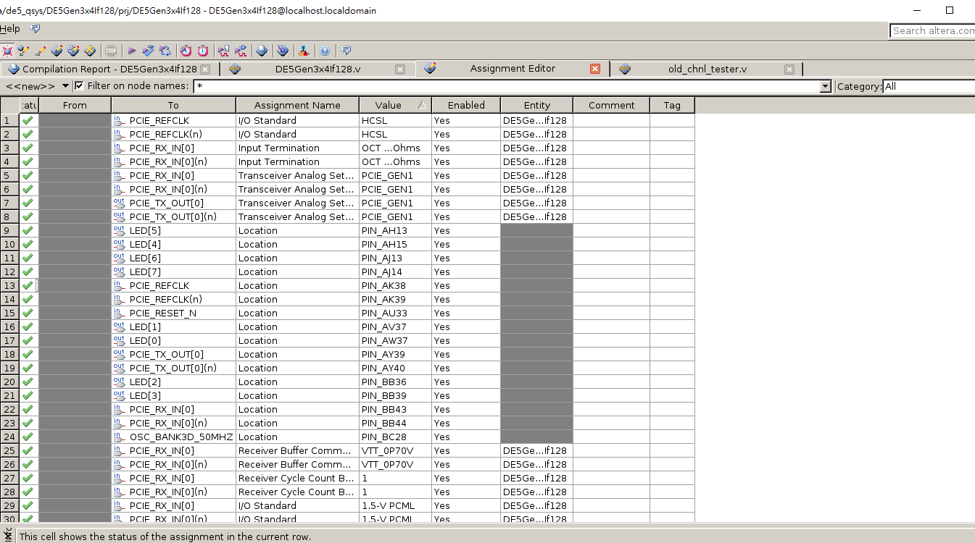
Changing PCIe generation
Go to assignment editor
Change Values accordingly
PCIE_GEN1
PCIE_GEN2
PCIE_GEN3

Slide 40
Changing width
Go to DE#Gen#x#lf###.v
Change parameter C_PCI_DATA_WIDTH to width
For IP QSysDE#Gen#x#If### pcie_system_inst
.rx_st_data (rx_st_data[C_PCI_DATA_WIDTH-1:0]),
.tx_st_data (tx_st_data[C_PCI_DATA_WIDTH-1:0]),

Slide 41
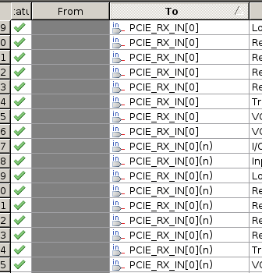
Changing number of lanes
Go to DE#Gen#x#lf###.v
Change parameter C_NUM_LANES to number of lanes
For IP QSysDE#Gen#x#If### pcie_system_inst
.pcieserial_tx_out0 (PCIE_TX_OUT[0]),
.pcieserial_tx_out1 (PCIE_TX_OUT[1]),
...
.pcieserial_tx_out# (PCIE_TX_OUT[#]),
AND
.pcieserial_rx_in0 (PCIE_RX_IN[0]),
.pcieserial_rx_in1 (PCIE_RX_IN[1]),
...
.pcieserial_rx_in# (PCIE_RX_IN[#]),
# = C_NUM_LANES - 1
Go to assignment editor
Add PCIE_RX_IN[#], PCIE_RX_IN[#](n), PCIE_TX_OUT[#], PCIE_TX_OUT[#](n),

Slide 42
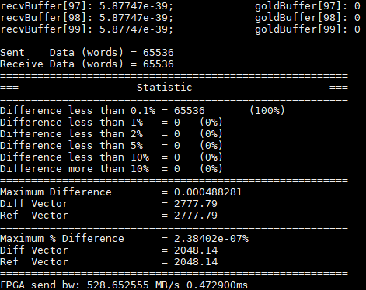
HW1.
The speed will decade from 250MHz to 125MHz for Practice 2.
Make sure you finish this.

Slide 43
Appendix 1: Modifying PCIe Appendix 2: testutil Appendix 3: _CLK version Appendix 4: DE5a Appendix 5: Setting up FPGA Appendix 6: Modify I/O more output

Slide 44
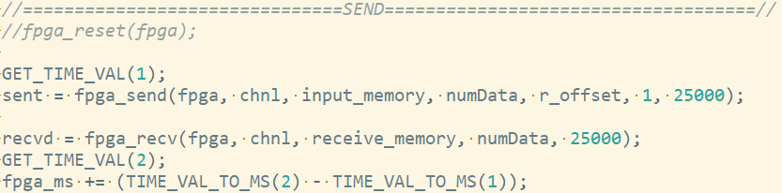
cpp file

Slide 45
Appendix 1: Modifying PCIe Appendix 2: testutil Appendix 3: _CLK version Appendix 4: DE5a Appendix 5: Setting up FPGA Appendix 6: Modify I/O more output

Slide 46
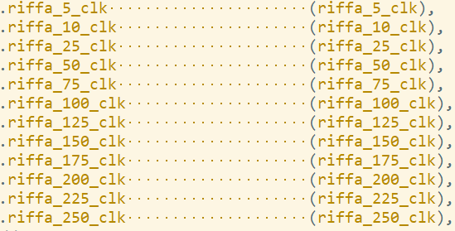
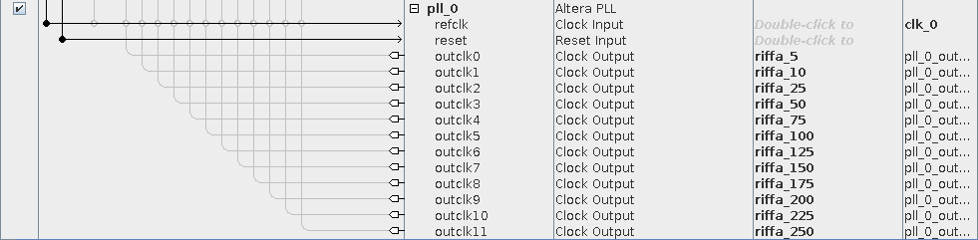
DE5QGen2x8If128_CLK
In hdl file
Top module
Use QSys to generate different clock
Open QSys file in ip directory
Modify the pll_0 IP for different clock
You can change the export name
Ensure consistency on QSys and Top module Qsys definition
There are twelve clock in RIFFA example, just delete some of them.

Slide 47
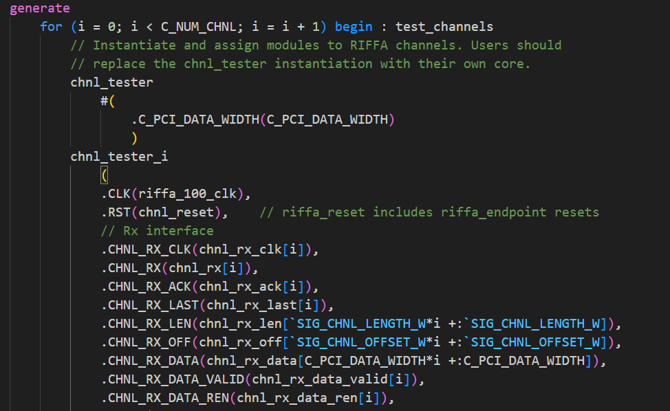

Using _CLK version
Open riffa_2.2.2/source/fpga/altera/de5/DE5QGen2x8If128_CLK/hdl/DE5QGen2x8If128_CLK.v“
Change module parameter: C_NUM_CHNL to 1
底下會有12個chnl_tester的instance，只留下你想要用的那個clk頻率的instance就好，其餘刪掉，並記得修改好線路編號
可參考雲端硬碟中的DE5QGen2x8If128_CLK.v 範例
quartus開啟project時記得打開_CLK版本的資料夾，燒到FPGA上時也是記得用_CLK版本的資料夾，接下來所有步驟相同，.sdc部分其實本來就已經設定好了，不用特意修改

Slide 48

tb_chnl_tester.v -> RX
建議從雲端中下載tb檔案來修改 (credit: 黃士豪 學長)
testbench中有模擬RIFFA TX傳輸行為，cur_input_idx為目前正在傳輸第幾個data，在符合條件時使idx增加
通常需要修改的是在第幾筆data時需要傳輸什麼，也就是data transaction part
Data transaction part
Protocol part

Slide 49

TX
testbench中有模擬RIFFA TX傳輸行為
在符合條件時接收資料，並讓cur_output_idx 增加
把CHNL_TX_DATA的資料跟golden比較
Protocol part
Data transaction part
極度建議用RTL模擬完chnl_tester再上板測試
珍惜生命，盡量不要以燒板子的方式debug

Slide 50
Signal Tap
https://hackmd.io/@VdgkdLfjTJqoAqqkM8zAvA/rk10ItfPR
有使用上問題的話可以詢問曾泓瑜學長或google直接搜尋關鍵字

Slide 51
Some hints
RX/TX 可以同時進行傳輸，也就是RX在傳輸的同時讓chn_tester中的CHNL_TX訊號也拉高來進行傳輸，但要注意REN,VALID等訊號的控制要寫好。
RX/TX 可以交互進行傳輸，利用RX_REN來使RX傳輸暫停，或使用TX_VALID訊號來使TX傳輸暫停，來控制在特定情況時要使用TX還是RX方向的傳輸。
善用tb_chnl_tester或signal tap來檢查RIFFA interface有哪裡是沒有處理好的。

Slide 52
Appendix 1: Modifying PCIe Appendix 2: testutil Appendix 3: _CLK version Appendix 4: DE5a Appendix 5: Setting up FPGA Appendix 6: Modify I/O more output

Slide 53
Data at
\\Bl430_ds918p\bl430_ds918p\MD501 Master Data\R07_黃家翰\Thesis\Oral_Presentation

Slide 54
Appendix 1: Modifying PCIe Appendix 2: testutil Appendix 3: _CLK version Appendix 4: DE5a Appendix 5: Setting up FPGA Appendix 6: Modify I/O more output

Slide 55
FPGA server
Install CentOS or Ubuntu
Change BIOS for Linux system, close windows secure reboot
Install RIFFA by the PDF file

Slide 56
Appendix 1: Modifying PCIe Appendix 2: testutil Appendix 3: _CLK version Appendix 4: DE5a Appendix 5: Setting up FPGA Appendix 6: Modify I/O more output

Slide 57
I/O data
In chnl_tester, total number of data to transfer is in line 134, numData.
rLen[21:2]
You can change the bits at most to [31:2] for more input or output data.

