Slide 1
Delay Analysis IRAP, GDR, and DU approaches
Hendry, Ye-Kui Wang, and Maxim Sychev
Huawei Technologies Co., Ltd.
March 7, 2019

Slide 2
Overview
Provide analysis of end-to-end delay and random access delay between encoder and decoder with IRAP/DU and GDR approaches.
End-to-end delay: time between a picture is captured to the time the picture is outputted.
Random access delay: time between a random access picture (IRAP or GDR) is captured to the time a clean picture is outputted in a random access event.

Slide 3
Encoding to decoding flow
Delay A: Encoding delay. Time needed for encoding an AU/DU
Delay B: Transmission delay. Time needed for sending an AU/DU from encoder CPB to decoder CPB
Delay C: Initial decoding delay. The delay between the time when the last bit of the first AU/DU arrives at the CPB and the time when decoding of the first AU/DU starts.
Delay D: Decoding delay. Time needed for decoding of an AU
Delay E: Output delay. The delay from the time when an AU is completely decoded to the time of output of the decoded picture.
Delay E is assumed to be equal to 0.

Slide 4
General assumptions (1)
Capture rate is calculated based on the picture rate
1000 ms / 32 pictures-per-second = 31.25 ms/picture.
Encoding time is obtained from encoding time of simulation with low-delay configuration (i.e., ET for each picture in encoder log).
The ET is normalized to fit one intra period into 1s time.
Capturing is assumed instantaneous and encoder starts as soon as a picture is captured.
Transmission of AU / DU from encoder CPB into network
Starts at the latter of the following two:
When the last bit of the current AU/DU is available in the encoder CPB
When the last bit of the previous AU/DU is available in the decoder CPB
The data used for this analysis, the bitstreams require bandwidth 4.1 Mbps and 4.3 Mbps for IRAP approach and GDR approach, respectively. Thus, it is assumed the available bandwidth is 4.5 Mbps.

Slide 5
General assumptions (2)
The time needed for decoding of each picture (Delay D) is bounded by the picture duration, that’s 31.25ms. The decoding process is assumed to start at regular time intervals (i.e., 31.25 ms).
To avoid underflow of decoder CPB, decoder starting time is delayed by an initial decoding start delay (Delay C)
Each picture is outputted as soon as it is decoded, assuming that also allows outputting pictures at regular time intervals (i.e., 31.25 ms).

Slide 6
Data used for analysis (1)
General simulation environment:
Test sequence: ChinaSpeed (coded with based QP 27)
Software used: AHG14 reference software with a bug fix for GDR implementation
For both tests, each picture uses 4 immediate previous pictures as reference pictures.
For IRAP approach:
An IDR is inserted every 32 pictures
Cfg file: Ref_lowDelayB_IntraPeriod.cfg
For GDR approach:
GDR refresh period 32
Cfg file: IntraRefresh_encOnly.cfg

Slide 7
Data used for analysis (2)

Slide 8
Data used for analysis (3)

Slide 9
Data used for analysis (4)
Encoder assumption: Encoder has good bit-rate control
Bit-rate variation among pictures are negligible
To simulate above, picture bit-count and encoding time are based on the average value over all coded pictures (i.e., 500 pictures)
For intra pictures: average bit-count and ET of all intra pictures
For inter pictures: average bit-count and ET of all inter pictures

Slide 10
Anchor – IRAP with AU based
Encoder delay is encoding time of 1 IRAP picture
After 1 IRAP picture encoding time delay, the last bit of the first picture is available in the encoder CPB thus transmission starts
The last bit of the first picture arrives at decoder CPB
To completely transmit the first IRAP picture, it takes 107.62ms
Note that the transmission of the first IDR always takes more than 100 ms. In practice, to reduce the final e2e delay, the encoder would skip the encoding a few pictures, e.g., 2 or 3 pictures.

Slide 11
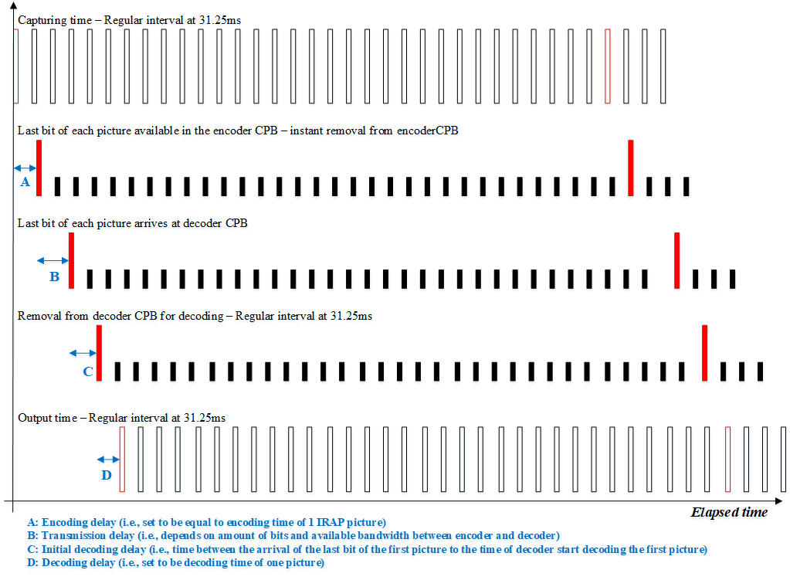
IRAP + AU based

Slide 12
Anchor – IRAP with AU based, with multiple VCL NAL units
An AU is encoded with multiple VCL NAL units
Transmission of coded data can start as soon as the last bits of the first VCL NAL unit of the first AU is available in the encoder CPB
Encoder delay is encoding time of 1 NAL unit
We assume an AU is coded with 32 VCL NAL units (for a fair comparison with GDR with 32 DUs)
The last bit of the first AU arrives at decoder CPB
To completely transmit the first IRAP picture, it still takes 107.62ms

Slide 13
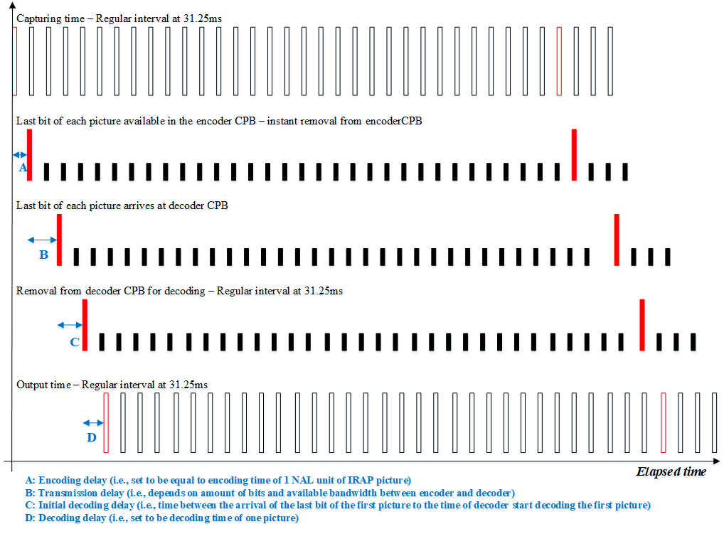
IRAP + AU based with multiple VCL NAL units

Slide 14
GDR with AU based
Encoder delay is encoding time of 1 picture
After 1 picture encoding time delay, the last bit of the first picture is available in the encoder CPB thus transmission starts
The last bit of the first picture arrives at decoder CPB
To completely transmit the first picture, it takes 28.58ms

Slide 15
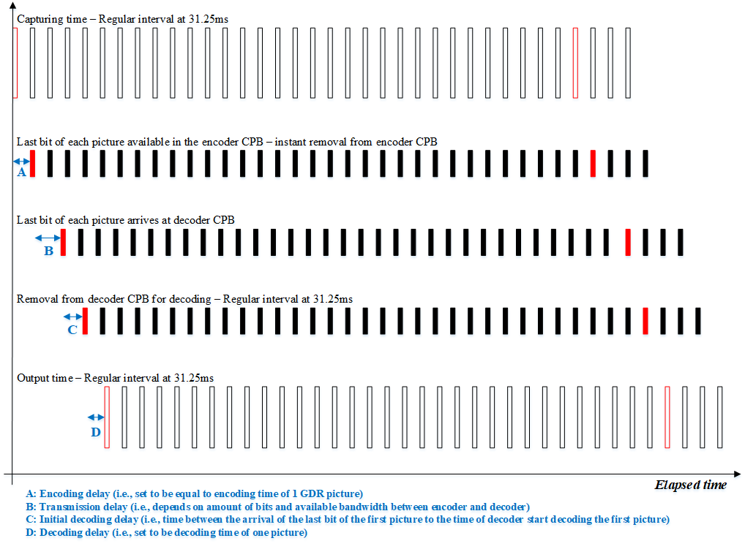
GDR + AU based

Slide 16
GDR with AU based, with multiple VCL NAL units
An AU is encoded with multiple VCL NAL units
Transmission of coded data can start as soon as the last bits of the first VCL NAL unit of the first AU is available in the encoder CPB
Encoder delay is encoding time of 1 VCL NAL unit. However, in this case, the first VCLl NAL unit of the picture that starts GDR period is an intra coded tile group, thus we should take NAL unit data (encoding time, transmission time, etc) from the IRAP approach
After 1 VCL NAL unit encoding time delay, the last bit of the first VCL NAL unit of the first picture is available in the encoder CPB thus transmission starts
We assume an AU is coded with 32 VCL NAL units (to nicely cover to nicely cover one random access period of 32 AUs, with progressively intra refreshing one DU per AU)
The last bit of the first AU arrives at decoder CPB
To completely transmit the first picture, it takes 28.58ms

Slide 17
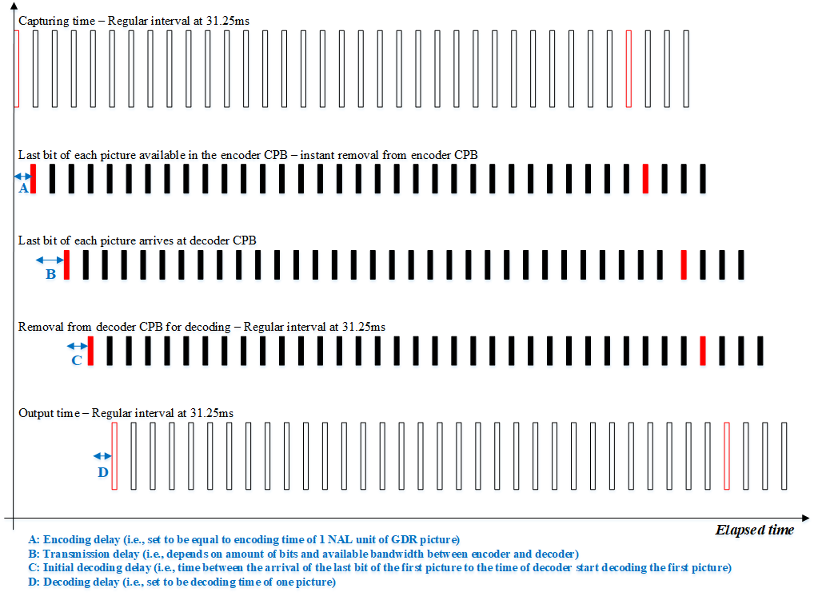
GDR + AU based with multiple NAL units

Slide 18
IRAP with DU based
Encoder delay is encoding time of 1 DU of IRAP
After 1 DU of IRAP picture encoding time delay, the last bit of the first DU of IRAP picture is available in the encoder CPB thus transmission starts
32 DUs per AU in this analysis.
This would allow the GDR+DU approach to nicely cover one random access period of 32 AUs, with progressively intra refreshing one DU per AU. And then apply the same DU number for the IRAP+DU approach to have a fair comparison
To completely transmit the first DU of the first IRAP picture, it takes 3.27 ms

Slide 19
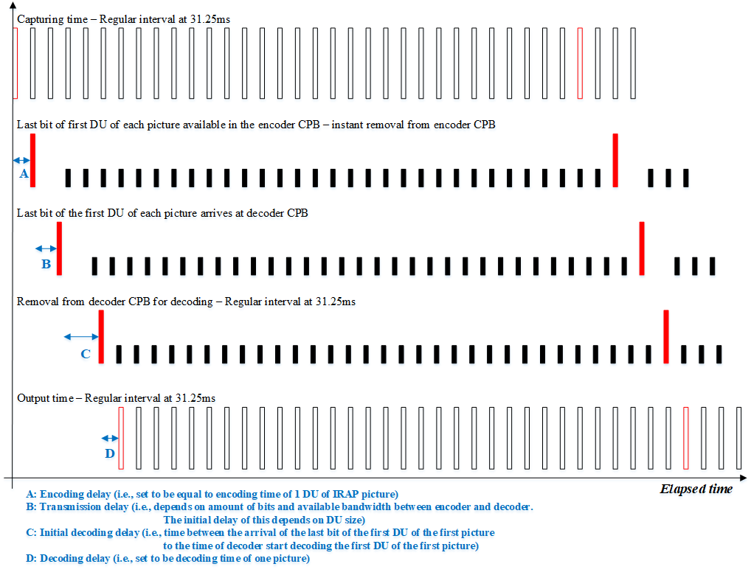
IRAP + DU based

Slide 20
GDR with DU based
Encoder delay is encoding time of 1 DU of a picture
In this case of GDR, the first DU of the picture that starts GDR period is an intra DU, thus we should take DU data (encoding time, transmission time, etc) from IRAP’s DU
After 1 DU of GDR picture encoding time delay, the last bit of the first DU of GDR picture is available in CPB thus transmission starts
32 DUs per AU in this analysis.
To completely transmit the first DU of the first IRAP picture, it takes 3.36ms
This value is the average transmission time of first DU from the two IRAP pictures in the IRAP test data

Slide 21
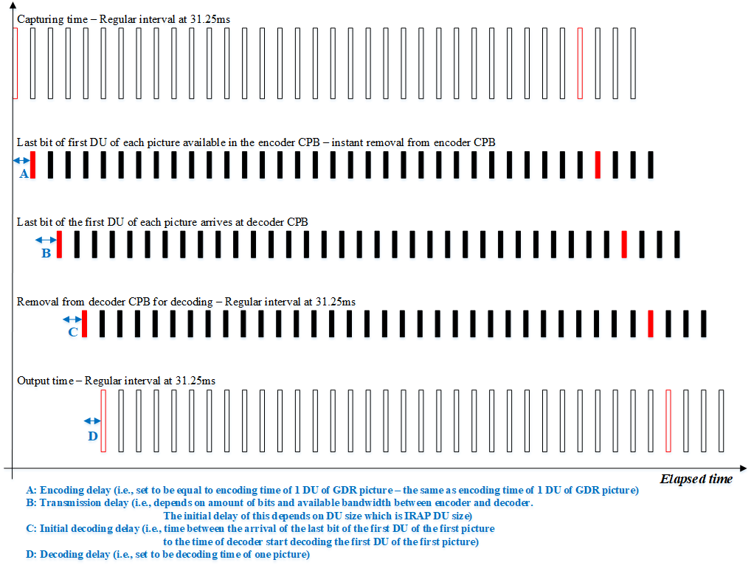
GDR + DU based

Slide 22
Summary
 | Delay A | Delay B | Delay C | Delay D | Final E2E delay | Initial join delay
 |  |  |  |  | (A + B + C + D)
IRAP with AU based | 39.66 | 107.62 | 74.67 | 31.25 | 253.20 | 253.20
IRAP with AU based, multiple VCL NAL units | 1.24 | 107.62 | 0.00 | 31.25 | 140.11 | 140.11
GDR with AU based | 31.25 | 28.58 | 0.00 | 31.25 | 91.08 | 1091.08
GDR with AU based, multiple VCL NAL units | 1.24 | 28.58 | 0.00 | 31.25 | 61.07 | 1061.07
IRAP with DU based | 1.24 | 3.36 | 73.97 | 31.25 | 109.83 | 109.83
GDR with DU based | 1.24 | 3.36 | 0.00 | 31.25 | 35.86 | 1035.86
Notes:
Wow, it seems that the GDR+AU based could be the best for the final e2e delay!!!
Why to have the yellow highlights?

Slide 23
Observations
For AU based, GDR has lower E2E delay than IRAP
The size of IRAP picture at the beginning causes delay for transmission of the second and forth pictures, this in turn require initial decoding start time delay to avoid decoder CPB underflow.
For AU based with multiple VCL NAL units in which encoder can start the first transmission as soon as the first VCL NAL unit encoding is completed, both the IRAP+AU and GDR+AU approaches enjoy some benefit in E2E delay reduction.
For DU based, GDR also has lower E2E delay than IRAP.
Again, the size of IRAP picture at the beginning causes delay for transmission of the DUs of the second picture. Thus the benefit of sending the first DU of the first picture early disappear.

