Slide 1
Flask Application on Mass Spectrum Data Analysis Using PymzML
Shih-Yin Chen
Health Informatics
University of San Francisco
August 10th, 2016

Slide 2
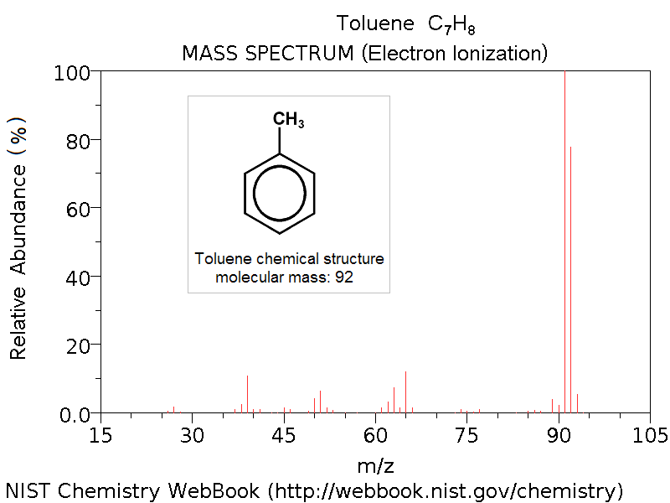
Mass Spectrum
A mass spectrum is an ion signal intensity vs. m/z (mass-to-charge ratio) plot representing a chemical analysis
m: the molecular or atomic mass number
z: the charge number of the ion
mass-to-charge ratio: a ratio between the mass of a given ion and the number of elementary charges that it carries
Notes:
A mass spectrum will usually be presented as a vertical bar graph, in which each bar represents an ion having a specific mass-to-charge ratio (m/z) and the length of the bar indicates the relative abundance of the ion.
Most of the ions formed in a mass spectrometer have a single charge, so the m/z value is equivalent to mass itself

Slide 3
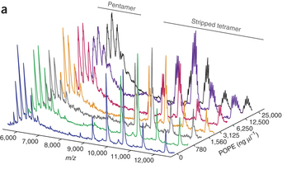
Mass Spectrum
Mass spectrometry (MS): an analytical technique that ionizes chemical species and sorts the ions based on their mass to charge ratio. (creates the mass spectrum plots)
Proteomics: the study of all proteins in a biological system (e.g., cells, tissue, organism) during specific biological events
Notes:
The complementation of genomics and proteomics is a lot more difficult to study than genomics because of the dynamic nature of protein expression.
Mass spectrometry is very useful for the study because it is a sensitive technique that can be used to detect, identify and quantitate molecules based on their mass and charge (m/z) ratio.
https://www.thermofisher.com/tw/zt/home/life-science/protein-biology/protein-biology-learning-center/protein-biology-resource-library/pierce-protein-methods/overview-mass-spectrometry.html.html

Slide 4
Mass Spectrum Format
JCAMP-DX
ANDI-MS or netCDF
mzData
mzXML
mzML

Slide 5
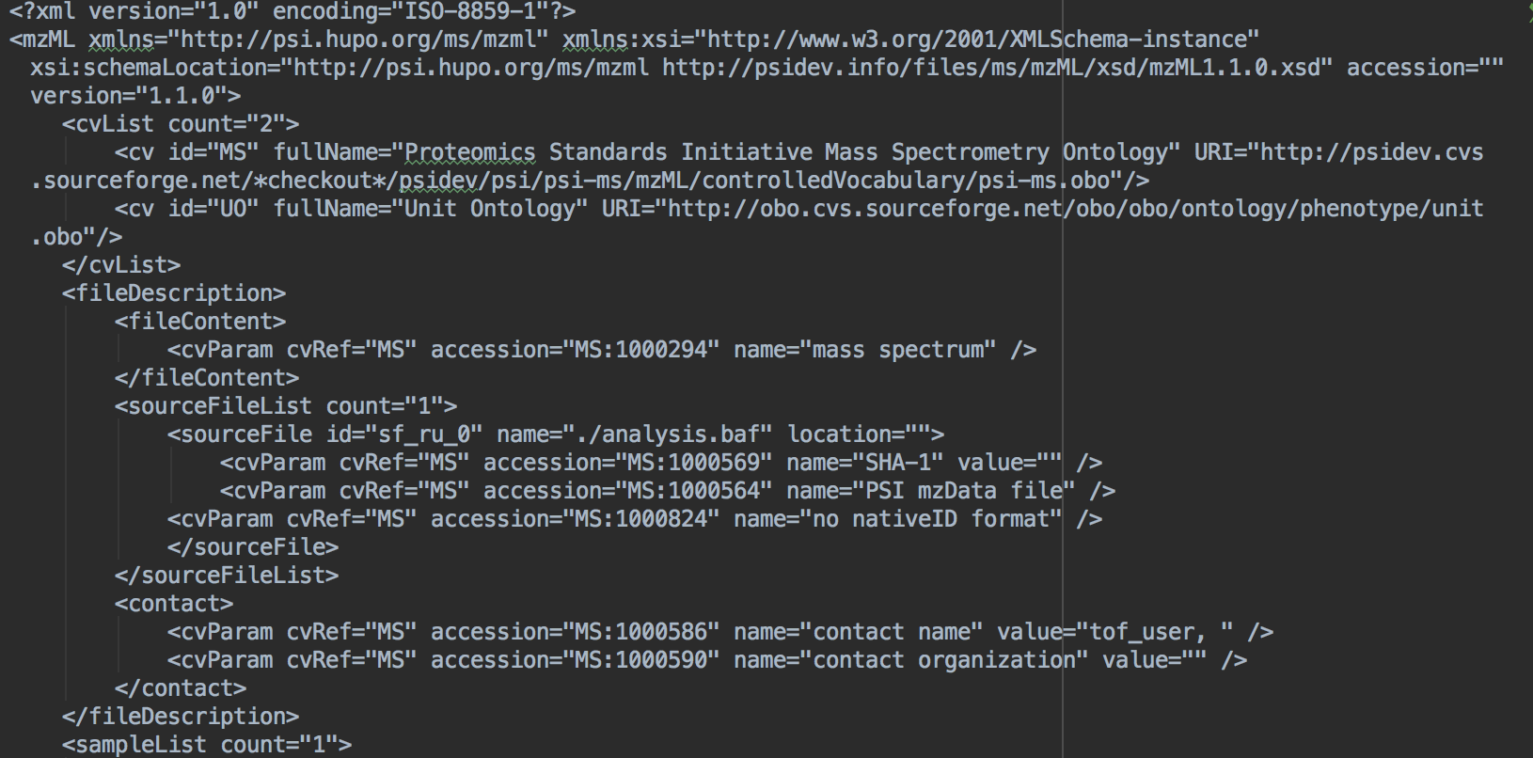

Slide 6
pymzML
Easy access to mass spectrometry (MS) data that allows the rapid development of tools
A very fast parser for mzML data, the standard in mass spectrometry data format
A set of functions to compare or handle spectra
Finding a peak
Plotting a spectrum
Compare Spectra
Highest peaks
Extract a specific Ion Chromatogram
Accessing the original XML Tree of a spectrum
Write mzML
Notes:
https://en.wikipedia.org/wiki/Mass_spectrometry_data_format

Slide 7
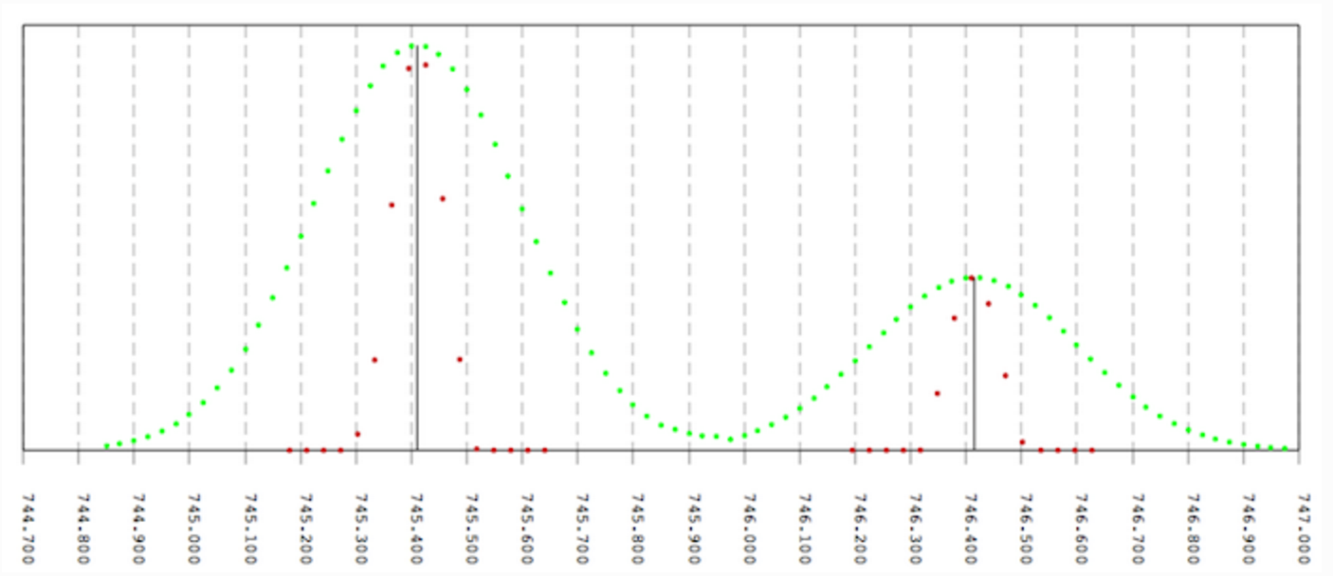

Slide 8
Flask Application
Uploading Files
Using the Uploaded Files to Implement the pymzML Functions
Form Validation with WTForms
HTML
Bootstrap

Slide 9
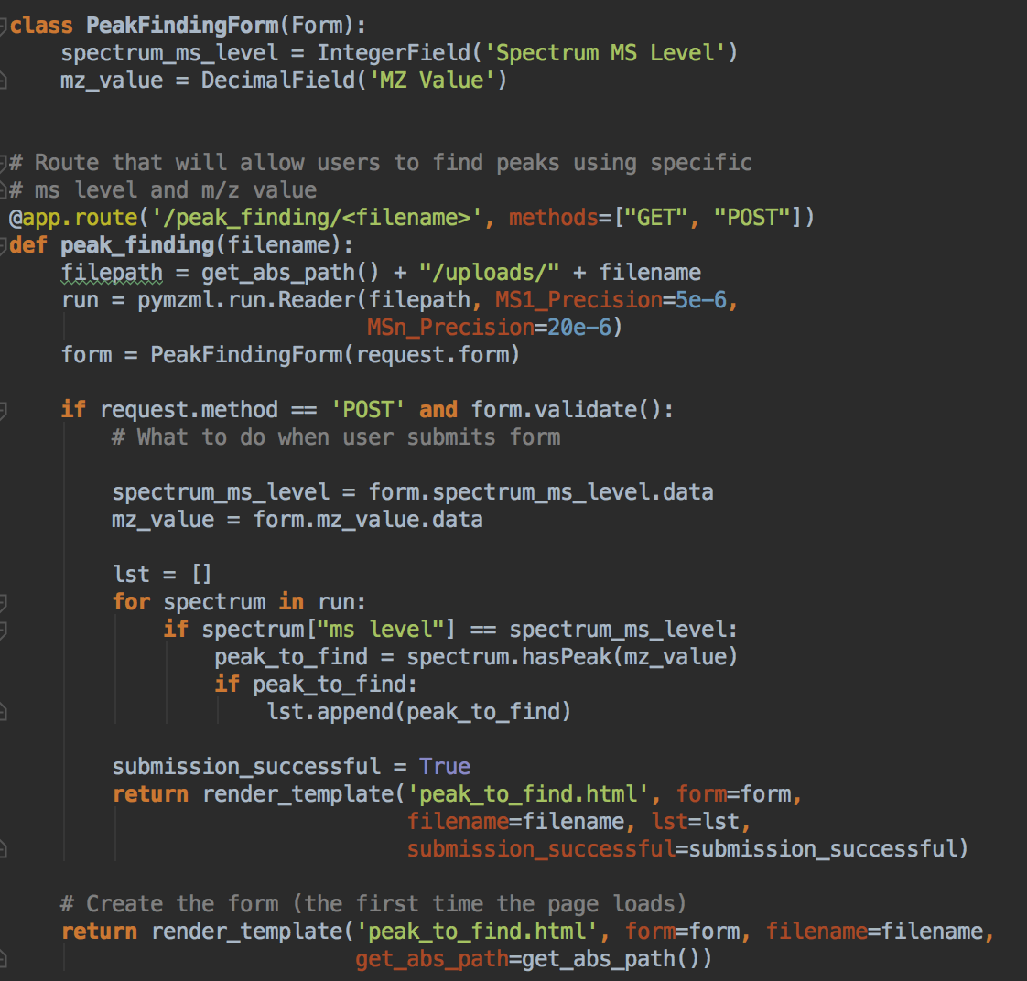

Slide 10
Demo

