Slide 1
Homework 5 (Due: 6/21)
Write the Matlab or Python code to compute the FFT of two N-point real signals x and y using only one N-point FFT. (20 scores)
[Fx, Fy] =fftreal(x, y)
The code should be handed out by NTUCool.

Slide 2
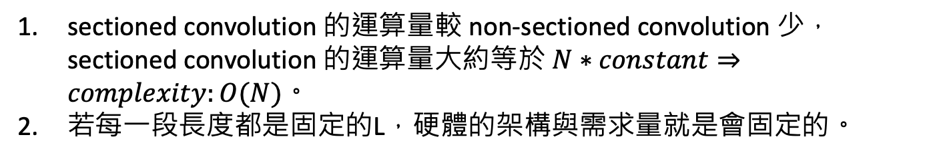
(2) Compared to the original non-sectioned convolution, what are the two main advantages of the sectioned convolution? (8 scores)
sectioned convolution 的運算量較 non-sectioned convolution 少， sectioned convolution 的運算量大約等於 $N∗constant⇒complexity:O(N)$。
若每一段長度都是固定的L，硬體的架構與需求量就是會固定的。
(3) Are the following applications suitable for the Walsh transform? Why? (a) calculating the linear convolution; (b) compressing a natural image; (c) stair-like signal analysis. (12 scores)
calculating the linear convolution：
不適合。Walsh transform 只有在 logical convolution 做 transform 後才會變成乘法，在 linear convolution 則沒有這個性質。
compressing a natural image：
不適合。當運算量不是問題的話，比較少使用 Walsh transform 而是會用 DCT。
stair-like signal analysis：
適合。跟 Walsh transform 一樣都是菱菱角角的樣子，用 Walsh transform會有優勢。

Slide 3
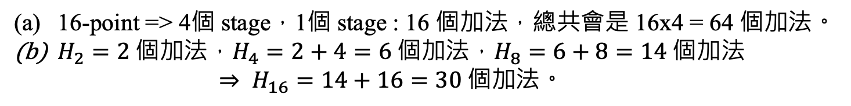
(4) What is the number of addition operations when we what to implement (a) the 16-point Walsh transform and (b) the 16-point Haar transform? (10 scores)
16-point => 4個 stage，1個 stage : 16 個加法，總共會是 16x4 = 64 個加法。
$H_{2}=2 個加法，H_{4}=2+4=6 個加法，H_{8}=6+8=14 個加法$
$$⇒ H_{16}=14+16=30 個加法。$$
(5) What are the two main advantages of the OFDM when compared to the original FDM? (8 scores)
OFDM 不同 channels 傳送的東西不會互相干擾，要還原訊號時比較能夠簡單就還原出來。
OFDM 跟 inverse 離散傅立葉轉換的式子是很像的，就可以利用傅立葉轉換的快速演算法來做調變解調。

Slide 4
(6) (a) What is the results of CDMA if there are three data [1 1 0], [0 1 1], [1 0 1] and these three data are modulated by the 1st, 6th, and 12th rows of the 16-point Walsh transform? (The beginning row is the 1st row).
(b) In (a), if the 8th and the 15th entries of the CDMA results are missed, can we recover the original data? Why? (5 scores)
(10 scores)
1st = [1 1 1 1 1 1 1 1 1 1 1 1 1 1 1 1], 6th = [1 1 -1 -1 -1 -1 1 1 -1 -1 1 1 1 1 -1 -1], 12th = [1 -1 -1 1 -1 1 1 -1 1 -1 -1 1 -1 1 1 -1]
(1) 將 0 變為 −1: [1 1 -1], [-1 1 1], [1 -1 1]
(2) [1 1 -1] modulated by 1st
[1 1 1 1 1 1 1 1 1 1 1 1 1 1 1 1 1 1 1 1 1 1 1 1 1 1 1 1 1 1 1 1 -1 -1 -1 -1 -1 -1 -1 -1 -1 -1 -1 -1 -1 -1 -1 -1 ]
[-1 1 1] modulated by 6st
[-1 -1 1 1 1 1 -1 -1 1 1 -1 -1 -1 -1 1 1 1 1 -1 -1 -1 -1 1 1 -1 -1 1 1 1 1 -1 -1 1 1 -1 -1 -1 -1 1 1 -1 -1 1 1 1 1 -1 -1]
[1 -1 1] modulated by 12st
[1 -1 -1 1 -1 1 1 -1 1 -1 -1 1 -1 1 1 -1 -1 1 1 -1 1 -1 -1 1 -1 1 1 -1 1 -1 -1 1 1 -1 -1 1 -1 1 1 -1 1 -1 -1 1 -1 1 1 -1]
(3) 相合
[1 -1 1 3 1 3 1 -1 3 1 -1 1 -1 1 3 1 1 3 1 -1 1 -1 1 3 -1 1 3 1 3 1 -1 1 1 -1 -3 -1 -3 -1 1 -1 -1 -3 -1 1 -1 1 -1 -3]

Slide 5
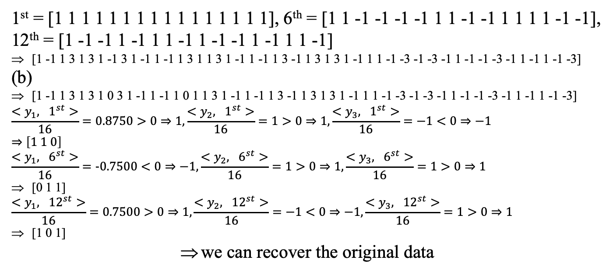
(6) (a) What is the results of CDMA if there are three data [1 1 0], [0 1 1], [1 0 1] and these three data are modulated by the 1st, 6th, and 12th rows of the 16-point Walsh transform? (The beginning row is the 1st row).
(b) In (a), if the 8th and the 15th entries of the CDMA results are missed, can we recover the original data? Why? (5 scores)
(10 scores)
1st = [1 1 1 1 1 1 1 1 1 1 1 1 1 1 1 1], 6th = [1 1 -1 -1 -1 -1 1 1 -1 -1 1 1 1 1 -1 -1], 12th = [1 -1 -1 1 -1 1 1 -1 1 -1 -1 1 -1 1 1 -1]
[1 -1 1 3 1 3 1 -1 3 1 -1 1 -1 1 3 1 1 3 1 -1 1 -1 1 3 -1 1 3 1 3 1 -1 1 1 -1 -3 -1 -3 -1 1 -1 -1 -3 -1 1 -1 1 -1 -3]
(b)
[1 -1 1 3 1 3 1 0 3 1 -1 1 -1 1 0 1 1 3 1 -1 1 -1 1 3 -1 1 3 1 3 1 -1 1 1 -1 -3 -1 -3 -1 1 -1 -1 -3 -1 1 -1 1 -1 -3]
$$\frac{<y_{1}, 1^{st}>}{16}=0.8750>0⇒1,\frac{<y_{2}, 1^{st}>}{16}=1>0⇒1,\frac{<y_{3}, 1^{st}>}{16}=−1<0⇒−1$$
$$⇒\left[1 1 0\right]$$
$$\frac{<y_{1}, 6^{st}>}{16}=-0.7500<0⇒−1,\frac{<y_{2}, 6^{st}>}{16}=1>0⇒1,\frac{<y_{3}, 6^{st}>}{16}=1>0⇒1$$
[0 1 1]
$$\frac{<y_{1}, {12}^{st}>}{16}=0.7500>0⇒1,\frac{<y_{2}, {12}^{st}>}{16}=−1<0⇒−1,\frac{<y_{3}, {12}^{st}>}{16}=1>0⇒1$$
[1 0 1]
we can recover the original data

Slide 6
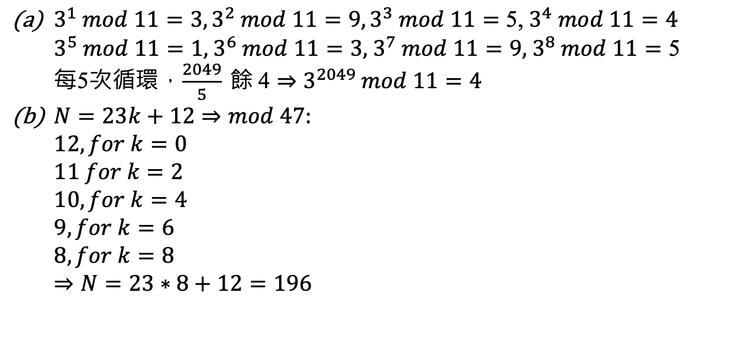
(7) (a) Please determine 3²⁰⁴⁹ (mod 11).
(Hint: Try to find a such that 3ª (mod 11) = 1).
(b) Suppose that N mod 23 = 12 and N mod 47 = 8. Please determine the minimal positive integer solution for N.
(Hint: We can use the fact that 46 mod 47 = -1 mod 47.) (8 scores)
$3^{1} mod 11=3,3^{2} mod 11=9,3^{3} mod 11=\text{5}\text{,}{ 3}^{4} mod 11=\text{4}$
$$3^{5} mod 11=\text{1,}{ 3}^{6} mod 11=\text{3,}{ 3}^{7} mod 11=\text{9,}{ 3}^{8} mod 11=\text{5}$$
每5次循環，$\frac{2049}{5} 餘 \text{4}⇒3^{2049} mod 11=4$
$N=23k+12⇒mod 47:$
$$12, for k=0$$
$$11 for k=2$$
$$10, for k=4$$
$$9, for k=6$$
$$8, for k=8$$
$$⇒N=23∗8+12=196$$

Slide 7
(8) Write at least three similarities between the NTT and the DFT. (7 scores)
Orthogonal：DFT 不同 row 做內積會＝0，NTT 不同 row 也是orthogonality。
Exact inverse： DFT and IDFT are exact inverses of each other， NTT 和 INTT 也是 exact inverse。
Circular Convolution：NTT 和 DFT 都遵循 circular convolution 定理，可以用來執行 circular convolution。

Slide 8
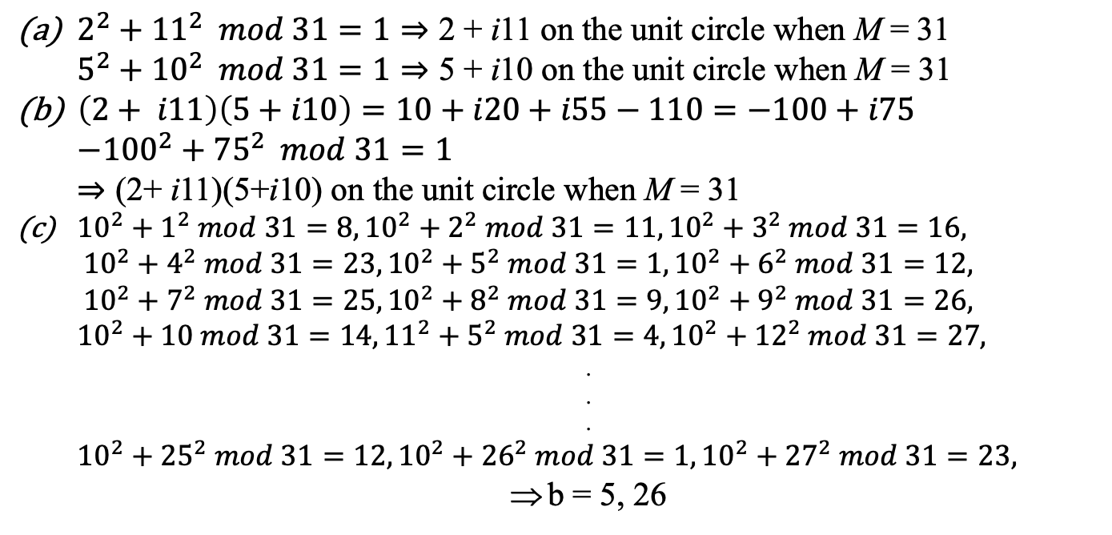
(9) For the complex number theoretic transform (CNT), if a complex integer number a + ib satisfies a² + b² = 1 mod M, then we say that a + ib is on the unit circle.
(a) Is 2+ i11 and 5+i10 on the unit circle when M = 31?
(b) Is (2+ i11)(5+i10) on the unit circle when M = 31?
(c) When a = 10, find all b ∈[1, 2, .., 30] such that a + ib is on the unit circle.
(12 scores)
$2^{2}+{11}^{2} mod 31=1⇒\text{2} \text{+ }\text{i}\text{11 }\text{on} \text{the} \text{unit} \text{circle} \text{when} \text{M}\text{ = 31}$
$$5^{2}+{10}^{2} mod 31=1⇒\text{5} \text{+} \text{i}\text{10} \text{on} \text{the} \text{unit} \text{circle} \text{when} \text{M}\text{ = 31}$$
$\left(2+ i11\right)\left(5+i10\right)=10+i20+i55−110=−100+i75$
$${−100}^{2}+{75}^{2} mod 31=1⇒\text{(2+ }\text{i}\text{11)(5+}\text{i}\text{10)} \text{on} \text{the} \text{unit} \text{circle} \text{when} \text{M}\text{ = 31}$$
${10}^{2}+1^{2} mod 31=8,{10}^{2}+2^{2} mod 31=11,{10}^{2}+3^{2} mod 31=16,$
$${10}^{2}+4^{2} mod 31=23,{10}^{2}+5^{2} mod 31=1,{10}^{2}+6^{2} mod 31=12,$$
$${10}^{2}+7^{2} mod 31=25,{10}^{2}+8^{2} mod 31=9,{10}^{2}+9^{2} mod 31=26,$$
$${10}^{2}+10 mod 31=14,{11}^{2}+5^{2} mod 31=4,{10}^{2}+{12}^{2} mod 31=27,$$
.
.
.
$${10}^{2}+{25}^{2} mod 31=12,{10}^{2}+{26}^{2} mod 31=1,{10}^{2}+{27}^{2} mod 31=23,$$
b = 5, 26

Slide 9
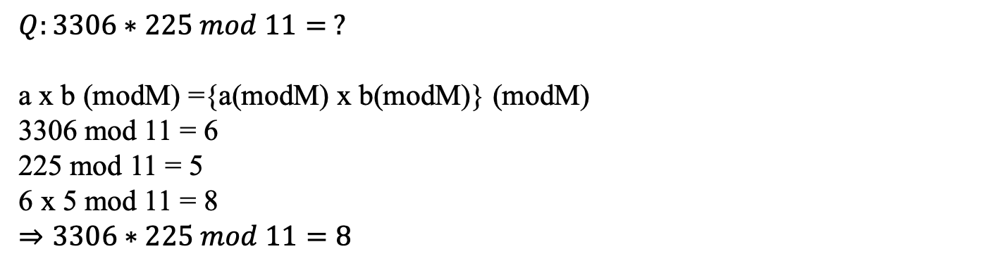
(Extra): Answer the questions according to your student ID number.
(ended with (1, 6), (2, 7), (3, 8), (4, 9))
$$Q:3306∗225 mod 11= ?$$
a x b (modM) ={a(modM) x b(modM)} (modM)
3306 mod 11 = 6
225 mod 11 = 5
6 x 5 mod 11 = 8
$⇒3306∗225 mod 11=8$

