Slide 1
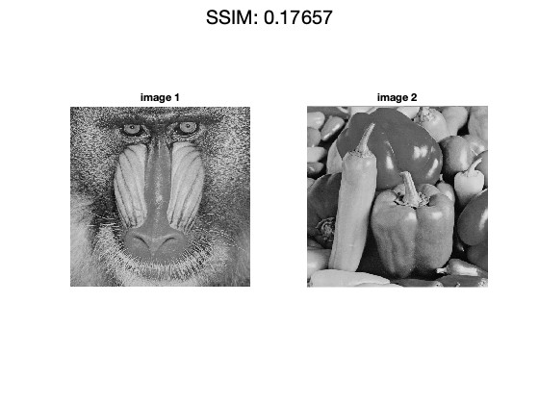
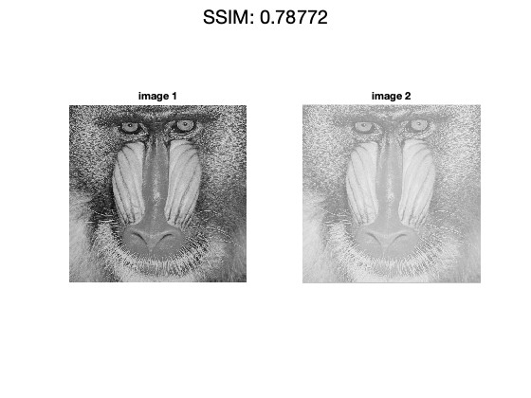
Homework 4 (Due: 5/24)
(1) Write a Matlab or Python program to measure the structural similarity (SSIM) of two images A and B. The sizes of A and B are equivalent.
SSIM(A, B, c1, c2)
where c1 and c2 are some adjust constants.
The Matlab or Python code should be handed out by NTUCool. (20 scores)

Slide 2
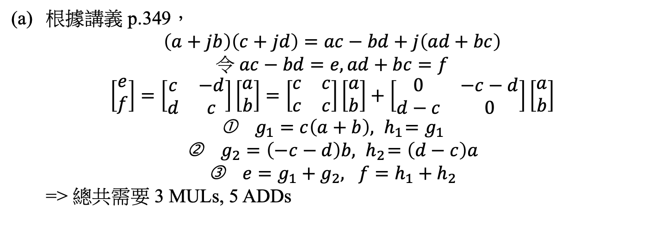
(2) (a) How do we use three real multiplications to implement a complex multiplication? (10 scores)
(b) Suppose that
How do we implement above matrix operation with the least number of real multiplications? (10 scores)
根據講義 p.349，
$$\left(a+jb\right)\left(c+jd\right)=ac−bd+j\left(ad+bc\right)$$
$$令 ac−bd=e,ad+bc=f$$
$$\left[\begin{matrix}e \\ f\end{matrix}\right]=\left[\begin{matrix}c & −d \\ d & c\end{matrix}\right]\left[\begin{matrix}a \\ b\end{matrix}\right]=\left[\begin{matrix}c & c \\ c & c\end{matrix}\right]\left[\begin{matrix}a \\ b\end{matrix}\right]+\left[\begin{matrix}0 & −c−d \\ d−c & 0\end{matrix}\right]\left[\begin{matrix}a \\ b\end{matrix}\right]$$
$g_{1}=c\left(a+b\right), { h}_{1}=g_{1}$
$g_{2}=\left(−c−d\right)b, { h}_{2}=\left(d−c\right)a$
$e=g_{1}+g_{2}, f=h_{1}+h_{2}$
=> 總共需要 3 MULs, 5 ADDs

Slide 3
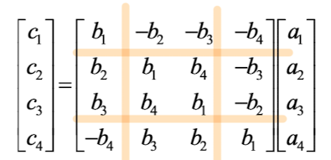
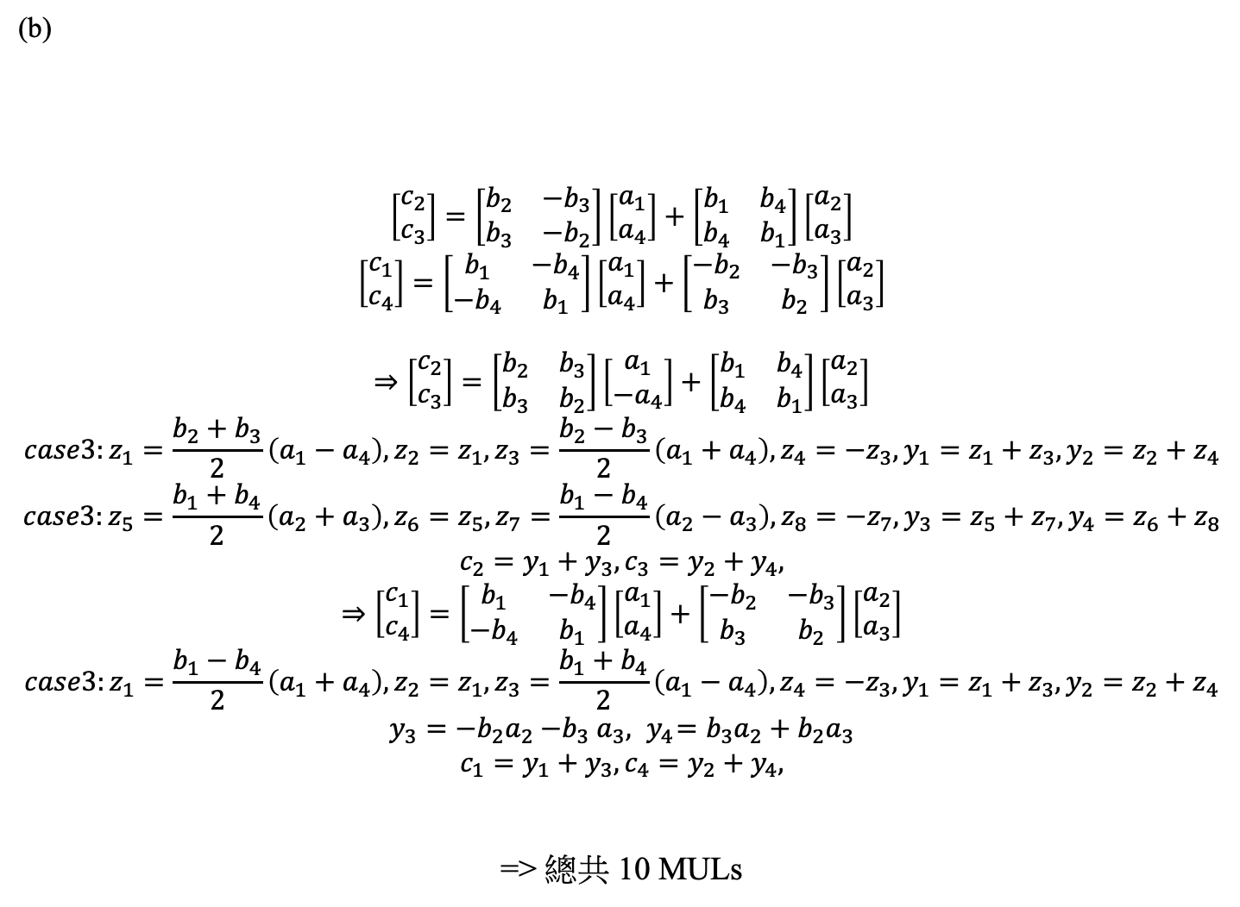
(b)
$$\left[\begin{matrix}c_{2} \\ c_{3}\end{matrix}\right]=\left[\begin{matrix}b_{2} & {−b}_{3} \\ b_{3} & {−b}_{2}\end{matrix}\right]\left[\begin{matrix}a_{1} \\ a_{4}\end{matrix}\right]+\left[\begin{matrix}b_{1} & b_{4} \\ b_{4} & b_{1}\end{matrix}\right]\left[\begin{matrix}a_{2} \\ a_{3}\end{matrix}\right]$$
$$\left[\begin{matrix}c_{1} \\ c_{4}\end{matrix}\right]=\left[\begin{matrix}b_{1} & {−b}_{4} \\ {−b}_{4} & b_{1}\end{matrix}\right]\left[\begin{matrix}a_{1} \\ a_{4}\end{matrix}\right]+\left[\begin{matrix}{−b}_{2} & {−b}_{3} \\ b_{3} & b_{2}\end{matrix}\right]\left[\begin{matrix}a_{2} \\ a_{3}\end{matrix}\right]$$
$$⇒\left[\begin{matrix}c_{2} \\ c_{3}\end{matrix}\right]=\left[\begin{matrix}b_{2} & b_{3} \\ b_{3} & b_{2}\end{matrix}\right]\left[\begin{matrix}a_{1} \\ {−a}_{4}\end{matrix}\right]+\left[\begin{matrix}b_{1} & b_{4} \\ b_{4} & b_{1}\end{matrix}\right]\left[\begin{matrix}a_{2} \\ a_{3}\end{matrix}\right]$$
$$case3:z_{1}=\frac{b_{2}+b_{3}}{2}\left(a_{1}−a_{4}\right),{z_{2}=z_{1},z}_{3}=\frac{b_{2}−b_{3}}{2}\left(a_{1}+a_{4}\right),z_{4}={−z}_{3},y_{1}=z_{1}+z_{3},y_{2}=z_{2}+z_{4}$$
$$case3:z_{5}=\frac{b_{1}+b_{4}}{2}\left(a_{2}+a_{3}\right),{z_{6}=z_{5},z}_{7}=\frac{b_{1}−b_{4}}{2}\left(a_{2}−a_{3}\right),z_{8}={−z}_{7},y_{3}=z_{5}+z_{7},y_{4}=z_{6}+z_{8}$$
$$c_{2}=y_{1}+y_{3},c_{3}=y_{2}+y_{4},$$
$$⇒\left[\begin{matrix}c_{1} \\ c_{4}\end{matrix}\right]=\left[\begin{matrix}b_{1} & {−b}_{4} \\ {−b}_{4} & b_{1}\end{matrix}\right]\left[\begin{matrix}a_{1} \\ a_{4}\end{matrix}\right]+\left[\begin{matrix}{−b}_{2} & {−b}_{3} \\ b_{3} & b_{2}\end{matrix}\right]\left[\begin{matrix}a_{2} \\ a_{3}\end{matrix}\right]$$
$$case3:z_{1}=\frac{b_{1}−b_{4}}{2}\left(a_{1}+a_{4}\right),{z_{2}=z_{1},z}_{3}=\frac{b_{1}+b_{4}}{2}\left(a_{1}−a_{4}\right),z_{4}={−z}_{3},y_{1}=z_{1}+z_{3},y_{2}=z_{2}+z_{4}$$
$${y_{3}=−b}_{2}a_{2}{−b}_{3}a_{3},{ y}_{4}=b_{3}a_{2}+b_{2}a_{3}$$
$$c_{1}=y_{1}+y_{3},c_{4}=y_{2}+y_{4},$$
=> 總共 10 MULs

Slide 4
(3) Determining the numbers of real multiplications for the (a) 125-point DFT,
(b) the 147-point DFT, and (c) the 385-point DFT. (15 scores)
125 = 5 x 25，使用 case2:
N = P1 x P2，5-point DFT 的乘法量為 10，25-point DFT 的乘法量為 148，有 24*4 個值不為 125/12 及 125/8 的倍數，則 125-point DFT 的乘法量為 25*10 + 5*148 + 3*24*4 = 1278。
147 = 3 x 49
49 = 7 x 7，使用 case2:
7-point DFT 的乘法量為16，則 49-point DFT 的乘法量為 7*16 + 7*16 + 3*6*6 = 332。
再使用 case1:
3-point DFT 的乘法量為 2，49-point DFT 的乘法量為 332，則 147-point DFT 的乘法量為 49*2 + 3*332 = 1094。
385 = 11 x 35，使用 case1:
11-point DFT 的乘法量為 40， 35-point DFT 的乘法量為 150，則 385-point DFT 的乘法量為 35*40 + 11*150 = 3050 。

Slide 5
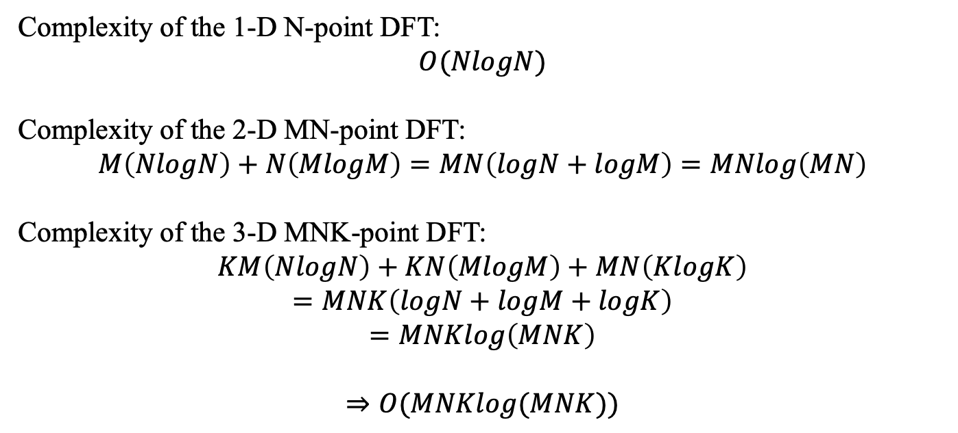
(4) What is the complexity of the 3D DFT as follows? Express the solution in terms of the big order. (10 scores)
Complexity of the 1-D N-point DFT:
$$O(NlogN)$$
Complexity of the 2-D MN-point DFT:
$$M\left(NlogN\right)+N\left(MlogM\right)=MN\left(logN+logM\right)=MNlog\left(MN\right)$$
Complexity of the 3-D MNK-point DFT:
$$KM\left(NlogN\right)+KN\left(MlogM\right)+MN\left(KlogK\right)$$
$$=MNK\left(logN+logM+logK\right)$$
$$=MNKlog\left(MNK\right)$$
$$⇒O(MNKlog(MNK))$$

Slide 6
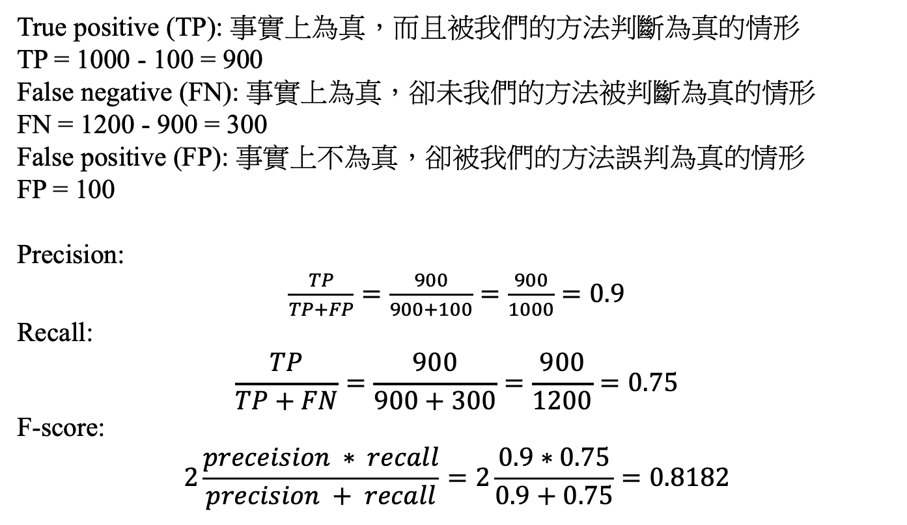
(5) Suppose that there are 1200 cars in a dataset and an algorithm detects 1000 cars. However, among the detected cars, 100 of them are in fact other objects. Determine the precision, the recall, and the F-score of the algorithm.
(10 scores)
True positive (TP): 事實上為真，而且被我們的方法判斷為真的情形
TP = 1000 - 100 = 900
False negative (FN): 事實上為真，卻未我們的方法被判斷為真的情形
FN = 1200 - 900 = 300
False positive (FP): 事實上不為真，卻被我們的方法誤判為真的情形
FP = 100
Precision:
$\frac{TP}{TP+FP}=\frac{900}{900+100}=\frac{900}{1000}=0.9$
Recall:
$$\frac{TP}{TP+FN}=\frac{900}{900+300}=\frac{900}{1200}=0.75$$
F-score:
$$2\frac{preceision ∗ recall}{precision + recall}=2\frac{0.9∗0.75}{0.9+0.75}=0.8182$$

Slide 7
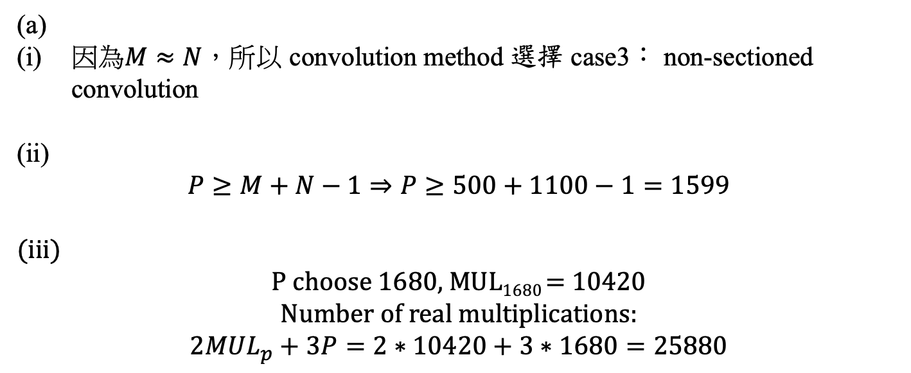
(6) Suppose that length(x[n]) = 1100. What is the best way to implement the convolution of x[n] and y[n] if
(a) length(y[n]) = 500, (b) length(y[n]) = 40,
(c) length(y[n]) = 6, and (d) length(y[n]) = 2 ? (25 scores)
Please show (i) the convolution method (direct, sectioned convolution, or non-sectioned convolution), (ii) the number of points of the FFT, (iii) and the number of real multiplications for the best implementation method. Also, consider the general case where x[n] and y[n] are complex sequences and the FFT of y[n] can be computed in prior.
(a)
因為$M≈N，所以$ convolution method 選擇 case3： non-sectioned convolution
(ii)
$$P≥M+N−1⇒P≥500+1100−1=1599$$
(iii)
P choose 1680, MUL₁₆₈₀ = 10420
Number of real multiplications:
$$2{MUL}_{p}+3P=2∗10420+3∗1680=25880$$

Slide 8
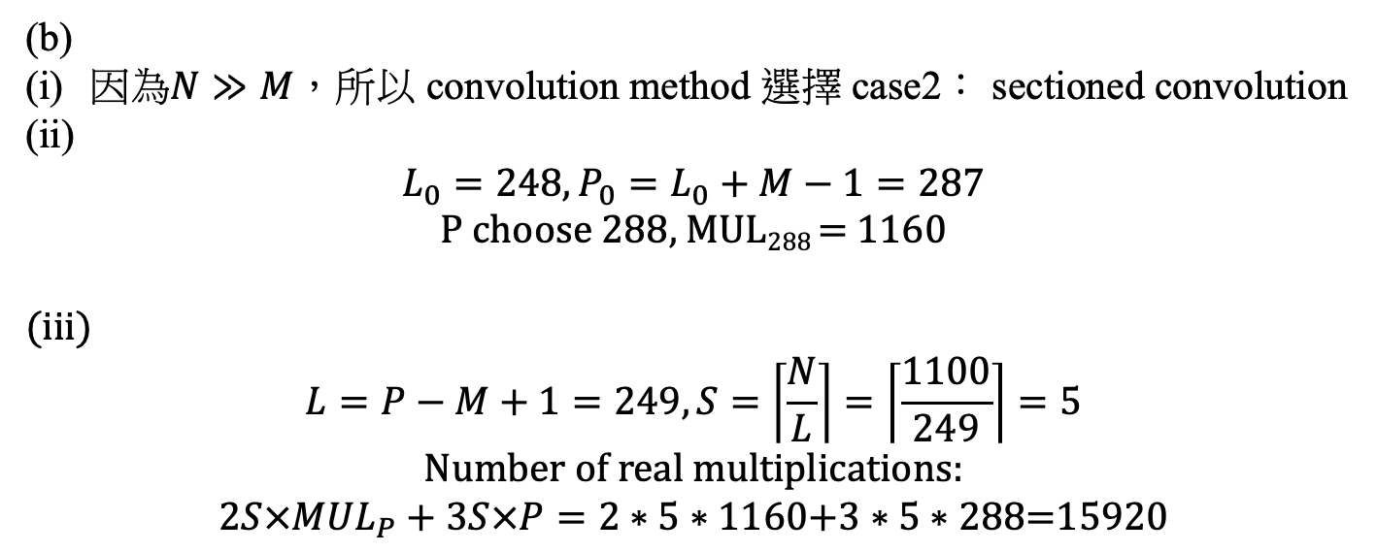
(6) Suppose that length(x[n]) = 1100. What is the best way to implement the convolution of x[n] and y[n] if
(a) length(y[n]) = 500, (b) length(y[n]) = 40,
(c) length(y[n]) = 6, and (d) length(y[n]) = 2 ? (25 scores)
Please show (i) the convolution method (direct, sectioned convolution, or non-sectioned convolution), (ii) the number of points of the FFT, (iii) and the number of real multiplications for the best implementation method. Also, consider the general case where x[n] and y[n] are complex sequences and the FFT of y[n] can be computed in prior.
(b)
因為$N≫M$，所以 convolution method 選擇 case2： sectioned convolution
(ii)
$$L_{0}=248, P_{0}=L_{0}+M−1=287$$
P choose 288, MUL₂₈₈ = 1160
(iii)
$$L=P−M+1=249, S=\left\lceil \frac{N}{L}\right\rceil =\left\lceil \frac{1100}{249}\right\rceil =5$$
Number of real multiplications:
$$2S×{MUL}_{P}+3S×P=2∗5∗1160\text{+3}∗\text{5}∗\text{288}\text{=}\text{15920}$$

Slide 9
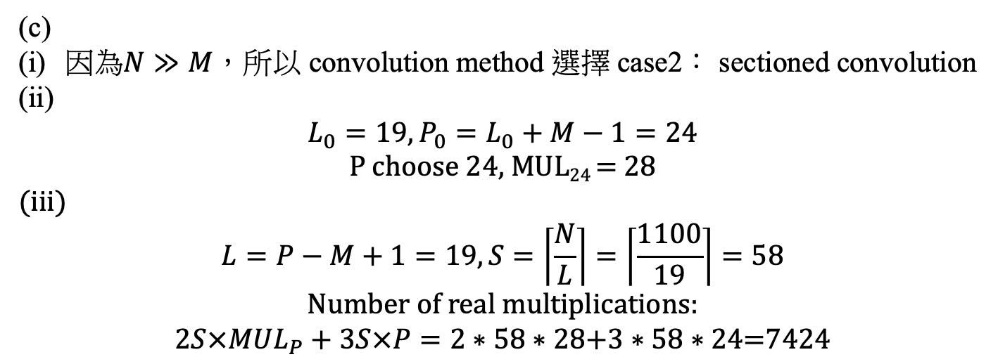
(6) Suppose that length(x[n]) = 1100. What is the best way to implement the convolution of x[n] and y[n] if
(a) length(y[n]) = 500, (b) length(y[n]) = 40,
(c) length(y[n]) = 6, and (d) length(y[n]) = 2 ? (25 scores)
Please show (i) the convolution method (direct, sectioned convolution, or non-sectioned convolution), (ii) the number of points of the FFT, (iii) and the number of real multiplications for the best implementation method. Also, consider the general case where x[n] and y[n] are complex sequences and the FFT of y[n] can be computed in prior.
(c)
因為$N≫M$，所以 convolution method 選擇 case2： sectioned convolution
(ii)
$$L_{0}=19, P_{0}=L_{0}+M−1=24$$
P choose 24, MUL₂₄ = 28
(iii)
$$L=P−M+1=19, S=\left\lceil \frac{N}{L}\right\rceil =\left\lceil \frac{1100}{19}\right\rceil =58$$
Number of real multiplications:
$$2S×{MUL}_{P}+3S×P=2∗58∗28\text{+3}∗\text{58}∗\text{24}\text{=}\text{7424}$$

Slide 10
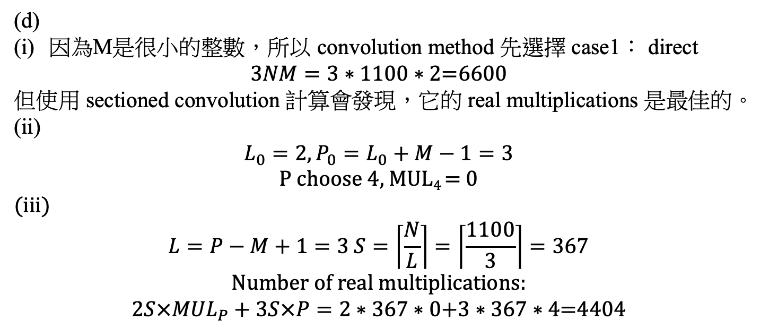
(6) Suppose that length(x[n]) = 1100. What is the best way to implement the convolution of x[n] and y[n] if
(a) length(y[n]) = 500, (b) length(y[n]) = 40,
(c) length(y[n]) = 6, and (d) length(y[n]) = 2 ? (25 scores)
Please show (i) the convolution method (direct, sectioned convolution, or non-sectioned convolution), (ii) the number of points of the FFT, (iii) and the number of real multiplications for the best implementation method. Also, consider the general case where x[n] and y[n] are complex sequences and the FFT of y[n] can be computed in prior.
(d)
因為M是很小的整數，所以 convolution method 先選擇 case1： direct
$$3NM=3∗\text{1100}∗\text{2}\text{=}\text{6600}$$
但使用 sectioned convolution 計算會發現，它的 real multiplications 是最佳的。
(ii)
$$L_{0}=2, P_{0}=L_{0}+M−1=3$$
P choose 4, MUL₄ = 0
(iii)
$$L=P−M+1=3 S=\left\lceil \frac{N}{L}\right\rceil =\left\lceil \frac{1100}{3}\right\rceil =367$$
Number of real multiplications:
$$2S×{MUL}_{P}+3S×P=2∗367∗0\text{+3}∗\text{367}∗\text{4}\text{=}\text{4404}$$

Slide 11
(Extra): Answer the questions according to your student ID number.
(ended with (2, 7), (3, 8), (4, 9), (0, 5))

