Slide 1
Homework 2 (Due: 4/12)
(1) Write a Matlab or Python code that uses the frequency sampling method to design a (2k+1)-point discrete differentiation filter H(F) = j2πF when -0.5 < F < 0.5 (k is an input parameter and can be any integer). (25 scores)
The transition band is assigned to reduce the error (unnecessary to optimize). (i) The impulse response and (ii) the imaginary part of the frequency response (DTFT of r[n], see pages 113 and 114) of the designed filter should be shown. The code should be handed out by NTU Cool.

Slide 2
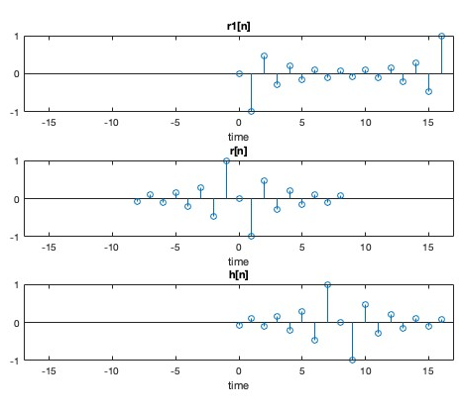
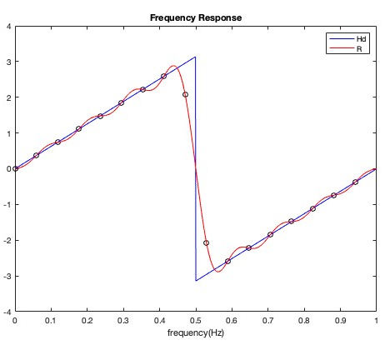
impulse response
the imaginary part of the frequency response
(i)
(ii)

Slide 3

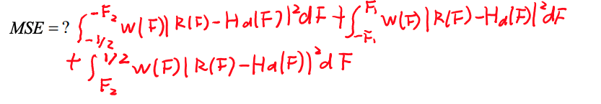
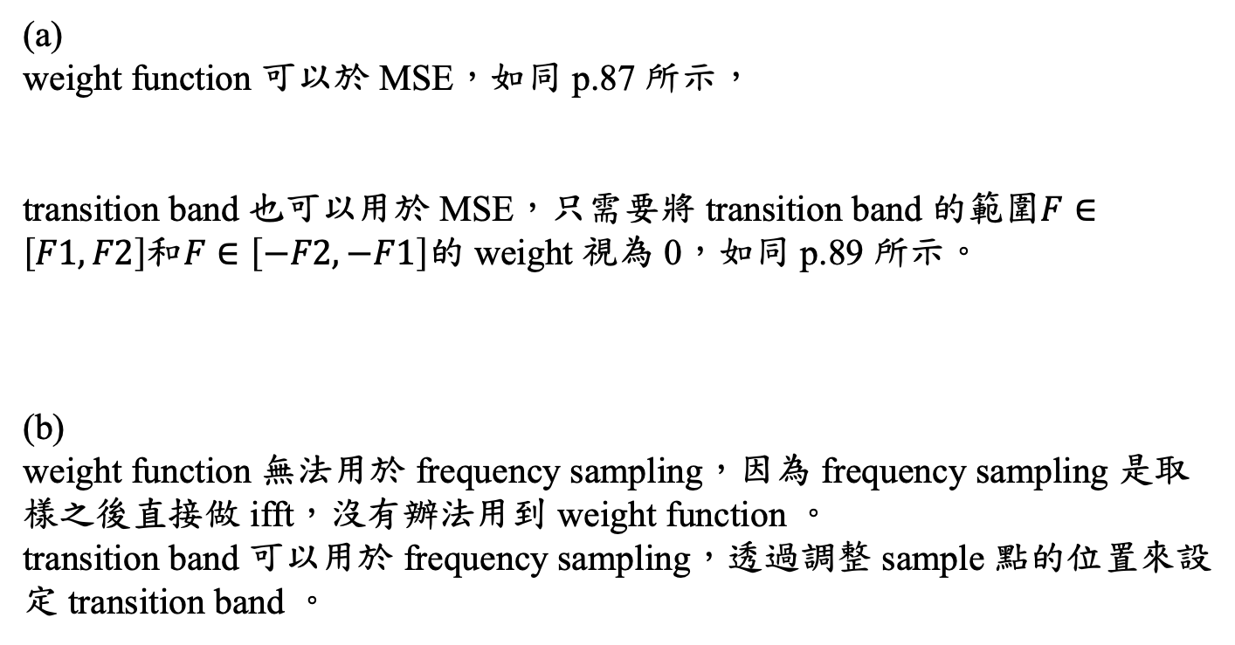
(2) Can the techniques of the weight function and the transition band be applied in the FIR filter designed by (a) the MSE method and (b) the frequency sampling method? Why? (10 scores)
(a)
weight function 可以於 MSE，如同 p.87 所示，
transition band 也可以用於 MSE，只需要將 transition band 的範圍$F∈\left[F1,F2\right]$和$F∈\left[−F2,−F1\right]$的 weight 視為 0，如同 p.89 所示。
(b)
weight function 無法用於 frequency sampling，因為 frequency sampling 是取樣之後直接做 ifft，沒有辦法用到 weight function 。
transition band 可以用於 frequency sampling，透過調整 sample 點的位置來設定 transition band 。

Slide 4
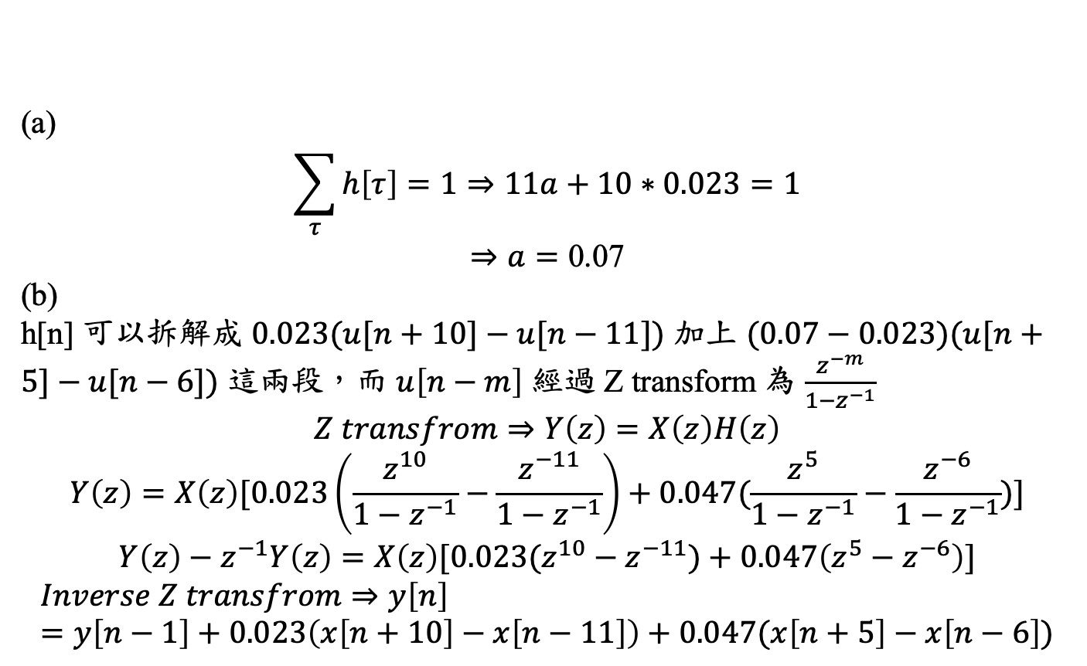
(3) Suppose that the smooth filter is h[n] = a for |n| ≦ 5, h[n] = 0.023 for 6 ≦ |n| ≦ 10, and h[n] = 0 otherwise. (a) What is the value of a? (b) What is the efficient way to implement the convolution y[n] = x[n] * h[n]? (10 scores)
(a)
$$\sum_{τ}{h\left[τ\right]=1}⇒11a+10∗0.023=1$$
$$⇒a=\text{0.07}$$
(b)
h[n] 可以拆解成 $0.023(u[n+10]−u[n−11])$ 加上 $(0.07−0.023)(u[n+5]−u[n−6])$ 這兩段，而 $u\left[n−m\right]$ 經過 Z transform 為 $\frac{z^{−m}}{1−z^{−1}}$
$$Z transfrom⇒Y\left(z\right)=X\left(z\right)H\left(z\right)$$
$$Y\left(z\right)=X\left(z\right)[0.023\left(\frac{z^{10}}{1−z^{−1}}−\frac{z^{−11}}{1−z^{−1}}\right)+0.047(\frac{z^{5}}{1−z^{−1}}−\frac{z^{−6}}{1−z^{−1}})]$$
$$Y\left(z\right)−z^{−1}Y\left(z\right)=X\left(z\right)[0.023(z^{10}−z^{−11})+0.047\left(z^{5}−z^{−6}\right)]$$
$$Inverse Z transfrom⇒y\left[n\right]=y\left[n−1\right]+0.023\left(x\left[n+10\right]−x\left[n−11\right]\right)+0.047(x\left[n+5\right]−x\left[n−6\right])$$

Slide 5
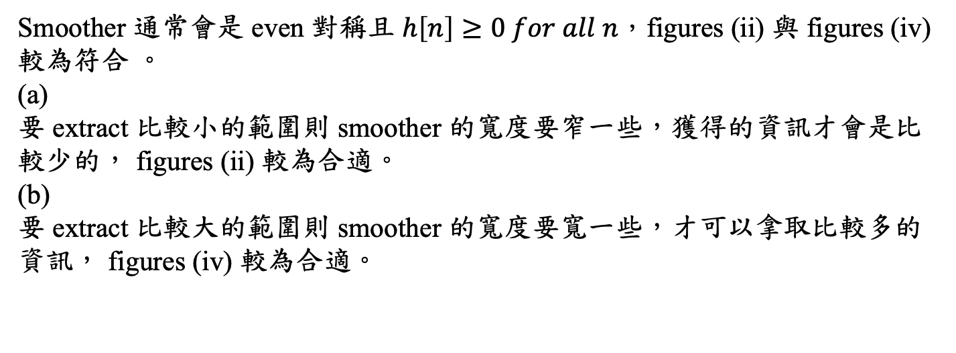
(4) The following figures are the impulse responses of some filters. Which one is a suitable smoother when we want to extract (a) small scaled features? (b) large scaled features? Also illustrate the reasons. (10 scores)
(i)
(ii)
(iii)
(iv)
Smoother 通常會是 even 對稱且 $h\left[n\right]≥0 for all n，\text{figures} \text{(}\text{ii}\text{)}$ 與 $\text{figures} \text{(}\text{iv}\text{)}$較為符合 。
(a)
要 extract 比較小的範圍則 smoother 的寬度要窄一些，獲得的資訊才會是比較少的， $\text{figures} \text{(}\text{ii}\text{)}$ 較為合適。
(b)
要 extract 比較大的範圍則 smoother 的寬度要寬一些，才可以拿取比較多的資訊， $\text{figures} \text{(}\text{iv}\text{)}$ 較為合適。

Slide 6
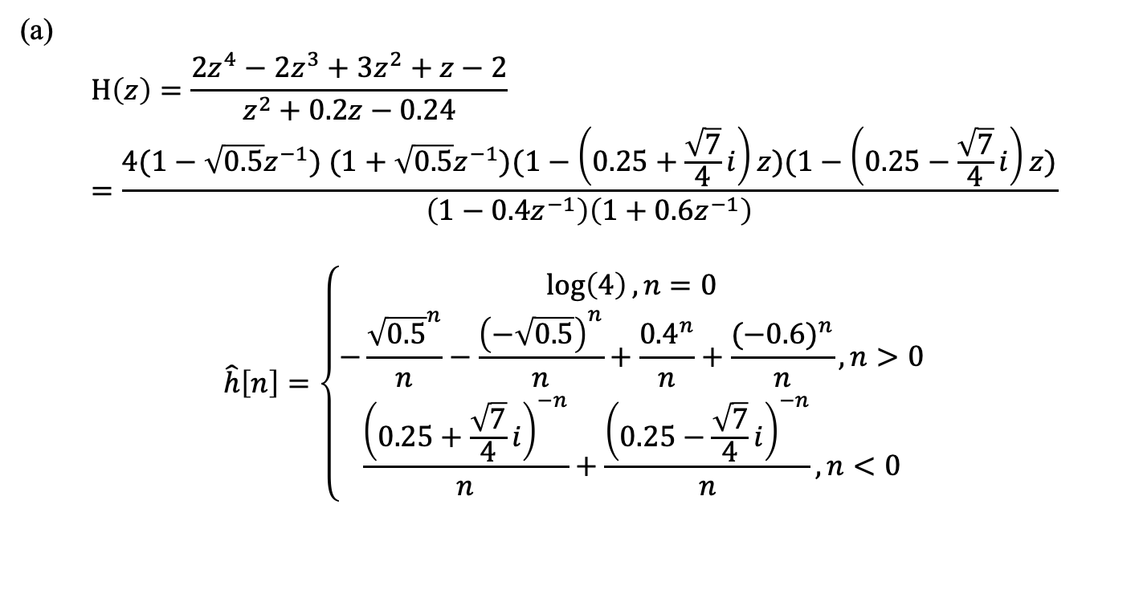
(5) If the z-transform of h[n] is
(a) Determine the cepstrum of h[n].
(Hint: z = 2^{-0.5} is one of the zeros of H(z))
(b) Convert the IIR filter into the minimum phase filter.
(20 scores)
(a)
$$H\left(z\right)=\frac{2z^{4}−2z^{3}+3z^{2}+z−2}{z^{2}+0.2z−0.24}=\frac{4(1−\sqrt{0.5}z^{−1}) (1+\sqrt{0.5}z^{−1})(1−\left(0.25+\frac{\sqrt{7}}{4}i\right)z)(1−\left(0.25−\frac{\sqrt{7}}{4}i\right)z)}{\left(1−0.4z^{−1}\right)\left(1+0.6z^{−1}\right)}$$
$$\hat{h}\left[n\right]=\left\{\begin{aligned}\log\left(4\right), n=0 \\ −\frac{{\sqrt{0.5}}^{n}}{n}−\frac{{\left(−\sqrt{0.5}\right)}^{n}}{n}+\frac{{0.4}^{n}}{n}+\frac{{(−0.6)}^{n}}{n}, n>0 \\ \frac{{\left(0.25+\frac{\sqrt{7}}{4}i\right)}^{−n}}{n}+\frac{{\left(0.25−\frac{\sqrt{7}}{4}i\right)}^{−n}}{n}, n<0\end{aligned}\right.$$

Slide 7
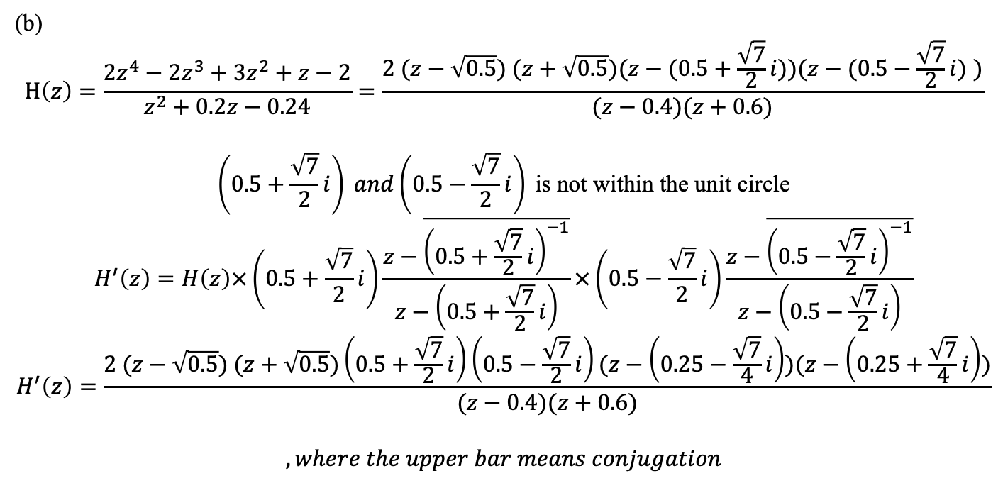
(5) If the z-transform of h[n] is
(a) Determine the cepstrum of h[n].
(Hint: z = 2^{-0.5} is one of the zeros of H(z))
(b) Convert the IIR filter into the minimum phase filter.
(20 scores)
(b)
$$H\left(z\right)=\frac{2z^{4}−2z^{3}+3z^{2}+z−2}{z^{2}+0.2z−0.24}=\frac{2 (z−\sqrt{0.5}) (z+\sqrt{0.5})(z−(0.5+\frac{\sqrt{7}}{2}i))(z−(0.5−\frac{\sqrt{7}}{2}i) )}{(z−0.4)(z+0.6)}$$
$$\left(0.5+\frac{\sqrt{7}}{2}i\right) and\left(0.5−\frac{\sqrt{7}}{2}i\right) \text{is} \text{not} \text{within} \text{the} \text{unit} \text{circle}$$
$$H^{′}\left(z\right)=H\left(z\right)×\left(0.5+\frac{\sqrt{7}}{2}i\right)\frac{z−\overline{{\left(0.5+\frac{\sqrt{7}}{2}i\right)}^{−1}}}{z−\left(0.5+\frac{\sqrt{7}}{2}i\right)}×\left(0.5−\frac{\sqrt{7}}{2}i\right)\frac{z−\overline{{\left(0.5−\frac{\sqrt{7}}{2}i\right)}^{−1}}}{z−\left(0.5−\frac{\sqrt{7}}{2}i\right)}$$
$$H^{′}\left(z\right)=\frac{2 (z−\sqrt{0.5}) (z+\sqrt{0.5})\left(0.5+\frac{\sqrt{7}}{2}i\right)\left(0.5−\frac{\sqrt{7}}{2}i\right)(z−\left(0.25−\frac{\sqrt{7}}{4}i\right))(z−\left(0.25+\frac{\sqrt{7}}{4}i\right))}{(z−0.4)(z+0.6)}$$
$$,where the upper bar means conjugation$$

Slide 8
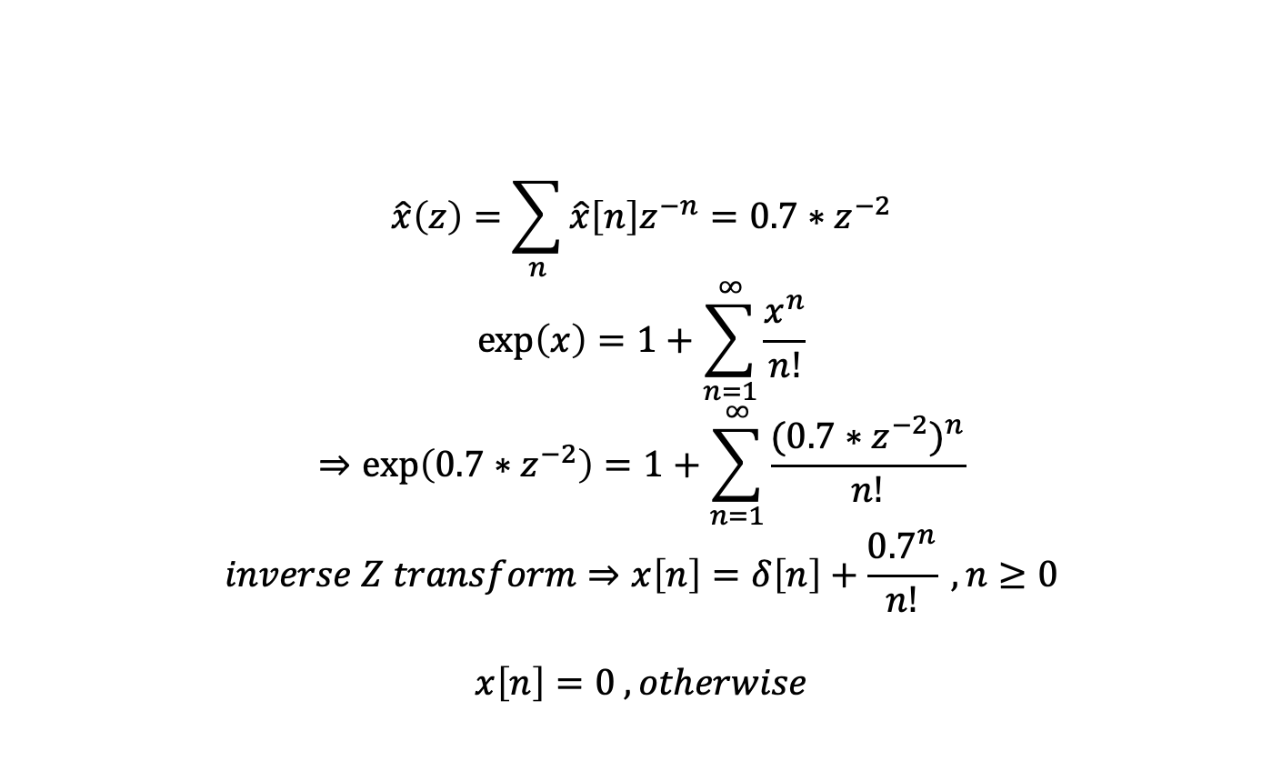
(6) Suppose that the cepstrum of a signal x[n] is
Determine x[n] using the Z transform and exp( ). (10 scores)
$$\hat{x}\left(z\right)=\sum_{n}{\hat{x}\left[n\right]z^{−n}=0.7∗z^{−2}}$$
$$\exp\left(x\right)=1+\sum_{n=1}^{∞}{\frac{x^{n}}{n!}}$$
$$⇒\exp\left(0.7∗z^{−2}\right)=1+\sum_{n=1}^{∞}{\frac{{(0.7∗z^{−2})}^{n}}{n!}}$$
$$inverse Z transform⇒x\left[n\right]=δ\left[n\right]+\frac{{0.7}^{n}}{n!} , n≥0$$
$$x\left[n\right]=0 , otherwise$$

Slide 9
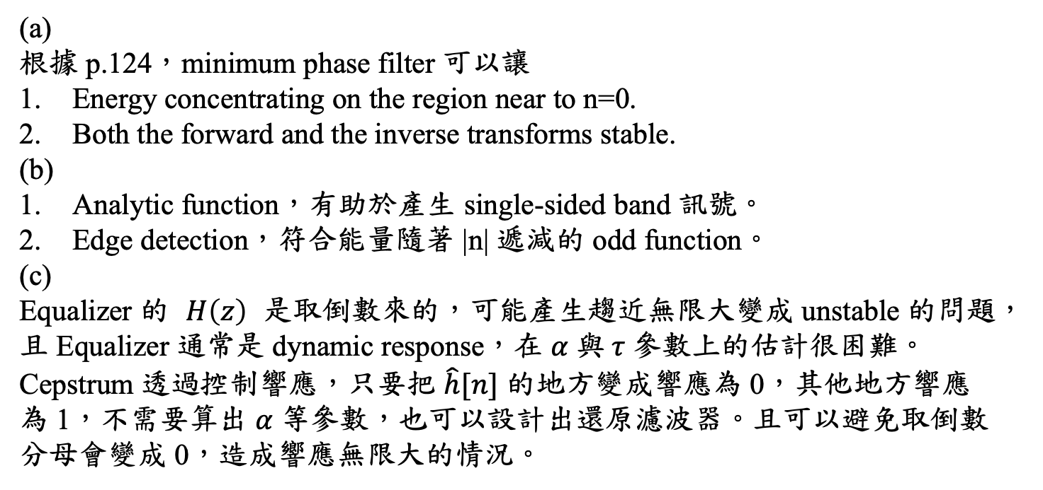
(7) (a) What are the two main advantages of the minimum phase filter? (b) In addition to time-frequency analysis, what are two main applications of the Hilbert transform? (c) Compared to the equalizer, what are the two main advantages of the cepstrum to deal with the multipath problem? (15 scores)
(a)
根據 p.124，minimum phase filter 可以讓
Energy concentrating on the region near to n=0.
Both the forward and the inverse transforms stable.
(b)
Analytic function，有助於產生 single-sided band 訊號。
Edge detection，符合能量隨著 |n| 遞減的 odd function。
(c)
Equalizer 的 $H\left(z\right)$是取倒數來的，可能產生趨近無限大變成 unstable 的問題，且 Equalizer 通常是 dynamic response，在 $α 與 τ$參數上的估計很困難。
Cepstrum 透過控制響應，只要把 $\hat{h}[n]$ 的地方變成響應為 0，其他地方響應為 1，不需要算出 $α 等$參數，也可以設計出還原濾波器。且可以避免取倒數分母會變成 0，造成響應無限大的情況。

Slide 10
(Extra): Answer the questions according to your student ID number.
(ended with (4, 9), (0, 5), (1, 6), (2, 7))
Q：
Matched filter 在訊號處理中主要可以用來做什麼？
A：
Matched filter 可以透過做 time reverse 的方式找到目標物件，在訊號處理中通常是用來做物件偵測 pattern recognition 以及 similarity measurement。

