Slide 1
Homework 1 (Due: March 22nd)
(1) Design a Mini-max highpass FIR filter such that (40 scores)
① Filter length = 21, ② Sampling frequency f_{s} = 8000Hz,
● Pass Band 1800~4000Hz  Transition band: 1600~2000 Hz,
■ Weighting function: W(F) = 1 for passband, W(F) = 0.8 for stop band .
□ Set Δ = 0.0001 in Step 5.
0 Hz
1600 Hz
1800 Hz
2000 Hz
※ The code should be handed out by NTUCool, too.
Show (a) the frequency response, (b) the impulse response h[n], and
(c) the maximal error for each iteration.

Slide 2
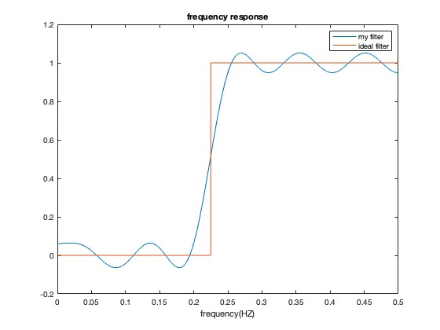
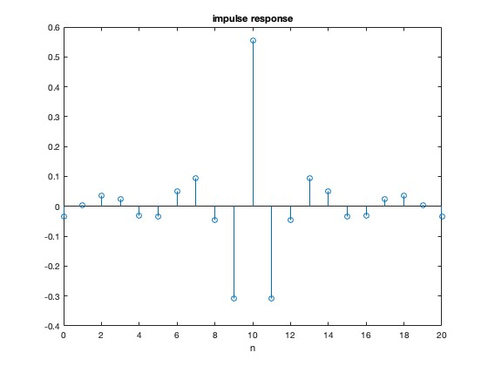

the frequency response
(b) the impulse response h[n]
(c) the maximal error for each iteration.

Slide 3
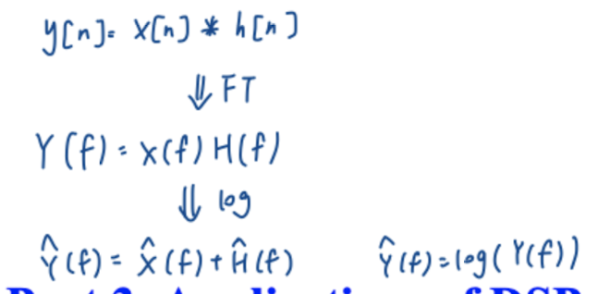
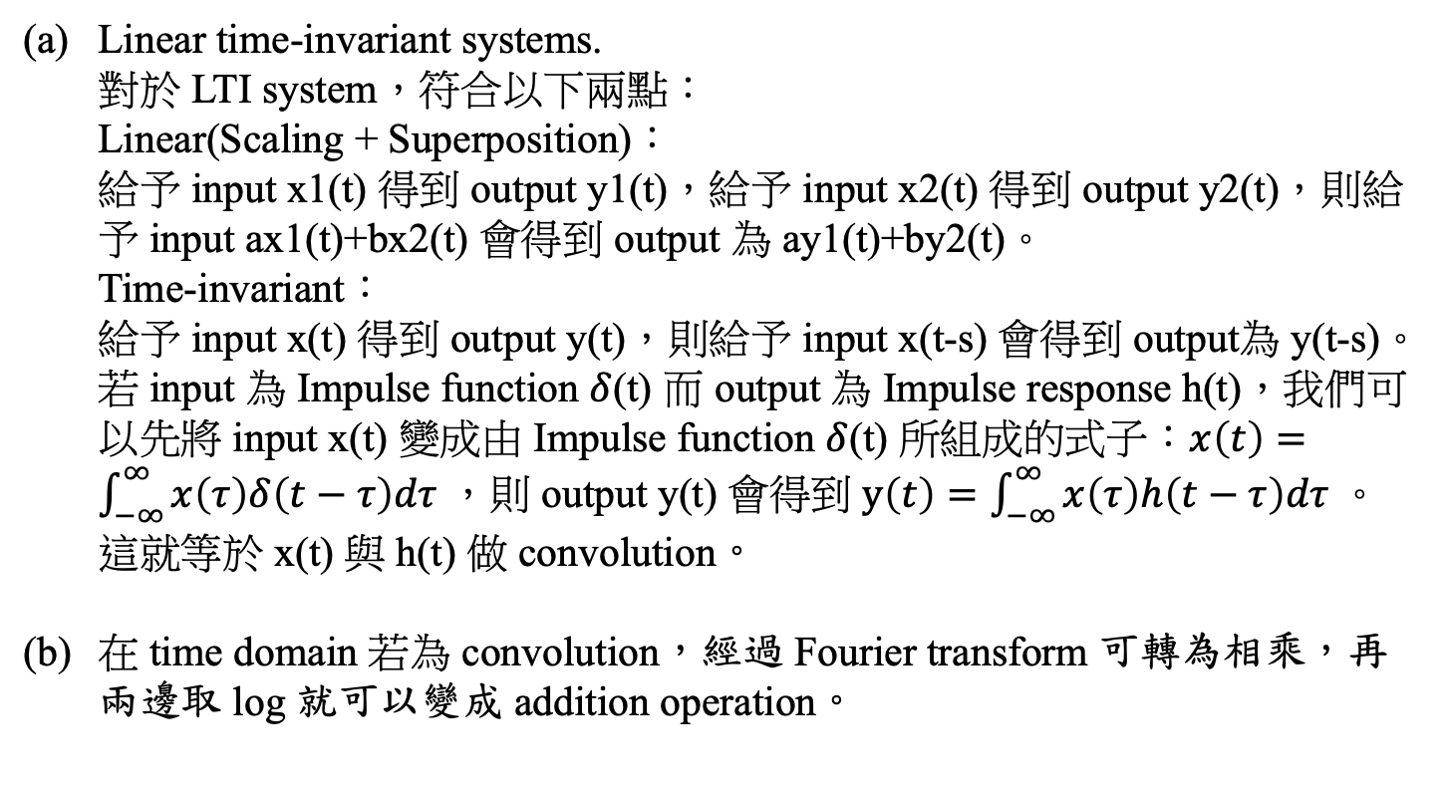
(2) (a) Which type of systems can be implemented by convolution?
(b) How do we convert convolution into an addition operation? (10 scores)
Linear time-invariant systems.
對於 LTI system，符合以下兩點：
Linear(Scaling + Superposition)：
給予 input x1(t) 得到 output y1(t)，給予 input x2(t) 得到 output y2(t)，則給予 input ax1(t)+bx2(t) 會得到 output 為 ay1(t)+by2(t)。
Time-invariant：
給予 input x(t) 得到 output y(t)，則給予 input x(t-s) 會得到 output為 y(t-s)。
若 input 為 Impulse function $δ$(t) 而 output 為 Impulse response h(t)，我們可以先將 input x(t) 變成由 Impulse function $δ$(t) 所組成的式子：$x\left(t\right)=\int_{−∞}^{∞}{x\left(τ\right)δ\left(t−τ\right)dτ}$ ，則 output y(t) 會得到 $y\left(t\right)=\int_{−∞}^{∞}{x\left(τ\right)h\left(t−τ\right)dτ}$ 。
這就等於 x(t) 與 h(t) 做 convolution。
在 time domain 若為 convolution，經過 Fourier transform 可轉為相乘，再兩邊取 log 就可以變成 addition operation。

Slide 4
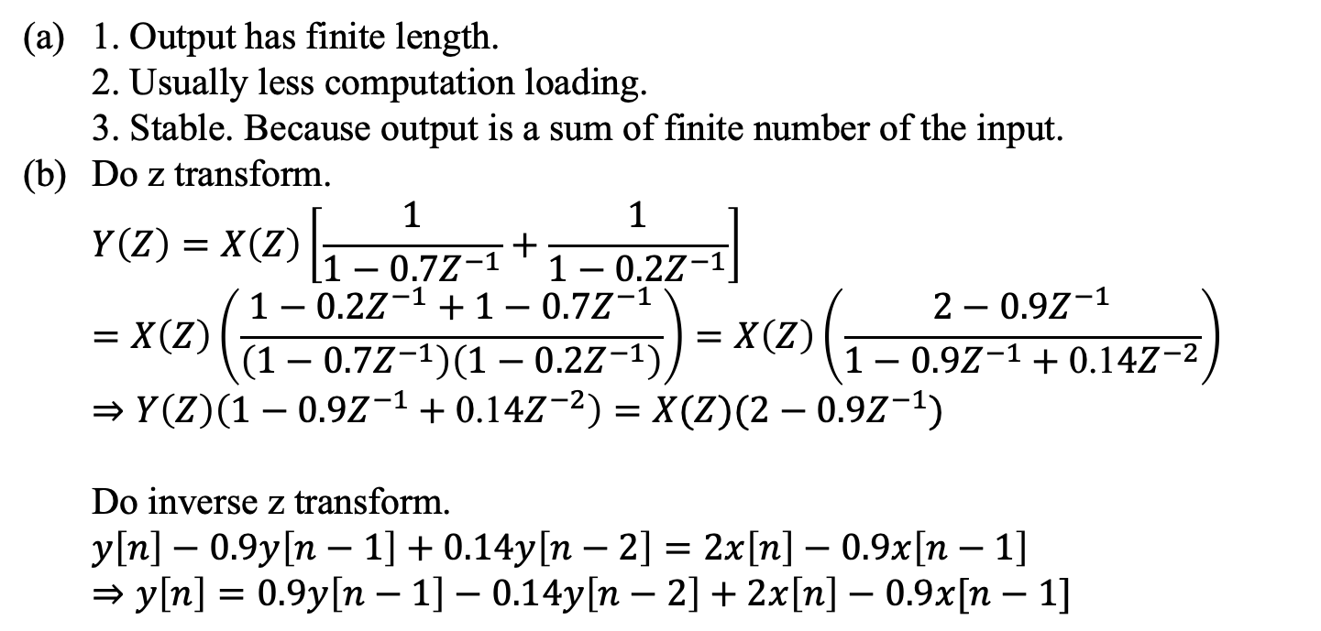
(3) (a) Describe three advantages of the FIR filter.
(b) How do we implement y[n] = x[n] *(0.7^{n}u[n]+ 0.2^{n}u[n]) using the recursive method where * means the convolution and u[n] is the unit step function?
(10 scores)
1. Output has finite length.
2. Usually less computation loading.
3. Stable. Because output is a sum of finite number of the input.
Do z transform.
$$Y\left(Z\right)=X\left(Z\right)\left[\frac{1}{1−0.7Z^{−1}}+\frac{1}{1−0.2Z^{−1}}\right]=X\left(Z\right)\left(\frac{1−0.2Z^{−1}+1−0.7Z^{−1}}{\left(1−0.7Z^{−1}\right)\left(1−0.2Z^{−1}\right)}\right)=X\left(Z\right)\left(\frac{2−{0.9Z}^{−1}}{1−{0.9Z}^{−1}+\text{0.1}4Z^{−2}}\right)$$
$$⇒Y\left(Z\right)\left(1−{0.9Z}^{−1}+\text{0.1}4Z^{−2}\right)=X(Z)(2−{0.9Z}^{−1})$$
Do inverse z transform.
$$y\left[n\right]−0.9y\left[n−1\right]+0.14y\left[n−2\right]=2x\left[n\right]−0.9x\left[n−1\right]$$
$$⇒y\left[n\right]=0.9y\left[n−1\right]−0.14y\left[n−2\right]+2x\left[n\right]−0.9x[n−1]$$

Slide 5
(4) What are the roles of (a) the transition band and (b) the weight function for minimax FIR filter design? (10 scores)
(a)
在不增加濾波器的點數的情況下，transition band可以讓誤差減少。 transition band越寬，設計出來的濾波器就相對平緩，passband 和 stopband的誤差就可以變小。有transition band的話，才有機會讓誤差<0.5。
(b)
可以透過給予passband 和stopband不同加權，在特定頻帶規定誤差要比較小， weight 就給大一點，在某些頻帶誤差允許大一些， weight就給小一點。

Slide 6
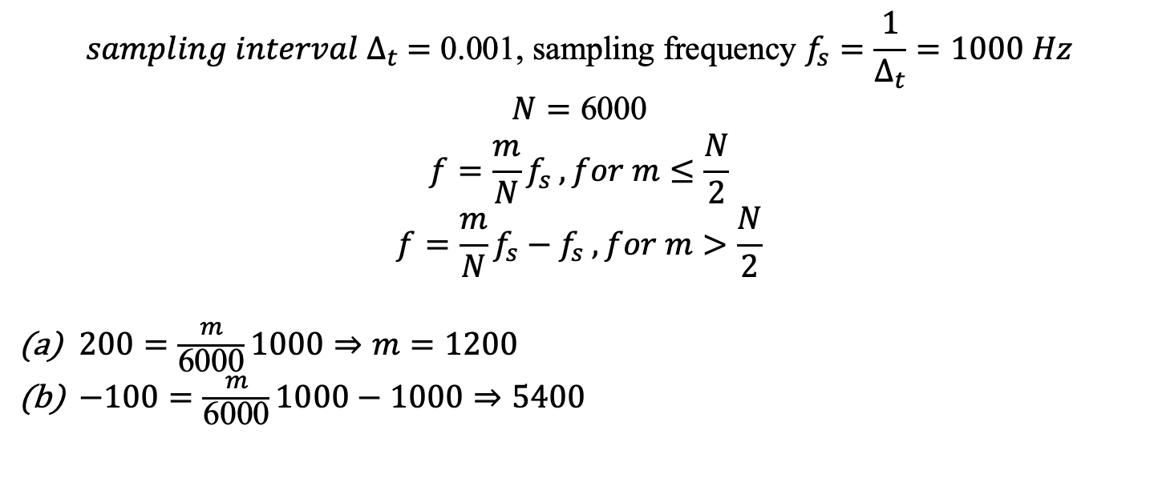
(5) Suppose that x[n] = y(0.001n) and the length of x[n] is 6000. If X[m] is the FFT of x[n], determine m such that X[m] correspond to the frequencies of (a) 200Hz and (b) -100Hz. (10 scores)
$${sampling interval ∆}_{t} =\text{0.001}\text{,} \text{sampling} \text{frequency} f_{s}=\frac{1}{∆_{t}}=1000 Hz$$
$$N=\text{6000}$$
$$f=\frac{m}{N}f_{s} , for m≤\frac{N}{2}$$
$$f=\frac{m}{N}f_{s}−f_{s} , for m>\frac{N}{2}$$
$200=\frac{m}{\text{6000}}1000⇒m=1200$
$−100=\frac{m}{\text{6000}}1000−1000⇒5400$

Slide 7
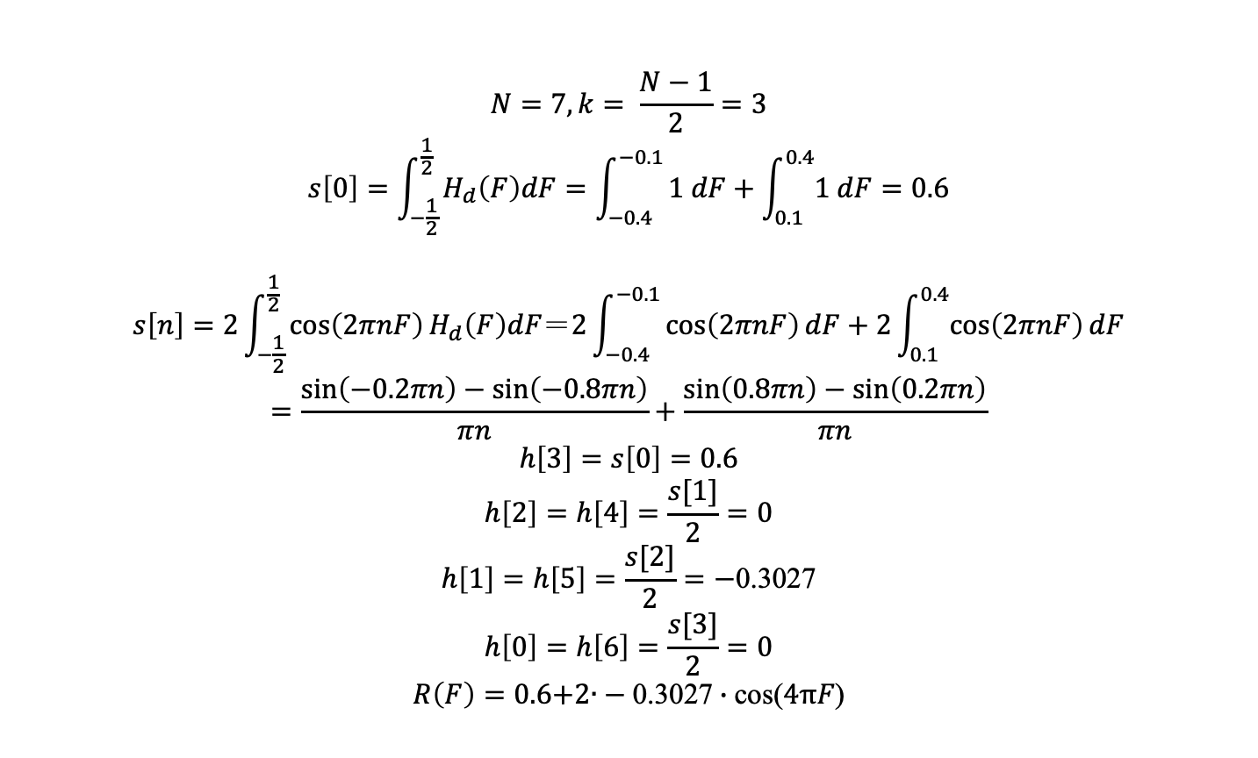
(6) Use the MSE method to design the 7-point FIR filter that approximates the band filter of H_{d}(F) = 1 for 0.1 < |F| < 0.4 and H_{d}(F) = 0 for |F| < 0.1 or |F| >0.4.
(10 scores)
$$N=7, k= \frac{N−1}{2}=3$$
$$s\left[0\right]=\int_{−\frac{1}{2}}^{\frac{1}{2}}{H_{d}\left(F\right)dF=\int_{−0.4}^{−0.1}{1 dF+\int_{0.1}^{0.4}{1 dF=0.6}}}$$
$$s\left[n\right]=2\int_{−\frac{1}{2}}^{\frac{1}{2}}{\cos\left(2πnF\right)H_{d}\left(F\right)dF＝2\int_{−0.4}^{−0.1}{\cos\left(2πnF\right)dF+2\int_{0.1}^{0.4}{\cos\left(2πnF\right)dF}}}$$
$$=\frac{\sin\left(−0.2πn\right)−\sin\left(−0.8πn\right)}{πn}+\frac{\sin\left(0.8πn\right)−\sin\left(0.2πn\right)}{πn}$$
$$h\left[3\right]=s\left[0\right]=0.6$$
$$h\left[2\right]=h\left[4\right]=\frac{s[1]}{2}=0$$
$$h\left[1\right]=h\left[5\right]=\frac{s[2]}{2}=−\text{0.3027}$$
$$h\left[0\right]=h\left[6\right]=\frac{s[3]}{2}=0$$
$$R\left(F\right)=0.6\text{+2}\text{∙}−\text{0.3027}∙\text{cos}\text{(}4πF\text{)}$$

Slide 8
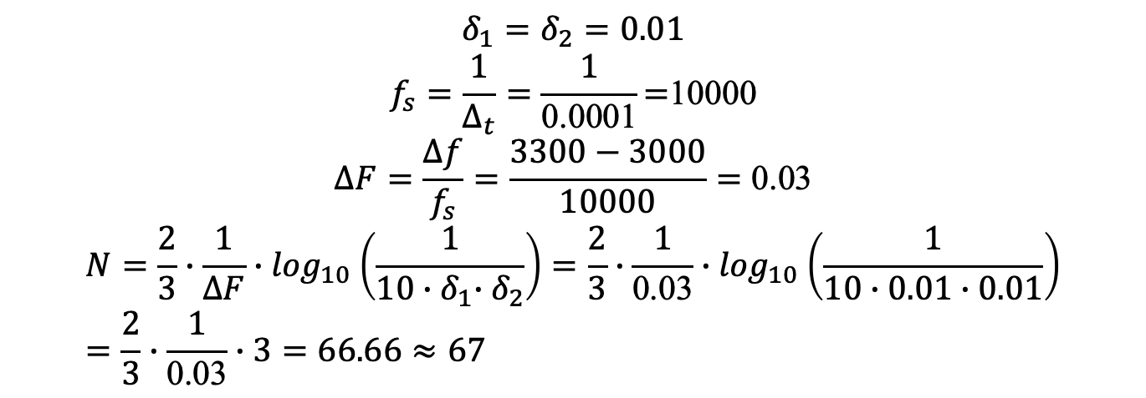
(7) Estimate the length of the digital filter if both the passband ripple and the stopband ripple are smaller than 0.01, the sampling interval Δ_{t} = 0.0001, and the transition band is from 3000Hz to 3300Hz. (10 scores)
$$δ_{1}=δ_{2}=0.01$$
$$f_{s}=\frac{1}{∆_{t}}=\frac{1}{\text{0.0001}}\text{=}\text{10000}$$
$$∆F=\frac{∆f}{f_{s}}=\frac{3300−3000}{10000}=\text{0.03}$$
$$N=\frac{2}{3}∙\frac{1}{∆F}{∙log}_{10}\left(\frac{1}{10{∙δ}_{1}{∙δ}_{2}}\right)=\frac{2}{3}∙\frac{1}{\text{0.03}}{∙log}_{10}\left(\frac{1}{10∙0.01∙0.01}\right)=\frac{2}{3}∙\frac{1}{\text{0.03}}∙3=66.66≈67$$

Slide 9
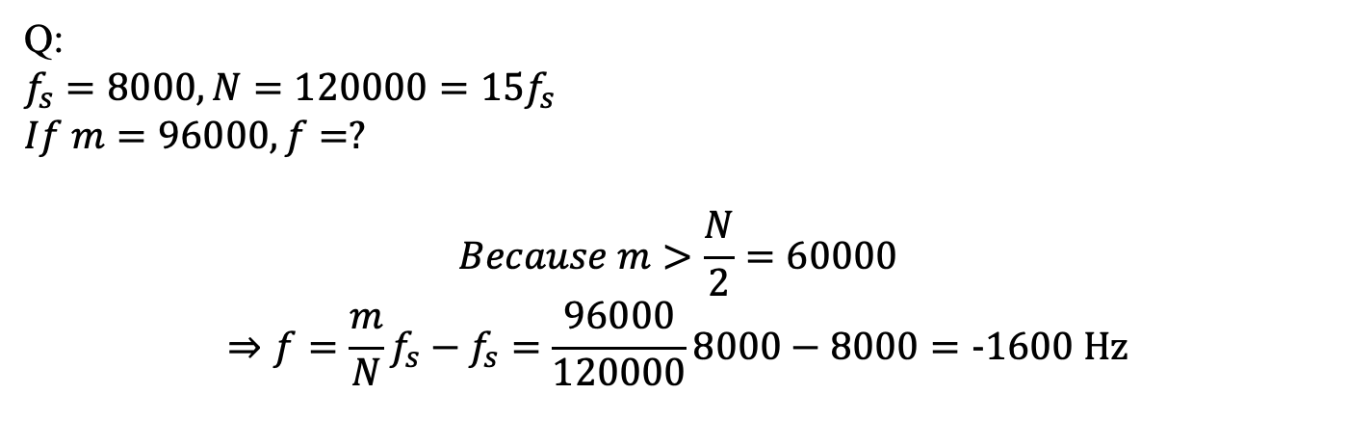
(Extra): Answer the questions according to your student ID number.
(ended with 0, 1, 2, 3, 5, 6, 7, 8)
Q:
$$f_{s}=8000, N=120000=15f_{s}$$
$$If m=96000, f=?$$
$$Because m>\frac{N}{2}=60000$$
$$⇒f=\frac{m}{N}f_{s}−f_{s}=\frac{96000}{120000}8000−8000=\text{−1600} \text{Hz}$$

