Slide 1
統計學一上 Chapter 4 : Numerical Descriptive Techniques
Oct. 11, 2017
By
Ching-Chin Chern

Slide 2
Agenda
Measures of Central Location
Measures of Variability
Measures of Relative Standing
Measures of Linear Relationship

Slide 3
Measures of Variability
Range
Variance
Standard Deviation
Coefficient of Variation

Slide 4
Computation of Standard Deviation
The standard deviation of a set of measurements is the square root of the variance of the measurements.

Slide 5
Why Standard Deviation?
Variance: squaring the original observations => Square the unit
e.g., variance of minutes => minute squared, variance of dollars => dollar squared
Goal: the measure of variability is expressed in the same unit as the original observations

Slide 6
Usage of Standard Deviation
Compare the variability of several distributions
Make a statement about the general shape of a distribution: apply Empirical rule or Chebyshev theorem

Slide 7
Measures of Variability
Range
Variance
Standard Deviation
Coefficient of Variation

Slide 8
The Coefficient of Variation
The standard deviation divided by the mean value. (Mean is used as the base value.)
This coefficient provides a proportionate measure of variation.

Slide 9
The Coefficient of Variation
A standard deviation of 10 may be perceived as large when the mean value is 100, but only moderately large when the mean value is 500.
Sample:
Population:

Slide 10
Example
Rates of return over the past 10 years for two mutual funds are shown below. Which one have a higher level of risk?
Fund A: 8.3, -6.2, 20.9, -2.7, 33.6, 42.9, 24.4, 5.2, 3.1, 30.05
Fund B: 12.1, -2.8, 6.4, 12.2, 27.8, 25.3, 18.2, 10.7, -1.3, 11.4

Slide 11
Compute CV
Fund A should be considered riskier because its coefficient of variability is larger

Slide 12
What if?
If
21
Fund A should be considered safer because its coefficient of variability is smaller.

Slide 13
The Break-Even Point
When will Fund A and Fund B are equally risky?
If average returns are fixed,
If standard deviations are fixed,

Slide 14
If and are fixed
Break-Even Point:
Fund A should have a return standard deviation of 13.2914 to be considered equally risky as Fund B.

Slide 15
If s_{A} and s_{B} are fixed
Break-Even Point:
Fund A should have a return of 20.1553 to be considered equally risky as Fund B.

Slide 16
Statistics is a Pattern Language
 | Population | Sample
Size | N | n
Mean
Variance
Standard Deviation |  | S
Coefficient of Variation | CV | cv

Slide 17
Agenda
Measures of Central Location
Measures of Variability
Measures of Relative Standing
Shape
Measures of Linear Relationship

Slide 18
Measures of Relative Standing and Box Plots
Describe another aspect of the shape of the distribution of data, and provide information about the relative standing of particular observations.

Slide 19
Example: GMAT
GMAT (Graduate Management Admission Test) is one of the requirements to enter an M.B.A. program. The score range from 200 to 800 with mean = 460.
Suppose your score is 600.
How well is your standing?

Slide 20
p^{th} Percentile
At most p% of the measurements are less than that value
At most 100(1-p)% of all the measurements are greater than that value.

Slide 21
p^{th} Percentile
Example: GMAT
Suppose 600 is the 78% percentile of a GMAT score. Then,
78% of all the scores lie here
22%
200
600
800

Slide 22
Location of Percentiles
Find the location of any percentile using the formula
where L_{p} is the location of the p^{th} percentile and n is the sample size

Slide 23
Example
Calculate the 25th, 50th, and 75th percentile of the following data :
0, 0, 5, 7, 8, 9, 12, 14, 22, 33.

Slide 24
25th Percentiles
After sorting the data, we have 0, 0, 5, 7, 8, 9, 12, 14, 22, 33.
0 5
Values
3.75
0
2.75
Location
2 3
Location
1
Location 3
The 2.75th location
Translates to the value
(.75)(5 – 0) = 3.75
Linear Interpolation

Slide 25
50th Percentiles
0, 0, 5, 7, 8, 9, 12, 14, 22, 33
The 50th percentile is halfway between the fifth and sixth observations, 8 and 9.
In the middle between 8 and 9, that is 8.5.

Slide 26
75th Percentiles
0, 0, 5, 7, 8, 9, 12, 14, 22, 33
The 75th percentile is one quarter of the distance between the eighth and ninth observation, 14 and 22 = 14 + .25(22 – 14) = 16.
Eighth
observation
Ninth
observation

Slide 27
Find the p Percentile
Find the percentile (p) of any number when the location (L_{p}) is known
where L_{p} is the location of the p^{th} percentile and n is the sample size

Slide 28
Example
Given the following data:
0, 0, 5, 7, 8, 9, 12, 14, 22, 33, find the percentile location of number 12.

Slide 29
Find the p Percentile
0, 0, 5, 7, 8, 9, 12, 14, 22, 33
⇒ p = 63.6364
The 63.6364th percentile is at location 7 which refers to number 12.

Slide 30
Commonly Used Percentiles
First (lower) decile=10th percentile
First (lower) quartile, Q₁=25th percentile
Second (middle) quartile, Q₂=50th percentile (median)
Third quartile, Q₃=75th percentile
Ninth (upper) decile=90th percentile

Slide 31
Quartiles
Measure of Noncentral Tendency
Split Ordered Data into 4 Quarters
25%
25%
25%
25%
Q₁
Q₂
Q₃

Slide 32
Quartiles and Variability
Quartiles can provide an idea about the shape of a histogram
Q₁ Q₂ Q₃
Q₁ Q₂ Q₃
Positively skewed
histogram
Negatively skewed
histogram

Slide 33
Inter-Quartile Range (IQR, 間距範圍, 四分位距)
This is a measure of the spread of the middle 50% of the observations
Large value indicates a large spread of the observations
Inter-Quartile Range = Q₃ – Q₁

Slide 34
Box ( & Whisker) Plot
This is a pictorial display that provides the main descriptive measures of the data set.
1.5 (IQR)
1.5 (IQR)
Whisker
Whisker
S
Q₁
Q₂
Q₃
L

Slide 35
Outliers
An unusually large or small value in a sample.
Its validity is suspected and some investigation is needed.
Be removed from the main body of a sample.

Slide 36
Define Outliers
Compute Inter-Quartile range: IQR = Q₃ – Q₁
Compute lower fence: Q₁–1.5IQR
Compute upper fence: Q₃+1.5IQR
Any observations drop out of the fence is outliers.

Slide 37
Outliers
1.5 (IQR)
1.5 (IQR)
Whisker
Whisker
S
Q₁
Q₂
Q₃
L
Lower Fence
Upper Fence
Any observations drop out of the fence is outliers.

Slide 38
Example
Providing information concerning the monthly bills of new subscribers in the first month after signing on with a telephone company.

Slide 39
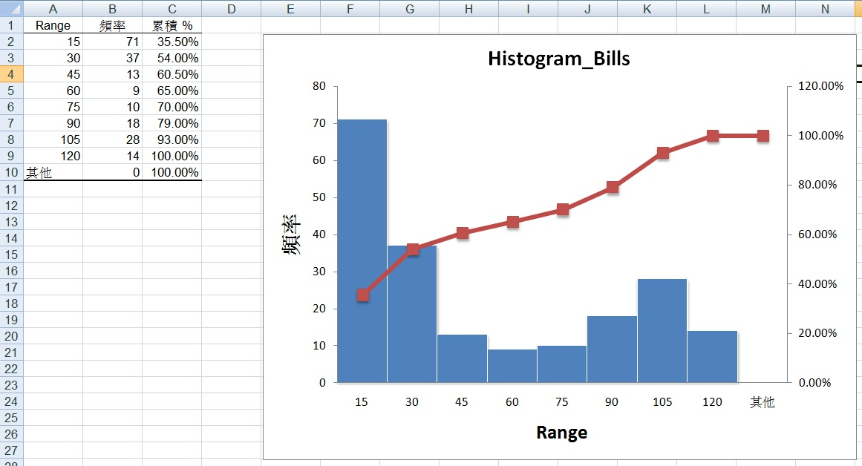
Excel Output

Slide 40
Box Plot
Lower Fence = 9.275–1.5(IQR) = -104.226
Upper Fence = 84.9425+1.5(IQR) = 198.4438
S=0
L=119.63
-104.226
9.275
84.9425
198.4438
26.905
No outliers are found

Slide 41
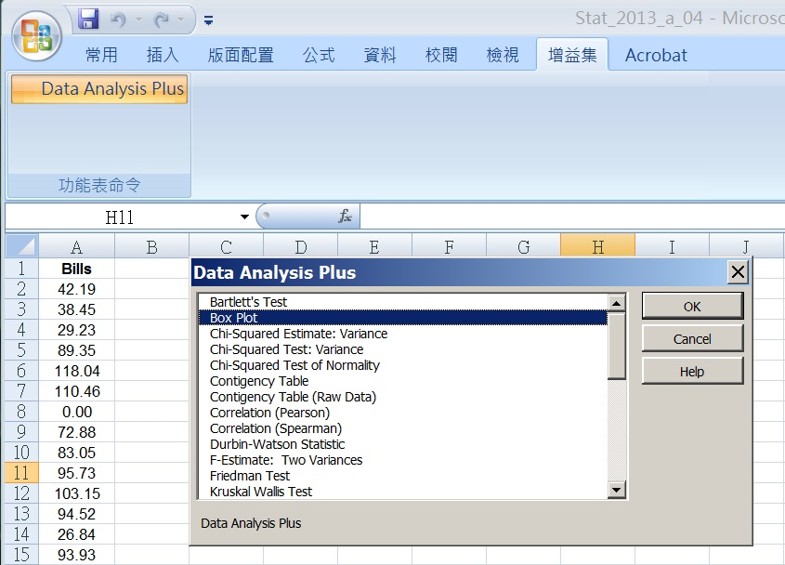
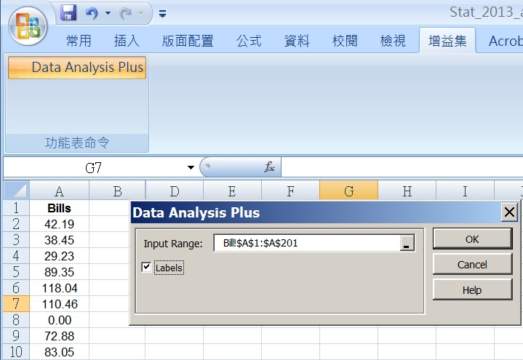
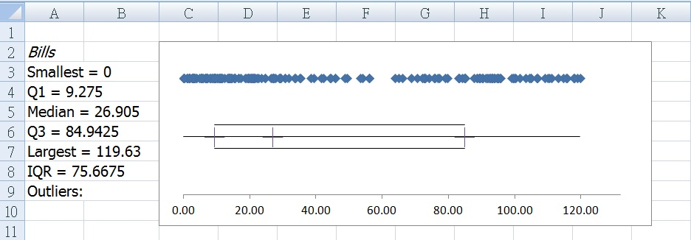
Excel Setup

Slide 42
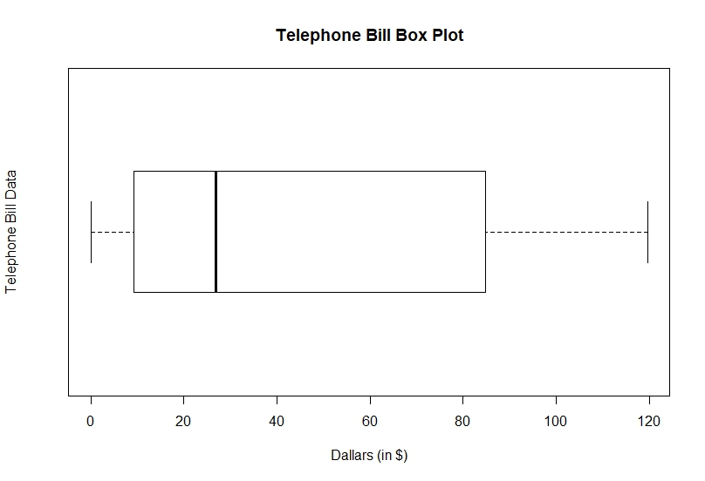
R Code for Box Plot
library(rJava)
library(XLConnect)
library(lmtest)
library(tseries)
library(snpar)
library(vcd)
library(MASS)
fileXls = "Telephone_bills.xlsx"
TB_data <- loadWorkbook(fileXls)
T_B <- readWorksheet(TB_data,1)
Bills <- T_B$Bills
n <- length(Bills)
boxplot(Bills, main="Telephone Bill Box Plot", xlab="Dallars (in $)", ylab="Telephone Bill Data", horizontal=TRUE)

Slide 43
Interpreting the Box Plot
…
0
Q₁
9.28
Q₂
26.91
Q₃
84.94
198.44
119.63
25%
50%
25%
The bills range from 0 to 119.63.
About half the bills are smaller than 26.91 and about half are larger than 26.91.
About half the bills lie between 9.28 and 84.94 and about a quarter lies below 9.28 and a quarter above 84.94.

Slide 44
Skewness
…
0
Q₁
9.28
Q₂
26.91
Q₃
84.94
198.44
119.63
25%
50%
25%
25%
25%
50%
The histogram is very strongly positively skewed

Slide 45
Example - GMAT
Create a box plot for the data regarding the GMAT scores of 200 applicants
449
417.5
512
537
575
669.5
788
512-1.5(IQR)
575+1.5(IQR)

Slide 46
Interpreting the Box Plot
Q₁
512
Q₂
537
Q₃
575
449
669.5
788
25%
50%
25%
The scores range from 449 to 788.
About half the scores are smaller than 537, and about half are larger than 537.
About half the scores lie between 512 and 575 and about a quarter lies below 512 and a quarter above 575.

Slide 47
Skewness
Q₁
512
Q₂
537
Q₃
575
669.5
788
449
25%
50%
25%
50%
25%
25%
The histogram is slightly positively skewed

Slide 48
Example
To examine the consistency of shots for a new innovative golf club, a golfer was asked to hit 150 shots, 75 with a currently used (7-iron) club, and 75 with the new club. The distances were recorded. Which 7-iron is more consistent?

Slide 49
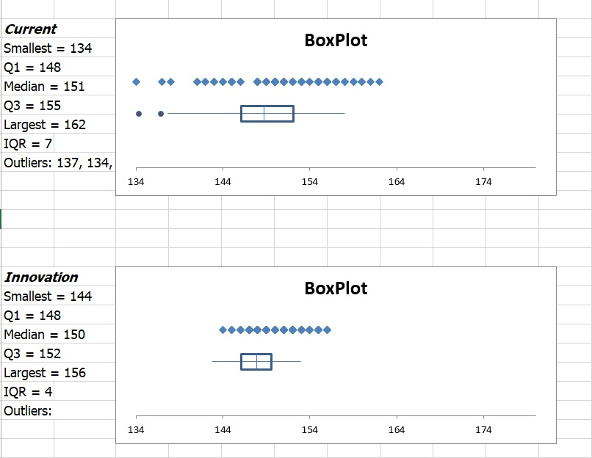
Excel Setup

Slide 50
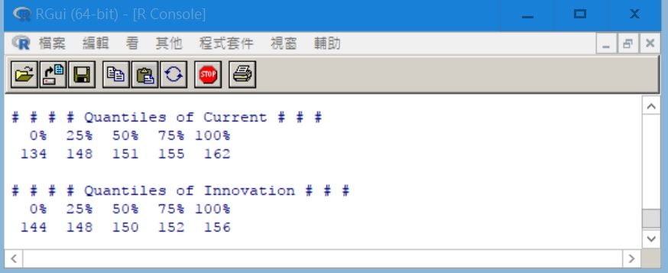
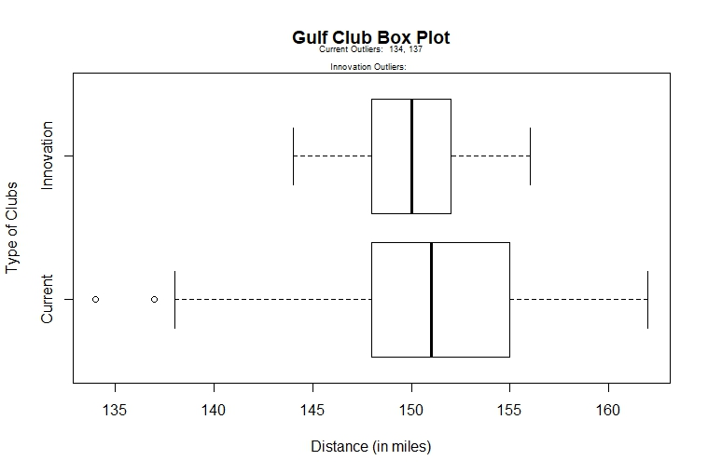
R Code for Box Plot
fileXls = "Gulf_Club.xlsx"
GC_data <- loadWorkbook(fileXls)
GC_CI <- readWorksheet(GC_data,1)
Current <- GC_CI$Current
Innovation <- GC_CI$Innovation
n <- length(Current)
cat("# # # # Quantiles of Current # # # ","\n")
Cur_quantile <- quantile(Current)
print(Cur_quantile)
cat(" ","\n")
cat("# # # # Quantiles of Innovation # # # ","\n")
Inv_quantile <- quantile(Innovation)
print(Inv_quantile)
Cur_outlier_values <- boxplot.stats(Current)$out # outlier values.
Inv_outlier_values <- boxplot.stats(Innovation)$out # outlier values.
boxplot(GC_CI, main="Gulf Club Box Plot", xlab="Distance (in miles)", ylab="Type of Clubs", horizontal=TRUE)
mtext(paste("Current Outliers: ", paste(Cur_outlier_values, collapse=", ")),cex = 0.6, line = 1)
mtext(paste("Innovation Outliers: ", paste(Inv_outlier_values, collapse=", ")), cex = 0.6, line = 0)
library(rJava)
library(XLConnect)
library(lmtest)
library(tseries)
library(snpar)
library(vcd)
library(MASS)

Slide 51
Example
A study was organized to compare the quality of service in 5 drive-through restaurants.
Interpret the results

Slide 52
Box Plot
Jack in the box is the slowest in service
Jack in the Box
Hardee’s service time variability is the largest
Hardee’s
McDonalds
Wendy’s
Wendy’s service time appears to be the shortest and most consistent with a few outliers
Popeyes

Slide 53
Skewness
Times are symmetric
Jack in the Box
Hardee’s
McDonalds
Times are positively skewed
Wendy’s
Popeyes

Slide 54
More Measures from Quartiles
Inter-Quartile Range (IQR) = Q₃ - Q₁
Midrange
Midhinge

Slide 55
Comparison
Mean =13.47
Median (Q₂) =12
Midrange =16
Midhinge = 13
Long right tail distribution

Slide 56
Agenda
Measures of Central Location
Measures of Variability
Measures of Relative Standing
Shape
Measures of Linear Relationship

Slide 57
Shape
Describes how data are distributed
Measures of shape
Skewness (Symmetry)
Kurtosis
Notes:
Shape
Concerned with extent to which values are symmetrically distributed.
Skew
The extent to which a distribution is symmetric or has a tail. Values are 0 if normal distribution. If the values are negative, then negative or left-skewed.

Slide 58
Measure of Movement
m₁ : 1st moment Σx/n ~ mean or x
m₂ : 2nd moment Σ(x - x)²/n ~ Variance
m₃ : 3rd moment Σ(x - x)³/n
m₄ : 4th moment Σ(x - x)⁴/n

Slide 59
Coefficient of Skewness
A measure of a data set’s deviation from symmetry.
g₁ > 0 : Skewed to right
g₁ = 0 : Symmetric
g₁ < 0 : Skewed to left

Slide 60
Coefficient of Skewness (Excel)
A measure of a data set’s deviation from symmetry.
g₂ > 0 : Skewed to right
g₂ = 0 : Symmetric
g₂ < 0 : Skewed to left

Slide 61
Skewness
Describes how data are distributed
Measures of shape
g₁ < 0
g₁ = 0
g₁ > 0
Left-Skewed
Symmetric
Right-Skewed
Mean
Median
Mode
Mean
=
Median
=
Mode
Mode
Median
Mean
Notes:
Shape
Concerned with extent to which values are symmetrically distributed.
Skew
The extent to which a distribution is symmetric or has a tail. Values are 0 if normal distribution. If the values are negative, then negative or left-skewed.

Slide 62
Computation of Skewness
x (x - x) (x - x)² (x - x)³
2 -1 1 -1
0 -3 9 -27
6 3 9 27
3 0 0 0
9 6 36 216
2 -1 1 -1
0 -3 9 -27
2 -1 1 -1
24 0 66 186
m₂ = 66/8
= 8.25
m₃ = 186/8
= 23.25
Skew to right

Slide 63
Coefficient of Kurtosis
A measure of a data set’s height.
K > 3 : Leptokurtic (Narrow-tall)
K = 3 : Mesokurtic (Regular)
K < 3 : Platykurtic (Wide-low)

Slide 64
Coefficient of Kurtosis (Excel)
A measure of a data set’s height.
K₂ > 0 : Leptokurtic (Narrow-tall)
K₂ = 0 : Mesokurtic (Regular)
K₂ < 0 : Platykurtic (Wide-low)

Slide 65
Kurtosis
Describes how data are distributed
Measures of shape
Regular
Narrow-tall
K = 3
K > 3
Wide-low
K < 3
Notes:
Shape
Concerned with extent to which values are symmetrically distributed.
Skew
The extent to which a distribution is symmetric or has a tail. Values are 0 if normal distribution. If the values are negative, then negative or left-skewed.

Slide 66
Kurtosis (Excel)
Describes how data are distributed
Measures of shape
Regular
Narrow-tall
K₂ = 0
K₂ > 0
Wide-low
K₂ < 0
Notes:
Shape
Concerned with extent to which values are symmetrically distributed.
Skew
The extent to which a distribution is symmetric or has a tail. Values are 0 if normal distribution. If the values are negative, then negative or left-skewed.

Slide 67
Example
m₂ = 66/8 = 8.25
m₄ = 1542/8 = 192.75
K = m₄/m₂^{4/2}
= 192.75/ (8.25)^{4/2}
= 2.83 < 3
~ Wide-low to regular

Slide 68
Kurtosis (Excel)
m₂ = 66/8
= 8.25
m₄ = 1542/8
= 192.75
Narrow-tall

Slide 69
Example
Rates of return over the past 10 years for two mutual funds are shown below. Which one have a higher level of risk?
Fund A: 8.3, -6.2, 20.9, -2.7, 33.6, 42.9, 24.4, 5.2, 3.1, 30.05
Fund B: 12.1, -2.8, 6.4, 12.2, 27.8, 25.3, 18.2, 10.7, -1.3, 11.4

Slide 70
Excel Output
g_{1,A} =0.1830
g_{1,B} =0.0902
K_{A} =1.6954
K_{B} =2.1921

Slide 71
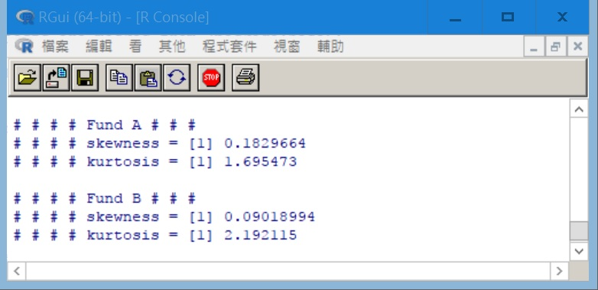
R Code
library(rJava)
library(XLConnect)
library(lmtest)
library(tseries)
library(snpar)
library(vcd)
library(MASS)
library(psych)
library(moments)
fileXls = "Funds_AB_example.xlsx"
ClubAB_data <- loadWorkbook(fileXls)
Club_AB <- readWorksheet(ClubAB_data,1)
Fund_A <- Club_AB$Fund_A
Fund_B <- Club_AB$Fund_B
n <- length(Fund_A)
cat("# # # # Fund A # # # ","\n")
cat("# # # # skewness = ")
print(skewness(Fund_A))
cat("# # # # kurtosis = ")
print(kurtosis(Fund_A))
cat(" ","\n")
cat("# # # # Fund B # # # ","\n")
cat("# # # # skewness = ")
print(skewness(Fund_B))
cat("# # # # kurtosis = ")
print(kurtosis(Fund_B))

Slide 72
Numerical Data Properties & Measures
Numerical
Data
Central
Tendency
Variation
Relative
Standing
Shape
Mean
Range
Percentile
Median
Skewness
Variance
Quartile
Mode
Standard
Deviation
Interquartile
Range
Kurtosis
Midrange
Midhinge
Coeff. of
Variation

Slide 73
General Guidelines for Exploring Data
Where is the approximate center of the distribution
Are the observation close or widely dispersed?
Modal class: Unimodal? Bimodal? Or multimodal?
Symmetric or skewed?

Slide 74
Agenda
Measures of Central Location
Measures of Variability
Measures of Relative Standing
Shape
Measures of Linear Relationship

Slide 75
Measures of Linear Relationship
Provide information as to the strength & direction of a linear relationship between two variables (if one exists)..

Slide 76
Measures of Association
Covariance: is there any pattern to the way two variables move together?
Correlation coefficient: how strong is the linear relationship between two variables

Slide 77
Example
I
IV
μ_{y} = 38.125
III
y
II
μ_{x} =3.125
x

Slide 78
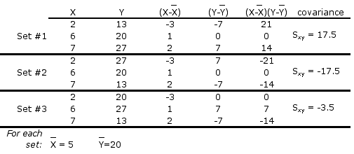
Covariance Illustrated 1/2
In each set, the values of X are the same, and the value for Y are the same; the only thing that’s changed is the order of the Y’s.

Slide 79
Covariance Illustrated 2/2
In set #1, as X increases so does Y; S_{xy} is large & positive
In set #2, as X increases, Y decreases; S_{xy} is large & negative
In set #3, as X increases, Y doesn’t move in any particular way; S_{xy} is “small”

Slide 80
The Covariance
Population Covariance = σ_{xy}
μ_{x} (μ_{y}) is the population mean of the variable X (Y) and N is the population size.
Sample Covariance = s_{xy}
n is the sample size.

Slide 81
Interpretation 1/3
Population Covariance = σ_{xy}
If the two variables move the same direction, (both increase or both decrease), the covariance is a large positive number.

Slide 82
Interpretation 2/3
Population Covariance = σ_{xy}
If the two variables move in two opposite directions, (one increases when the other one decreases), the covariance is a large negative number.

Slide 83
Interpretation 3/3
Population Covariance = σ_{xy}
If the two variables are unrelated, the covariance will be close to zero.

Slide 84
The Coefficient of Correlation
A normalization process
This coefficient answers the question: How strong is the association between X and Y?

Slide 85
The Coefficient of Correlation
Population:
Sample:

Slide 86
The Value of ρ(r)
+1
0
-1
Strong positive
linear relationship
COV(X,Y)>0
ρ
or
r
or
=
No linear
relationship
COV(X,Y)=0
Strong negative
linear relationship
COV(X,Y)<0

Slide 87
Linear Relationship
|r| < 0.25 : very weak
0.25 ≤ |r| < 0.5: moderately weak
0.5 ≤ |r| < 0.75: moderately strong
0.75 ≤ |r| ≤ 1: very strong
Positive or Negative linear relation

Slide 88
Example
Compute the covariance and the coefficient of correlation to measure how advertising expenditure and sales level are related to one another.

Slide 89
Scatter Diagram
Excel scatter diagram
Advertising expenditure and sales
have “positive relationship”
Advertising expenditure and sales
appear to have linear relationship

Slide 90
Computation
x
y
xy
x²
y²
Similarly, s_{y} = 8.839

Slide 91
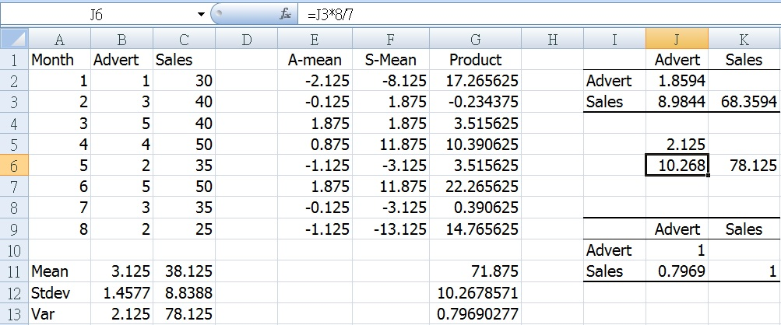
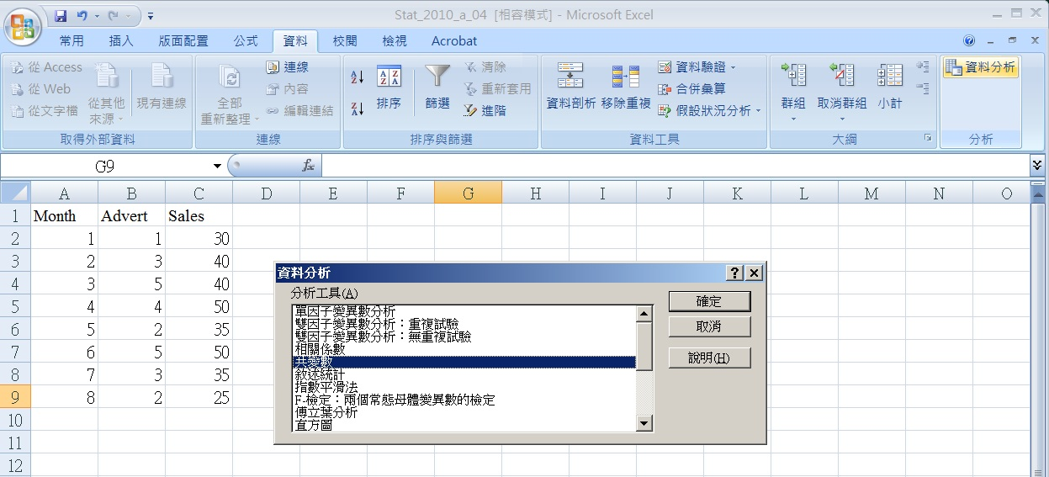
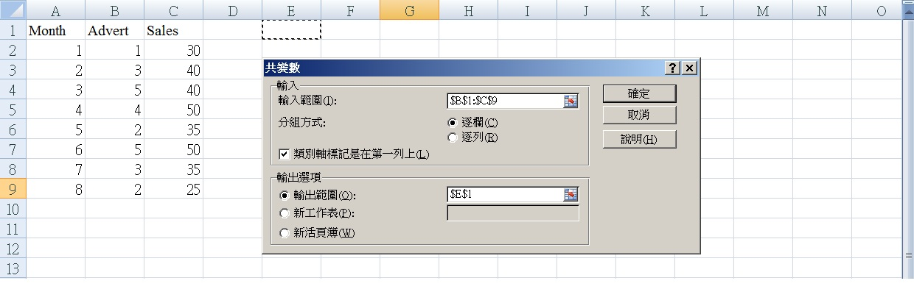
Excel Setup

Slide 92
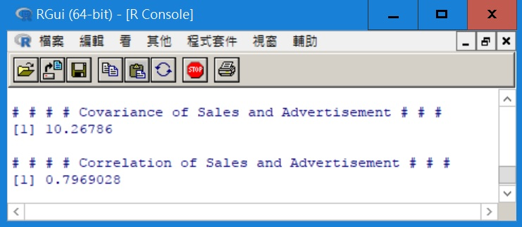
R Code for Correlation
fileXls = "sales_advert_example.xlsx"
SA_data <- loadWorkbook(fileXls)
Sales_AD <- readWorksheet(SA_data,1)
Advert <- Sales_AD$Advert
Sales <- Sales_AD$Sales
n <- length(Sales)
cat("# # # # Covariance of Sales and Advertisement # # # ","\n")
coe_cov <- cov(Advert, Sales)
print(coe_cov)
cat(" ","\n")
cat("# # # # Correlation of Sales and Advertisement # # # ","\n")
coe_corr <- cor(Advert, Sales)
print(coe_corr)
library(rJava)
library(XLConnect)
library(lmtest)
library(tseries)
library(snpar)
library(vcd)
library(MASS)

Slide 93
Covariance Interpretation
Covariance matrix
The covariance (10.268) indicates that advertisement expenditure and sales level are positively related

Slide 94
Coefficient of Correlation
Correlation matrix
The coefficient of correlation (.7969) indicates that there is a very strong positive linear relationship between advertisement expenditure and sales level.

Slide 95
Example
Consider the following case, where MBA grade point averages are compared with GMAT scores. Is the GMAT score a good predictor of MBA success?

Slide 96
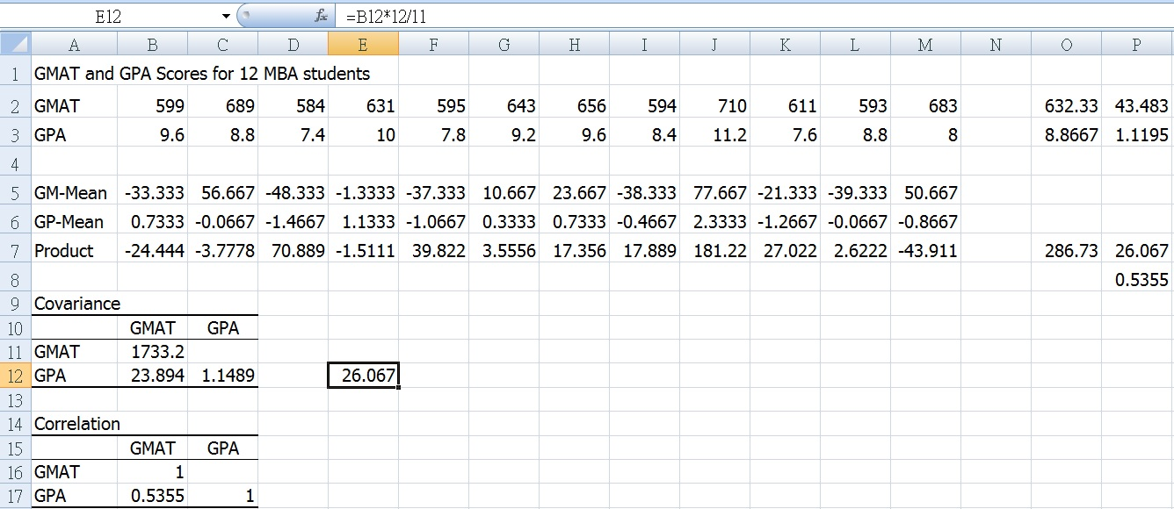
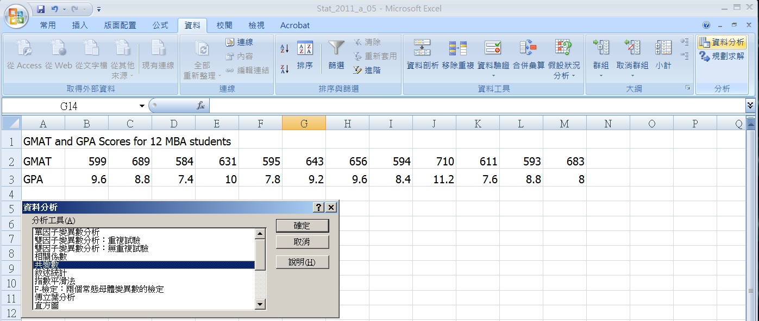
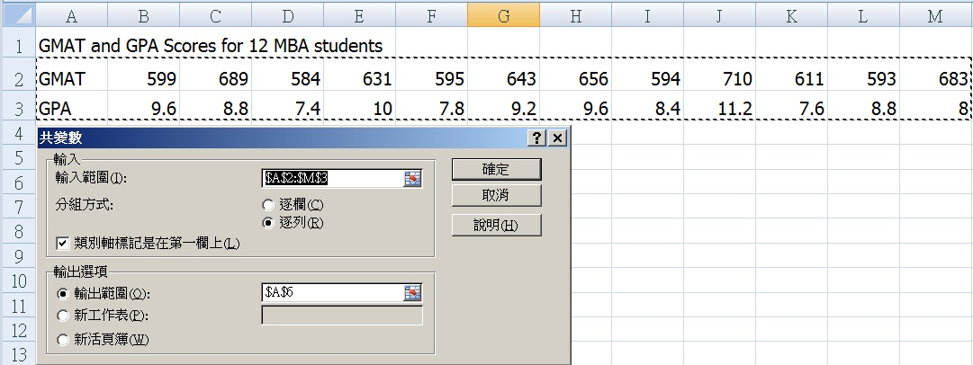
Data
The following scores are given:

Slide 97
Interpretation 1/2
These two statistics tell us that there is a positive linear relationship (26.067) between GMAT score and GPA.

Slide 98
Interpretation 2/2
The coefficient of correlation (0.5355) tells us that the linear relationship is “moderately strong positive”.

Slide 99
Parameters vs. Statistics
 | Population | Sample
Size | N | n
Mean
Variance |  | S²
Standard Deviation |  | S
Coefficient of Variation | CV | cv
Covariance |  | S_{xy}
Coefficient of Correlation |  | r

Slide 100
Approximating Descriptive Measures for Grouped Data
Needed in two cases:
when approximated values suffices the needs,
when only secondary grouped data are available.

Slide 101
Approximating Descriptive Measures for Grouped Data
The number
of classes
f_{i}m_{i} is approx.equal to the number of measurements in class i
The midpoint of class i
Frequency of class i
n = f₁+f₂+…+ f_{k}

Slide 102
Example
Approximate the mean and standard deviation of the telephone call duration problem, as represented by the frequency distribution
Class Class Frequency Midpoint
i limits f_{i} m_{i} f_{i}m_{i} f_{i}m_{i}²
1 2-5 3 3.5 10.5 36.75
2 5-8 6 6.5 39.0 253.5
3 8-11 8 9.5 76.0 722.0
. . . . . .
6 17-20 2 18.5 37.0 684.5 n = 30 312.0 3,751.5

Slide 103
Computation
Class Class Frequency Midpoint
i limits f_{i} m_{i} f_{i}m_{i} f_{i}m_{i}²
1 2-5 3 3.5 10.5 36.75
2 5-8 6 6.5 39.0 253.5
3 8-11 8 9.5 76.0 722.o
. . . . . .
6 17-20 2 18.5 37.0 684.5 n = 30 312.0 3,751.5
3.5
6.5
9.5
12.5
15.5
18.5

Slide 104
End of Chapter 4 Part B

Slide 105
Homework
4.49, 4.53, 4.57
Compute and interpret covariance and r for 4.69 and 4.75
6.3, 6.11, 6.15

Slide 106
Notations
L - the largest observation
Q₃ - The upper quartile
Q₂ - The median
Q₁ - The lower quartile
S - The smallest observation
IQR = Q₃ – Q₁
1.5IQR
1.5IQR
Whisker
Whisker
S
Q₁
Q₂
Q₃
L

Slide 107
Midrange
Middle of Smallest & Largest Observation
Affected by Extreme Values
x
+
x
Midrange =
smallest
largest
2

Slide 108
Example
Find the midrange.
7, 8, 12, 17, 29, 18, 4, 27, 30, 2, 4, 10, 21, 5, 8
2
30
x
+
x
Midrange =
smallest
largest
= 16
2

Slide 109
Midhinge
Middle of 1st & 3rd Quartiles
Not Affected by Extreme Values
Q
Q
1
+
3
Midhinge =
2

Slide 110
Example
Find the midhinge.
7, 8, 12, 17, 29, 18, 4, 27, 30, 2, 4, 10, 21, 5, 8
Q₁ = 5, Q₂ = 12, Q₃ = 21
Q
Q
5
+
21
1
3
Midhinge =
= 13
2

Slide 111
Coefficient of Skewness

Slide 112
Coefficient of Kurtosis

