Slide 1
Chapter 7: Random Variables and Discrete Probability Distributions
Oct. 25, 2017
By
Ching-Chin Chern

Slide 2
Agenda
Random Variables and Probability Distributions
Bivariate Distributions
Known Theoretical Discrete Probability Distributions

Slide 3
Random Variables
A function that assigns a numerical value to each outcome of a random experiment in a sample space.
A random variable reflects the aspect of a random experiment that is of interest to us.

Slide 4
Types of Random Variables
There are two types of random variables based on their value ranges
Discrete random variable
Continuous random variable.

Slide 5
Probability Distribution
A probability distribution is a table, formula, or graph that describes the values of a random variable and the probability associated with these values.

Slide 6
Types of Probability Distributions
Since we’re describing a random variable, we have two types of probability distributions:
Discrete probability distribution
Continuous probability distribution

Slide 7
Discrete Probability Distribution
1
2
3
4
5

Slide 8
Discrete Probability Distribution
To calculate P(X = x), the probability that the random variable X assumes the value x, add the probabilities of all the simple events for which X is equal to x.

Slide 9



Example
Consider the random experiment of flipping a coin twice.
Once
Twice

Slide 10
Probability Distribution
X: The number of heads that turn-up when a coin is flipped twice.
Simple event x Probability
HH 2 1/4
HT 1 1/4
TH 1 1/4
TT 0 1/4
x p(x)
0 1/4
1 1/2
2 1/4
1/2
1/4
1/4 if x=0 or 2
p(x)=
1/2 if x=1
x
0
1
2

Slide 11
Requirements of Discrete Probability Distribution
If a random variable can take values x_{i}, then the following must be true:

Slide 12
Probability of Events
The probability distribution can be used to calculate probabilities of different events.
The probability of getting at least one head when flipping a coin twice.
1/4 if x=0 or 2
p(x)=
1/2 if x=1

Slide 13
Probability as Relative Frequency
In practice, often probabilities are estimated from relative frequencies.

Slide 14
Example
A survey reveals the following frequencies (1,000s) for the number of color TVs per household.
# of TVs | # of households
0 | 1,218
1 | 32,379
2 | 37,961
3 | 19,387
4 | 7,714
5 | 2,842
Total | 101,501

Slide 15
Relative Frequencies
# of TVs | # of households
0 | 1,218
1 | 32,379
2 | 37,961
3 | 19,387
4 | 7,714
5 | 2,842
Total | 101,501
x | P(x)
0 | 0.012
1 | 0.319
2 | 0.374
3 | 0.191
4 | 0.076
5 | 0.028
Total | 1.000
1218
101501

Slide 16
Probability Distribution

Slide 17
Determining Probability of Event
x | P(x)
0 | 0.012
1 | 0.319
2 | 0.374
3 | 0.191
4 | 0.076
5 | 0.028
Total | 1.000
Calculate the probability of the following event:
P(The number of color TVs is two or more)
= P(X=2) + P(X=3) + P(X=4) + P(X=5)
= .374 + .191 +.076 +.028 = .669
= P(X ≥ 2)
or = 1 – P(X ≤ 1)

Slide 18
Probability Trees
There is no requirement that the branches splits be binary, nor that the tree only goes two levels deep, or that there be the same number of splits at each sub node…

Slide 19
Example
A mutual fund sales person knows that there is 20% chance of closing a sale on each call she makes.
What is the probability distribution of the number of sales if she plans to call three customers?

Slide 20
Probability Rules and Trees
Define event S = {A sale is made} and X as the # of sales
(.2)(.2)(.8)= .032
Second
Call
Third Call
P(S)=.2
S S S
S S S^{C}
S S^{C} S
S S^{C} S^{C}
S^{C} S S
S^{C} S S^{C}
S^{C} S^{C} S
S^{C} S^{C} S^{C}
First
Call
P(S)=.2
X P(x)
3 .2³ = .008
2 3(.032)=.096
1 3(.128)=.384
0 .8³ = .512
P(S^{C})=.8
P(S)=.2
P(S)=.2
P(S^{C})=.8
P(S^{C})=.8
P(S)=.2
P(S^{C})=.8
P(S)=.2
P(S^{C})=.8
P(S₂|S₁)
P(S)=.2
P(S^{C})=.8
P(S^{C})=.8

Slide 21
Describing the Population by a Probability Distribution
The probability distribution represents a population
Describing the population by computing various parameters: specifically, the population mean and population variance

Slide 22
Expected Value 1/2
The expected value (mean, μ) of a random variable X is the weighted average of the possible values it can assume, where the weights are the corresponding probabilities of each x_{i}.

Slide 23
Expected Value 2/2
Given a discrete random variable X with values x_{i}, that occur with probabilities P(x_{i}), the expected value of X is

Slide 24
Example
A survey reveals the following relative frequencies for the number of color TVs per household.
x | P(x)
0 | 0.012
1 | 0.319
2 | 0.374
3 | 0.191
4 | 0.076
5 | 0.028
Total | 1.000
E(X) = 0(.012) + 1(.319) + 2(.374) + 3(.191) + 4(.076) + 5(.028) = 2.084

Slide 25
Variance 1/2
The variance is the weighted average of the squared deviations of the values of X from their mean μ, where the weights are the corresponding probabilities of each x_{i}.

Slide 26
Variance 2/2
Let X be a discrete random variable with possible values x_{i} that occur with probabilities P(x_{i}), and let E(x_{i}) = μ. The variance of X is defined to be

Slide 27
Standard Deviation
The standard deviation of a random variable X, denoted σ, is the positive square root of the variance of X.

Slide 28
Example
X: the number of color TVs per household.
E(X) = 2.084
Var(X) =
(0−2.084)²(.012) + (1−2.084)²(.319) + (2−2.084)²(.374) + (3−2.084)²(.191) + (4−2.084)²(.076) + (5−2.084)²(.028) = 1.107
x | P(x)
0 | 0.012
1 | 0.319
2 | 0.374
3 | 0.191
4 | 0.076
5 | 0.028
Total | 1.000
σ = (1.107)^{1/2} = 1.0521

Slide 29
Applying Empirical Rule
Approximately 68% of the numbers of color TVs per household lie between 1.0369 and 3.1411, or [2.089 – 1(1.0521), 2.089 + 1(1.0521)]
Approximately 95% of the numbers of color TVs per household lie between 0.0152 and 4.1932, or [2.089 – 2(1.0521), 2.089 + 2(1.0521)]
Approximately 99.7% of the numbers of color TVs per household lie between –1.0673 and 5.2453, or [2.089 – 3(1.0521), 2.089 + 3(1.0521)]

Slide 30
Laws of Expected Value
Let c be a constant and X be a random variable.
E(c) = c
E(c + X) = c + E(X)
E(cX) = c E(X)

Slide 31
Example
0
Monthly sales have a mean (μ) of $25,000 and a standard deviation (σ) of $4,000. Profits are calculated by multiplying sales by 30% and subtracting fixed costs of $6,000. Please find the mean monthly profit.

Slide 32
Solution 1/2
0
Describe the problem statement in algebraic terms:
Sales have a mean of $25,000 ➔ μ_{Sales} = E(Sales) = 25,000
Profits are calculated by… ➔ Profit = .30(Sales) – 6,000

Slide 33
Solution 2/2
0
E(Profit) = E[.30(Sales) – 6,000]
=E[.30(Sales)]–6,000 [by rule #2]
=.30E(Sales) – 6,000 [by rule #3]
=.30(25,000) – 6,000 = 1,500
Thus, the mean monthly profit is $1,500

Slide 34
Laws of Variance
Let c be a constant and X be a random variable.
Var(c) = 0
Var(cX) = c² Var(X)
Var(X + c) = Var(X)

Slide 35
Example
0
Monthly sales have a mean (μ) of $25,000 and a standard deviation (σ) of $4,000. Profits are calculated by multiplying sales by 30% and subtracting fixed costs of $6,000. Please find the standard deviation of monthly profits.

Slide 36
Solution 1/3
0
Sales have a standard deviation (σ) of $4,000 ➔ Var(Sales) = 4,000² = 16,000,000 (remember the relationship between standard deviation and variance )
Profits are calculated by… ➔
Profit = .30(Sales) – 6,000

Slide 37
Solution 2/3
0
The variance of profit is
= Var(Profit)
= Var[.30(Sales) – 6,000]
= Var[.30(Sales)] [by rule #3]
= (.30)²Var(Sales) [by rule #2]
=(.30)²(16,000,000) = 1,440,000

Slide 38
Solution 3/3
0
Again, standard deviation is the square root of variance, so standard deviation of Profit = (1,440,000)^{1/2} = $1,200
The mean monthly profit is $1,500
The standard deviation of monthly profit is $1,200.

Slide 39
Agenda
Random Variables and Probability Distributions
Bivariate Distributions
Known Theoretical Discrete Probability Distributions

Slide 40
Bivariate (Joint) Distribution
Used when the relationship between two random variables is studied.
The probability that X assumes the value x, and Y assumes the value y is denoted
p(x, y) = P(X=x and Y=y)

Slide 41
Bivariate Probability Distribution
The Bivariate (Joint) probability function must satisfy the following conditions:

Slide 42
Example
Xavier and Yvette are two real estate agents. Let X and Y denote the number of houses that Xavier and Yvette sell each week, respectively.

Slide 43
The Bivariate (Joint) Probability Distribution
p(0,0)
Y \ X | 0 | 1 | 2 | P(y)
0 | 0.12 | 0.42 | 0.06 | 0.60
1 | 0.21 | 0.06 | 0.03 | 0.30
2 | 0.07 | 0.02 | 0.01 | 0.10
P(x) | 0.40 | 0.50 | 0.10 | 1.00
p(0,1)
P(Y=1), the marginal
probability
p(0,2)
P(X=0)
The marginal probability

Slide 44
3-D Plot
p(x,y)
x p(x) y p(y)
0 .4 0 .6
1 .5 1 .3
2 .1 2 .1
E(X)=.7 E(Y)=.5
V(X)=.41 V(Y)=.45
0.42
0.21
0.12
0.06
0.06
y = 0
X
0.07
0.03
0.02
y=1
0.01
y=2
Y
x=0
x=1
x=2

Slide 45
Covariance
The covariance is a measure of the direction to which two random variables tend to move at the same time.

Slide 46
The Coefficient of Correlation
Measure how strong and the direction of the linear relationship between X and Y
The standard deviation

Slide 47
Example
Find the covariance of X and Y.
Calculation of the expected values:
μ_{x}=Σx_{i} p(x_{i})= 0(.4)+1(.5)+2(.1)=.7
μ_{y}=Σy_{i} p(y_{i})= 0(.6)+1(.3)+2(.1)=.5
Y \ X | 0 | 1 | 2 | P(y)
0 | 0.12 | 0.42 | 0.06 | 0.60
1 | 0.21 | 0.06 | 0.03 | 0.30
2 | 0.07 | 0.02 | 0.01 | 0.10
P(x) | 0.40 | 0.50 | 0.10 | 1.00

Slide 48
Covariance
COV(X,Y) = Σ(x − μ_{x})(y − μ_{y}) p(x,,y) = (0−.7)(0−.5)(.12) + (0−.7)(1−.5)(.21) + (0−.7)(2−5)(.07) +…+ (2−.7)(2−.5)(.01) = −.15
There is a negative linear relationship between the two variables
Y \ X | 0 | 1 | 2 | P(y)
0 | 0.12 | 0.42 | 0.06 | 0.60
1 | 0.21 | 0.06 | 0.03 | 0.30
2 | 0.07 | 0.02 | 0.01 | 0.10
P(x) | 0.40 | 0.50 | 0.10 | 1.00

Slide 49
Variances
Var(X) = Σ(x_{i}−μ_{x})² p(x_{i}) = (0−.7)²(.4) + (1−.7)²(.5) + (2−.7)²(.1)=.41
σ_{x} = [Var(X)]^{1/2} = .64
In a similar manner, Var(Y) = .45
σ_{y} = [.45]^{1/2}=.67
Y \ X | 0 | 1 | 2 | P(y)
0 | 0.12 | 0.42 | 0.06 | 0.60
1 | 0.21 | 0.06 | 0.03 | 0.30
2 | 0.07 | 0.02 | 0.01 | 0.10
P(x) | 0.40 | 0.50 | 0.10 | 1.00

Slide 50
Coefficient of Correlation
To find how strong the relationship between X and Y,
There is a moderately weak negative linear relationship between X and Y.

Slide 51
Calculating Conditional Probability
Based on a joint probability distribution, the conditional probability is computed as:

Slide 52
Conditional Probabilities
Y \ X | 0 | 1 | 2 | P(y)
0 | 0.12 | 0.42 | 0.06 | 0.60
1 | 0.21 | 0.06 | 0.03 | 0.30
2 | 0.07 | 0.02 | 0.01 | 0.10
P(x) | 0.40 | 0.50 | 0.10 | 1.00
The sum is
equal to 1.0

Slide 53
Condition for Independence 1/2
Two random variables, X and Y, are said to be independent when
P(X=x|Y=y) = P(X=x) or
P(Y=y|X=x) = P(Y=y).

Slide 54
Condition for Independence 2/2
This leads to the following relationship for independent variables
P(X = x and Y = y)
= P(X = x) P(Y = y)

Slide 55
Example
Since P(X=0|Y=1)= .7 but P(X=0) = .4, The variables X and Y are not independent
Y \ X | 0 | 1 | 2 | P(y)
0 | 0.12 | 0.42 | 0.06 | 0.60
1 | 0.21 | 0.06 | 0.03 | 0.30
2 | 0.07 | 0.02 | 0.01 | 0.10
P(x) | 0.40 | 0.50 | 0.10 | 1.00

Slide 56
Check Independence
P(X = 1)P(Y = 1) = .50(.30) = .15
P(X = 1 and Y = 1) = .06
P(X = 1)P(Y = 2) = .50(.10) = .05
P(X = 1 and Y = 2) = .02
No, the two variables are not independent, which implies that Xavier and Yvette are competing with each other because ρ = −.35.
Y \ X | 0 | 1 | 2 | P(y)
0 | 0.12 | 0.42 | 0.06 | 0.60
1 | 0.21 | 0.06 | 0.03 | 0.30
2 | 0.07 | 0.02 | 0.01 | 0.10
P(x) | 0.40 | 0.50 | 0.10 | 1.00

Slide 57
Example
The table below represent the joint probability distribution of the variable X and Y. Are the variables X and Y independent?
Y \ X | 1 | 2
1 | 0.28 | 0.42
2 | 0.12 | 0.18

Slide 58
Check Independence
Y \ X | 1 | 2 | P(y)
1 | 0.28 | 0.42
2 | 0.12 | 0.18
P(x)
0.70
0.30
Compare the other two pairs. Yes, the two variables are independent
0.40 0.60 1.00
P(X = 1)P(Y = 1) = .40(.70) = .28
P(X = 1 and Y = 1) = .28
Find the marginal probabilities of X and Y. Then apply the multiplication rule.
P(X = 1)P(Y = 2) = .40(.30) = .12
P(X = 1 and Y = 2) = .12

Slide 59
The Sum of Two Variables
To calculate the probability distribution for a sum of two variables X and Y observe the example below.
Y \ X | 0 | 1 | 2 | P(y)
0 | 0.12 | 0.42 | 0.06 | 0.60
1 | 0.21 | 0.06 | 0.03 | 0.30
2 | 0.07 | 0.02 | 0.01 | 0.10
P(x) | 0.40 | 0.50 | 0.10 | 1.00

Slide 60
Find the Sample Space for X+Y
X+Y is the total number of houses sold. X+Y can have the values 0, 1, 2, 3, 4.
So the sample space for X+Y is {0, 1, 2, 3, 4}

Slide 61
P(X+Y)
P(X+Y = 0) = P(X=0 and Y=0) = .12
The probabilities P(X+Y=3) = 0.05 and P(X+Y=4) = 0.01 are calculated the same way. The distribution follows:
P(X + Y = 1) = P(X = 0 and Y = 1) +
P(X = 1 and Y = 0) = .21 + .42 = .63
P(X+Y=2) = P(X=0 and Y=2)+ P(X=1 and Y=1)
+ P(X=2 and Y=0) = .07 + .06 + .06 = .19
Y \ X | 0 | 1 | 2 | P(y)
0 | 0.12 | 0.42 | 0.06 | 0.60
1 | 0.21 | 0.06 | 0.03 | 0.30
2 | 0.07 | 0.02 | 0.01 | 0.10
P(x) | 0.40 | 0.50 | 0.10 | 1.00
x + y 0 1 2 3 4
p(x+y) .12 .63 .19 .05 .01

Slide 62
Expected Value and Variance of X+Y
When the distribution of X+Y is known (see the previous example) we can calculate E(X+Y) and Var(X+Y) directly using their definitions.

Slide 63
Example
x + y 0 1 2 3 4
p(x+y) .12 .63 .19 .05 .01
E(X+Y) = 0*.12 + 1*.63 + 2*.19 + 3*.05 + 4*.01 = 1.2
Var(X+Y) = 0²*.12 + 1²*.63 + 2²*.19 + 3²*.05 + 4²*.01 − 1.2² = 0.56

Slide 64
The Expected Value and Variance of X+Y
Var(X+Y) = E[(X+Y)²] – [E(X+Y)]²
= E[X²+2XY+Y²] – [E(X)+E(Y)]²
= E[X²] + 2E[XY] + E[Y²] – [E(X)]² – 2E[X]E[Y] – [E(Y)]²
= Var(X) + Var(Y) + 2COV(X,Y)
E(X+Y) = E(X) + E(Y)
Var(X+Y) = Var(X) + Var(Y) + 2COV(X,Y)
When X and Y are independent COV(X,Y) = 0, and Var(X+Y) = Var(X) + Var(Y).

Slide 65
In General
E(aX+bY) = aE(X) + bE(Y)
Var(aX + bY)
= a²Var(X) + b²Var(Y) +
2 ab COV(X,Y)
= a²Var(X) + b²Var(Y) +
2 ab ρσ_{x}σ_{y}

Slide 66
Variance of X + Y
Y \ X | 0 | 1 | 2 | P(y)
0 | 0.12 | 0.42 | 0.06 | 0.60
1 | 0.21 | 0.06 | 0.03 | 0.30
2 | 0.07 | 0.02 | 0.01 | 0.10
P(x) | 0.40 | 0.50 | 0.10 | 1.00
COV(X,Y)= −.15
ρ = −.35
Var (X) = .41
Var (Y) = .45
Var(X+Y)
= Var(X) + Var(Y) + 2 COV(X,Y)
= 0.41 + 0.45 + 2(−0.15) = 0.56

Slide 67
Example
An investor has decided to invest equal amounts of money in two investments (Investment portfolio diversification).
Investment Item | Mean Return | Standard Deviation
Investment 1 | 15% | 25%
Investment 2 | 27% | 40%

Slide 68
Questions?
Find the expected return on the portfolio.
If ρ = 1, .5, or 0, find the standard deviation of the portfolio.

Slide 69
Expected Returns
The return on the portfolio can be represented by
R_{p} = w₁R₁ + w₂R₂
= .5R₁ + .5R₂
The relative weights are proportional to the amounts invested.
Thus, E(R_{p}) = w₁E(R₁) + w₂E(R₂)
= .5(.15) + .5(.27) = .21

Slide 70
Variance
The variance of the portfolio return is
Var(R_{p}) = w₁² Var(R₁) + w₂² Var(R₂) + 2 w₁w₂ ρ σ₁σ₂
The variance will be dependent on how strong the relationship between these two investments

Slide 71
Different ρ
For ρ=1: Var(R_{p})=.1056
σ_{p}=.3250
For ρ=.5: Var(R_{p})=.0806
σ_{p}=.2839
For ρ=0: Var(R_{p})=.0556
σ_{p}=.2358
Larger diversification is expressed by smaller correlation. As the correlation coefficient decreases, the standard deviation decreases too.

Slide 72
The Expected Value and Variance of Σc_{i}X_{i}
E(Σc_{i}X_{i}) = Σc_{i}E(X_{i})
Var(Σc_{i}X_{i}) = Σc_{i}²Var(X_{i}) + 2Σc_{i}c_{j}COV(X_{i}, X_{j})

Slide 73
Agenda
Random Variables and Probability Distributions
Bivariate Distributions
Known Theoretical Discrete Probability Distributions

Slide 74
Known Theoretical Discrete Probability Distributions
The Binomial Distribution
The Poisson Distribution
Geometric Probability Distribution
Hypergeometric Probability Distribution

Slide 75
The Bernoulli Trial
Result in only one out of two outcomes
A coin flipped (heads or tails)
An election candidate (wins or loses)
An employee is male or female
A car uses 87 octane gasoline, or another gasoline.

Slide 76
Binomial Experiment
There are n trials (n is finite and fixed).
Each trial is a Bernoulli trial with two outcomes (success and failure).
The probability p of success is the same for all the trials.
All the trials of the experiment are independent.

Slide 77
Binomial Random Variable
The binomial random variable counts the number of successes in n trials of the binomial experiment.
By definition, this is a discrete random variable.

Slide 78
Binomial Distribution Tree
Third trial
Second trial
P(S₃|S₂,S₁)
S₃
P(SSS) = p³
P(S₃) = p
S₂
P(S₂|S₁)
P(S₂)=p
S₁
First trial
P(F₃|S₂,S₁)
F₃
P(SSF)=p²(1-p)
P(F₃)=1-p
S₃
P(S₃)=p
P(SFS)=p(1-p)p
P(S₁) = p
P(F₂|S₁)
P(S₃|F₂,S₁)
P(F₂)=1-p
F₂
F₃
P(F₃|F₂,S₁)
P(SFF)=p(1-p)²
P(F₃)=1-p
P(S₂|S₁)
P(S₃|S₂,F₁)
S₃
P(FSS)=(1-p)p²
S₂
P(S₃) = p
P(S₂|F₁)
P(F₁) = 1-p
P(S₂)=p
P(F₃|S₂,F₁)
F₃
P(FSF)=(1-p)p(1-p)
P(F₃)=1-p
P(S₃|F₂,F₁)
S₃
P(FFS)=(1-p)²p
F₁
P(S₃) = p
P(F₂)=1-p
P(F₂|F₁)
F₂
P(F₃|F₂,F₁)
P(F₃)=1-p
F₃
P(FFF)=(1-p)³

Slide 79
Binomial Distribution
Let X be the number of successes
in three trials. Then,
SSS
P(SSS)=p³
SS
P(SSF)=p²(1-p)
P(X = 3) = p³
X = 3
X = 2
X = 1
X = 0
S S
P(SFS)=p(1-p)p
P(X = 2)=3p²(1-p)
S
P(SFF)=p(1-p)²
P(X = 1)=3p(1-p)²
SS
P(FSS)=(1-p)p²
P(X = 0) = (1-p)³
S
P(FSF)=(1-p)p(1-p)
This multiplier is calculated in the following formula
S
P(FFS)=(1-p)²p
P(FFF)=(1-p)³

Slide 80
Calculating the Binomial Probability
In general, The binomial probability is calculated by:

Slide 81
Example: n = 3 1/2
P(X = 0) = (1- p)³
P(X = 1) = 3 p(1-p)²

Slide 82
Example: n = 3 2/2
P(X = 2) = 3 p²(1- p)
P(X = 3) = p³

Slide 83
Different Shapes

Slide 84
The Shape of the Binomial Distributions
In general, for any number of trials n:
1. Symmetric if p = 0.5
2. Skew to the right if p < 0.5
3. Skewed to the left if p > 0.5

Slide 85
Example
5% of a catalytic converter production run is defective.
A sample of 3 converters is drawn. Find the probability distribution of the number of defectives.

Slide 86
Check the Following Conditions 1/2
A converter can be either defective or good.
There is a fixed finite number of trials (n=3)

Slide 87
Check the Following Conditions 2/2
Assume the converter state is independent on one another.
The probability of a converter being defective does not change from converter to converter (p = .05).
The conditions required for the
binomial experiment are met.

Slide 88
Definition
Let X be the binomial random variable indicating the number of defectives.
Define a “success” as “a converter is found to be defective”.

Slide 89
Compute Probability
Fine the sample space of X = {0, 1, 2, 3}
X P(X)
0 .8574
1 .1354
2 .0071
3 .0001

Slide 90
Mean and Variance of Binomial Random Variable
E(X) = μ = np
Var(X) = σ² = np(1 − p)
For the above example:

Slide 91
Table 1 on Pages B-1 to B-5
Use Table 1 of Appendix B to check the probability with n and p. The tabulated values are

Slide 92
Example
Records show that 30% of the customers in a shoe store make their payments using a credit card. This morning 20 customers purchased shoes.
Let X be the number of customers using a credit

Slide 93
Question 1
What is the probability that at least 12 customers used a credit card?
This is a binomial experiment with n=20 and p=.30
=> Page B-4
p
k
P(At least 12 used credit card) = P(X≥12)
.01 ……….. .30
0
.
.
11
= 1 – P(X ≤ 11)
= 1 – .9949 = .0051
.9949

Slide 94
Question 2
What is the probability that at least 3 but not more than 6 customers used a credit card?
p
k
.01 ……….. .30
P(3 ≤ X ≤ 6)=
0
2
.
6
.0355
P(X=3 or 4 or 5 or 6)
=P(X ≤ 6) − P(X ≤ 2)
.6080
=.608 −.0355 = .5725

Slide 95
Question 3
What is the expected number and the variance of customers who used a credit card?
E(X) = np = 20(.30) = 6
Var(X) = np(1-p) = 20(.30)(.70) = 4.2

Slide 96
Question 4
Find the probability that exactly 14 customers did not use a credit card.
Let Y be the number of customers who did not use a credit card and hence = 20 – X
P(Y = 14) = P(X = 6)
= P(X ≤ 6) − P(X ≤ 5)
= .608 - .4164 = .1916

Slide 97
Question 5
Find the probability that at least 9 customers did not use a credit card.
Let Y be the number of customers who did not use a credit card.
P(Y ≥ 9) = P(X ≤ 11) = .9949

Slide 98
Known Theoretical Discrete Probability Distributions
The Binomial Distribution
The Poisson Distribution
Geometric Probability Distribution
Hypergeometric Probability Distribution

Slide 99
Poisson Experiment
The Poisson experiment typically fits cases of rare events that occur over a fixed amount of time or within a specified region.

Slide 100
Typical Poisson Experiment
The number of errors a typist makes per page
The number of customers entering a service station per hour
The number of telephone calls received by a switchboard per hour

Slide 101
Properties of the Poisson Experiment 1/3
The number of successes (events) that occur in a certain time interval is independent of the number of successes that occur in another time interval.

Slide 102
Properties of the Poisson Experiment 2/3
The probability of a success in a certain time interval is
the same for all time intervals of the same size,
proportional to the length of the interval.

Slide 103
Properties of the Poisson Experiment 3/3
The probability that two or more successes will occur in an interval approaches zero as the interval becomes smaller.

Slide 104
Poisson Random Variables
The Poisson randon variable indicates the number of successes that occur during a given time interval or in a specific region in a Poisson experiment

Slide 105
Probability Distribution
Let x be the number of success and μ is the average number of success or arrival rate.

Slide 106
Poisson Probability Distribution with μ = 1

Slide 107
Different Poisson Shapes
with μ =2
with μ = 5
with μ =7

Slide 108
Example
Cars arrive at a tollbooth at a rate of 360 cars per hour and assuming a Poisson process. What is the probability that only two cars will arrive during a specified one-minute period?

Slide 109
Solution
Let X denote the number of arrivals during a one-minute period.
The probability distribution of arriving cars for any one-minute period is Poisson with μ = 360/60 = 6 cars per minute.

Slide 110
Table 2 on Pages B-6 to B-7
Use table 2 of Appendix B to check the probability of Poisson Distribution with μ. The tabulated values are

Slide 111
Question 1
What is the probability that only two cars will arrive during a specified one-minute period?
P(X = 2)
= P(X ≤ 2) – P(X ≤ 1)
= .062 – .0174 = .0446

Slide 112
Question 2
What is the probability that at least four cars will arrive during a one-minute period?
P(X ≥ 4)
= 1 – P(X ≤ 3)
= 1 – .1512 = .8488

Slide 113
Poisson Approximation of the Binomial
When n is very large, binomial probability table may not be available.
If p is very small (p < .05), the binomial probabilities can be approximated by the Poisson distribution.

Slide 114
Poisson Approximation of the Binomial
Use μ = np and make the following approximation:
With parameters
n and p
With μ = np

Slide 115
Example
A warehouse has a policy of examining 50 sunglasses from each incoming lot, and accepting the lot only if there are no more than two defective pairs.

Slide 116
Question?
What is the probability of a lot being accepted if, in fact, 2% of the sunglasses are defective?
Let X be the number of defective items when sampling 50 sunglasses.
X is a binomial random variable with n = 50 and p = 0.02

Slide 117
Large Sample but Small p
Tables for n = 50 (large sample) are not available and p <. 05.
Thus, a Poisson approximation is appropriate.
[μ = (50)(.02) =1]
P(X_{Poisson} ≤ 2) = .9197 (true binomial probability = .922)

Slide 118
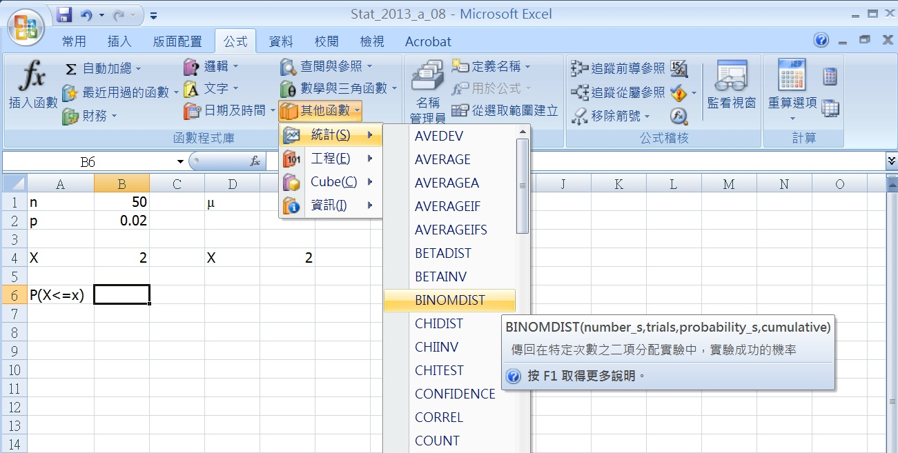
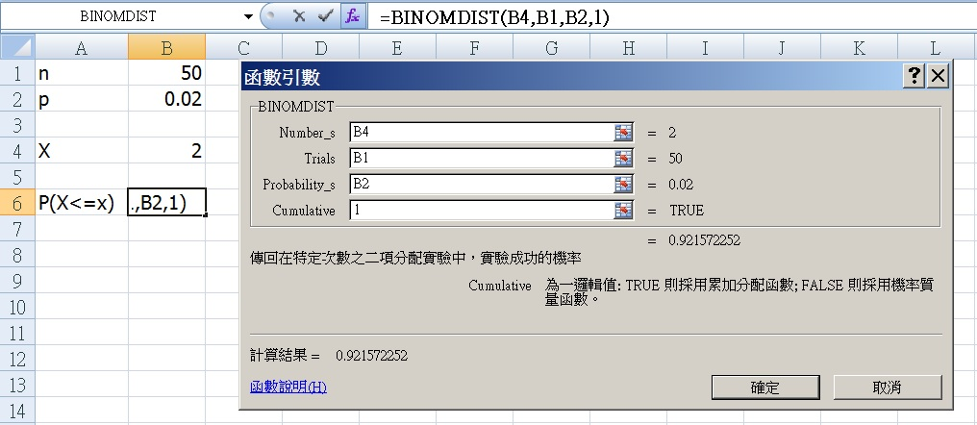
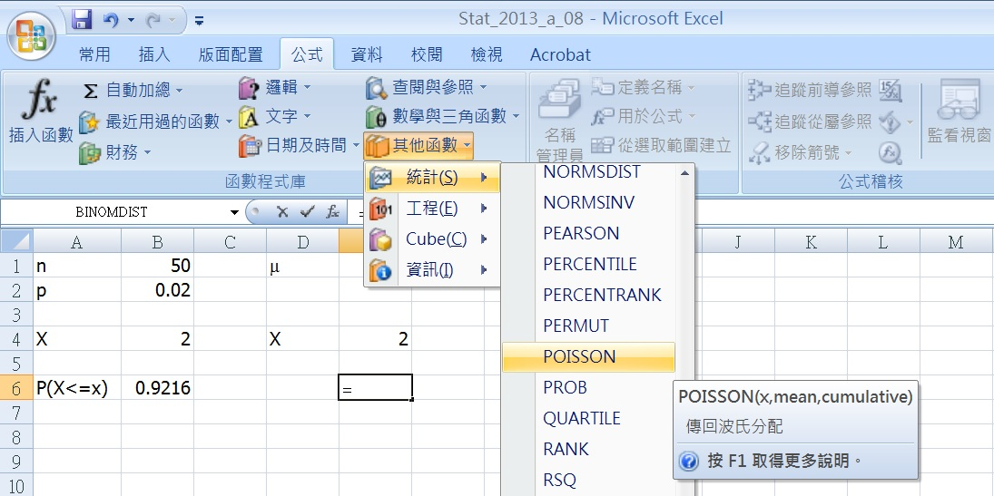
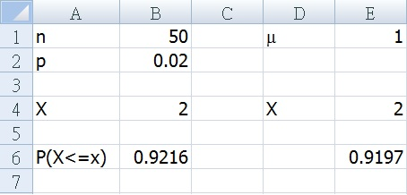
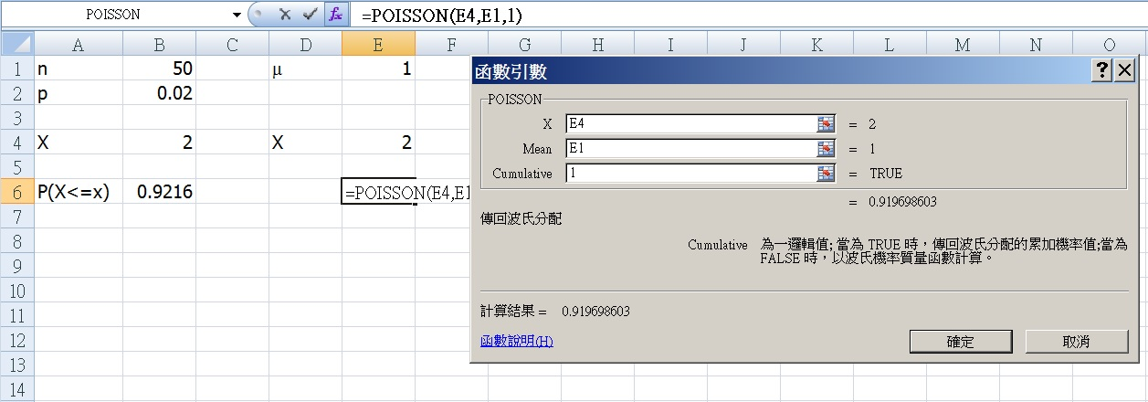
Excel Setup

Slide 119
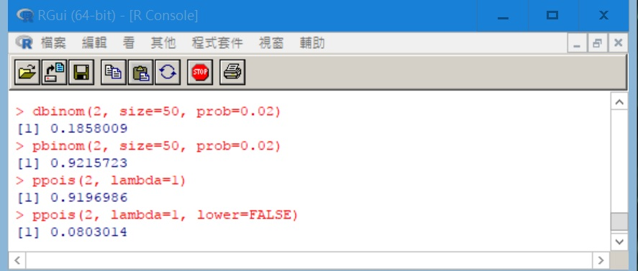
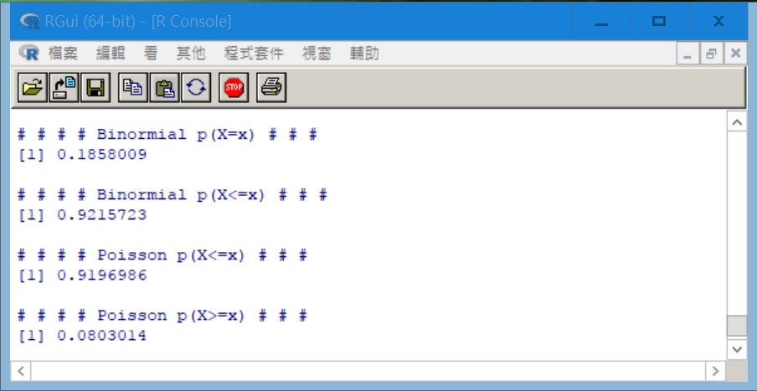
R Code
n <- 50
p <- 0.02
x <- 2
m <- n*p
cat("# # # # Binormial p(X=x) # # # ","\n")
print(dbinom(x, size = n, prob = p))
cat(" ","\n")
cat("# # # # Binormial p(X<=x) # # # ","\n")
print(pbinom(x, size = n, prob = p))
cat(" ","\n")
cat("# # # # Poisson p(X<=x) # # # ","\n")
print(ppois(x, lambda = m))
cat(" ","\n")
cat("# # # # Poisson p(X>=x) # # # ","\n")
print(ppois(x, lambda = m, lower=FALSE))

Slide 120
End of Chapter 7 Part A

Slide 121
Homework
7.11, 7.27, 7.37
7.51, 7.55
7.63
7.97, 7.105
7.115, 7.119

Slide 122
Random Experiment
A process or course of action, whose outcome is uncertain.
Experiment | Outcome
Flip a coin | Heads or Tails
Record the test scores of a Statistics class | Any number between 0 and 100
Measure the time to assemble a PC | A positive real number

Slide 123
Random Variables
X is the number of head for flipping a coin once (value of X could be 1 or 0)
Y is the test score of a Statistics class (0 ≤ Y ≤ 100)
Z is the time to assemble a PC (0 ≤ Z ≤ ∞)

Slide 124
Discrete Random Variable
A random variable is discrete if it can assume only a countable number of values.
After the first value is defined, the second value and any value thereafter are known
0
1
2
3 ...
0
1.1
2.2
3.3 …
The number of values is countable.
E.g. values on the rolling of 2 dices: 2, 3, 4, …, 12

Slide 125
Continuous Random Variable
A random variable is continuous if it can assume an uncountable number of values.
After the first value is defined, any number can be the next one
0
1/8
1/4
1/2
1
2
The number of values is uncountable
E.g. time (30.1 minutes? 30.10000001 minutes?)

Slide 126
Linear Relationship
|ρ| < 0.25 : very weak
0.25 ≤ |ρ| < 0.5: moderately weak
0.5 ≤ |ρ| < 0.75: moderately strong
0.75 ≤ |ρ| ≤ 1: very strong
Positive or Negative linear relation

