Slide 1
FARMASSIST
One stop for farmers..

Slide 2
By-
SHIVAM SHARMA JITIN KUMAR SINGH
HARSHVARDHAN
VIVEK TYAGI
B-Tech, CSE, 2nd year

Slide 3
Problem Statement
Nowadays we can see the farmers are committing suicides because of no proper cost for agro products. The middlemen who will not allow the farmers to sell their agro products in government market yards. Middlemen are buying the agro products at cheaper cost and selling the products at government price tags. Here the farmer hardship has no result. There is no proper platform till now which helps farmers in all info for farmers at one place.

Slide 4
Farmassist
The main aim is to design and develop a digital trading platform “Digital Trading Platform For Agro Products” for agro products to support small scale farmers in marketing their farm produces. It also provides them other necessary services during farming season. The demand from the large scale consumers across the country will be mapped to the supply from the famers eliminating the middle men.
Farmers
Farmers
Consumer/
User
Farmassist

Slide 5
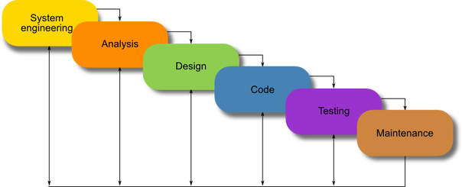
Tech Used:
Hardware Specifications
Processor: Run on any processor
Laptop or PC
RAM: 4 GB
System type: 32-bit or 64-bit Operating System
Software Specifications
Operating System – Windows 10
Google Maps
Web Browser
Visual Studio Code
Further info in report..

Slide 6
SYSTEM DESIGN
The system under consideration has been divided into several modules taking in consideration the above-mentioned criteria. The different modules are:
Main Module
Tutorial Module
Buy Product Module
Sell Product
Weather Report Module

Slide 7
Thank You!

