Slide 1
Object Oriented Programming (OOP) and
Programming Languages
Data Science Week 1

Slide 2
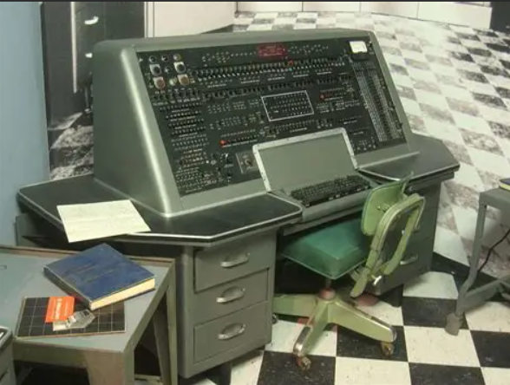

We've come along way...
1952
2025
Univac I - First American Commercial Computer
Used magnetic tape and punch cards for code
Standard work PC – A 2019 estimate puts aprox. 2 billion (desktops, servers and laptops) globally (https://www.scmo.net/)

Slide 3
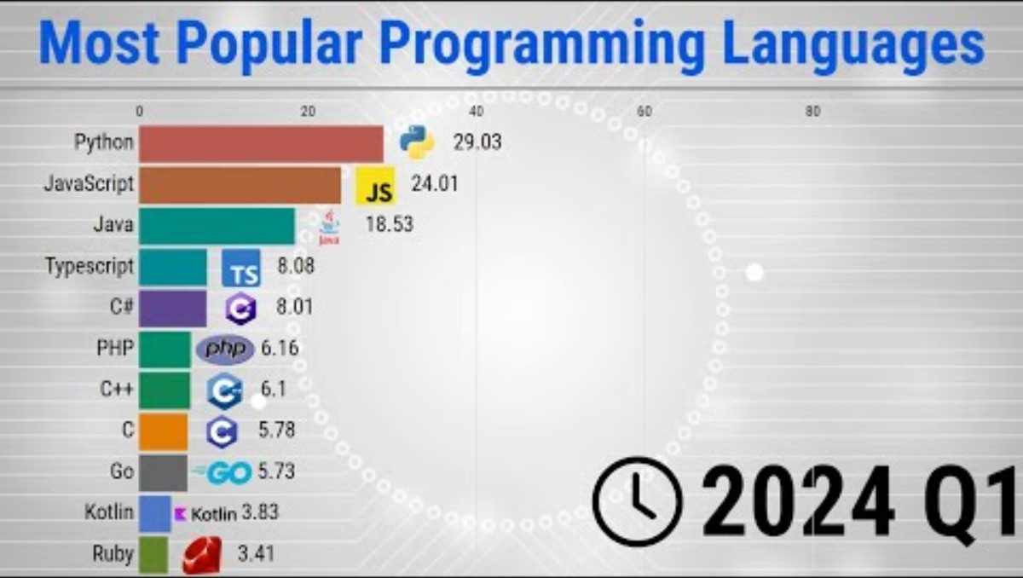
Notes:
1960s–1970s: Birth of High-Level Programming
1960s: The advent of high-level languages like FORTRAN and COBOL marked a significant shift from machine code and assembly languages. FORTRAN facilitated scientific computing, while COBOL was tailored for business applications.
1970s: The introduction of C and Pascal brought structured programming paradigms, emphasizing readability and maintainability.
💻 1980s–1990s: Object-Oriented Programming and the Rise of the Web
1980s: Object-Oriented Programming (OOP) gained prominence with languages like C++ and Smalltalk, promoting code reuse and modularity.
1990s: The emergence of the World Wide Web led to the popularity of JavaScript for client-side scripting and Java for server-side applications, emphasizing portability and scalability.
🌐 2000s–2010s: Dynamic Languages and Open Source Movement
2000s: Languages like Python, Ruby, and PHP gained traction due to their simplicity and effectiveness in web development. The open-source movement flourished, with communities contributing to the growth of these languages.
2010s: JavaScript solidified its dominance with frameworks like React and Node.js, enabling full-stack development. Go and Rust emerged, focusing on performance and concurrency.
🤖 2020s: AI Integration and Natural Language Processing
2020s: The integration of Artificial Intelligence (AI) into programming tools became more prevalent. For instance, GitHub Copilot, powered by OpenAI's Codex, assists developers by suggesting code snippets.
Nvidia CEO Jensen Huang highlighted the transformative impact of AI on computing, emphasizing that AI simplifies interaction with technology by enabling programming through natural human language rather than traditional coding languages.

Slide 4
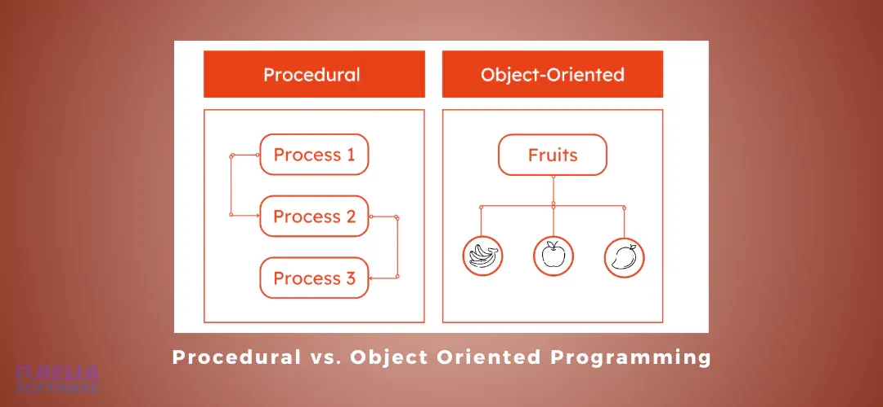

Slide 5
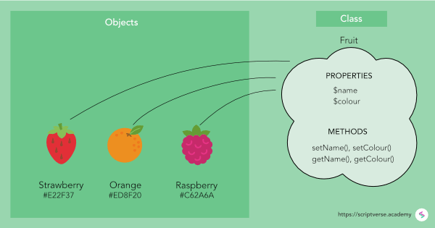

Slide 6
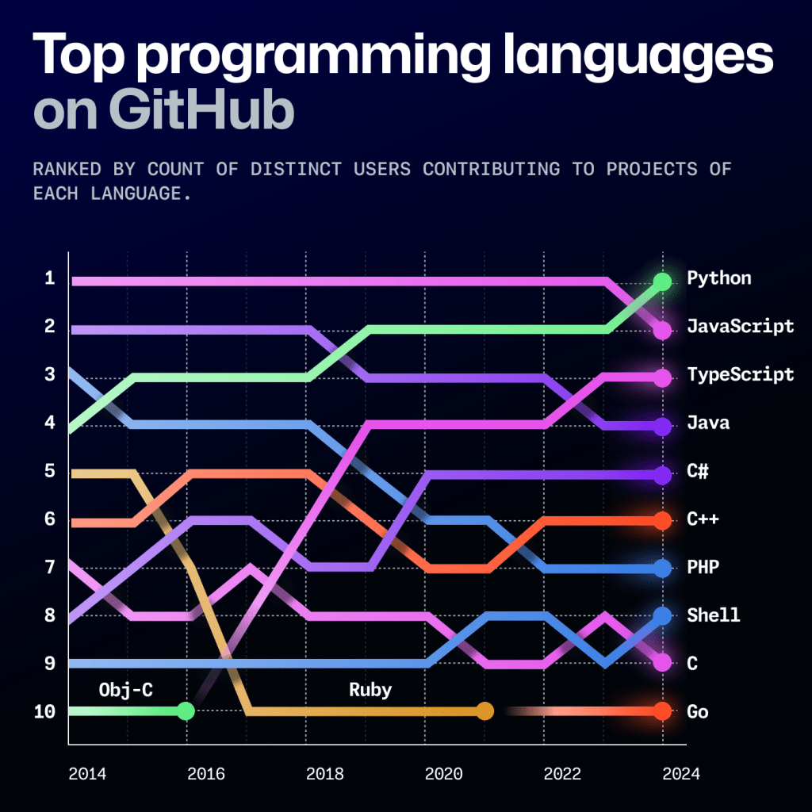
Octoverse: AI leads Python to top language as the number of global developers surges - The GitHub Blog

Slide 7
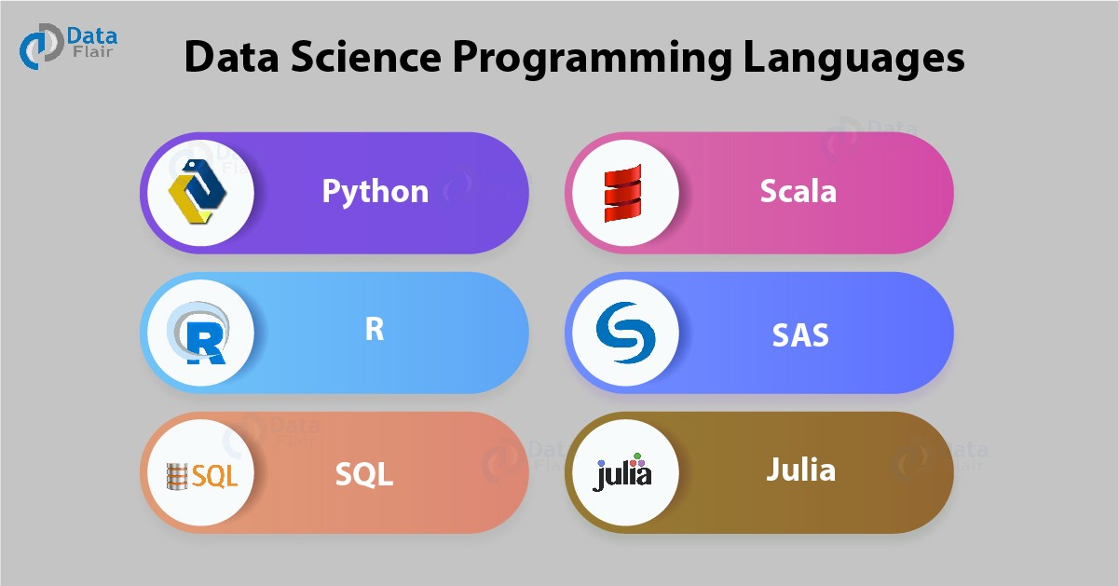
https://medium.com/datadriveninvestor/top-6-data-science-programming-languages-for-2019-39ba1b6819a8

Slide 8
Ok....so what does R have going for it?
https://stackshare.io/stackups/javascript-vs-python-vs-r

Slide 9
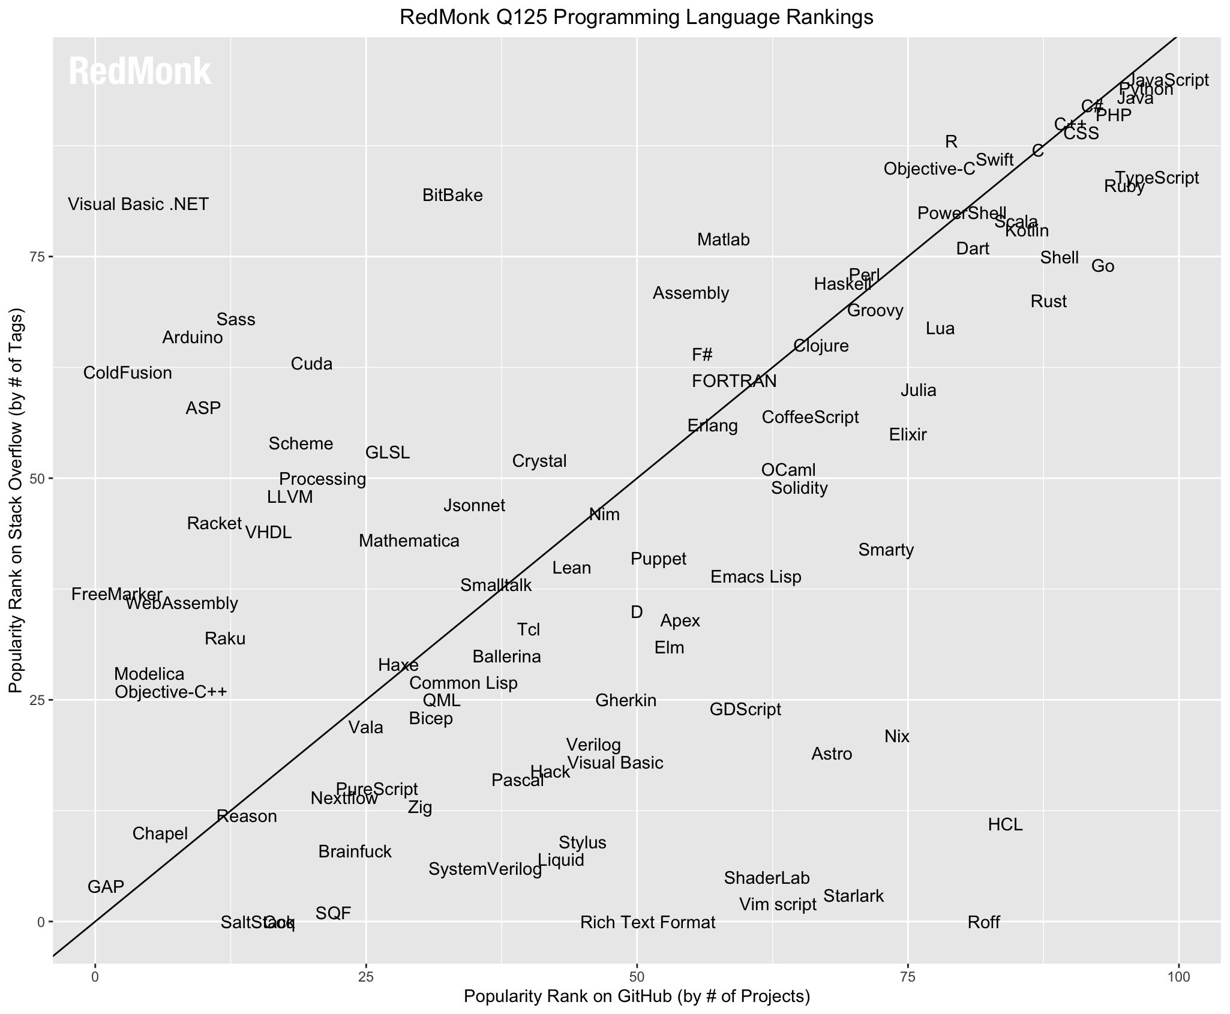
https://redmonk.com/sogrady/2025/06/18/language-rankings-1-25/

Slide 10
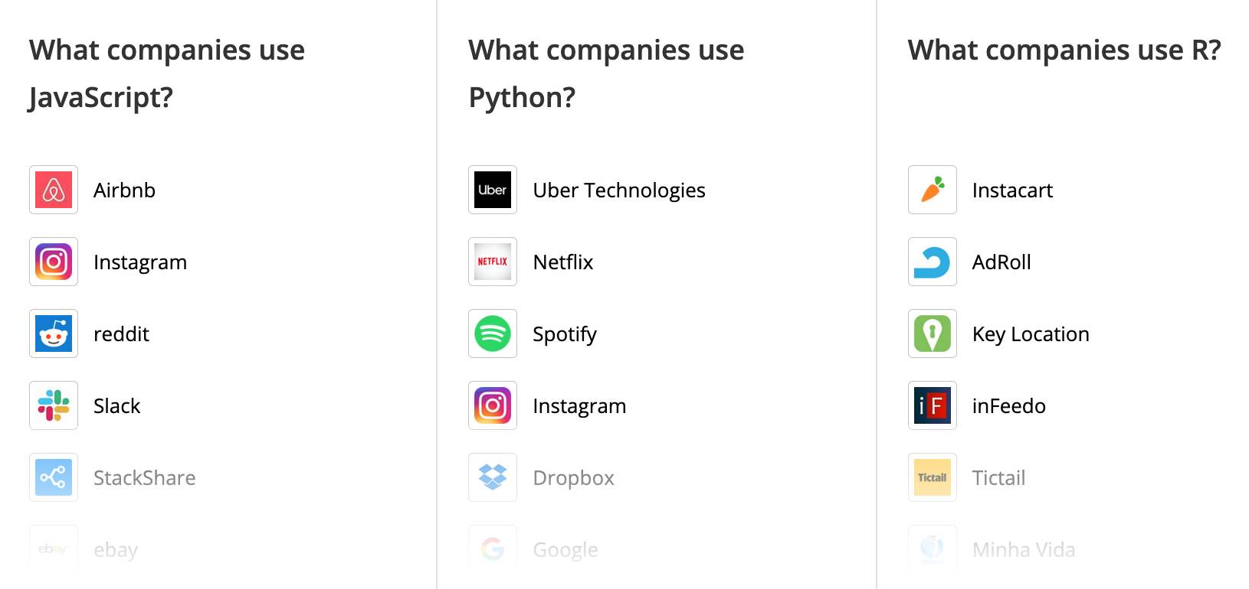
https://stackshare.io/stackups/javascript-vs-python-vs-r

Slide 11
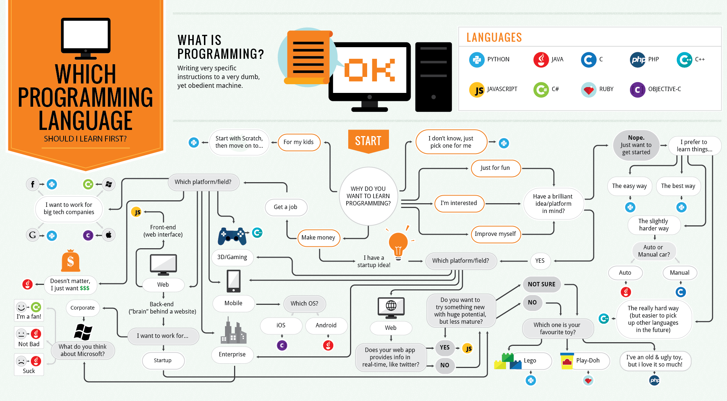

Slide 12
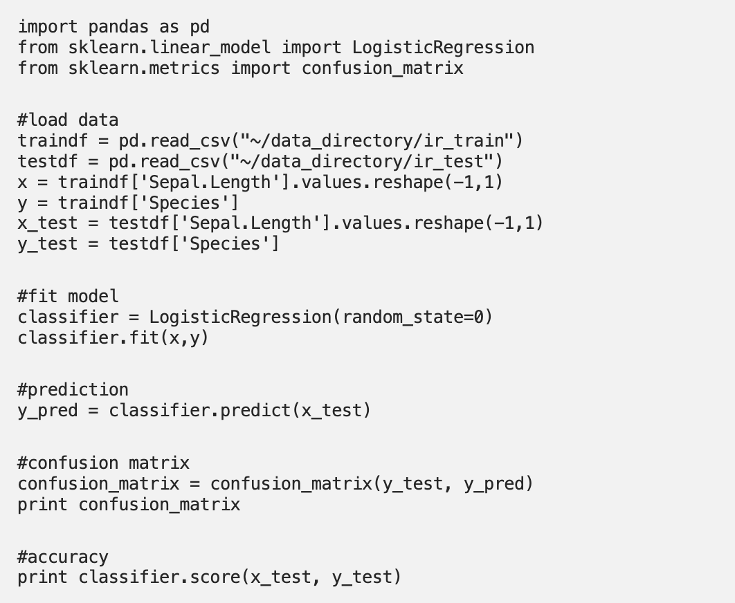
Guess the programming language?

Slide 13
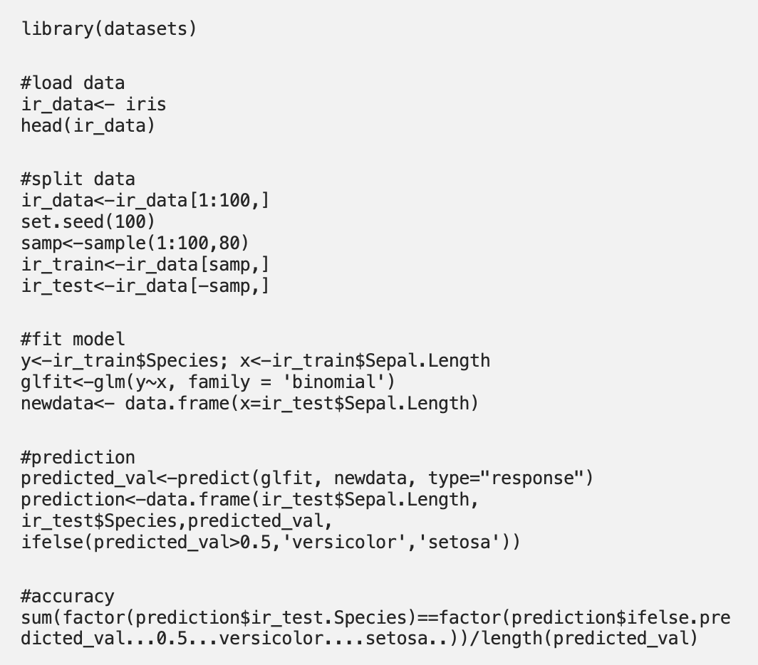
Guess the programming language?

Slide 14
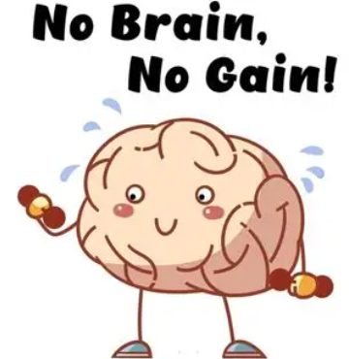
OK, NOW LET'S GET STARTED AND PRACTICE SOME OOP!
Login to Github – and access the refresher script in weekly materials / week 1
FLIPPED CLASSROOM
This refresher is based around the material covered by the coding club tutorials and data camp material set before class
Feel free to look back over the materials or ask the teaching teach to help, and remember...Train your brain!

