Slide 1

Combination of Neural Networks and Gaussian Processes Neural Processes
Jiale Shi
Department of Chemical and Biomolecular Engineering
University of Notre Dame
Bayesian Machine Learning; Notre Dame, IN
Apr/23/2019

Slide 2
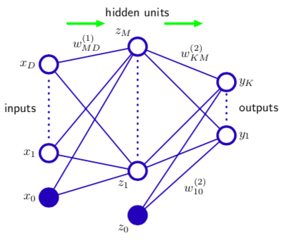
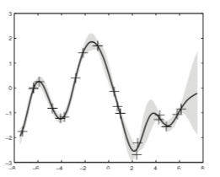
Background
Neural Networks (NNs)
Gaussian Processes (GPs)
Advantages:
fit complex patterns
scale with 𝒪(n)
Drawbacks:
represent a single function
fail to capture uncertainty
overfitting
Advantages:
represent a distribution over possible functions
capture uncertainty
Drawbacks:
scale with 𝒪((n)³)
hard to find a suitable kernel function
Bishop. PRML.
Murphy. Machine learning.

Slide 3
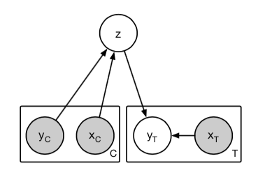
Neural Processes (NPs)
NPs combines elements from NNs and GPs, and can represent a distribution of possible functions over stochastic processes and also be very efficient.
Graphical Model
Carnelo, M et al. Neural Processes (2018).

Slide 4
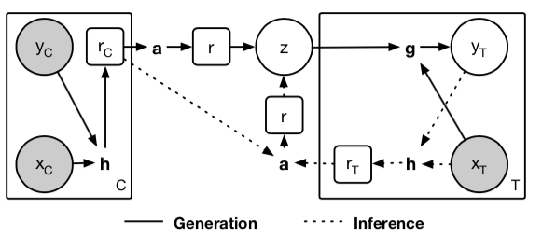
Model
Generation:
context points (x_{c}, y_{c})
latent representation r_{c}
sample z and map(z, x_{t}) and get the predictive distribution y_{t}
Computational diagram
Carnelo, M et al. Neural Processes (2018).

Slide 5
Model
Inference:
q(z|context) to approximate the conditional prior p(z|context)
q(z|context, target) to approximate the conditional prior p(z|context, target)
Computational diagram
Carnelo, M et al. Neural Processes (2018).

Slide 6
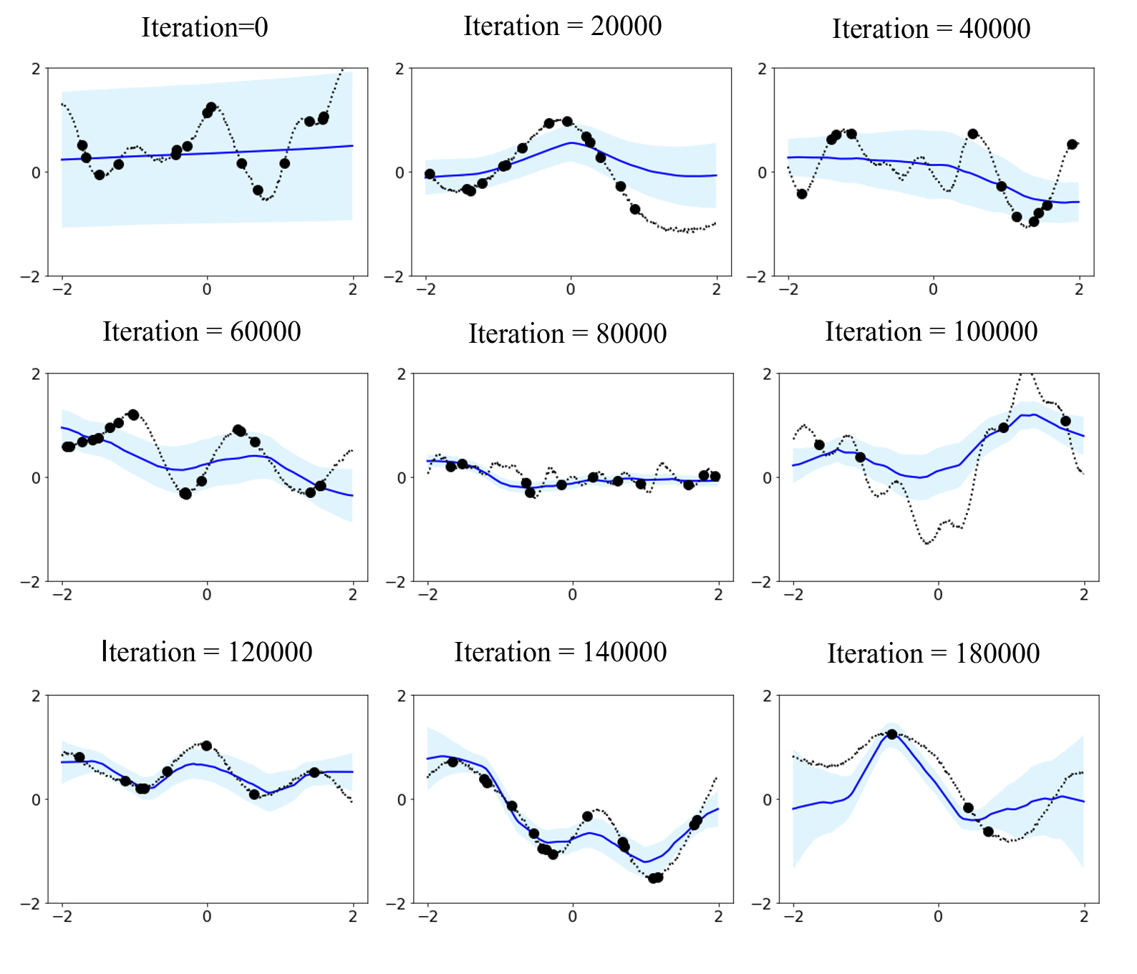
Results
1-D function regression
Draw f_{d} ~ GP(0,k)
Draw x_{i} ~ U(-2,2)
Define y_{i} := f_{d}(x_{i})
Divide pairs (x_{i}, y_{i}) random into context and target data and perform one optimization step
Repeat
(x_{i}^{(d)},y_{i}^{(d)})_{C} ; (x_{i}^{(d)},y_{i}^{(d)})_{T}
Maximum context data points = 20

Slide 7
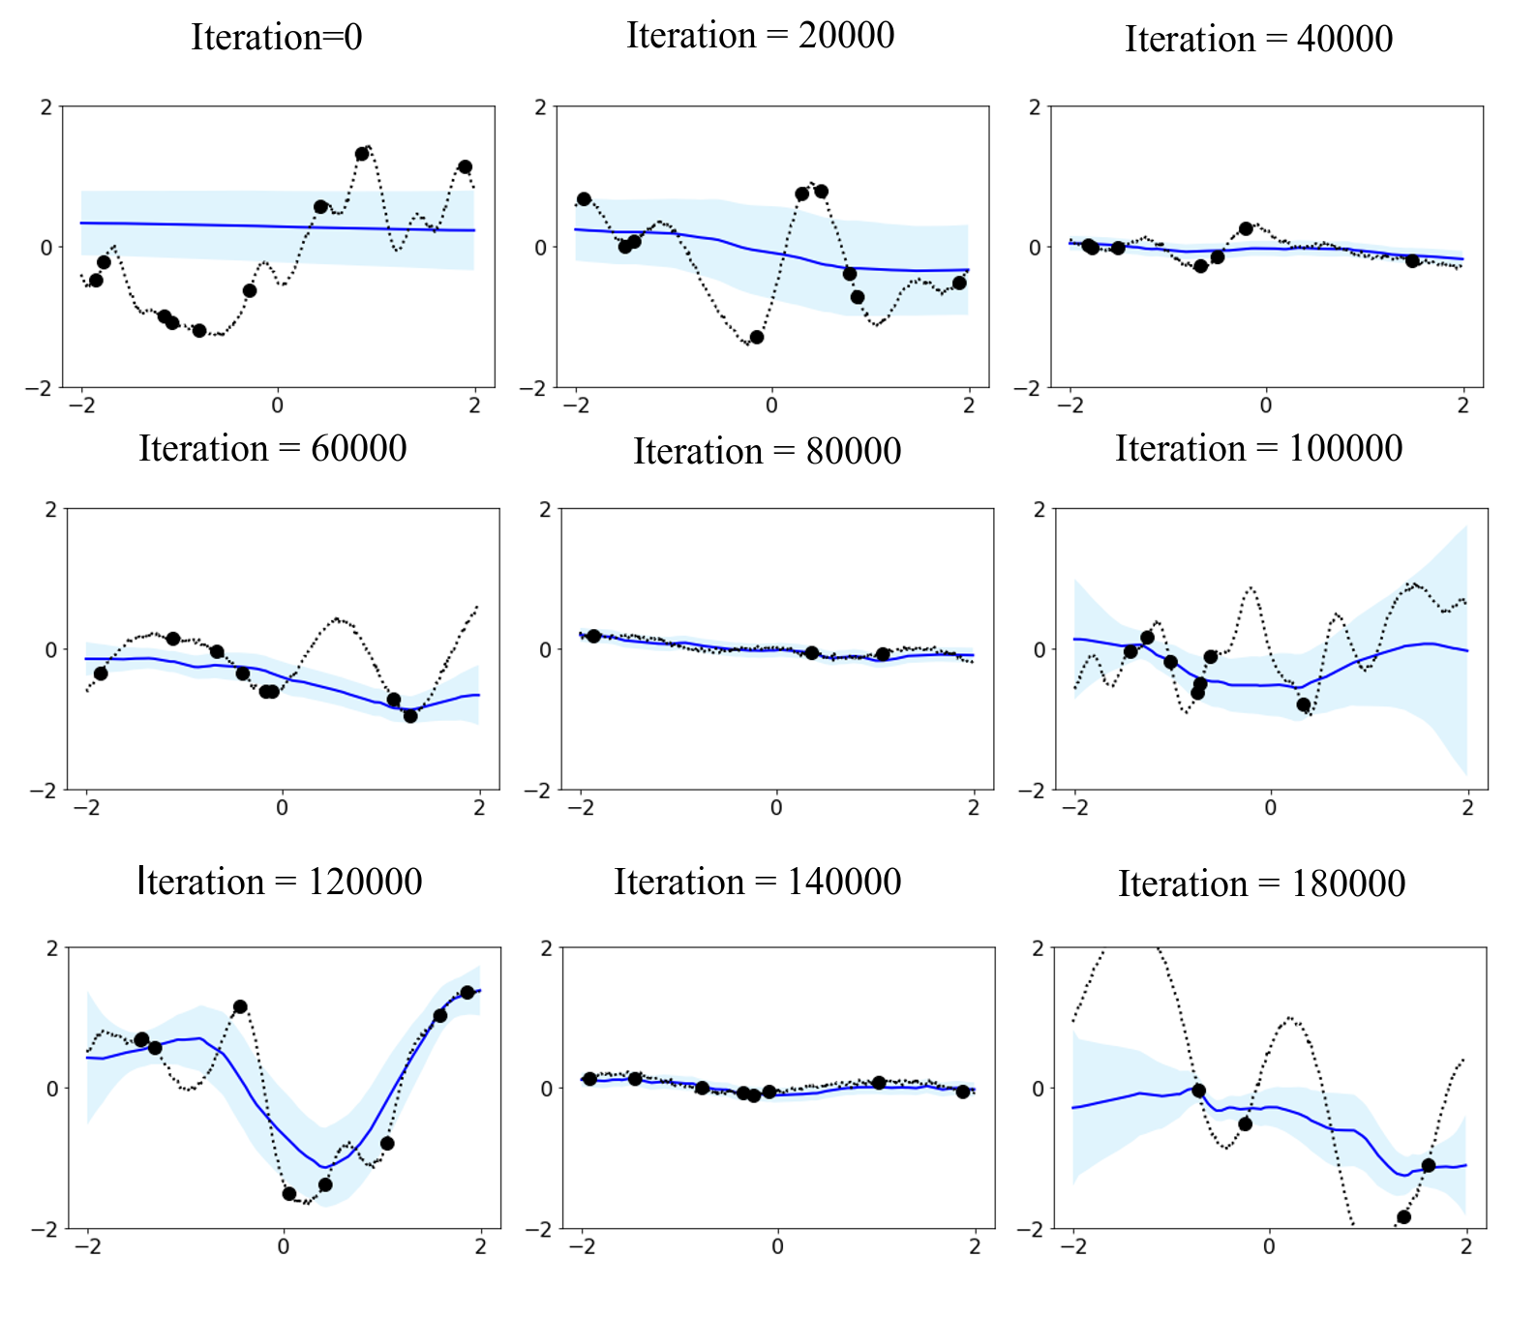
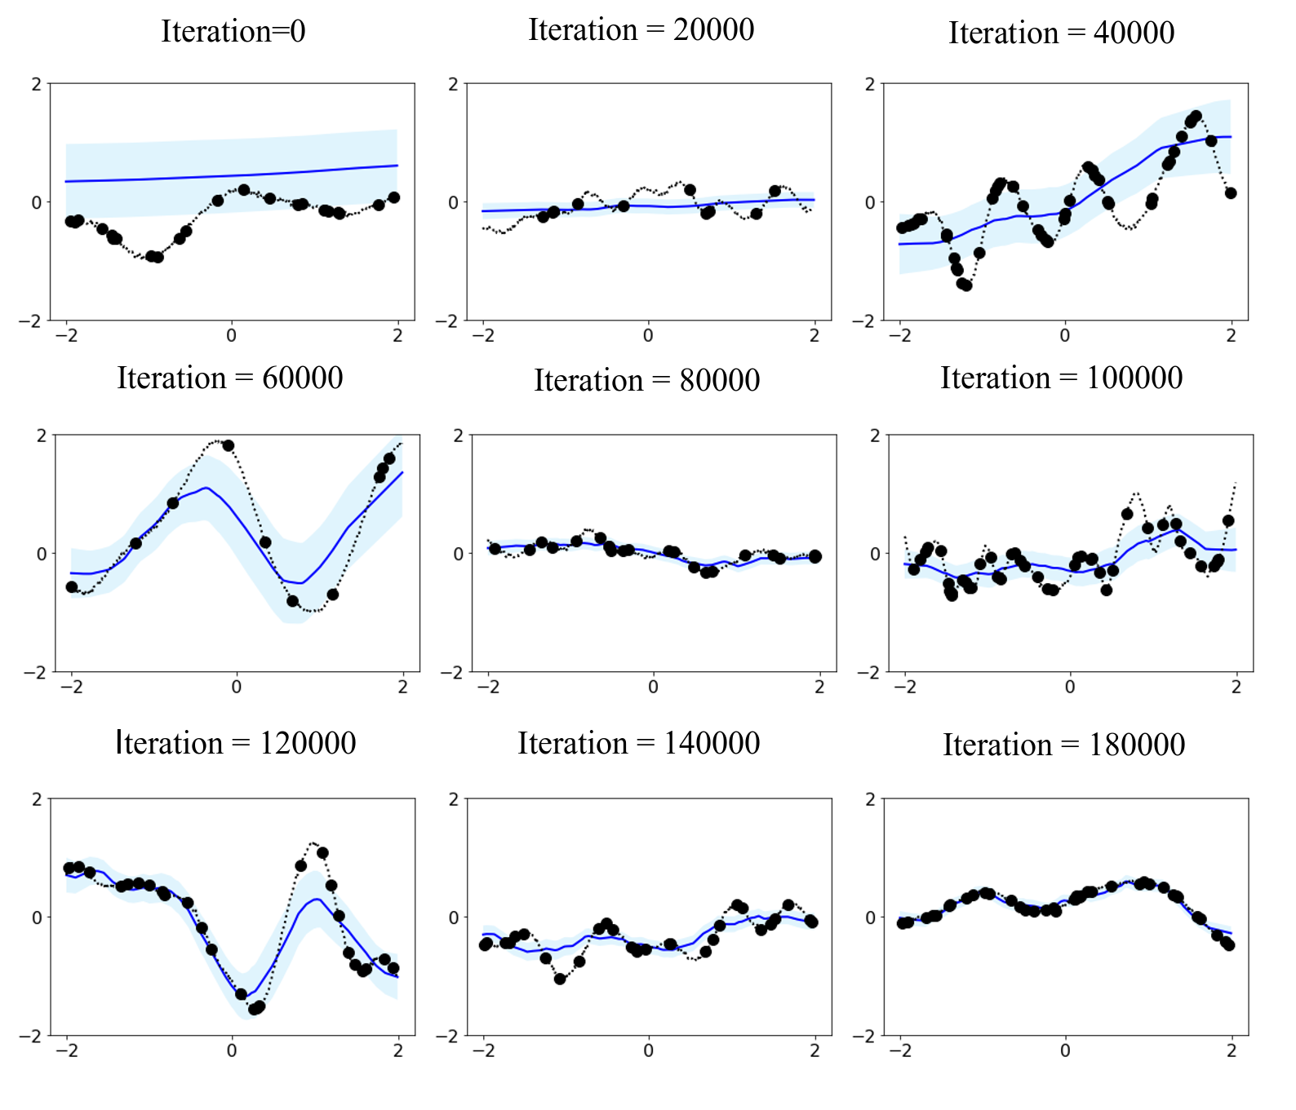
Results
Maximum context data points = 10
Maximum context data points = 50

Slide 8
Discussions
NPs fit observed data efficiently with linear complexity in the number of context input-output pairs, 𝒪(n+m)
NPs can learn a wide family of conditional distribution.
NP can learn predictive distributions conditioned on context sets of arbitrary size.
NPs don’t require a handcrafted kernel, and learn an implicit measure from the data directly.

Slide 9
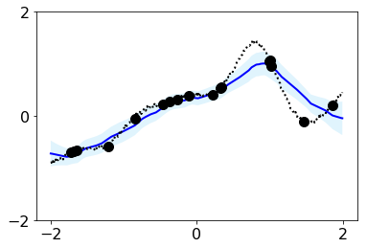
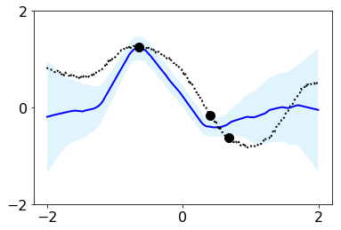
Discussions
NPs suffer a fundamental drawback of underfitting, giving inaccurate predictions at the inputs of the observed data they condition on.
Iteration: 14000
Iteration: 18000

Slide 10
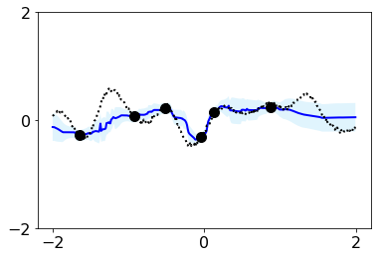
Development
Attentive Neural Processes (ANP)
Incorporate attention into NPs, allow each input location to attend to the relevant context points for the prediction.
𝒪(n(n+m))
Kim, H et al. Attentive Neural Processes (2019).

Slide 11
Acknowledgements
Prof. Jonathan K. Whitmer
Prof. Nicholas Zabaras
Dr. Souvik Chakraborty

Slide 12
Q&A

Slide 13
Background
Neural Networks (NNs)
NNs are Flexible non-linear functions which are straightforward to train.
Gaussian Processes (GPs)
GPs provides a probabilistic framework for learning a distribution over a wide class of non-linear functions.

Slide 14
Background
Few-shot learning
Meta-learning

Slide 15
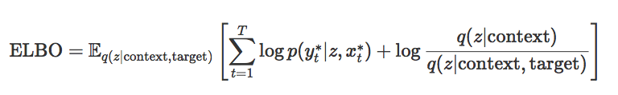
Model
Inference:
q(z|context, target) to approximate the conditional prior p(z|context, target)
q(z|context) to approximate the conditional prior p(z|context)
Carnelo, M et al. Neural Processes (2018).

Slide 16
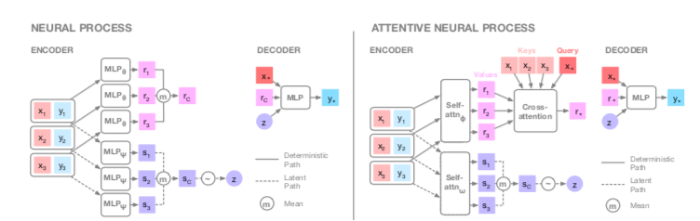
ANP
Kim, H et al. Attentive Neural Processes (2019).

