Slide 1
Microservice
Andy Chen
Notes:
Interview question:
how to trace microservice
how to communicate with different servers
how to handle problem when we use microservice
where to deploy microservice

Slide 2
Why MicroService
What is microservice?
Microservice is an architecture design pattern. It splits one large application into multiple small and independent service based applications. Each service only does one thing.
Good/Advantage of MicroService
You can update/modify one service without downtime of the entire application.
You can easily scale up to add more services
For each service, you can use different tech stacks
Bad/Drawbacks of MicroService
Communication between services requires more time and resources
DevOps – need more server and people to maintain each servers
Notes:
Interview question:
what's the difference between webservice and microservice
difference: traditional project or microservice project

Slide 3
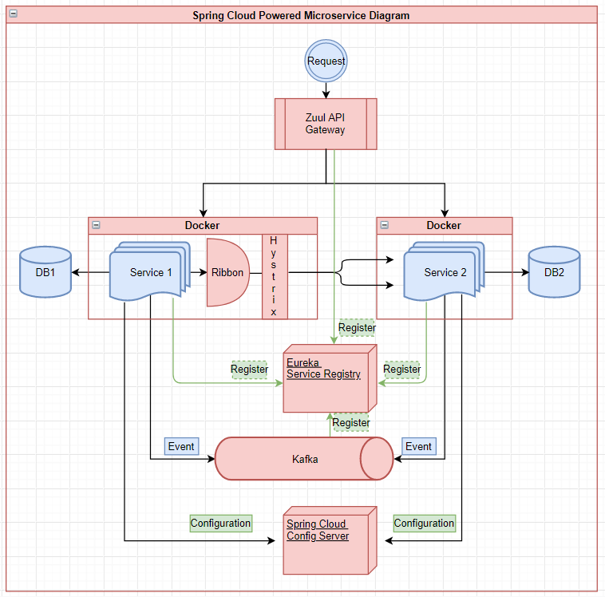
Component
Spring Cloud
Zuul API Gateway
Eureka
Ribbon Load Balancer
Hystrix Circuit Breaker
Config Server
Kafka
Docker

Slide 4
Eureka
Why using Eureka and how to register service in Eureka?
Why?
Eureka register service by serviceid, monitor service health status, auto-register new services
How to register service?
1) @EnableEurekaClient in client service
2) Give service a service id – spring.application.name = serviceid
3) In client service application.properties, set eureka server default url
Notes:
Interview question:
1) how to register eureka service/api gateway

Slide 5
Hystrix – Circuit Breaker
Why using Hystrix
When one service calls another, but the another service has a problem
Hystrix can catch all problems of underlying services and process a fallback plan
Steps to use hystrix
1) add hystrix dependencies – hystrix_starter & hystrix_dashboard
2) add @EnableCircuitBreaker
3) write the restTemplate method to call another service and fallback method
4) add @HystrixCommand(fallback=“fallback_method”)
Notes:
Interview question:
what's circuit breaker
how hystrix works

Slide 6
Zuul API Gateway
Why?
For microservice, each service has its own domain(host+port), You donot want customer to see them. To expose only one domain to customer, we need zuul api gateway
*Zuul can handle url – security, filter, redirect, block

Slide 7
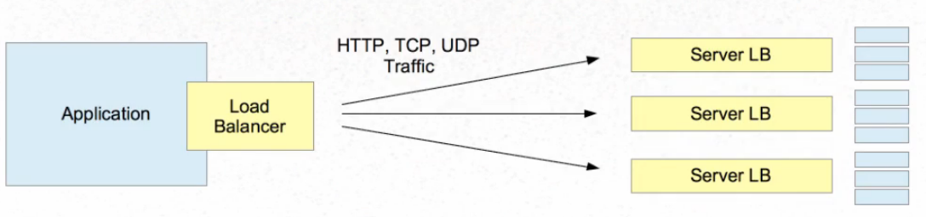
Load Balancer
Server Side Load Balancer
Client Side Load Balancer
Why client side is better?

Slide 8
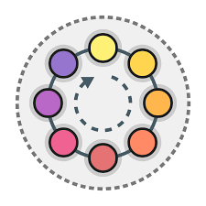
Load Balancer Algorithms
Some most popular Ribbon load balancer rules
Round Robin
Availability Filtering
Weighted Response Time
Random

Slide 9
Config Server
Notes:
Interview question:
1) what's the config server in microservice?

Slide 10
KAFKA – important notes
Explain kafka
Message broker/agent, producer and consumer, producer sent message to kafka server and kafka server dispatch message to different queue based on routing key, consumer will get message from queue
Benefit using kafka
1. very fast
2. large amount of data
3. Asynchronous and Concurrent
4. Replay
Kafka vs RabbitMQ vs JMS
Notes:
Interview question:
kafka: what's the difference between topic and queue
Kafka: how do you use it? What scenario you used it?
how to handle security issue when using kafka

Slide 11
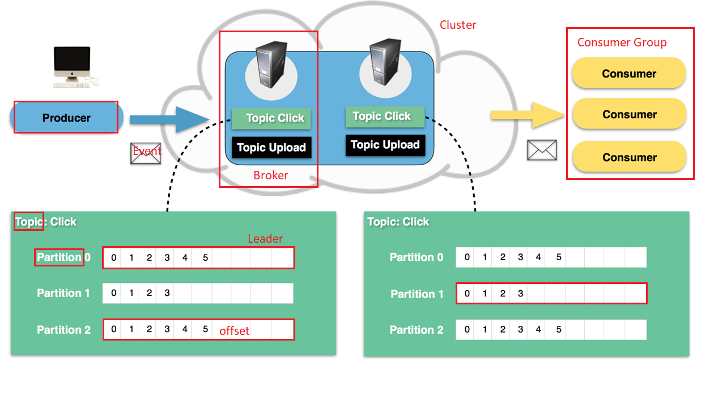
KAFKA Diagram
Producer
Consumer/Consumer Group
Cluster
Broker
Topic
Partition(leader/replica/offset)
Event/Message
Notes:
Interview question:
what's the Partition key (./clustering key/primary key/Composite key)
how to do messaging in synchronized project..

Slide 12
KAFKA: Topic and Fault Tolerance
No Queue, only Topics
Producer sends message to topic, consumer group listens to all partitions inside each topic.
Consumer sends heartbeat to kafka cluster for updating its status
Consumer subscribes to different partitions
FAULT TOLERANCE: Partition has replica with replica factor, only leader is consumed by consumer group, if leader is down, replica will become leader
MAINTAIN ORDER: events have same key so that they will send to same partition and consumed in order

Slide 13
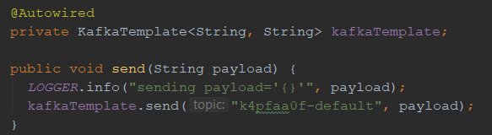

KAFKA: Producer and Consumer
Kafka version: kafka2 was released in middle 2018
Notes:
Interview question:
1) how producer and consumer works in kafka

Slide 14
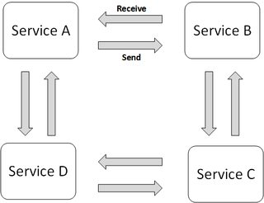
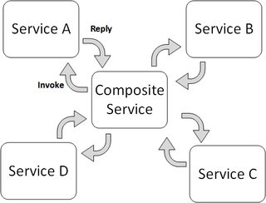
Transaction: Saga Pattern
History: Traditional global transaction Pattern: 2-phase commit
and why it may not be good for microservice
What is Saga Pattern – a sequence of independent local transactions
How to implement Saga Pattern
Events/Choreography
Command/Orchestration

Slide 15
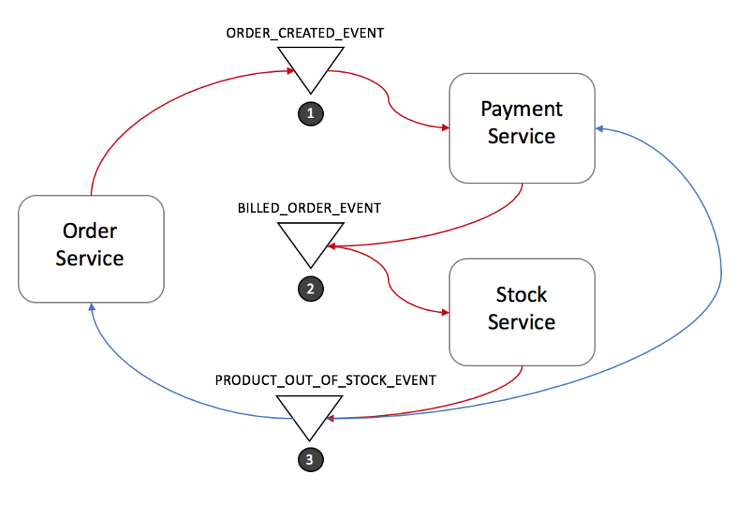
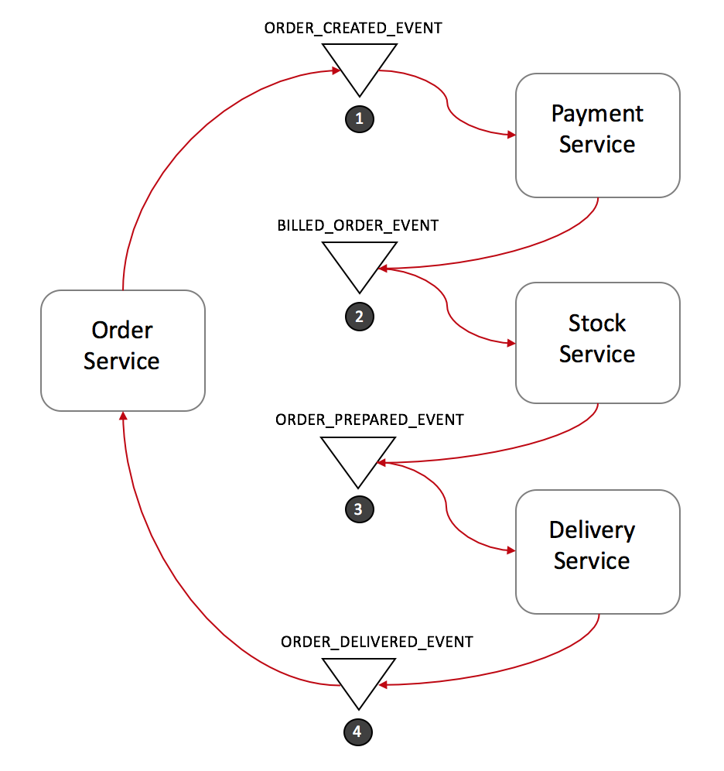
Saga: Events/Choreography
Pro:
Easy to understand
Easy to build
Con:
Hard to scale – hard to track who is listening to whom
Cyclic dependency
Normal Forward flow
Rollback flow
Pros & Cons

Slide 16
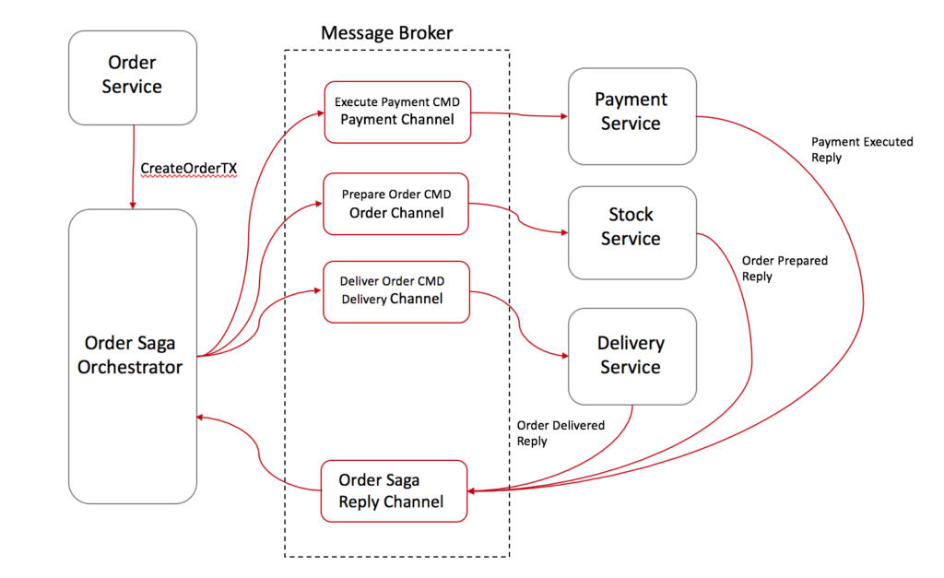
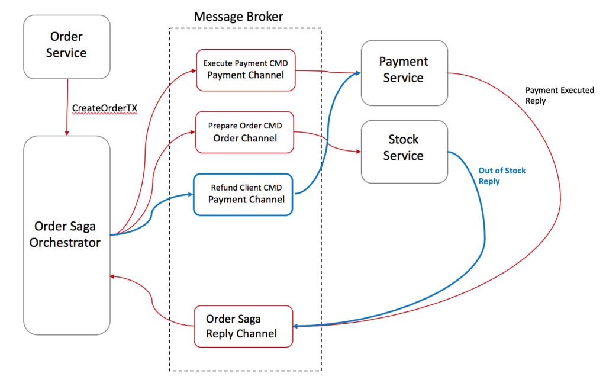
Saga: Command/Orchestration
Pro:
No cyclic dependency
Centralized orchestrator – easy to add new service
Service are independent
Con:
Relying too much on Orchestrator
Increase DevOps for new service
Normal Forward flow
Rollback flow
Pros & Cons

Slide 17
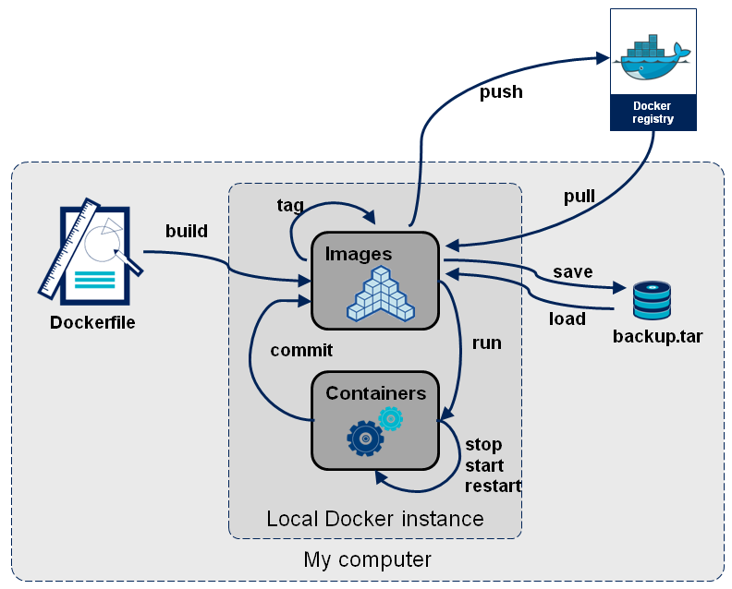
Docker
Docker vs Virtual Machine
Docker pull
Docker commit / push
Docker run
Notes:
Interview question:
what's the workflow of docker
docker for image means?

Slide 18
End of MicroService

