Slide 1

Choose a few files as sample to run normal CNMF-E individually. Each file will get some neurons that are common to all sample files as well as some unique neurons that file only in that file.
Sample folder
Generate a common spatial footprint of neuron (A): merge common ones and keep unique ones.
Use this A to extract neuron temporal C in all data you are interested in.
data folder

Slide 2
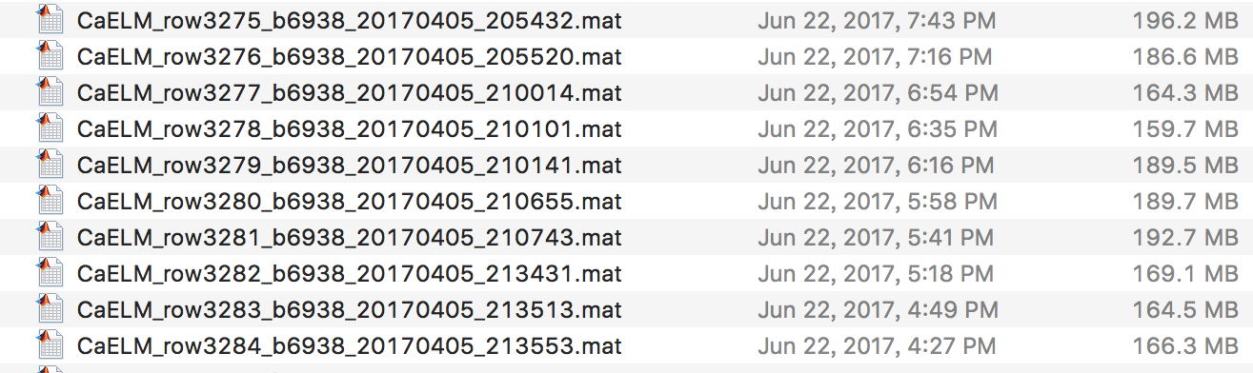
A
A
A
A
delete samples with empty A.
Concatenate A’s, altogether K neurons.
A
A0s
Sample folder
A
1
2
3
4
5
6
①Normal CNMF-E for each sample file i individually
Output: A0s{i}, File(i)
A0s’ mask
③ Similar neurons extracted in different files should have similar spatial footprint as well as similar temporal traces across files. User-specified correlation threshold is used in this step.
Merge their A. Only neurons that are found at least twice are kept, ie, only neurons merged are kept into Afinal. See MergeAC() for detailed merging strategy. Output: Afinal,MC,newIDs,merged_ROIs
② For each sample data
For each A0 mask cell element, use it on background subtracted sample data to extract C (Each mask cell starts with fresh data). After extraction of one neuron, re-estimate its A and peel the signal (A*C) off.
The result is put in structure ACS. ACS(i) has file i’s BigC, its STD, and BigA. See A2C2A() for details.
Sample data 1’s BigC (Time1)
data 2’s
data 3’s
Time1
Time2
Time3
.
.
.
.
.
.
Time1
.
.
.
ACS
K
4
5
6
Sample data 2’s A0s
1
2
3
{1}
2
3
4
5
6
Sample data 1’s A0s
{1}
2
3
4
5
6
Afinal
Sample data 3’s A0s
1
2
3
4
5
6
⑤ Use this A to extract neuron temporal C in all data you are interested in. No initiation and iteration for data. Use background subtraction strategy in the normal cnmf-e to subtract background, then use regression to find C corresponding to A. Save results in neuron_batch.neuron. See more in key variable table: neuron_batch.
Each sample file has a BigC and a BigA
data folder

Slide 3
Key Variables | Description
A0s | Cell array. A0s{i} contains the A for sample data i.
File | Structure. Length of sample number. Containing two fields, 'options','Ysignal'. Options keeps the neuron.options. Ysignal keeps the background subtracted and de-noised data, which is essentially A*C after iteration.
Mode | String, either 'initiation’or ‘massive’, which means sampling and extracting all data respectively.
ACS | Structure. Length of sample number. Three fields. 'Ain','Cin','STD'. ‘Ain’and ‘Cin’is the BigA and BigC in Figure2(ReadMe). ‘STD’is the standard deviation of each temporal traces(Cin).
ind_del | In the output of final result, neuron_batch. ind_del here is an index for neurons that have temporal traces not deconcolved successfully or are all zeros. From all files’ind_del, in output log file of each run, “First x neurons are successfully deconvolved in each files” is printed to inform you of this. The number of x is sum(~ind_del_final).
Afinal | The final A used to extract all file’s C.
neuron_batch | Structure, length of data file number. Each row of neuron_batch stands for each data file, which has information/data in 4 fields, 'ind_del','signal','FileOrigin','neuron'. Ind_del, see above. signal is a matrix where each row is the neuron’s background subtracted and denoised signal: median(jA(jA>0)*jC). FileOrigin is a structure, essentially a row of dir(Datadir). neuron is the result of CNMF-E using Afinal. This “neuron” does not contain full information as a normal CNMF-E due to the steps it skips. See section Summary of differences between CNMF-E (basic) and CNMF-E (BatchVer) in ReadMe for more information.

