Slide 1
Eigenvector and Eigenvalue
Eigen-decomposition with change of basis
from the German adjective eigen ‘own.’
Shijie Gu
Nov 29, 2018
Some slides modified from Prof. Michale Fee’s slides for
9.40 - Intro to Neural Computation, MIT

Slide 2
Preview
To facilitate this section, I asked students to watch two youtube videos with animations:
Change of Basis: https://www.youtube.com/watch?v=P2LTAUO1TdA&t=0s&index=13&list=PLZHQObOWTQDPD3MizzM2xVFitgF8hE_ab
Eigenvectors and Eigenvalues: https://www.youtube.com/watch?v=PFDu9oVAE-g&list=PLZHQObOWTQDPD3MizzM2xVFitgF8hE_ab&index=13

Slide 3
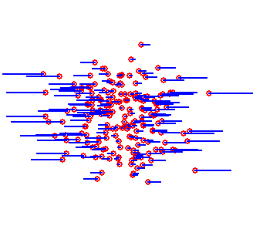
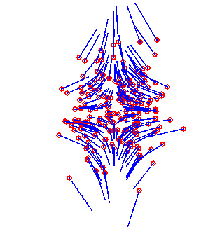
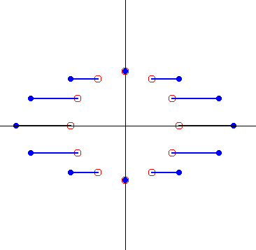
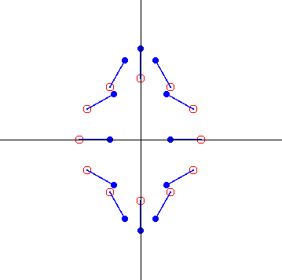
Intro to Eigenvectors and eigenvalues
Some vectors are rotated, some are not.
Matrix transformations have special directions
These are all diagonal matrices

Slide 4
Some vectors are rotated, some are not.
For a diagonal matrix, vectors along the axes are scaled, but not rotated.

Slide 5
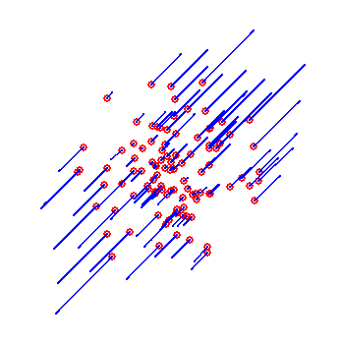
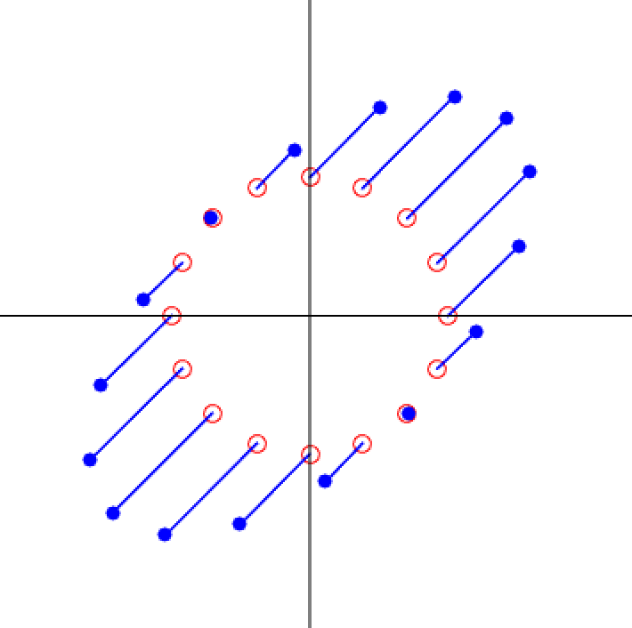
Intro to Eigenvectors and eigenvalues
Another example

Slide 6
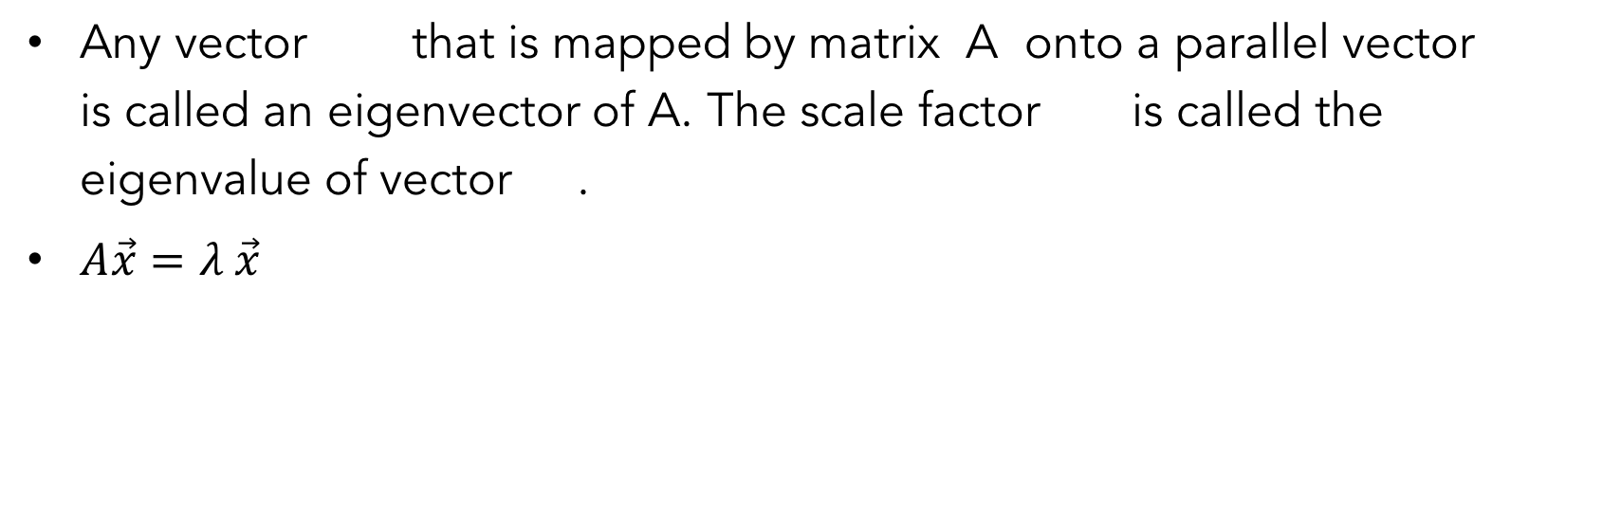




Eigenvectors and eigenvalues
Any vector that is mapped by matrix A onto a parallel vector is called an eigenvector of A. The scale factor is called the eigenvalue of vector .
$A\vec{x}=λ \vec{x}$
$$\vec{x}$$
$$λ\vec{x}$$
$$λ$$
$$\vec{x}$$
Why do we need to find out eigenvectors and eigenvalues?
To simplify calculation:
$A\vec{x}=λ \vec{x}$ : what is $A^{100}\vec{x} ?$

Slide 7
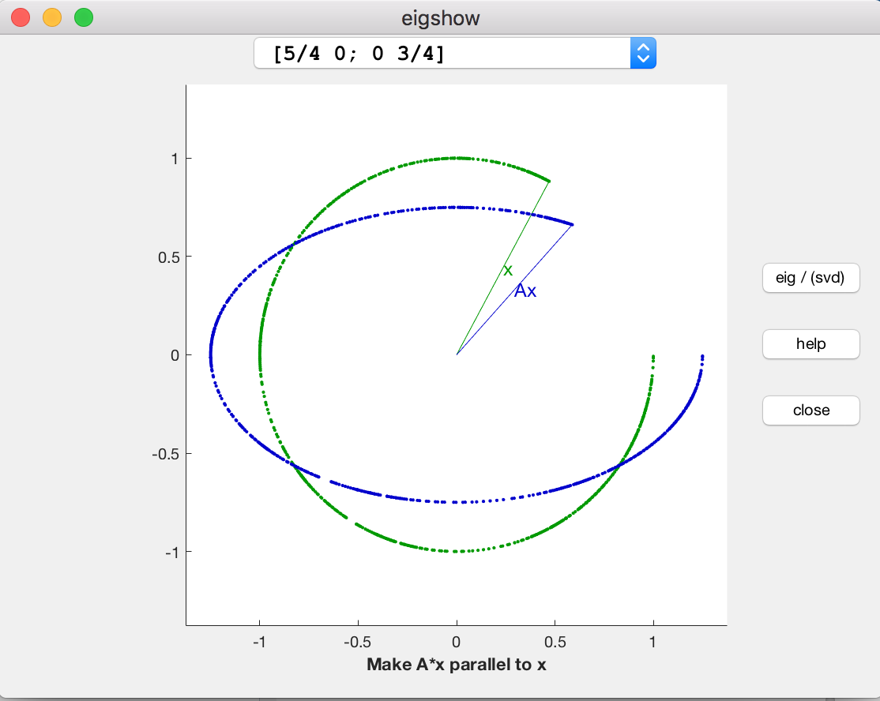
Optional: Some visualization (no need to dig into it)
You can take a look at https://blogs.mathworks.com/cleve/2013/07/08/eigshow-week-1/
Code for eigshow() is emailed to you.

Slide 8
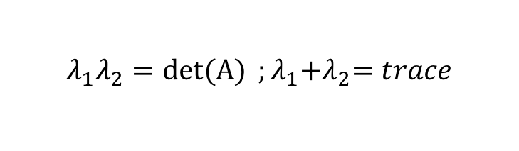

求解 Eigenvectors and eigenvalues
What are the eigenvalues of a general 2-dim matrix A ?
we only want solutions where
Which means $A−λI$ has a non-empty nullspace, thus it is not invertible:
Characteristic equation of matrix A
$$λ_{1}λ_{2}=det(A){ ;λ_{1}{+λ}_{2}=trace}$$

Slide 9

求解 Eigenvalues
What are the eigenvalues of a general 2-dim matrix?
Characteristic equation of matrix A
$$λ_{1}λ_{2}=\det{A;λ_{1}{+λ}_{2}=trace}$$
Solutions are given by the quadratic formula
eigenvalues can be real, complex, imaginary
(one way to understand them will be explored in Chapter 6.3)
For matrix not invertible: there must be one eigenvalue equal to 0.
(zero is an eigenvalue iif A is not invertible)

Slide 10
求解 Eigenvalues
For a symmetric matrix
The eigenvalues of a symmetric matrix are always real.

Slide 11
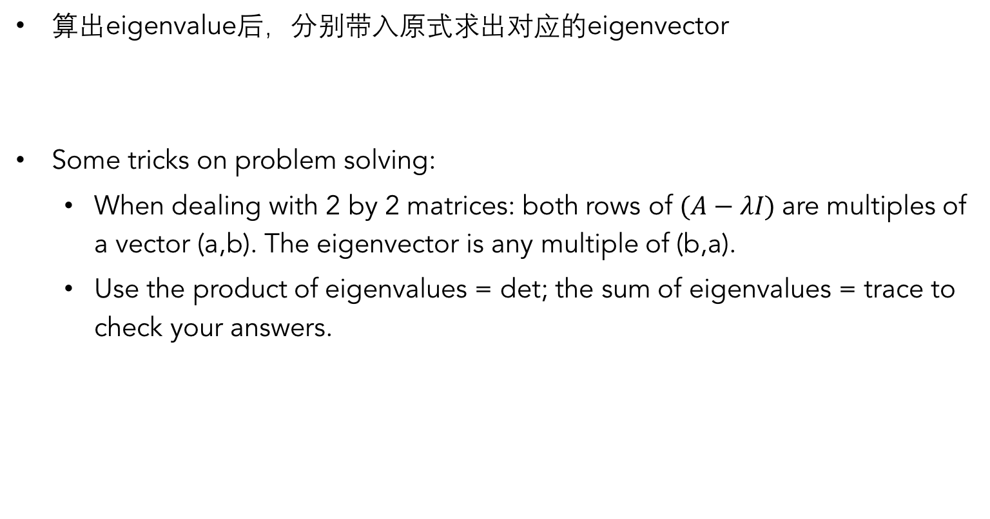
求解 Eigenvectors
算出eigenvalue后，分别带入原式求出对应的eigenvector
Some tricks on problem solving:
  When dealing with 2 by 2 matrices: both rows of $(A−λI)$are multiples of a vector (a,b). The eigenvector is any multiple of (b,a).
  Use the product of eigenvalues = det; the sum of eigenvalues = trace to check your answers.

Slide 12
Eigenvectors
Note that eigenvectors are not unique…
If is an eigenvector of A
then so is
… so we usually write eigenvectors as unit vectors
Chapter 6.4: For a symmetric matrix, the eigenvectors of A are orthogonal (and we write them as unit vectors)…
… the eigenvectors of A form a complete orthonormal basis set.

Slide 13
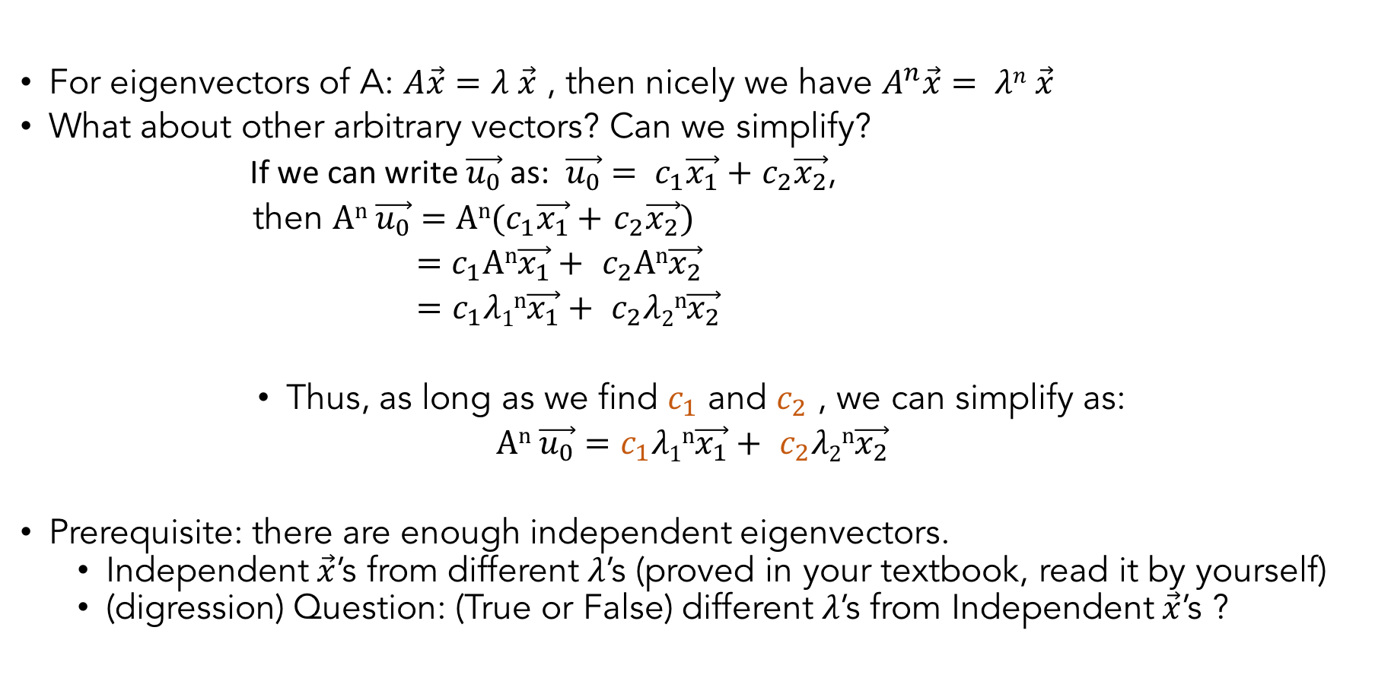

For eigenvectors of A: $A\vec{x}=λ \vec{x}$ , then nicely we have $A^{n}\vec{x}= λn \vec{x}$
What about other arbitrary vectors? Can we simplify?
If we can write $\vec{u_{0}}$ as: $\vec{u_{0}}= c_{1}\vec{x_{1}}+$ $c_{2}\vec{x_{2}}$,
then $An \vec{u_{0}}=An(c_{1}\vec{x_{1}}+$ $c_{2}\vec{x_{2}})$
$=c_{1}An\vec{x_{1}}+ c_{2}An\vec{x_{2}}$
$=$ $c_{1}λ1n\vec{x_{1}}+ c_{2}λ2n\vec{x_{2}}$
Thus, as long as we find $c_{1}$ and $c_{2}$ , we can simplify as:
$An \vec{u_{0}}=c_{1}λ1n\vec{x_{1}}+ c_{2}λ2n\vec{x_{2}}$
Prerequisite: there are enough independent eigenvectors.
  Independent $\vec{x}$’s from different $λ$’s (proved in your textbook, read it by yourself)
  (digression) Question: (True or False) different $λ$’s from Independent $\vec{x}$’s ?
Finding $c_{1}$ and $c_{2}$is essentially a process called ’change of basis’

Slide 14
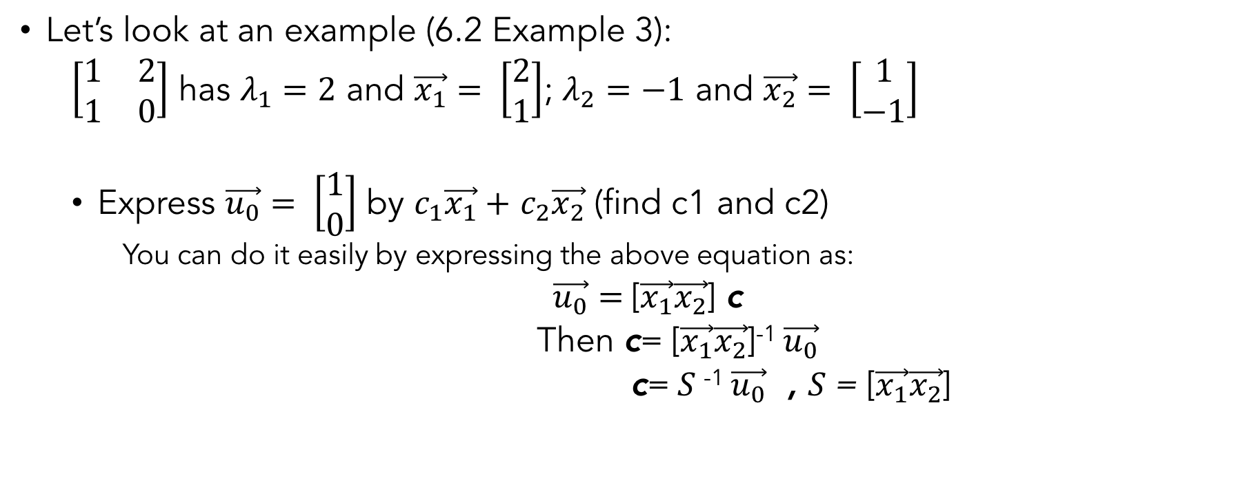

Change of Basis
Decompose other non-eigenvectors into combinations of eigenvectors
(Finding $c_{1}$ and $c_{2}$)
Let’s look at an example (6.2 Example 3):
  $\left[\begin{matrix}1 & 2 \\ 1 & 0\end{matrix}\right]$ has $λ_{1}=2$ and $\vec{x_{1}}= \left[\begin{aligned}2 \\ 1\end{aligned}\right]$; $λ_{2}=−1$ and $\vec{x_{2}}= \left[\begin{aligned}1 \\ −1\end{aligned}\right]$
  Express $\vec{u_{0}}= \left[\begin{aligned}1 \\ 0\end{aligned}\right]$ by $c_{1}\vec{x_{1}}+$ $c_{2}\vec{x_{2}}$ (find c1 and c2)
    You can do it easily by expressing the above equation as:
  $\vec{u_{0}}=$[$\vec{x_{1}}\vec{x_{2}}$] c
  Then c= [$\vec{x_{1}}\vec{x_{2}}$]⁻¹ $\vec{u_{0}}$
  c= $S$⁻¹ $\vec{u_{0}}$ , $S$= [$\vec{x_{1}}\vec{x_{2}}$]

Slide 15
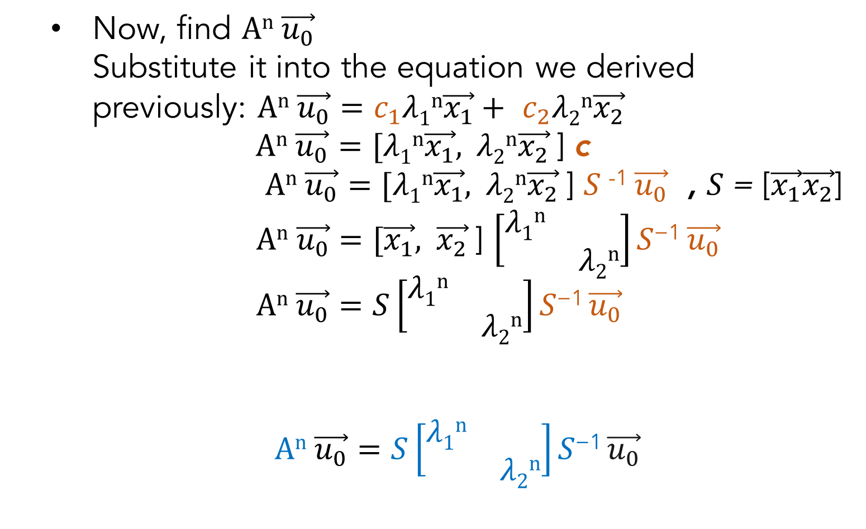
Eigen-decomposition
  Now, find $An \vec{u_{0}}$
    Substitute it into the equation we derived previously: $An \vec{u_{0}}=c_{1}λ1n\vec{x_{1}}+ c_{2}λ2n\vec{x_{2}}$
    $An \vec{u_{0}}=[λ1n\vec{x_{1}}, λ2n\vec{x_{2}}$] c
  $An \vec{u_{0}}=[λ1n\vec{x_{1}}, λ2n\vec{x_{2}}$] $S$⁻¹ $\vec{u_{0}}$ , $S$= [$\vec{x_{1}}\vec{x_{2}}$]
  $An \vec{u_{0}}=[\vec{x_{1}}, \vec{x_{2}}$] $\left[\begin{matrix}λ1n & \\ & λ2n\end{matrix}\right]S\text{−1 }\vec{u_{0}}$
  $An \vec{u_{0}}=S\left[\begin{matrix}λ1n & \\ & λ2n\end{matrix}\right]S\text{−1} \vec{u_{0}}$
  $An \vec{u_{0}}=S\left[\begin{matrix}λ1n & \\ & λ2n\end{matrix}\right]S\text{−1} \vec{u_{0}}$
Explain intuitively what it means.
Eigen-decomposition

Slide 16
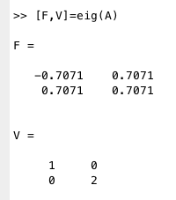
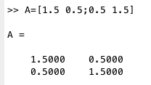
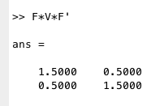
Homework assistant: MATLAB
Matlab has a function ‘eig’ to calculate eigenvectors and eigenvalues
The Transpose here is because A is symmetric. For now, understand it as F⁻¹

Slide 17


Diagonalizing
  $An =S\left[\begin{matrix}λ1n & \\ & λ2n\end{matrix}\right]S\text{−1}$
Eigen-decomposition
  $$S\text{−1}AnS=\left[\begin{matrix}λ1n & \\ & λ2n\end{matrix}\right]$$
Diagonalizing

Slide 18
Application for diagonalization
Recurrent networks
M is a diagonal matrix
1
2
3
a =
1
2
3
We have n independent equations – each neuron acts independently of all the others
A simple system to solve

Slide 19
Recurrent networks
What if it the system is not described by a diagonal matrix?
We can let’s make M diagonal!
Change basis into eigenbasis

Slide 20
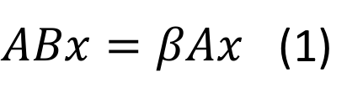




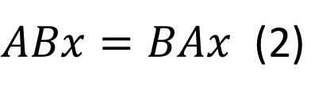


Eigenvectors of AB
If x is an eigenvector of B
$$ABx=Aβx$$
$ABx=βAx$ (1)
This side of reasoning is flawed. To prove the inverse, some advanced linear algebra is needed, we will skip them.
If x is also an eigenvector of A
If $AB=BA$
$$ABx=βλx$$
$ABx=BAx$ (2)
Similarly,
$$BAx=βλx$$
$βAx=BAx$ by (1) and (2)
Therefore,
$$AB=BA$$
All Ax’s are also eigenvectors of B,
So eigenvectors of A’s are eigenvectors of B
Suppose both A and B can be diagonized, they share the same eigenvector matrix S if and only if AB=BA

Slide 21
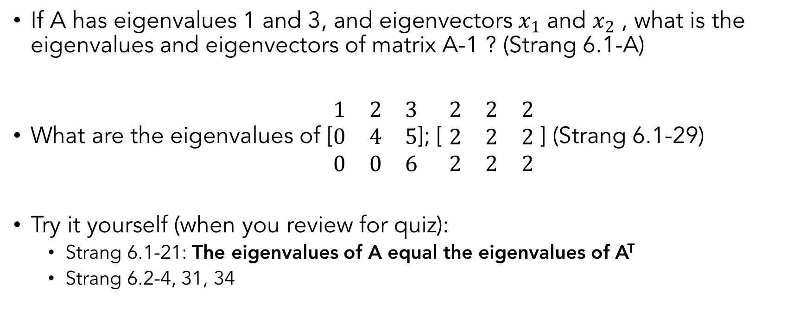
More exercises
If A has eigenvalues 1 and 3, and eigenvectors $x_{1}$ and $x_{2}$ , what is the eigenvalues and eigenvectors of matrix A-1 ? (Strang 6.1-A)
What are the eigenvalues of [$\begin{matrix}1 & 2 & 3 \\ 0 & 4 & 5 \\ 0 & 0 & 6\end{matrix}$]; [ $\begin{matrix}2 & 2 & 2 \\ 2 & 2 & 2 \\ 2 & 2 & 2\end{matrix}$ ] (Strang 6.1-29)
Try it yourself (when you review for quiz):
  Strang 6.1-21: The eigenvalues of A equal the eigenvalues of A^{T}
  Strang 6.2-4, 31, 34

