Slide 1


Group Link Prediction in Bipartite Graphs with Graph Neural Networks
accepted by Pattern Recognition
Shijie Luo ª, He Li ^{a,∗}, Jianbin Huang ª, Xiaoke Ma ª, Jiangtao Cui ª, Shaojie Qiao ^{b}, Jaesoo Yoo ^{c}
ª School of Computer Science and Technology, Xidian University
^{b} School of Software Engineering, Chengdu University of Information Technology
^{c} Department of Information and Communication Engineering, Chungbuk National University

Slide 2
Motivation
Link prediction, a powerful tool to analyze relationships between pairs of entities in networks, has gathered substantial interest across disciplines.
Almost all existing link prediction methods focus on links between pairs of objects, however, the pattern of link formation is not exclusively limited to pairs of objects. For instance, users in a group-buying activity want to attract potential members for more discount; the leader of a work team wants to recruit new employees to increase productivity.

Slide 3
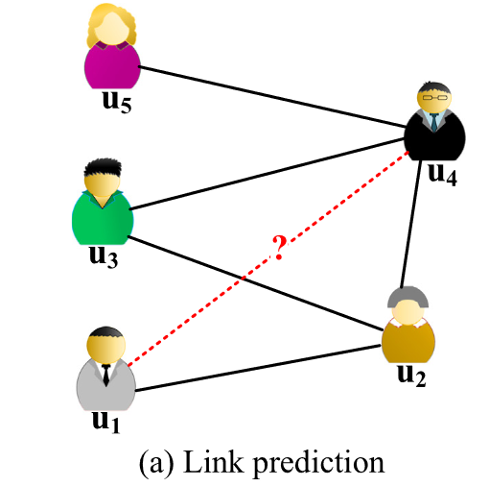
Background - Conventional Link Prediction
Conventional link prediction infers the links between nodes:
Heuristic link prediction methods, such as Common Neighbor, Adamic-Adar.
Embedding techniques-based models, such as RARE, GripNet, SNMF-FC.
Other well-designed methods, such as HL-GNN, NOH, NSLR-HMANN.
Most of link prediction methods focus only on the relationships between pairs of entities; however, the analysis of relationships between individuals and groups also deserves attention, i.e., group link prediction.

Slide 4
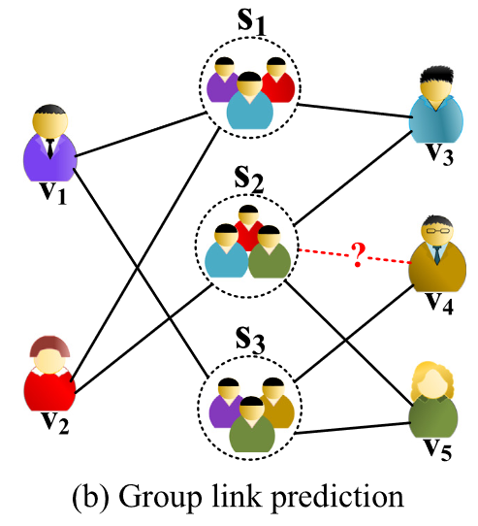
Background - Group Link Prediction
Three limitations still remain in existing group link prediction methods :
Users are assumed to be isolated from each other, leading to ignore information about local neighbors (i.e., co-group members) that can laterally characterize link preferences.
Simply treating the group as a collection of individuals and summing up the vectors of members as the representation of group may not model the group well.
Performing the prediction task through parameter tuning directly, these models fail to utilize the node content information that helps to improve the prediction accuracy.

Slide 5
Contributions
We propose a novel group link prediction method called BiGLP based on the representative architecture of GNNs to uncover the links between individuals and groups.
BiGLP provides a new perspective to integrate intra-group relationships (the affiliations between individuals and their respective groups) and inter-group relationships (the connections between different groups) to model groups.
Extensive experiments on four real-world datasets are conducted to validate our BiGLP, and the experimental results on these datasets demonstrate that BiGLP outperforms the competing methods by a significant margin.

Slide 6

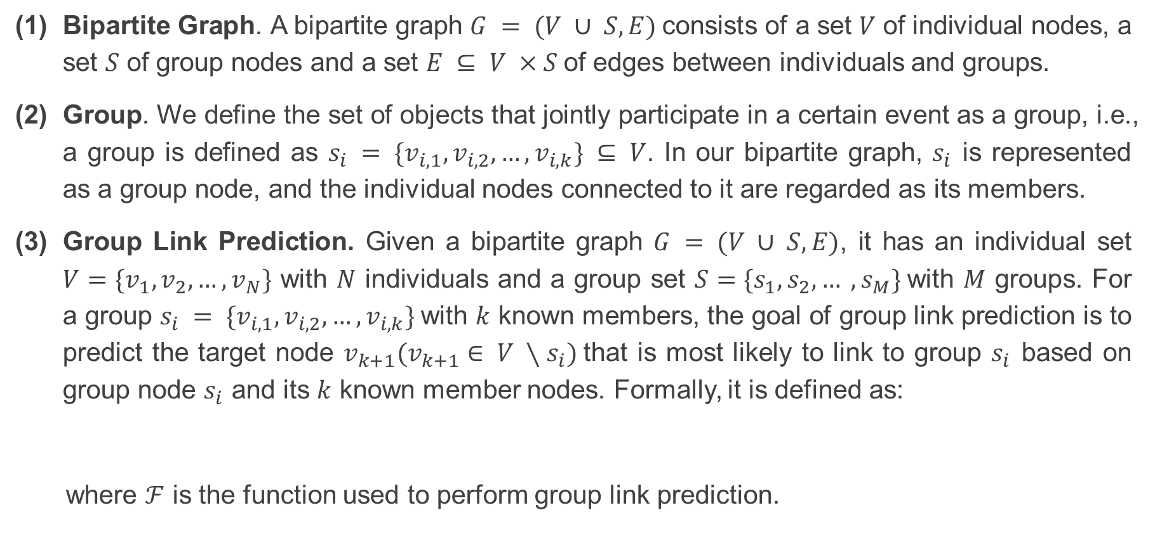
Definitions and Problem
Bipartite Graph. A bipartite graph $G = (V ∪ S, E)$consists of a set 𝑉 of individual nodes, a set 𝑆 of group nodes and a set $E ⊆ V ×S$of edges between individuals and groups.
Group. We define the set of objects that jointly participate in a certain event as a group, i.e., a group is defined as $s_{i} = \{v_{i,1}, v_{i,2}, …, v_{i,k}\} ⊆ V$. In our bipartite graph, $s_{i}$ is represented as a group node, and the individual nodes connected to it are regarded as its members.
Group Link Prediction. Given a bipartite graph $G = (V ∪ S, E)$, it has an individual set $V=\{v_{1}, v_{2}, …, v_{N}\}$ with $N$ individuals and a group set $S=\{s_{1}, s_{2}, … , s_{M}\}$with $M$ groups. For a group $s_{i} = \{v_{i,1}, v_{i,2}, …, v_{i,k}\}$with $k$ known members, the goal of group link prediction is to predict the target node $v_{k+1}(v_{k+1}∈ V ∖s_{i})$that is most likely to link to group $s_{i}$ based on group node $s_{i}$ and its $k$ known member nodes. Formally, it is defined as:
where $ℱ$ is the function used to perform group link prediction.
(Eq. 1)

Slide 7
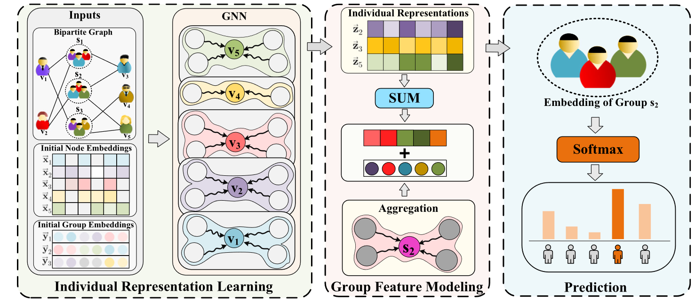
Methodology - Overall of proposed BiGLP
BiGLP includes individual representation learning, group feature modeling and prediction.

Slide 8

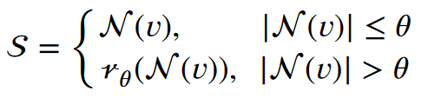




BiGLP - Individual representation learning
Neighbor sampling without replacement:
(Eq. 2) - neighbors of central individual node
(Eq. 3) - neighbor sampling
(Eq. 4) - multi-layer neighbor sampling
Embedding update:
(Eq. 5) - neighborhood information aggregation
(Eq. 6) - concatenation of previous-layer central node
information and neighborhood information
(Eq. 7) - linear transformation
Notes:
无放回邻居采样

Slide 9



BiGLP - Group feature modeling
(Eq. 9) - group vector from intra-group perspective
(Eq. 10) - neighbors of central group node
(both link to a sample individual node)
(Eq. 11) - group vector from inter-group perspective
(Eq. 12) - combination of intra-group and inter-group perspective
(obtain final group vector)

Slide 10
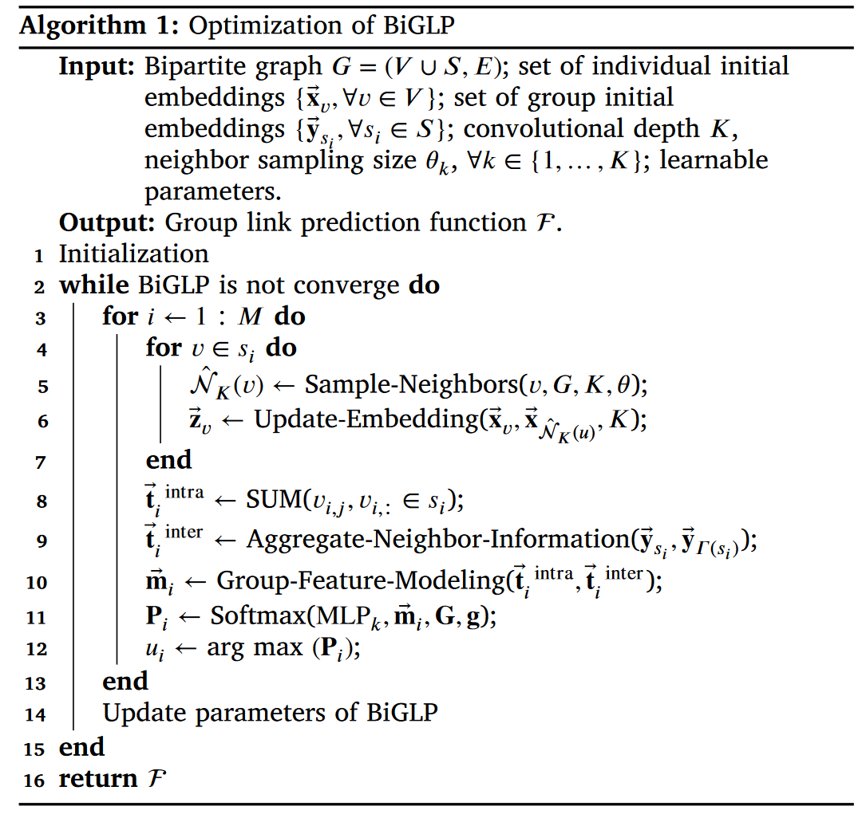


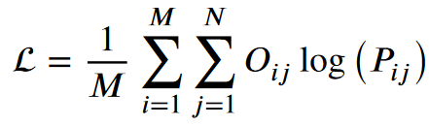
BiGLP - Prediction & Optimization
(Eq. 13) - transformation
(Eq. 14) - softmax for prediction
(Eq. 15) - objective function
(cross-entropy loss function)

Slide 11
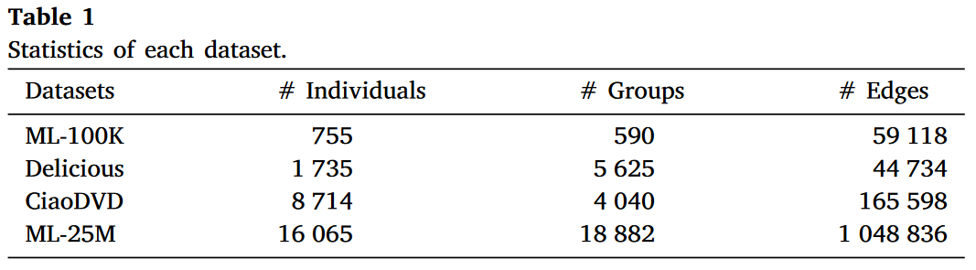
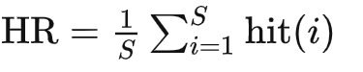
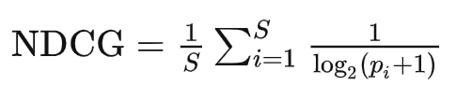

Experiments - Experimental Setup
Datasets
Baselines
Three group link prediction methods:
LSTM-based model (LSTM),
CVAE-based model (CVAE)
CVAEH
Four neural networks-based methods:
MLP
GraphSAGE
LightGCN
GIN
Metrics
Hit Ratio
Normalized Discounted Cumulative Gain
Mean Reciprocal Rank

Slide 12
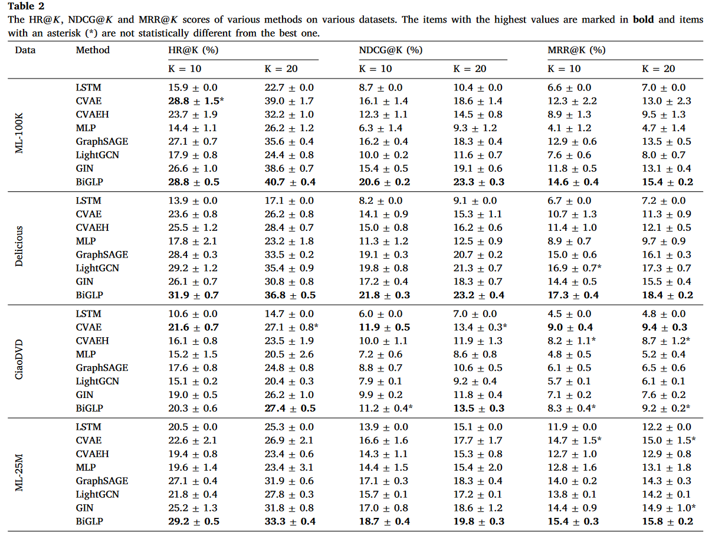
Experiments - Main Results
BiGLP demonstrates superior performance compared to the majority of competing baselines, particularly in the scenario of ranking targets.
GNN-based baselines perform relatively poor on dataset CiaoDVD, possibly due to insufficient neighborhood information for adequate user feature learning.
GNN-based methods always display remarkable stability in their performance, validating our claim that neighborhood information indeed proves beneficial for group link prediction, given their inherent capability to combine contextual details.

Slide 13
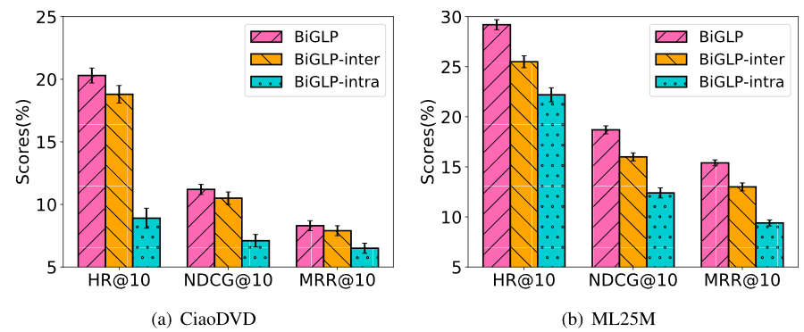
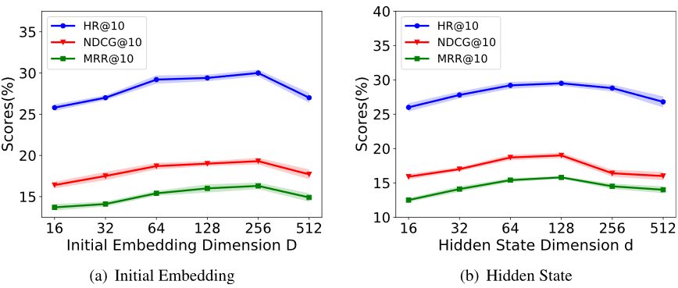
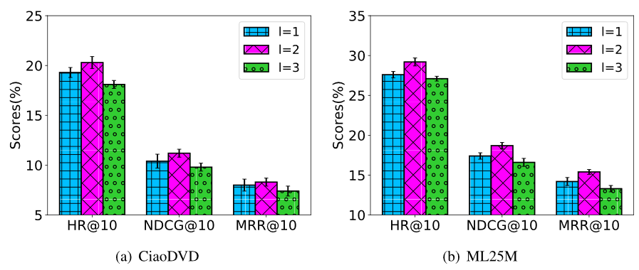
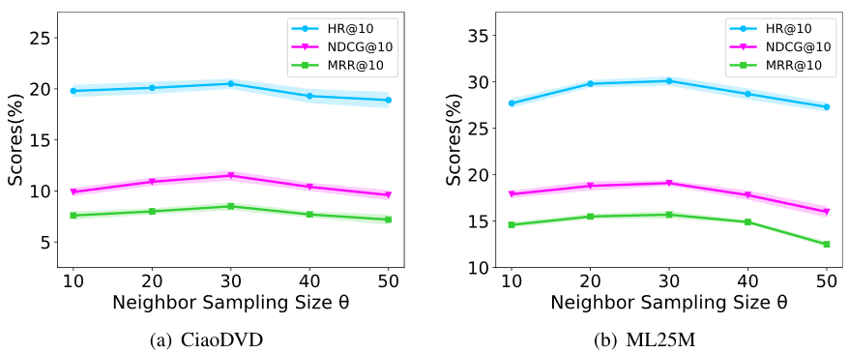
Experiments - Ablation Study & Hyper-parameter Study
Ablation study.
Effect of embedding dimension.
Effect of the number of convolutional layer.
Effect of neighbor sampling size.

Slide 14
Conclusion
In this work, we propose a novel group link prediction method BiGLP. District from previous methods that simply treat groups as a collection of individuals, BiGLP can naturally combine intra-group relationships and inter-group relationships to learn representations of groups and infer links.
Our proposed method provides a novel perspective that integrates intra-group relationships and inter-group relationships to learn higher quality group representations for solving the problem of group link prediction.

Slide 15
THANK YOU

