Slide 1


Dynamic Group Link Prediction in Continuous-Time Interaction Network
Shijie Luo, He Li* and Jianbin Huang
School of Computer Science and Technology, Xidian University

Slide 2
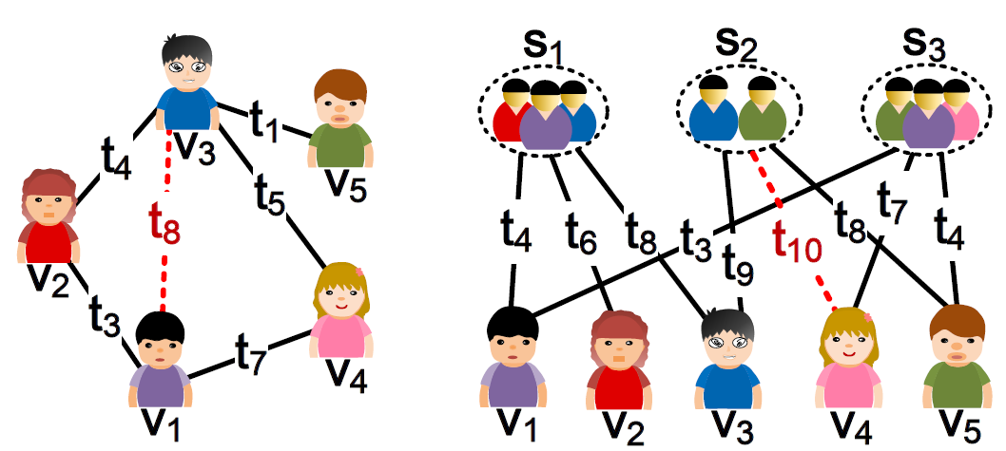
Background -
Conventional Link Prediction
Conventional link prediction infers the links between nodes:
Heuristic link prediction methods, such as Common Neighbor, Adamic-Adar.
Embedding techniques-based models, such as DeepWalk, node2vec, HTNE.
Other well-designed methods, such as TDGNN, GC-LSTM, DeepLinker.
Most of link prediction methods focus only on the relationships between pairs of entities; however, the analysis of relationships between individuals and groups also deserves attention, i.e., group link prediction.

Slide 3
Background -
Group Link Prediction
There are three limitations of previous group link prediction methods applied to dynamic group link prediction problem:
Previous group link prediction methods rarely discuss future links between individuals and groups, but tend to uncover missing ones.
Individuals are assumed to be isolated from each other, which neglects the neighborhood information that laterally depicts dynamic link preferences.
Equal treatment of all group members leads to ignoring the diversity of members’ importance in groups.

Slide 4
Contributions
We propose a novel continuous-time group link prediction method, CTGLP, to infer the future links between individuals and groups.
We propose a new graph neural network CTGNN with a continuous-time neighbor sampling strategy, to learn the representations of individuals.
We propose an importance-based group modeling function to model the groups into the latent space.
Extensive experiments on various datasets with and without unseen nodes are conducted to validate CTGLP.

Slide 5
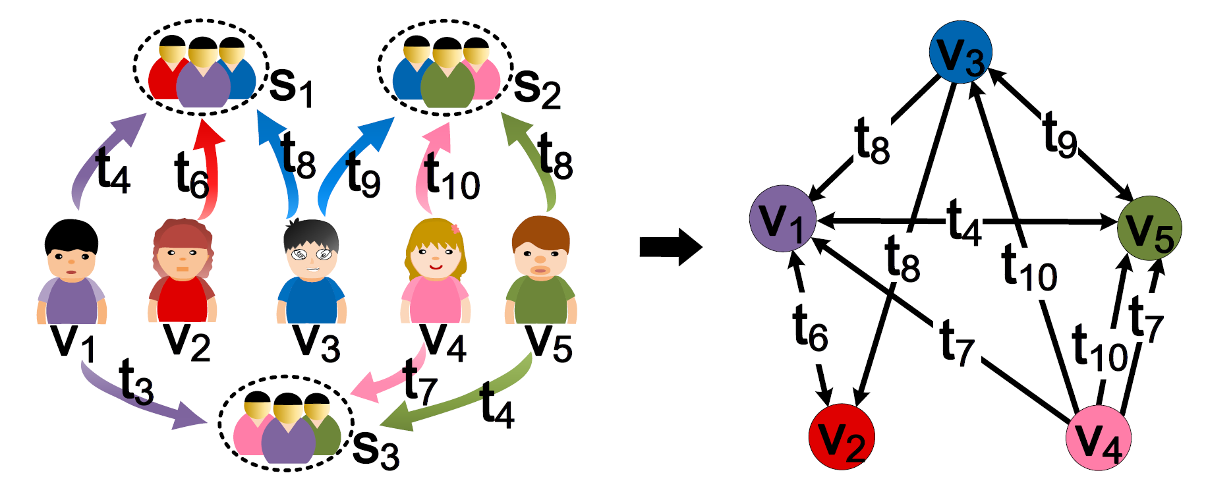
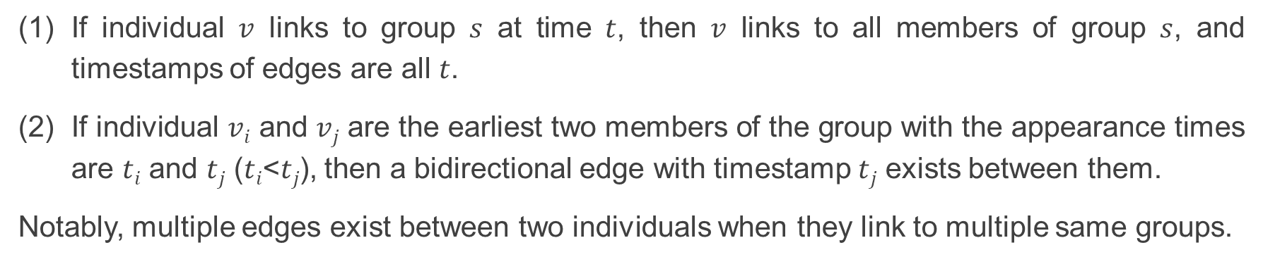
Preliminaries -
Continuous-time interaction networks
If individual $v$ links to group $s$ at time $t$, then $v$ links to all members of group $s$, and timestamps of edges are all $t$.
If individual $vi$ and $vj$ are the earliest two members of the group with the appearance times are $ti$ and $tj$ ($ti$<$tj$), then a bidirectional edge with timestamp $tj$ exists between them.
Notably, multiple edges exist between two individuals when they link to multiple same groups.

Slide 6
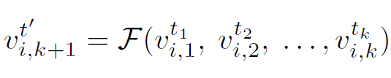
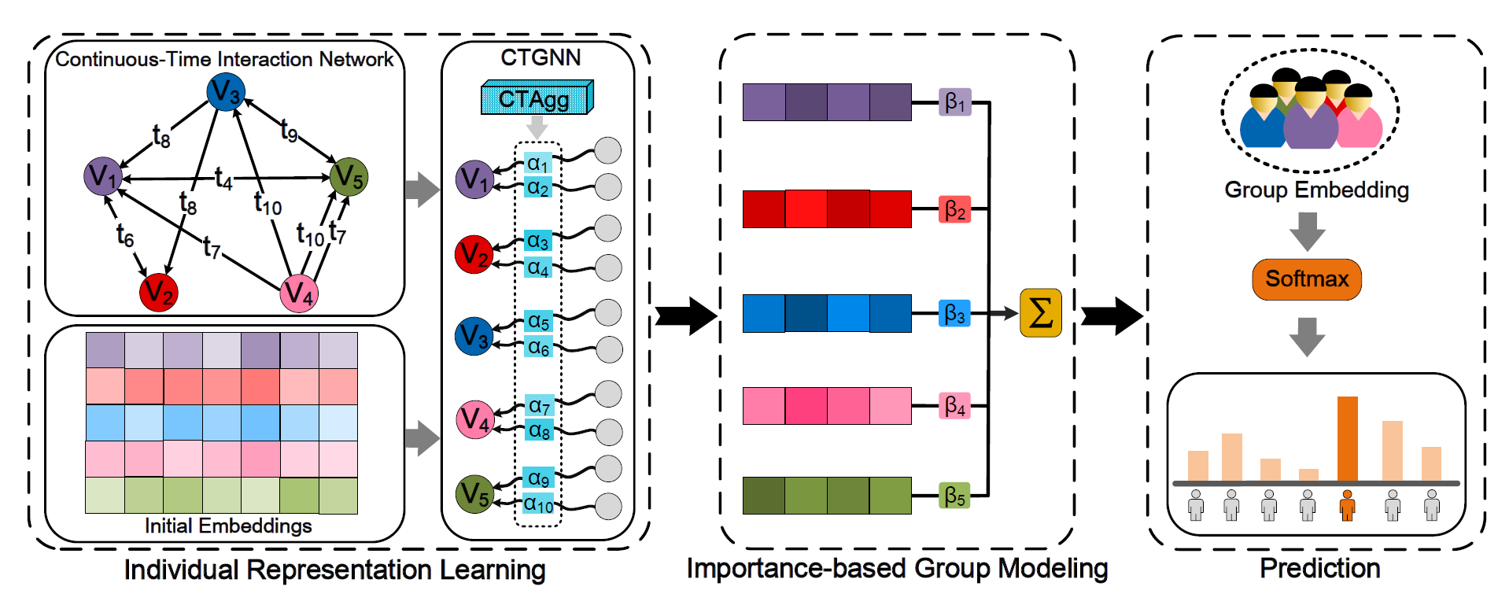
Methodology -
Overall of proposed CTGLP
Problem formulation:
(Eq. 1)

Slide 7


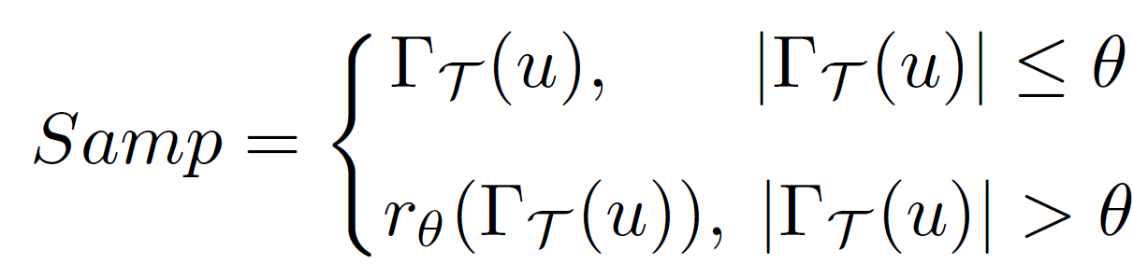


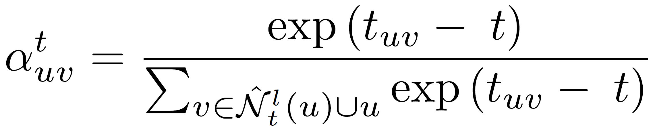


Methodology -
1. Individual representation learning
Continuous-time neighbor sampling:
(Eq. 2)
(Eq. 3)
(Eq. 4)
layer 1
layer 2
Embedding update:
α₁
(Eq. 5)
(Eq. 6)
(Eq. 7)
(Eq. 8)
α₂

Slide 8
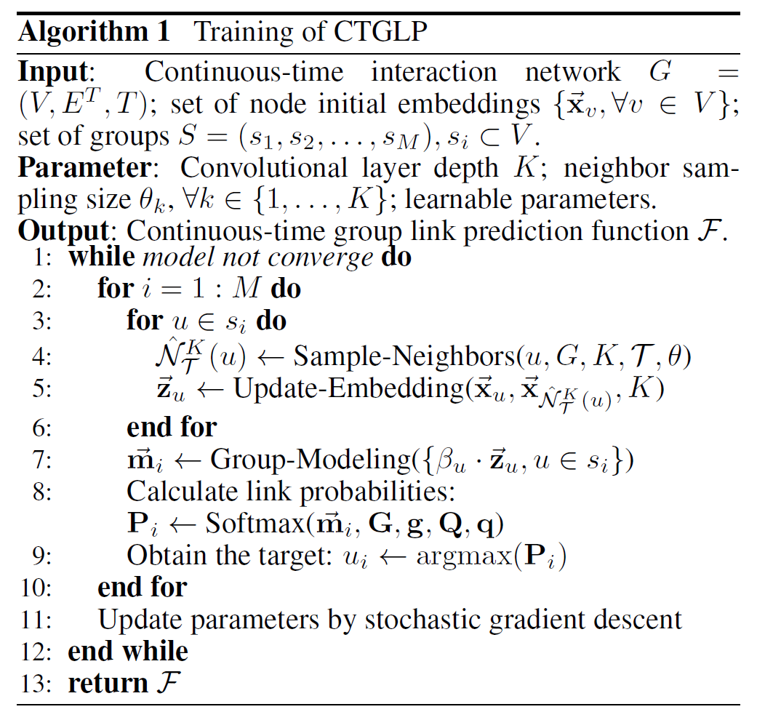
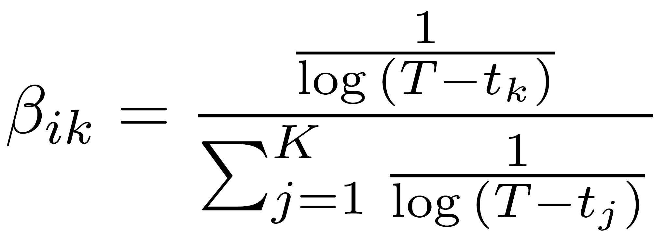
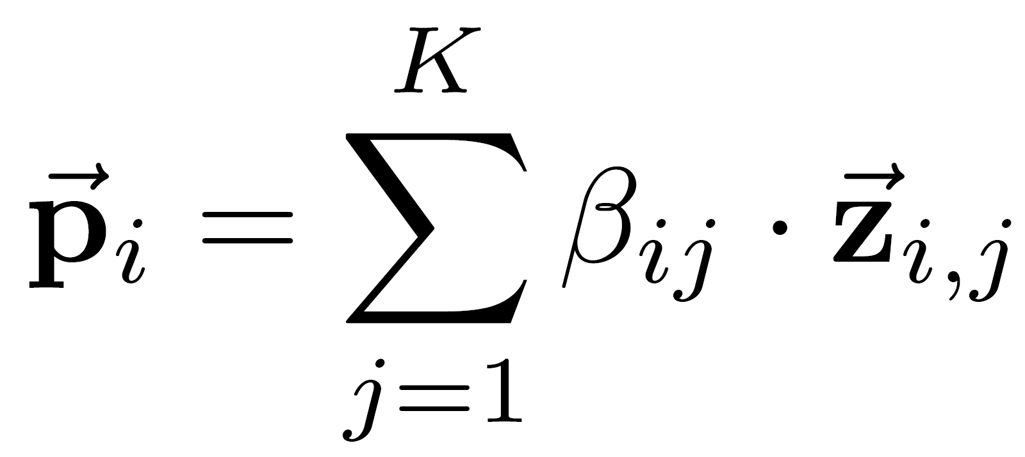



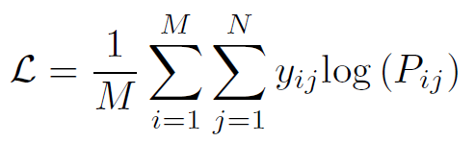
Methodology
2. Importance-based group modeling
(Eq. 9)
(Eq. 10)
(Eq. 11)
3. Prediction and loss function
(Eq. 12)
(Eq. 13)
(Eq. 14)

Slide 9
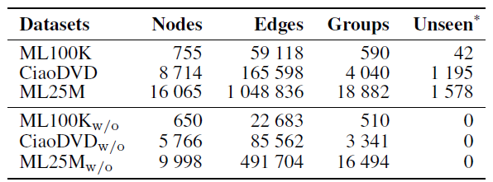
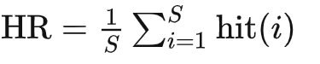
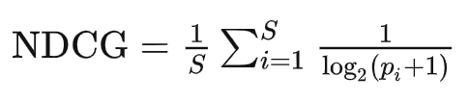

Experiments -
Experimental setup
Datasets
Baselines
Three group link prediction methods:
1) LSTM-based model (LSTM), 2) CVAE-based model (CVAE) and 3) CVAEH.
Two neural networks-based methods:
1) MLP and 2) GraphSAGE.
Two heuristic link prediction methods:
1) AA and 2) CN.
Three network embedding-based methods:
1) DeepWalk (DW), 2) node2vec (n2v) and 3) HTNE.
Metrics
Hit Ratio
Normalized Discounted Cumulative Gain
Mean Reciprocal Rank

Slide 10
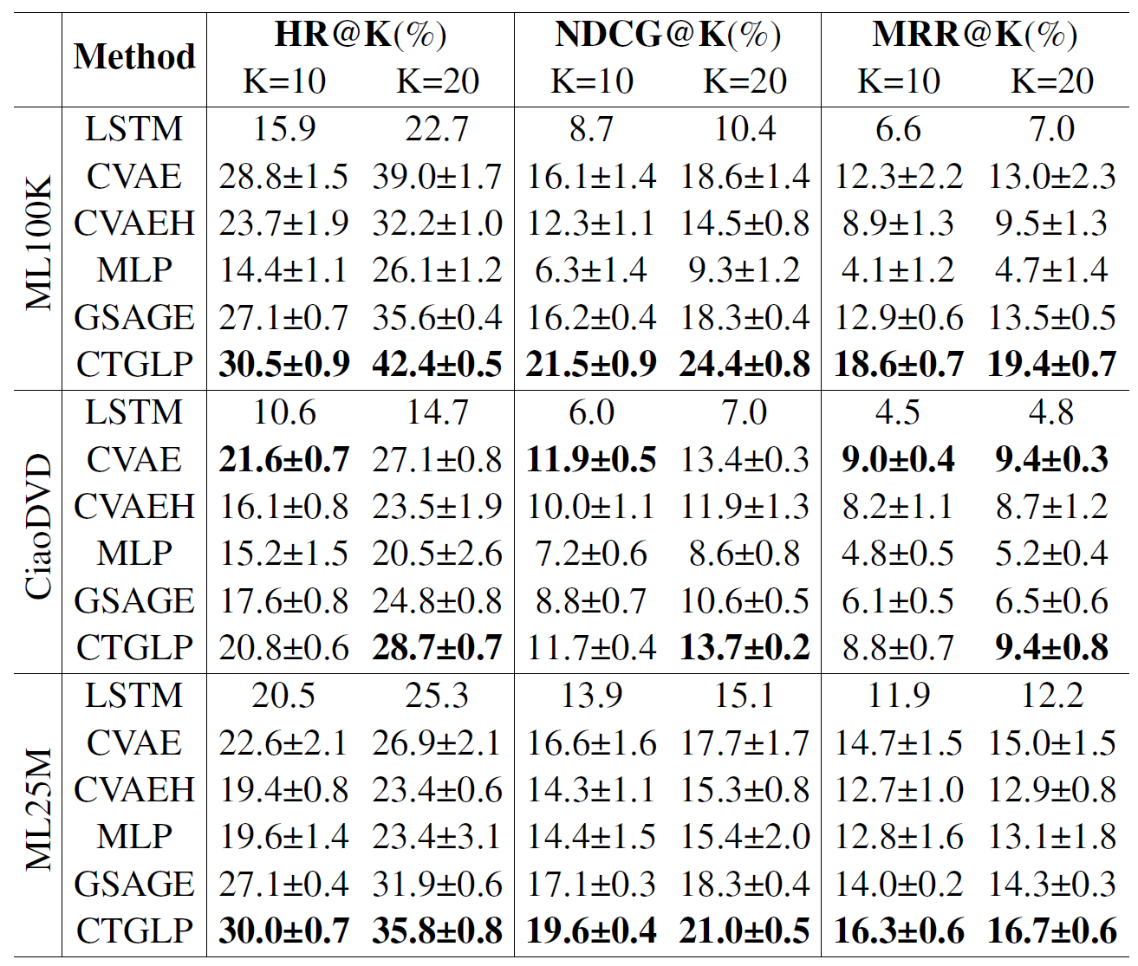
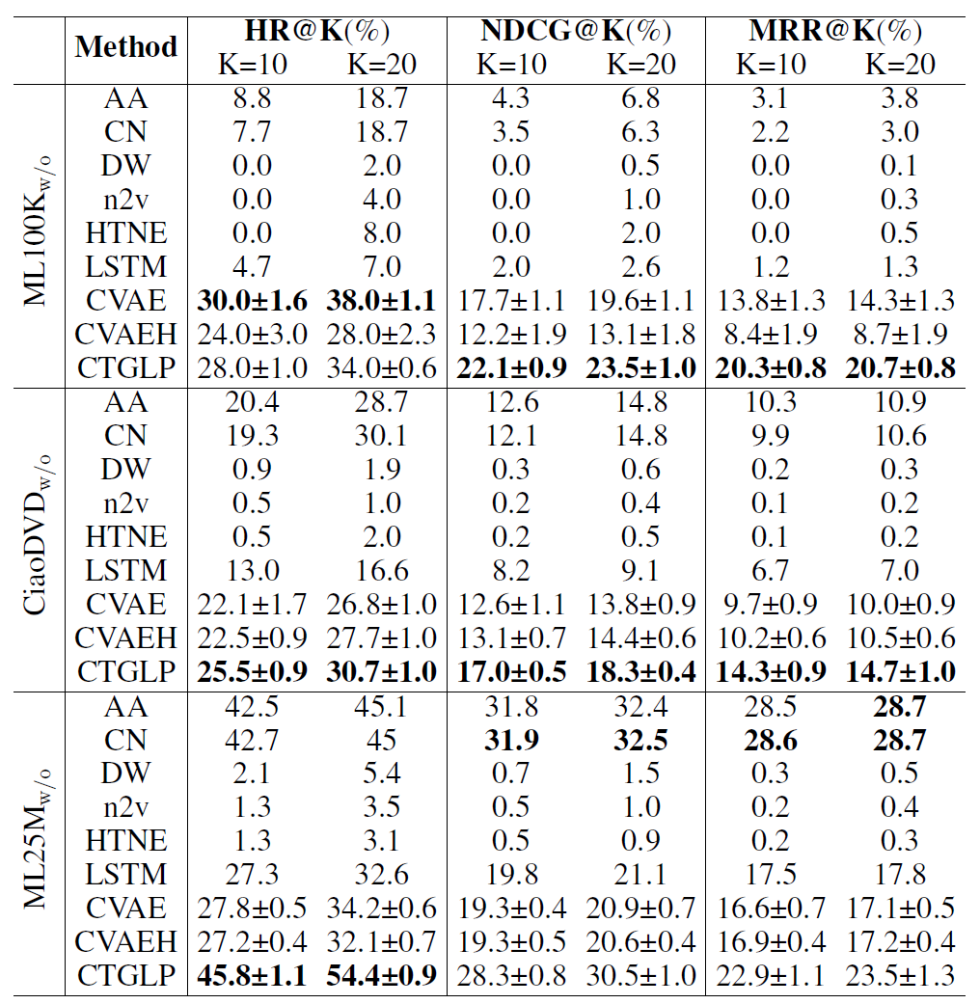
Experiments -
Performance comparison
Performance on datasets with unseen nodes.
Performance on datasets without unseen nodes.

Slide 11
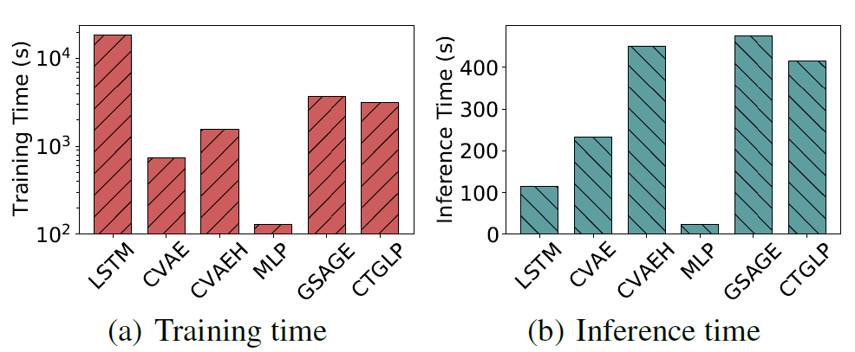
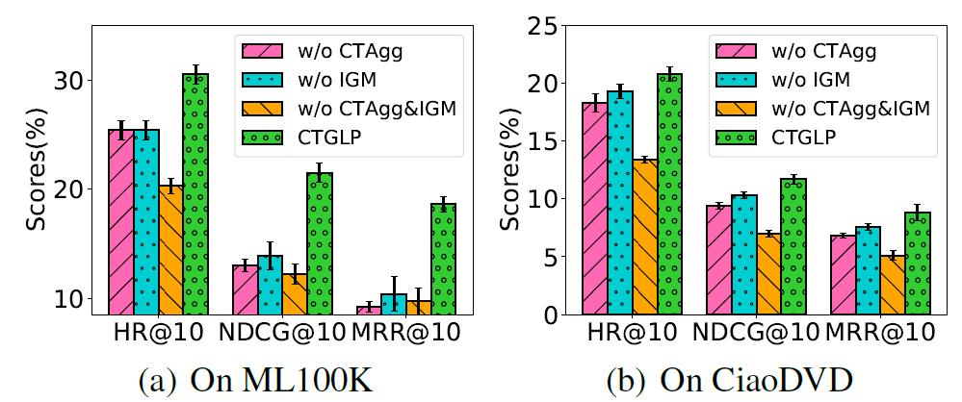
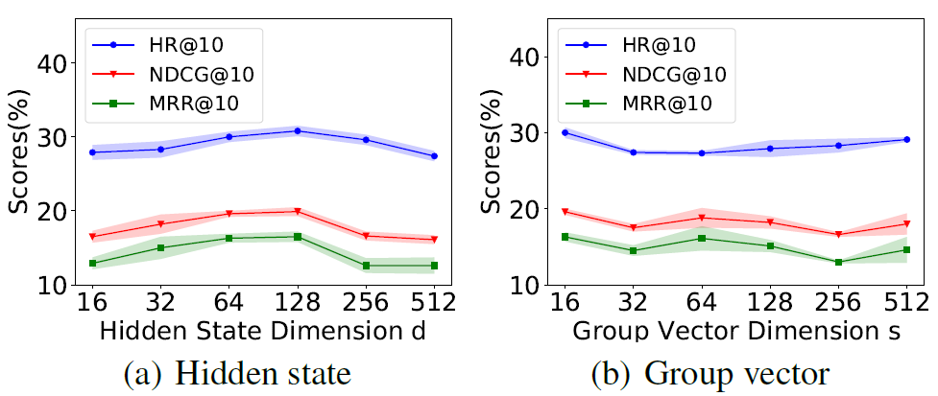
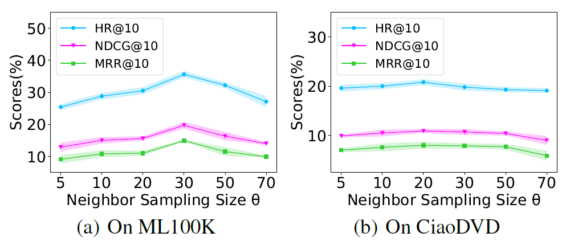
Experiments
Comparison of training and inference time.
Ablation study.
(Fig. 4)
(Fig. 5)
Effect of Embedding Dimension.
Effect of Neighbor Sampling Size.
(Fig. 6)
(Fig. 7)

Slide 12
THANK YOU

