Slide 1
Data Science and Applied Machine Learning Project 1
By: Collin Kress, Shijon Das, Liam Searle

Slide 2



Introduction/Background
How did Covid affect the states?
The observed states were:
California(a large population),
Virginia(a medium population),
Idaho(a small population)
California’s population:40.5 M
Virginia’s population: 9.1 M
Idaho’s population: 2.0 M
Notes:
Before we chose a goal, we decided limit our dataset to a smaller field and do a compare of different states based on their populations. A state with a large population, a state with a medium population, and a state with a small population. The states we chose, in order, are California, Virginia, and Idaho.
https://en.wikipedia.org/wiki/List_of_U.S._states_and_territories_by_population (Where the images were retrieved from)

Slide 3
Goals of Research
Goals
What is the relationship between a states population and the number of covid cases?
Of those cases, how many were admitted to the hospital and/or required bedcare? What is the percentage of bedcare patients to admitted patients?
Are the community levels a good representation of how covid affected the states?
How did Covid affect states of differing populations? Is there a visible pattern?
Notes:
Goals were something of a rough patch as we couldn’t figure out what we all wanted to look at, so we developed 3 goals to link together. The first was what is the relationship between a states population and the number of cases, next was how many people were admitted to the hospital and required bedcare, and finally, did the percentages of our data line up with what the original dataset had to say about the severity of the covid levels. We wanted to see how covid affected different states of differing populations

Slide 4
Methodology (i.e. what analysis did you preform)
Took subsets of each of the states
Split up the subsets into months
Added columns for covid cases, covid hospital admissions and covid inpatient bed utilization
Categorically encoded the community level transmissions where 1 represents Low, 2 represents Medium and lastly 3 represents High
Used pandas, numpy and matplotlib libraries for carrying out our goals

Slide 5
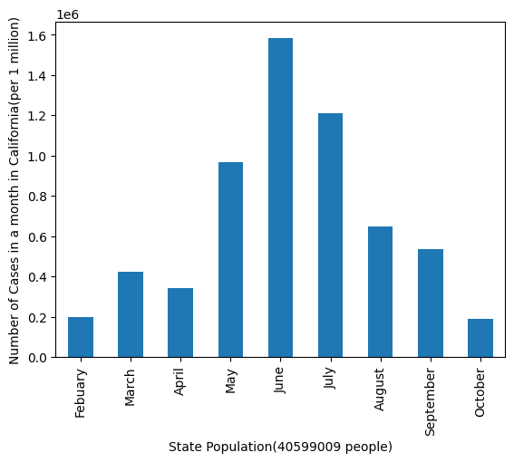
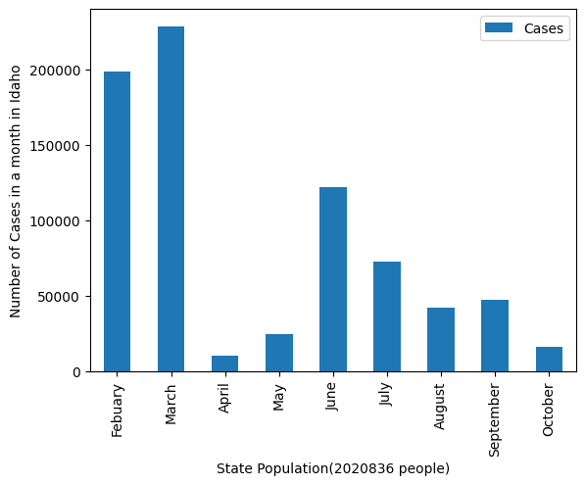
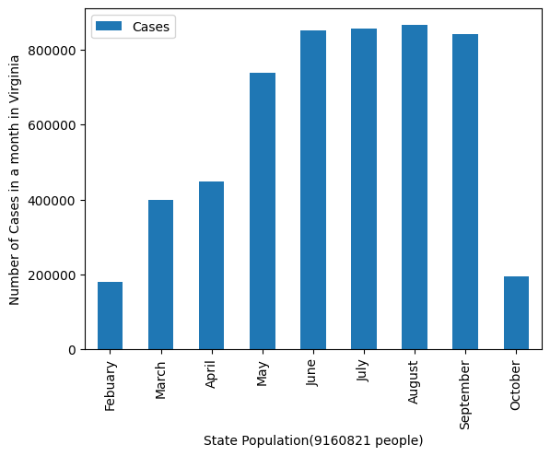
Results
Month wise cases

Slide 6
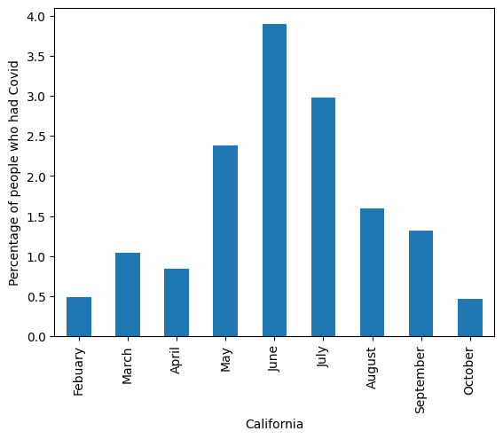
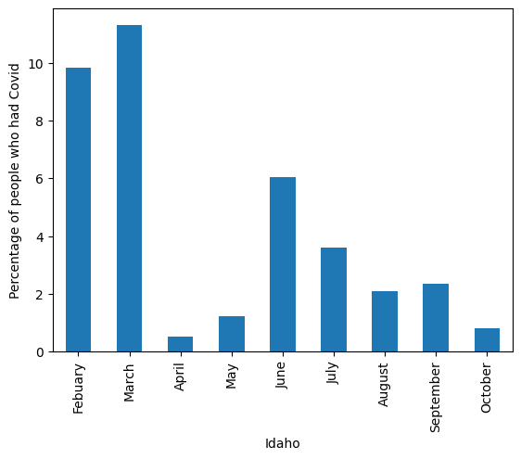
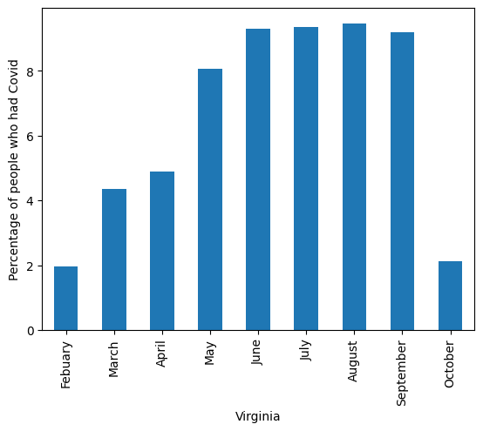
Results
Percentage of people who had covid

Slide 7
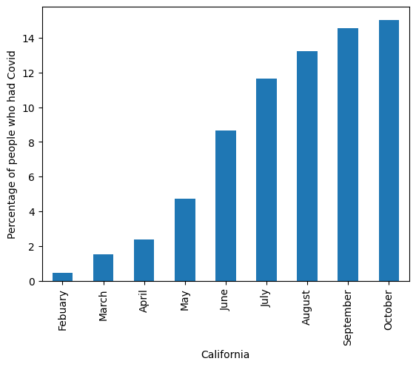
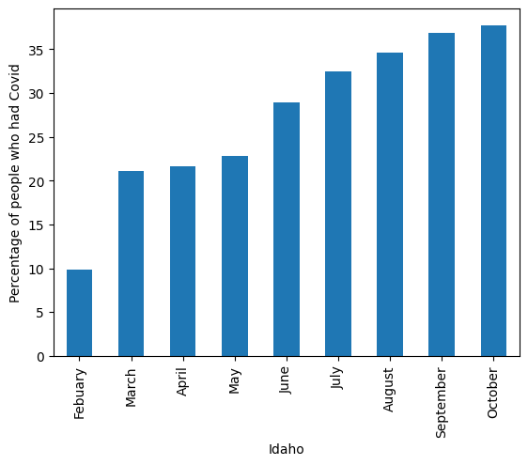
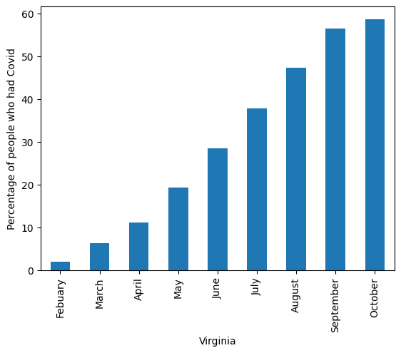
Results
Cumulative Percentage of people who had covid

Slide 8
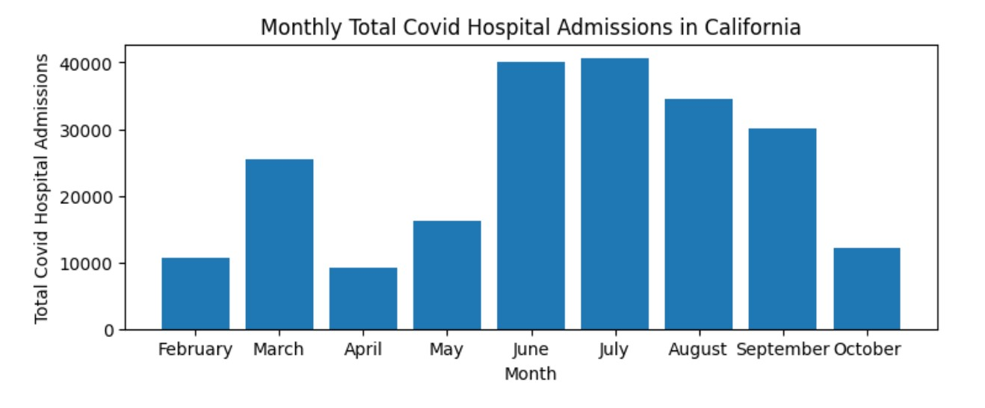
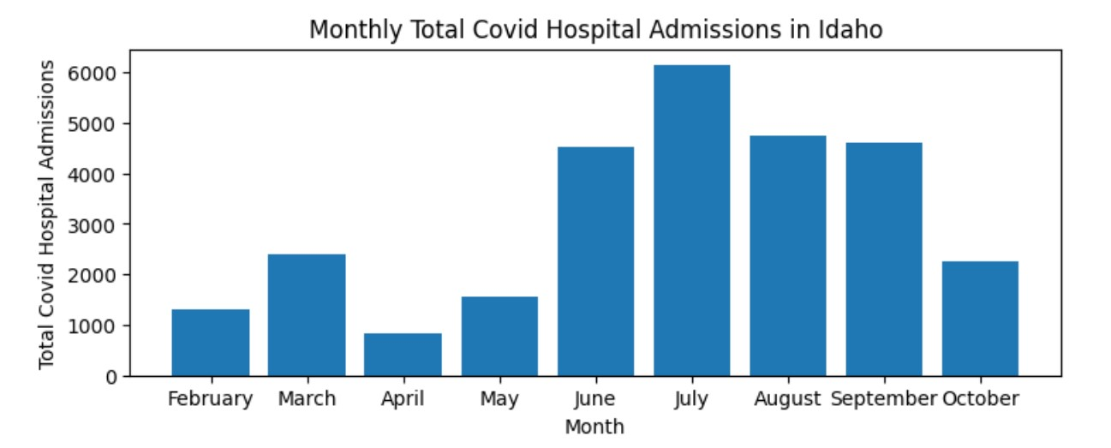
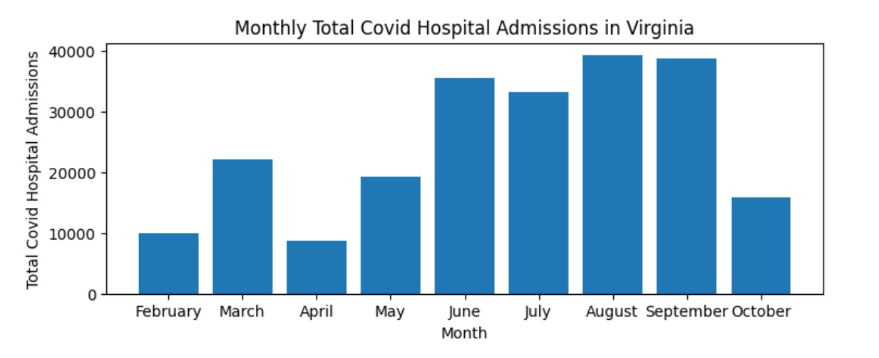
Results
Monthly total covid hospital admissions

Slide 9
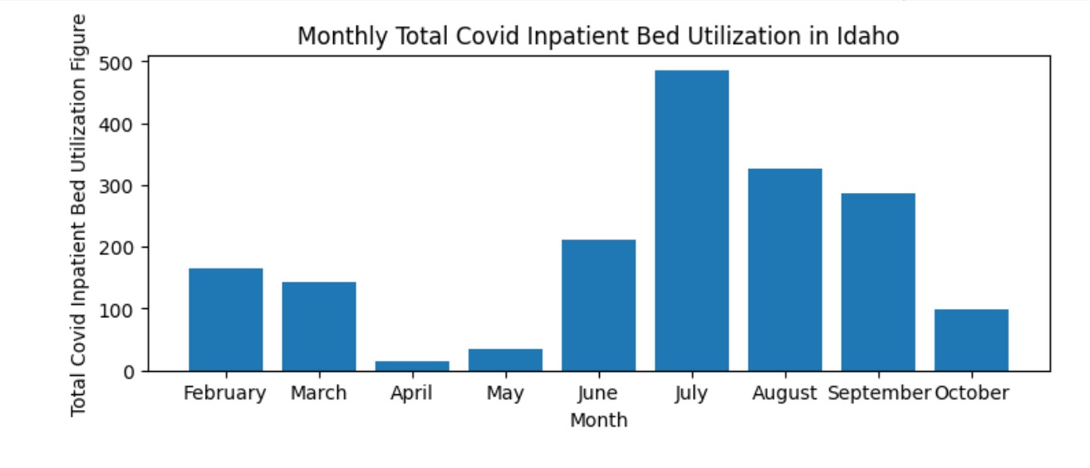
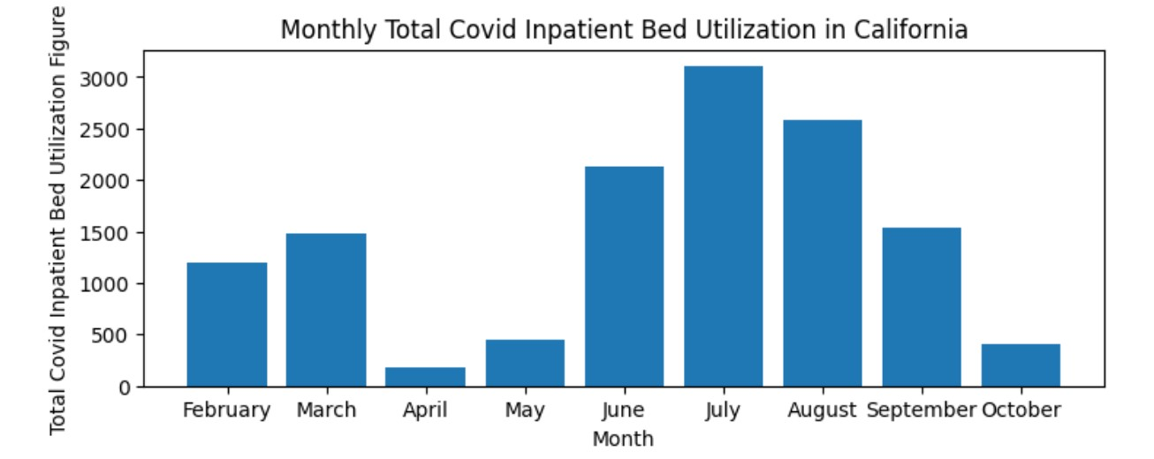
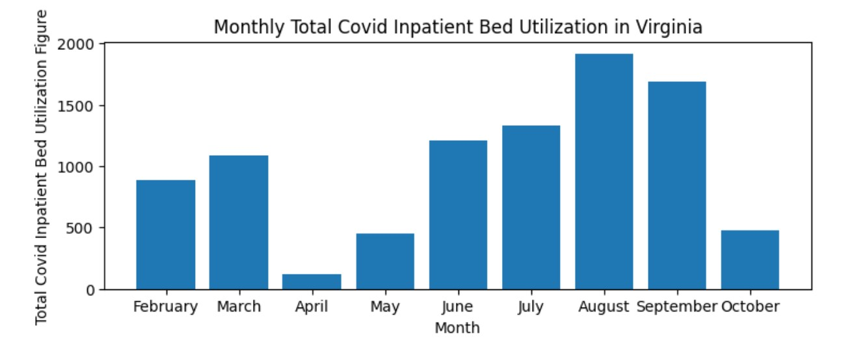
Results
Monthly total covid inpatient bed utilization

Slide 10
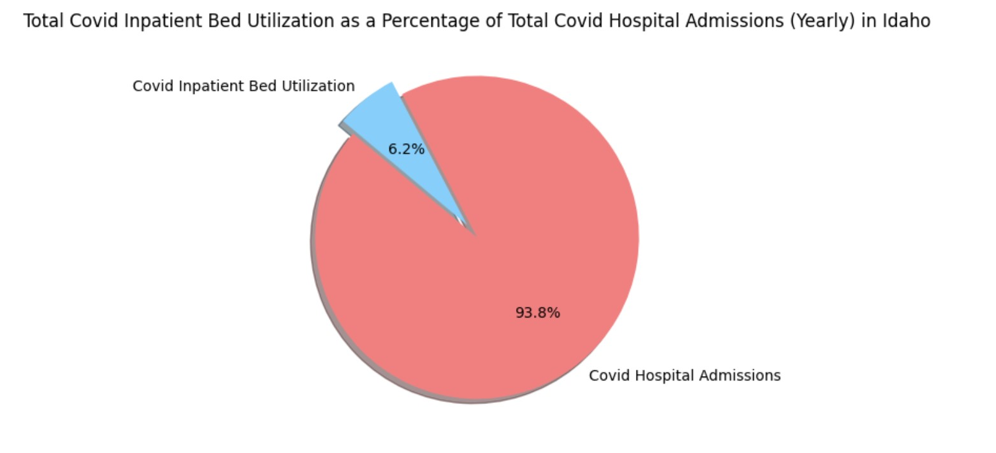
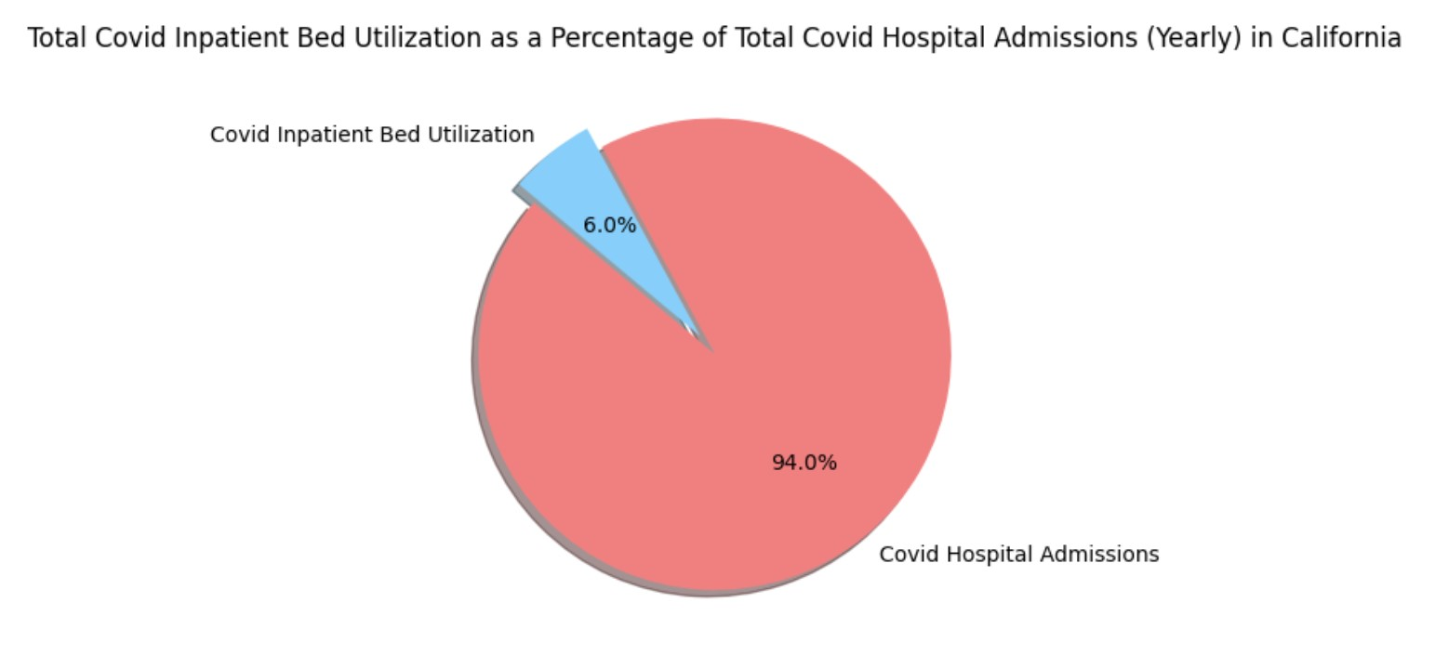
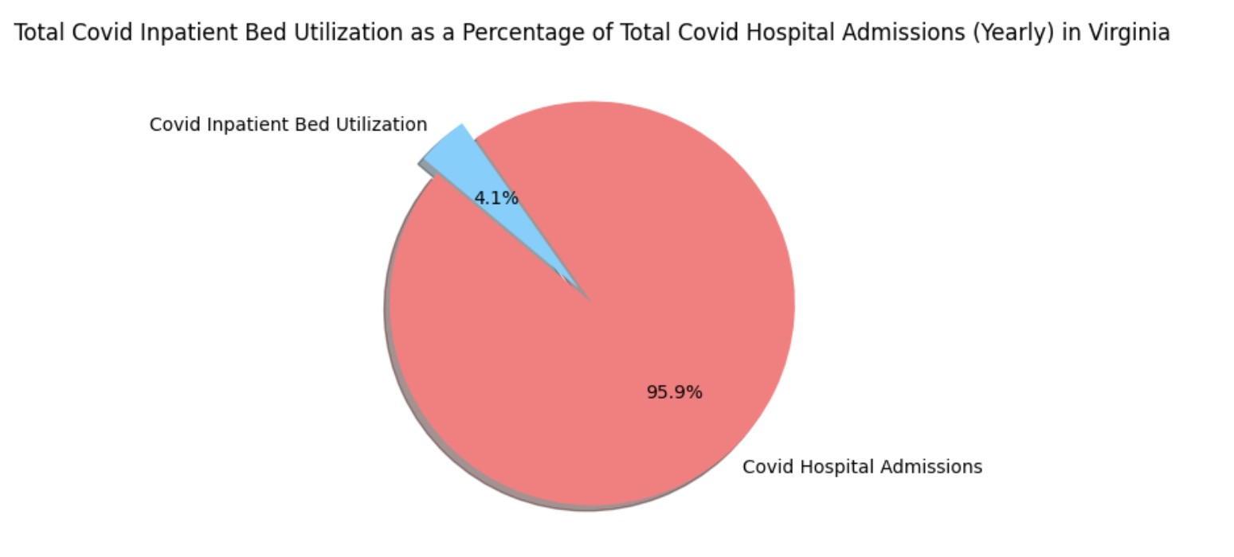
Results
Yearly bed utilization as a percentage of total covid hospital admissions

Slide 11
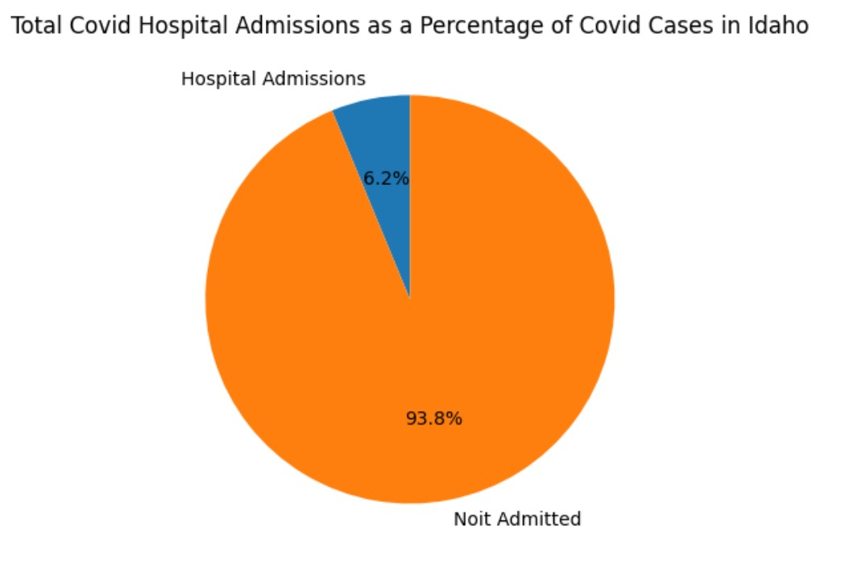
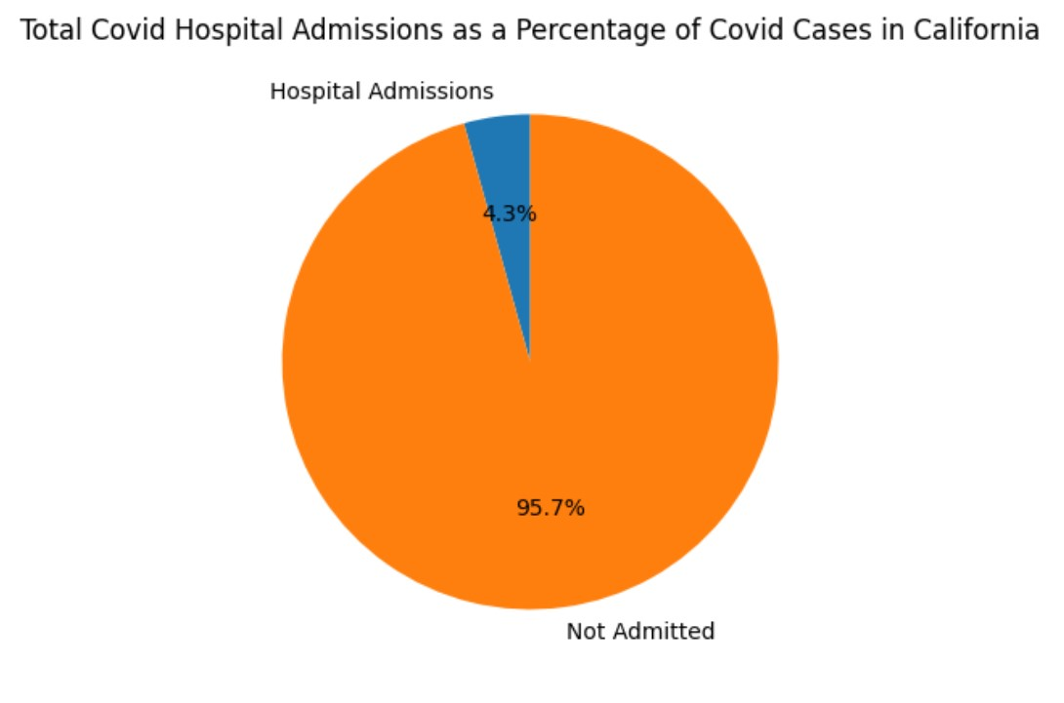
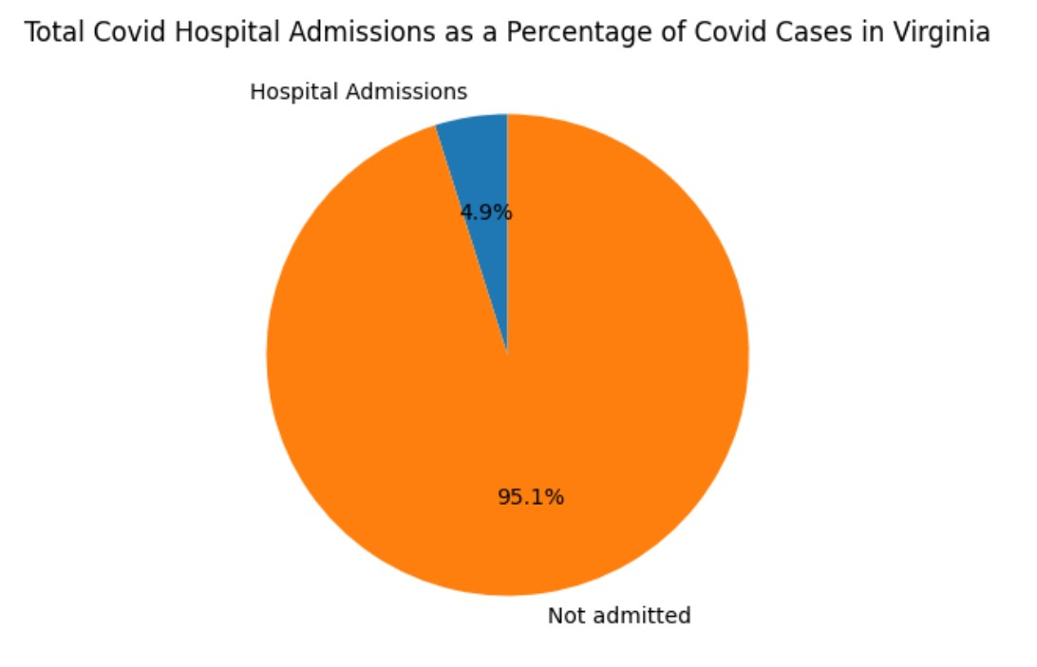
Results
Total covid hospital admissions as a percentage of covid cases

Slide 12
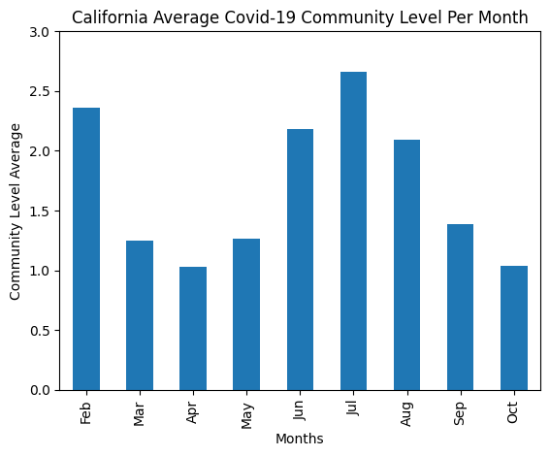
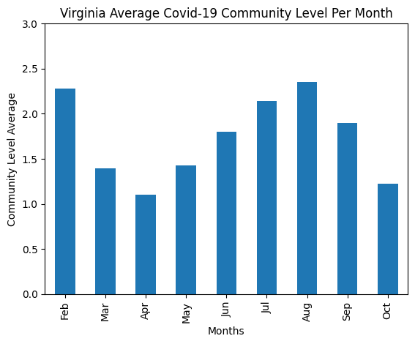
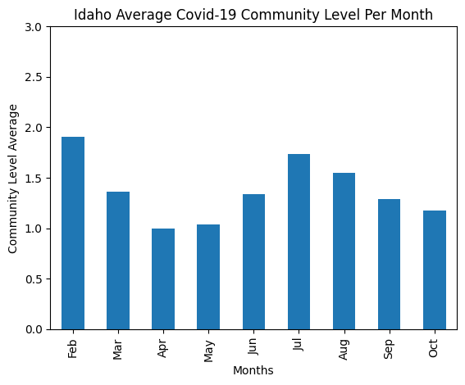
Results
Average covid-19 community level per month

Slide 13
Results
Idaho
California
Virginia

Slide 14
Analysis of the Results
What is the relationship between a state’s population and the number of covid cases?
Analysis: State population did seem to affect the total number of covid cases the state had.

Slide 15



Analysis of the Results
What is the relationship between a state’s population and the number of covid cases? (cont…)
Analysis: However, state population was not directly correlated with the percentage of covid cases.

Slide 16
Analysis of the Results
Of those cases, how many were admitted to the hospital?
Analysis: As the state population decreased, the admission rates increased

Slide 17
Analysis of the Results
What is the percentage of bedcare patients to admitted patients?
Analysis: There doesn’t seem to be any correlation between state population and bed utilization

Slide 18
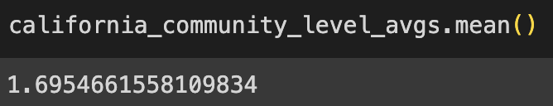
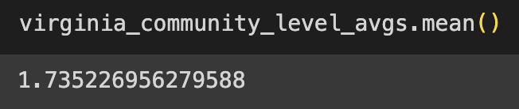
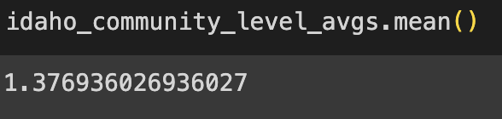
Analysis of the Results
Are the community levels a good representation of how covid affected the states?
Analysis: Based on the previous results, the community levels seem to aline.

Slide 19
Conclusions/Reflection
Correlations seemed to be between:
Cases
Admissions
Community Levels
Seemingly no correlation between:
Percentage of cases vs population
Bed utilization
Things we might have to reconsider
Virginia’s seemingly differing results
February as an outlier month
Other observations
Summer months seemed to show an increase in covid presence throughout all states

