Slide 1


Case Study 2-Talent Management -Attrition
Shiju Raju
MSDS 6306, Doing Data Science, Summer 2021
Due Date-Aug 7, 2021.

Slide 2
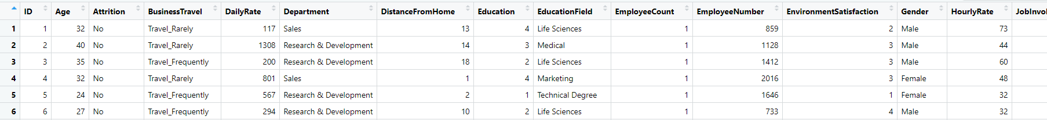
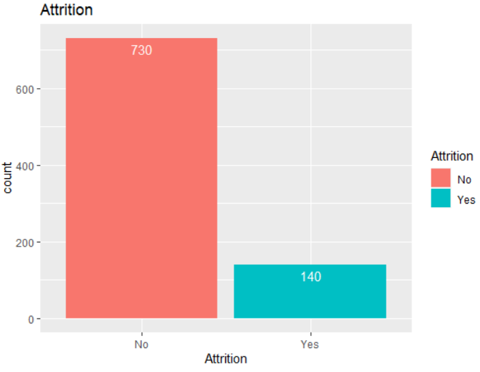
Case Study 2.data
36 Variables
870 observations
Variables Analyzed
Age
Job Satisfaction
Relationship Satisfaction
Monthly Income
Education Level
Commuting distance
Gender
Education Field
Marital Status
Work Life Balance
Years Since Last Promotion
Years in current Role
Overtime
84%
16%

Slide 3
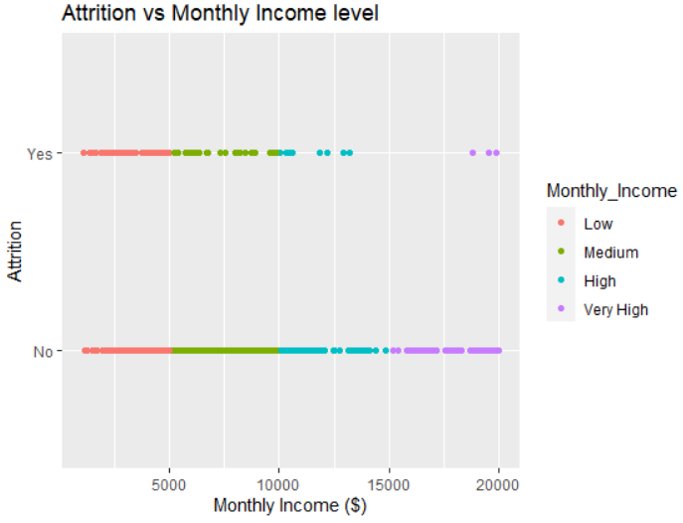
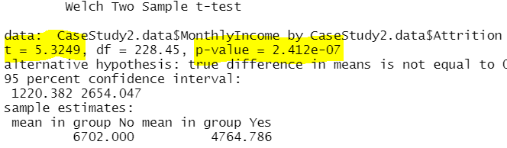

Gap among very high income earners

Slide 4
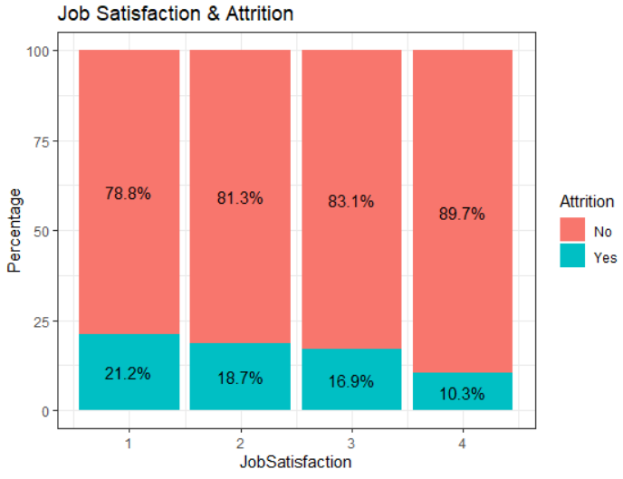
Conclusion
Job Satisfaction increase from 1 to 4 decreased attrition by half

Slide 5
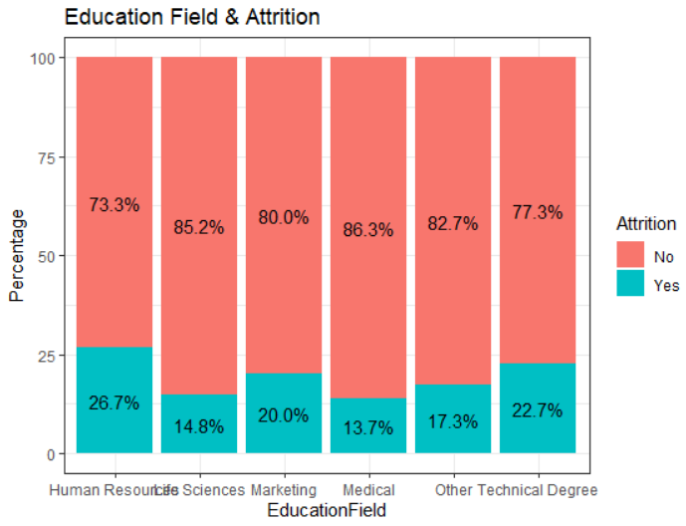
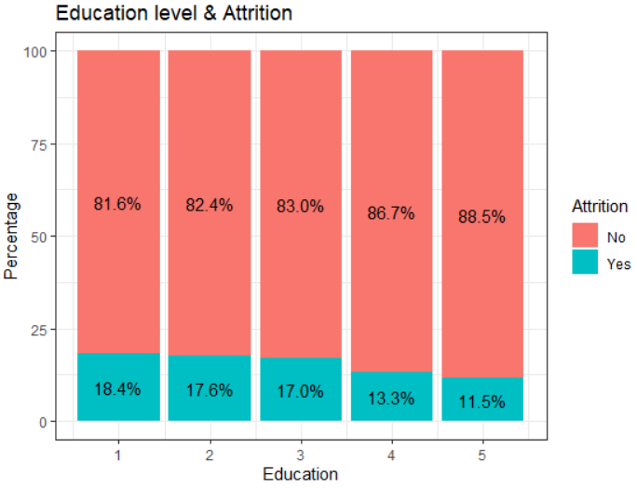
Conclusion
HR, Technical Degrees tend to have high level of attrition
Conclusion
Increase in Education level decreases Attrition

Slide 6
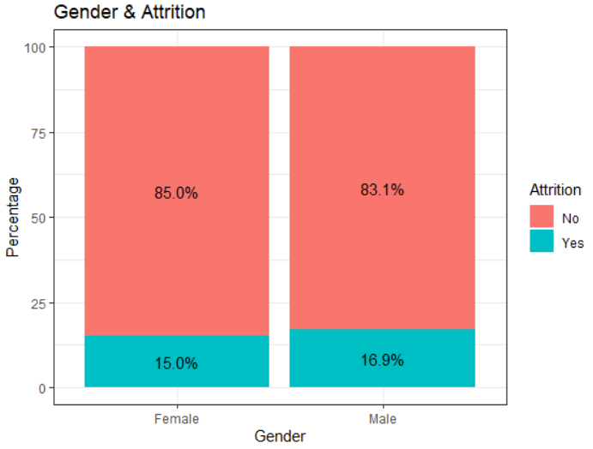
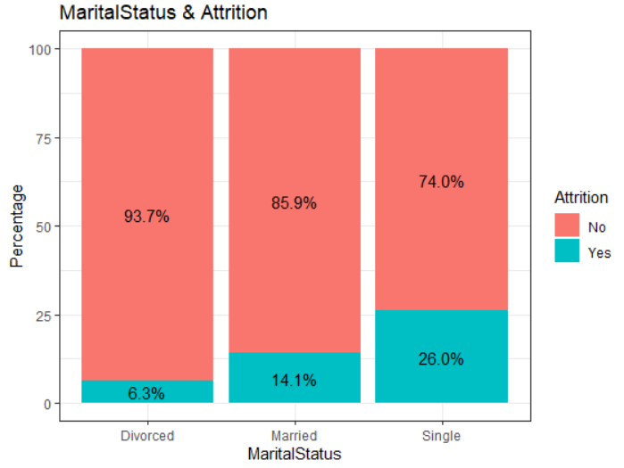
Conclusion
No significant difference in gender when it comes to attrition
Conclusion
Single people tend to quit more often than married or divorced.
Married people tend to quit more often than divorcees.

Slide 7
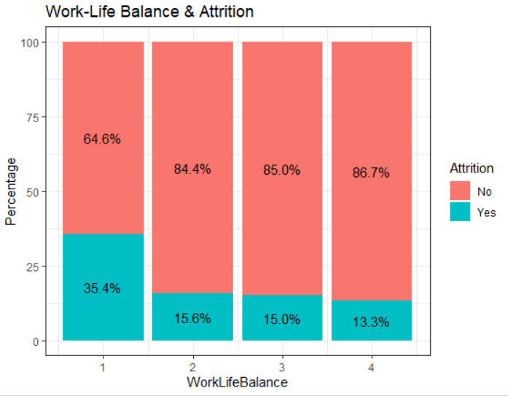
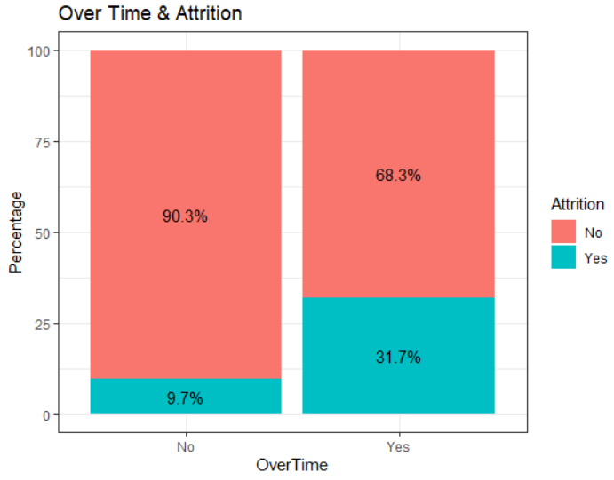
Conclusion
Low work-life balance increases attrition
Conclusion
High overtime requirement leads to high attrition

Slide 8
Top three Factors that causes turnovers
Low Work-Life Balance
High Overtime
Low Income

Slide 9
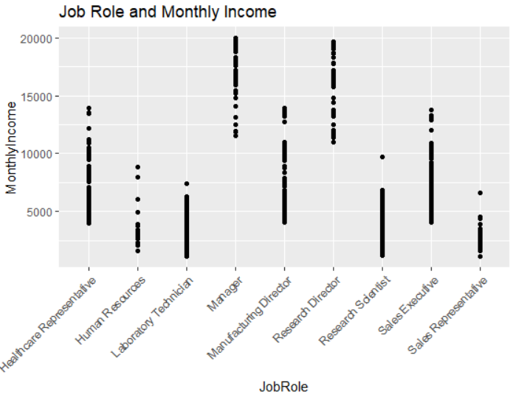
JOB SPECIFIC TRENDS
Conclusion
Higher Salaries are in Managerial or Director level positions.

Slide 10
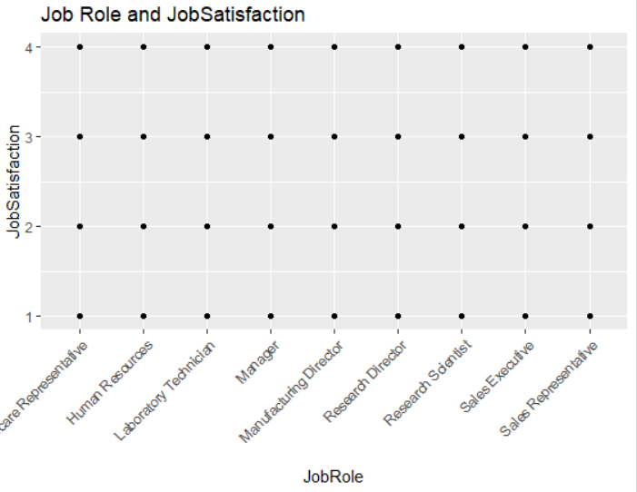
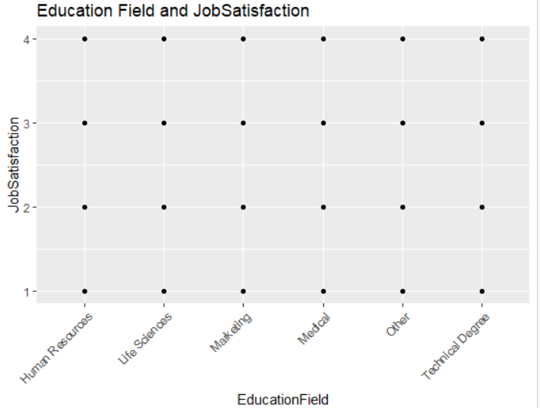
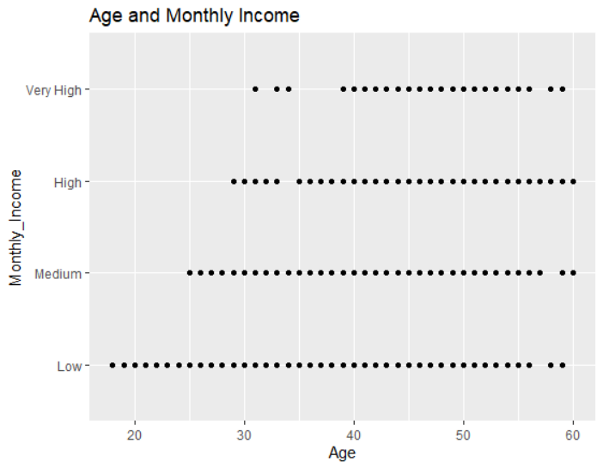
JOB SPECIFIC TRENDS
Conclusion-Inconclusive . Job Satisfaction varies from 1-4 for both JobRoles and Education Field.

Slide 11
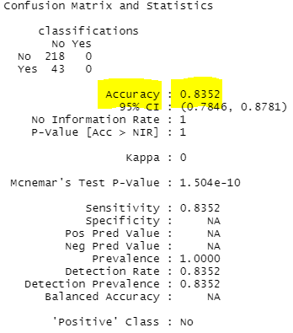
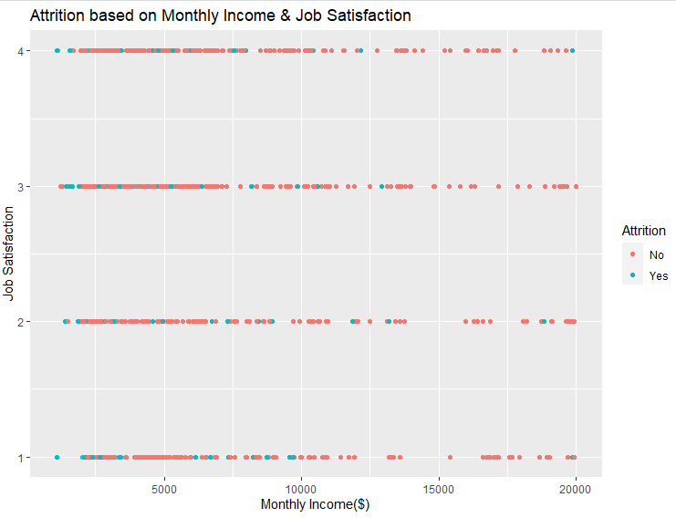
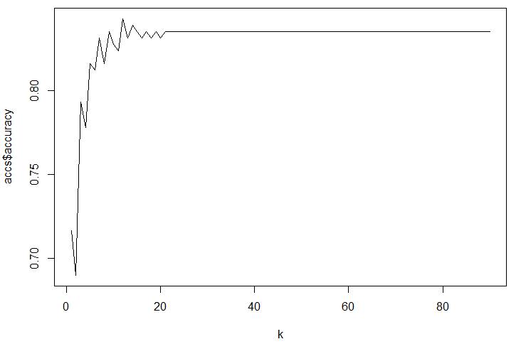
Prediction –Attrition-kNN

Slide 12
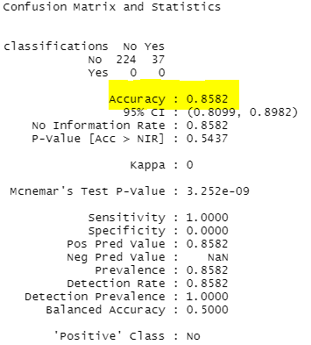
Prediction –Attrition-Naïve Bayes

Slide 13
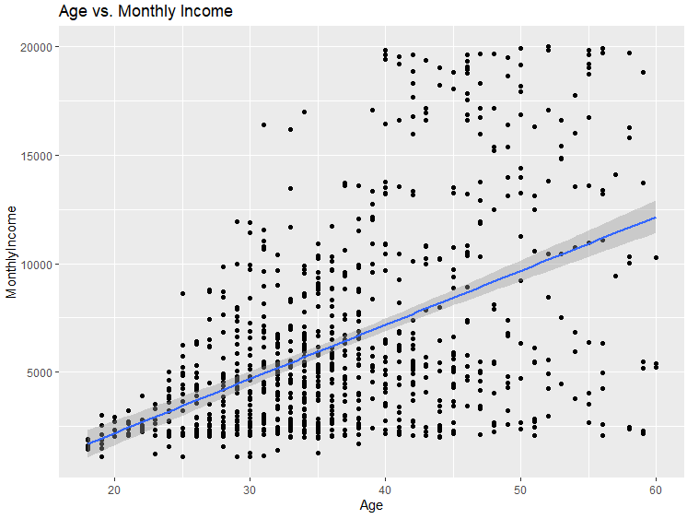
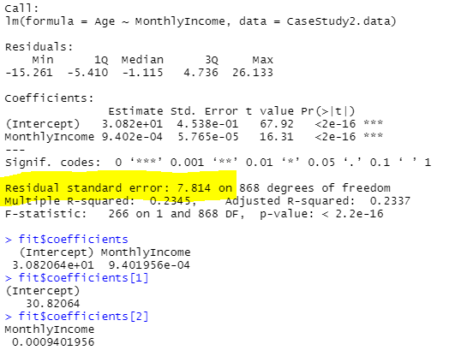
Prediction –Salary-Linear Regression

Slide 14
Case Study 2-Talent Management -Attrition
Shiju Raju
MSDS 6306, Doing Data Science, Summer 2021
Due Date-Aug 7, 2021.

