Slide 1
Estimation of human physiological time from single blood samples
JTK analysis (p<0.05) – 37 genes
Union of Time indicating genes in [1-3] (135 genes)
Sample-wise normalization
Sample-wise normalization
Pairwise gene ratio
log2(gene A) – log2 (gene B)
Z score transformation
(log2(geneA)-sample mean)/ SD
Bivariate regression model with elastic net regularization
ratio TimeMachine
Z-score TimeMachine
Predicted phase
Predicted phase
[1] J. J. Hughey (2017) [2] Laing et al (2017) [3] Braun et al (2018)

Slide 2
Arher – 7616 X 259 (log2 mormalized)
Moller- 7616 X 356
Braun – 7616 X 154
Combine all 3 data set and done the z-score normalization across the sample – 7616 X 767 (Log2 + z score normalized)
JTK analysis on combined data set, where DLMO values are used as time points (which is rounded to nearest integer (decimal less than 0.5 rounded down and decimal equell to or greater than 0.5 rounded up)
Number of cyclic genes in combined data set- 2254 (q<0.05),
Intersection of 134 time indicating genes in previous studies and cyclic genes – 23 genes
Find the gene combination which shows a phase difference between 6-18 – (85 gene pair combination)
Find the gene ratio (expression ratio) of gene pair combination which shows phase difference > 6-18
Done the net regression.

Slide 3
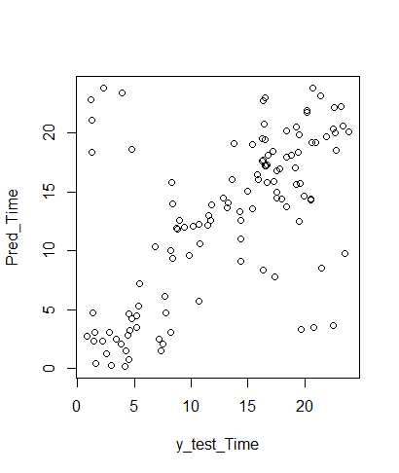
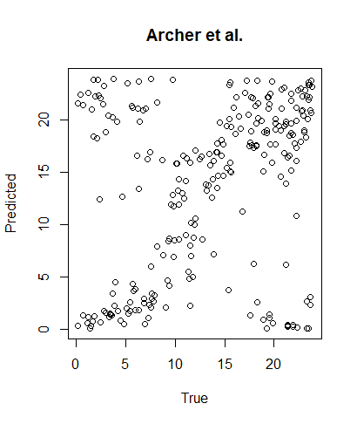
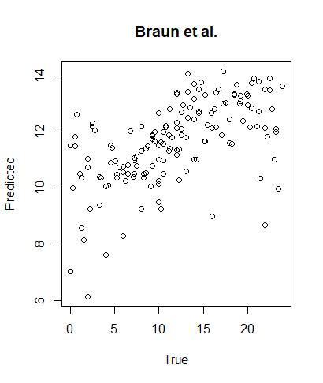
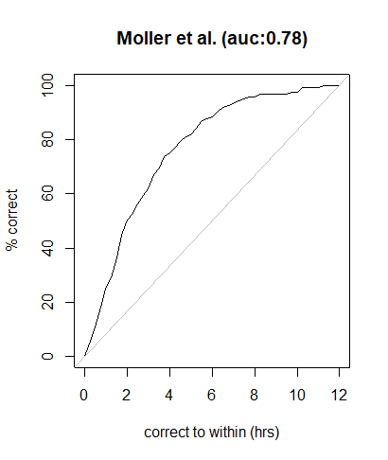
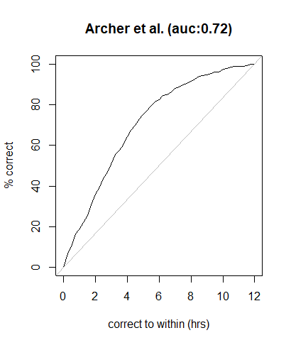
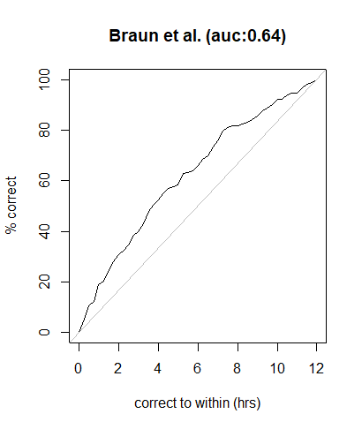
ML prediction of DLMO
Moller et al.

