Slide 1
SleepMat 2024 (Gamma)
09/16/2024
Shiju Sisobhan

Slide 2
SleepMat Updates
Include different interval lengths for sleep loss, rebound and cumulative sleep loss/rebound
Screening analysis (Rank plot) and Identify ‘hits’ based on p values calculated against control genotypes
3. Report the environmental conditions in the incubator for each run
4. Report Missing values (Data disruption) in SleepMat analysis

Slide 3
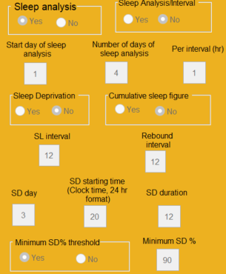
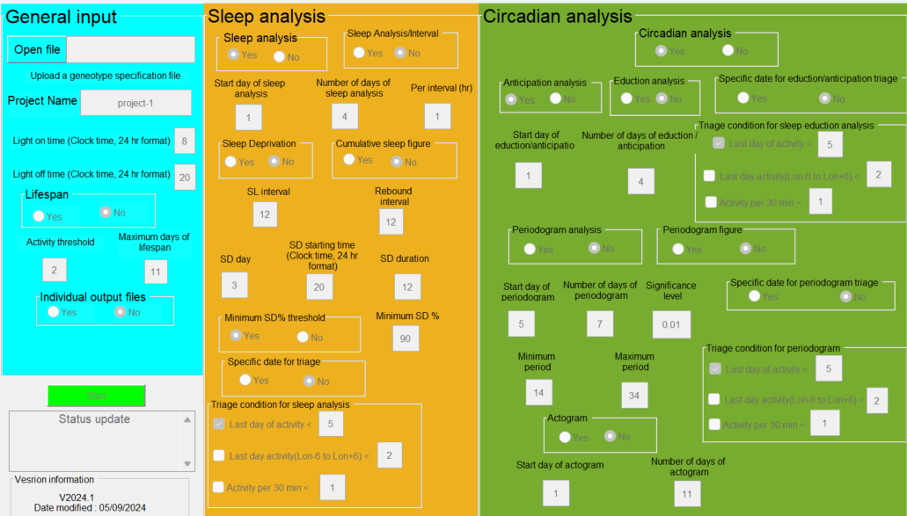
Sleepmat Update: GUI for Different interval lengths for sleep loss, rebound and cumulative sleep loss/gain

Slide 4
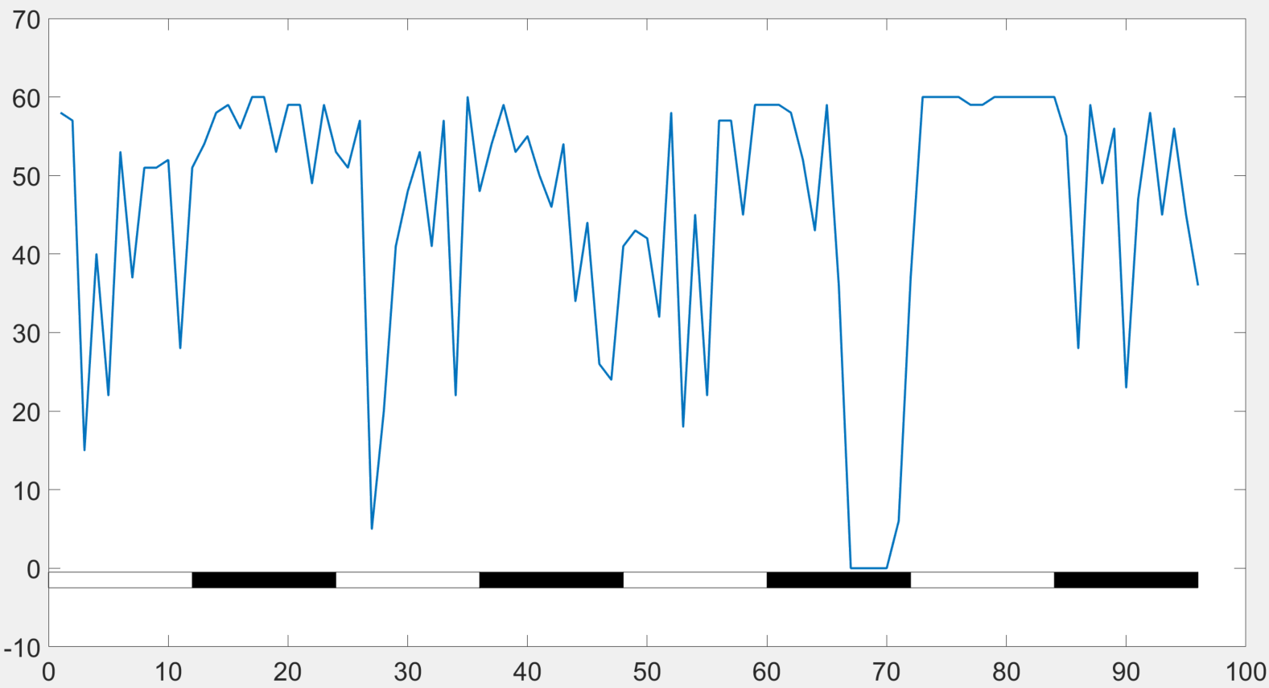
Validation of Sleep deprivation analysis with different interval lengths for deprivation and rebound
PDF01 female
Sleep loss Interval length= 12 hrs
Sleep loss = A – C
=190 min
Sleep loss (%) = (A – C)/A X 100
= 35.31%
Sleep gain interval length =6 hr
Sleep gain = D – B
= 120 min
Sleep gain (%) = (D - B)/B X 100
= 50.42 %
A
B
C
D
Sleep/hr
Sleepmat results
Genotype | Run number | Monitor number | Channel | Sleep lost (min) | Percentage sleep lost | Sleep gain (min) | Percentage sleep gain
PDF01 female | 2615 | 108 | 2 | 190 | 35.315 | 120 | 50.4201

Slide 5
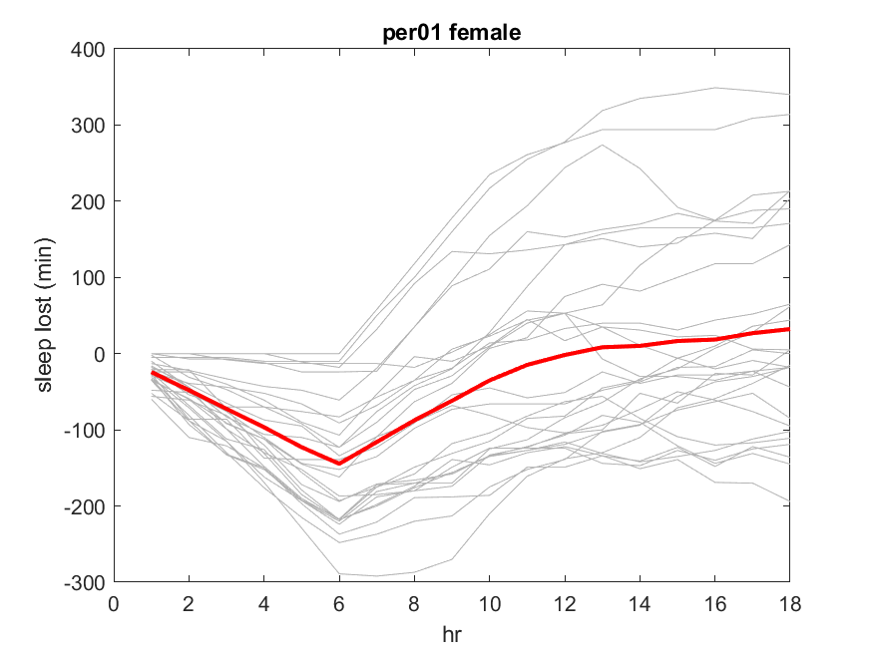
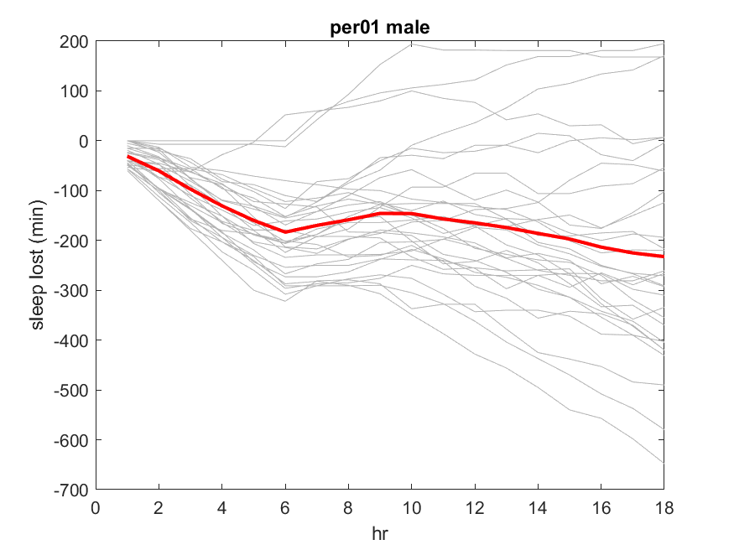
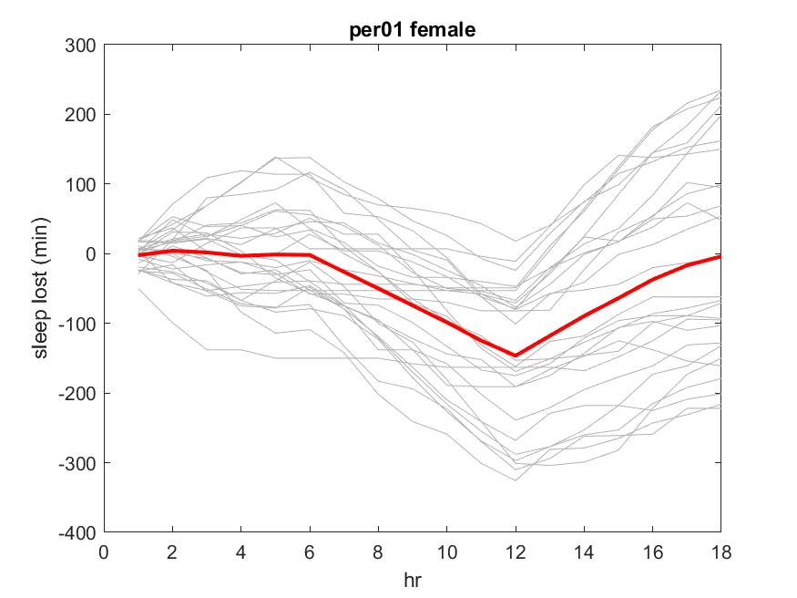
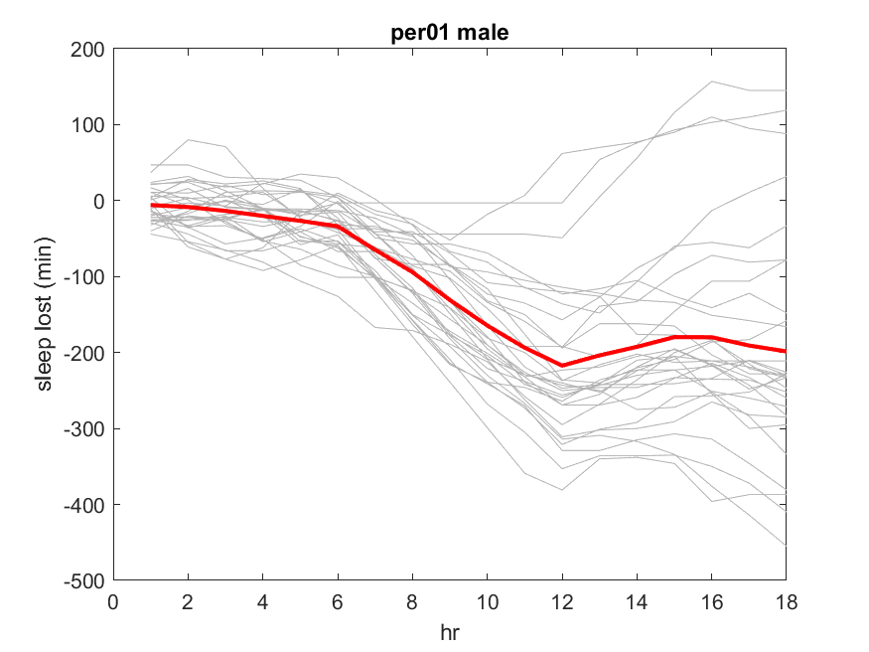
Cumulative sleep lost/gain (min) plot
Sleep deprivation duration – 6hr (2AM to 8 AM)
SL Interval =6, Rebound interval = 12
SL Interval =12, Rebound interval = 6

Slide 6
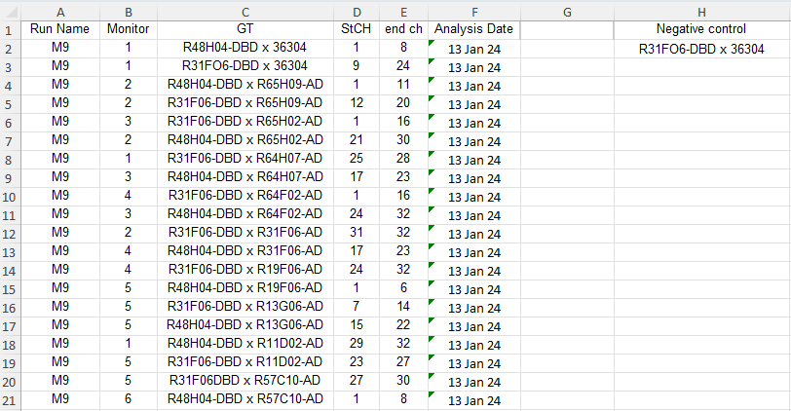
Sleepmat Update: Screening analysis (Rank plot) and Identify ‘hits’ based on
P-values calculated against control genotypes
Triage date
Genotype specification file
Control genotype

Slide 7
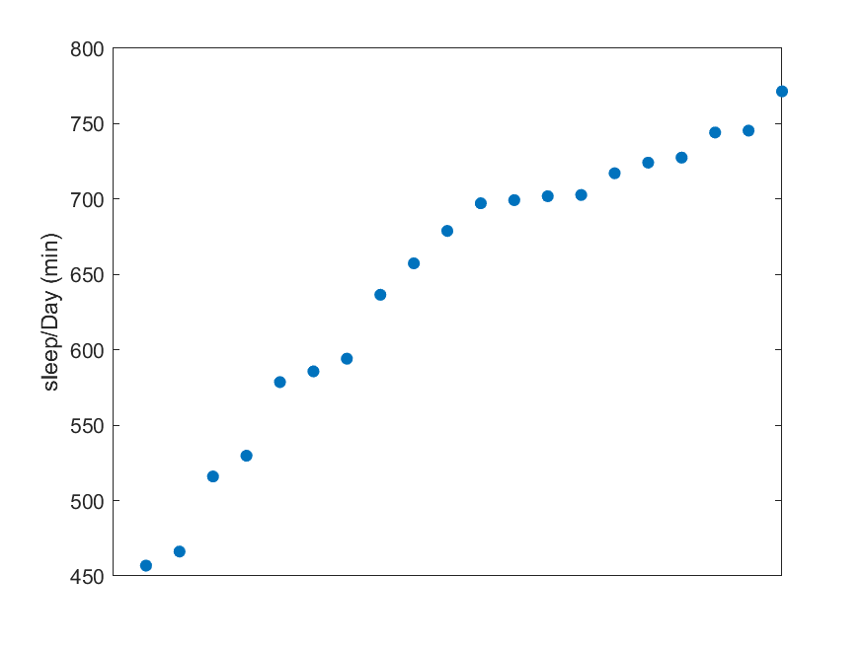
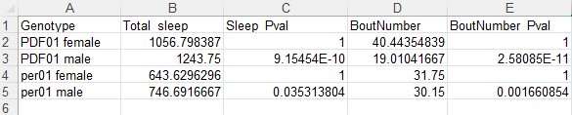
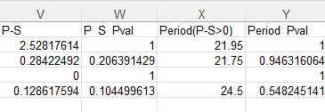
Screening Results for each run
Screening plot
Screening data

Slide 8
Sleepmat Update: Report the environmental conditions in the incubator for each run
Environment monitor collects, temperature, light, and humidity level data (For each run).
The environment monitors have specific numbers just like the behavior boards (eg:Monitor51.txt).
It has a 32-channel data format, with Channel 4 representing the average light and Channel 9 representing the average temperature.
The environmental condition report is a double plot, with time versus average light on one axis and time versus average temperature on the other.

Slide 9
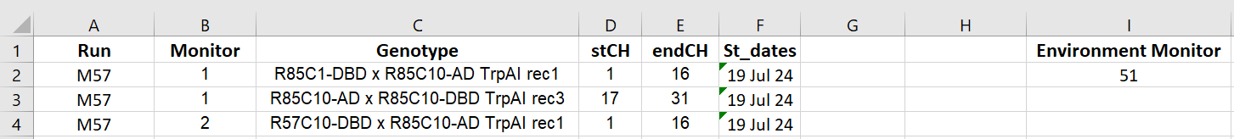
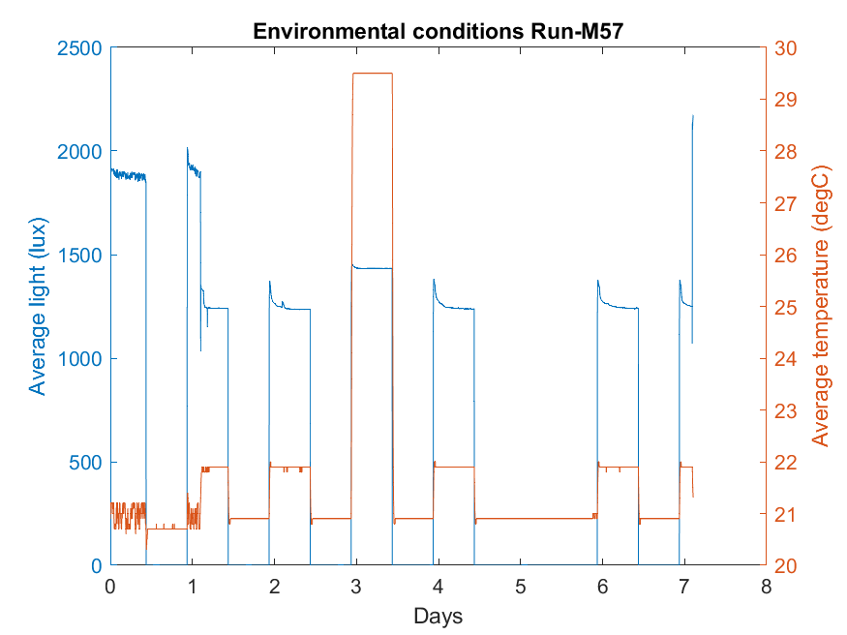
Environmental Conditions Reporting method
Input
Triage date
Output
Control genotype
SleepMat Assumptions:
Environmental monitor files are in the same folder as the behavior board files.
The behavioral board does not have the same board number as the environmental monitor file.

Slide 10
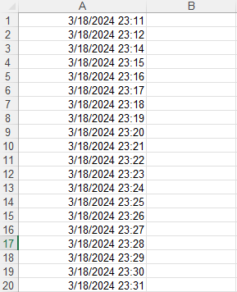
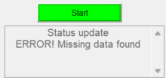

Report Missing values (Data disruption) in SleepMat analysis
Confirm that DAM data collection is continuous and that the analysis accounts for any disruptions in the data.
Error Message
Missing time spreadsheet

