Slide 1
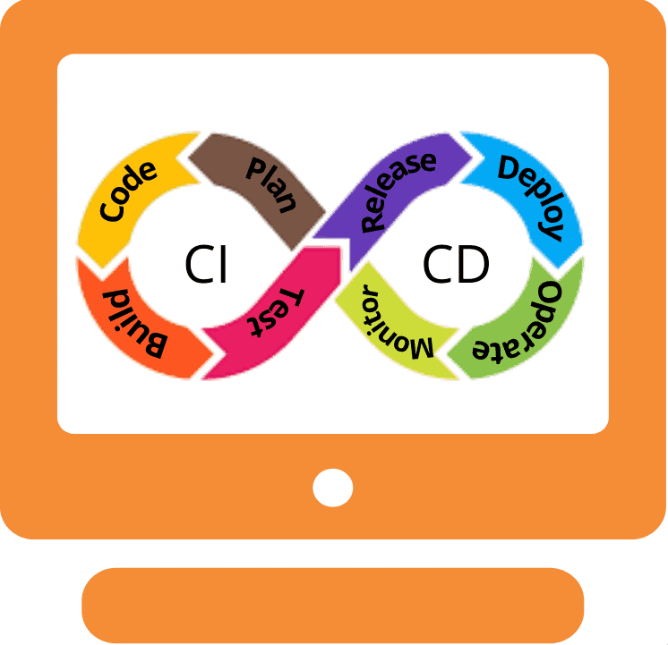
CI/CD innovation
and UdaPeople product
Presenter: Luan Nguyen

Slide 2
AGENDA
Introduction​ CI/CD
Where Does CI/CD Fit In?
​Benefits of CI/CD Best Practices for CI/CD ​​

Slide 3
Introduction
In software engineering, CI/CD or CICD is the combined practices of continuous integration (CI) and (more often) continuous delivery or (less often) continuous deployment (CD)

Slide 4
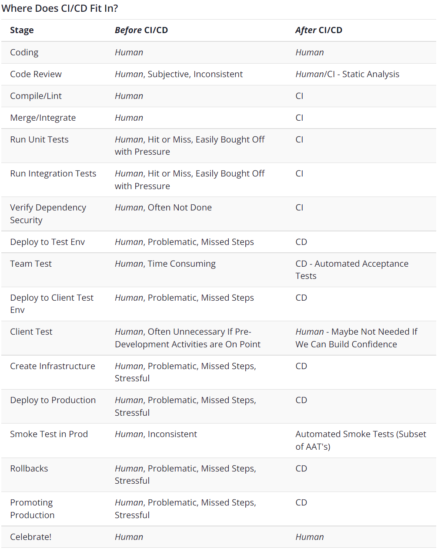
Where Does CI/CD Fit In?

Slide 5
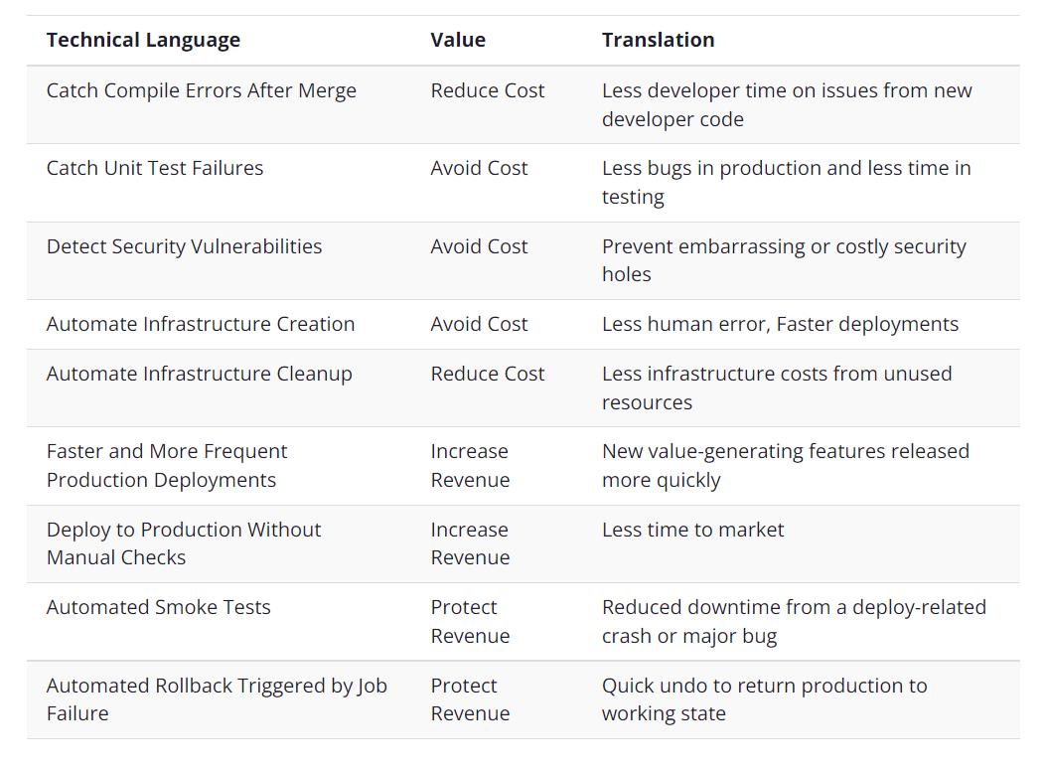
Benefits of CI/CD

Slide 6
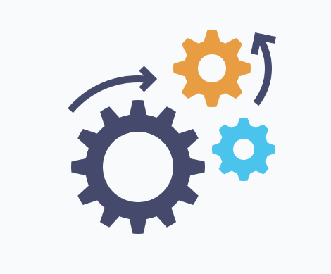


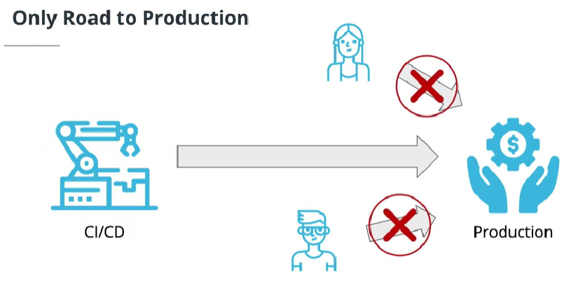

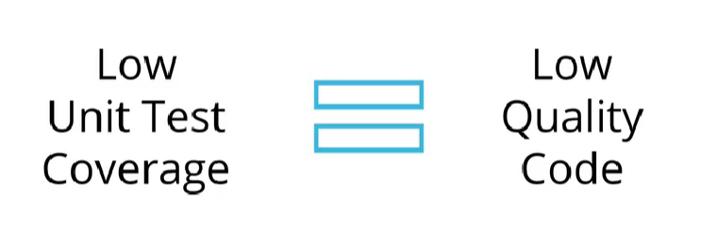
Best Practices for CI/CD
Fail Fast
Measure Quality
Only Road to ProductioN
Maximum Automation
Fast deployment
Finding and investigating failures as fast as possible. The faster you can bring your code failures to light, the faster you can fix them.
Measure your code quality so that you can see the positive effects of your improvement work
Any other person or process that meddles with production after CI/CD is running will inevitably cause CI/CD to become inconsistent and fail
find and reveal failures as fast as possible. The faster you can bring your code failures to light, the faster you can fix them.
So fast

Slide 7
SUMMARY
What are we waiting for? CI/CD allows organizations to ship software quickly and efficiently and save the money! UdaPeople product needs it!

Slide 8
THANK YOU

