Slide 1
MT5_Trader
Quant research + live trading pipeline
architecture & code overview
Python
polars
pyarrow
backtest engine
MetaTrader5
Streamlit

Slide 2
Tech stack
Language & build
Data & compute
Backtest & research
Live execution
• Python ≥3.11
• hatchling
• uv
• polars
• pyarrow
• numpy · scipy
• no-lookahead engine
• matplotlib
• JupyterLab · pytest
• MetaTrader5
• runner loop · watchdog
• Telegram alerts
Config & secrets
Dashboard
Data ingestion
Testing
• pyyaml (config/*.yaml)
• python-dotenv
• Streamlit
• Plotly · pandas
• Binance · Dukascopy
• economic calendar
• pytest — full suite
• 211 tests green
MT5_Trader
2 / 9

Slide 3
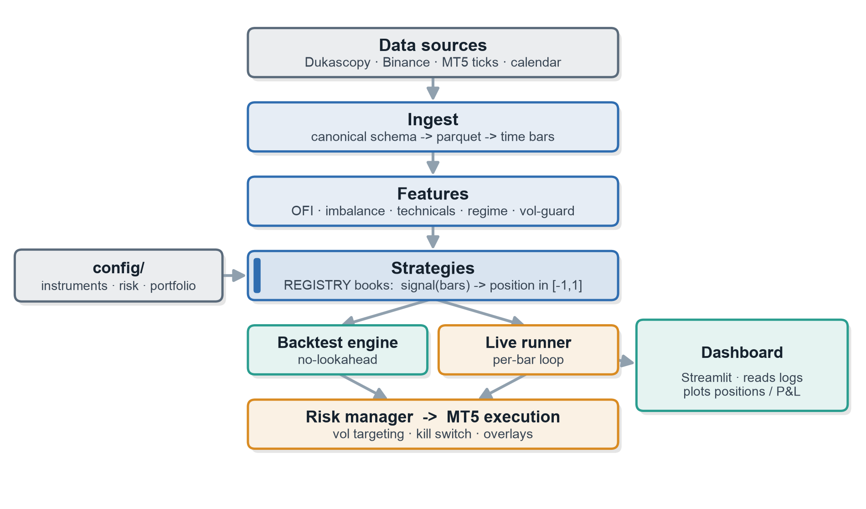
System architecture
data → features → strategies → backtest / live → risk → execution
MT5_Trader
3 / 9

Slide 4
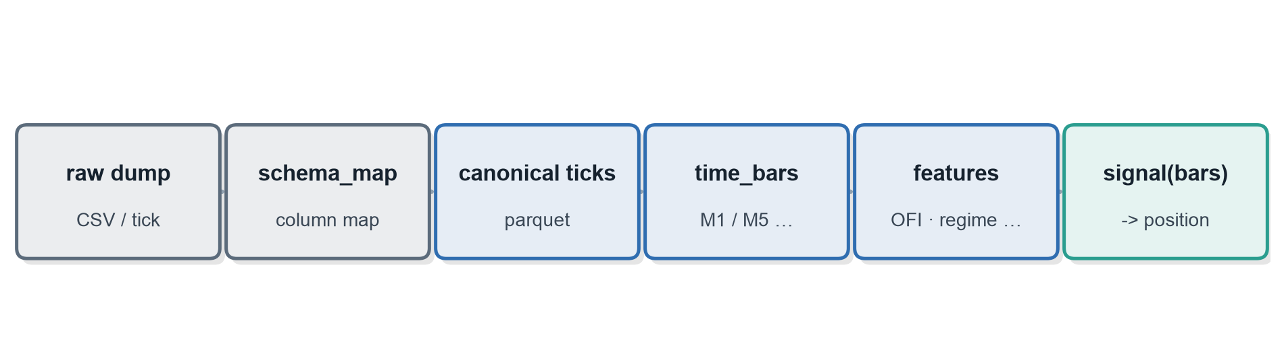
Data pipeline
raw market data → canonical bars → features → signal
MT5_Trader
4 / 9

Slide 5
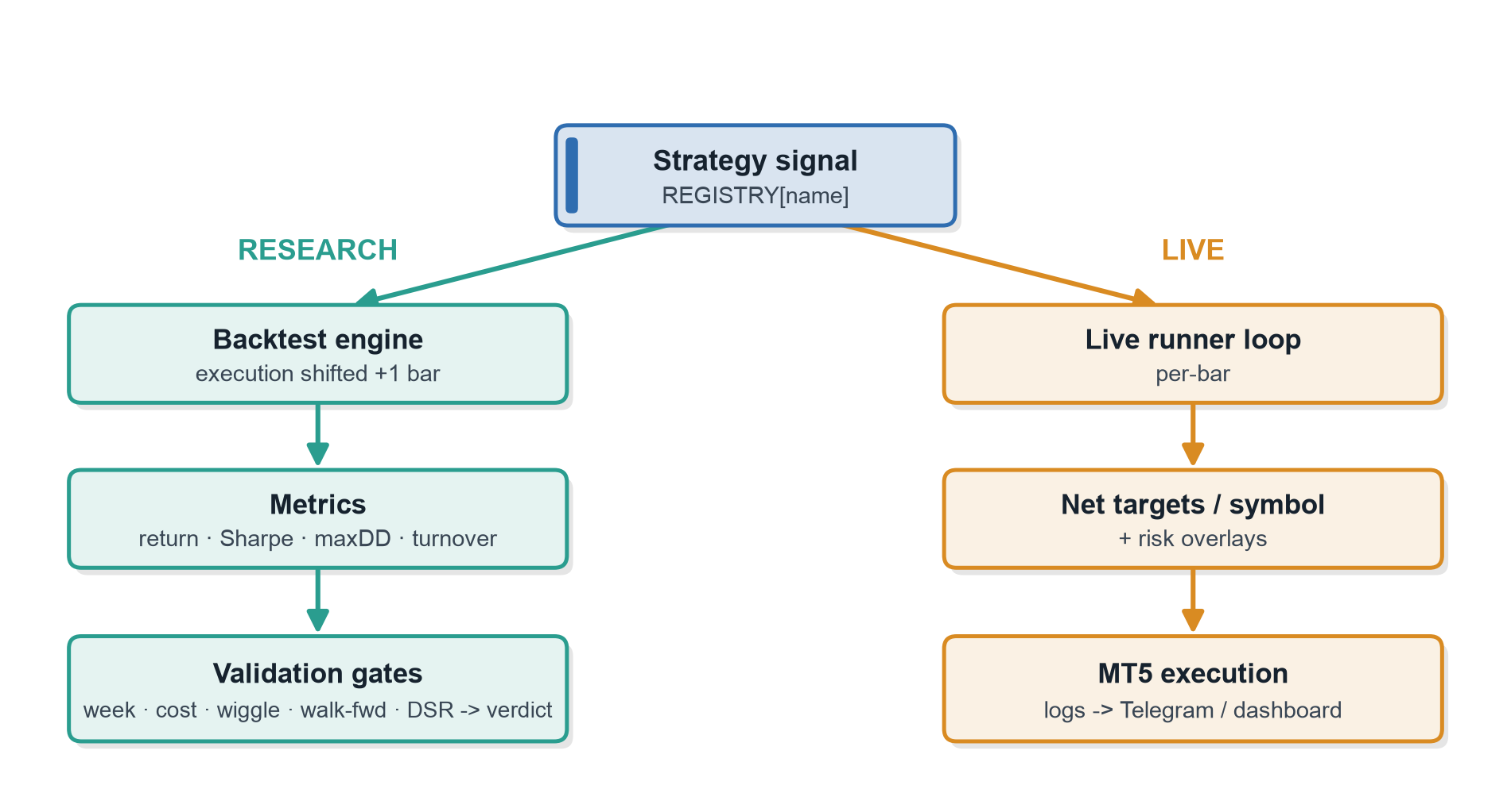
From signal to order
one strategy abstraction, two execution paths
MT5_Trader
5 / 9

Slide 6
Strategy abstraction
one tiny contract every strategy implements
signal(bars) → one target position in [-1, 1] per bar
One method. A strategy is a “book” — nothing but signal(bars). −1 = full short, +1 = full long.
Auto-discovered. @register adds a book; the engine, validator and live runner all find it by name.
No look-ahead. signal[t] sees only data up to bar t — the engine trades it one bar later.
Add in one file. Copy the template, write signal(). No engine changes, no plumbing.
Compose a portfolio. Weight the books in config; targets are netted per symbol before ordering.
MT5_Trader
6 / 9

Slide 7
AI-native by design
built with — and built for — AI coding agents
1
Built with AI agents — Developed end-to-end with AI coding agents; repo conventions (CLAUDE.md, typed contracts, tests) steer the agent.
2
Agent-friendly extension — One narrow contract — signal(bars) → position. Registry auto-discovery; copy a template to add an edge, no engine changes.
3
Machine-readable research loop — Structured trials / stash / verdicts + automated validation gates emit a PASS/FAIL verdict an agent can act on.
4
Guardrails for autonomous iteration — No-lookahead enforced by tests for every strategy; evidence gate before sizing; 211-test suite is the feedback signal.
research loop: propose → backtest → validation gates → verdict → promote / stash
MT5_Trader
7 / 9

Slide 8
Repository layout
src/mt5_trader/
data/ ingestion · canonical schema · bars
features/ microstructure (OFI, imbalance) · technicals · regime
backtest/ vectorized engine + metrics (no-lookahead)
strategies/ registry-based books (signal → position)
risk/ vol targeting + kill switch
live/ MT5 gateway + runner loop (Windows VPS)
pipeline/ validation gates · trials · stash
config/ instruments · risk · portfolio (YAML)
scripts/ ingest · run_backtest · run_live · research/eval
dashboard/ Streamlit monitoring app
tests/ pytest suite
MT5_Trader
8 / 9

Slide 9
How it runs & how it's tested
research locally · deploy live on a VPS
Research
uv sync --extra dev · uv run pytest
Backtest
uv run scripts/run_backtest.py --strategy vwap_trend --symbol XAUUSD
Go live
python scripts/run_portfolio.py (MT5 + creds via env, on Windows)
Every edge is gated. Five checks before it trades — consistent weekly, survives 4× costs, parameter-robust, out-of-sample, multiple-testing adjusted.
Risk sits on top. Vol-targeted sizing and a daily kill switch on the net position; optional spike and event mutes.
Always watched. Runner logs feed a Streamlit dashboard and a Telegram daily report.
MT5_Trader
9 / 9

