Slide 1
Methods

Slide 2
An Alternate solution for smartphone-based urinalysis
Here normal dip strips are used.
Cropping is done following 4 algorithms.
RGB values are calculated for refrence and experimental images through ANN mapping model.
Finally similarity algorithms are applied to match the obtained images with stored data.
No external hardware is used

Slide 3
A smartphone algorithm with inter-phone repeatability for the analysis of colorimetric tests
No extra hardware only mobile camera.
Uses CMOS sensor to measure electromagnetic radiation from the colored test zones.
The app locates the reference colors (100 pixels) and transforms and averages the CMOS data in non-linear RGB.
Converts RGB to 2D and uses distance between the refrence and sample to determine the results.

Slide 4
Cell Phone based Colorimetric Analysis for Point-of-Care Settings
Through the analysis of over 10,000 images, it has been shown saturation method outperforms existing methods over wide range of conditions.
Transforms RGB to HSV and computing MPI

Slide 5
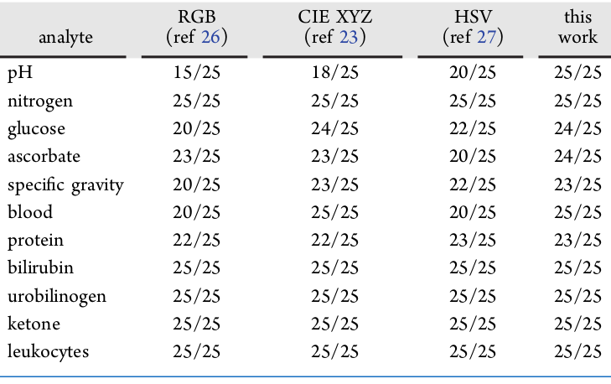
Color Space Transformation-Based Smartphone Algorithm for Colorimetric Urinalysis

Slide 6
Continued.....
Original RGB color space was converted to CIELab color space which was best for human vision. First, RGB to XYZ, which was transformed to CIELab.
Extra hardware is needed to get clear data.

Slide 7
A smartphone-based calibration free portable urinalysis device
Design to dip strip is changed for compactness and better image processing in the utilized algorithm.
Method is to convert image recieved to RGB color space and then comparing with refrence average of previous and next spot.
Extra hardware is used for ambient light conditions.

Slide 8
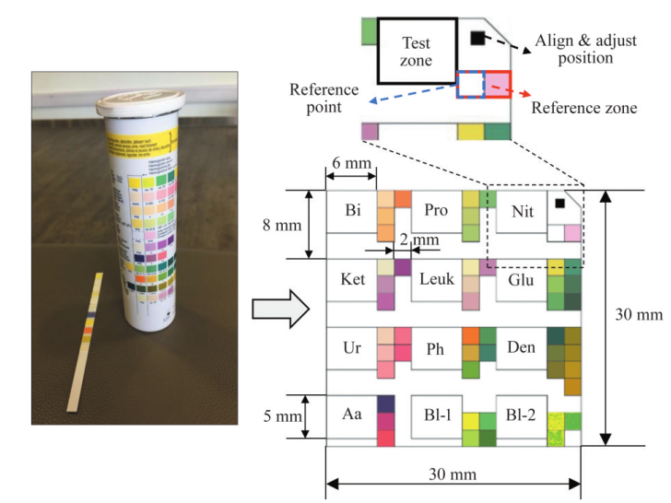
Continued....

Slide 9
Quantifying colorimetric tests using a smartphone app based on machine learning classifiers.
The RGB values were also converted to HSV and LAB color spaces, The computed mean RGB,HSV and LAB values of the patches were used.
The peroxide content were measured based on different illumination.

Slide 10
Smartphone-based colorimetric detection system for portable health tracking
On Image dialation and expansion are utilized to minimize noise before HSV conversion.
HSV conversion along with transportion is applied
In-Range, Closing and erosion are applied to get a mast of all space other than coloured section.
Then mask is attched to initial image
Correcting all noise and finally detection part.

