Slide 1
Analysis For Papers From 2007 To 2019
Towards the Selection of the Best Machine Learning Techniques and Methods for Urinalysis

Slide 2
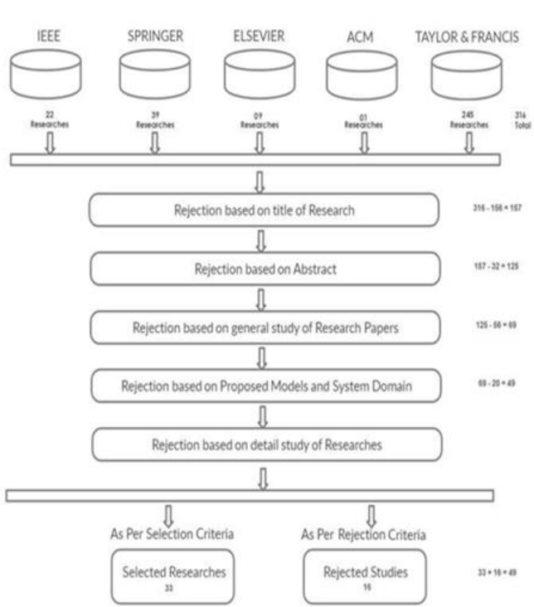
Paper sorting.

Slide 3
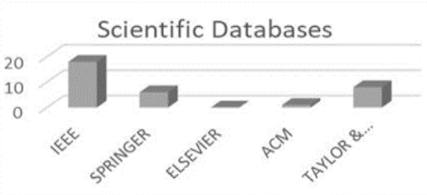
No of paper selected from each sites

Slide 4
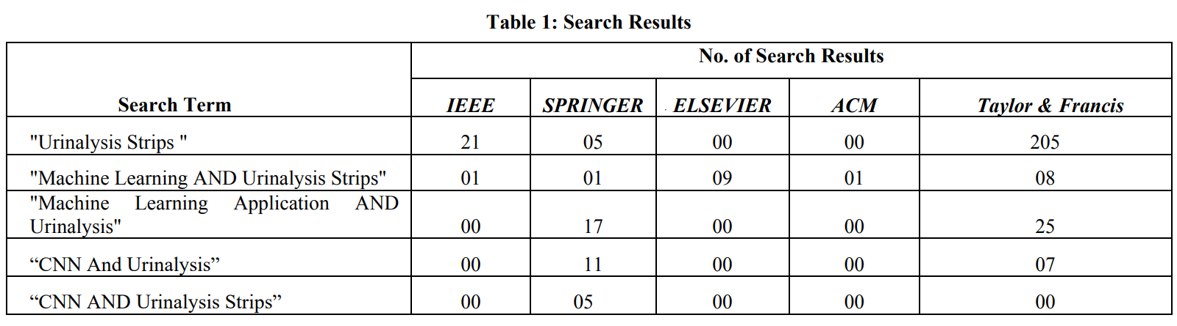

Slide 5
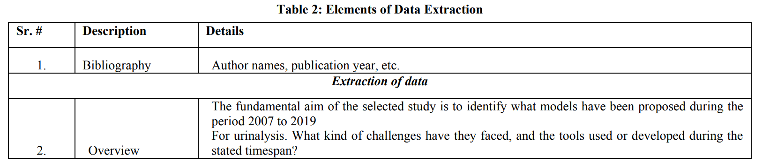

Slide 6
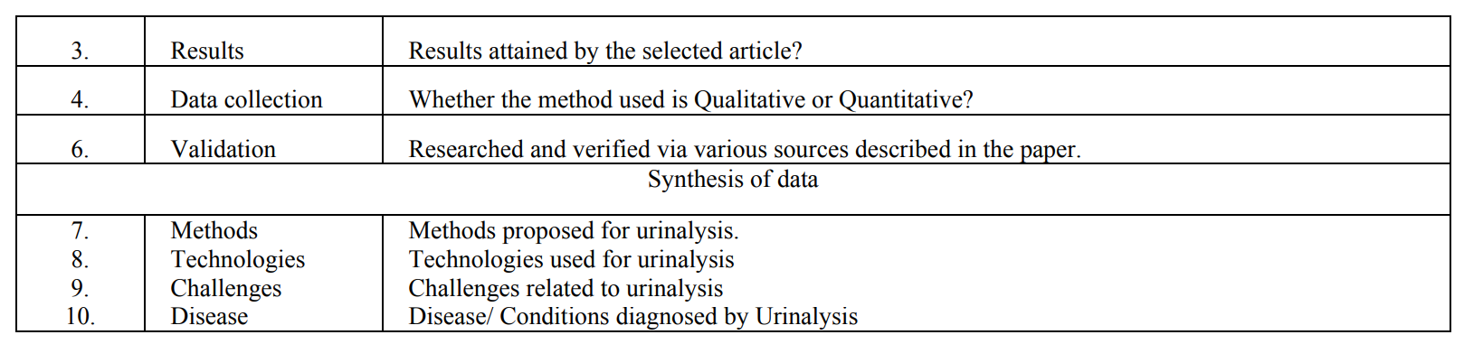

Slide 7
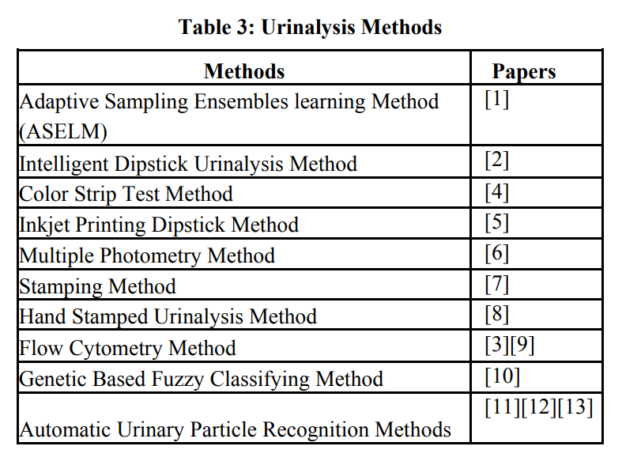

Slide 8
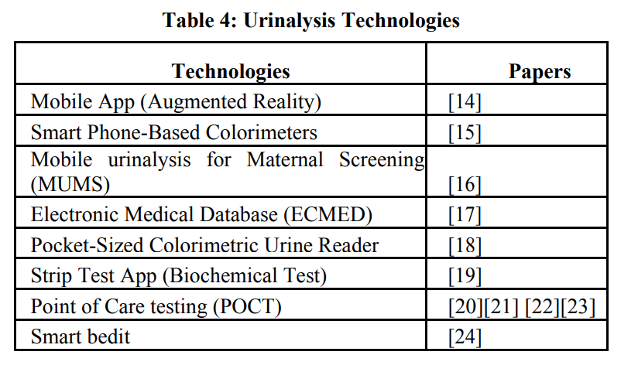

Slide 9
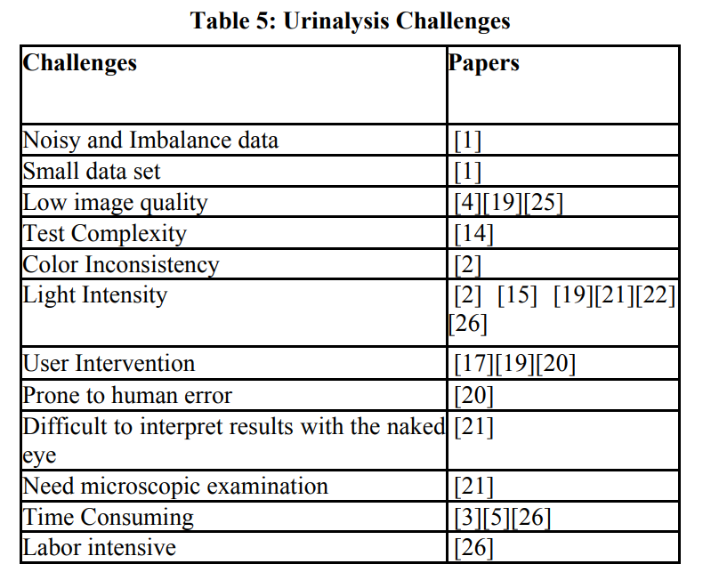

Slide 10
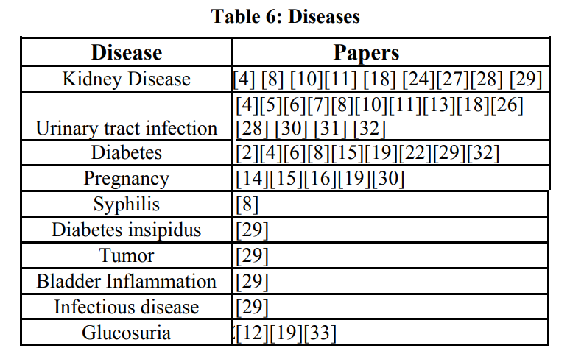

Slide 11
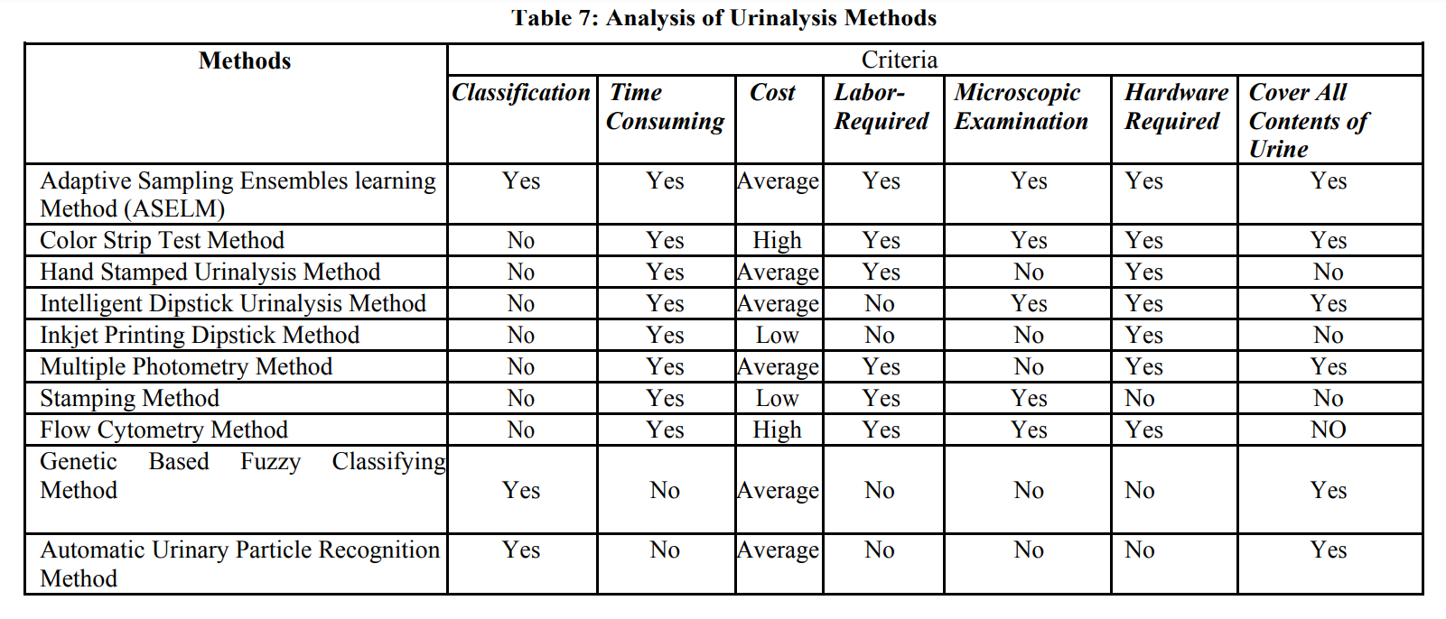

Slide 12
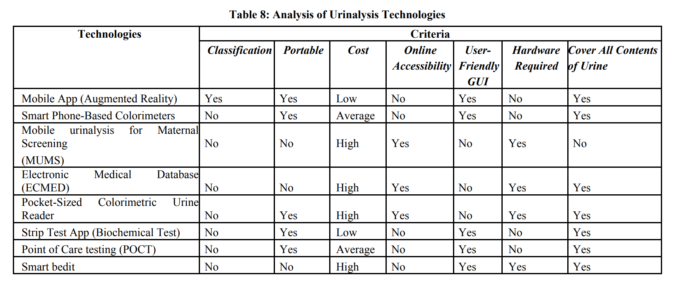

Slide 13
[1] P. Wu, M. Zhu, P. Pu and T. Jiang, "An Adaptive Sampling Ensemble Learning Method for Urinalysis Model", 2010 2nd International Conference on Information Engineering andComputer Science, 2010.
Available:10.1109/iciecs.2010.5678258 [Accessed 21 July 2019].
[2] R. Ginardi, A. Saikhu, R. Sarno, D. Sunaryono, A. Kholimiand R. Shanty, "Intelligent Method for Dipstick Urinalysis Using Smartphone Camera", Information and Communication Technology, pp. 66-77, 2014.
Available:10.1007/978-3-642-55032-4_7 [Accessed 23 July 2019].
[3] F. de Boer et al., "Accurate and fast urinalysis in febrile patients by flow cytometry", Infectious Diseases, vol. 49, no.5, pp. 380-387, 2017.
Available:10.1080/23744235.2016.1274048 [Accessed 26 July 2019].

Slide 14
[4] C. Ongkum, K. Keawmitr and E. Boonchieng, "Analysis system for urine strip test using image processing technique", 2016 9th Biomedical Engineering International Conference (BMEiCON), 2016. Available:10.1109/bmeicon.2016.7859610 .
[5] N. Arnett, A. Vergani, A. Winkler, S. Ritter and K. Mehta,"Inexpensive urinalysis test strips to screen for diabetes in developing countries", 2016 IEEE Global Humanitarian Technology Conference (GHTC), 2016. Available:10.1109/ghtc.2016.7857339 [Accessed 22 July 2019].
[6] N. Frazzette, J. Dobson, A. Mukhtar and B. Burt, "Can we manufacture diagnostic test strips using an Inkjet printer?", 2015 IEEE Global Humanitarian Technology Conference (GHTC), 2015. Available:10.1109/ghtc.2015.7344008.
[7] J. Ro et al., "Development of a Plural Colorimeter Module for Urinalysis Strip Readers", 2007 International Conference on Convergence In2019].
[8] G. Gundermann, S. Sen, S. Ritter and K. Mehta, "Stamping: A low-cost manufacturing method to deposit assays", 2016 IEEE Global Humanitarian Technology Conference (GHTC), 2016. Available: 10.1109/ghtc.2016.7857341.
[9] M. Velikova, P. Lucas, R. Smeets and J. Terwisscha van Scheltinga, "Fully-automated interpretation of biochemical tests for decision support by smartphones", 2012 25th IEEE International Symposium on Computer-Based Medical Systems (CBMS), 2012. Available: 10.1109/cbms.2012.6266352 [Accessed 25 July 2019].
[10] P. Wu, E. Goodman, T. Jiang and M. Pei, "A hybrid GAbased fuzzy classifying approach to urinary analysis modeling", Proceedings of the 11th annual conference companion on Genetic and evolutionary computation conference - GECCO '09, 2009. Available: 10.1145/1570256.1570381 .
[11] Y. Liang, R. Kang, C. Lian and Y. Mao, "An End-to-End System for Automatic Urinary Particle Recognition with Convolutional Neural Network", Journal of Medical Systems, vol. 42, no. 9, 2018. Available: 10.1007/s10916-018-1014-6.
[12] Y. Zhou and H. Zhou, "Automatic Classification and Recognition of Particles in Urinary Sediment Images", Lecture Notes in Electrical Engineering, pp. 1071-1078, 2011. Available: 10.1007/978-94-007-1839-5_116 [Accessed 27 July 2019].
[13] P. Andreini, S. Bonechi, M. Bianchini, A. Mecocci and V. Di Massa, "Automatic Image Classification for the Urinoculture Screening", Intelligent Decision Technologies, pp. 31-42,2015. Available: 10.1007/978-3-319-19857-6_4 .
[14] R. Fletcher, N. Pignatelli, A. Jimenez-Galindo and S. GhoshJerath, "Development of smart phone tools for printed diagnostics: Challenges and solutions", 2016 IEEE Global Humanitarian Technology Conference (GHTC), 2016. Available: 10.1109/ghtc.2016.7857355

Slide 15
[15] K. Konnaiyan, S. Cheemalapati, M. Gubanov and A. Pyayt, "mHealth Dipstick Analyzer for Monitoring of Pregnancy Complications", IEEE Sensors Journal, vol. 17, no. 22, pp. 7311-7316, 2017. Available: 10.1109/jsen.2017.2752722.
[16] J. Neumeyer, J. Prince, A. Miller, B. Koeneman, S. Figueria and U. Kim, "Mobile urinalysis for maternal screening: Frugal medical screening solution and patient database to aidin prenatal healthcare for expecting mothers in thedeveloping world", 2016 IEEE Global Humanitarian Technology Conference (GHTC), 2016. Available:10.1109/ghtc.2016.7857337 [Accessed 23 July 2019].
[17] R. Sicat, G. Tangonan and M. Guico, "Patient-Centric Medical Database with Remote Urinalysis Test", 2009 WRI World Congress on Computer Science and Information Engineering, 2009. Available: 10.1109/csie.2009.512 [Accessed 23 July 2019].
[18] D. Lee, W. Ick Jang and M. Yeon Jung, "A pocket-sized colorimetric urine reader for telemedicine in the developing countries", 2011 IEEE SENSORS Proceedings, 2011. Available: 10.1109/icsens.2011.6127234 [Accessed 21 July 2019].
[19] J. Bekhof, B. Kollen, L. Groot-Jebbink, C. Deiman, S. van de Leur and H. van Straaten, "Validity and interobserver agreement of reagent strips for measurement of glucosuria", Scandinavian Journal of Clinical and Laboratory Investigation, vol. 71, no. 3, pp. 248-252, 2011.Available: 10.3109/00365513.2011.558109 [Accessed 27July 2019].
[20] M. Ra, M. Muhammad, C. Lim, S. Han, C. Jung and W. Kim, "Smartphone-Based Point-of-Care Urinalysis Under Variable Illumination", IEEE Journal of Translational Engineering in Health and Medicine, vol. 6, pp. 1-11, 2018. Available: 10.1109/jtehm.2017.2765631 [Accessed 25 July2019].
[21] G. Budianto, T. Harsono and H. Yuniarti, "Strip Test Analysis Using Image Processing for Diagnosing Diabetes and Kidney Stone Based on Smartphone", 2018 International Electronics Symposium on Knowledge Creation and Intelligent Computing (IES-KCIC), 2018. Available: 10.1109/kcic.2018.8628569 [Accessed 25 July 2019].
[22] S. Mohamed, "UCHEK: an affordable smartphone based point of care diagnostic system for a low resource medical setup", Appropriate Healthcare Technologies for Low Resource Settings (AHT 2014), 2014. Available:10.1049/cp.2014.0783 [Accessed 25 July 2019].
[23] C. Florkowski, A. Don-Wauchope, N. Gimenez, K. Rodriguez-Capote, J. Wils and A. Zemlin, "Point-of-care testing (POCT) and evidence-based laboratory medicine (EBLM) – does it leverage any advantage in clinical decision making?", Critical Reviews in Clinical Laboratory Sciences, vol. 54, no. 7-8, pp. 471-494, 2017. Available: 10.1080/10408363.2017.1399336 [Accessed 27 July 2019].
[24] S. Ahn, K. Lee, D. Kim and V. Joseph, "Ubiquitous Healthcare Architecture Using SmartBidet and HomeServer with Embedded Urinalysis Agent", Ubiquitous Intelligence and Computing, pp. 205-213. Available: 10.1007/978-3-540-73549-6_21 [Accessed 27 July 2019].
[25] C. Naugler and D. Church, "Automation and artificial intelligence in the clinical laboratory", Critical Reviews in Clinical Laboratory Sciences, vol. 56, no. 2, pp. 98-110, 2019. Available: 10.1080/10408363.2018.1561640 [Accessed 26 July 2019].
[26] D. Kocer, F. Sarıguzel and C. Karakukcu, "Cutoff values for bacteria and leukocytes for urine sediment analyzer FUS200 in culture-positive urinary-tract infections", Scandinavian Journal of Clinical and Laboratory Investigation, vol. 74, no. 5, pp. 414-417, 2014. Available:10.3109/00365513.2014.900189 [Accessed 26 July 2019].
[27] D. Bren-Cardali, L. Dao, J. Destruel, R. Fernandez, S. Figueira and U. Kim, "Urinalysis Screening for Rural Communities", 2018 IEEE Global Humanitarian Technology Conference (GHTC), 2018. Available: 10.1109/ghtc.2018.8601586 [Accessed 23 July 2019].
[28] M. Beňovská, O. Wiewiorka and J. Pinkavová, "Evaluation of FUS-2000 urine analyzer: analytical properties and particle recognition", Scandinavian Journal of Clinical and Laboratory Investigation, vol. 78, no. 1-2, pp. 143-148, 2018.
Available: 10.1080/00365513.2017.1423108 [Accessed 26 July 2019].
[29] N. Tachpetpaiboon, K. Kularbphettong and S. Janpla, "Expert System for Diagnosing Disease Risk from Urine Tests", Advances in Intelligent Systems and Computing, pp. 241-248, 2018. Available: 10.1007/978-981-13-0344-9_20 [Accessed 27 July 2019].
[30] A. Bertao and T. Dong, "Stability of colorimetric results in the detection of urine biomarkers using a paper-based analytical device", 2017 39th Annual International Conference of the IEEE Engineering in Medicine and Biology Society (EMBC), 2017. Available:10.1109/embc.2017.8036793 [Accessed 23 July 2019].
[31] M. Fritzenwanker, C. Imirzalioglu, T. Chakraborty and F. Wagenlehner, "Modern diagnostic methods for urinary tract infections", Expert Review of Anti-infective Therapy, vol. 14, no. 11, pp. 1047-1063, 2016. Available: 10.1080/14787210.2016.1236685.
[32] K. Shinozawa, N. Hagita, M. Furutani and R. Matsuoka, "A Data Mining Method for Finding Hidden Relationship in Blood and Urine Examination Items for Health Check", Advances in Data Mining. Applications and Theoretical Aspects, pp. 44-50, 2009. Available:10.1007/978-3-642-03067-3_5 [Accessed 27 July 2019].
[33] J. Delanghe, "NEW SCREENING DIAGNOSTIC TECHNIQUES IN URINALYSIS", Acta Clinica Belgica, vol. 62, no. 3, pp. 155-161, 2007. Available: 10.1179/acb.2007.026 [Accessed 26 July 2019].

Slide 16
1).33 research during 2007-2019
2).10 methods, 8 Technologies, 12 challenges, and 10 diseases.
3).Genetic Based Fuzzy Classifying Method and Automatic Urinary Particle Recognition Method are the most optimum options due to the fact that their computational time is minimum as well as they do not require any supportive hardware.
4).Mobile App (Augmented Reality) is the best option among the identified technologies.

