Slide 1

Lending Club Case Study
Shikha Chandrakar
Shamanth n

Slide 2
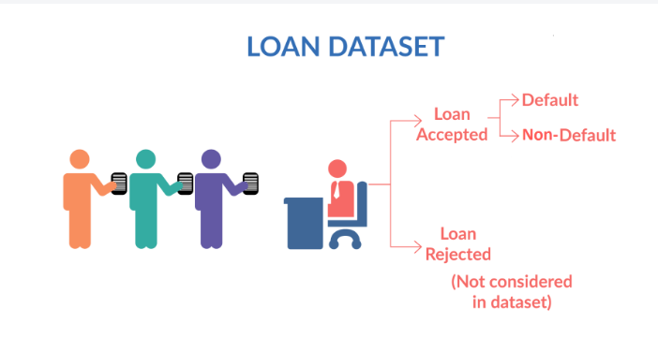
Business Objective
In this case study, we will be applying concepts learned as part of EDA and apply them to the Lending Club Case Study. We will also develop a basic understanding of risk analytics in banking and financial services and understand how data is used to minimize the risk of losing money while lending to customers.
Problem Statement
The data given contains information about past loan applicants and whether
they ‘defaulted’ or not.
When a person applies for a loan, there are two types of decisions that
could be taken by the company:
Loan accepted: If the company approves the loan, there are 3 possible
scenarios described below:
Fully paid: Applicant has fully paid the loan (the principal and the interest rate).
Current: Applicant is in the process of paying the installments, i.e., the tenure of the loan is not yet completed. These candidates are not labeled as 'defaulted'.
Charged-off: Applicant has not paid the installments in due time for a long period, i.e., he/she has defaulted on the loan.
Loan rejected: The company has rejected the loan (because the candidate does not meet their requirements, etc.).

Slide 3
Data Cleaning and Manipulation Process
Handling Missing Values
Remove Columns with 100% Null Values
Drop Non-Unique Columns
Assess and Drop Columns with High Null Percentage
Correct and Standardize Datatypes
Exclude Unnecessary Columns
**Remove current data as it is not useful for analyzing the behavior of charged-off and fully paid borrowers

Slide 4
Analysis
The analysis has been performed based on both numeric and categorical features to comprehensively understand the data.
1. Univariate Analysis
Description: Examines each numeric and categorical feature individually.
Purpose: To understand the distribution and summary statistics (e.g., mean, median, mode) of each feature.
Outcome: Provides insights into the general characteristics and distribution of features, helping to identify patterns and anomalies.
2. Segmented Univariate Analysis
Description: Analyzes numeric and categorical features within different segments or groups.
Purpose: To explore how feature distributions vary across different segments (e.g., loan grades, states, or employment length).
Outcome: Highlights differences between segments, revealing how feature characteristics influence or are influenced by segment-specific behaviors.
3. Bivariate Analysis
Description: Investigates the relationship between two variables, exploring how they interact with each other.
Purpose: To identify correlations or dependencies between pairs of features, such as loan amount and default status.
Outcome: Provides insights into how changes in one variable might impact another, aiding in understanding relationships that drive default or repayment behaviors.

Slide 5
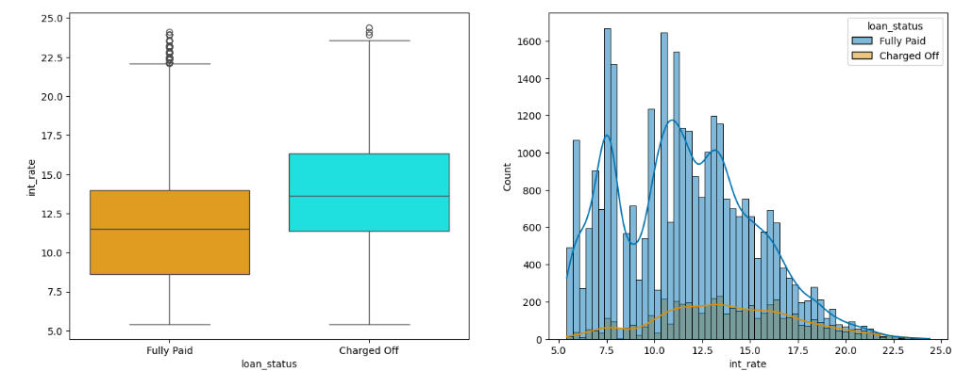
Interest Rate V/S Loan Status
Interest Rate: (The lower the interest rate, the higher the chances of loan repayment.)

Slide 6
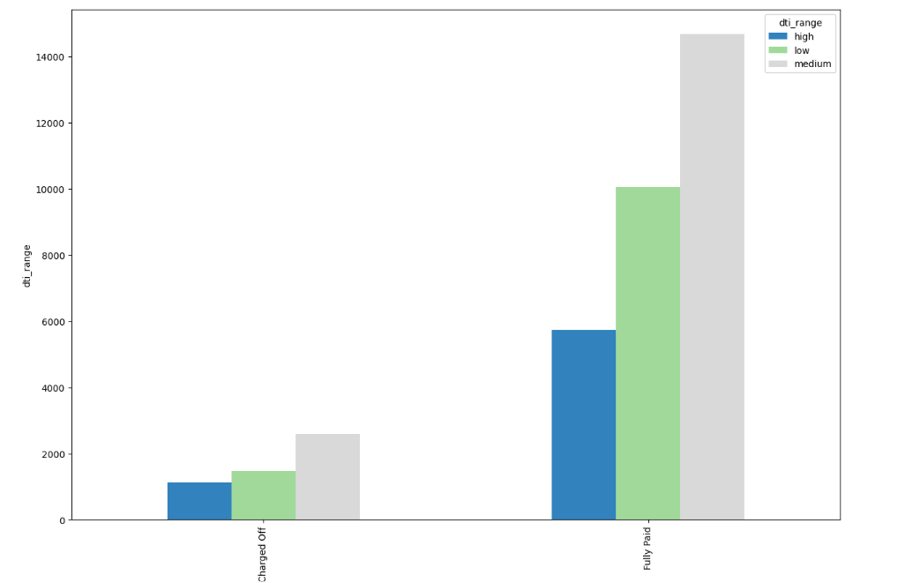
DTI V/S Loan Status
DTI: A higher Debt-to-Income (DTI) ratio is associated with a greater likelihood of default.

Slide 7
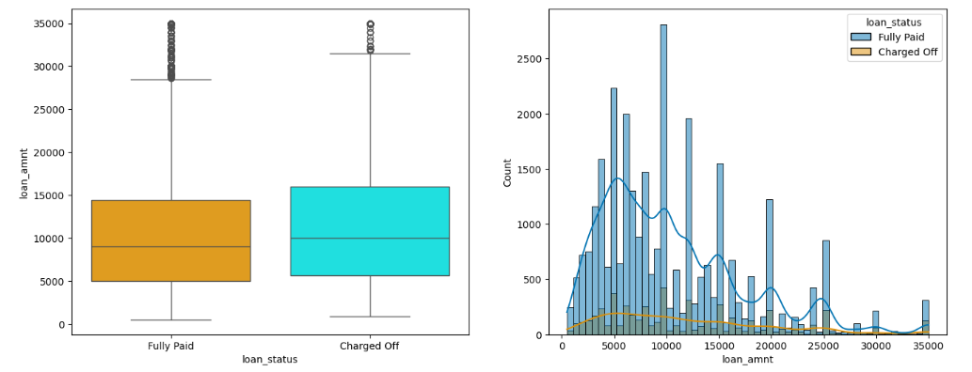
Loan Amount V/S Loan Status
Loan Amount: (The higher the loan amount, the higher the chances of loan default.)

Slide 8
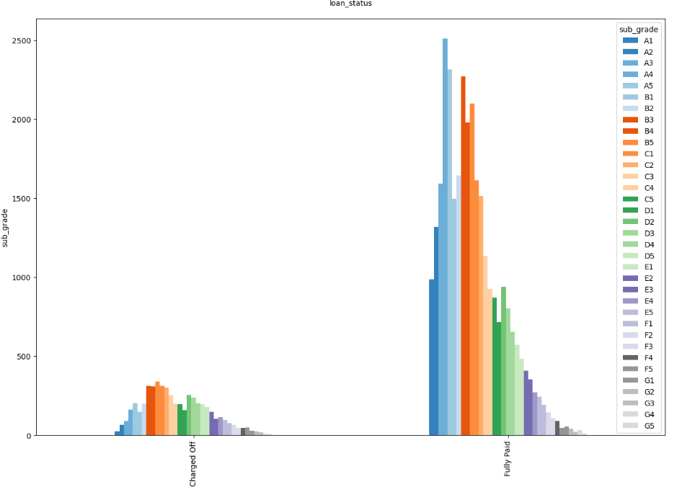
Grade V/S Loan Status
Grades: Loans graded A and B have higher chances of repayment, while grades C, D, E, F, and G have the maximum defaulters

Slide 9
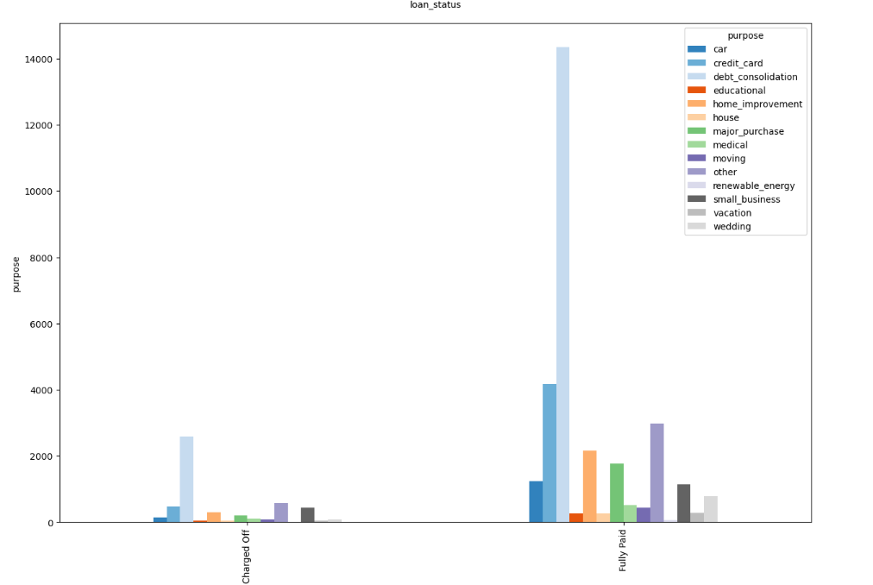
Purpose V/S Loan Status
Purpose: The purpose for which the loan is availed. Categories such as debt consolidation, credit card, home improvement, and small business are major areas where losses are more prevalent.

Slide 10
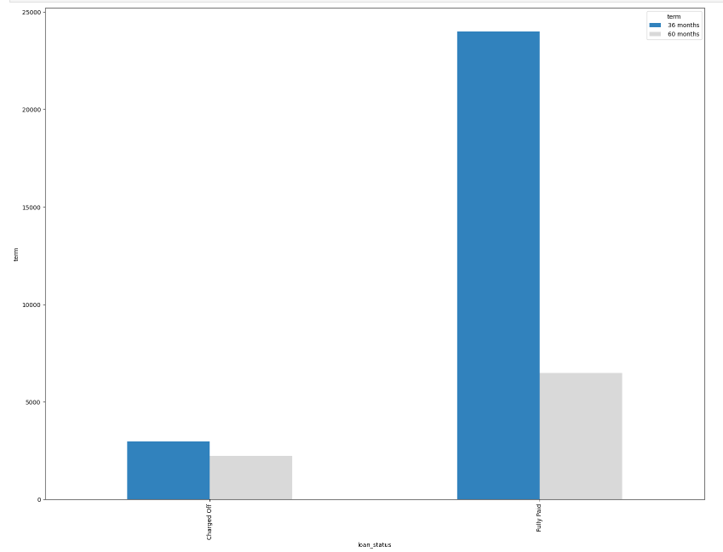
Term V/S Loan Status
The duration of the loan. (The shorter the duration, the lower the chances of defaulters.)

Slide 11
Insights from Segmented Analysis in Numeric Columns
Loan Amount- Minor impact on loan status; higher loan amounts are associated with increased frequency of charge-offs.
Funded Amount - Slight dependency on loan status; borrowers with higher funded amounts show a higher default rate.
Funded Amount Invested - Similar trend to funded amount; higher funded amounts invested lead to more defaults.
Interest Rates-Higher interest rates are linked to a greater likelihood of default.
Installment Payments-Higher installment payments correlate with a higher default rate, though the difference is minimal.
Annual Income-Higher income is associated with a fully paid loan status, but the difference is minor.
Debt-to-Income (DTI) Ratio-Higher DTI ratios are associated with a higher likelihood of default.
Experience-Borrowers with either 10 years of experience or less than 1 year show high counts in both Fully Paid and Charged Off categories.
Yearly Trend-The year 2011 has the highest counts of both Charged Off and Fully Paid borrowers.

Slide 12
Insights from Bivariate analysis in Categoric Columns
Loan Term-Borrowers with a 36-month term are well-represented in both Charged Off and Fully Paid categories.
Grade-Grade A loans have a high number of Fully Paid loans and a low number of Charged Off loans. Grades C, D, and E show higher numbers of Charged Off loans compared to Grade A.
Subgrades-Trends observed in Grades are similarly reflected in Subgrades.
Employment Length-High representation of borrowers with 36 months term in both Charged Off and Fully Paid categories.
Home Ownership-'RENT' and 'MORTGAGE' categories have high numbers in both loan statuses and the highest default rates.
Income Verification-Loans with unverified income sources have the highest number of defaulters.
Debt Consolidation-This loan purpose has the highest number of defaulters.
State Analysis-California (CA) has the highest number of both Charged Off and Fully Paid borrowers. Nevada (NV) also shows a significant number of defaulters.

Slide 13
Conclusion
Loan Term
Shorter durations are associated with lower chances of default.
Interest Rate
Lower interest rates are linked to higher chances of repayment.
Purpose
Debt consolidation and credit card loans show higher default rates.
Debt-to-Income (DTI) Ratio
Higher DTI ratios are associated with a greater likelihood of default.
Address State
California (CA) and Florida (FL) have high loan default rates.
Years of Employment
Longer employment duration generally improves repayment likelihood.
Annual Income
Higher income levels correlate with higher chances of loan repayment.
Grades
Loans graded A and B have higher chances of repayment compared to other grades.
Verification Status
Higher default rates are observed in 'Verified' and 'Source Verified' categories compared to 'Not Verified.'
Loan Amount
Higher loan amounts are associated with higher chances of default.

