Slide 1
OOP Concepts

Slide 2
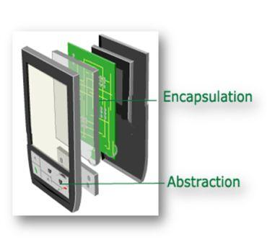

Slide 3
Abstraction
Abstraction is the concept of hiding irrelevant details.In other words make complex system simple by hiding the unnecessary detail from the user.
Abstraction is implemented in Java using interface and abstract class.
Information Hiding
Programming for interface than implementation
Giving just the abstract view ... no need to know how it works ...
Functional abstraction -> use a method without worrying about its implementation
Data abstraction -> data types, user defined data types

Slide 4
Encapsulation
Encapsulation is a process of binding or wrapping the data and the codes that operates on the data into a single entity. This keeps the data safe from outside interface and misuse.
Encapsulation is implemented using private, package-private and protected access modifier.
Data Hiding
Encapsulate whatever changes
Useful when we have to make some changes in our class yet not affect others.

Slide 5
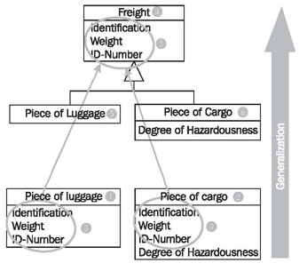
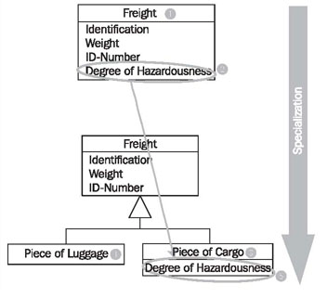
Generalisation and Specialisation
Generalization is the process of extracting shared characteristics from two or more classes, and combining them into a generalized superclass.
In contrast to generalization, specialization means creating new subclasses from an existing class. If it turns out that certain attributes, associations, or methods only apply to some of the objects of the class, a subclass can be created.

Slide 6
Forms of Generalisation
Hierarchy -> In the case of hierarchy, the commonalities are organized into a tree structured form.
Genericity -> In this case, the commonality is expressed with the aid of a parameter.
Polymorphism -> Polymorphism captures commonality in algorithms.
Patterns -> A pattern expresses a general solution (the key components and relationships) to a commonly occurring design problem.

Slide 7
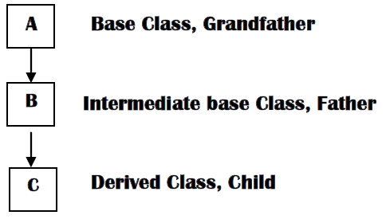
Inheritance
Inheritance is the implementation mechanism for the generalization/specialization relationship.

Slide 8
Inheritance
https://docs.oracle.com/javase/tutorial/java/IandI/subclasses.html
Subclass/derived/extended/child
Superclass/base/parent
Reusability
Multiple inheritance not allowed in java (Object class is by default parent of all classes)
A subclass inherits all the members (fields, methods, and nested classes) from its superclass.
Constructors are not members, so they are not inherited by subclasses, but the constructor of the superclass can be invoked from the subclass.
A subclass inherits all of the public and protected members of its parent, no matter what package the subclass is in. If the subclass is in the same package as its parent, it also inherits the package-private members of the parent.
Object obj = new MountainBike(); (Allowed as implicit cast)
MountainBike myBike = (MountainBike)obj; (Explicit cast...not allowed without cast)
if (obj instanceof MountainBike)
Dynamic binding means the JVM will decide at runtime which method implementation to invoke based on the class of the object. Polymorphism means you can use a variable of a superclass type to hold a reference to an object whose class is the superclass or any of its subclasses.
Inheritance is also sometimes said to provide "weak encapsulation," because if you have code that directly uses a subclass, such as Apple, that code can be broken by changes to a superclass, such as Fruit.

Slide 9
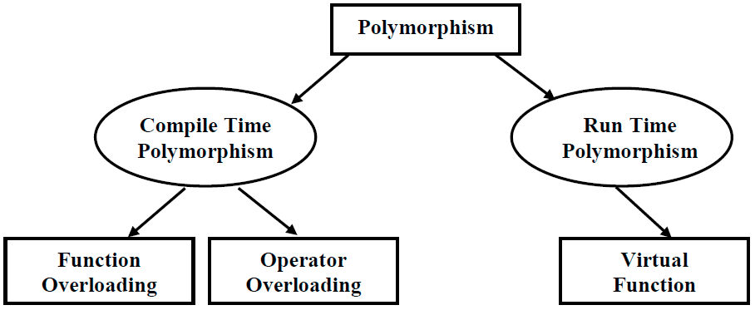
Polymorphism

Slide 10
Polymorphism
Polymorphism is the ability of an object to take on many forms.
Any Java object that can pass more than one IS-A test is considered to be polymorphic.
In Java, all Java objects are polymorphic since any object will pass the IS-A test for their own type and for the class Object.
Virtual method invocation ... virtual methods. All methods in Java are virtual.
Method overloading -> static polymorphism
Method overriding -> dynamic polymorphism.
Because, in case of overloading, at compile time the compiler knows which method to link to the call. However, it is determined at runtime for dynamic polymorphism.

Slide 11
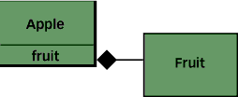
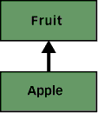
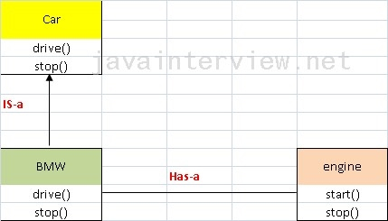
Composition v/s Inheritance
For code reuse
Composition (Has-a) : Inheritance (Is-a) :

Slide 12
Composition v/s Inheritance
http://www.artima.com/designtechniques/compoinh.html
Comp -> strong encapsulation ... because a change to a back-end class needn't break any code that relies only on the front-end class. For example, changing the return type of Fruit's peel() method from the previous example doesn't force a change in Apple's interface and therefore needn't break Example2's code.
Inh -> weak encapsulation
Is-a means "A is a type of B", A inherits B.
Has-a means "A has B" , and strongly associated.
Inh -> superclass, subclass
Comp -> Front end class, Back end class
With inheritance, a subclass automatically inherits an implementation of any non-private superclass method that it doesn't override. With composition, by contrast, the front-end class must explicitly invoke a corresponding method in the back-end class from its own implementation of the method. This explicit call is sometimes called "forwarding" or "delegating" the method invocation to the back-end object.

Slide 13
Composition v/s Inheritance
A change to the interface of a back-end class necessitates a change to the front-end class implementation, but not necessarily the front-end interface.
By contrast, a change to a superclass's interface can not only ripple down the inheritance hierarchy to subclasses, but can also ripple out to code that uses just the subclass's interface.
Composition -> dynamic binding (run time binding)
Inheritance -> static binding (compile time binding)
Don't use inheritance just to get code reuse (If there is no is-a relationship).
Don't use inheritance just to get at polymorphism (If there is no is-a relationship).
Composition -> easier to change interface of front end and back end class.
Inheritance -> easier to add new subclasses
Both -> easy to chanfe implementation (not interface) of any class

Slide 14
Aggregation vs Composition
A "owns" B = Composition : B has no meaning or purpose in the system without A
A "uses" B = Aggregation : B exists independently (conceptually) from A
In composition, when the owning object is destroyed, so are the contained objects. In aggregation, this is not necessarily true.

Slide 15
Association, Aggregation and Composition
Association (Using Relationship )
  No owner
  Have their own lifetime
  Child objects all are independent
Aggregation (Using with Parent)
  Single owner
  Have their own lifetime
  Child objects belong to a single parent
Composition (Death Relationship)
  Single owner
  Owner's life time
  Child objects belong to a single parent
http://www.codeproject.com/Articles/330447/Understanding-Association-Aggregation-and-Composit

Slide 16
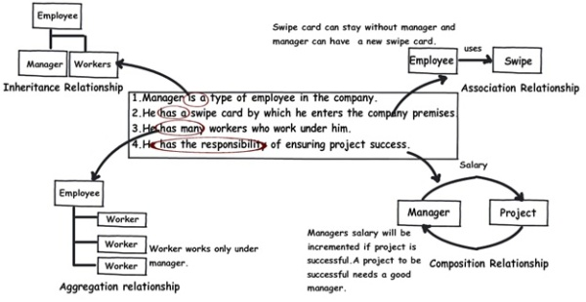
Association, Aggregation and Composition

Slide 17
Association, Aggregation, Composition and Inheritance
Association: uses a
  Ex:a Class Man uses a Class Pen
Aggregation: has a
  Ex:a Class Man has a Class Car ( Car is still there when Man die )
Composition: owns a
  Ex:a Class Man owns a Class Heart ( When Man die, Heart die)
Inheritance: is a
  Ex:a Class Man is a Class Human ( Man is a Human )

Slide 18
OOAD Headfirst Book

Slide 19
Steps for well designed applications
Make sure your software does what your customer wants you to do. -> functinality
Apply basic OO principles to add flexibility. -> object properties and encapsulation
Strive for a maintainable, reusable design. -> delegation and aggregation

Slide 20
UML diagrams
Class diagram
  Has attributes and operations with type
  Type[*] -> to indicate unlimited objects of that type .. multiplicity
  A line from source class to target class -> association and a number near target class indicates how many instances are related to source class ... source class need not write explicitly associated class name in itas attributes, its understood ... arrow at target
  Aggregation -> to show that a thing(source) is made up of the other(target) ... unfilled diamond at source
  Composition -> to show a thing (source) owns other thing ... filled diamond at source
  Generalisation -> unfilled triangle towards base class
  Abstract class name in italics
  <<interface>>

Slide 21
Use textual description of the problem you're trying to solve to make sure that your design lines up with the intended functionality of your application.
Objects
  Should do what their names indicate
  Each should represent a single concept
  Unused properties are a dead giveaway
Encapsulation -> keep parts of code which stay same separate from parts which change ... avoid duplicate code ... encapsulate what varies
Functionality -> for customers
Flexibility -> to make less fragile and easy to grow and change
Design Pattern -> reuse
Delegation -> the act of one object forwarding an operation to another object to be performed on behalf of the first object ... reusability
Objects should be lossely coupled -> for flexibility and ease of change

Slide 22
Requirement Gathering
Requirement -> A singular need detailing what a particular product or service should be or do.
  Plan for things going wrong
  One requirement -> one need
A use case -> what your system does to accomplish a particular customer goal ... one or more scenarios ... a scenario is basically the sequence of steps that lead from start to end
  3 parts of use case
    Must be of Clear Value ... must help in achieving goal
    Must have Start and Stop points
    Must have an External Initiator
  One use case -> one goal only
  Use cases are in layman language
  One use case has main path(normal flow) and alternate path(s) (exceptions)
Users are not part of System
Requirement list .... use case -> scenario sequence of steps ... compare both to include missing requirements

Slide 23
Analysis
Identify the real world problems
Textual analysis : looking at nouns and verbs in your use case to figure out classes and objects ... nouns -> classes, main focus ... verbs -> methods
Don't make class of the users of the system as far as you need to store a lot of info of them for long

Slide 24
Good Design
Each class should have only one reason to change to make code resilient to change -> leading to encapsulation in future
Encapsulate what varies
Code to an interface rather than to an implementation
Cohesion : a cohesive class does one thing really well and doesn't try to do or be something else .... a measure of how closely related the operations of a class are -> leading to only one reason to change

Slide 25
Big systems design
Commonality -> what system is like
Variability -> what system is not like
Features
Requirements
Use case diagram
  Actors -> that interacts with system
  System boundary -> box ... stuff to be coded inside
  Use cases names (using feature list) -> oval
  <<include>> , <<extend>>
Domain Analysis
Divide and conquer
Same as small probs
Design Pattern at last

Slide 26
Architecture -> It is our design structure and highlights the most important parts of our app, and the relationships between those parts.
Focus on features that are : -> to reduce risk in project
  Essence of our system
  We are unsure of their meaning
  We are unclear how to implement them
Use commonality analysis -> while implementing confusing set of features

Slide 27
Design Principles
OCP (Open-Close Principle)
  Close for modification
  Open for extension
  Abstraction + encapsulation
DRY (Don't Repeat Yourself)
  Avoid duplicate code by abstracting out things that are common and placing those things in a single location.
  ONE requirement in ONE place
SRP (Single Responsibility Principle)
  Every object in your system should have single responsibility, and all the object's services should be focused on carrying out that single responsibility
  Each object should have only one reason to change
  Cohesion
  Check : classname methodname itself
    eg., automobile drives itself -> wrong
    eg., automobile starts itself -> right
LSP (Liskov Substitution Principle)
  Subtypes must be substitutable for their base types
  If you want to use functionality in another class, but you don't want to change that functionality, consider using delegation instead of inheritance
  Use delegation, composition and aggregation over inheritance for flexibility
  Use inheritance when one object behaves like another, rather than just IS-A relationship.
  Delegation -> delegate behaviour to another class when you don't want to change the behaviour, but it's not your object's responsibility to implement that behaviour on its own.
  Composition -> you can reuse behaviour from one or more classes, and in particular from a family of classes, with composition. Your object completely owns the composed objects, and they do not exist outside of their usage in your object.
  Aggregation -> when you want the benefits of composition, but you're using behaviour from an object that does exist outside of your object, use aggregation.
  Subclass is the only class that can change another class' behaviour

Slide 28
Development approaches
Feature driven development -> complete one feature at a time ->
  Granular
  Functionality driven
  Works for many disconnected features system
Use case driven development -> complete one scenario at a time
  Big picture
  User centric
  Works for transaction systems having lengthy, complicated processes
Test driven development -> Test scenarios :
  Creating class, setting and getting values
  Changind the values
  Checking for non existent property values
  Each test is for a particular functionality ... tests behaviour of our class
  Test cases
    Have id and name
    Tests one specific thing ... atomic
    One input from user
    Expected output
    Have starting state..eg., creating a class
    Separate test cases for common properties and unit specific properties of a class
    Format : ID, What we're testing, Input, Expected Output, Starting state

Slide 29
Programming practices
Programming by contract -> agreement between client and programmer about wrong behaviour
  Return null or unchecked exception
Defensive programming -> programmer himself handles the wrong behaviour
  Return empty object or throw checked exception

Slide 30
OOAD Lifecycle
Feature list -> what to do ... functionality
Use case diagram -> how will be used ... usage
Break up the problem
Requirements -> then make use cases
Domain analysis -> then build class diagram
Preliminary design
Implementation
Delivery

Slide 31
Anti-Patterns -> lead to bad design
  eg., Gas Factory -> overly complex and not maintainable designs
CRC cards (Class Responsibilty Collaborator)
Sequence Diagrams
State Diagrams
Unit Testing -> test each small piece of functionality of classes ... eg., JUnit

Slide 32
Design Patterns
Singleton
Decorator
Factory pattern

